Slide 1
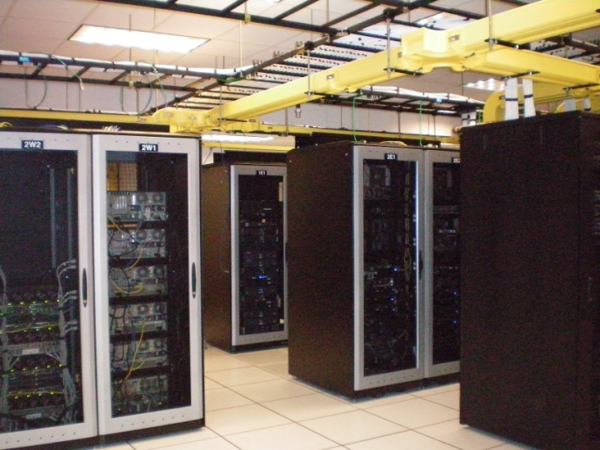
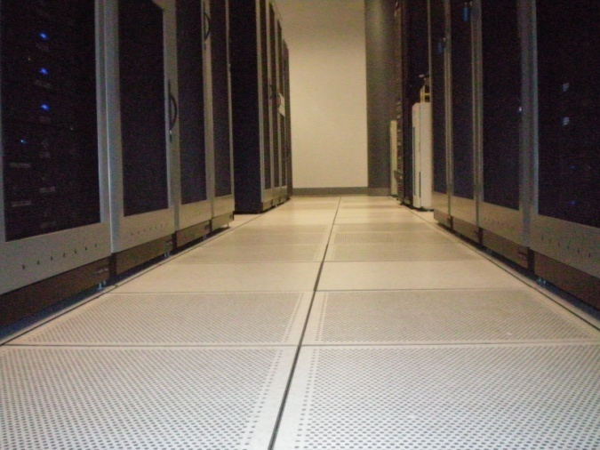

Data Center Infrastructure
Tom Jordan <jordant@uww.edu>
NOC Manager, University of Wisconsin Whitewater
Notes:
First became interested in data center infrastructure about 3 years ago, when I took a job that made me responsible for it
In my first few months, CIO and technologists made it clear that current limitations were a problem, and that modernization should be priority
I made it my priority as well – read trade magazines
Corporate example – consolidated 12 data centers down to 3, 5 years, 500 million
We’re smaller – I figured we could do it in 1 year for 100 million
that’s exactly how my boss responded –
We took a more incremental approach, and that’s what I’ll be talking about today

Slide 2
Agenda
Describe UW-Whitewater’s Data Center environment and challenges
Describe infrastructure areas and how we improved them
Talk about TIA 942 Data Center standards and how they guided our decision-making
Discuss Blade Servers, Virtualization and Greening the Data Center
Notes:
Overall, our story is one of addressing DC infrastructure deficiencies incrementally
- No new facility
- No major capital renovation
- No migration to alternate facility

Slide 3
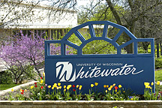

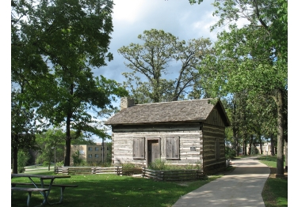
About the University of Wisconsin Whitewater
We are a four-year residential University located in Southeastern Wisconsin
  Roughly 10,000 students, 40% residential
  46 undergraduate majors, 13 graduate programs
  One campus location with about 45 buildings on campus
Notes:
An interesting thing about Whitewater’s IT footprint is that we’re just in the range between big and small
- almost small enough to take a more casual ‘one man band’ approach, but not quite
- almost large enough to sustain ‘large IT organization’ types of processes, but not quite
Our data center was no exception to this. There was enough there that the concept of a “room with servers in it” was falling apart. We needed to start thinking about the data center from a professional hosting perspective.

Slide 4
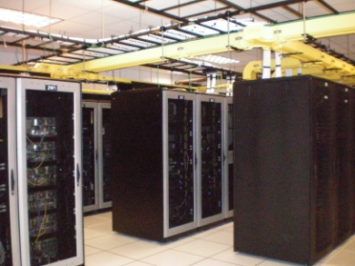
Our campus technical environment
Network environment:
  Gb Ethernet, switched in the closets and routed at the core
  2 main aggregation points on campus
Workstation environment
  Primarily Windows XP, with strong Mac presence.
  About 3000 workstations on campus
Political Environment
  A fair degree of centralization
  Some server hosting outside of central IT
Notes:
Also cover staffing environment
We’re fortunate to have a strong technical infrastructure staff. They were instrumental in helping us in the renovation process.

Slide 5
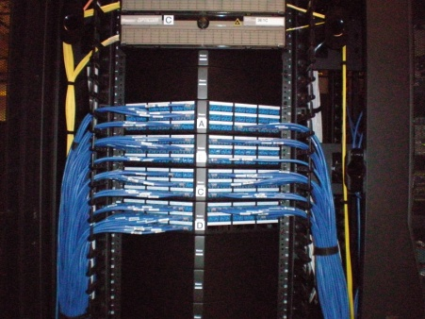
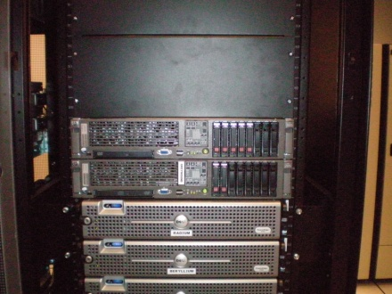
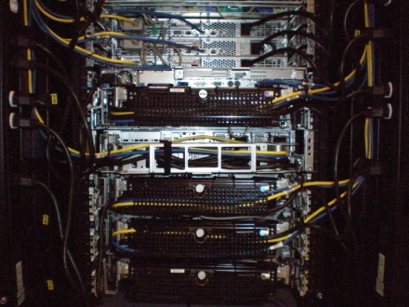
Our data center environment
Roughly 150 servers
  Mostly rack-mount, but a few towers
  60% Windows 2003 Servers
  30% NetWare or (SuSE) Linux
  5% HP Unix
  5% “other”
  80% physical, 20% virtual
Fibre Channel SAN environment (~20TB)
Gb Ethernet for server connectivity
Notes:
IT is fairly centralized, so we host a number of departmental systems in our campus data center. This is another reason why it’s essential that it be a modern, sustainable facility.
We need to DC to be a showcase to get over objections about central hosting
- Need central hosting for integrated security, firewalling, etc

Slide 6
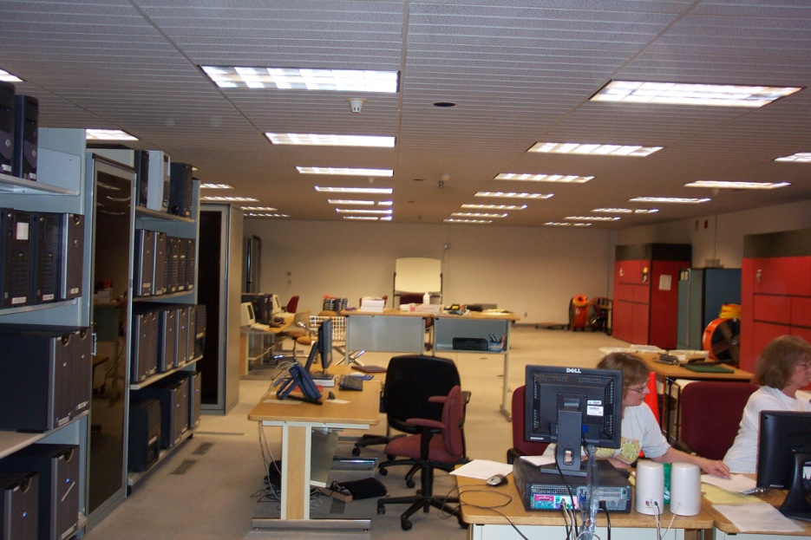
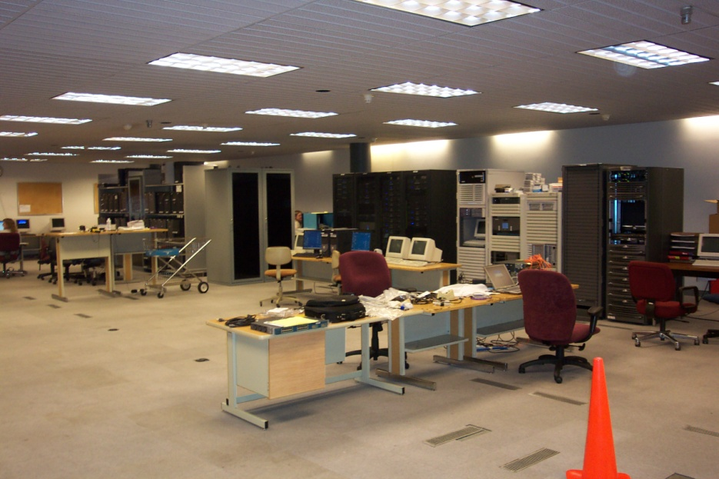
Our data center challenges
Started life as a “data processing center”
  Power, cooling and floor layout designed for older mainframe environment
  Combined operations area and machine room area.
  Complete with “Paper Room” and “I/O Window”
Notes:
Noisy and uncomfortable for people
Too hot and too cluttered for servers

Slide 7
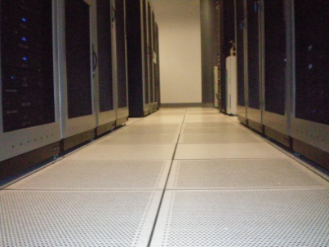
Where we started
We knew that we needed to modernize
Toured several hosting centers and corporate data centers in the region.
Used TIA 942 standard for data centers as a guide
Decided to design ourselves rather than engage a specialized data center design firm.

Slide 8

What we learned
Appropriate infrastructure is critical
  To support modern equipment
  To prepare for future trends
  To meet operational and compliance needs
This infrastructure includes
  Physical layout and Cable Plant
  Power Distribution
  Cooling
  Fire Suppression
  Physical Security and Access Control

Slide 9
So what are the trends?
Consolidation and virtualization
  Server
  Storage
  Network and I/O Channel
As equipment becomes more compact, it pushes power and heat densities higher and higher.
Facilities need to be able to scale accordingly.

Slide 10
Power Distribution
Addressed as part of a data center UPS replacement project
  Calculated expected power loading per rack
  Estimated expected growth rates in 5, 10, 15 and 20 year horizons
  Established a power growth plan based on projections and natural choke points within projections
    Size of room and maximum equipment
    Size of PDU / UPS / power distribution equipment
    Sizing of building electrical service
  Made sure that current equipment could handle 5 and 10 year projections.
  Made sure that plan could expand into 15 and 20 year horizons.
Notes:
Our goals in power budgeting:
Build out based on what we know to be current trends
Don’t over-build based on needs that are 10 years out
Don’t over-build past the capabilities of the facility

Slide 11
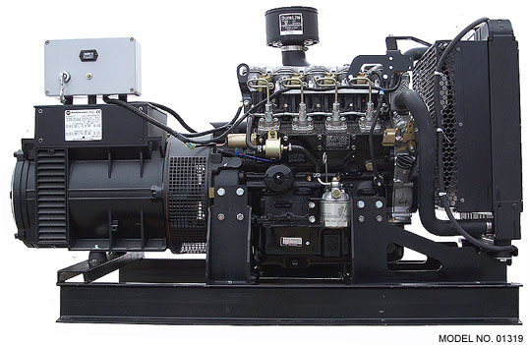
An ideal power distribution scenario
Black Circuit
Black Circuit
Dual-Circuit PDU’s
White Circuit
White Circuit
“A” Grid PDU
“B” Grid PDU
Server Enclosure
“A” Grid UPS
“B” Grid UPS
Utility Power Service A
Utility Power Service B
Backup Generator(s)

Slide 12
Our scenario
Black Circuit
Black Circuit
Dual-Circuit PDU’s
White Circuit
White Circuit
“A” Grid PDU
“B” Grid PDU
Server Enclosure
“A” Grid UPS
“B” Grid UPS
Utility Power Service A
Utility Power Service B
Backup Generator(s)

Slide 13
Cooling
Let’s assume that machines are almost perfectly efficient
  1 kW energy in == 1 kW heat out
  That kW of energy is equivalent to:
    1.34 horsepower
    Slightly less than the average home’s energy consumption in 1 hour
  That kW of heat
    Is 3414 BTU, enough to boil a little over 2 gallons of water
    Is enough energy to melt 500 pounds of ice over 24 hours

Slide 14
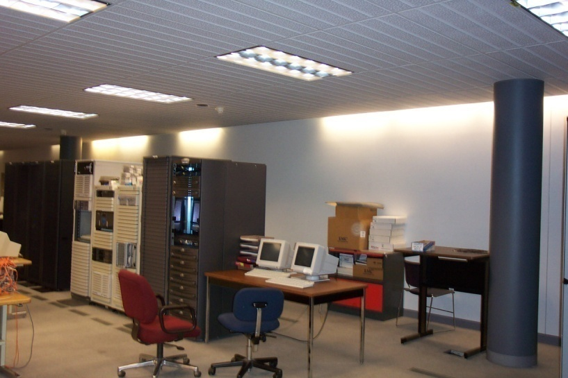
Our challenges with cooling
Excessive cooling capacity for the load
  75 Tons of cooling capacity
  About 15 Tons of cooling load
Despite that, we still had heat problems
  Airflow and distribution
  Poor cold air delivery
  Poorly sealed floor
  Poor rack venting
  Obstructions behind racks

Slide 15
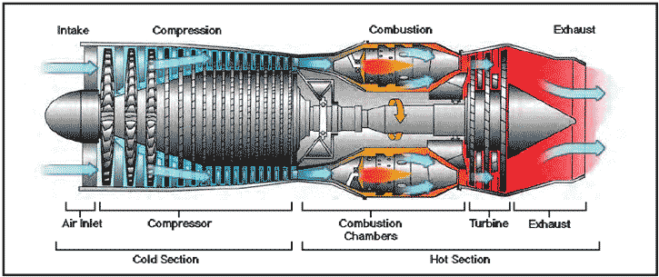
For your consideration
Q: What’s the principle difference between this:
and this:
A: Fuel Economy. ☺

Slide 16
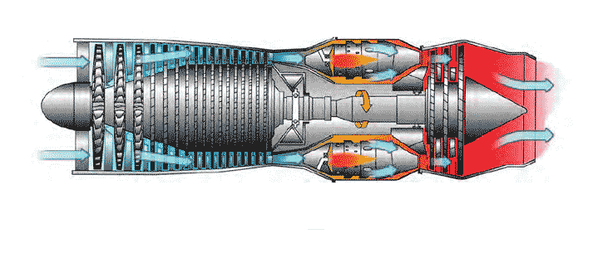

Rack Orientation
FRONT
FRONT
REAR
FRONT
REAR
REAR
Raised Floor
Subfloor

Slide 17
Rack Orientation - Problem
High pressure traps heat in the back of the rack
REAR
FRONT
REAR
Raised Floor
Subfloor

Slide 18
Rack Orientation – Hot / Cold Aisle
REAR
FRONT
FRONT
REAR
Raised Floor
Subfloor

Slide 19
What this means for a floor layout
COLD AISLE
COLD AISLE
COLD AISLE
Server Enclosures
Server Enclosures
Server Enclosures
Server Enclosures
Server Enclosures
HOT AISLE
Server Enclosures
HOT AISLE
HOT AISLE
HOT AISLE
A/C Unit
A/C Unit
1 Perforated Tile = 1 Ton of Cooling

Slide 20
What this did for us
With no change to air conditioning set points
  Inlet temperatures dropped 10°F
  Exhaust temperatures dropped 10°F
Based on annual energy costs, this saves over $30,000 per year
That’s some green… ☺

Slide 21
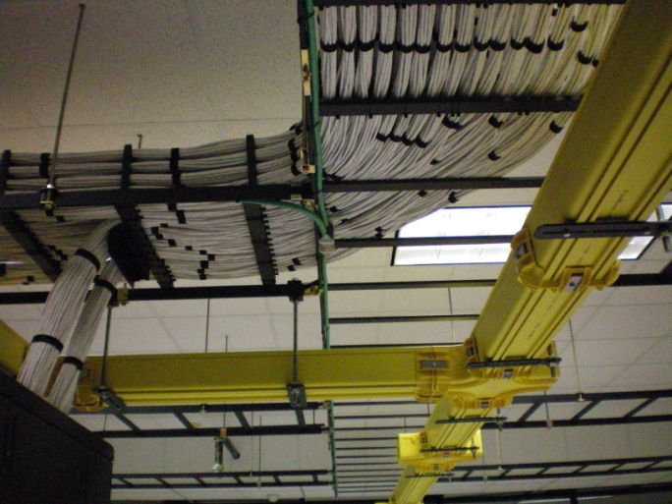
Cable Plant
Two most important factors:
  Keep it clean
  Keep it contained
Clean and well organized
  Provides better airflow
  Prevents damage to cable and connector
  Minimizes likelihood of unintended change
  Is far more pleasant to work with
Notes:
Out in the open – mistakes and shoddy workmanship can’t hide!

Slide 22

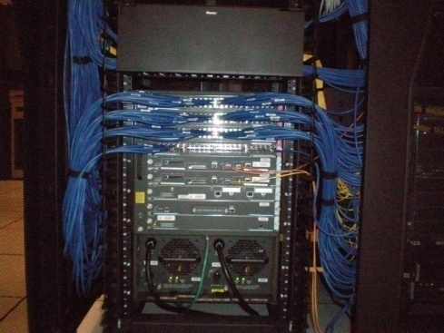
Some Important Considerations
Bend radius
  Should be no less than 18x cable diameter
Routing
  Do not restrict airflow
  Clean and well dressed runs
  Bundle and support interstitial cabling
Terminations
  Clean and well dressed panels
  Clear and consistent labeling
Color code for greater clarity

Slide 23
Some cabling standards / resources
TIA 568B – Commercial Building Wiring Standard
TIA 942 – Standards for Data Centers
TDMM – Telecommunications Distribution Methods Manual
  Published by BICSI (Building Industry Cabling Standards Institute)

Slide 24
The TIA 942 Recommendation
Main Distribution Area
(Routers, Backbone, SAN Switches, etc)
Horizontal Distribution Area
Horizontal Distribution Area
Rack/Cabinet
Rack/Cabinet
Rack/Cabinet
Rack/Cabinet
Rack/Cabinet
Rack/Cabinet

Slide 25
How we incorporated this
Server Enclosures
Server Enclosures
Main Distribution
Server Enclosures
Server Enclosures
Server Enclosures
Overhead Cable Distribution
A/C Unit
A/C Unit

Slide 26

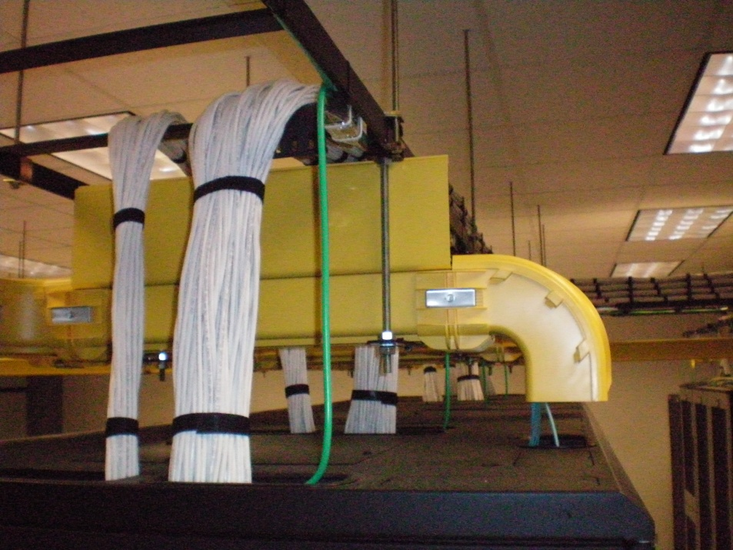
Our overhead cable distribution scheme

Slide 27
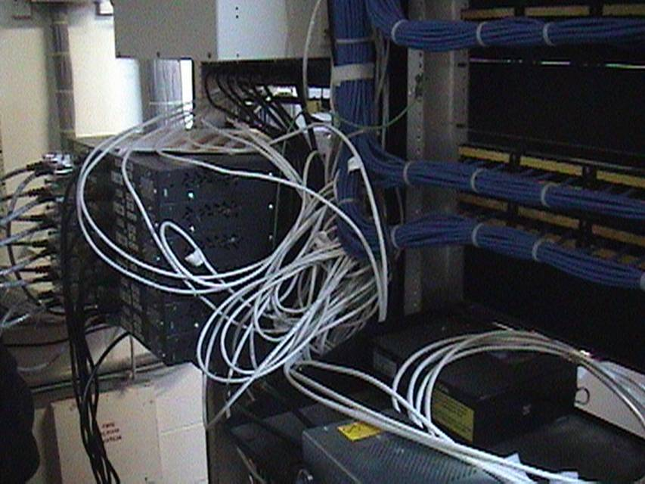
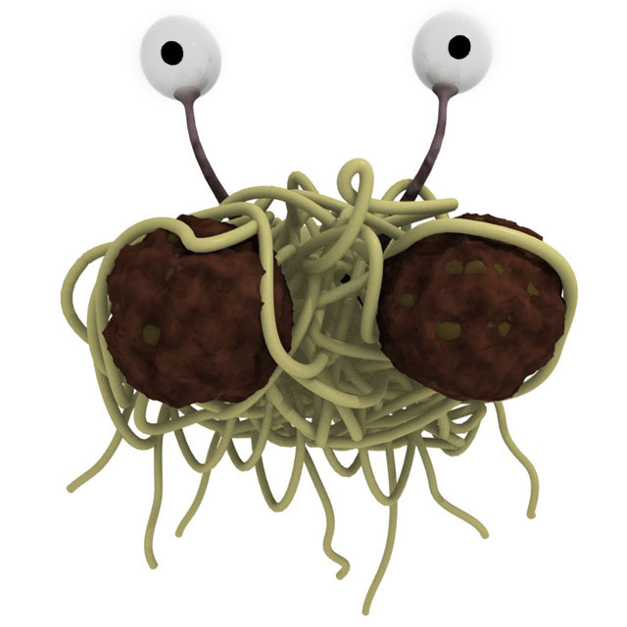
Contrasts…

Slide 28
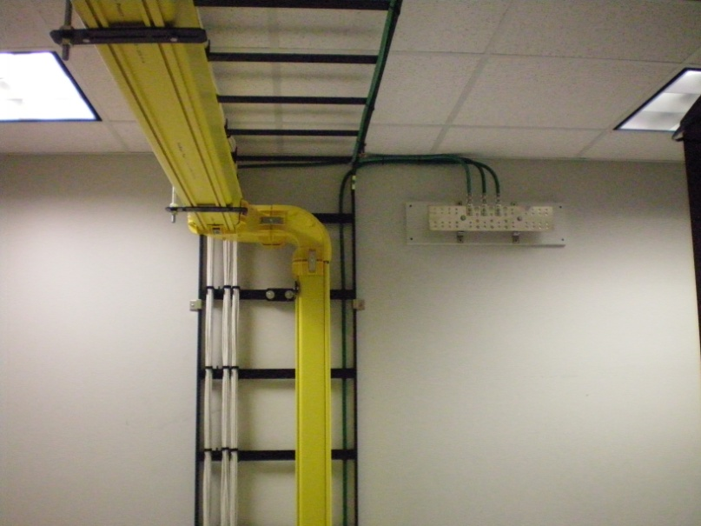

One more network to remember
Don’t forget about your grounding network
It can save someone’s life
It can save your equipment
Notes:
You need it. It’s important. ‘Nuff said.
Now how to go about it – ground each and every rack.

Slide 29
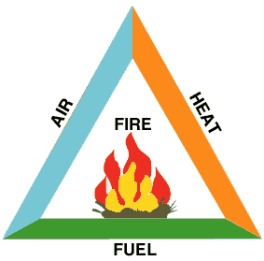
Fire suppression
Anyone remember the fire triangle?
Fire needs:
  Fuel (controlled by you)
  Air (suppressed by gaseous systems (Halon, FM-200, INERGEN)
  Heat (suppressed by sprinkler systems)
Notes:
Remove any one of these things and the fire goes out

Slide 30
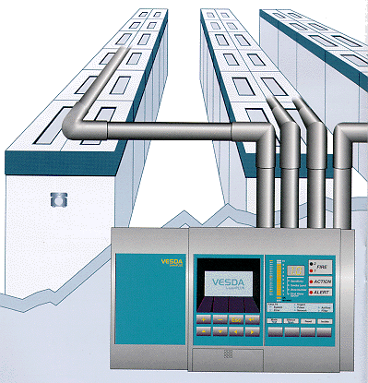
Water in the Data Center?
Dual-interlock sprinkler systems
  Require two conditions to be met before discharge
    VESDA System must detect smoke
    Sprinkler head must fuse
  Pipes are dry unless activated
  Only fused head discharges

Slide 31
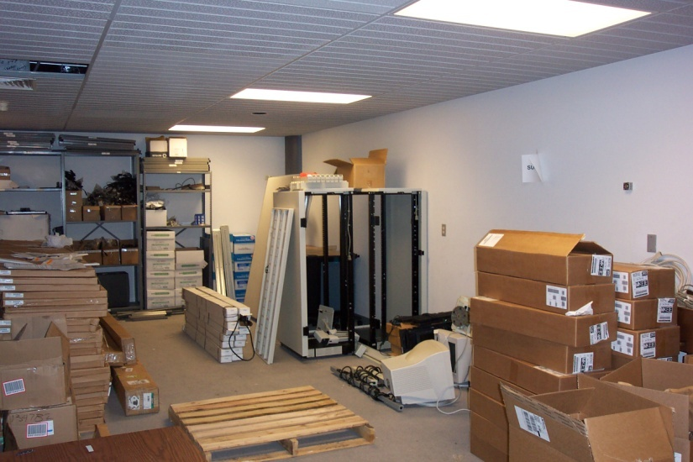
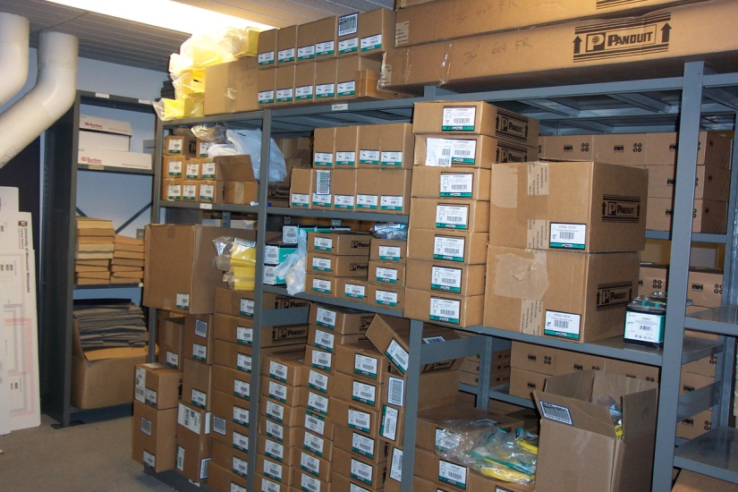
What can we do about fuel?
Create staging areas for storing and unboxing equipment
Keep the data center environment free of paper, cardboard, dust, dirt, etc.
Power down and remove equipment that’s no longer in service
Notes:
If you don’t need it, don’t run it. That helps with greening your operation as well.

Slide 32
Physical Security
Access Control
  Entry / exit
Identification of personnel
  Employees, Contractors, Vendors
Surveillance
  Video
  Environmental
Physical Security Audit Compliance
  - PCI DSS, etc

Slide 33
Greening the data center
First, understand your energy consumption
Second, review your utility usages & costs
Third, strategize on how to reduce energy costs
  Free cooling
  Limit air mixing
  LEED - Leadership in Energy and Environmental Design
The most effective way to green is to run less stuff.
Consolidation and virtualization can help you do that.

Slide 34
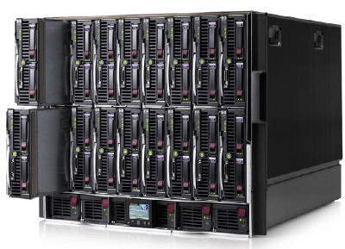
Blades and Virtualization
Blade servers
  Use less energy and generate less heat
    Rough estimates of 25-30% less
  Condense that energy and heat into a smaller area
  Increases need to extract heat effectively

Slide 35
Blades and Virtualization
Virtualization means fewer physical servers, not fewer servers
  Will help on energy costs and capital costs
  Will not reduce staffing needs directly
  Can help with staffing indirectly
    Standardization of hardware
    Standardization of images (ITIL Release Management)
Notes:
Staffing and automation
- There is overhead in supporting mgmt infrastructure
- Automation / release mgmt helps lots of things
- workload
- consistency
- documentation
- audit
- Automation also shifts remaining work to higher skill levels

Slide 36
In summary
Data Center infrastructure is critical for supporting upcoming trends
  Consolidation
  Virtualization
Thoughtful design of data center infrastructure can both support modern operations and limit energy costs.
It can also improve operations and infrastructure stability.

Slide 37
Questions?

