Slide 1

Developing Low Cost Applications Using Off-shore Companies
Juany C. Jardines
Director of Research & Academic Computing
Memorial Sloan-Kettering Cancer Center

Slide 2
Memorial Sloan-Kettering Cancer Center
Located in Manhattan’s upper East Side
World’s oldest & largest private cancer center
Over 9000 employees
21,000 patients admitted
443,000 outpatient visits
8 Research Programs

Slide 3
Brief History

Slide 4
Vendor Selection Criteria

Slide 5
Cost options

Slide 6
Off-Shore
Off-shore becomes the selling point of vendors on short list. It becomes clear that this is the only option for staying within budget.

Slide 7
Company Selected: EPAM
15 years in business
Based in New Jersey
Development Centers in Eastern Europe & Russia
CMMI level 4 & ISO 9001:2000 certifications
Solid Methodology
On-shore and Off-shore personnel
Expertise in .Net development framework
Fixed and Time & Materials pricing available

Slide 8
EPAM Development Centers
** Our development team is in Saratov

Slide 9
Projects undertaken to date
Student Information System (2005-2006)
  Gerstner Sloan-Kettering Graduate School of BioMedical Science
Laboratory Managemet System (2007 – 2008)
  Monoclonal Antibody Core Facility
Grant Central (2008)
  Office of Sponsored Projects

Slide 10
Student Information System
Full Development Cycle Needed
Payment: Fixed Price
  Business Analysis (on-shore)
    Analysis completed before vendor provided full project price
  Story Board creation (on-shore)
  Development (off-shore)
  Testing & QA (off-shore and on-shore)
  Project Management (on-shore)
When to use: large projects, lack of resources, lack of expertise, hard deadline

Slide 11
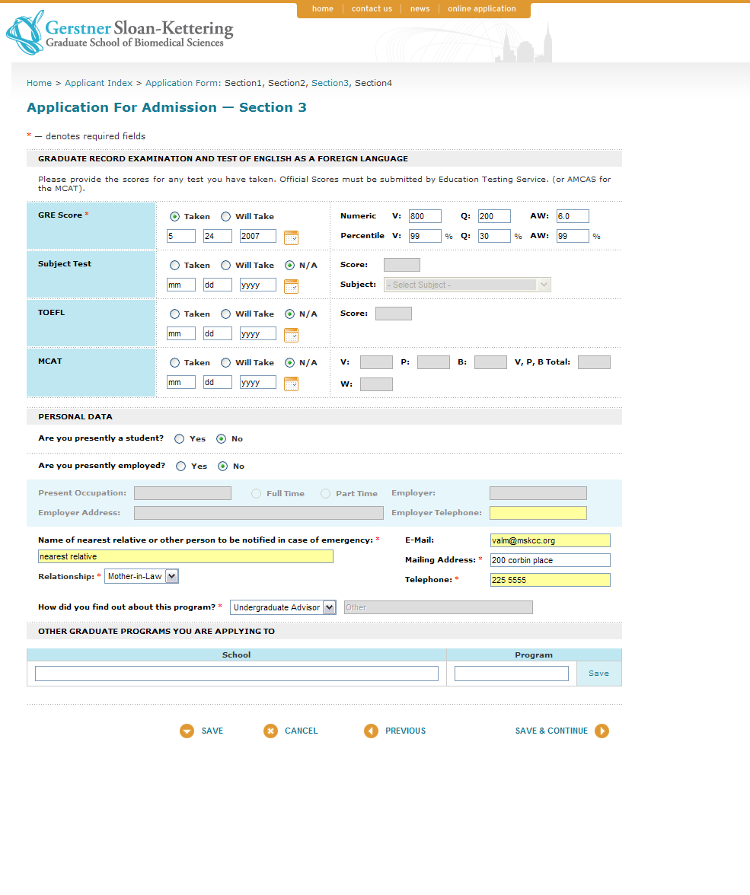
GSK – PhD Application – Sec. 3

Slide 12
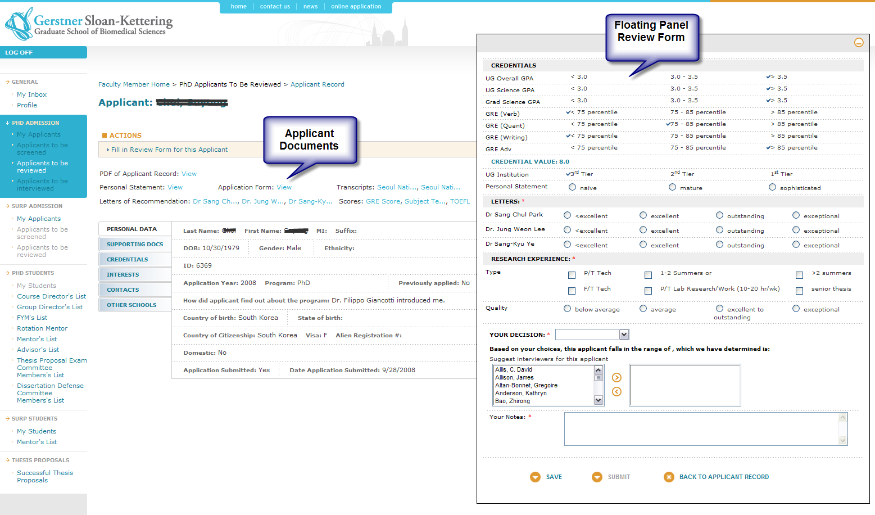
GSK – PhD Admissions

Slide 13
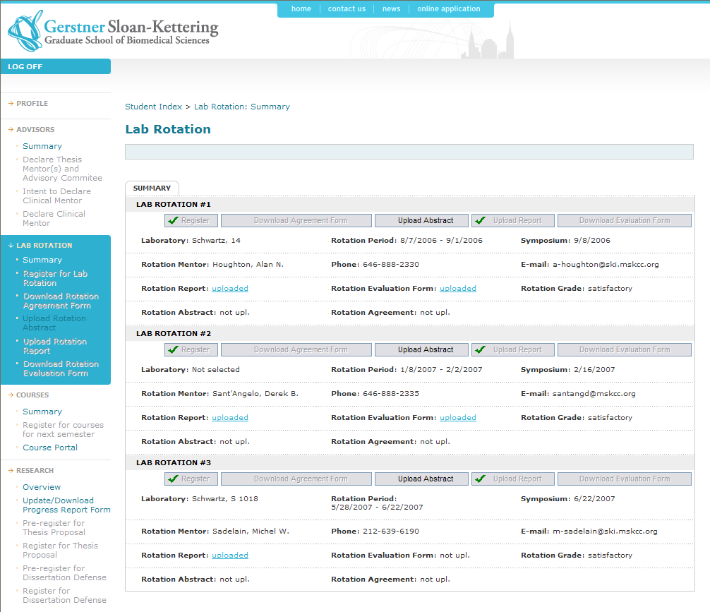
GSK – Student Lab Rotation

Slide 14
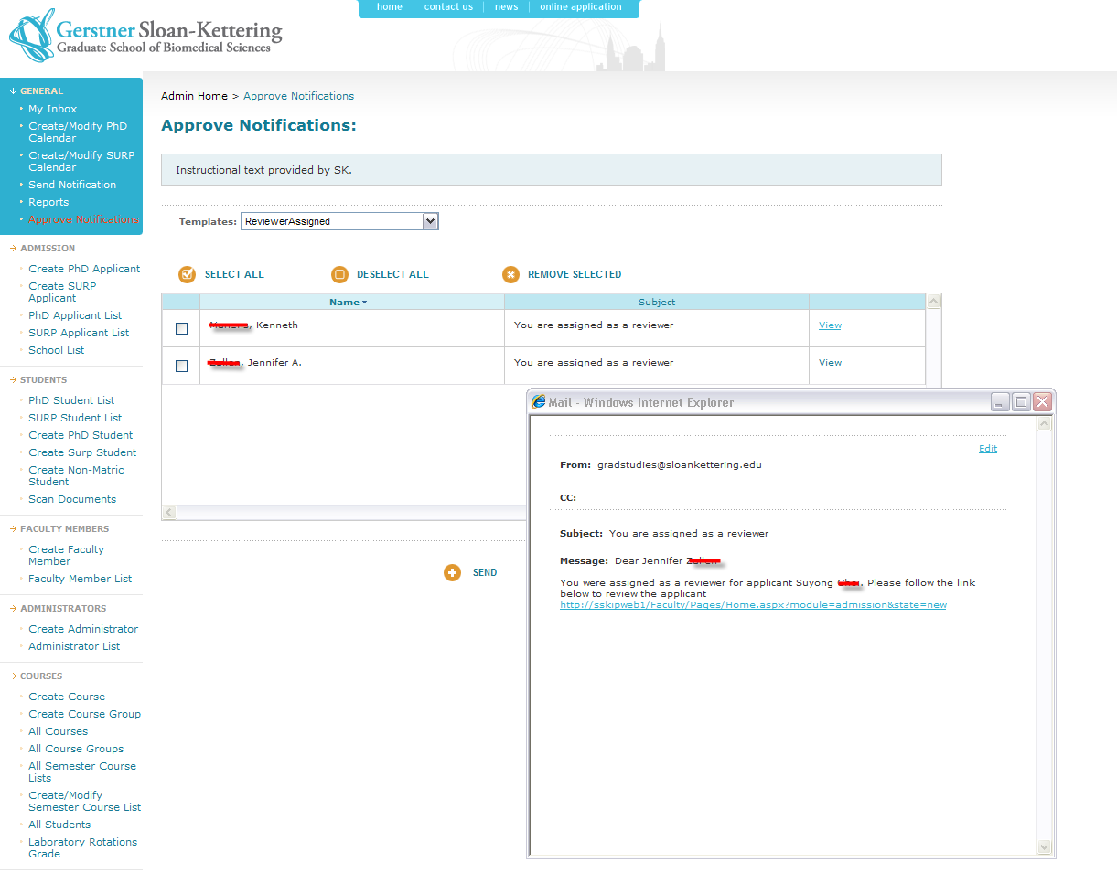
GSK – Mail Notification Approval

Slide 15
Off-shore vs On-shore pricing
 | In-house | On-shore | Off-shore
Project Management | $30,000.00
Business Analysis |  | $47,000.00
Testing/QA | $30,000.00
Development |  |  | $205,000.00
Sub-total | $60,000.00 | $47,000.00 | $205,000.00
Total | $312,000.00
 | in-house | On-shore | Off-shore
Project Management | $30,000.00
Business Analysis |  | $47,000.00
Testing/QA | $30,000.00
Development |  | $683,333.00
Sub-total | $60,000.00 | $730,333.00
Total | $790,333.00
Total Savings $478,333
Note that this price is for the initial scope of application, 6 modules. There have been many changes since then.

Slide 16
Monoclonal Antibody Core Facility
LIMS
Method: Co-development
  Database (MSKCC)
  Administrative module (MSKCC)
  User module (outsourced, off-shore)
  Testing & QA (joint effort)
  Support (MSKCC)
Payment: Time & Material with cap
When to use: Need shorten development life cycle, lack of resources, lack of expertise in particular area.

Slide 17
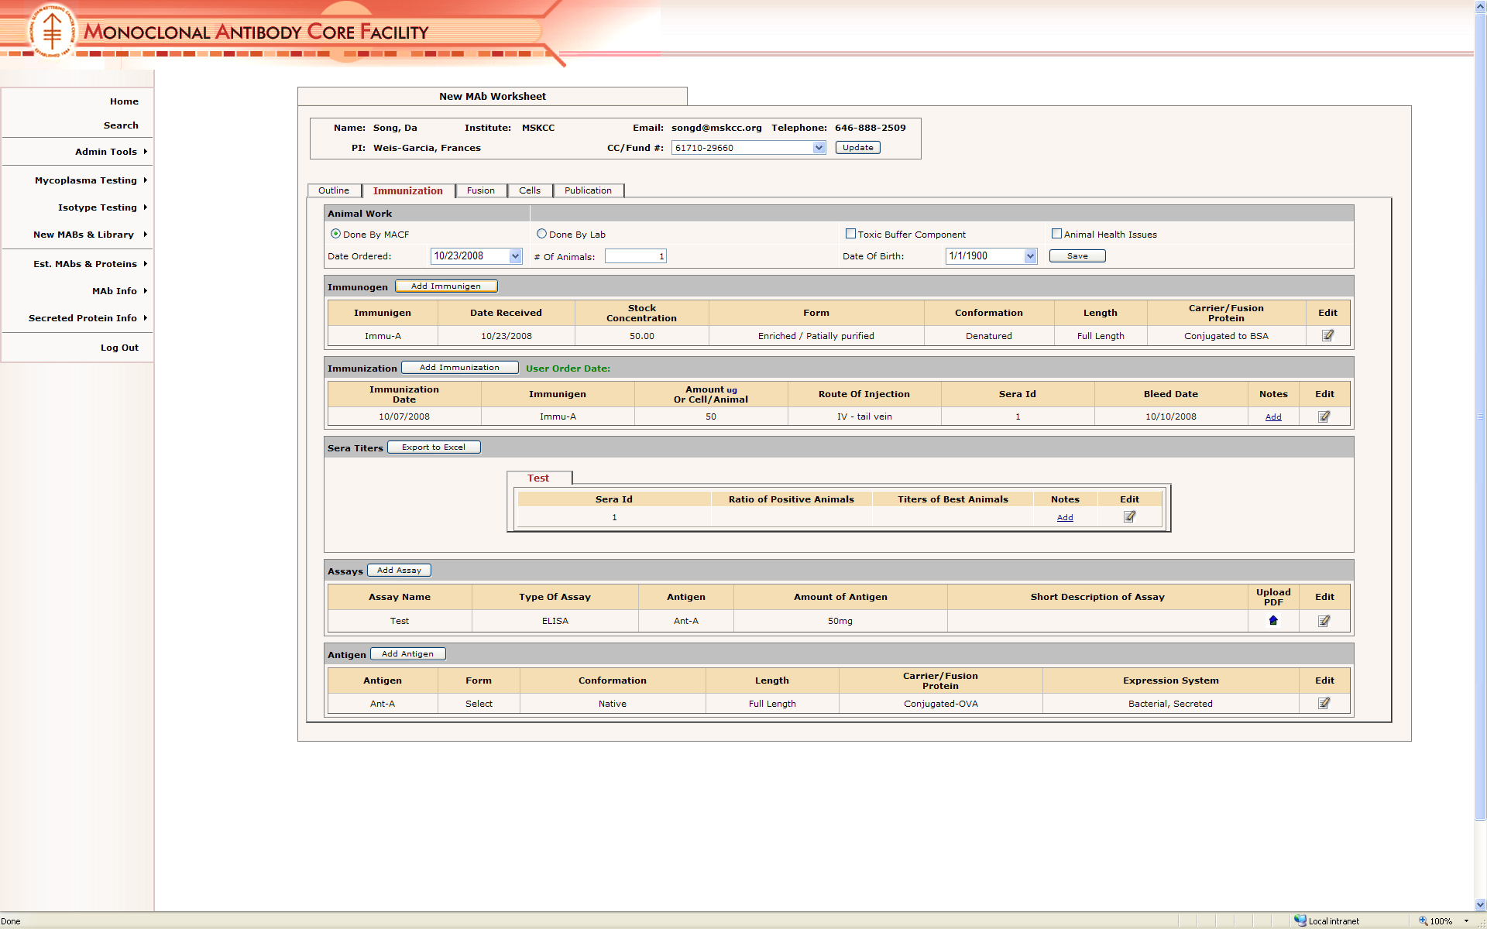
MACF Immunization

Slide 18
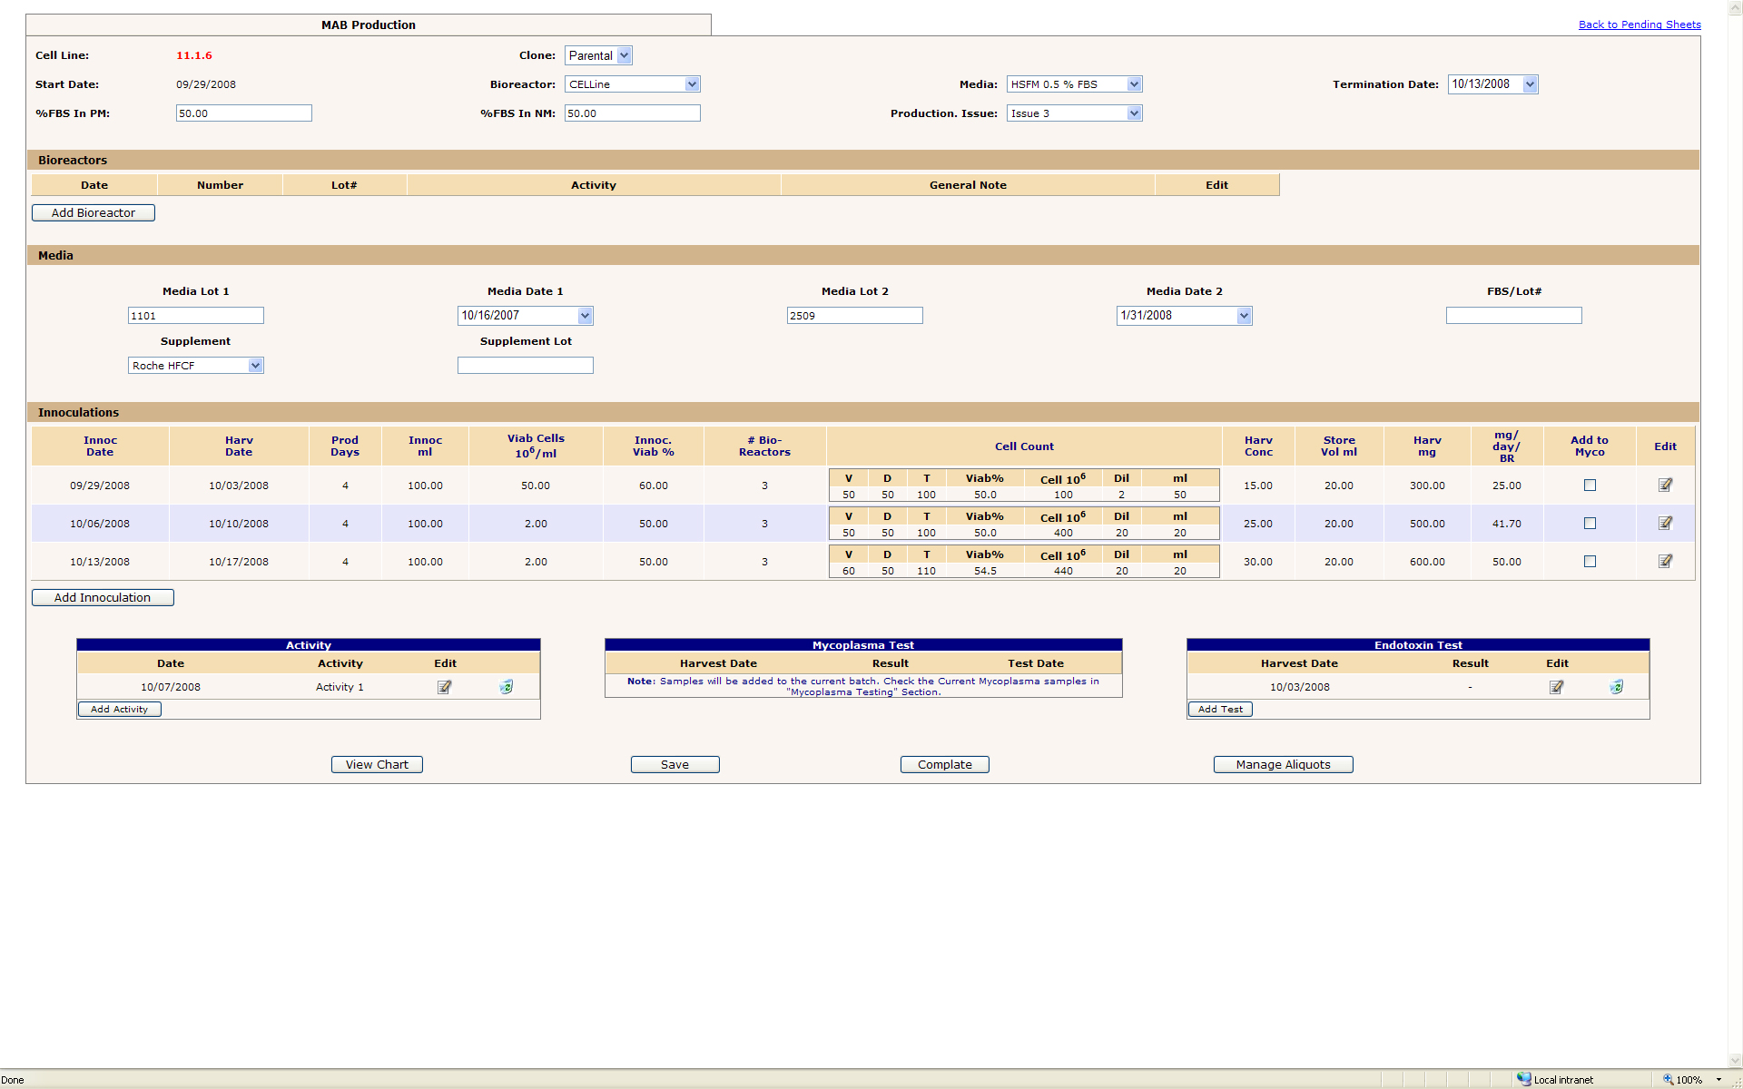
MACF Production

Slide 19
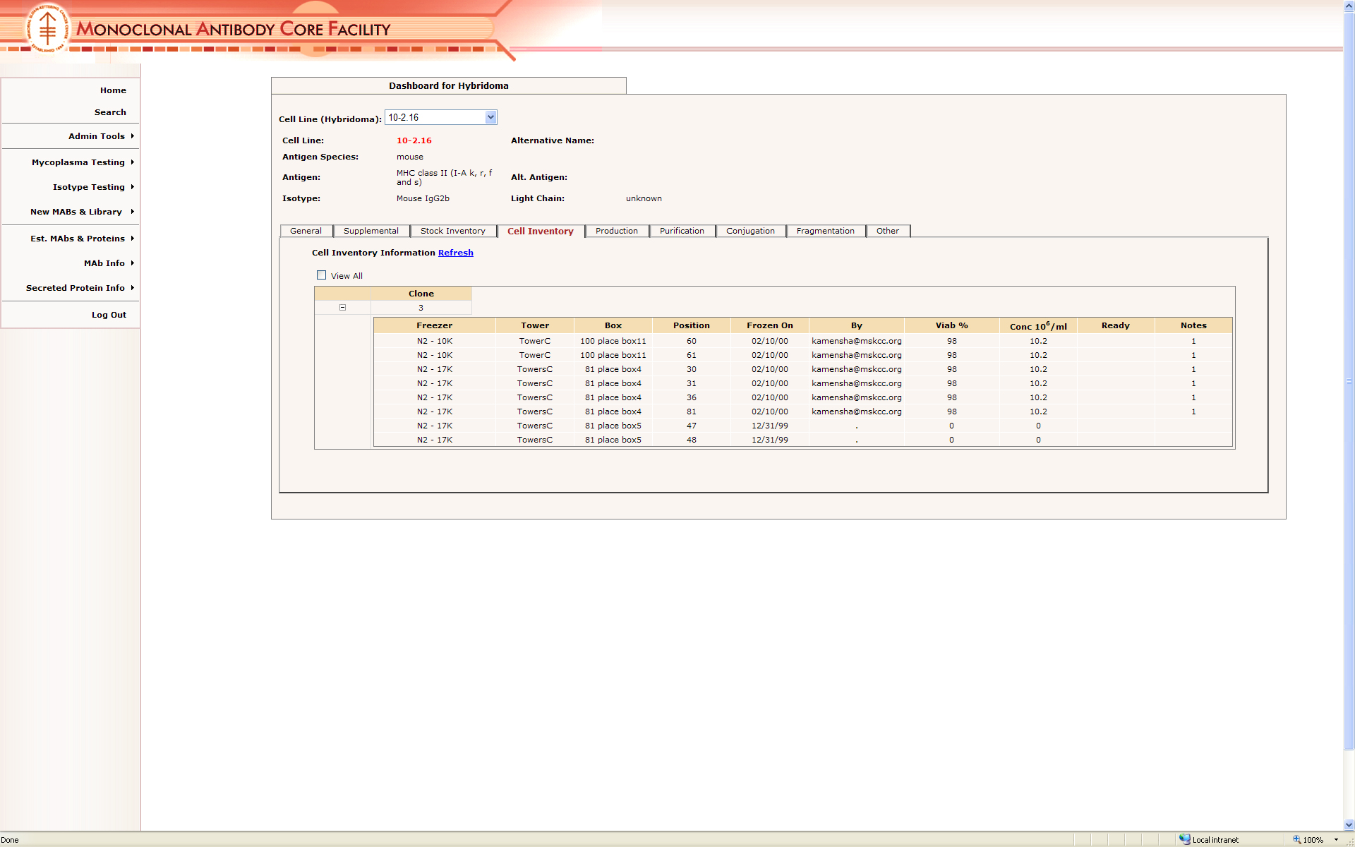
MACF Cell Inventory

Slide 20
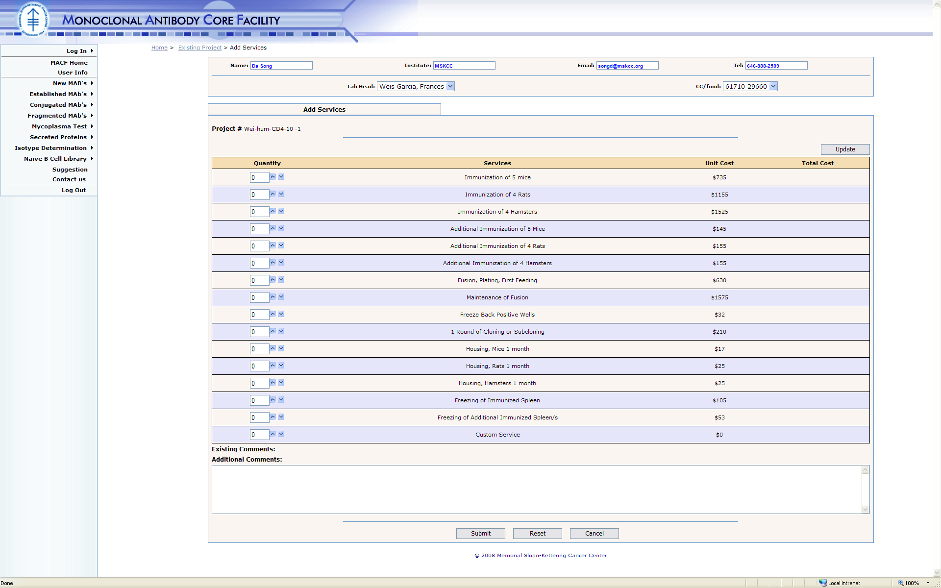
MACF User – Add Service

Slide 21
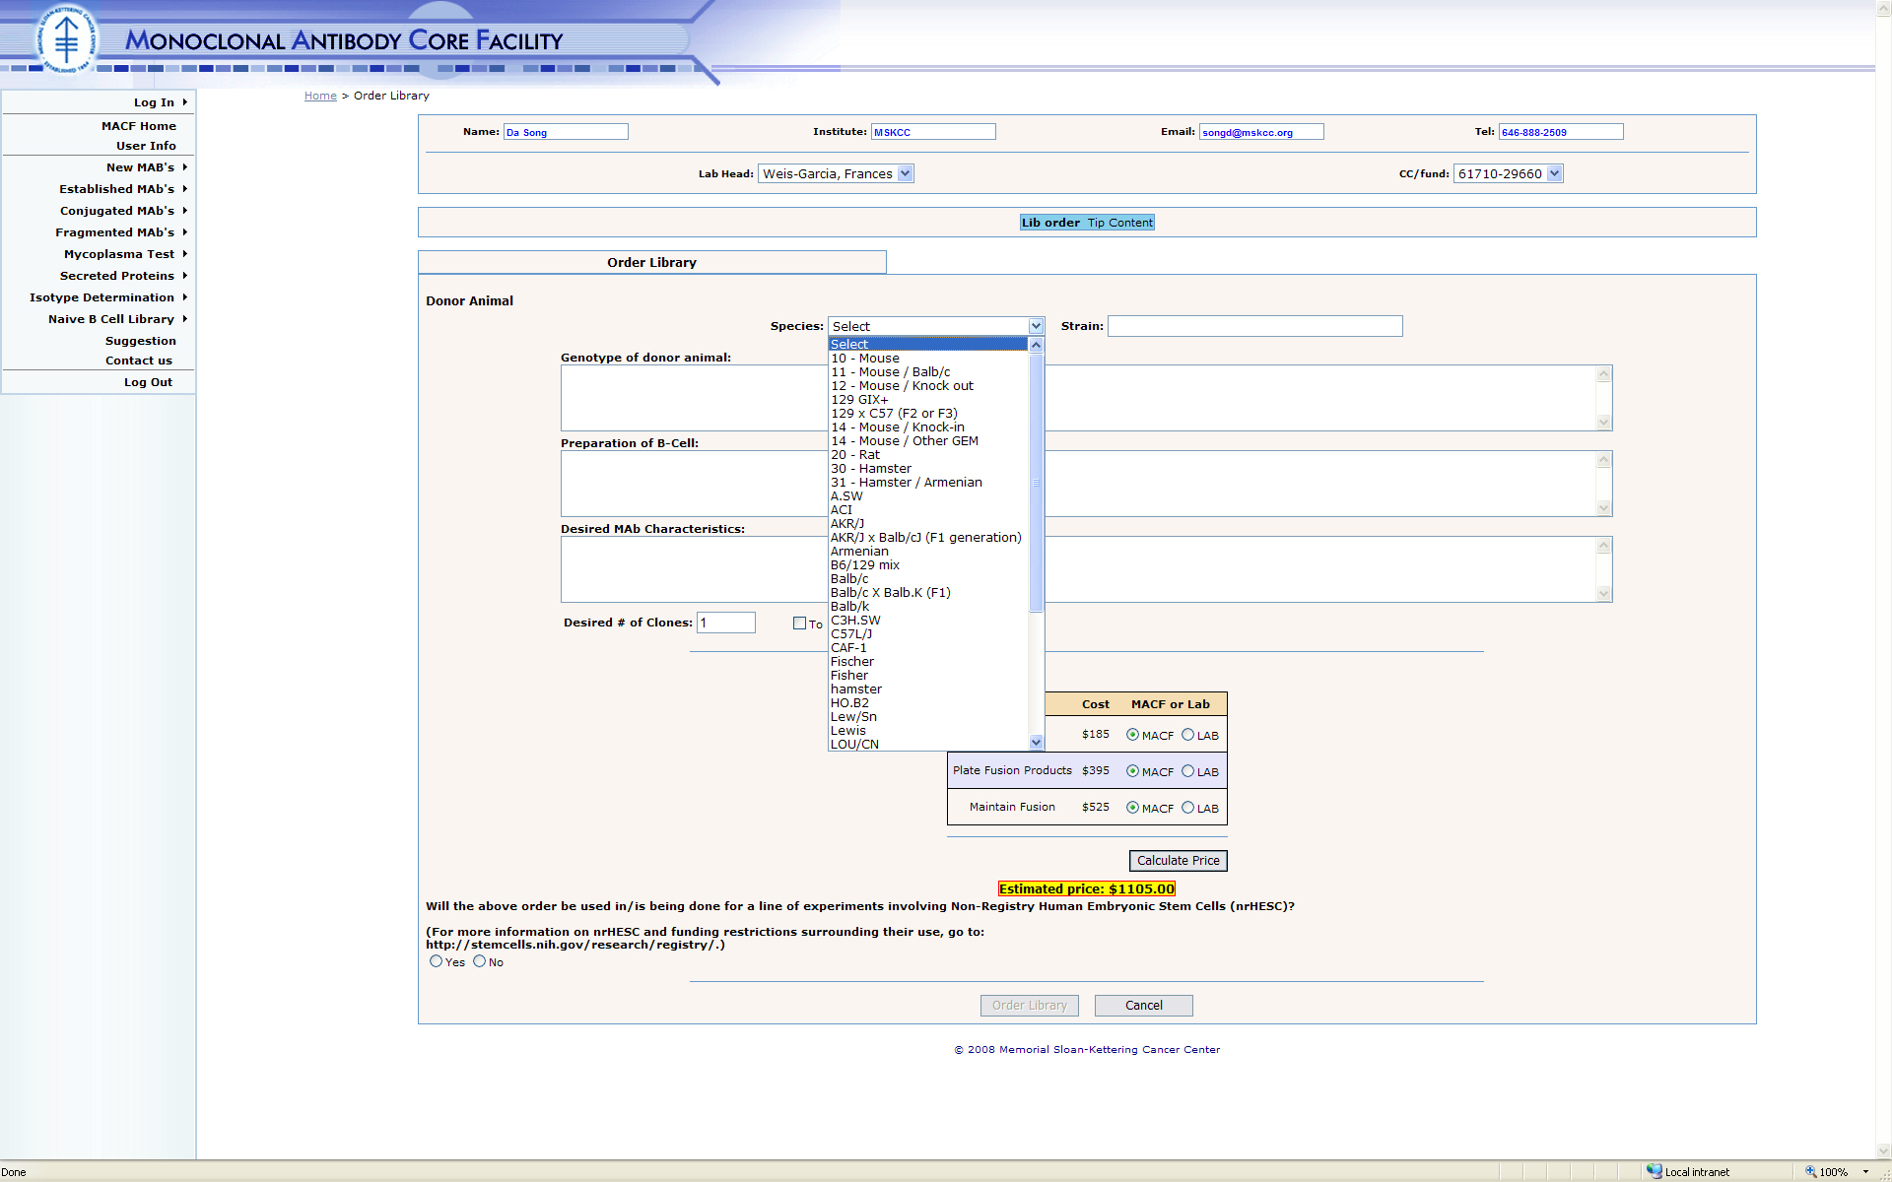
MACF User – Naïve b cell Library

Slide 22
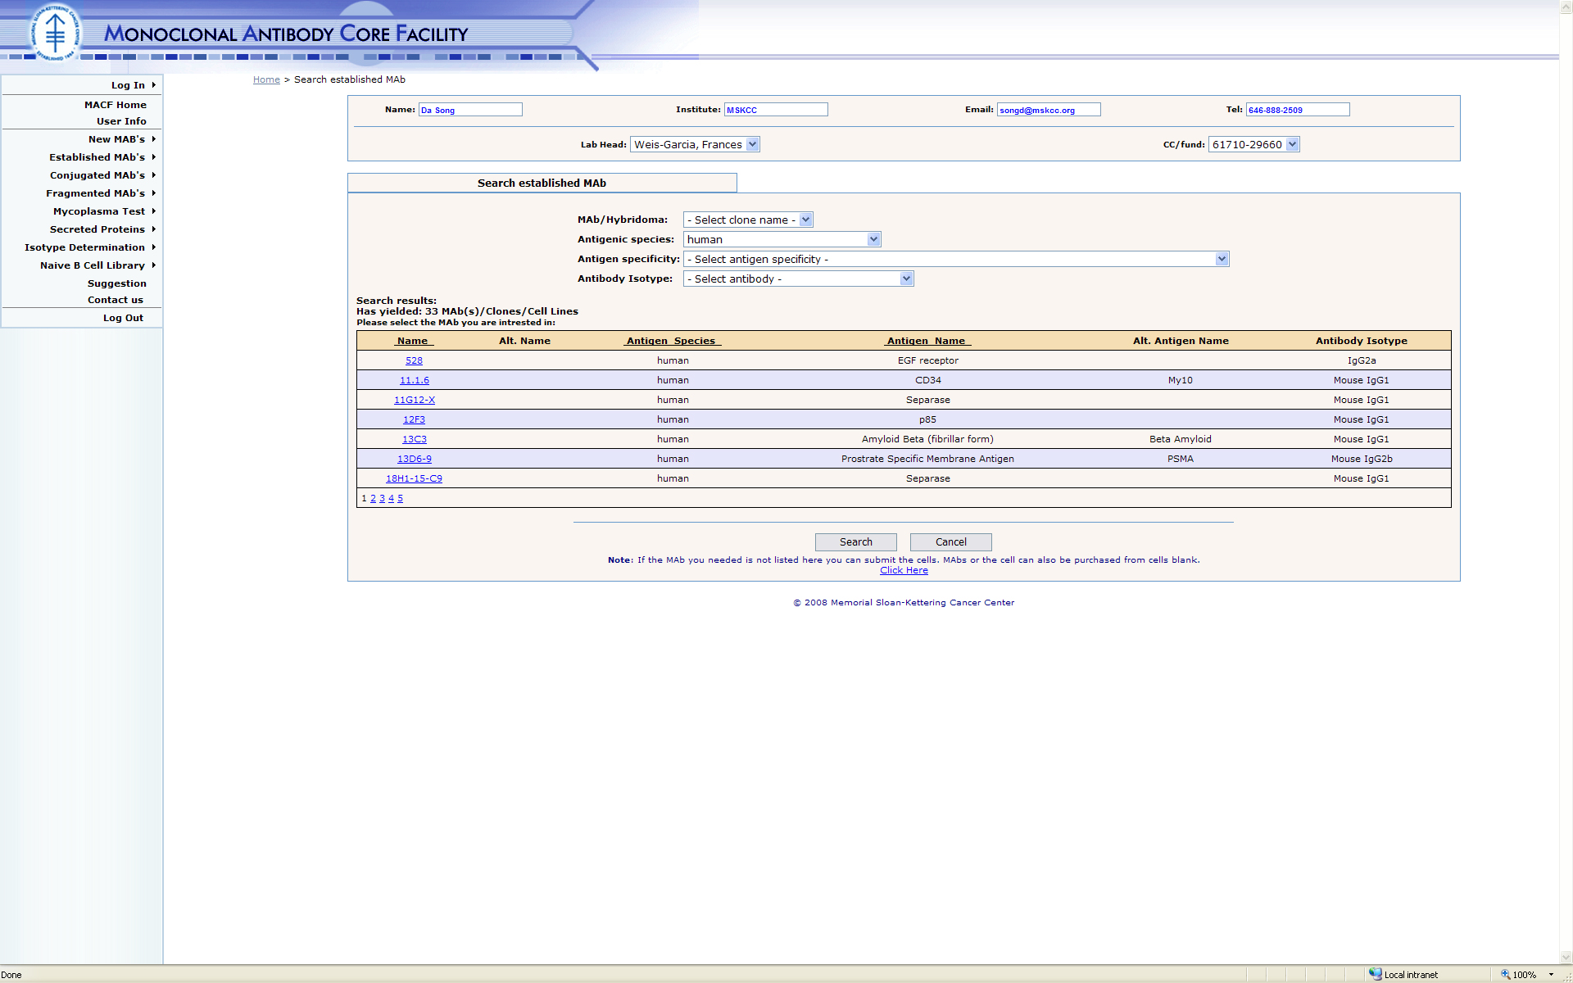
MACF User – Established Mab

Slide 23
Office of Sponsored Projects
Grants Central
Method: Full development, outsourced, off-shore
Payment: Time & Material
  Grants Central allows researchers and their administrative support staff to electronically initiate the review and approval of:
    All proposals submitted to funding agencies and sponsors
    Certifications & Assurances by Principal Investigators
    All notices of awards
    SKI fund account requests
    Reports and e-mail notifications
When to use: Need shorten development life cycle, lack of resources, lack of expertise in particular area.

Slide 24
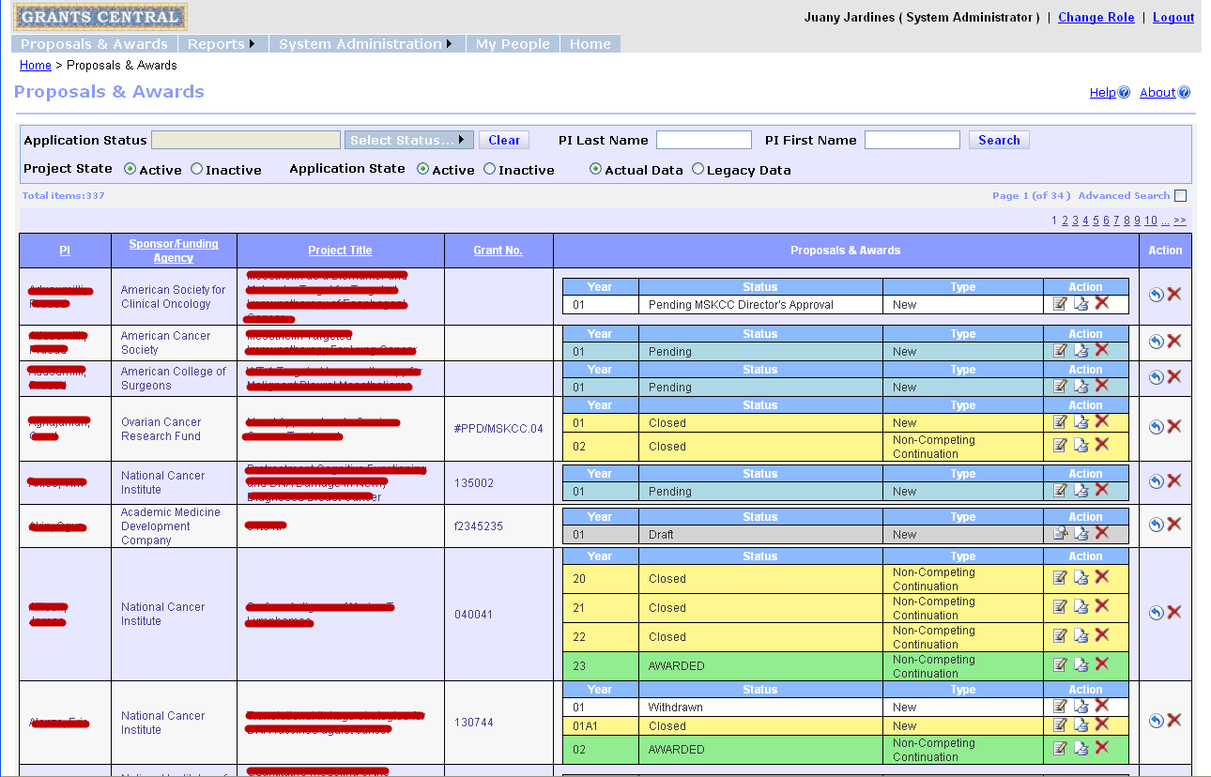
Grants Central
Proposals & Awards

Slide 25
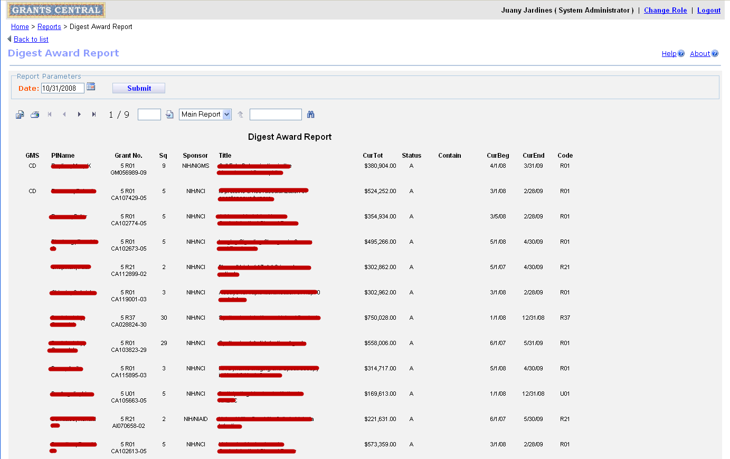
Grants Central
Digest Award Report

Slide 26
Cons
Language: Accents can be difficult to understand
Time Zone differences may cause work hours to shift
Development team may change without notification
Lack of familiarity with scientific terms
Error messages & prompts may not use correct US English terms
Critical components of production are not available in development environment

Slide 27
Pros
Price
24 hour development cycle can be achieved
Documentation is thorough
Vast knowledge
Development team can grow/shrink as needed
More simultaneous projects can be undertaken
Systemic methodology is used
Modules can be re-used for other applications

Slide 28
Lessons Learned
Have a shared calendar since holidays do not coincide and tend to be longer
Vendor’s infrastructure may be as robust so outages in the country will impact deadlines
Determine frequency of builds to be delivered
Ensure common view of bug tracking
Ensure you can support the application once project is complete
Testing will need to be more thorough
You will need internal staff to support the development effort

Slide 29
Bug Tracking

Slide 30
Documents

Slide 31
Defects Chart

Slide 32
Project Plan Tasks

Slide 33
For more information:
Memorial Sloan-Kettering Cancer Center
  http://www.mskcc.org
EPAM – Vendor
  http://www.epam.com
Gerstner Sloan-Kettering Graduate School of Biomedical Sciences
  http://www.sloankettering.edu
Juany: jardinej@mskcc.org
Developers: valm@mskcc.org, songd@mskcc.org, zhangq@mskcc.org

