Slide 1
Copyright Carol L. Smith, Dave Berque and Terri Bonebright 2008. This work is the intellectual property of the author. Permission is granted for this material to be shared for non-commercial, educational purposes, provided that this copyright statement appears on the reproduced materials and notice is given that the copying is by permission of the author. To disseminate otherwise or to republish requires written permission from the author.

Slide 2

Beyond the Prototype:
Scaling a Grassroots Tablet PC Pilot for
Large Scale Campus Integration
Dave Berque, Chair of Computer Science
Terri Bonebright, Chair of Psychology
Carol L. Smith, Interim Chief Information Officer
Notes:
Carol

Slide 3
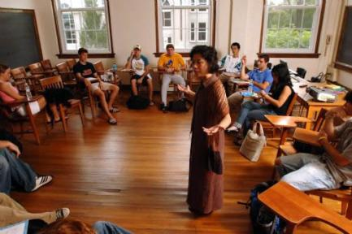
Setting the Stage . . .
DePauw University
  Residential, Liberal Arts University
  2,300 students
  Typical class sizes 8 - 30 students
Teaching is paramount:
“Pedagogy should drive technique and technology adoption”
A one-to-one student laptop program, but not yet a Tablet program
  What began as 2 HP Grants to enhance 3 courses
  Led to even broader impact!
Notes:
Carol

Slide 4
Guiding Principles
A Way, not The Way
Communicate Broadly and Openly
Change is Process not an Event
Notes:
Carol

Slide 5
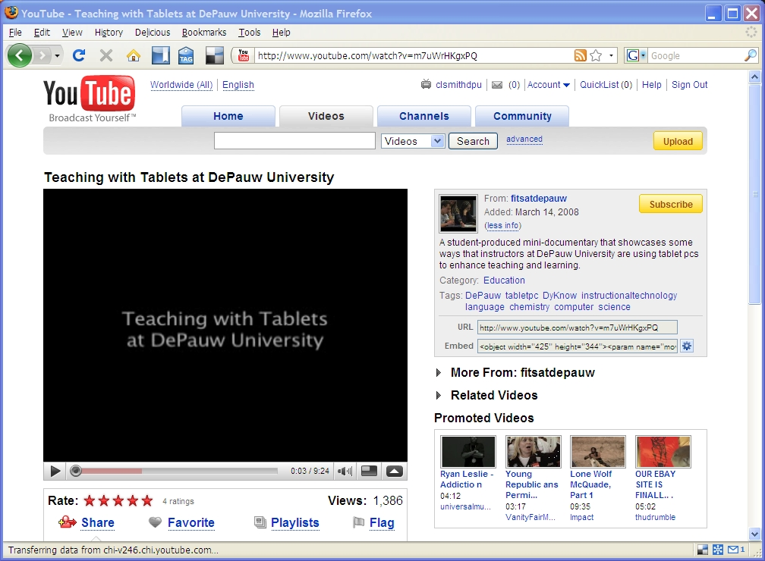
YouTube: Search for “Tablet DePauw”
Notes:
Carol

Slide 6
Pilot Tablet Use: Additional Examples
Cognitive Psychology
  Instructor feedback on papers
  Instructor and student use during class with DyKnow
  Interactive work with graphs during class
Foundations of Education
  Instructor feedback on papers
              Pen + Mobility + Software facilitates . . .
                Collaborative group work in the classroom
                Quick informative feedback
                Accurate and contextual note-taking
Notes:
Dave

Slide 7
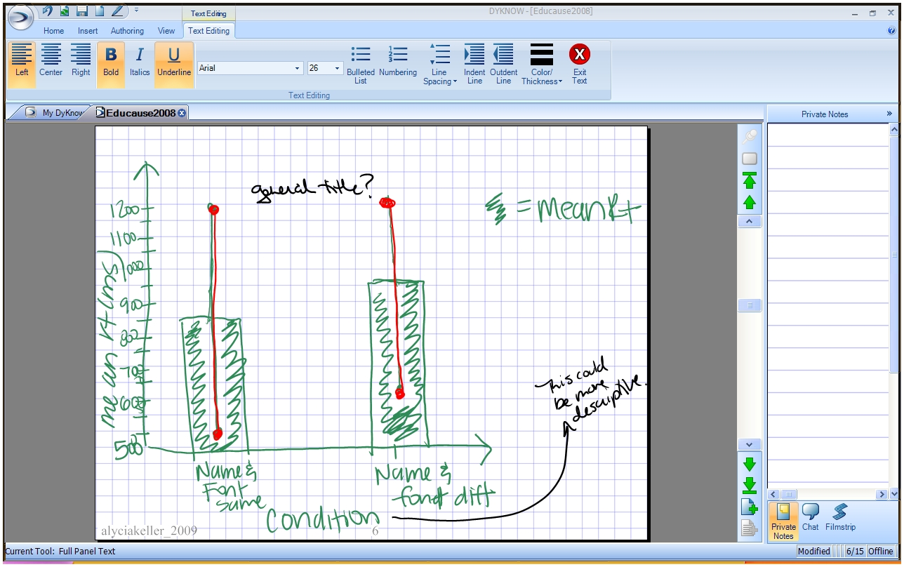
Graphing Activity Using DyKnow
(Psychology Course)
Notes:
Dave

Slide 8
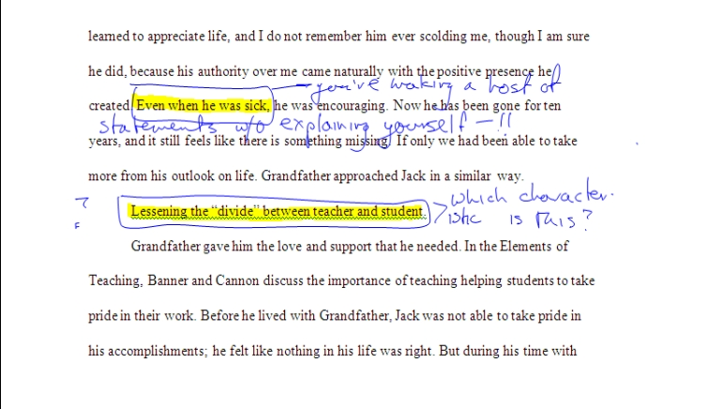
Feedback on Student Writing Using Word
(Education Course)
Notes:
Dave

Slide 9
Moving Beyond the Prototype
Where do we go from here? – How do we get there?
Principle #1:
A way, not The way!
  Local presentations of what faculty did as examples
  Then find out what spins others want to take
  Support them as they apply their own spin
  Do not assume one size fits all
Notes:
Dave

Slide 10
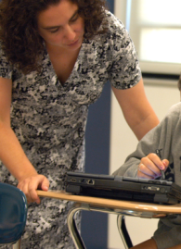
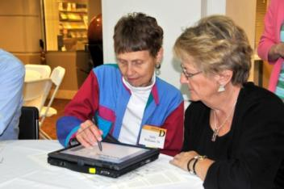
Moving Beyond the Prototype
Where do we go from here? – How do we get there?
Principle #2:
Communicate Broadly and Openly
  Faculty teaching and research presentations
  Day long and week long workshops (supporting mini projects)
  Student groups (special presentations and sessions)
  Local K12 schools (enrichment classes)
  Admission office student recruitment days
  Alumni office reunion weekend
Notes:
Dave

Slide 11
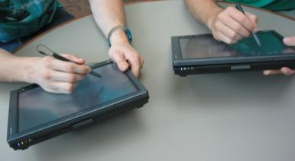
Phase Two
Received Academic Vice President matching funds
E-mailed the Faculty - Do you want a Tablet PC?
  About 40 responders said ‘Yes’
Hosted a one hour exposure session
    25 participants
Invited proposals to prototype using a Tablet PC
  How will you use the Tablet in your classes?
  Do you agree to attend faculty development session?
  Do you agree to participate in debriefings?
  All but one faculty member responded!
Notes:
Dave

Slide 12
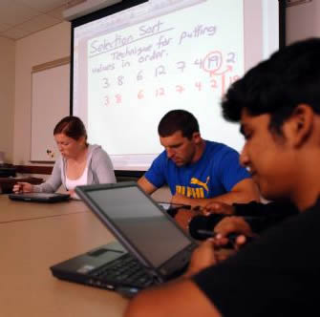
Results
25+ Faculty members received tablets for spring 2008
Wide Range of Disciplines, including:
  Biology, Chemistry, Physics, Psychology, Spanish, Japanese, Russian, Arabic, Greek, Political Science, Communications, Education, Music, Computer Science, others
Supported through:
  Instructional technologist consultations
  Tablet User Group (TUG)
  Visiting speaker
  Informal networking
Notes:
Dave

Slide 13
Highlights of Faculty Survey
When asked to indicate their level of agreement with the statement
"Using a Tablet PC has been valuable to my teaching."
  23 faculty members strongly agreed
  5 faculty members agreed
  2 were neutral
  0 disagreed somewhat
  0 strongly disagreed
When asked to indicate their level of agreement with the statement
"It is important to me to continue to use a Tablet PC next year."
  25 strongly agreed
  5 agreed somewhat
  0 were neutral
  0 disagreed somewhat
  0 strongly disagreed
Notes:
Dave

Slide 14
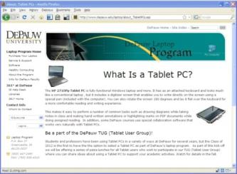
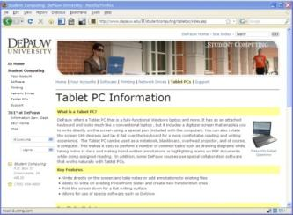
Outcomes
Principle #3:
Change is a process, not an event
Institutionalization:
  Faculty Tablet PC Option started fall 2008
  Student Tablet PC Option started fall 2008
  Continued support and assessment
  (users groups: TUG & STUG)
Ongoing Research and Collaboration
  NITLE Instructional Innovations Fund grant to host a Tablet PC workshop for faculty members at Midwest liberal arts colleges in spring 2009
  Feedback sought from you now!
Notes:
Carol

Slide 15
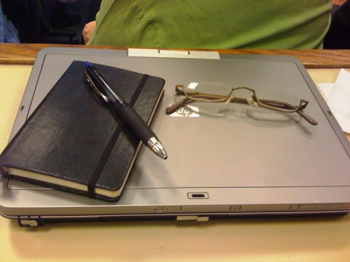
From Our Story to Your Story . . .
What similar transformations have you experienced and/or
what similar transformations would you like to experience?
Please share your Experience… Advice… Questions…
Notes:
Carol

Slide 16
Beyond the Prototype:
Scaling a Grassroots Tablet PC Pilot for
Large Scale Campus Integration
Dave Berque, Chair of Computer Science
dberque@depauw.edu
Terri Bonebright, Chair of Psychology
tbone@depauw.edu
Carol L. Smith, Interim Chief Information Officer
clsmith@depauw.edu

Slide 17
Beyond the Prototype:
Scaling a Grassroots Tablet PC Pilot for
Large Scale Campus Integration
Dave Berque, Chair of Computer Science
Terri Bonebright, Chair of Psychology
Carol L. Smith, Interim Chief Information Officer
Notes:
Carol

