Slide 1
Campus Emergency Notification
@UNC-Wilmington
EDUCAUSE National Conference
October 30, 2008
Bruce P. Myers
Information Technology Systems Division
Technology Needs Assessment and Consulting
The University of North Carolina, Wilmington
Notes:
State mandate to eliminate use of SSN as a personal identifier

Slide 2
What Topics Will We Cover?
Campus profile: Geographic location, campus population
Organizational structure: Campus departments, councils, in/outside partners
Technologies: Focus upon the various methods that we are currently using, and those that we consider WIP’s
Pros/Cons of the Methods: What works, what to beware of, and ways to improve the effectiveness of communications

Slide 3
Unique Challenges for the Campus:
Our Location and Diverse Population
Campus Locations:
  Main campus is in Wilmington, NC ..the Southeastern North Carolina coast
  Between the Cape Fear River and Atlantic Ocean
  660 acres in size
  Satellite locations:
    Center for Marine Sciences (15 miles)
    Alumni, Advancement, Marketing & Business Affairs Offices (< 5 miles)
The Diverse Campus Population:
  Students (active): 13,000
    On-site, day and evening classes, living on/off campus
  Employees and part-time workers: 2,000
    They are mobile when on-campus (not always in the office)
Others:
  Visitors attending special events (cultural arts, sporting)
  Contractors for construction and specialized services
  Library use, walking or driving the campus grounds
  Adjacent residential neighborhoods
Each of these groups are affected by our notification process..
Our Approach: Maximize effectiveness by using a multi-layered approach
Fact: no single method will reach everyone !!

Slide 4
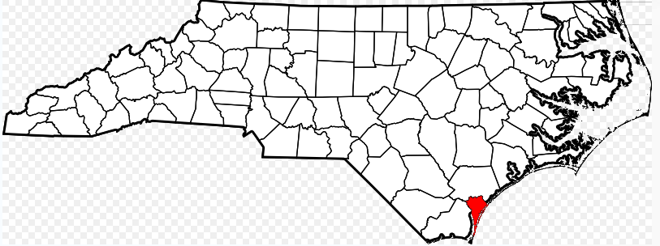
Our Campus Location

Slide 5
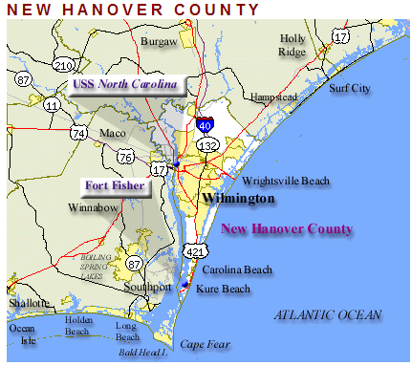

Slide 6
Unique Challenges for the Campus:
Our Location and Diverse Population
Campus Locations:
  Main campus is in Wilmington, NC ..the Southeastern North Carolina coast
  Between the Cape Fear River and Atlantic Ocean
  660 acres in size
  Satellite locations:
    Center for Marine Sciences (15 miles)
    Alumni, Advancement, Marketing & Business Affairs Offices (< 5 miles)
The Diverse Campus Population:
  Students (active): 13,000
    On-site, day and evening classes, distance ED, living on/off campus
  Employees and part-time workers: 2,000
    They are mobile when on-campus (not always in the office)
Others:
  Visitors attending special events (cultural arts, sporting)
  Contractors for construction and specialized services
  Library use, walking or driving the campus grounds
  Adjacent residential neighborhoods
Each of these groups are affected by our notification process..
Our Approach: Maximize effectiveness by using a multi-layered approach
Fact: no single method will reach everyone !!

Slide 7
How are we Structured for Handling Emergencies ?
Emergency Management:
  Comprehensive program, all hazards focus
  Housed within the Environmental Health & Safety department
  UNCW Emergency Operations Plan : Contains hazard specific annexes (e.g., the hurricane plan).
Crisis Decision Team:
  Made up of senior university officials (Chancellor’s cabinet / VC level)
  Responsible for making critical decisions during an emergency or disaster: Cancellation of classes, closure of the university, campus evacuation
  Conducts crisis communications and meets regularly during an incident
Emergency Operations Group (action follow-through):
  UNCW Staff members who play an operational role during an emergency
  Aligned with Wilmington and County EMS departments
  Conducts response actions and activities during an event
  Resource gathering, campus preparation steps, reparation of critical facilities

Slide 8
Organizational Structure
Law Enforcement
Environmental Health & Safety
Crisis Decision Team
Information Technologies
Marketing & Communications
Housing & Residence Life
Business/Student
/Academic Affair(s)
New Hanover County EMS

Slide 9
UNCW’s Areas of Focus for 2007/2008
Emergency Communications enhancements :
  SeaHawk siren system
  TV alert notification system (cable interrupt)
  Text messaging alert tests to students, faculty and staff via the PIER system (Public Information Emergency Response system)
  University marquee outside of campus (main thoroughfare)
Education and Training:
  New employee orientation awareness training
  ITSD Security officer: in-class lectures regarding cyber-awareness
  Safety Symposium and Information Fair for faculty, staff and students (started in Sept, 2008)
Emergency Management Planning:
  Conducted (5) “table top” and functional exercise scenarios: hurricane, active shooter, gas leak, pandemic flu, and hostage
  NIMS (Nat’l Incident Mgmt System, FEMA) training offered (on-site and online) to senior officers and first responders ..(50) trained personnel
Physical Security:
  109 new door card readers installed (238 across 46 campus buildings)
  New standards are being implemented for all classroom doors
  (Lenel system)
Notes:
NIMS was created in 2004 by the Homeland Security Dept

Slide 10

Methods of Communication..
SeaHawk Siren system:
  Installed and activated July, 2007
  Horn arrays are strategically located on (2) campus buildings
  Testing plan:
    Low volume functional test on the 2nd Monday of each month
    Full volume test on the 2nd Monday of January, July, and September
  Campus police department conduct tests and are the primary operators of the system, along with the County EC center.
  UNCW.edu website has instructions for campus and surrounding neighborhoods
  Limitations & Challenges:
    Effective for those who are outside or near the siren at the time of warnings
    Environmental factors may confuse the message (wind, other ambient noise)

Slide 11
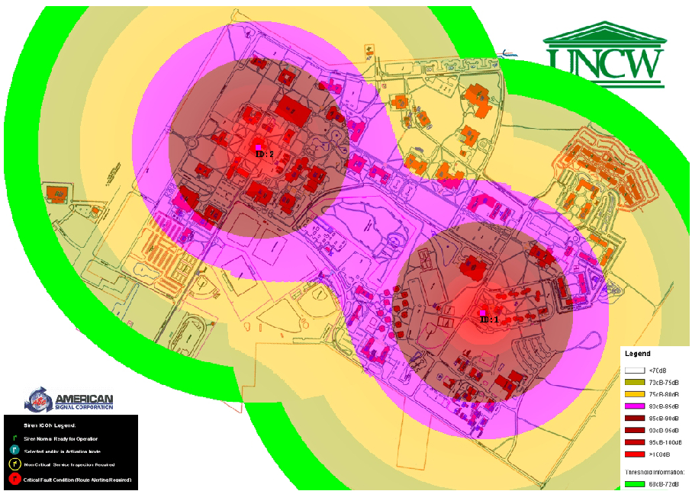
The Siren Coverage Map

Slide 12
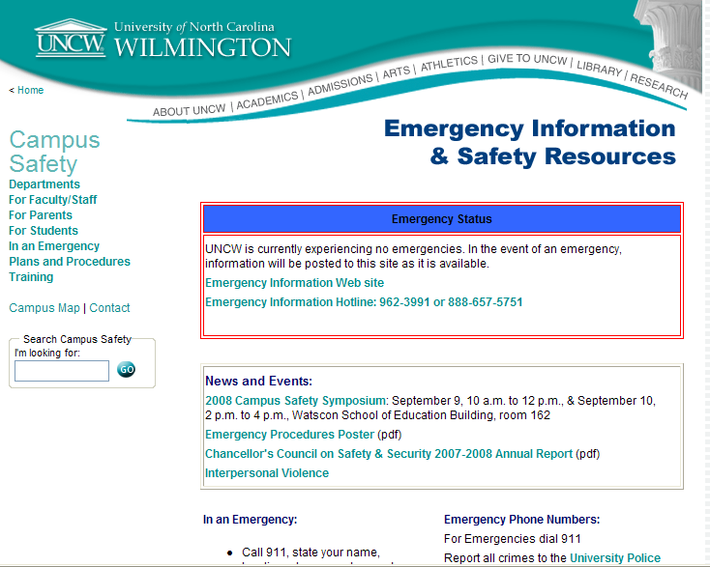
Our Environmental Health & Safety Website

Slide 13

Methods of Communication..
E-mail, Text, and Web:
Hosted with a 3rd party provider (PIER, since Fall 2006)
Managed by our Marketing and Communications department
Acts as a backup site for UNCW.edu if our site goes offline
Data supplied by UNCW and stored on PIER:
  Banner (ERP): Name, campus e-mail address, location are updated weekly
  Personal cellphones: Self-Service “opt-in” registration for faculty/staff/students
  Site documentation: campus buildings, key personnel w/contact information are stored on the PIER website
2007 Text Message Test results:
  A 91% delivery success rate to cellphones was achieved across ~1,500 faculty/staff/students
  1/2 of the failures due to incorrect phone #’s or lack of a text messaging plan.
  A regular testing plan is currently in development
Limitations & challenges:
  Up-to-date and accurate information ..very important !!
  Are you on the grid (on-line) ?
  Reliability of SMS texting systems: speed, congestion during peak period

Slide 14
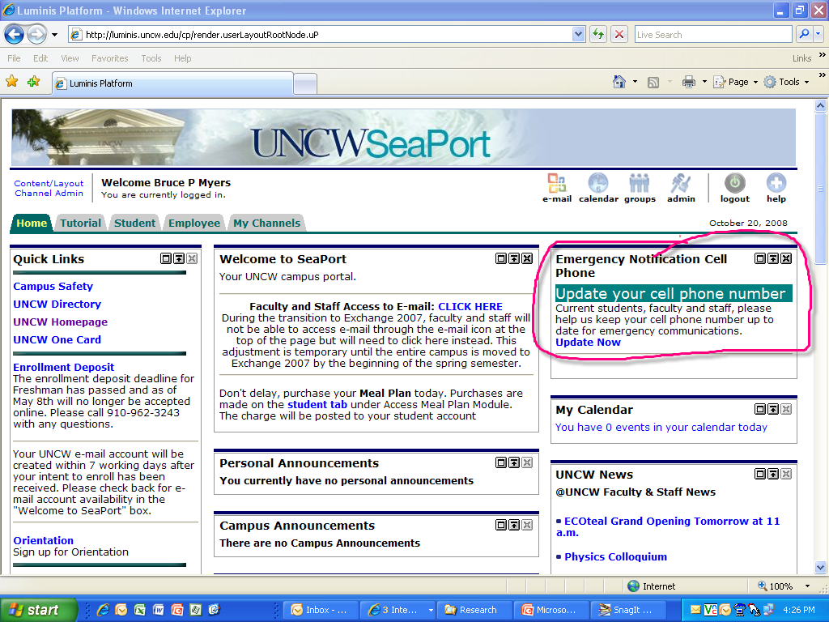
Our SeaPort Portal & Cellphone Signup

Slide 15
Cellphone Captures..
Reasons for the sharp increase:
Student Orientation
Involvement Fair
Parents (nagging does work !!)

Slide 16
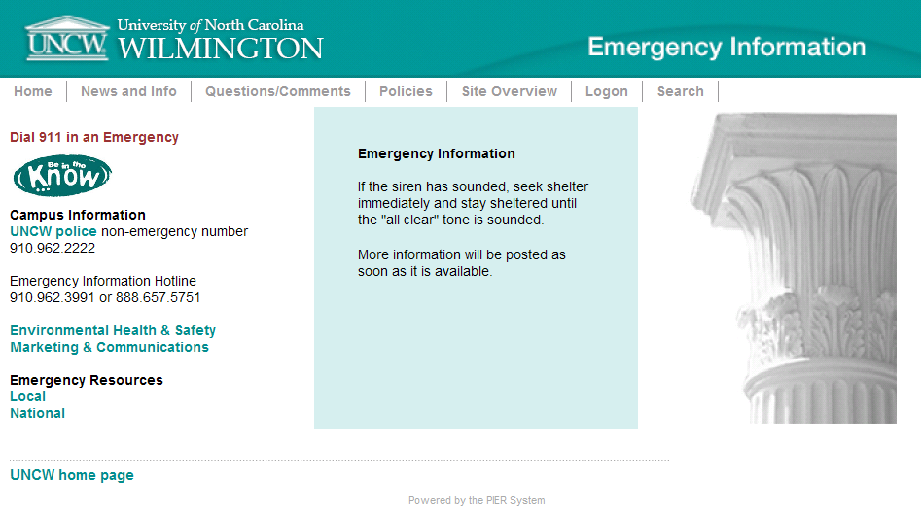
Our External Web Presence (PIER)..
Used as a substitute if our network or IT facilities are unavailable
Contains the latest information if there is an Emergency

Slide 17
Methods of Communication..
Cable TV Interruption:
  Breaks into the cable broadcast and takes control of all campus programming
  Displays an instructional page, and allows for live announcements
  Reaches viewers in residence halls and common spaces across campus (approximately 4,000 endpoints)
  Started using in January, 2008
  Testing Plan: Tests are scheduled with the siren system
  Limitations & Challenges:
    Will not interrupt DVR/DVD/gaming users
    Does not reach entire campus population (satellite offices)
    Hardware is a mix of components; support and turnaround times are too lengthy
    Remote access to control content was not implemented..technical issues

Slide 18


TV Cable Interrupt
Normal Broadcast using the Cable Network
Time-Warner
Cable
UNCW-TV
Broadcast Sources…
Campus TV
Endpoints
(Idle)

Slide 19
Interrupted Broadcast for Emergencies..
Alert
Alert
Time-Warner
Cable
Alert
UNCW-TV
Campus TV
Endpoints
Broadcast Sources…
(Active)

Slide 20
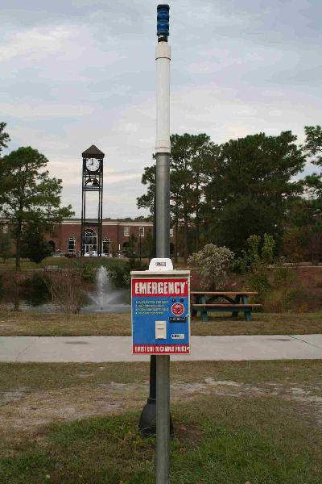

Campus Safety and Reporting Emergencies..
Callboxes:
Approximately (100) callbox locations on campus
(2) way communications capability to report emergencies
Locations were defined using campus “safety walks” with students
Major use to-date: people who are lost on the campus,
  need an escort, or other assistance
E-911 Services:
All buildings/rooms are uniquely identified by location of call
All residence rooms have a landline installed for this purpose

Slide 21
Communication Methods UNCW is Pursuing..
Facebook and MySpace for EN (exploratory):
  “Push” notifications to a UNCW group ,or individuals ID’d as UNCW sign-ins
Siren Interface to Desktop Units (exploratory):
  “Push” technology to desktop units (for domain log-ins)
2-Way Intercom System (funded):
  To be deployed to academic classrooms and satellite locations across the UNCW data network
Upgrade to the TV cable interruption system (funded):
  We need this upgrade to continue with this method..
Digital Signage / IP TV (exploratory):
  Proof of Concept initiative in-place..completes in January, 2009
Upgrade to our Text/Voice Messaging System (funded):
  ConnectEd to be used.. full-featured, robust, flat-rate per contact per year

Slide 22


Digital Signage/IP TV Network
Master
-and-
Individual Control
Broadcast Sources
Digitized Signal
Marketing
Lecture
Awareness
Topics
Advertisement
TV Programming
Classrooms
Local / Remote
Administrative
Student Store
Lounges

Slide 23
IP Based Intercom System
Interface – wall mounted, IP Based Telecom system.
Works by
  Two way classroom communication for the Police and Technology Assistance Center.
Contains
  Hardware wall mount communication device
  Software for communication with help desk/police.
Dependency: Network reliability

Slide 24
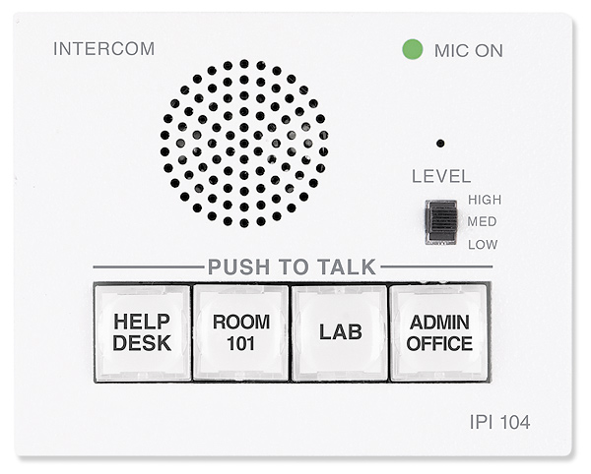
Intercom System
!!!
Police
!!!

Slide 25
Challenges: Regulations and Budgets
Higher Education Opportunity Act of 2008 (HR 4137):
  August, 2008 provision within the bill: to alert everyone on a campus about an emergency within 30 minutes. Provision has since been repealed.
School Safety Enhancements Act (HR 2352):
  Contains much of the same language as the HEOA..
  Well-intended for safety..Regulation overload for campuses?
  What constitutes an “emergency”?
DHS/FEMA’s role in an Emergency Alert System:
  Forming a public-private partnership with commercial mobile service (CMS) providers to screen and send text alerts to mobile phones
  Providers have until Sept, 2008 to choose participation in the program
  Approx. 244 million Americans subscribe to a wireless program (81 %)
Budgetary Pressures..the impending cutbacks:
  2% reductions achieved to-date
  An additional 4% anticipated
  Budget reduction team formed by the Chancellor
  How much EN is “good enough”?

Slide 26
Conclusions and Lessons Learned
Design with a multi-layered approach: No single method will cover all hazards
Collaborate with Stakeholders: Gathering police, communications, security, IT, and other key decision makers at the same time to form plans and discuss options is essential
Buy, build, or contract services? Decide upon the correct “mix” of products and services to support your EN strategy...we have done all (3)
Minimize product maturity risk: Understand the limitations of the technologies being used for your EN strategy (e.g., cable interrupter)
Buildings on the UNC-W campus are in a state of change:
  Renovations and new construction are going on side-by-side
  Outfitting them with updated technology (wireless I/P, more safe building materials) is helping to enable solutions and minimize our risks.
EN Drills (direction from police, safety & communications teams):
  Too frequent, and they start to become ordinary
  Not often enough, and they are forgotten.
Communications plan: We use orientation seminars, handouts/fliers to keep sharpened awareness, presence of Emergency personnel at on-campus fairs/shows for Q&A
EN centerpieces: Set your priorities (what we will do), determine your methods (how we will do it), and instill a governance model (develop policies , procedures, and review for changes and improvements)

Slide 27
References & Citations
Inside Higher Education (insidehighered.com)
  “HEA: A Huge, Exacting Accountability Bill”, August, 2008
  “Emergency Overload”, September, 2008
School Safety Enhancements Act (HR 2352):
  http://thomas.loc.gov/home/gpoxmlc110/h2352_ih.xml
Higher Education Opportunity Act (HR 4137):
  http://thomas.loc.gov/cgi-bin/query/z?c110:H.R.4137:
The Gartner Group (gartner.com):
  “FEMA Will Play Middleman in Emergency Alert System”, September, 2008
UNCW:
  Chancellor’s report: “2008 Council on Safety and Security”
  Assistance from Marketing/Communications, ITSD, and the Environmental Health and Safety department(s)

Slide 28
Q & A…
Contact Information:
Bruce P. Myers
Business and Technology Analyst
Technology Needs Assessment & Consulting
UNC-Wilmington
myersbp@uncw.edu
910.962.7652

Slide 29
Copyright Bruce Myers, 2008.
This work is the intellectual property of the author. Permission is granted for this material to be shared for non-commercial, educational purposes, provided that this copyright statement appears on the reproduced materials and notice is given that the copying is by permission of the author. To disseminate otherwise or to republish requires written permission from the author.

