Slide 1
CRM Adventures: Three Perspectives
Edward Kelty – Rio Salado College
Robert B. Luikart – The Ohio State University
Sherri Yerk-Zwickl – Lehigh University
Copyright 2008. This work is the intellectual property of the authors. Permission is granted for this material to be shared for non-commercial, educational purposes, provided that this copyright statement appears on the reproduced materials and notice is given that the copying is by permission of the authors. To disseminate otherwise or to republish requires written permission from the authors.

Slide 2
CRM Adventures: Three Perspectives
Introductions & Institution Overviews
  Edward Kelty – Rio Salado College
  Robert B. Luikart – The Ohio State University
  Sherri Yerk-Zwickl – Lehigh University
CRM Implementation Stories
  Lehigh University
  The Ohio State University CFAES
  Rio Salado College

Slide 3
Ground Rules
Q&A
  fill out a card, give to convener
  Use the microphones
Cell phones – (you know the drill)

Slide 4

CRM @ Lehigh University
Founded in 1865
4600 undergrads,
2000 grad students,
600 Faculty, 1100 Staff
4 Colleges (Arts & Sciences, Engineering, Business, Education)
Research Intensive Private University

Slide 5
What is CRM?
Technology that:
  Provides integrated applications that address the operational needs of customer facing entities (functions, web sites, and partners)
  Enables the integration of effort
  Enables the creation of a single customer database
  Provides a set of analytical tools for reporting and analyzing customer behavior.
Notes:
Depending on who you talk to CRM is
Sales Force Automation
Marketing tools
Self Service tools
Customer Centric approach

Slide 6
What is CRM?
“The strategic purpose of CRM is to enable the organization to use customer interactions and customer history in a manner that leverages long term, profitable growth.”
- Peterson, G. “A Lexicon for Customer Relationship Management Success” Technology Evaluation Centers 8 March 2006. 29 September 2008.
<http://www.technologyevaluation.com/Research/ResearchHighlights/CRM/2008/09/research_notes/MI_CR_XGP_09_29_08_1.asp>.

Slide 7
Our Goals
Expand our ability to connect
Leverage our existing data

Slide 8
The Back Story
History
  July 2005 cross-university committee formed
  Researched needs, evaluated products
  August 2006 SunGard meeting
  November 2006 – LU invited to partner
  January 2007 – today: lots of meetings!

Slide 9
Development Partners
Ithaca College
Johnson County Community College
Lehigh University
Mississippi State University
Old Dominion University
Seton Hall University
Texas A&M University
University of Alaska
University of Illinois – Global Campus

Slide 10
Where we are today…
Recruiting and Admissions Relationships
  June 2008 live
  Initial areas of focus
    Counselor workspace
    Campaign tool
    Interactions
    Applicant portal
Performance & Analytics
  Implementation underway (11/17/08)

Slide 11
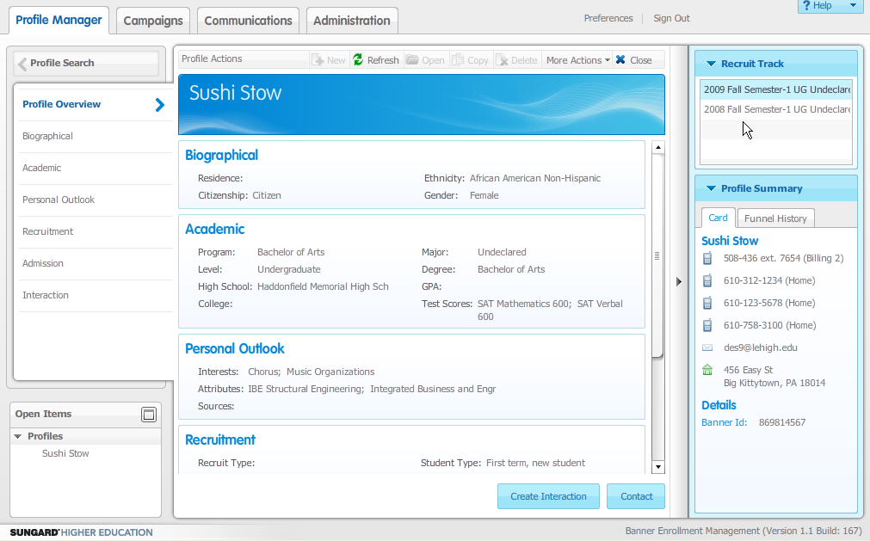
Relationships

Slide 12
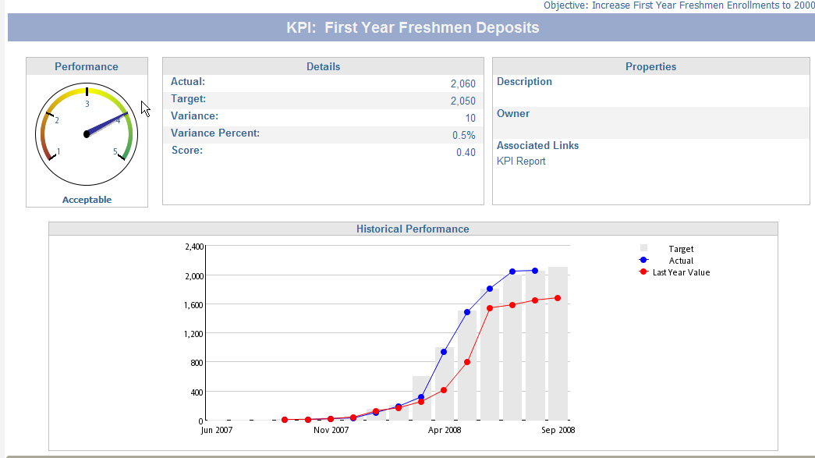
Performance

Slide 13
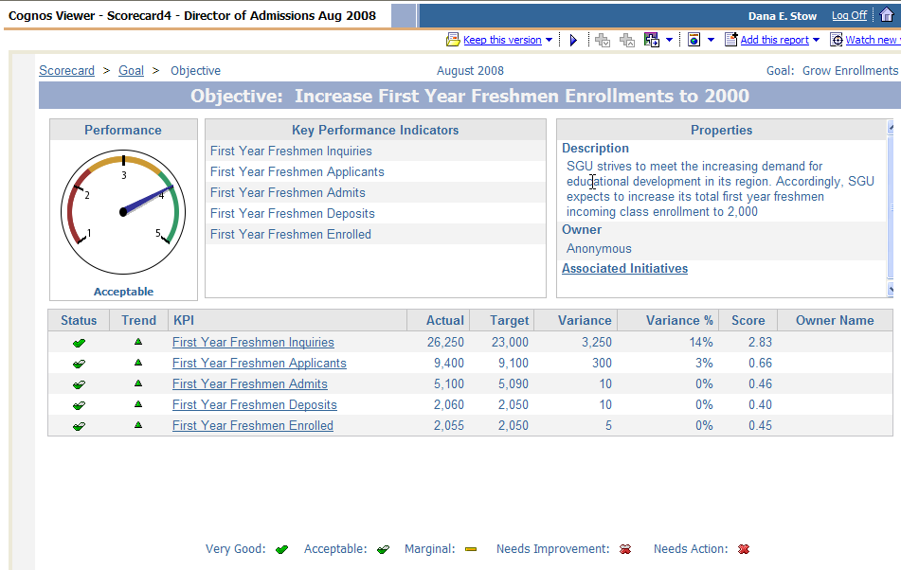
Performance

Slide 14
What’s in our Future?
Graduate Admissions implementation
Student Retention Development Partner
Advancement product…

Slide 15
Lessons Learned
Be realistic
Communicate, communicate, communicate
Define goals up front
It’s about people, not technology
This is a song that never ends…

Slide 16
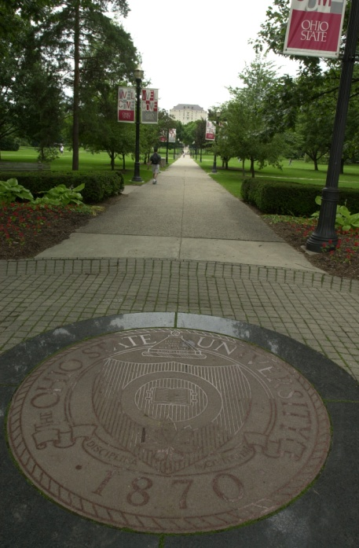
CRM @ OSU CFAES
Project for the College of Food, Agricultural, and Environmental Sciences
  Includes OSU Extension
  Three Campuses, 88 Extension Offices, 12 Research Stations, Three Farm Laboratories
  2,200 faculty/staff, 3,200 students

Slide 17
Drivers for CRM @ OSU CFAES
OSU CFAES and 21st Century Business Needs
  Become “Customer” focused
  Use software to support business functions
  Use information databases to track customers, target market programs, and evaluate program impact
  Market and deliver products using the web
  Present a consistent “branded” image

Slide 18
Drivers for CRM @ OSU CFAES
Other Business Needs
  Manage Volunteer involvement
  Manage Campaigns
  Forecasting of issues
  Develop market research from customer base

Slide 19
CRM Planning @ OSU CFAES
Key Questions:
  What is our CRM strategy?
  Is the organization ready for CRM?
  Are stakeholders in agreement on the need for CRM?
  Is there a solid business case for CRM?
  Do we have a way to implement CRM?

Slide 20
CRM Planning @ OSU CFAES
Interesting Answers:
  Buy software
  We’ll try it, but don’t change anything
  We’ve done fine for 100 years
  Business case?
  You mean you want money to do this?

Slide 21
CRM Planning @ OSU
Project plan as developed:
  Phase One: $150,000; up to 1 year implementation (3-4 months to develop strategy)
  Phase Two: $100,000-150,000 to add business functions; rollout across CFAES
  Leadership: Administrator assigned for oversight
  Management: Assign faculty/staff and technical support

Slide 22
What We Learned @ OSU
Senior executives had the right vision
Inability to articulate a clear strategy lead to lack of organizational commitment
  A vendor brochure is not a strategy
Absent business plan resulted in too few resources to initiate the project
We were fortunate to stop a runaway I/T project before it got started

Slide 23
CRM @ Rio Salado
Founded in 1978 –alternative and distance learning
Student Groups
  31,000 online learners
  6,500 dual enrollment
  12,200 Partnership
  11,000 ABE, GED, ESL and Prison
30 full time faculty, 1100 adjunct faculty 500 staff
Classes start every Monday!

Slide 24
Influencing factors in implementing CRM @ Rio
Our Presidents goal “100,000 students by 2012!
National trend of declining enrollment
I routinely heard this type of topic come up: “We have all this data on our students, can’t we find a way to use it to do better recruitment and retention?”

Slide 25
Influencing factors in implementing CRM @ Rio
PeopleSoft is coming!
  Implement something before PeopleSoft or forever hold your peace.

Slide 26
CRM Selection @ Rio
May 2006 – Gartner ITExpo
  Talked to several analysts – based on our environment, Microsoft CRM with assistance from an integrator that was familiar with CRM & Education
June 2006 – Met Microsoft sales rep
  I asked one question – “Who’s the best out there”
    The answer “Crowe Chizek”

Slide 27
CRM Selection @ Rio
July 2006 – Contracted with Crowe Chizek to do an initial functional specification and full implementation quote
Late Fall 2006 / Early Spring 2007 finalized procurement
Crowe Chizek onsite February 2007
Deployment of Rio CRM August 2007

Slide 28
Implementation Phases @ Rio
Phase 0
  Hardware, Software, Technology Training
Phase I
  Design user interfaces, Integration, User Training, Workflows, Early Warning, Reports
Phase II
  Information request webpage, enhanced workflows and additional enhancements

Slide 29
Implementation Phases @ Rio
Phase III
  LSQ Integration, Automated Risk assessments / Workflows
Phase IV
  Corporate sales team integration with CRM, Goldmine Data Migration

Slide 30
CRM @ Rio Today
Numerous automated workflows to improvement recruitment
Outbound call center using it for campaigns
A long to-do-list of additional enhancements

Slide 31
What we learned @ Rio
Communicate, communicate, communicate
It’s about people, not technology
MS-CRM can be configured to do almost anything – stay focused
Having an integrator, with experience in education, was invaluable
Training, support and more training!

Slide 32
Q&A

Slide 33
Contact Info
  Edward Kelty, Rio Salado College
    edward.kelty@riomail.maricopa.edu
  Robert B. Luikart, The Ohio State University
    luikart.7@cfaes.osu.edu
  Sherri Yerk-Zwickl, Lehigh University
    shy2@lehigh.edu

