Slide 1
Have MLS, Will Travel
How We Got out of the Library and into Academic IT

Slide 2
Panelists
Chris Jorgensen
Research & Instructional Technologist
Center for Health Policy & Ethics
Creighton University
Kristina Lively
Webmaster
University at Buffalo Law School
Karla Lucht
Computer Assisted Instruction Specialist
Instructional Technology & Design Office
Graduate School of Library & Information Science
University of Illinois at Urbana-Champaign
William W. Wells, Jr.
Chief Information Officer
University of Southern Maine

Slide 3


Slide 4


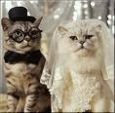


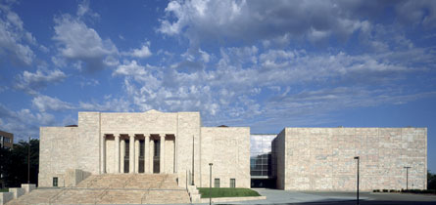
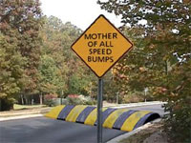

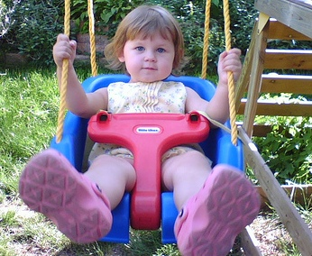
Chris’s Career
Start
Library Assistant (Circ.)
1997 – 1999
Library Technician (Ref.)
1999 - 2001
B.A. in English
1997
Married to Omahan
1997
Joslyn Art Museum
Reference and Web Services Librarian
Reinert-Alumni Library
2003 - 2005
MSLIS (online)
2003
Reference Librarian
2001-2002
Head Librarian
2002 - 2003
SAHM
2005-2007
(Also, PT Ref Librarian, NLA C&U Section Webmaster, Attachment Parenting Yahoo Group Moderator)
Research and
Instructional Technologist
2007-present

Slide 5







Kristina’s Wanderings
1993
M.L.S. Library Science
The Catholic University
of America
Washington, DC
1989
B.A. Music
Mercer University,
Atlanta, GA
Student Worker
Jimmy Carter
Presidential Library
Atlanta, GA
1991 - 1994
Archives Technician
National Archives and
Records Administration
Office of Presidential Libraries
Washington, DC
Student Aide
Mercer University Library
Atlanta, GA
?
2008 - Present
Webmaster
University at Buffalo
Law School
Buffalo, NY
1994 - 2007
Senior Electronic Resources Librarian,
Webmonster
National Endowment for Democracy
Washington, DC

Slide 6

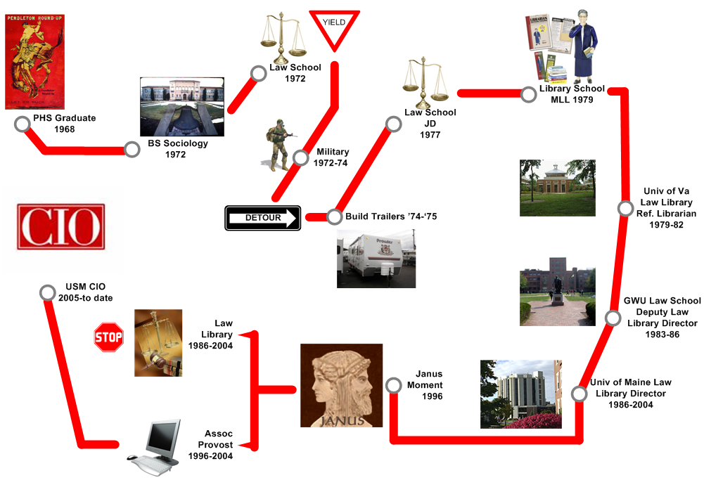
Bill’s career path(?)
Start
Next?

Slide 7




Karla’s Excellent Career Journey
Graduate Assistant
LIS Library
Reference
Webmaster
Milner Library
Intern
Research Assistant
B.A.
English Studies
Illinois State University
Graduate Assistant
GSLIS User Services/
Help Desk
M.S.
Library & Info. Science
Graduate School of
Library & Info. Science (GSLIS)
University of Illinois at U-C
2007
Waitress
Bartender
South Korea
English Instructor
Library Consultant
2002-2005
English Program
Teaching Assistant
Wife &
Mom
Computer-Assisted Instruction Specialist
Instructional Technology & Design Office
Graduate School of Library & Information Science
University of Illinois at Urbana-Champaign
(w00t)
PhD
Student
L.I.S.

Slide 8
Useful librarian skills?

Slide 9
Success?

Slide 10
Disadvantages?

Slide 11
Kinds of jobs?

Slide 12

Skills of LIS Grads?

Slide 13
Librarian CIO?

Slide 14

Advice?

Slide 15

Questions?

Slide 16
Thanks!
Further Questions?
  Chris Jorgensen
  chrisjorgensen@creighton.edu
  Kristina Lively
  kristinalively@gmail.com
  Karla Lucht
  klucht@illinois.edu
  Bill Wells
  wells@usm.maine.edu

