Slide 1

Soft Selling Tough Issues
Sheri Thompson, IT Communications & Planning Officer
& Brian Nichols, Chief Information Security Officer
Copyright Sheri J. Thompson & Brian Nichols, 2008. This work is the intellectual property of the authors. Permission is granted for this material to be shared for non-commercial, educational purposes, provided that this copyright statement appears on the reproduced materials and notice is given that the copying is by permission of the authors. To disseminate otherwise or to republish requires written permission from the authors.

Slide 2

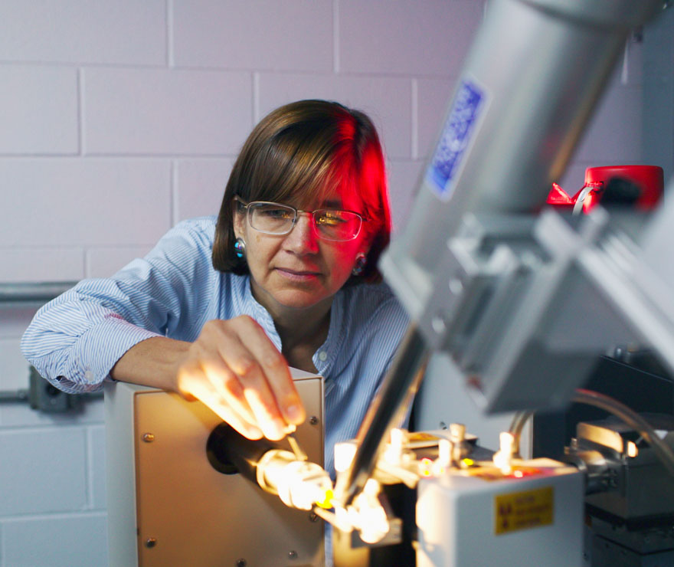



About LSU

Slide 3
IT @LSU
First CIO hired in April 2005; VCIT in 2008
IT organization “reorganized” in September 2005
  Office of CIO (HR/Finance, Security/Policy, Communications/Planning)
  4 divisions (NI, RE, UIS, USS)
Flagship IT Strategy
  Community-authored
  10 key recommendations
  Secure and safeguard integrity of infrastructure and information
  Develop communications channels

Slide 4
IT Security & Policy@LSU
Established IT Security and Policy Office in Fall 2005
  Appointed LSU’s first Chief IT Security & Policy Officer
  9 FTE’s
Commissioned external security audit
  LSU IT security rated “Fair” - no glaring holes, but …
  94 recommendations for improvements in policy and practice
IT Security and Policy addressed in the Flagship IT Strategy (FITS)
  Essentially, a call to follow the audit recommendations

Slide 5
IT Communications @LSU
After FITS completed, focus changed to communications
1.5 full time designers (ITS Webpages, IT marketing, IT publications)
2 student workers (IT marketing)
Funding from STF

Slide 6
What about your college?
Do you have an IT Security/Policy function?
Do you have an IT Communications function?
How do you communicate policies?

Slide 7

Tough Issues
DMCA/RIAA
Network Security
Virus Protection
Data Breaches
Identity Theft

Slide 8

Why Are There Tough Issues?
“Typical” College IT Environment
Extremely “open” by culture and tradition
25,000 – 75,000 networked devices
Hardware and software deployed diverse
Usually first to implement new technologies…..before matured
Networked systems being probed continually for vulnerabilities

Slide 9
DMCA/RIAA
Legislation enacted by Congress in 1998; HEOA 2008
Educate users about current state of copyright law as it applies to file sharing and to keep up to date on changes to legislation
Preventative measures to ensure proper use of peer-to-peer (P2P) applications
LSU Student Government provides legal music service via Ruckus

Slide 10
Network Security/Virus Protection
ILOVEYOU, May 2000
    ~$5.5 billion in damages
    Approximately 24 hours, ~10% of all computers connected to Internet
SQL Slammer, January 2003
    ~75,000 systems within 10-minutes
Blaster, August 2003
    Over 100,000 systems in first week
    ~1.2 million in damages
Storm BotNet, January 2007
    ~10 million systems
    Zombie botnet

Slide 11
Data Breach Overview
Huge problem nationally for colleges and universities
  In the Chronicle weekly
On the rise again…..
  65 publicized security breaches in 2006
  112 publicized security breaches in 2007
  ~150 publicized security breaches in 2008 to date
Explanation for increase
  New organizations devoting more attention to IT security?
  States with breach notification laws that prohibit institutions from keeping security incidents private?
  Simply more breaches?
Out of pocket cost to victims $500 – $1,500

Slide 12
Louisiana Notification Law
Signed by Governor in July 2005; effective January 1, 2006
  Requires notification to any Louisiana resident whose unencrypted personal information was, or is reasonably believed to have been, acquired by an unauthorized person as a result of a security breach
  Notification should be made in the most expedient time possible and without unreasonable delay, consistent with the legitimate needs of law enforcement

Slide 13
Identity Theft
Averages among 18-24 years old:
  $8,248 fraud amount
  139 days fraud lasts
  123 days to detect
  56 days to resolve
  69% committed by friend or acquaintance
  54% self-detected

Slide 14
What about your college?
What are your tough issues?
How do you address them?

Slide 15

Take the ball and
run with it.

Slide 16
Strategy & Tactics
Issues
Audiences
Responsibility
Threat levels
Accountability
ROI
Variety of

Slide 17
Where Do I Begin?
Assess your resources
What talent do you have available to you?
What funding?
What media?
Delivery mechanisms?
Who looks where?
Establish priorities
What messages are important?
To whom? When?

Slide 18

Focus on Students
Largest population (highest incidents)
Best ROI
More apt to change?

Slide 19
Resource Creativity*
  Talk is cheap– visit dorms, student groups, classes
  Student workers are usually affordable
  Become someone’s pet project (marketing student group? Service learning?)
  Ask your neighbors (Student Life may have $$$ and/or resources)
  Free-sources
  What else?
*Doing Something with Nothing

Slide 20
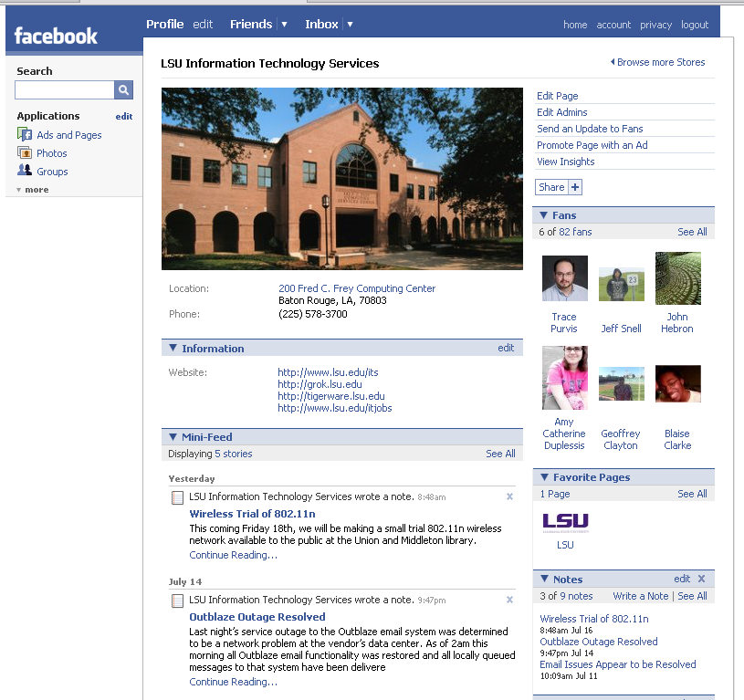

Slide 21
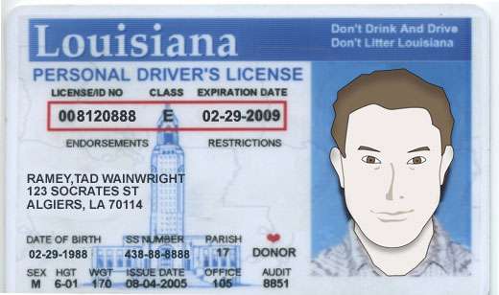
Meet Tad

Slide 22
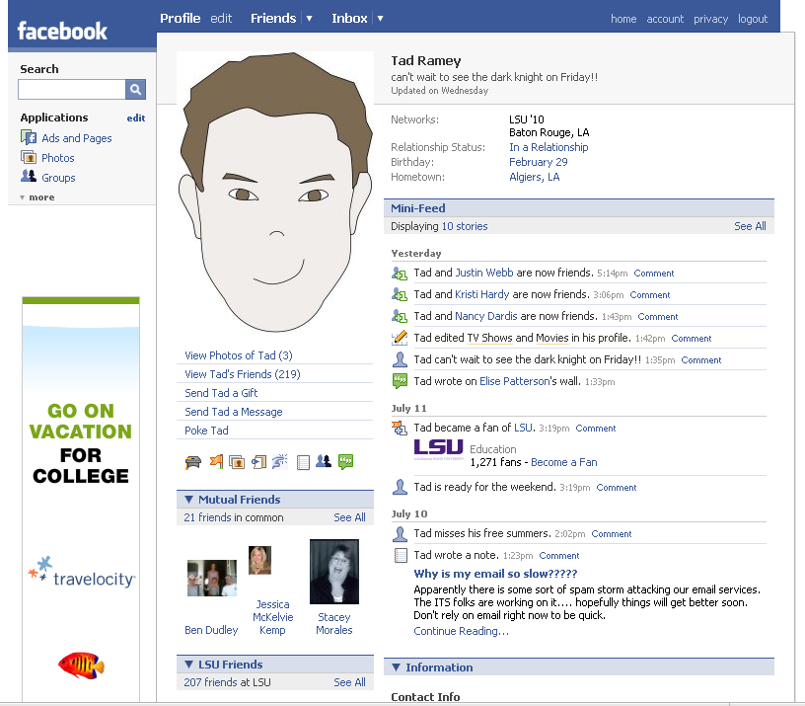

Slide 23
Identity theft
Phishing Attacks
Zombie Computers
Credit Monitoring

Slide 24


Slide 25
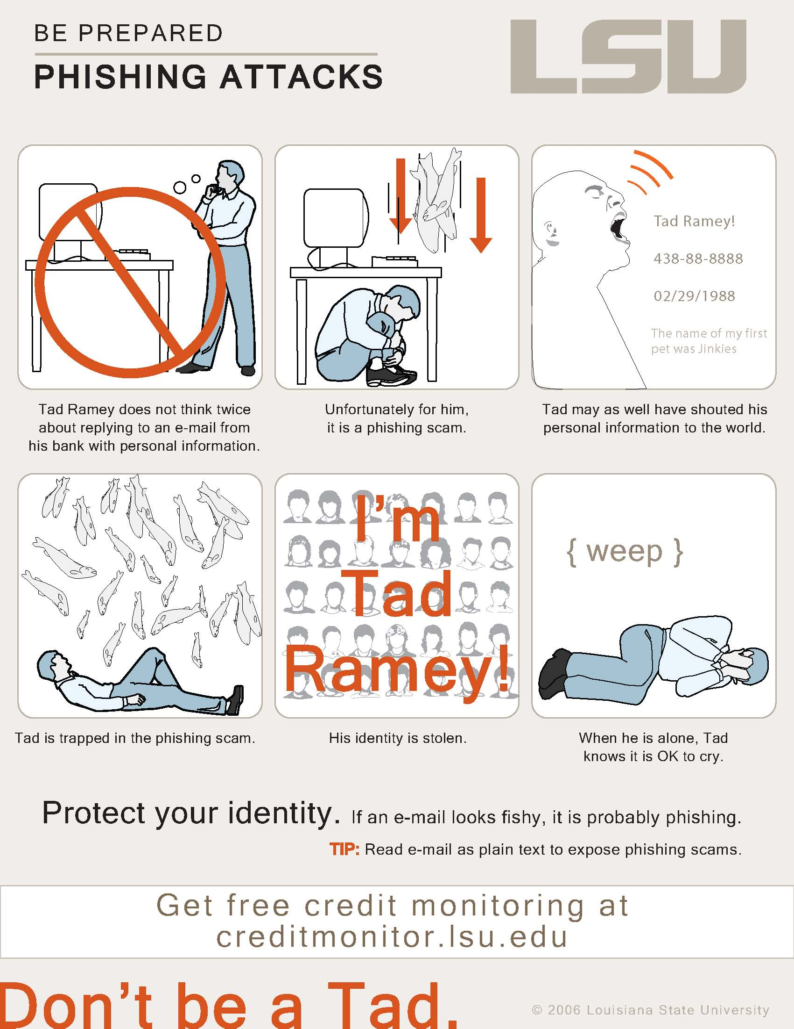

Slide 26
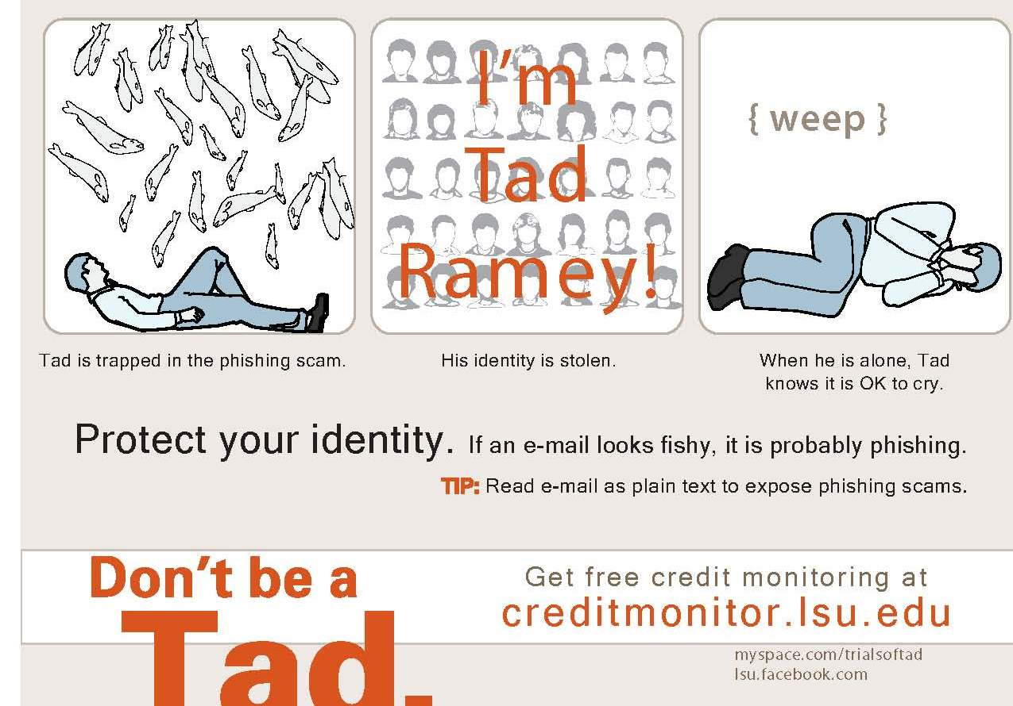

Slide 27
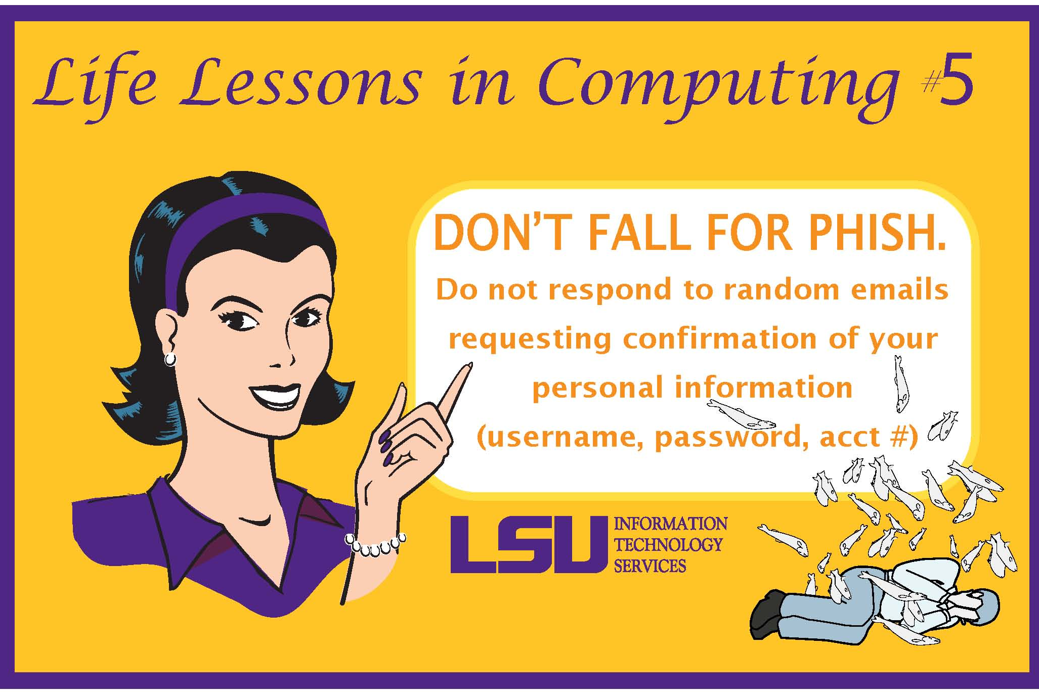

Slide 28
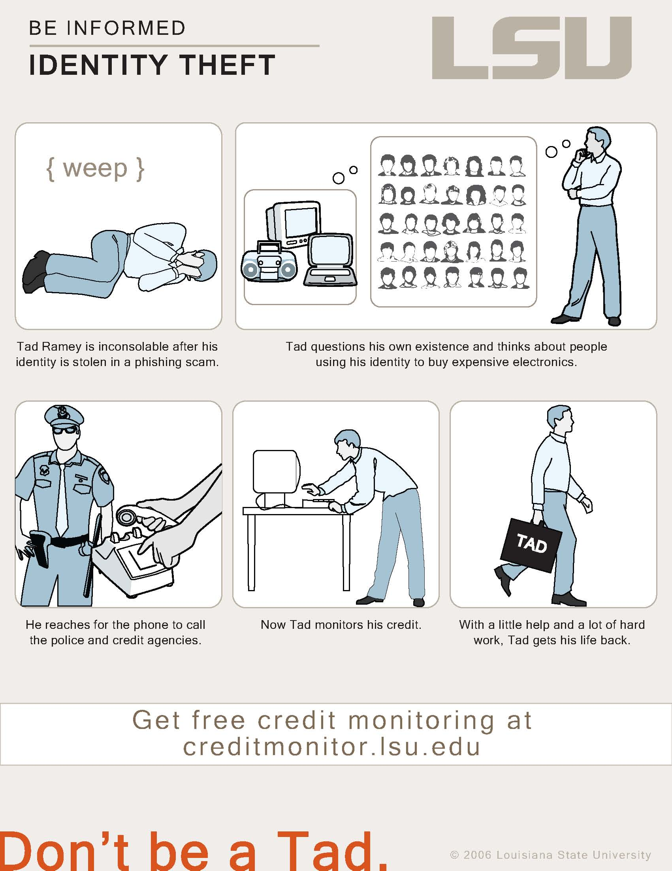

Slide 29
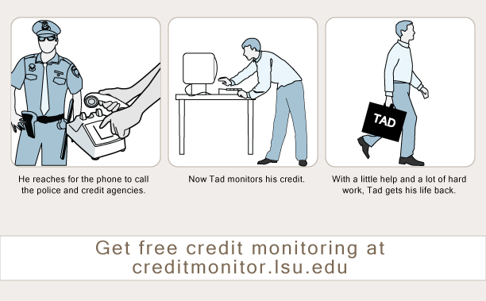

Slide 30


Slide 31
Network security
Virus Protection
Physical Security

Slide 32
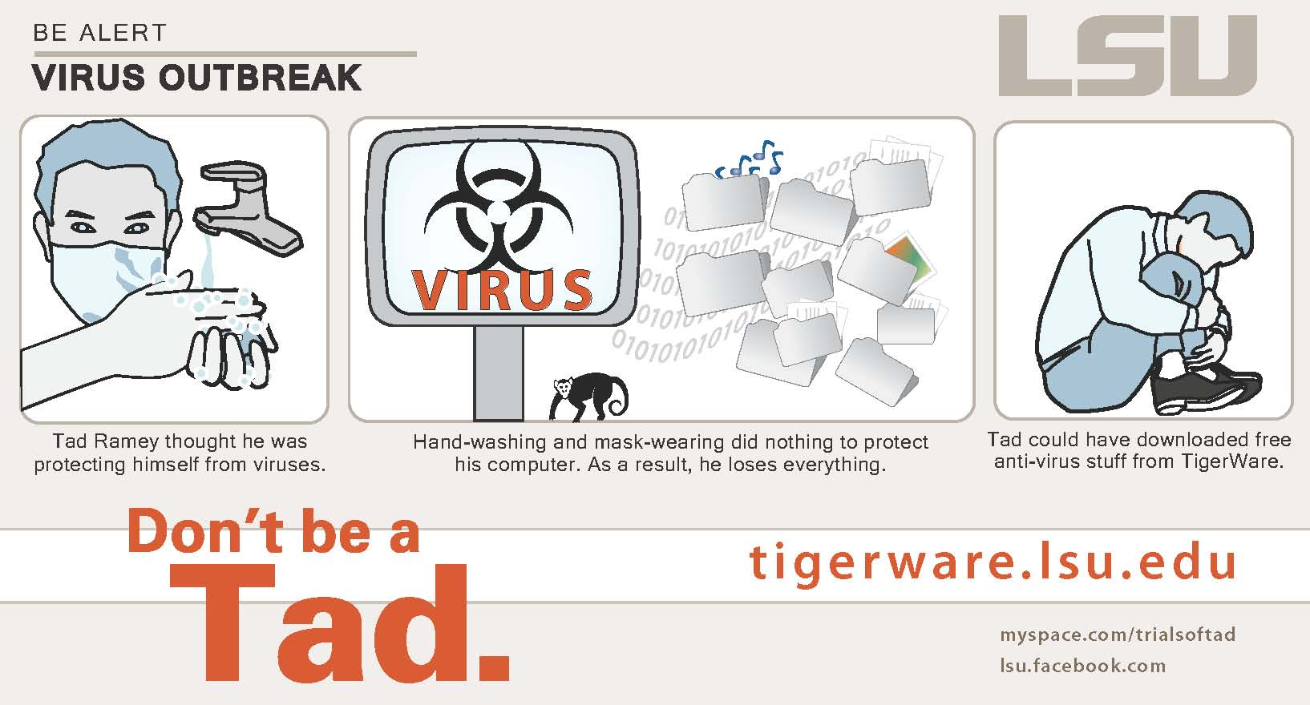

Slide 33
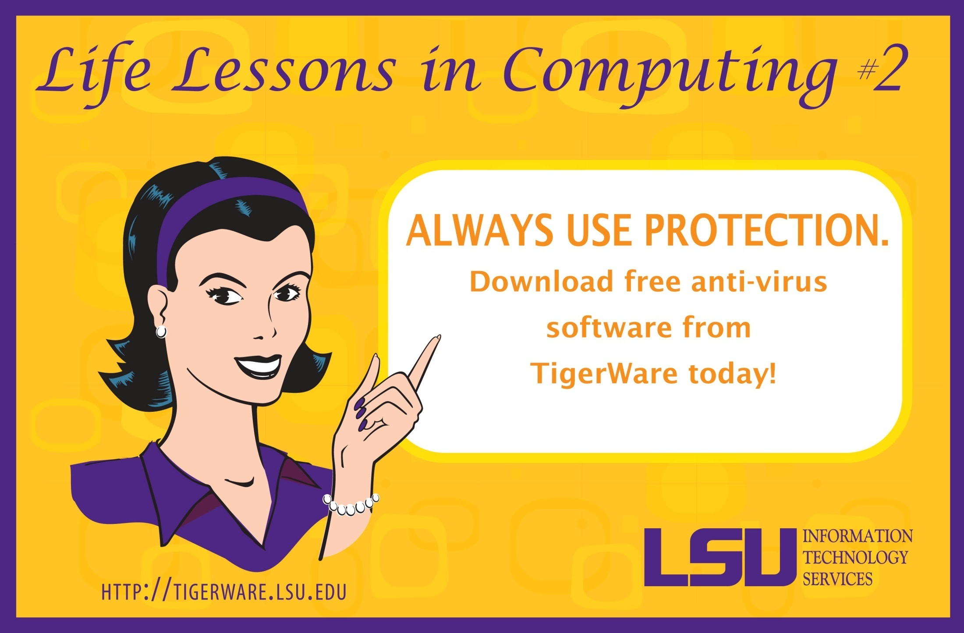

Slide 34
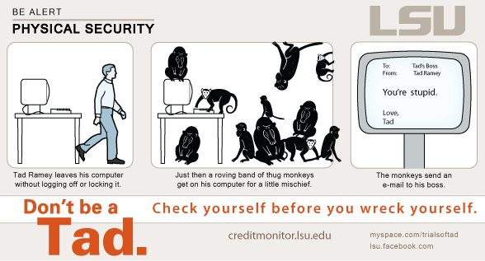

Slide 35
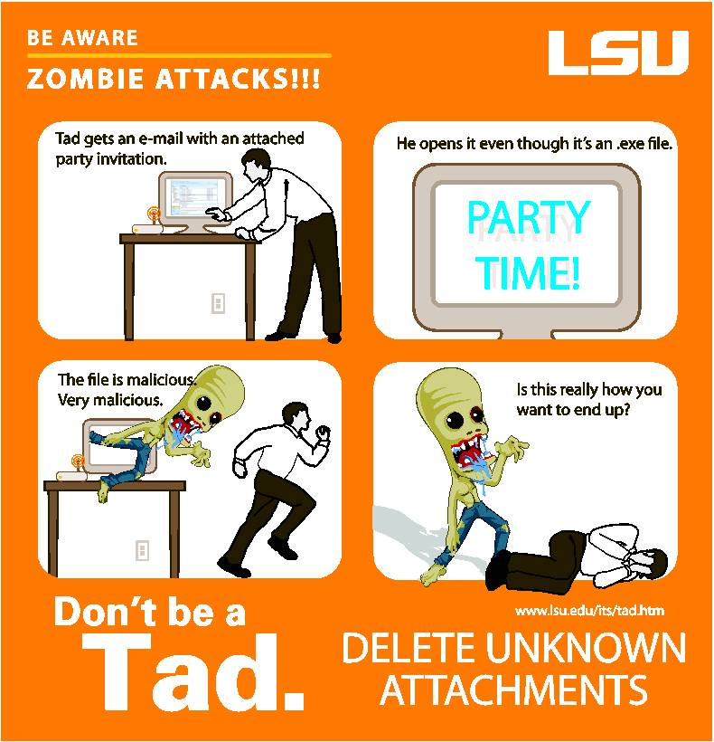

Slide 36
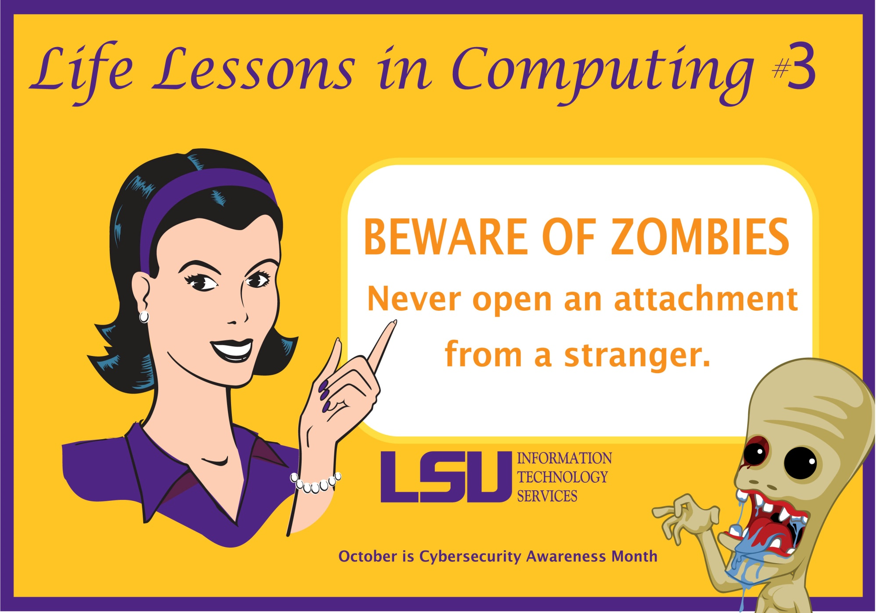

Slide 37
DatA breaches
Encryption
Credit Monitoring

Slide 38
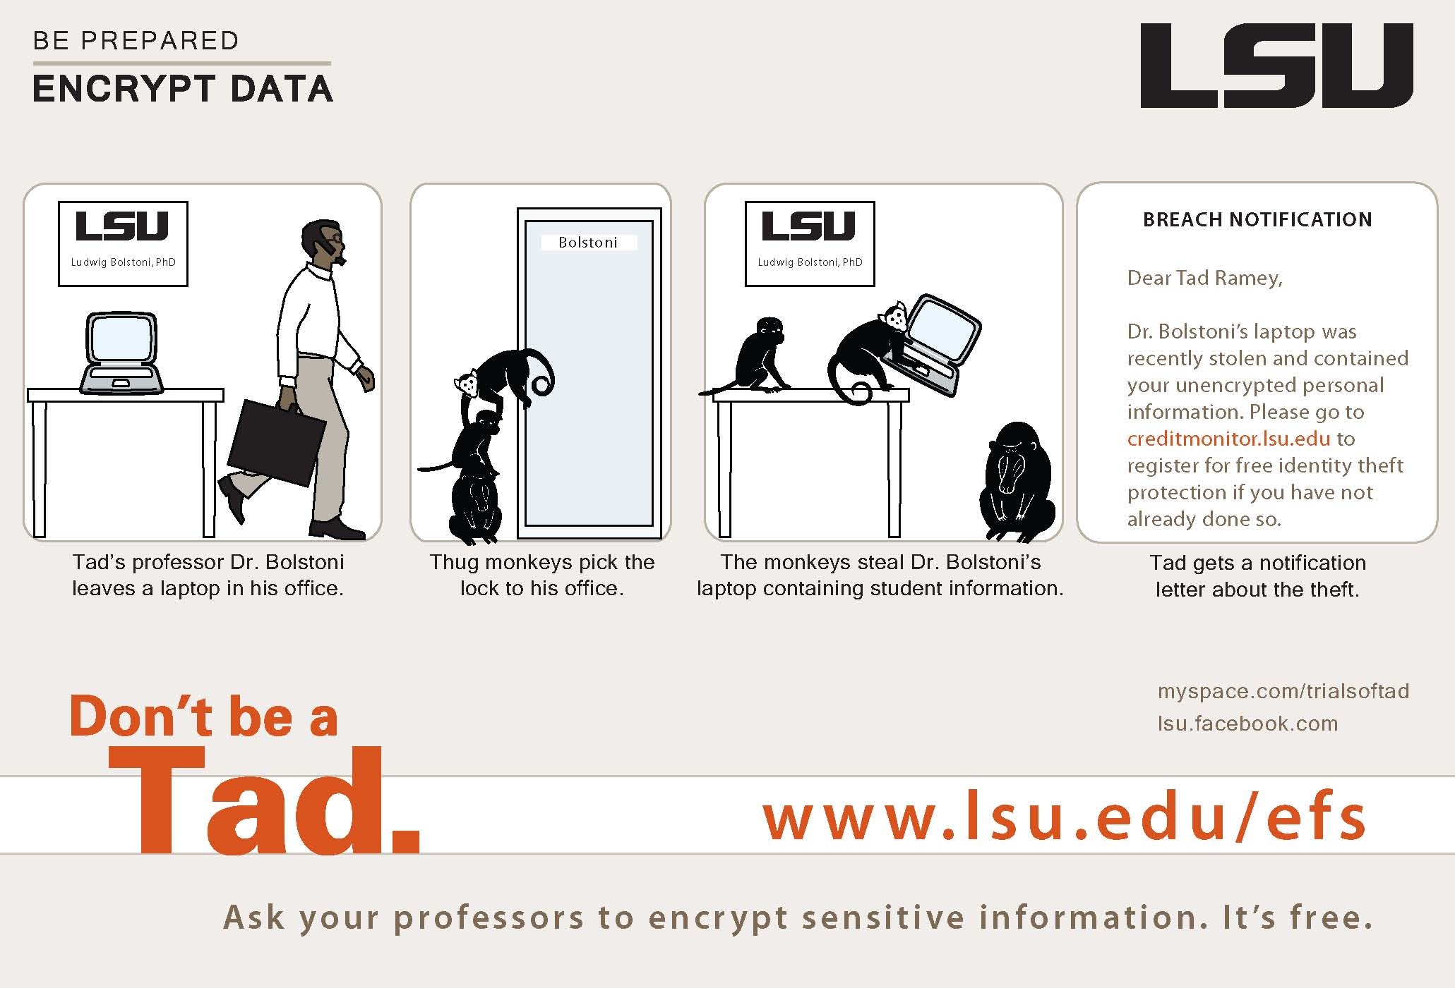

Slide 39


Slide 40
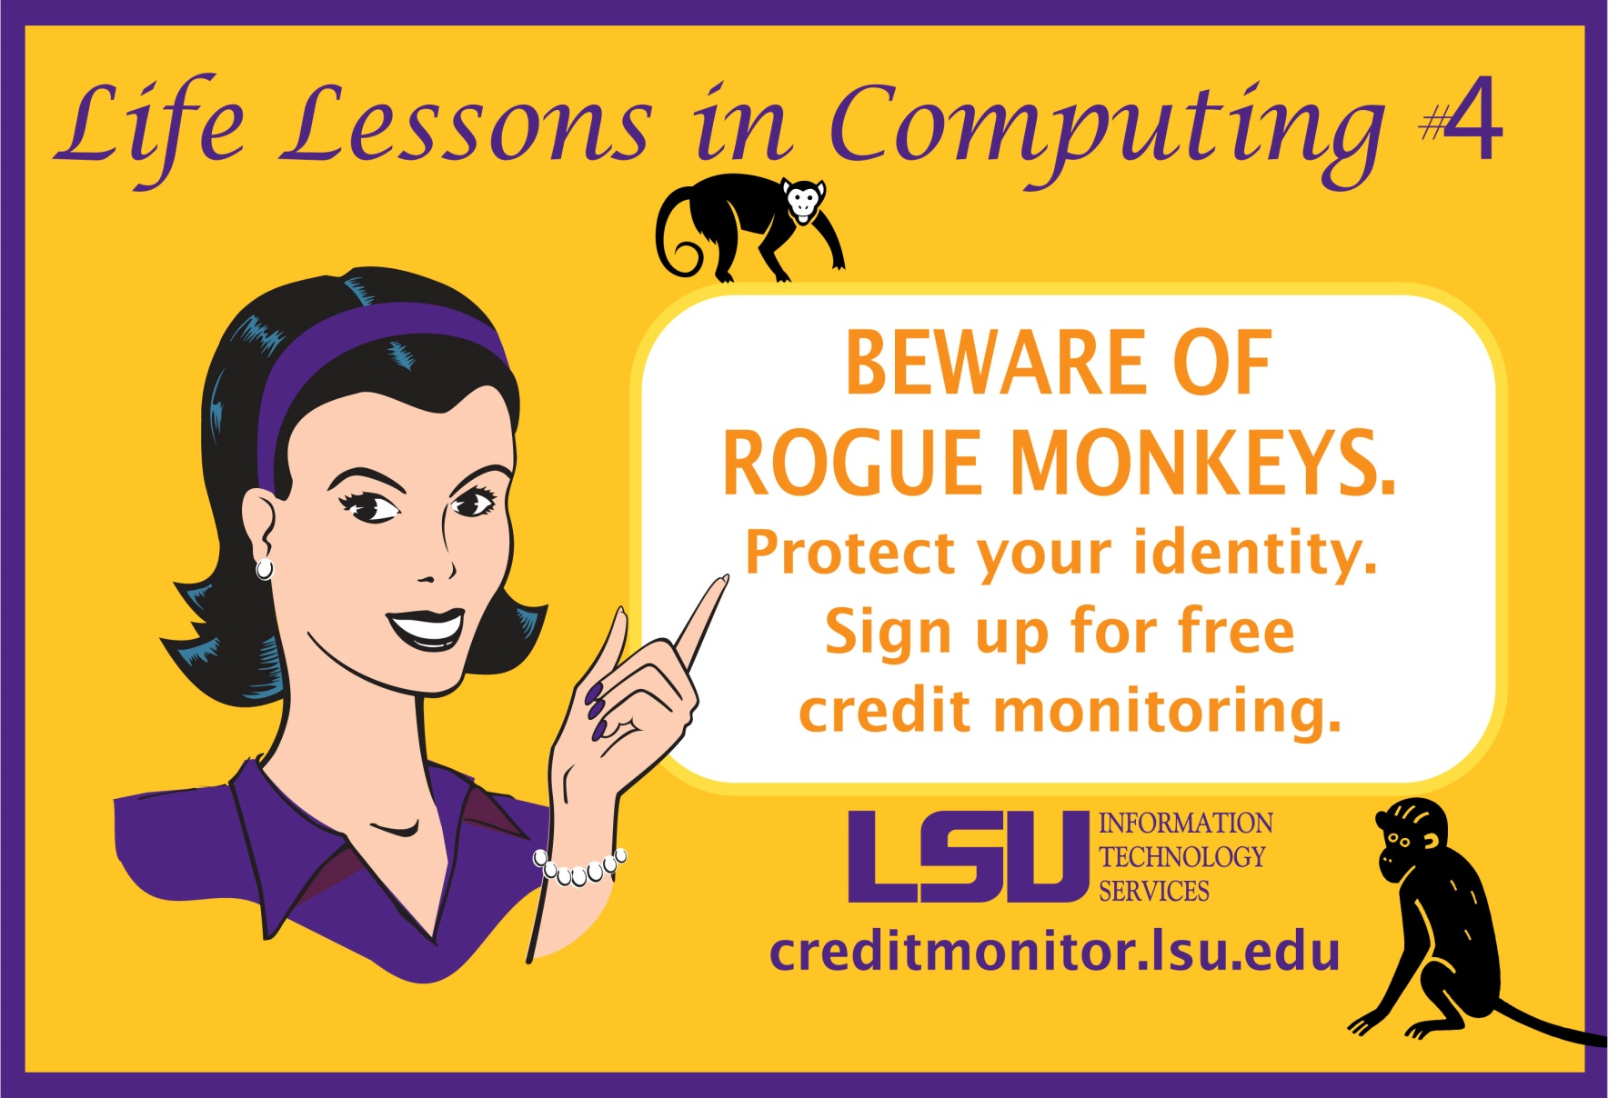

Slide 41
DMCA/RIAA
Legal Ramifications

Slide 42
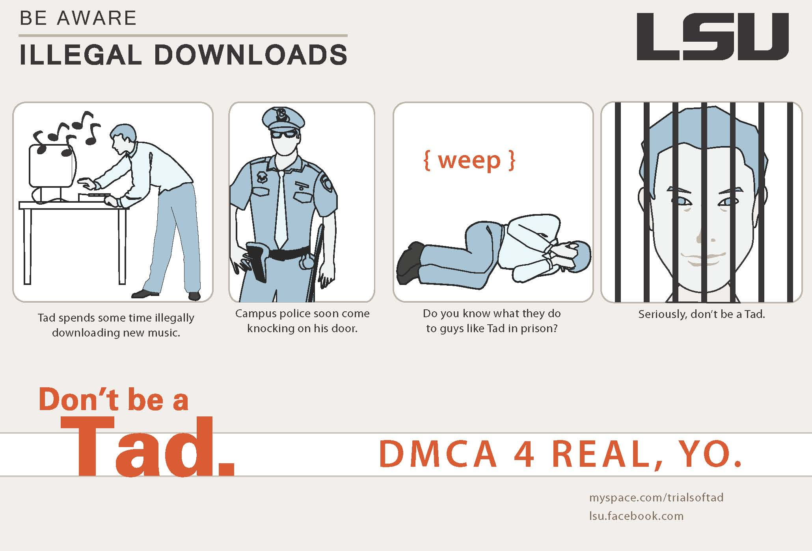

Slide 43
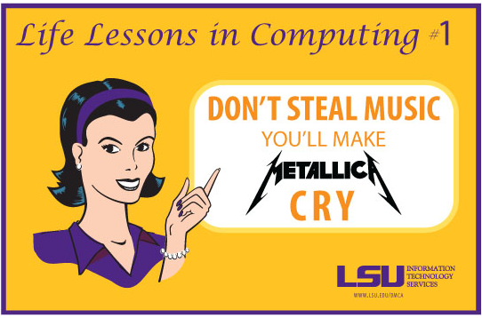

Slide 45
References
Federal Trade Commission, ID Analytics, Privacy Rights Clearinghouse
Educational Security Incidents (ESI)
Javelin Strategy & Research April ‘06 “The Demographics of Identity Fraud”

Slide 46
Questions?
sjt@lsu.edu
bnichols@lsu.edu

