Slide 1
Driving Substantive Teaching & Learning Improvement Using the Five Sloan-C Pillars of Quality
Presentation By: Jon Mott & Larry Seawright
Co-Contributors: Stephanie Allen & Whitney Ransom
BRIGHAM YOUNG UNIVERSITY
“Making a Significant Difference,” Educause 2008 • Orlando, Florida

Slide 2
Does Technology Make a Difference?
“Making a Significant Difference,” Educause 2008 • Orlando, Florida

Slide 3
Does Instructional Design Make a Difference?
“Making a Significant Difference,” Educause 2008 • Orlando, Florida

Slide 4
How Can We Tell?*
*How do we
convince others?
“Making a Significant Difference,” Educause 2008 • Orlando, Florida

Slide 5
The Traditional Approach
Comparative Media Studies
Long History of “NSD”
But what are we really measuring?
“Making a Significant Difference,” Educause 2008 • Orlando, Florida

Slide 6
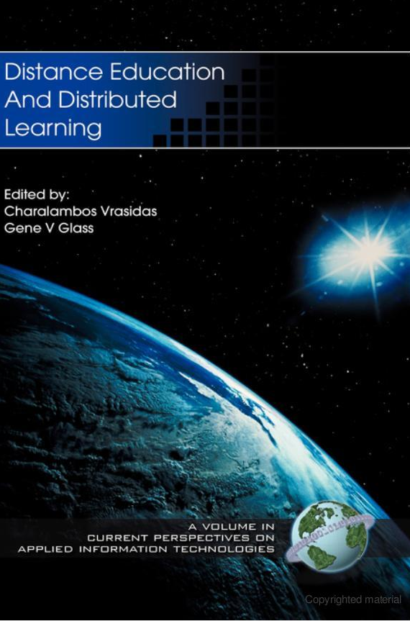
Sir John Daniel*
Comparing test scores is a “futile tradition.”
Comparing instructional media is a “pointless endeavour.”
Teaching and learning systems are complex realities.
The usual result is ‘no significant difference’.
We should examine “new learning technologies on their own terms.”
*Preface, Distance Education & Distributed Learning (2002, Published by IAP).
“Making a Significant Difference,” Educause 2008 • Orlando, Florida
Notes:
“with the futile tradition of comparing the test performances of students using new learning technologies with those who study in more conventional ways. This is a pointless endeavour because any teaching and learning system, old or new, is a complex reality. Comparing the impact of changes to small parts of the system is unlikely to reveal much effect and indeed, ‘no significant difference’ is the usual result of such research.”
Instead we should examine “new learning technologies on their own terms.”

Slide 7
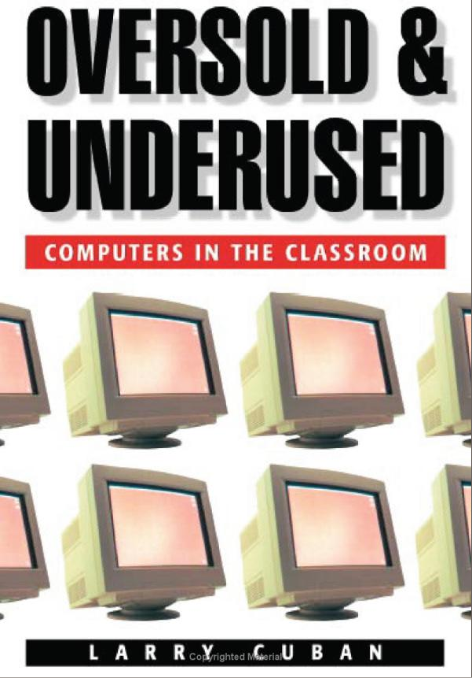
Larry Cuban*
Study of K-20 in Silicon Valley:
Teachers use technology to “maintain existing practices.”
Technology is general “peripheral to the daily routines.”
Teaching & learning activity is largely unchanged.
“Lecturing still absorbs half to two-thirds” of teaching time.
Instructional Technology Often
Automates the Past!
*Oversold & Underused: Computers in the Classroom (2001, Harvard University Press).
“Making a Significant Difference,” Educause 2008 • Orlando, Florida

Slide 8
An Alternative Approach
Design-Based Research
Goal-Driven
Results-Focused
Iterative
New Technology =
New Possibilities
“Making a Significant Difference,” Educause 2008 • Orlando, Florida

Slide 9
Goal-Driven Design & Evaluation
PROBLEM
GOAL
Strategy
Tactics
SOLUTION
RESULTS
“Making a Significant Difference,” Educause 2008 • Orlando, Florida

Slide 10
A Framework of Goals
Learning
Effectiveness
Access
(Flexibility)
Faculty
Satisfaction
Cost
Effectiveness
Student
Satisfaction
QUALITY
* Janet C. Moore. 2005. Sloan Consortium Quality Framework and the Five Pillars,
The Sloan Consortium (http://www.aln.org/publications/books/qualityframework.pdf).
“Making a Significant Difference,” Educause 2008 • Orlando, Florida

Slide 11
CASE 1: Learning Effectiveness
PROBLEM: Introductory Chemistry Courses
Limited Lab Time & Space
Cost & Safety Concerns
Student “Cook-Booking”
“Making a Significant Difference,” Educause 2008 • Orlando, Florida

Slide 12
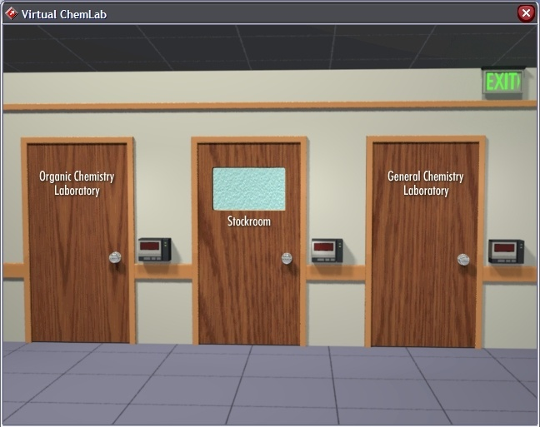
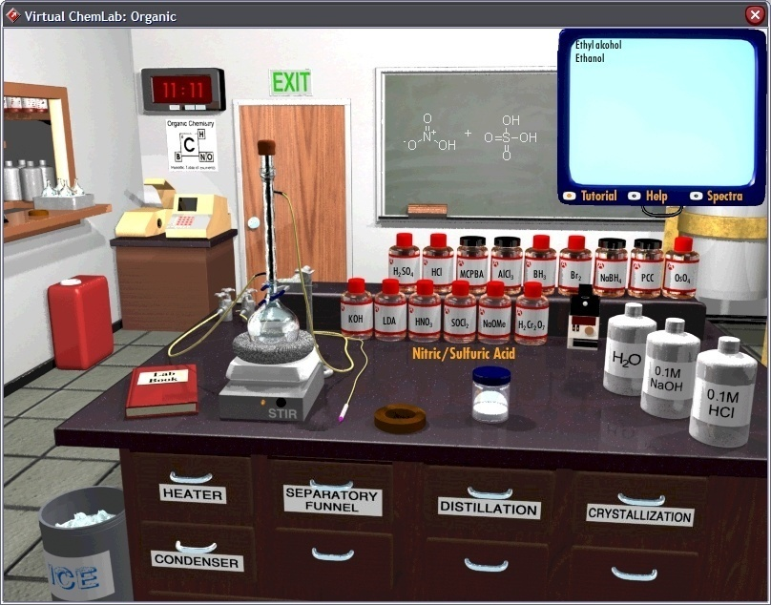
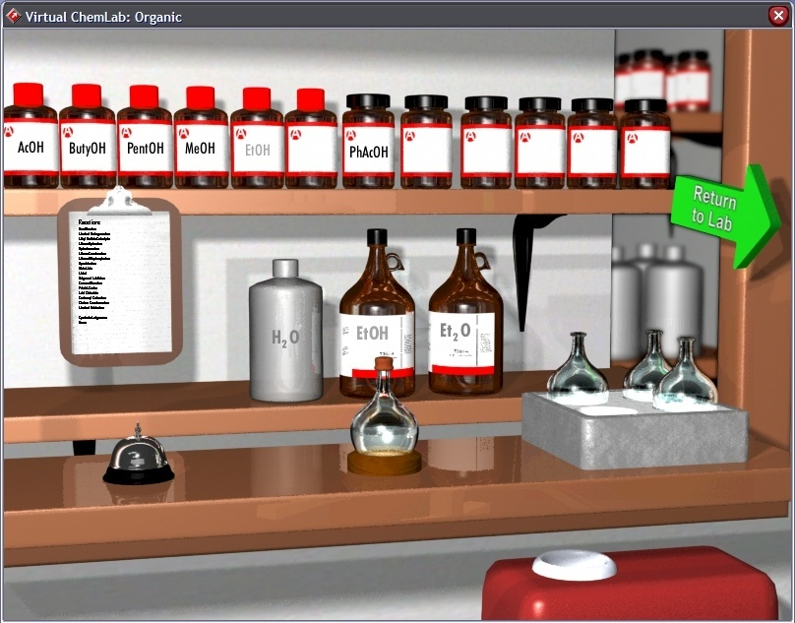
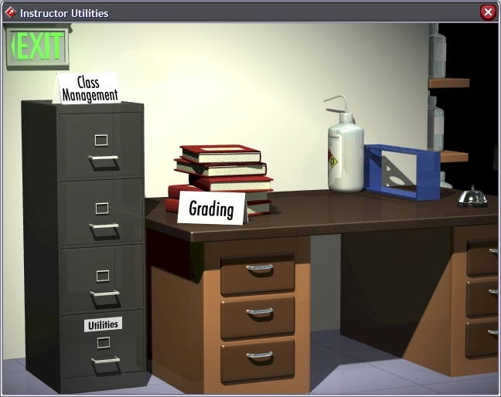
CASE 1: Learning Effectiveness
SOLUTION: Introductory Chemistry Courses
STRATEGY: Safe, Virtual Environment
TACTIC: Build 3D Virtual Lab w/ Maya & Adobe Director
  Semi-Realistic Environment
  Multiple Labs
  Instructor Interface
“Making a Significant Difference,” Educause 2008 • Orlando, Florida

Slide 13
CASE 1: Learning Effectiveness
RESULTS: Introductory Chemistry Courses
Students think “more like chemists,” i.e. they think more critically and are better at solving chemistry problems
Performance comparable or better than students with significant “wet” lab time
“Making a Significant Difference,” Educause 2008 • Orlando, Florida

Slide 14
CASE 2: Cost Effectiveness
PROBLEM: Introductory Accounting
Significant Faculty Time
(Limited Time for Upper Division Courses)
Repetitive Instruction
Redundant Remediation
“Making a Significant Difference,” Educause 2008 • Orlando, Florida
Notes:
2-3000 students / year

Slide 15
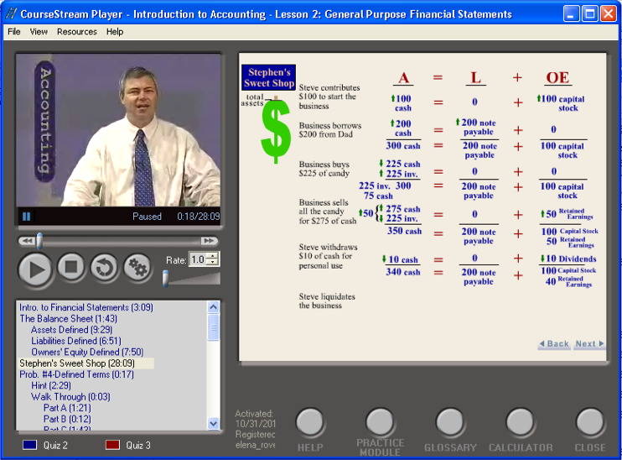
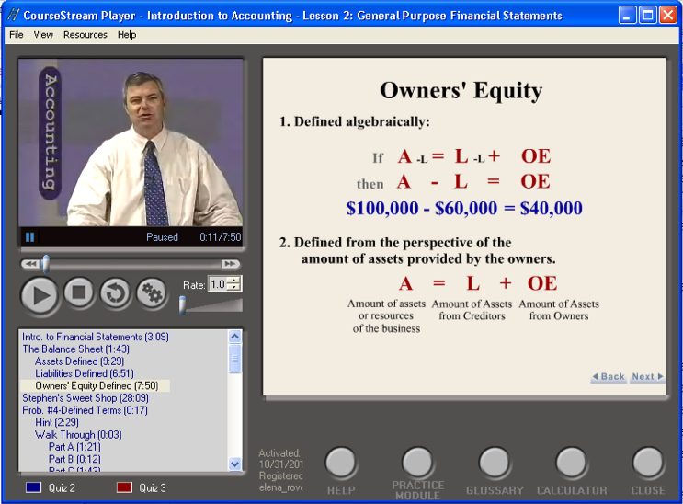
CASE 2: Cost Effectiveness
SOLUTION: Introductory Accounting
STRATEGY: Hybrid Course
TACTIC: Self-Paced CD-Based Course w/ Video & Presentation Slides
  Substantial “Drill-Down” Materials
  Supplementary “Applied Accounting” Lectures
“Making a Significant Difference,” Educause 2008 • Orlando, Florida
Notes:
2-3000 students / year

Slide 16
CASE 2: Cost Effectiveness
RESULTS: Introductory Accounting
Costs & Time Reduced
Student Satisfaction Improved
Heightened Interest in Accounting Major
“Making a Significant Difference,” Educause 2008 • Orlando, Florida
Notes:
2-3000 students / year

Slide 17
CASE 3: Access
PROBLEM: Audiology & Speech
Limited Access to Audiometer & Patients for Practice
In-Class Demonstrations Ineffective
“Making a Significant Difference,” Educause 2008 • Orlando, Florida
Notes:
2-3000 students / year

Slide 18
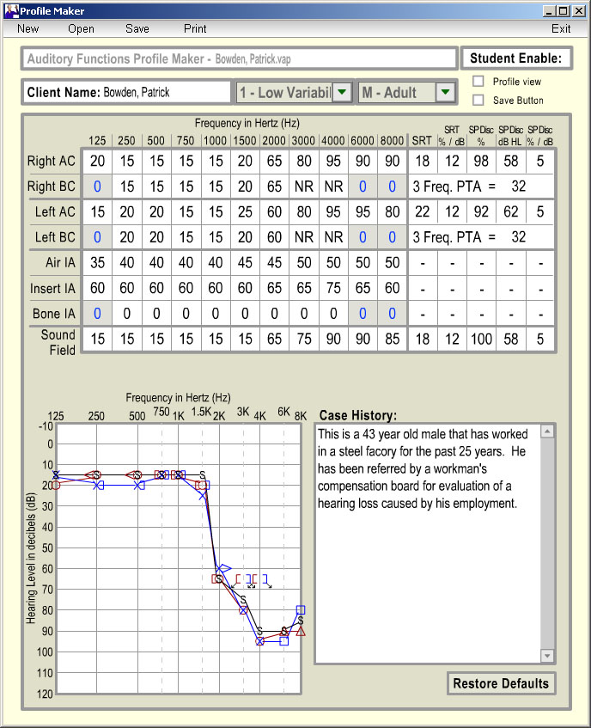
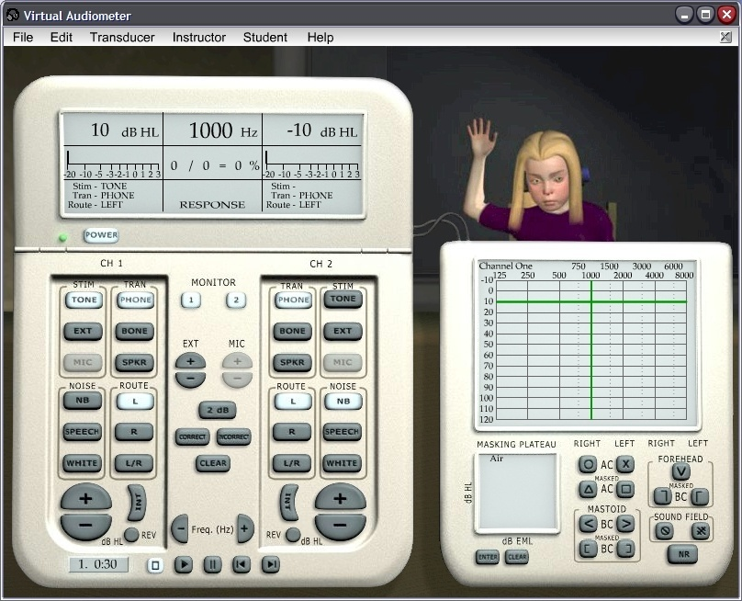
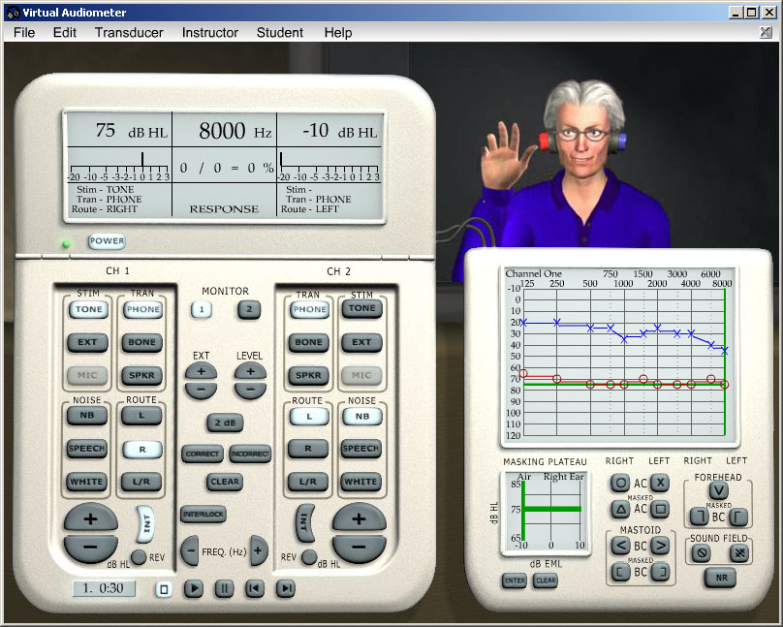
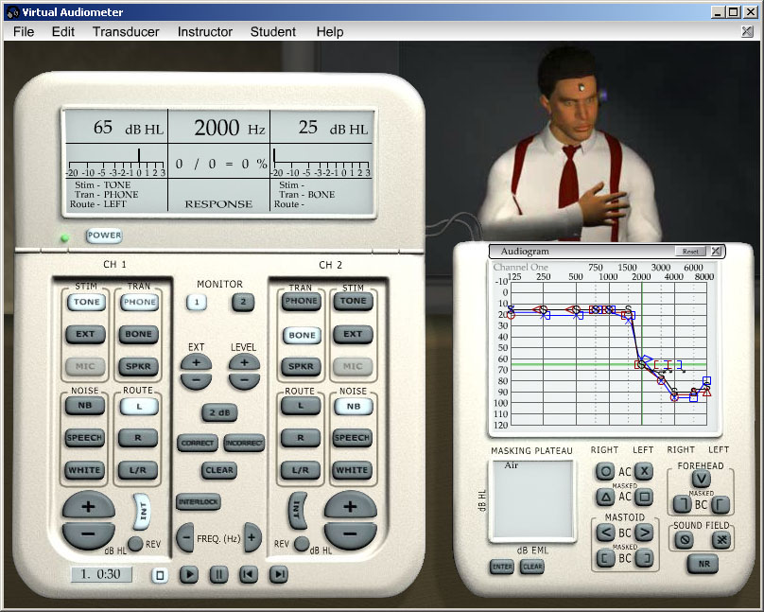
CASE 3: Access
SOLUTION: Audiology & Speech
STRATEGY: Create Virtual Tools & Environment
TACTIC: Build Virtual Audiometer w/ Maya & Adobe Director
  Virtual Patients w/ Customizable Profiles
  Self-Paced Practice Mode
  Instructor Assignments
“Making a Significant Difference,” Educause 2008 • Orlando, Florida
Notes:
2-3000 students / year

Slide 19
CASE 3: Access
RESULTS: Audiology & Speech
Substantially Enhanced Access
Students Acquire Skills Faster
“Making a Significant Difference,” Educause 2008 • Orlando, Florida
Notes:
2-3000 students / year

Slide 20
CASE 4: Student Satisfaction
PROBLEM: Histology
Tedious Methods for Studying Samples
Limited Access to Slides & Microscopes
No Contextual Support
“Making a Significant Difference,” Educause 2008 • Orlando, Florida

Slide 21
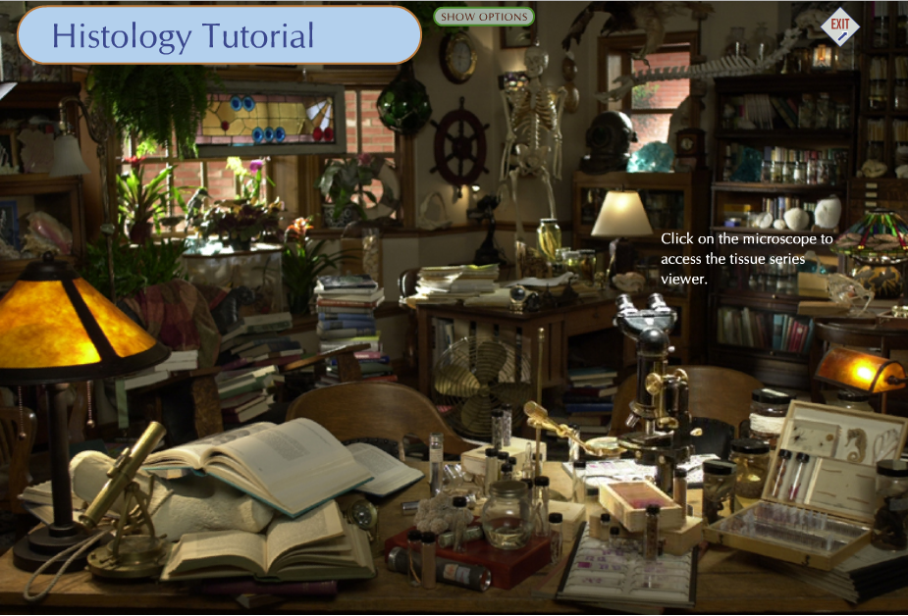
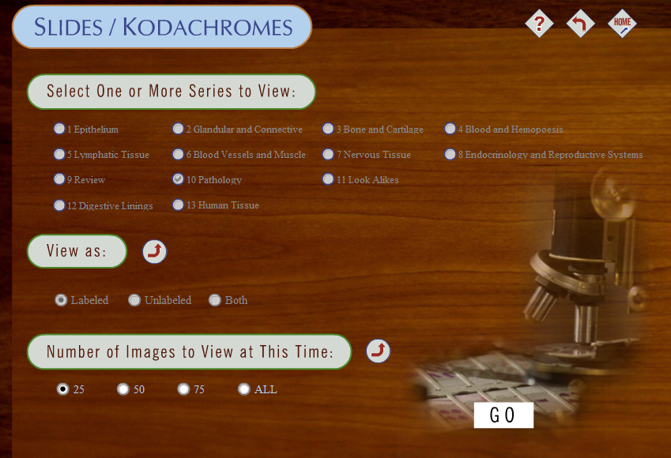
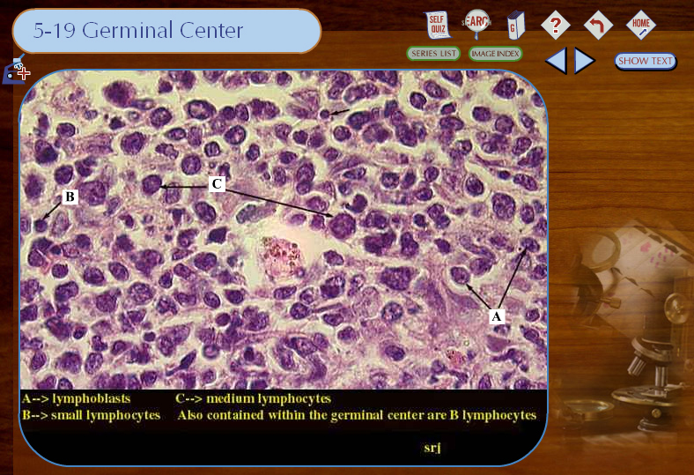
CASE 4: Student Satisfaction
SOLUTION: Histology
STRATEGY: Self-Paced, Flexible Study Tools
TACTIC: CD-Based & Online Histology Tutorial
  Thousands of Digitized Samples
  Contextual Information & Help
  Drill & Practice Tools
“Making a Significant Difference,” Educause 2008 • Orlando, Florida

Slide 22
CASE 4: Student Satisfaction
RESULTS: Histology
Student Satisfaction ↑
Student Reliance on Tool
“Making a Significant Difference,” Educause 2008 • Orlando, Florida

Slide 23
CASE 5: Faculty Satisfaction
PROBLEM: Classroom Interaction
Poor Feedback From Students During Class
Low Participation in Discussion
“Making a Significant Difference,” Educause 2008 • Orlando, Florida

Slide 24

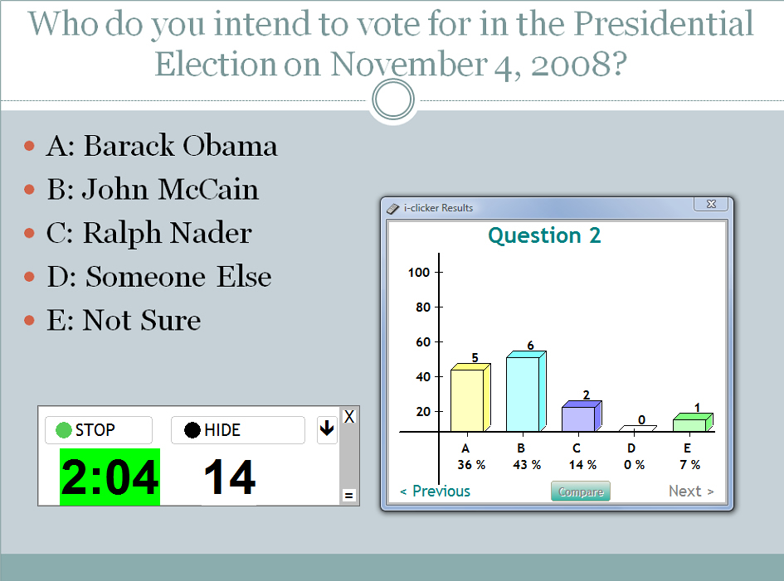
CASE 5: Faculty Satisfaction
SOLUTION: Classroom Interaction
STRATEGY: In-Class Response System
TACTIC: Standardized on iClicker
  Multiplatform
  Easy to Use
  Integrated w/ Blackboard
“Making a Significant Difference,” Educause 2008 • Orlando, Florida

Slide 25
CASE 5: Faculty Satisfaction
RESULTS: Classroom Interaction
Real-Time Formative Assessment
Better Class Discussion
Faculty Very Satisfied
“Making a Significant Difference,” Educause 2008 • Orlando, Florida

Slide 26
CONCLUSION
Technology HAS a Significant Impact
The Impact is Demonstrable
Starting w/ Clear Goals is the Key
  Articulate Problem
  Design Solution Aimed at Problem
  Develop Solution
  Implement Solution
  Evaluate: Problem Solved?
  Surprise! This looks like ADDIE!
  One More “I” – ITERATE!!!
“Making a Significant Difference,” Educause 2008 • Orlando, Florida

Slide 27
Goal-Driven Design & Evaluation
PROBLEM
GOAL
Strategy
Tactics
SOLUTION
RESULTS
“Making a Significant Difference,” Educause 2008 • Orlando, Florida

Slide 28
Discussion
“Making a Significant Difference,” Educause 2008 • Orlando, Florida

Slide 29
jonmott@byu.edu
Larry_Seawright@byu.edu
http://ctl.byu.edu
http://at.byu.edu
http://jonmott.com

