Slide 1
Copyright Rebecca (Becky) Vasquez 2008. This work is the intellectual property of the author. Permission is granted for this material to be shared for non-commercial, educational purposes, provided that this copyright statement appears on the reproduced materials and notice is given that the copying is by permission of the author. To disseminate otherwise or to republish requires written permission from the author.

Slide 2


Educause 2008 Annual Conference
Measuring Usability:
Life After Deploying Your Portal
Becky Vasquez
Director
Student and Technology Services
Notes:
2

Slide 3
Agenda
About Embry-Riddle Aeronautical University
How to perform a usability study
Recording and using results
Improvements

Slide 4
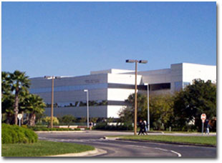

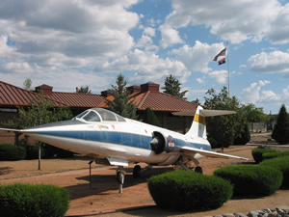
About Embry-Riddle
Aeronautical University
Educating more than 32,000 students per year
Two residential campuses (Florida and Arizona)
Worldwide Campuses – 130 Locations
  + 2700 Students enrolled in Online Learning
Daytona Beach
Campus
World Wide Campuses
Prescott
Campus
Notes:
ERAU educates more than 32,000 students annually in undergraduate and graduate programs at residential campuses in Prescott, Ariz., and Daytona Beach, Fla., through the Extended Campus at more than 130 teaching centers in the United States, Canada, Europe, and the Middle East, and through distance learning.
2700 Students are enrolled in Online Learning, fully utilizing Blackboard for online courses.
USAFA - United States Air Force Flight Training Academy, Embry-Riddle’s contract with U.S. Air Force Academy provides introductory flight training to cadets and lieutenants who will become Air Force pilots.
JetBlue - Embry-Riddle and JetBlue Airways have an educational collaboration agreement that encourages cooperation between the two organizations – including educational training programs for JetBlue crewmembers. The airline has an aggressive education and training program to keep pace with the growth.

Slide 5
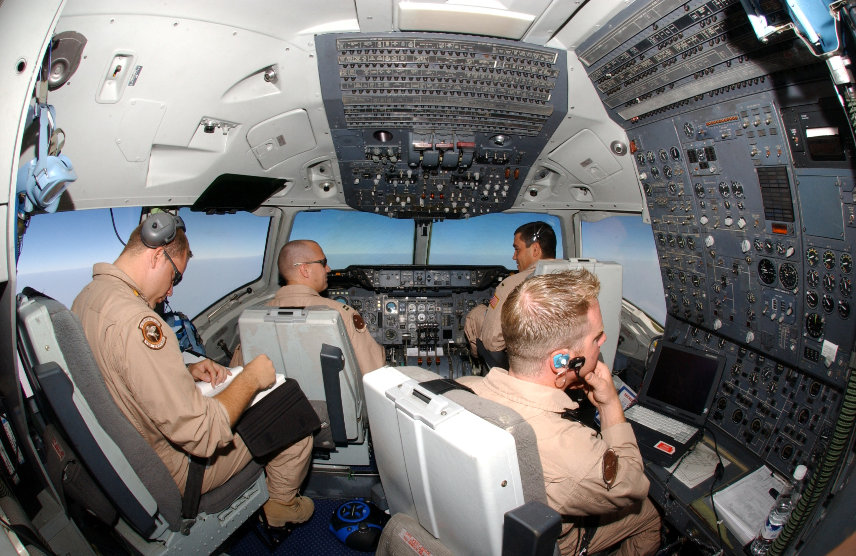
Insert Student Photo

Slide 6
U
T
I
B
L
usability
A
I
Y
s
Notes:
Many of us deployed portals a few years ago, sometimes against hard time lines – get it out there. Now what?
Today I will discuss how we performed a usability study, the methodology, results and some lessons learned along the way.

Slide 7

Campus Strategic Plan
  Intranet Upgrade
Sponsored by Chancellor
Partnership with IT
Project Charter
  Improve usability

Slide 8

Usability Study
Measures application usability or overall user friendliness
Human factors
Real world insight
Data driven results
What works and what doesn’t
Recommendations
Benchmark and assessment
Notes:
Avoid politics and antidotal evidence, how this works over a focus group

Slide 9
Methodology
Method outlined by Nielsen Norman Group
Morae software captured:
  Voice
  Video
  Screens
  Graphical data representation of time and success
Notes:
This can also be done without software.

Slide 10

Getting Started
Facilitators
Budget
  Software
  Travel
  Appreciation Gifts
Participants
  6 each “group”
Notes:
What makes good facilitators? Participants – not extensive web development skills

Slide 11
Schedule for 1 ½ hours
Private location
Identify up to 15 tasks
  Maximum 3 minutes each
Provide technology redundancy

Slide 12
Participation thank-you and confirmation
Define usability study
When and where
Identify facilitator
Set expectations
Emphasize you are testing your portal/intranet and not them!
Explain how results are shared
Provide a “thank you” gift

Slide 13
Facilitator role:
Introduce the study
Minimal conversation
Set behind and to the side to discourage discussion
Give participation gift when complete
Notes:
Facial expressions, give example

Slide 14
Scripted greeting for facilitator(s)
Introduction
Explanation
Emphasize you are testing the portal and not them!
It’s not about feelings, be honest
Talk out loud
Recording permission “Understanding Your Participation”

Slide 15
3 questions to ask prior to beginning study:
  How many hours a week would you say you spend using the portal/intranet, including email?
  How do you spend that time?
  What is your favorite thing to do in the portal/intranet?
Survey at end of study

Slide 16
Tasks Examples
Go to ERNIE and login.
Find the online transcript request form.
Locate where you can change your PIN.
Find the Worldwide 2007-2008 Catalog.
Find the per credit hour tuition rate range for Worldwide undergraduate students.
Find where you can sell back your used textbooks.
Find the Student Ombudsman Services page.
Notes:
Although they don’t represent everything that is done in the intranet, you will get information and recommendations that can be used in several places throughout the portal/intranet.

Slide 17
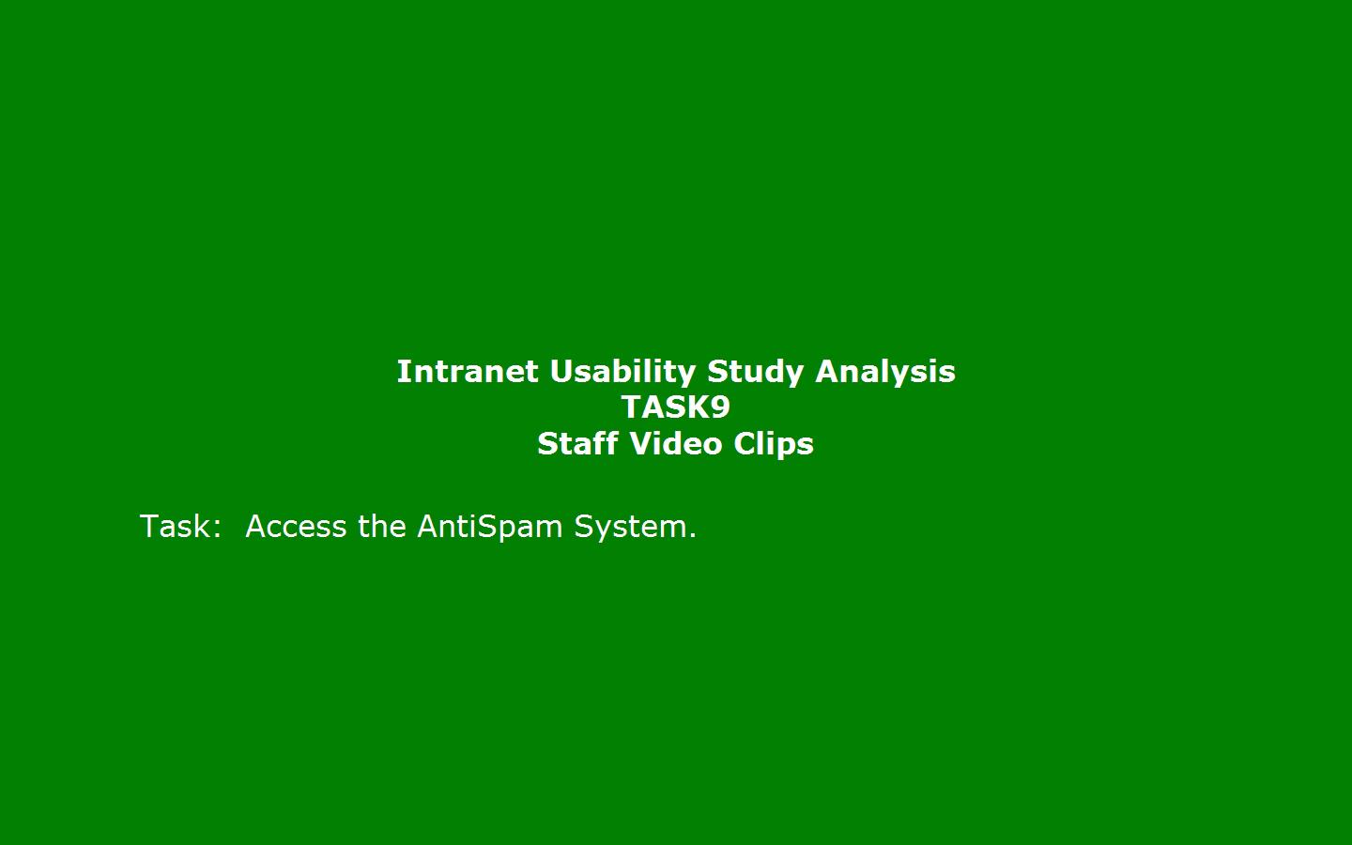
Clip from study

Slide 18
After the Study
Review recordings
Document observations and recommendations
Example: Login to the Portal
  Observation: “When I hit home in Blackboard, I expect it to go to ERNIE and it doesn’t.”
  Recommendation: “Standardize where “Home” in Blackboard and other applications in the intranet go to.
Notes:
Document exactly what participants said when possible.

Slide 19
Average Time on Task

Slide 20
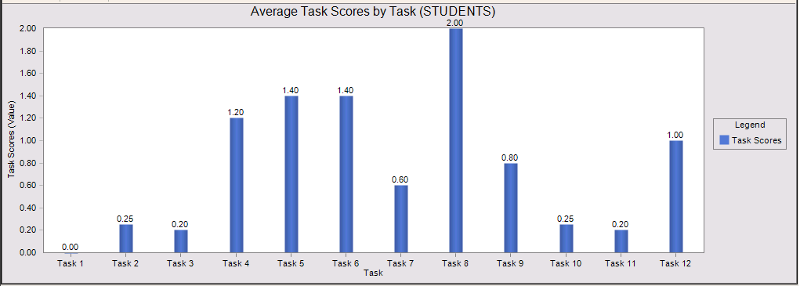
Success on Task
Score Definitions:
0 = Completed with ease
1 = Completed with difficulty
2 = Failed to complete

Slide 21
Survey Results

Slide 22
Usability Study Summary
Executive Summary
Index
Methodology
Study Results
  Graphs and Data
Recommendations
Survey Results
Screen Shots
Notes:
Our summary was 30 pages. Held sessions to review them.

Slide 23

Good News!
Rich content
Single sign-on services
Access to multiple systems

Slide 24

Other News
2 portal systems
Inconsistent navigation
Various looks and feels

Slide 25
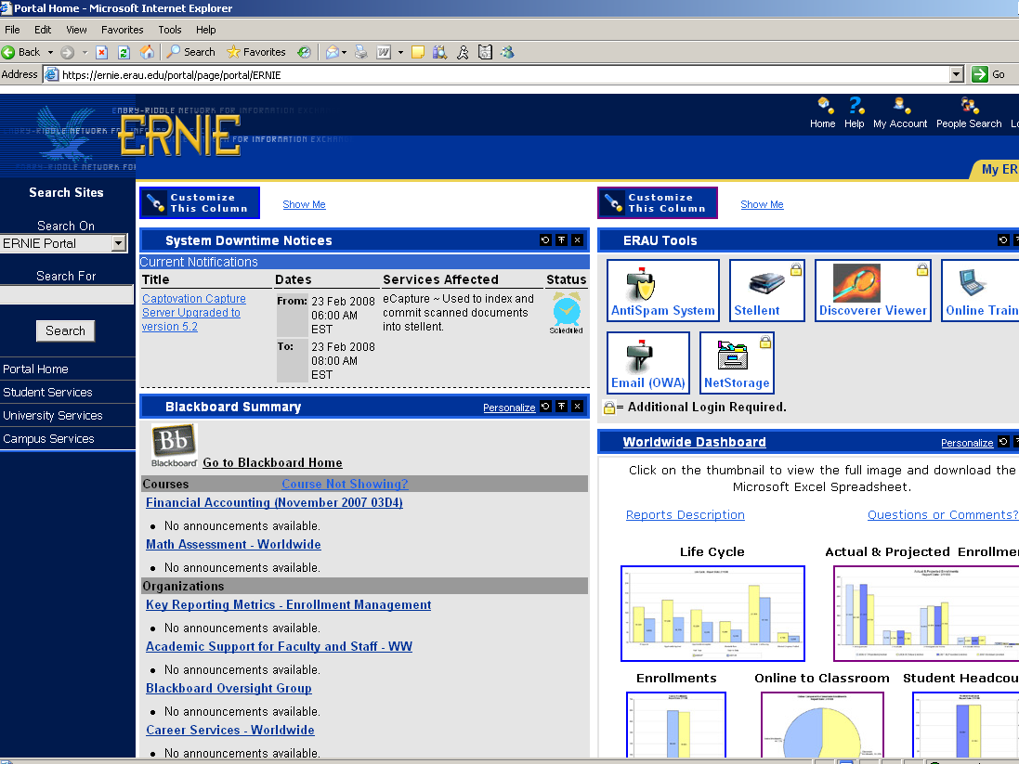
Tasks found through left hand side navigation took less time and had higher success rates.
Tasks involving Tools had moderate success.

Slide 26
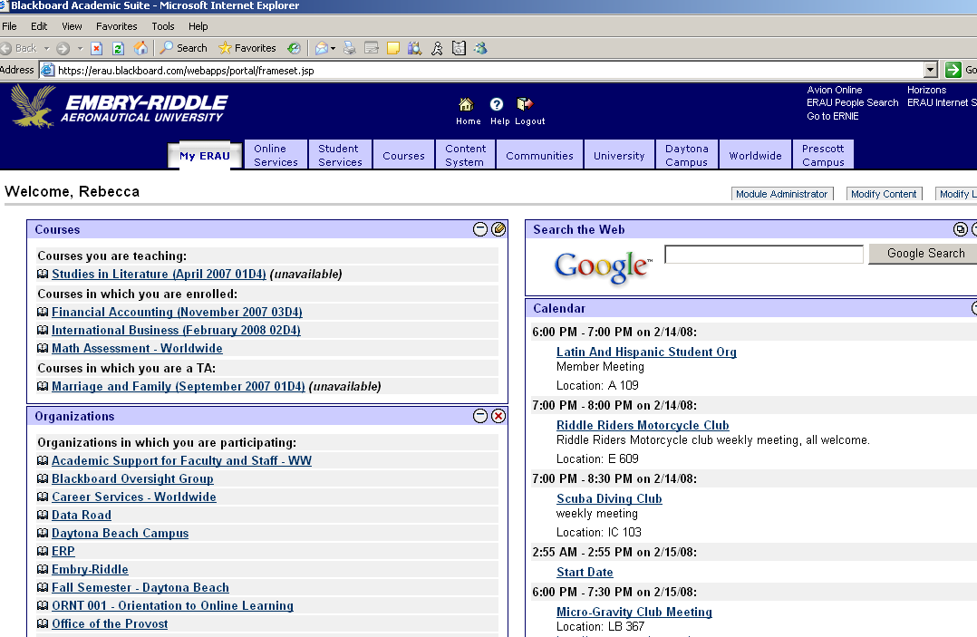
Confusion over what should be found in ERNIE versus Blackboard.

Slide 27

52 recommendations
  Create centralized training area
  Remove “online”
  Don’t use system names
Categorize
Assign
Timelines
Use best practices
  Hyperlink
Keep it simple!
Notes:
Many have been put into place already and others ongoing. Some simple like linking from text book buyback service from the bookstore site, linking withdrawal form from web registration, removing Ww or campus reference in link names, removing the word online, etc.

Slide 28
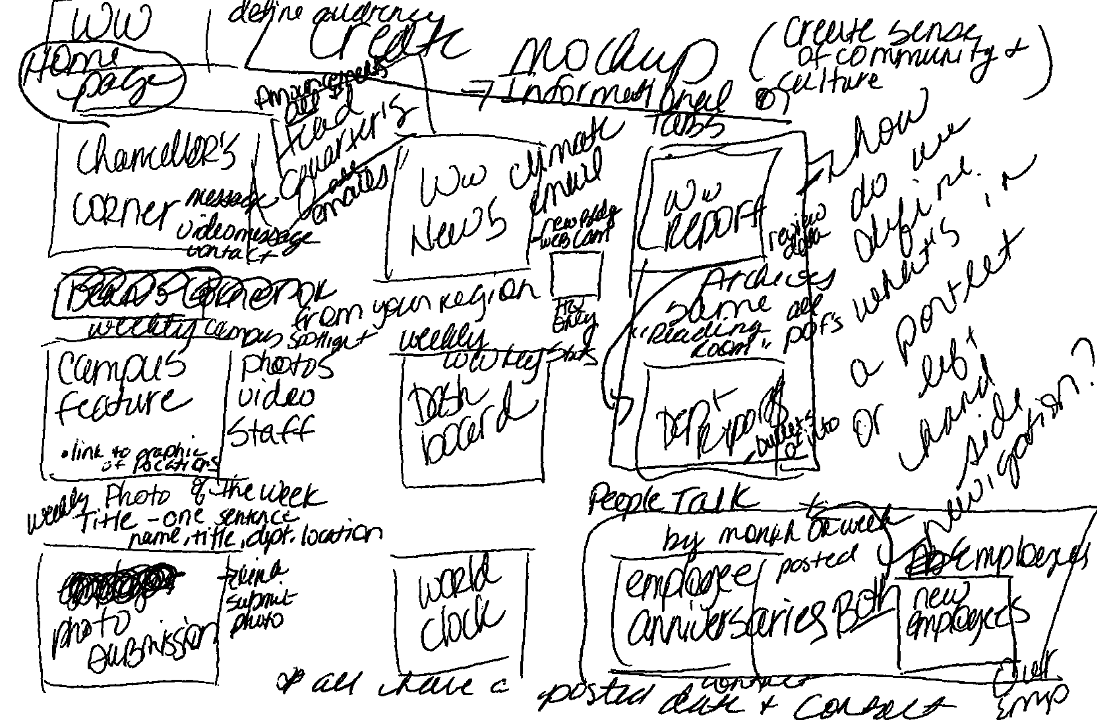

Slide 29
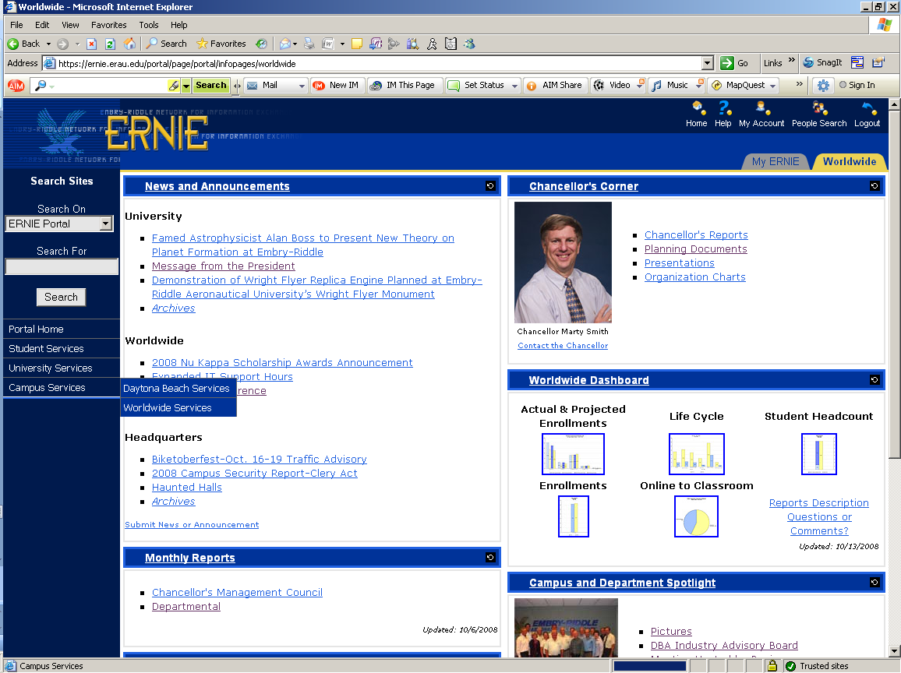
New Worldwide tab

Slide 30

Becky Vasquez
vasquezb@erau.edu
386.226.6948

Slide 31
References
Krug, Steve. Don’t Make Me Think. Berkeley, California: New Riders Publishing; 2000.
Molich, Rolf. (2007). 230 Tips and Tricks for Better Usability Testing. Retrieved in July, 2007 from http://www.NNgroup.com/reports/tips/usertest.
Pernice, Kara & Schade, Amy. (April, 2007). Intranet Usability I and II. A workshop and presentation delivered at the Nielsen Norman Group Usability Week 2007.

