Slide 1
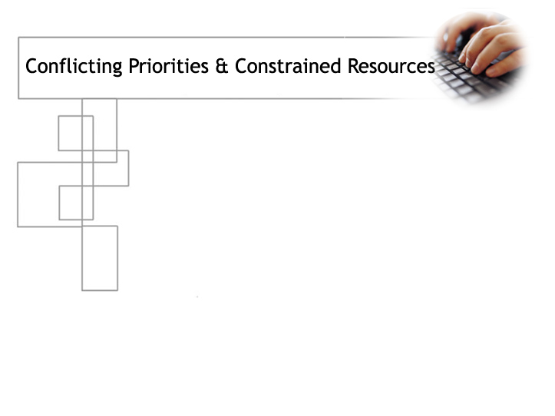

The soft side of Application Development
in a non-profit setting
Sheri Stahler, Associate Vice President
Jeremy Shafer, Director, Solutions Development
Jerry Hinkle, Executive Director
Copyright Temple University, Computer Services 2008. This work is the
intellectual property of the author. Permission is granted for this material
to be shared for non-commercial, educational purposes, provided that this
copyright statement appears on the reproduced materials and notice is given
that the copying is by permission of the author. To disseminate otherwise or
to republish requires written permission from the author.
Notes:
How can higher education IT Managers show progress and convey value?
How do you manage client expectations?
What “soft skills” are essential in this niche?

Slide 2
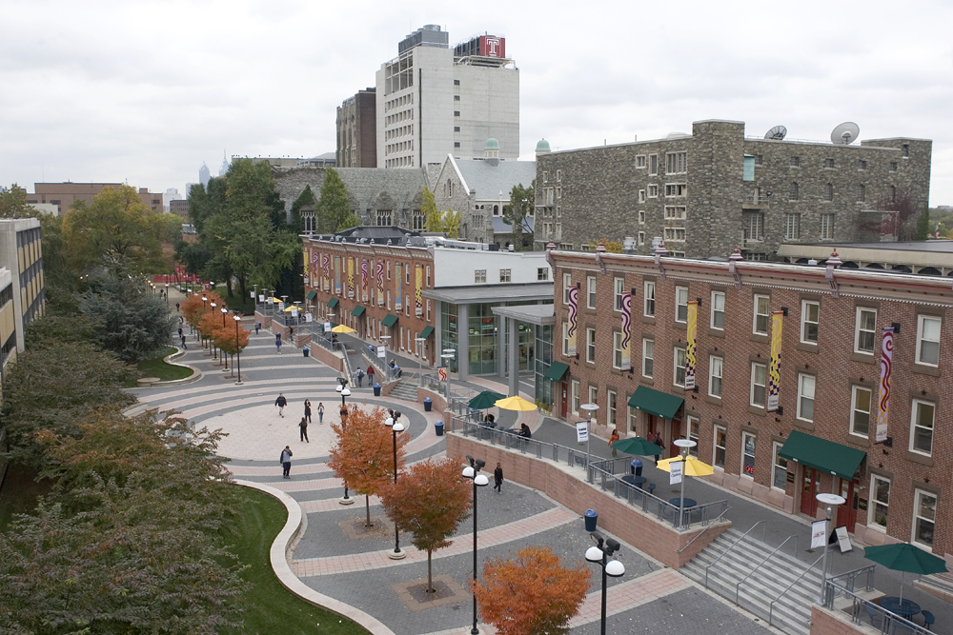
About Temple University
Notes:
2
Computer ownership facts 93% own their own computers 45% laptops

Slide 3
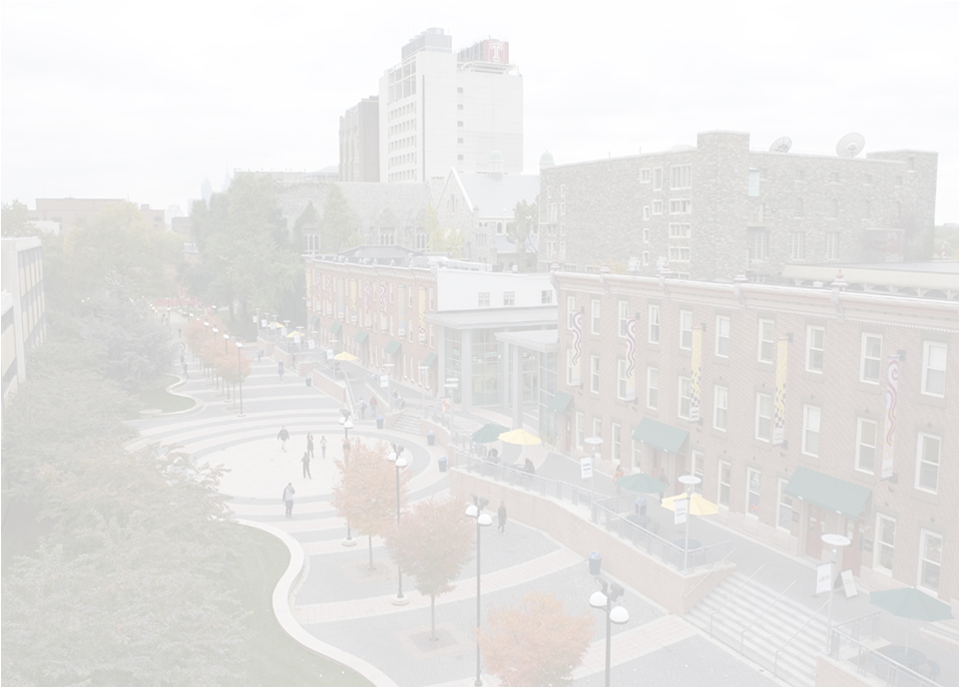
About Temple University
Location
Enrollment
Computer Services organization
Solutions Development group
Representative projects
Notes:
Philadelphia, PA. 36,000 enrollment, Over 250 Computer Services employees.
Solutions Development group designs and maintains custom web-based applications for university departments. Examples might include online Help system for Help Desk, invitation system for the President’s Office, Faculty Expertise database for Provost’s Office, election systems for student and faculty governance

Slide 4
The problem . . .
You provide a service
It’s “free”
Everybody wants it
Everybody wants it all
Everybody wants it all

Slide 5


Slide 6
“I was wondering if you could help me with a small project...
It all starts with...
. . . It shouldn't take too much time.
. . . but we have a bit of a deadline.
Notes:
to Medium

Slide 7
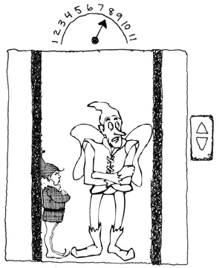
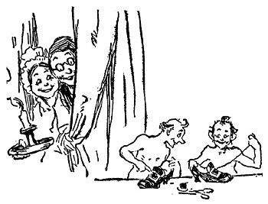
What often happens
  Elevators
  Elves
  Elevated expectations
Notes:
GAIL I added an animation to make the elevator ride “up” on entry.
That’s funny!

Slide 8
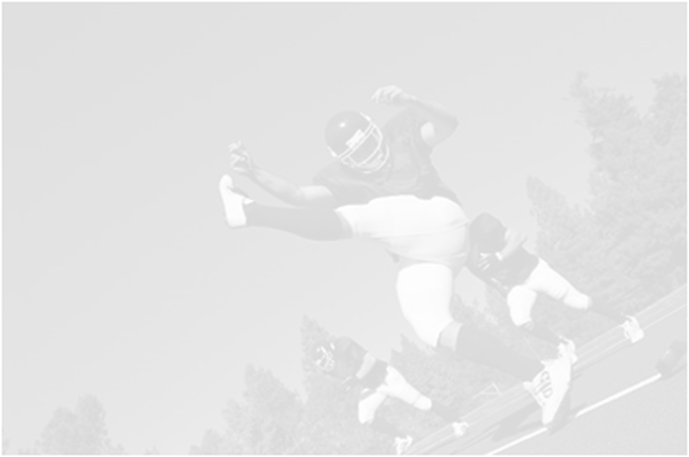
What needs to happen
  Standardized request system
  Defined needs and expectations
  Established checkpoints and notifications
  Actual endpoint
  Plan for maintenance

Slide 9

A few questions . . .
  How does a casual inquiry become a project?
  How do you keep a “little” project from growing too big?
  How can you grasp your client’s needs and expectations?
  How do you explain complexity, time, and scope to client?
  How do you manage portfolios of projects?

Slide 10
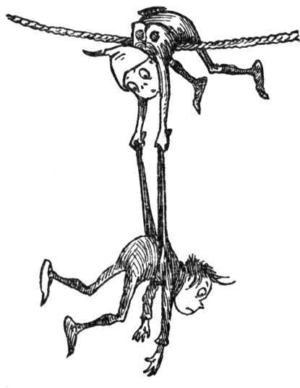
The challenges . . .
  Trifold constraint, unconstrained
  Our understanding of client
  Client’s understanding of us

Slide 11


Slide 12
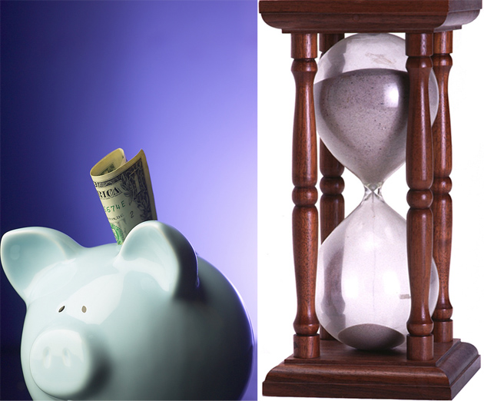

Slide 13


Slide 14
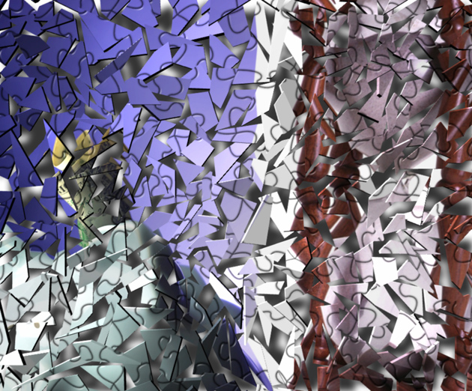

Slide 15
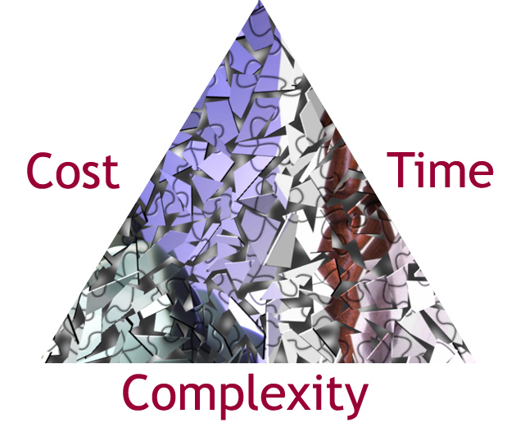

Slide 16

A meeting of the (unlike) minds
Watch out for these common assumptions:
  “Everyone thinks just like me”
  “I know what my client wants”
  “I know what my client really needs”
  “Everyone's priorities are the same as mine”
  “Everyone knows how really busy we are”

Slide 17


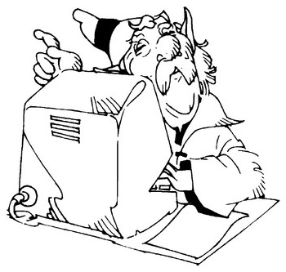
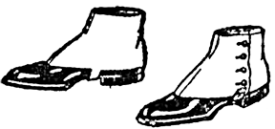

Client understanding of product

Slide 18
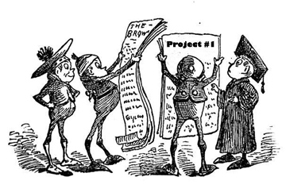
Take a walk on the soft side
Managing Projects
Nurture and orchestrate your client’s expectations and assumptions

Slide 19
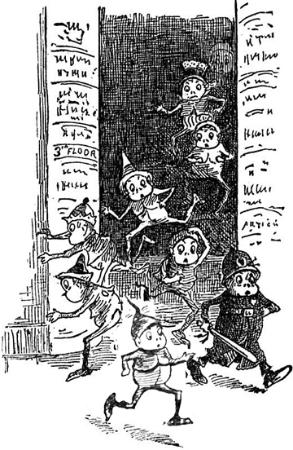
Initial inquiry phase
  A "necessary evil," watch your step!
  Usually informal
  Can be misleading on both sides
  Move to the next formal step
  Keep your staff on the same page
  with responses
Notes:
Teach all staff to have a "party line"
Scripting and boilerplate if necessary

Slide 20
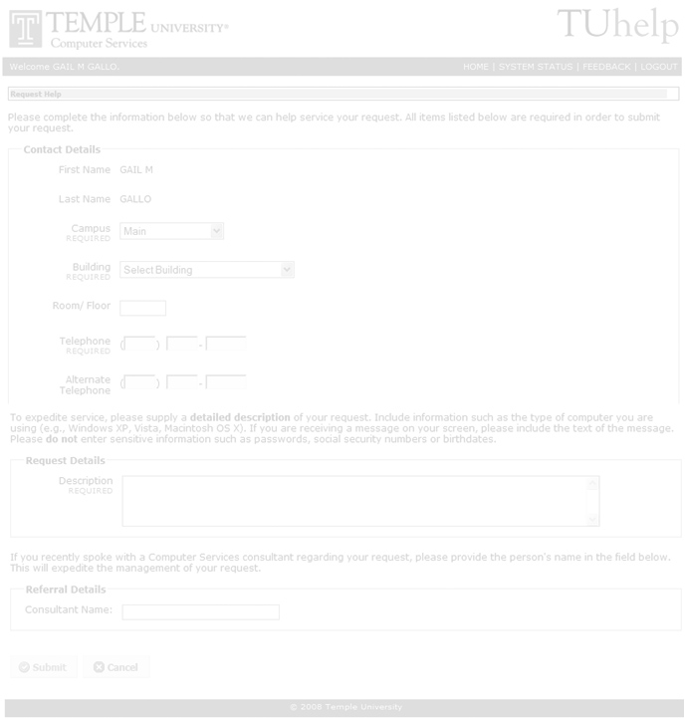
Formal request phase
  Develop a standard, uniform way of officially submitting requests
  Makes it "official" with both parties
  Helps with tracking
  Structured follow-ups
Notes:
We use "TUhelp", which gives client and IT a tracking number, so request doesn't get lost
Respond within 48 hours
Meet within 14 days
Make it clear that project is not yet approved or started

Slide 21
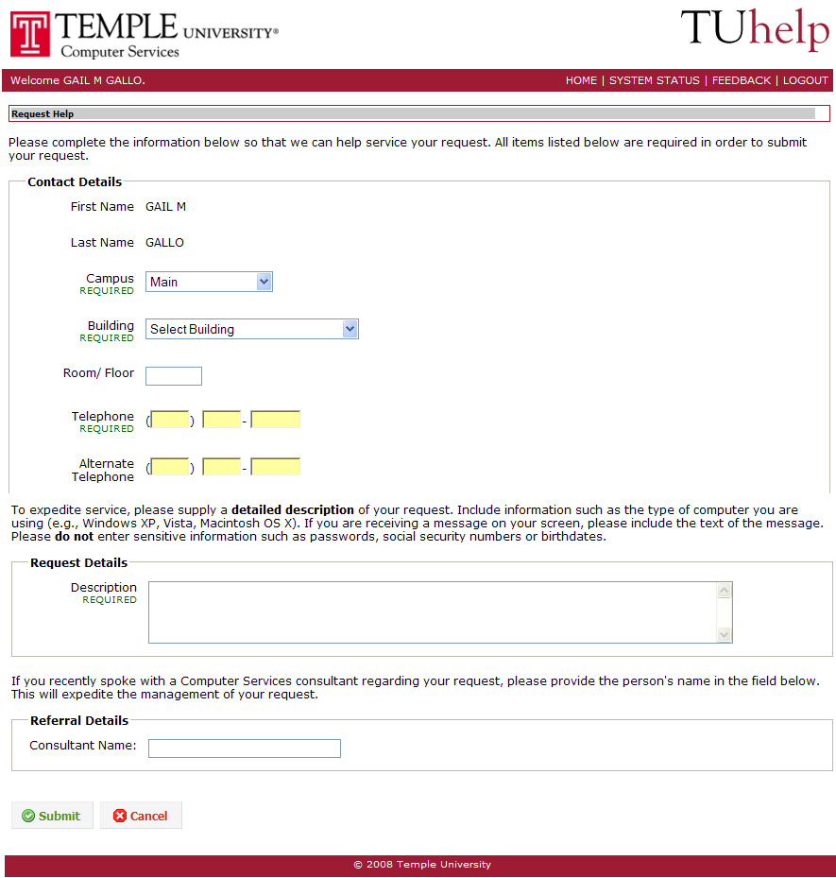
TUhelp Screen

Slide 22
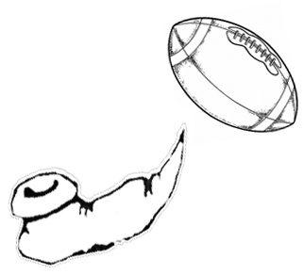
Kickoff phase
  Determine actual needs
  Define both parties expectations
  Look at short and long term solutions
  Determine if there’s a fit
  Create a summary of work
  Define next steps
Notes:
Listen!
Define needs in writing
Ask for time constraints
Make client aware of your process
Make client aware of your workload
A quick fix "band-aid" goes a long way
Long Term needs, benefits of phased implementation

Slide 23
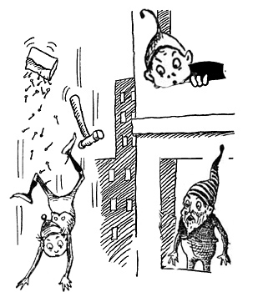
Client understanding of process
Waterfall development
Agile development
Notes:
Help GAIL, we need a graphic here…. Maybe a woodcut waterfall, our a architectural design, or elves building something.

Slide 24
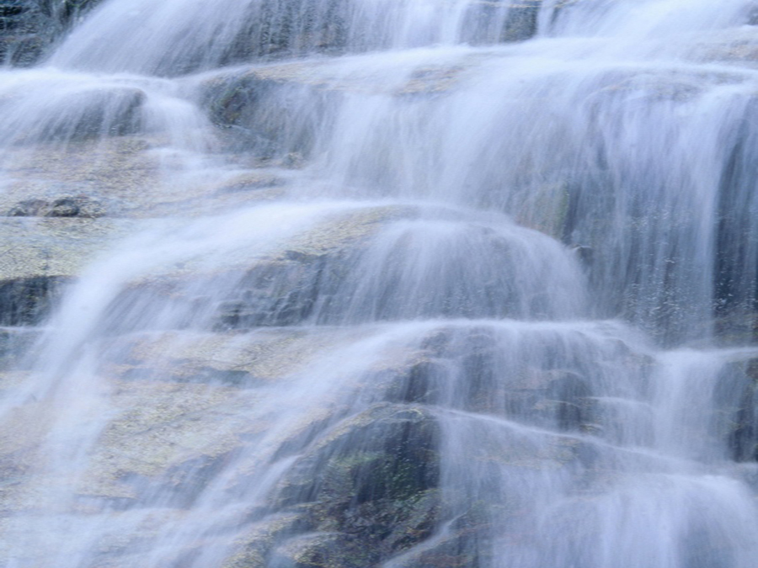


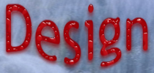


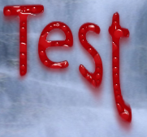
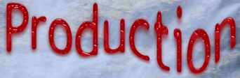
11

Slide 25
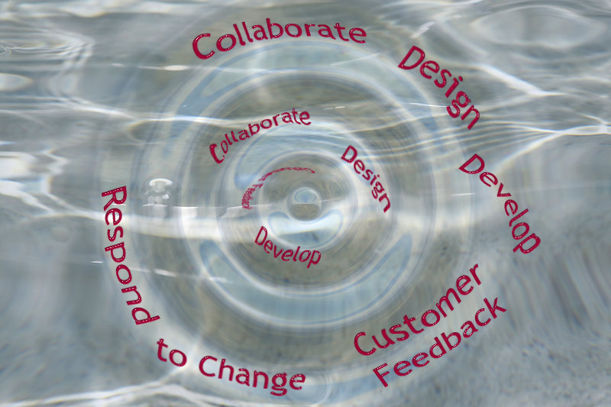

Slide 26
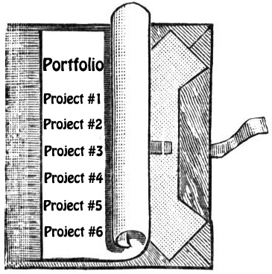
Creating value
  "It's free, but not cheap"
    quantify your portfolio
    profile your projects
    profile your clients
  Compare with outside contractors
    "Real life" costs will add instant value
    Some clients may actually choose
    this option
      Serving a "broker" role with vendors
      or freelancers
      Serve a "mentor" role for student workers

Slide 27
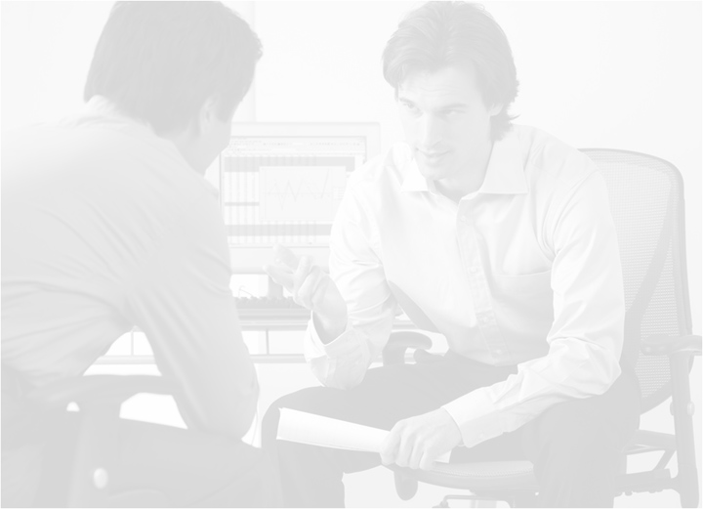
Checkpoints
  What is a checkpoint?
  Regular meetings of decision-makers and hands-on staff
  "Hey, why do we need all these meetings"?
  In-person and automated checkpoints
Notes:
Without these, project expectations can go awry
Avoids "development limbo"
Can control scope creep
In-person, regular meetings are critical
Conference calls if necessary
Automatic notification and self-service systems
Pending requests
Scheduled requests
Active request

Slide 28
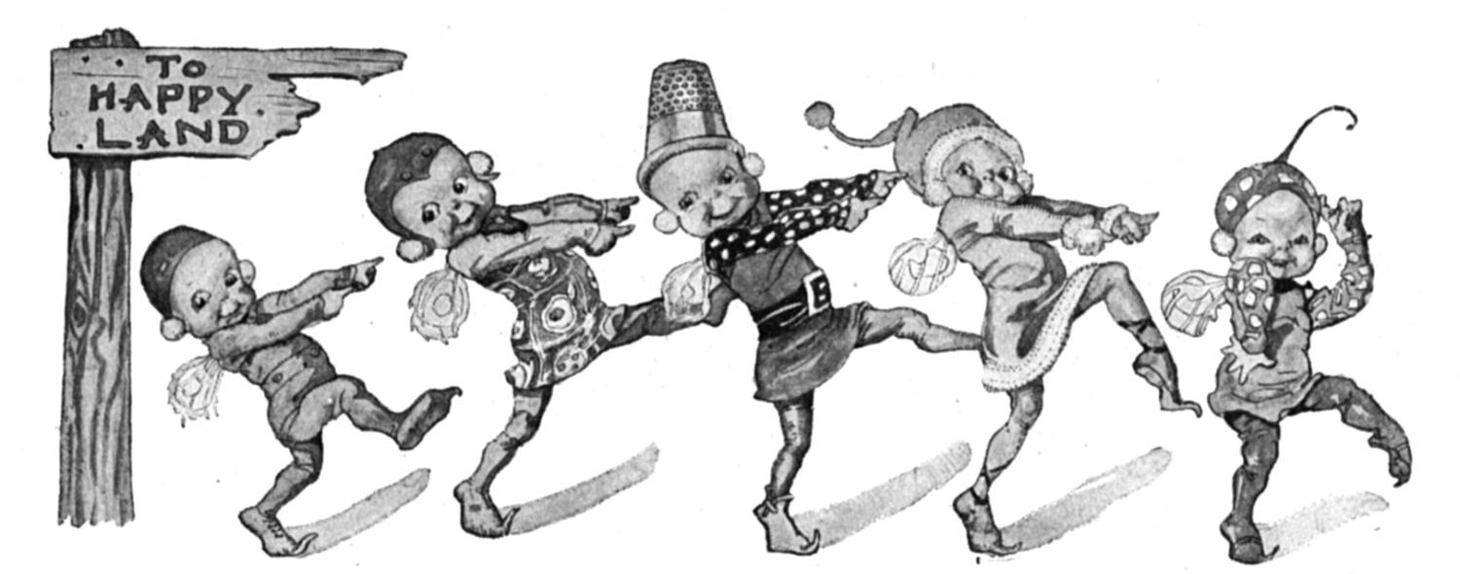
"Are We Done Yet?" phase
  When is the project over?
  Define the end at the beginning
  Agile development and checkpoints help
  Formal notification of completion
  Is the project really ever over?

Slide 29
Maintenance phase
  Old Projects never die...
  Initial debugging
  Regular maintenance and fixes: the 3% rule
  Empowering the client by design: Content management
  "Never design a project that only you can maintain"
  Remember cyclical factors for future scheduling
Bugs
Cycle
3%
Notes:
Seasonal revisions
Overall product lifecycle
Jerry – this graphic is good. I changed to grayscale to fit the rest of the theme. Will come back to this if I have time.

Slide 30
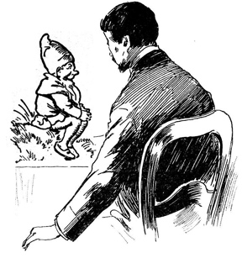
Communication is key
  Listen! Understand your client's needs and expectations
  Set expectations
    Create a summary of work
  Regular, scheduled follow-ups
    Kickoffs
    Checkpoints
  Communicate, communicate, communicate!

Slide 31
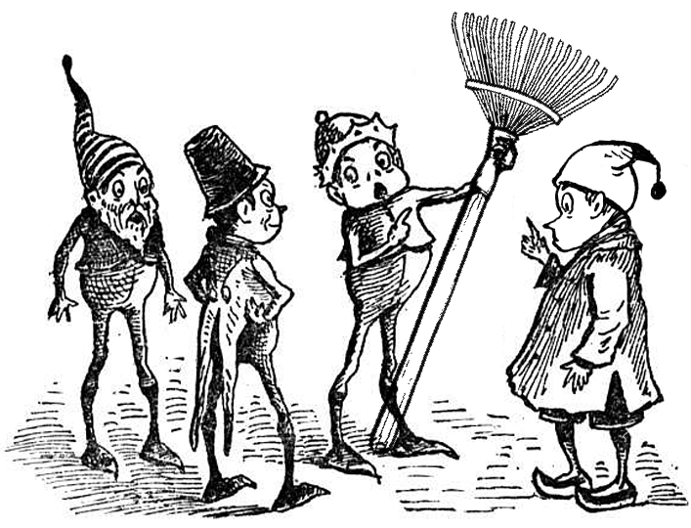
How does your garden grow?
Managing Portfolios
Tools and techniques for cultivating
your institution’s projects

Slide 32
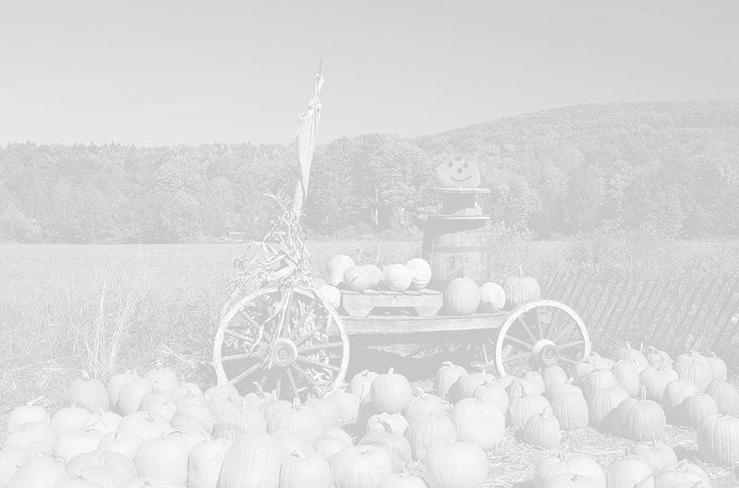
Portfolio Management
Managing projects just the start
Cultivating your whole project portfolio
Upgrading your tools
Harvesting your crop

Slide 33
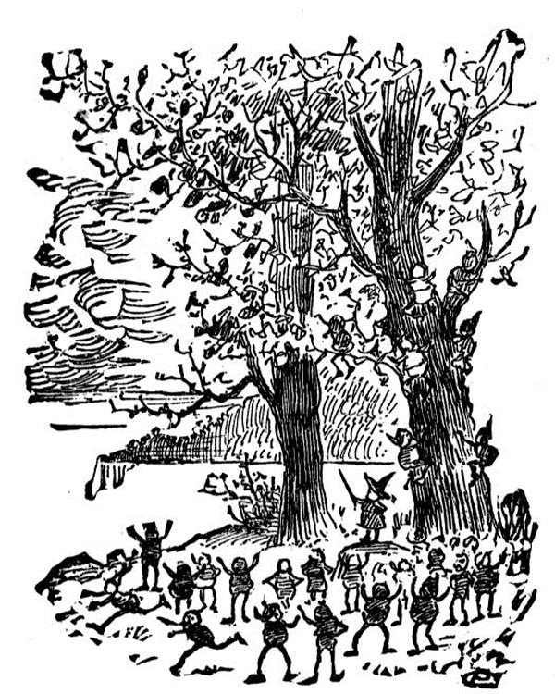
Seeing the forest and the trees
  Not just about individual projects
  Need to manage entire project portfolio
  Who is your client?
    The department requesting the project?
    The university officer overseeing many
    departments?
  Need tools for both you and your
  clients to manage portfolios

Slide 34
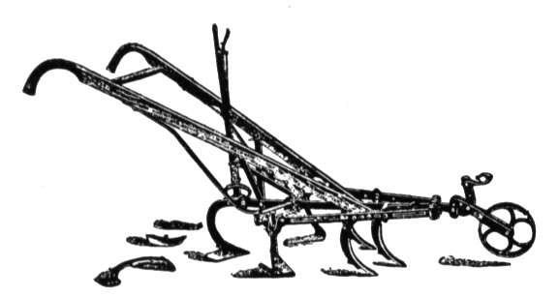
Traditional Tools
  Project Management software
  Pros
    Helps you manage your project
    Provides high level of detail
  Cons
    The “huh?” factor
    Too much detail for clients
    One-sided approach

Slide 35
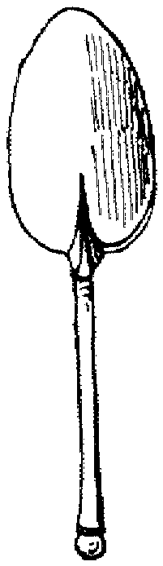
Traditional Tools
  Incident Tracking Systems
  Pros
    Captures project requests
    Can provide reminders and tracking for IT group
  Cons
    One-sided approach
    Too much detail for clients
    Addresses request, but not the plan

Slide 36
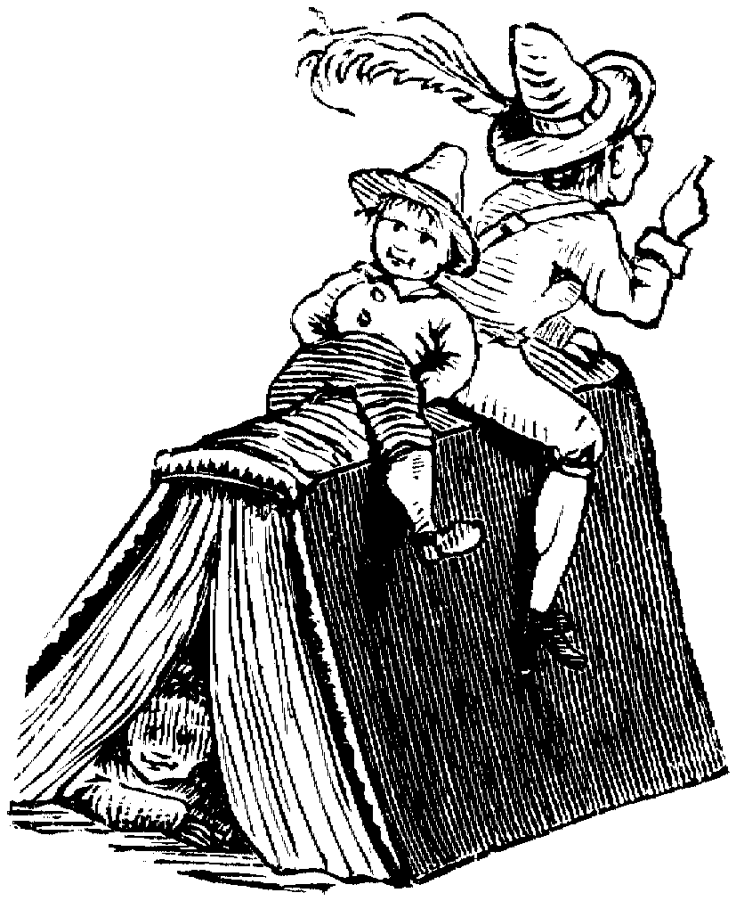
“2.0” Tools: Service Catalogs
  Provides a full catalog of services
  “Packages” services into bundles
  Allows client to submit their own request
  Allows clients to track requests

Slide 37

“2.0” Tools: Collaborative Apps
  Lets clients and IT easily share plans
  Enhances “agile” development through collaboration with clients
  Any time, anywhere interaction
  Potential for library of resources

Slide 38
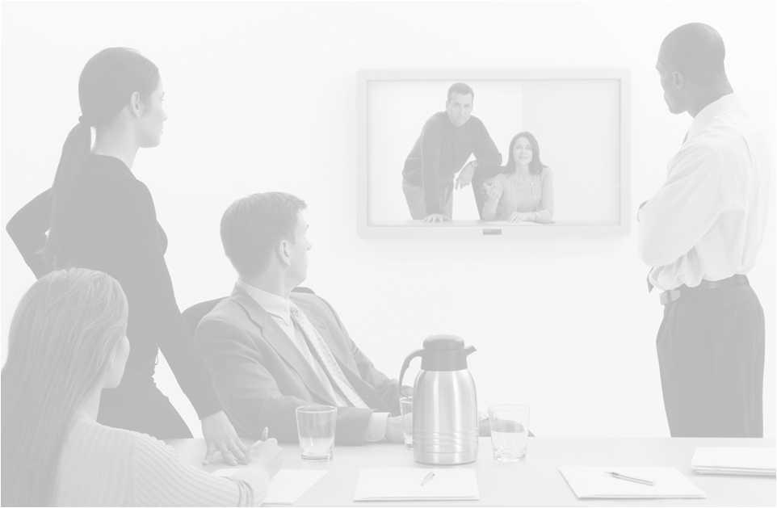
“2.0” Tools: Conferencing Tools
  Encourages “Checkpoints” without having to meet in person
  Screen-sharing video, audio
  Remote development for multi-campus settings
  Recording allows for review of client’s needs

Slide 39
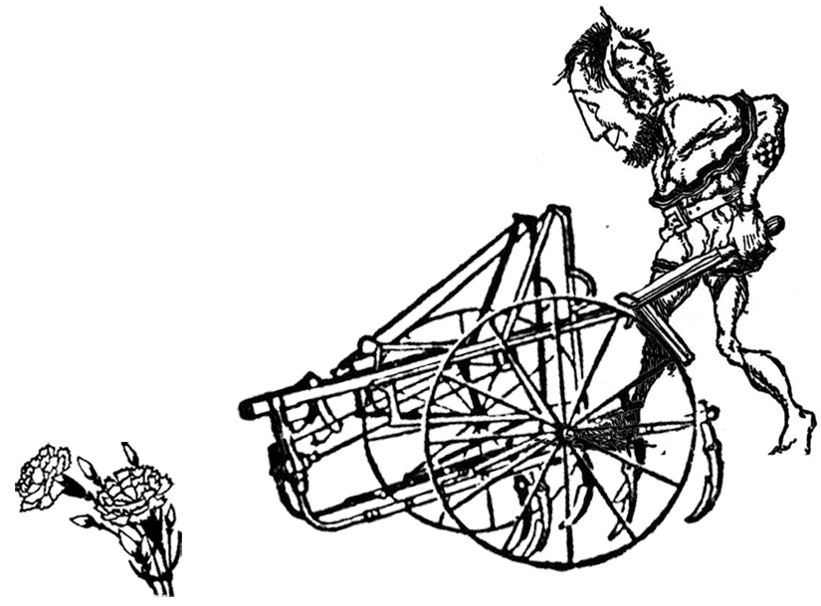
Harvesting your portfolio
Use your portfolio to showcase tools
  Internally
  Externally
Taking it on the road
What’s ahead “Democratization” of IT

Slide 40

”Gardening” your whole portfolio
Weeding
Thinning
Pruning
Replanting
Controlling Pests
Harvesting
Eliminate unwanted projects
Eliminate weakened projects
Control scope creep
Remember the lifecycle
in your schedule
Eliminate tasks outside
your scope
Publicize your best
projects

Slide 41
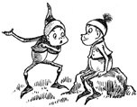
In summary...
  Listen to your client
  Remember that we all "think different"
  Establish structured "soft side" process:
    Formal request process
    Kickoff
    Checkpoint
    Define endpoint
    Maintenance
Use the proper tools for both
project and portfolio management

Slide 42

Questions?
Please contact us at:
solutionsdev@temple.edu
Sheri Stahler sstahler@temple.edu
Jeremy Shafer jeremy@temple.edu
Jerry Hinkle ghinkle@temple.edu

