Slide 1

Examples of a Mid Size College’s Experience with SaaS –
Am I working in a Cloud?
Presented by:
Nadine Stern - VP for IT and Enrollment Services
The College of New Jersey

Slide 2
Who I am
VP of IT and Enrollment Services at The College of New Jersey
Enrollment Services – Financial Aid, Student Accounts, Records & Registration and the Center for Institutional Effectiveness
Mid-size College
Full time enrollment – 6000
Approximately 3600 residential students
Centralized IT with approximately 60 staff members

Slide 3
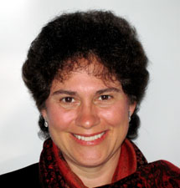

Who I am not
Tracy Mitrano – Cornell
Director of IT Policy and of
Computer Policy and Law Program
Richard Katz – Vice President - Educause
Notes:
Tracy’s “cloud” accomplishments –
Memo entitled “Outsourcing and Cloud Computing for Higher Education – August 2009” found under Challenges and opportunities in outsourcing and cloud computing on Cornell’s IT Policy page
A few references of Richard’s “cloud” accomplishments:
Editor of “The Tower and the Cloud: Higher Education in the Age of Cloud Computing” – 10/2008
Co-author – “Demystifying Cloud Computing for Higher Education” - ECAR research bulletin 9/2009

Slide 4
Have we been in the cloud for years?
“Saas ..is the use of application software run by a third-party provider and accessed by users via the Internet”
Phil Goldstein – Alternative IT Sourcing Strategies: From the Campus to the Cloud
The National Student Clearinghouse (2002)
Notes:
So here, you can talk about why you decided to do this presentation and once we delved into the research we think we’ve been using Software as a Service and/or Cloud computing for years.
EDUCAUSE definition - “delivery of scalable IT resources over the Internet, as opposed to hosting and operating those resources locally.” From 7 Things You Should Know About Cloud Computing – August 2009
TCNJ has been working with the Clearing House since 2002. Here is a blurb that Records and Registration put together. Most noticeably the section about the data we provide (and raised a question for me about how will we do this in PAWS without all SSNs). According to Phil Goldstein’s quote above – I would say this fits the bill!
The National Student Clearinghouse serves as a central repository and single point of contact for the collection and exchange of comprehensive enrollment, degree, diploma and certificate records, maintaining and electronic registry containing 93 million student records from more than 3300 colleges who enroll 92% of the of US college students. Their core business is providing enrollment status and deferment information for financial aid students on behalf of its participating institutions to guaranty agencies, lenders, servicers and the Department of Education.
Also, here you may want to talk about what you know since the next slide is what you don’t know
Technology requires different expertise than it did just a few years ago
My IT staff will question everything (and that’s a good thing)

Slide 5
What I know I don’t know
Have I been in a cloud for years and just didn’t realize it?
Am I working in a cloud now?
Will the clouds be followed by a storm?
Will I have an umbrella?
(I am not trying to define Cloud Computing or SaaS)
Notes:
Here might be a good place to say something like you’ve all read the same articles I have so you aren’t going to rehash that, but rather, you will share our experiences with them

Slide 6
Why is TCNJ moving to the Cloud?
Budget constraints
Sales people can do a demo that makes any technology product look amazing (and sometimes even FREE)
Increase in requests from departments
And THE PREDICTIONS are coming true
Notes:
Budget constraints:
every server needs a backup server even with virtualization that is an added cost
Business continuity planning now also requires off-site backups
Everything seems to be mission critical!
Blackboard for access
Student System
Financial System
Course Management System
Email
Sales team: It’s never as simple as the sales team has indicated.
Many departments are doing their own research to “fill a need” and will come to IT with a solution to their need.
For last bullet point - Educause - Not specifically mentioned as one of the top 10, but referenced in Top-Ten IT Issues 2009:
1 – funding IT – “another area for cost savings is cloud/grid computing
2 – Administrative/ERP Information systems talks about “Has the institution considered outsourcing administrative/ERP systems?”
3 – security – nothing here
4 – infrastructure/cyberinfrastructure – “As evidenced by the buzz surrounding cloud computing, stakeholders are increasingly less concerned about where the applications end and where the network begins”
5 – teaching and learning with technology – nothing here
6 – Identity/Access Management – “Outsourcing, hosted, and cloud computing solutions present new challenges”
7 – Governance, Organization and Leadership – nothing here
8 – DR/BC – surprisingly nothing here specifically
9 - Agility, Adaptability and responsiveness - nothing specific but raises the question - “Are IT leaders present during campus wide discussions about how the institution needs to adapt and respond to the changing world?”
10 – LMS – nothing here

Slide 7
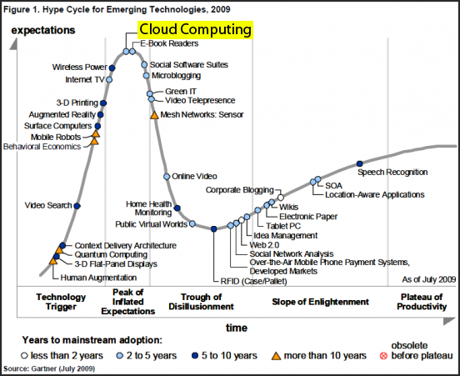
Gartner Hype Cycle
Notes:
At the peak of Inflated Expectations – Gartner 2009
Definition of peak of inflated expectations – “a frenzy of publicity typically generates over-enthusiasm and unrealistic expectations. There may be some successful applications of a technology, but there are typically more failures.”

Slide 8

Notes:
More clouds on the cover this year..
New Media Consortium and Educause Learning Initiative joint venture – Horizon Report -
Cloud Computing – Time-to-Adoption Horizon: One Year or Less – See below from the 2009 Horizon report
“The emergence of very large “data farms” — specialized data centers that host thousands of servers — has created a surplus of computing resources that has come to be called the cloud. Growing out of research in grid computing, cloud computing transforms once-expensive resources like disk storage and processing cycles into a readily available, cheap commodity. Development platforms layered onto the cloud infrastructure enable thin-client, web-based applications for image editing, word processing, social networking, and media creation. Many of us use the cloud, or cloud-based applications, without even being aware of it. Advances in computer science to ensure redundancy and protection from natural disasters have led to data being shared across many different hosting facilities. Improved infrastructure has made the cloud robust and reliable; as usage grows, the cloud is fundamentally changing our notions of computing and communication.”

Slide 9
IT concerns
Data security/identity theft - privacy and protection of data
How do we (they?) authenticate?
Data integration to and from the vendor
Data Integrity – should not become a data source
Funding issues – yearly license or subscription costs and on-going maintenance costs – is it cheaper to buy in the long run?
And where is the budget – IT or the department?
Notes:
Data Integrity – do not let this become a “source” of data which is housed in campus systems

Slide 10
….More concerns
Project Governance –who runs the project
Backup/Disaster Recovery/Business Continuity
Contract/Legal concerns
Purchasing process – for “free apps” --RFP??
Federal and state regulations and compliance (FERPA, HIPPA, server locations)
RELIABILITY (even google has outages)
Vendor integrity
Notes:
Project Governance notes – who is the PM? Who decides if this is an “easy” hosted solution; does it fit IT priorities
Here you wanted to talk about the RFI discussion. Purchasing doesn’t know how to be involved in the “free” hosted solutions in the cloud like Google mail and Open Source Learning Management Systems.
Reliability – I was writing this when google had their outages……….

Slide 11
Taking a step back
As the trend grew, we:
Were cautious because of past history
  Student workers developing apps then graduating
  Vendors merging or going out of business
Required buy-in from the requesting area
  Functional Users and Business Analyst roles evolved
  Project Manager from requesting department
Where does project fit in IT Project Priorities
  it seems “simple” to the users
Notes:
Providing solutions through hosted solutions or cloud computing was a way for everyone to get what they wanted – okay, almost everyone. Trying to “squeeze” in another project for IT is always a challenge because in the past, a department would request this type of software and then leave it to IT to develop the project plan, including serving as project manager.
We realized that this was an option to be embraced BUT that we had to develop a strategy for how and when we would use hosted solutions and/or cloud computing and could also use what we were learning in our in-house projects.
Moving forward with these requests, we realized that if the department were to be truly invested in the success of the project, that someone from the requesting department needed to be project manager – cloud or no cloud.

Slide 12
TCNJ HAS hosted solutions
CommonApp – 2005
Campus Call – 2005
Nuesoft - 2007
NACE Link - 2008
Bowmac REDI - 2009
Activity Insight from Digital Measures - 2009
Blackbaud GROW and NetCommunity* - 2010
Notes:
CommonApp
Campus Call – 2005 - gift giving from alumni
Nuesoft – 2007 - student health services uses for scheduling and tracking – we provide basic bio-demo info keyed on emplid
NACE Link – 2008 – Career Services – replaced monstertrak
Bowmac REDI – 2009 – critical incident planning
Digital Measures – 2009 - Activity Insight from Digital Measures makes it easy for your faculty and staff to keep track of the activities they accomplish, such as the teaching, research and service information found on their CVs.
Blackbaud – GROW and NetCommunity* - 2010 - hosted BUT required web server (more on next slide)

Slide 13
TCNJ’s Newest “Hosted” Solution
Notes:
Stress the part about even though it’s “hosted” we still need to have a front end web server

Slide 14
The Changing Face of Technology
Informal “Hosted” Solutions
Faculty, staff and students are already using hosted solutions:
  Gmail and google apps
  Wikis and blogs
  Facebook/Twitter
  They see a need, they find a simple solution
  Doesn’t always translate to enterprise wide solution
Notes:
Here you can talk about how we used to “encourage” faculty to use email accounts, desktop computers, etc. Now, faculty are using technology without us and sometimes IT doesn’t find out about it until it’s a support issue.

Slide 15
What has come out of the cloud?
Checklist that incorporates cross function team questions including IT, business analysts, project manager and functional users
Service Providers Requirements:
Privacy and Confidentiality: Holding IT Service Providers Accountable
Project Governance being developed for hosted and non-hosted solutions
Project Governance team for prioritization being formed –just because the system is hosted does not mean it is at the top of the priority list
Checklist and Service Provider Requirements
Notes:
http://www.tcnj.edu/~it/educause2009.htm
Has service provider requirements
Has old hosted solutions questions – but will have:
new hosted/in house template for questions to ask when evaluating projects
our IT project governance document and team

Slide 16
Pros of working in the cloud
Disaster Recovery/Business Continuity
Inexpensive storage
Energy savings to the College
No concern about platform
  Hosted solutions provide expertise that we don’t have - IT staff can’t be expected to know it all

Slide 17
Cons of working in the cloud
Fear of the unknown – how secure is our data?
Loss of control
Missed learning opportunity for IT staff
Funding issues – is it really cheaper over 5-10 years
FREE is not “free” – IT resources: even servers
IT taking on non-traditional IT roles (like contract review, vetting safety of vendor environments)
Notes:
Loss of control – “Ultimately, we users may have to make a trade-off – sacrificing some degree of freedom and control in exchange for convenience.” – Today’s Forecast: Cloudy from Newsweek – 11/10/2008 – Daniel Lyons – Techtonic shifts, page 24
Funding issues:
– yearly license/subscription – need to compare cost of hosted to in-house over 5-10 year period
What happens when the “hosted” solution changes its business model (e.g. if google starts to charge for email)

Slide 18
What’s next for TCNJ
Develop RFI for Cloud Computing/SaaS
Implement project governance plan including prioritization process
Gmail for alumni and students – can google apps be far behind
Define new roles and retrain IT staff in support of hosted solutions including contract issues and negotiations, offsite infrastructure review

Slide 19
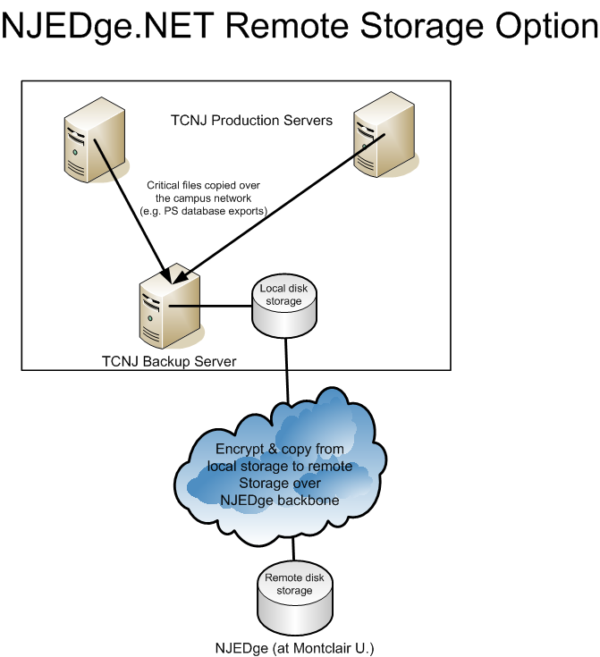
What’s next for TCNJ

Slide 20
What’s next for TCNJ
Disaster Recovery/Business Continuity Planning services
Develop standard process for identifying break-even point for cost effectiveness– include equipment replacement, staff time
Due diligence for existing contracts
Develop a plan for an exit strategy – just in case
  What if Google start to charge for email??
Notes:
Develop standard process for break-even – include equipment replacement, staff time, etc – we need to develop a method to evaluate TCO over 5 to 10 year span – is it less expensive to bring it in house in the long run? (including server replacement cycle and staff time). Should we periodically evaluate bringing hosted solutions in house?

Slide 21
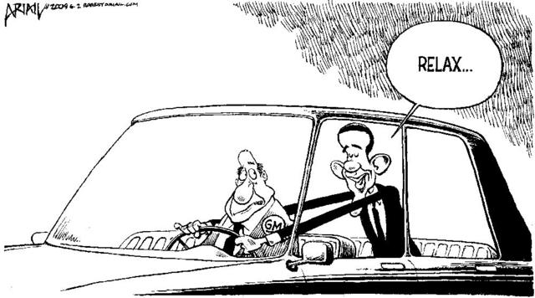
What’s next for TCNJ
IT still a driver – but now a back seat driver

Slide 22
TCNJ - IT Questions Regarding Hosted Solutions
General
What department is leading this initiative?
Who is the project manager?
Is there buy-in for the constituents using the product?
Are there other products/services similar to this one already in place on campus and if so, is the current product a viable solution?
Notes:
IT needs a copy of the contract to start reviewing that to make sure we have no issues with it and a project plan before purchase.

Slide 23
TCNJ - IT Questions Regarding Hosted Solutions
Funding:
What is the initial cost of the hosted solution and who is funding?
What is the yearly maintenance fee and who is funding?
Are there additional hardware costs and who is funding?
Will we require maintenance contracts for any additional hardware and if so, what is the cost?
Does the initial cost cover training and implementation?
How many licenses are we getting?
Is there any data conversion cost with this project?

Slide 24
TCNJ - IT Questions Regarding Hosted Solutions
Technical:
Is this a web based solution or is there a client to install?
Will this system be integrated with other systems on campus? If so, is there a cost associated with this and who will write the interface?
How are users authenticated? Do they use a single sign-on solution like CAS (Central Authentication Service)? Will it be done through our system or will there be external authentication with new ids/passwords?
What databases are supported?

Slide 25
TCNJ - IT Questions Regarding Hosted Solutions
Technical continued:
What type of impact will the application have on campus servers?
Can we limit the software to be accessible only via VPN and on campus? Is access limited to a set of IP addresses for security reasons?
Do we need to dedicate a certain amount of Internet bandwidth to the site hosting the software?
If this product interfaces with another product, does it place any limitations on our upgrade cycle? Will this product affect the ability of any current system to be upgraded in the future?

Slide 26
TCNJ - IT Questions Regarding Hosted Solutions
Logistical/Support Issues:
How much time will this take to implement from a personnel perspective?
What is the implementation timeframe?
What kind of technical support will be available for both functional users and technical support staff?
What type of end user support is provided by the vendor?
What kind of questions should the Help Desk be prepared for? Who should the Help Desk forward calls to for non-technical issues?

Slide 27
TCNJ - IT Questions Regarding Hosted Solutions
Data Issues:
Who owns the data?
How will we load the data to the system - and get data back to a TCNJ system if needed?
If we own the data, in what format do we get the data back if we ask for it?
What are the vendor’s policies on FERPA and privacy issues?
Has IT conducted a “security” review of this company’s approach to data storage, security, backups, and privacy?
Has the custodian of the data agreed that this data can reside offsite? Where will the data be hosted and where will the data be stored (in the US or overseas)?

Slide 28
Nadine Stern stern@tcnj.edu

Slide 29
Copyright- The College of New Jersey , 2009. This work is the intellectual property of the author. Permission is granted for this material to be shared for non-commercial, educational purposes, provided that this copyright statement appears on the reproduced materials and notice is given that the copying is by permission of the author. To disseminate otherwise or to republish requires written permission from the author.

