Slide 1
Leadership Lightning Round
Moderator: Julie Ouska julie.ouska@cccs.edu
David L. Smallen dsmallen@hamilton.edu
Brian T. Nichols bnichols@lsu.edu
Debra H. Allison debra.allison@muohio.edu
Mur Muchane mumuchane@davidson.edu
Martin Ringle ringle@reed.edu
November 4, 2009

Slide 2
Copyright David L. Smallen, Brian T. Nichols, Debra H. Allison, Mur Muchane, Martin Ringle, 2009. This work is the intellectual property of the authors. Permission is granted for this material to be shared for non-commercial, educational purposes, provided that this copyright statement appears on the reproduced materials and notice is given that the copying is by permission of the authors. To disseminate otherwise or to republish requires written permission from the authors.

Slide 3
Different But Not Rocket Science
David L. Smallen | November 4, 2009
Vice-President for Information Technology
Hamilton College

Slide 4

Hamilton College Context 2009-2010
Budgets
  3% increase it tuition and fees (lowest in 40+ years)
  1% increase in salaries – flat $500
  Institutional 4% reduction in non-salary expenses for 2009-2010
  Likely 4% additional reduction in non-salary expenses for 2010-2011
  No cuts in personnel
    Review of vacancies by senior staff
  Additional level of approval for travel but no cuts
  Goal: Create structural - not one time -changes

Slide 5

Track change
Mobility by students
  Data on student use of wireless in residence halls (10 -20% of wired ports are used)
    Action: Don’t replace wired electronics going forward
  Data on use of public computing labs
    Action: Reduce the inventory of computers on campus by 10%
  Ninety-eight percent of students have wireless laptops
    Action: Encourage students to use their own computers during the day versus public access computers for basic stuff.

Slide 6

Track change
Infrastructure (fully funded replacement plans exist)
  Desktop machines are more powerful
    Action: Lengthen replacement cycles
  Success with server virtualization
    Action: Accelerate server virtualization
  Availability of free anti-virus solutions
    Action: Drop Sophos licensing for students
  Maturation of open-source alternatives
    Action: Pilot open-source LMS

Slide 7
Reexamine existing paradigms
Current model emphasizes “just-in-case” student staffing
  Action: Study usage and move to just-in-time when possible (showing movies, supporting events, monitoring labs)
Software applications have been locally hosted
  Action: Pilot and then outsource e-mail and calendaring
  Action: Pilot consortium hosting of applications (NY 6)
Help Desk front-line is staffed professionally
  Action: Change to student as Tier 1 at most hours

Slide 8
Reexamine existing paradigms
Print is primary media for distribution
  Action: Review all opportunities to move publications to Web
    Board web site
    Donor register
    Campus telephone directory
    All variety of reference materials
Print is free, copying costs
  Action: Implement print management
  Action: Investigate consolidation of print, copying, fax, scanning – both technologies and management

Slide 9
My Budget’s Being Cut!
Brian Nichols | November 4, 2009
Chief IT Security & Policy Officer
Louisiana State University

Slide 10
Louisiana State University
Flagship public university in Louisiana
  ~30,000 students; ~5,000 faculty/staff
Organizational Review (OR) - 2005
  Examined in preparation for founding/restructuring of ITS
  Identified ~$1.2 million in potential gross savings
Organizational Efficiency Review (OER) - 2008
  Circumstances main driver
  Chaired by Chief IT Security & Policy Officer
  Organization Review Committee (ORC) - Deputies/Officers
  Overall ITS budget ~$25 million

Slide 11
Introspective Phase
Goals:
  Identify unproductive redundancies in services
  Identify areas that could be outsourced/out-hosted to ‘the cloud’
  Target amount ~ 5% of overall ITS budget
Completed in ~1-month (November-December 2008)
  ~$4.7 million in potential gross savings identified
Presented results/recommendations to CIO/VCIT
  Not included were savings from outsourcing opportunities
  Opinion of ORC that need to investigate outsourcing or out-hosting to ‘the cloud’ opportunities in-depth
Mid-year cut ~$443K (one-time)

Slide 12
BUDGET REDUCTION PHASE
Present impact analysis if budget cut beyond 5%; scenarios for 10%, 15%, 20%, and 25% cuts
What must cut in terms of funding and resultant services?
Identified and assigned priority to services
  Higher priority assigned, greater impact
Concentrated efforts on not “spreading pain” around equally
Attempted to illustrate directly costs of reductions, AND to maintain core services at an excellent level
Completed in late January 2009 (~1-month)
  ~$4.1 million in expenditures/services that could be absorbed, reduced, or eliminated identified; budget cuts beyond 5% could not be accomplished w/o significant cuts in services

Slide 13
Lessons Learned
Large part of IT is essential, like a utility
Investments in essential IT services AND people (i.e., humanware) are largest part of most IT budgets
Need to keep in mind strategic IT investments – those services that help provide institution with a competitive advantage in teaching and research missions
IT environment changes quickly!
Experience was invigorating, BUT stressful!

Slide 14
Outlook
$120 million cut to HE for FY 09-10; ITS cut ~$530K
Governor asked college board to recommend how to cut $146 million for FY 10-11
Projected $936 million budget shortfall next year; total $1.93 billion over next two fiscal years
Current budget projections show HE budget being cut by ~$635 million by 2012
Due to Louisiana constitution/fiscal management, HE and healthcare will take the biggest hit

Slide 15
Budget Reductions: Challenge and Opportunity
Debra H. Allison | November 4, 2009
Interim Vice President for Information Technology
Miami University

Slide 16
Miami University
IT Budget Background
Central IT budget at start of FY09: $22.95M
  198 Staff (IT, telecom, print, photo, video)
FY09 Reductions: $350,000
FY10 Reductions: $3.1M + $500,000 annually
FY11 Reduction: $750,000
Total Reduction as of FY11: $4.2M
  Staff 158, down 20% (20 vacant, 20 filled positions)
  Budget -18%; Total funding -20%
Back to FY06 level for budget; FY05 for staff
Notes:
Takes us back to FY06 for positions and funding
FY2010 cut:
2.315M round 1
750K round 2, part 1
750K round 2, part 2
500,000 unbudgeted for capital equipment

Slide 17
Miami University
External Review
External IT Review – two months duration
  Three respected higher ed CIOs
  Accomplished through conference calls
  Evaluation of vision, org structure, opportunities
Recommendations
  “Guiding Principles” for realignment
  IT organizations can’t be static
  Eliminate 3 of 10 leadership team positions
  Keep focused on the future

Slide 18
Miami University
Internal Review
  “Guiding Principles” for budget decisions
  First: non-personnel items
  Second: vacant positions
  Third: filled positions
  Evaluation framework
  Level of effort required to implement change
  Amount of the savings to be achieved
  Impact on the University’s strategic goals
Re-evaluate & look for unintended consequences
Notes:
Brainstorm
Don’t eliminate all vacant positions – some need to be refilled; others reconfigured for strategic purposes

Slide 19
Miami University
Creative Approaches
Freed up funds for strategic initiatives
  Software Licensing
  Business Intelligence
  Professional development
Break down the silos
  Created Extended Leadership Team & E-Team
  Created Communities of Practice
  Introduced “Moose on the table”
Notes:
Software – about 10% of budget

Slide 20
Miami University
Lessons Learned
  Over-communicate with President, staff & stakeholders
  President’s view – this is transformative
  “Moose issues” don’t fester
  Managers don’t have a lock on good ideas
  Governance is a key asset
  Guiding Principles help ease tensions
  Don’t waste a good crisis – leverage it
  Keep focused on the future
Notes:
Guiding principles help ease tensions during and after

Slide 21
Thinking Differently About IT in Difficult Times
Mur Muchane | November 2009
Executive Director of Information Technology Services
Davidson College

Slide 22

ABOUT DAVIDSON
National Liberal Arts College
Located in Davidson, North Carolina
~ 170 faculty, 500 staff
~ 1700 students, all residential
10:1 student to faculty ratio
~ 25% loss of endowment value
2.5% cut in FY09 and 3.0% in FY10
Wide variety of IT cuts

Slide 23

Garden-variety cuts in FY09 & FY10
Renegotiating contracts with vendors
Phone per room to phone per hallway
Reducing software licenses
Managed student printing
More virtualization
Travel and training
Extended replacement cycles in some areas
Open source software

Slide 24

Rethinking ERP Platform
HP 9000PA-Risc servers running HP-UX
Intel-based servers running Linux
Significant savings
  Costs of hardware
  Operating System Licensing
  On-going support and maintenance

Slide 25
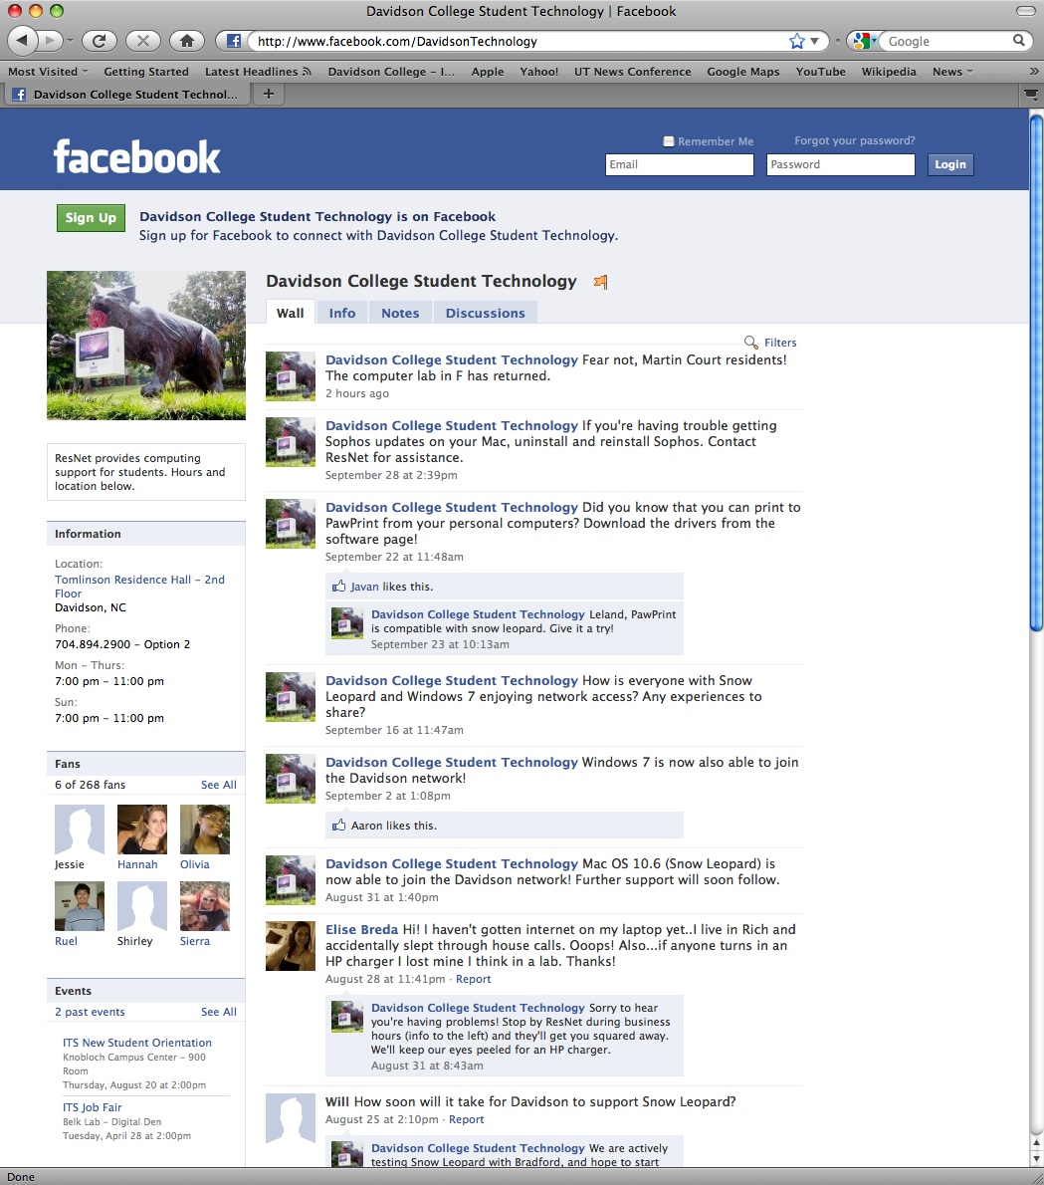
Rethinking Student Support
Facebook
Twitter
Orientation materials on flash drives

Slide 26
Fungibility & Flexibility
Martin Ringle | November 4, 2009
Chief Technology Officer
Reed College

Slide 27
Reed College • Context
Small private liberal arts college
  Non-salary budget reduction of 5% for 2009-10
  No budget reductions for 2010-11
  No staff reductions
  Salary increase of 1% + merit raises for 2009-10
Fiscal crisis in 1991-92
  Commitment to open source
  Fiscal strategy based on fungibility & flexibility

Slide 28
Fungibility
Technology Innovation Fund
  Unrestricted quasi-endowment
  CIO control
  Retained cross fiscal years
  May be used as contingency fund during deficit
Equipment replacement as operating line
  Automatic 3% growth + new equipment increases
  Retained across fiscal years
  May be used as contingency fund during deficit

Slide 29
Flexibility
Workload elasticity
  10-40% temporary workload reductions
  Primarily management & high-salary staff
  No reduction in benefits
  Extra hours if needed
Telecommunications option
  Open source (Asterisk) in lieu of NEC
  Platform replacement savings ~$300,000
  Annual operating reduction ~$30,000

Slide 30
What did you think about this session?
Your input is important to us!
Click on “Evaluate This Session” on the conference program page.

