Slide 1
Copyright Gerard Flynn and Thomas Hoover 2009. This work is the intellectual property of the author. Permission is granted for this material to be shared for non-commercial, educational purposes, provided that this copyright statement appears on the reproduced materials and notice is given that the copying is by permission of the author. To disseminate otherwise or to republish requires written permission from the author.

Slide 2
Abstract
Pepperdine University is conducting a 12-month study to assess the costs and feasibility of replacing desktop computers with virtual machines that allow multiple people to share a single PC. Results from a pilot implementation will be shared revealing costs, power usage, ease of administration, user satisfaction, and recommendations for installation.

Slide 3
Virtual Desktops: 60% cheaper
but are they worth it?
Gerard Flynn
Director of Technology & Learning
Thomas Hoover
Director of Instructional Technology
November 4, 2009

Slide 4
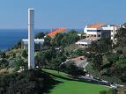
VIRTUALIZATION SURVEY
1) Is your institution using virtualization?
2) To vote: Text a CODE to 99503
YES 45926
NO 42404

Slide 5
About Pepperdine University
  Small Private Christian Liberal Arts school
  Five Southern California Campuses
  Campuses around the world
Notes:
About Pepperdine University
Overview of Pepperdine and some initiatives
Pepperdine
Private Christian
Malibu, CA
5 schools
SEAVER , SOL, SPP, GSBM GSEP
7600 Students
1200 Staff
700 Faculty

Slide 6
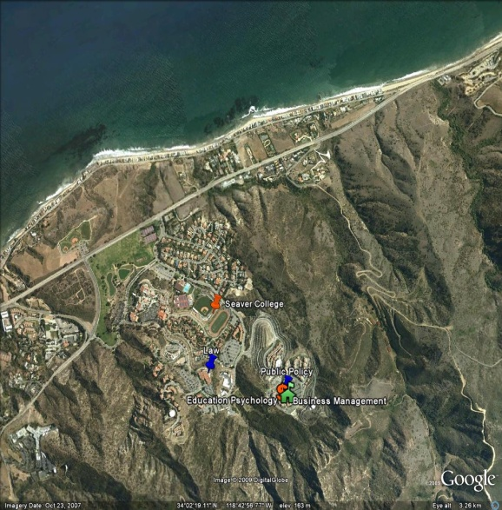
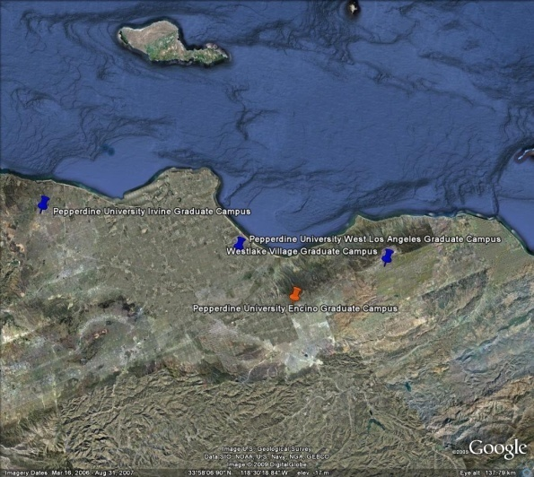
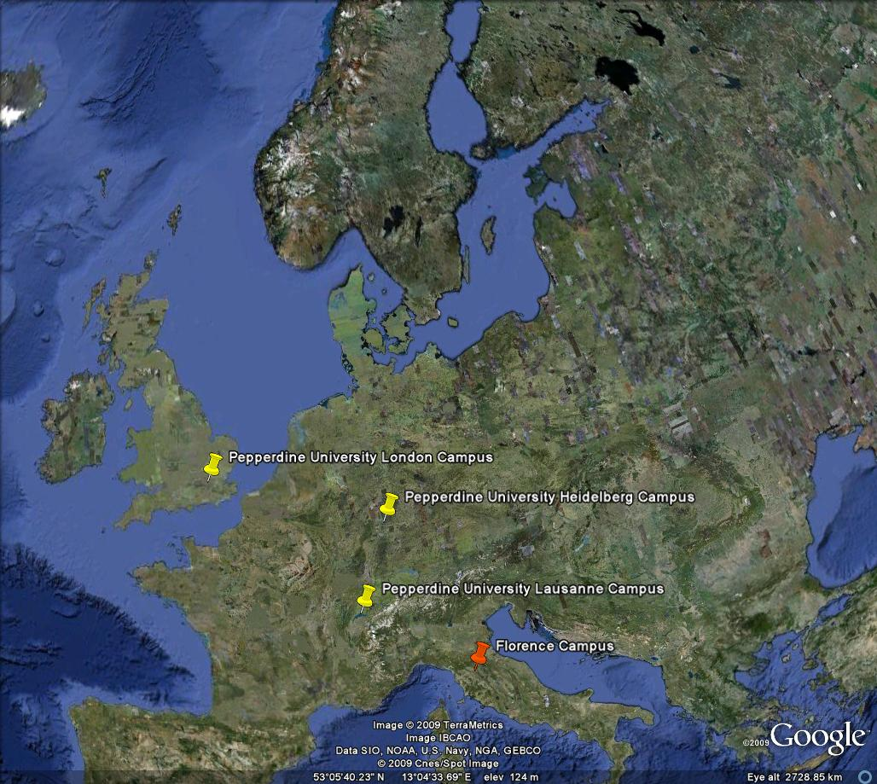
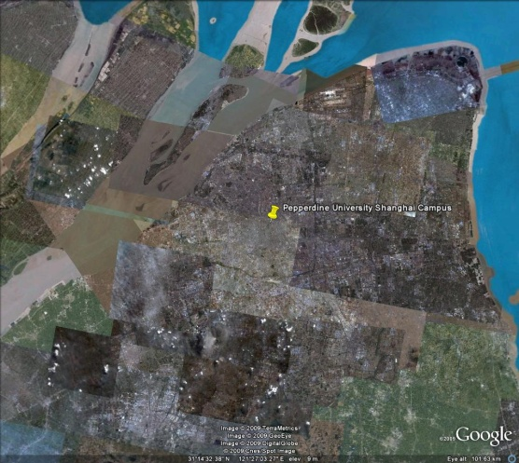
About Pepperdine University

Slide 7
Why desktop VM?

Slide 8
Which VM?

Slide 9

Which VM?

Slide 10
How it works
Notes:
1 PC powers multiple units
Utilizes software Virtualization
Uses windows profiles

Slide 11
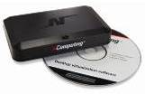
X-series
Includes vSpace
Lowest cost
Best multimedia
PC in the same room (10m)
1 watt per user
Up to 11 users per PC (with 2 kits)
X350 (3-user kit), X550 (5 user kit)
$70 per seat
Notes:
X-series.

Slide 12
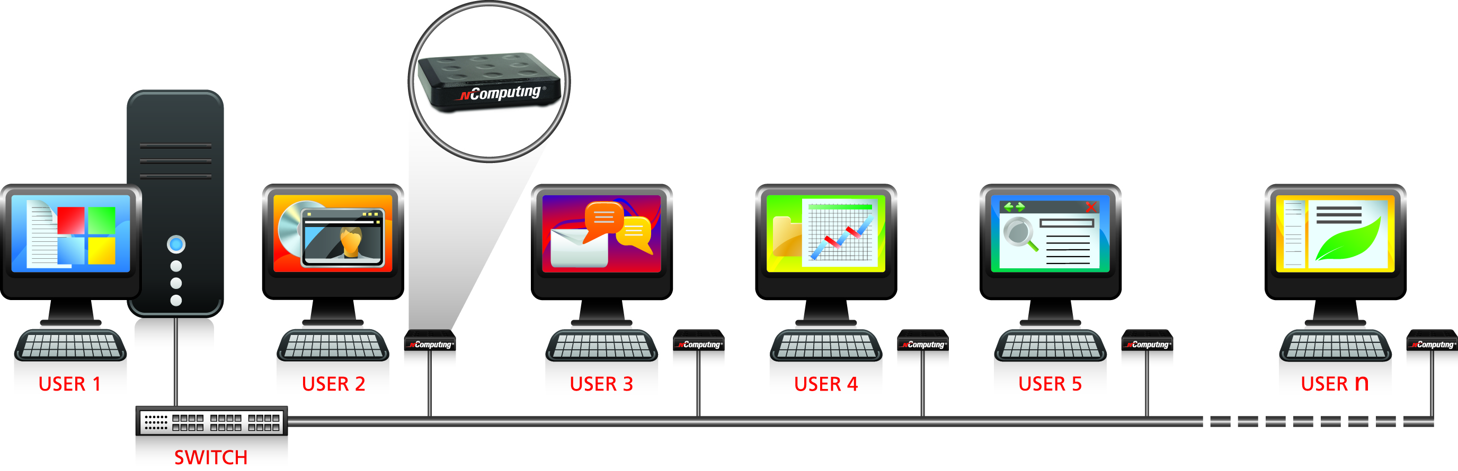
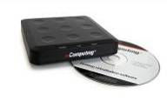
L-series
Includes vSpace
Most flexible
Most users per PC
No distance limits
5 watts per user
Up to 30 users per computer
L130, L230 (adds USB and microphone)
$149 per seat
Notes:
And now the L-series.

Slide 13
X-series
Includes vSpace
Lowest cost
Best multimedia
PC in the same room (10m)
1 watt per user
Up to 11 users per PC (with 2 kits)
X350 (3-user kit), X550 (5 user kit)
$70 per seat
L-series
Includes vSpace
Most flexible
Most users per PC
No distance limits
5 watts per user
Up to 30 users per computer
L130, L230 (adds USB and microphone)
$149 per seat
Notes:
Compare and contrast

Slide 14


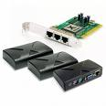
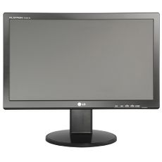
Notes:
Full Array of solutions

Slide 15
Cost per unit
Notes:
NComputing units are inexpensive, but they require:
Keyboard
Mouse
Monitor
Thus, an L-series with 19-inch widescreen, keyboard and mouse would cost about $300

Slide 16
NComputing Installations
Location | Model | #
MALIBU
Sandbar Café | L230 | 16
ISL | L230 | 28
ISL Classroom | L330 Dec/Jan | 10
IT Admin | L230 | 2
HAC | X550 | 5
CCB | L230 | 12
Psychology Lab | L230 | 15
Drescher | L230 | 4
SOL | L230 | 6
WEST LA
First Floor Library/IT Space | L230 | 6
Second Floor Kiosk | X300 | 3
Irvine | L230 | 4
Encino | L230 | 3
TOTAL |  | 108

Slide 17
Total Cost: all PC lab computers vs. NComputing
Notes:
Our actual cost to implement 108 NComputing units
Keys- we utilized some existing desktops, monitors and mice and keyboards
New lcd monitor plus mice and keyboard gives them the illustration it is a new computer

Slide 18

Power Usage

Slide 19
Energy Cost Comparison

Slide 20
Where installed?
Notes:
Public
Academic

Slide 21
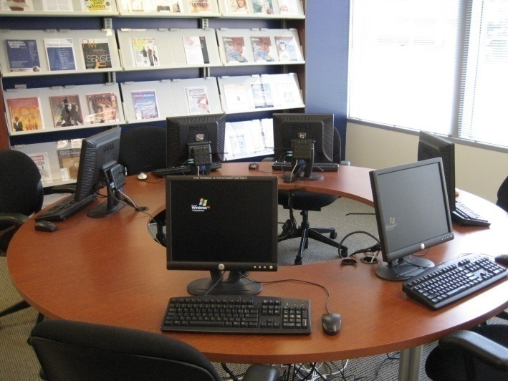
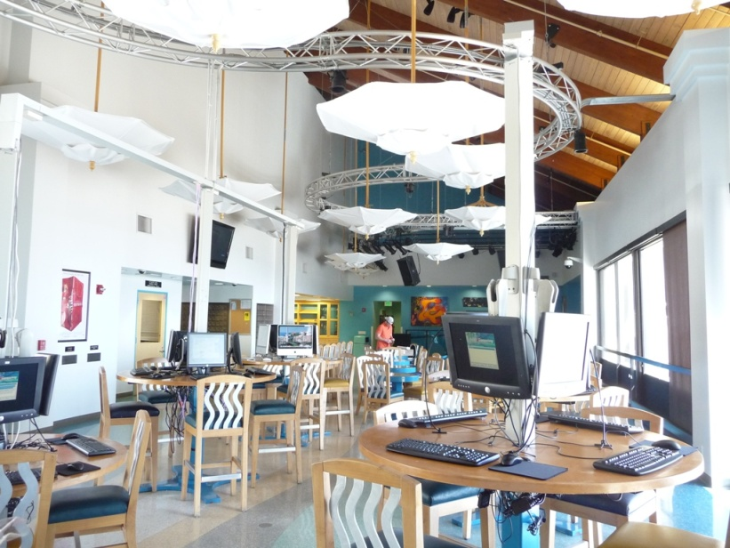
Public Areas

Slide 22

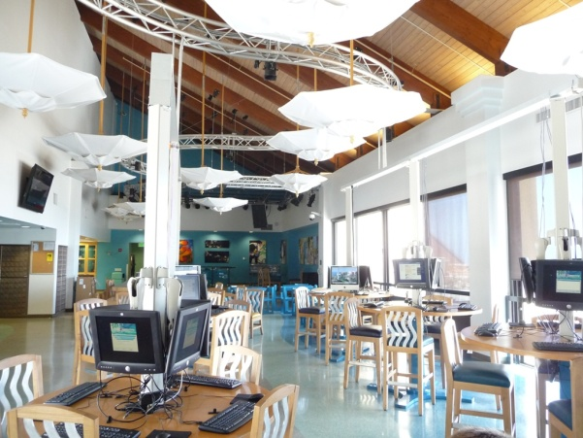
Sandbar Café Malibu Campus
16 L230 Units
Windows Server 2003
HP Compaq DC5800s
Intel Core 2 Duo
4 GB RAM
80 GB HDD
(30 possible)
Notes:
Sandbar Café Malibu Campus
Complaints from students
Old out of warranty computers
Not enough money to replace computers
Empty tables with monitors there
16 L230 Units
Windows Server 2003
HP Compaq DC5800s
Intel Core 2 Duo
4 GB RAM
80 GB HDD
(30 possible)
- hosted from another location

Slide 23
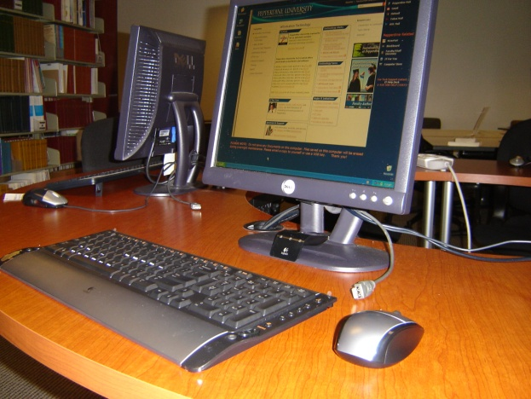
West Los Angeles Graduate Campus
6 L230 Units
HP DX2300M
Windows XP (6 Users – Lab environment)
1.6 GHZ
2 GB Ram
80 GB Hard Drive
Kiosks
3 X300 units
Regular PC Host Machine
Notes:
WLA Grad campus
6 L230 Units
HP DX2300M
Windows XP (6 Users – Lab environment)
1.6 GHZ
2 GB Ram
80 GB Hard Drive
Kiosks
3 X300 units
Regular PC Host Machine

Slide 24
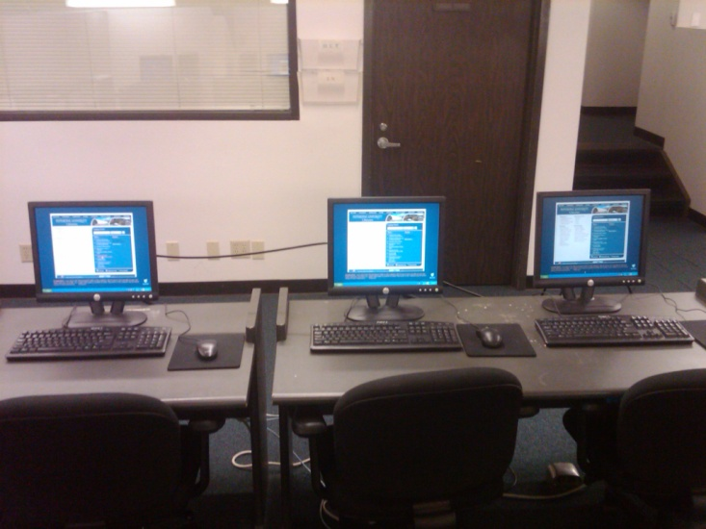
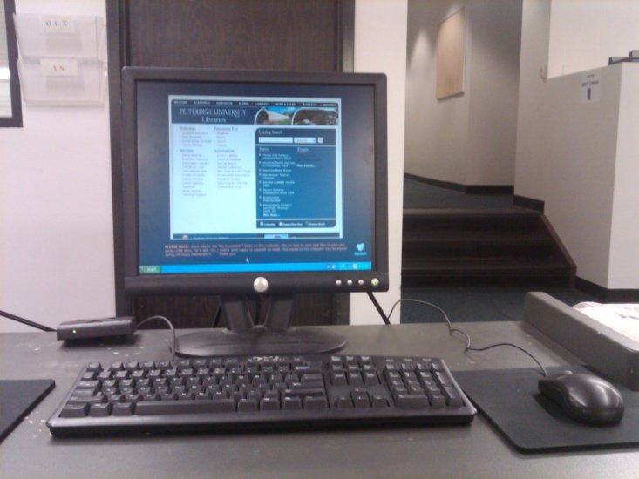
Malibu Payson Library
3 X300 Units
Windows XP Pro
Dell Optiplex GX270
P4 2.8 GHz
768 MB RAM
40 GB HDD

Slide 25
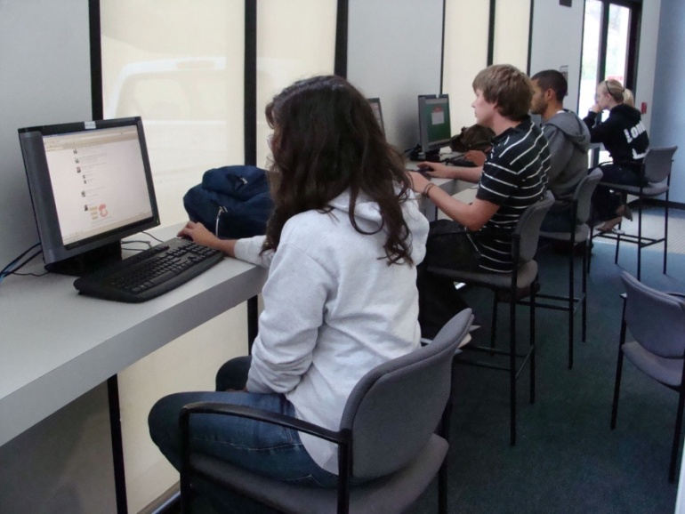
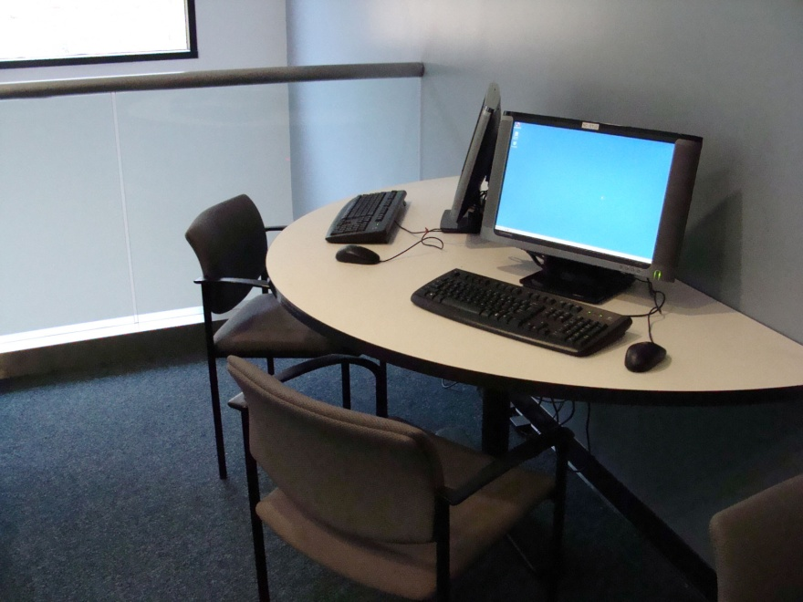
Center for Communications and Business Café
Notes:
- Center for Communications and Business Café
- 14 machines
14 wide screen lcds and brand new mouse and keyboard around $300
if we upgrade the lab in 5 years, we just change one pc

Slide 26
Academic Areas

Slide 27
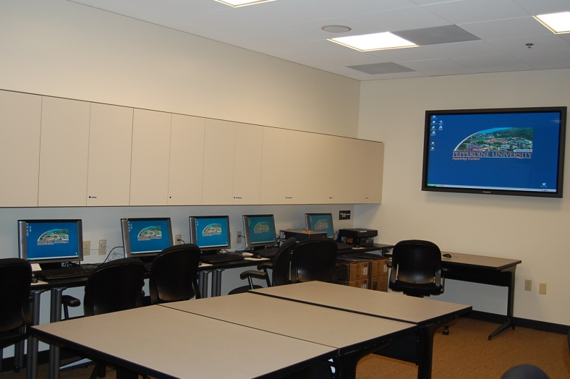
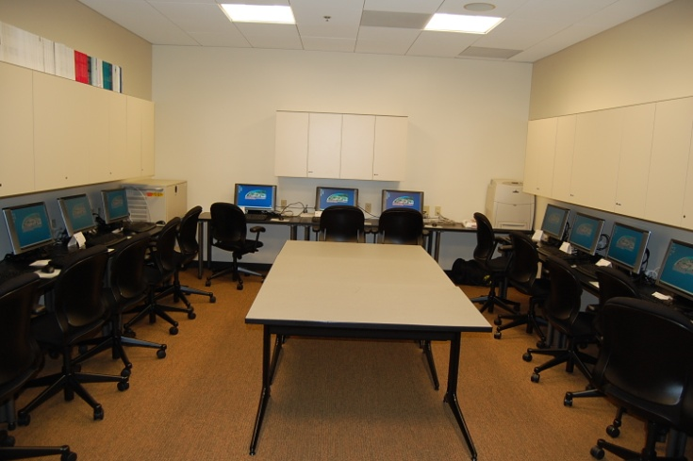
Psychology Lab
15 L230 units
Regular PC Host Machine

Slide 28
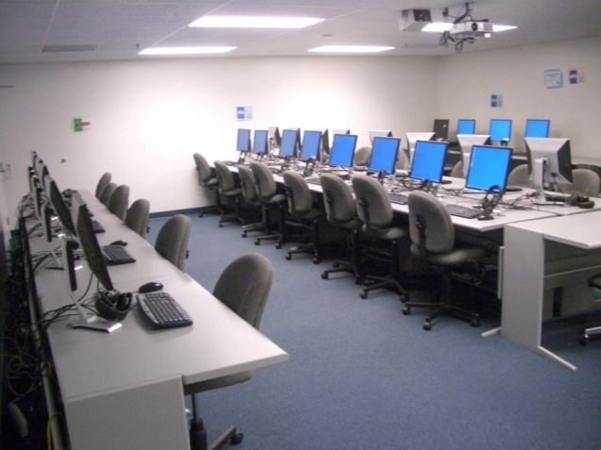
International Studies Labs
28 L230 units
Regular PC Host Machine
Notes:
International Studies Lab
Undergrad language lab 28 units L230
Division chair loves it
Did not have money to replace/refresh old out of warranty machines
Using microphone and headsets at each unit
Software used Audacity in addition to Microsoft Office

Slide 29
NComputing at Seaver College
Notes:
International Studies Chairman: Thomason

Slide 30
Ease of Admin
Notes:
You know what we used, how it works, and where we used it…
What about the ease of administration (or lack thereof)

Slide 31
Ease of Admin
Set up
OS
Programs installed
Would you recommend NComputing?

Slide 32
Admin
Pros
  Quick to start-up
  Clean desktop (small unit frees up space)
  Programs load quickly
  Can load files via USB
  No Theft
Cons
  Must contact administrator for add-ins/programs?
  Administrators sometimes shut down server when I am on it
  Video quality on L230 models is inferior
  Initial splash screen is unfamiliar
  Windows Updates

Slide 33
End User Satisfaction
Notes:
We issued surveys and conducted focus groups of students who used NComputing.

Slide 34
What ACTIVITIES do you do on these new computing devices?
Answer | Response | %
Check e-mail | 86 | 98%
Browse Internet for fun | 55 | 63%
Use Blackboard | 54 | 61%
Do homework | 47 | 53%
Do research for class | 33 | 38%
Use Sakai | 32 | 36%
Other: please explain | 6 | 7%

Slide 35
Which PROGRAMS do you use…
Answer | Response | %
Mozilla Firefox | 58 | 64%
Internet Explorer | 46 | 51%
Microsoft Word | 33 | 37%
Microsoft PowerPoint | 7 | 8%
Microsoft Excel | 6 | 7%
Audacity | 0 | 0%
Other: (please explain) | 3 | 3%

Slide 36
How would you rate the SPEED…
Answer | Response | %
Slow | 7 | 8%
Average | 42 | 47%
Fast | 29 | 32%
No opinion | 12 | 13%
Total | 90 | 100%

Slide 37
How would you rate the VIDEO performance…
Answer | Response | %
Very Bad | 4 | 5%
Bad | 10 | 12%
Neither Good nor Bad | 35 | 41%
Good | 30 | 35%
Very Good | 7 | 8%
Total | 86 | 100%

Slide 38
OVERALL EXPERIENCE
(compared to same lab last year)
Answer | Response | %
Much Worse | 3 | 4%
Worse | 7 | 8%
About the Same | 34 | 40%
Better | 30 | 35%
Much Better | 11 | 13%
Total | 85 | 100%

Slide 39
Were you aware that new computing devices were installed in these location(s)?
Answer | Response | %
Yes | 59 | 61%
No | 37 | 39%
Total | 96 | 100%

Slide 40
Were you aware that the new computing devices are using desktop virtualization?
Answer | Response | %
Yes | 14 | 16%
No | 71 | 84%
Total | 85 | 100%

Slide 41
POSITIVE Experiences
“The work/desk space saved by not having CPUs everywhere is extremely helpful.”
“Its great that you have sustainable computers.”
“They are very fast and efficient.”

Slide 42
NEGATIVE Experiences
“Slight lag on the displays when playing video or graphic intensive programs…
“There is no slot for flash drives so I must email myself everything beforehand.”
“Web pages lag when scrolling.”
Notes:
The units DO have USB cables, but we need to educate users better.
The lag may be due to
The limitations of the PC we used to run the units (we originally cobbled together existing equipment)
The number if simultaneous users.

Slide 43
NComputing at Seaver College
Notes:
Undergraduate budget Manager: Semerau

Slide 44
Notes:
Poll Anywhere results
Press F5 or enter presentation mode to view the poll

Slide 45
Are you interested?
Our Wiki: http://tinyurl.com/2009pepvm
NComputing: http://ncomputing.com/Solutions/Education.aspx
NComputing Cost Calculator: http://ncomputing.com/Portals/0/docs/calculators/guide_tcocalculator.xls
Birds of a Feather meeting
  NOW (11/4/09 from 4:55 – 6:10 p.m.)
  Korbel Ballroom 4 E/F

