Slide 1
Making Progress:
Measurement, Collaboration, and Communication
Pattie Orr
Becky King
Baylor University

Slide 2

Success?

Slide 3
Measurement
Collaboration
Communication

Slide 4

Some Info about Baylor
Mission: To educate men and women for worldwide leadership and service by integrating academic excellence and Christian commitment with a caring community.
Fall 2009 Facts:
  12,149 undergraduate students
  2,465 graduate/professional students
  893 faculty, 1288 staff
  151 bachelor, 75 masters, 29 doctoral programs plus two education specialist programs

Slide 5
Baylor IT/Libraries Organization
Vice President for Information Technology and Dean of University Libraries
University
Libraries
Information Technology Services
Other Libraries
Other Libraries
Electronic Library
Internet Services
Client Services
Information
Systems
& Services
Security, Servers,
& Networking
Systems

Slide 6
More talk about Baylor IT
Admin systems – a mixed bag
LMS
  Fall 09 in Blackboard
    96.1% of students had at least one class active
    55.35% of all courses for the term active
    72.5% of instructors had at least one course active
    518 organizations were active
Email

Slide 7
Change is good?
Change is good.
You go first.
- Dilbert
Culture change
  Baylor 2012
  SACS reaccreditation
  Annual department assessments
Organization change
  New VP/Dean position
  New Director of Communications & Marketing
  Renewed emphasis on advisory groups

Slide 8
Some of our challenges
More complex technologies
Hugely increasing expectations
Cost increases & funding cuts
No increases in IT staffing
Increased emphasis on research
Rate of upgrades/releases increasing
Aging infrastructure
Unfunded government mandates
Etc…

Slide 9
And so…
Measurement
  How we’re incorporating assessment into our work and plans in the Libraries/ITS division
Collaboration
  How we’re using various campus groups and constituencies for consultation and input
Communication
  How we’re working to improve internal & external communication

Slide 10
Measurement

Slide 11
Why do we care?
Resource allocation
Achieve university’s mission & goals
Build trust
Understand community needs
Correct problem areas

Slide 12



Measurement efforts
Customer feedback form
After Help ticket resolution
After training classes
In Self-Service Help
Annual ECAR Study of Students & IT
EDUCAUSE Core Data survey
Annual departmental assessments
MISO Survey

Slide 13
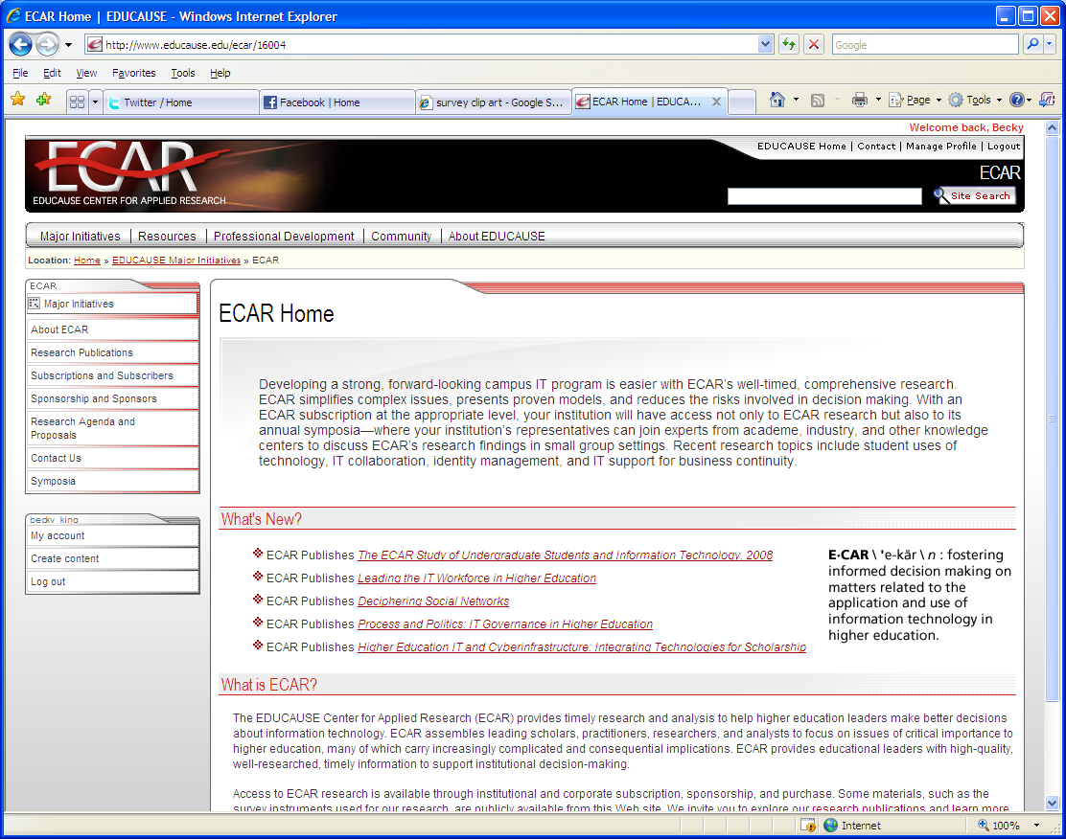
ECAR student survey
Text, text, TEXT!
Social networking – yes; gaming & Second Life – not so much
Opinion of IT use in classes
Effectiveness of IT in classes
Smart phones
Legal/ethical issue knowledge
Mostly similar to other schools

Slide 14

MISO survey – IT key findings
Outage notifications
BearWeb and Blackboard
Input into computing decisions
Satisfaction with tools available
Feel uninformed
Mac support
How they learn
www.misosurvey.org
Notes:
For more info on the MISO survey, contact Dave Consiglio (dconsiglio@brynmawr.edu)

Slide 15
MISO survey – IT actions
PC Jubilee
Mac support
Online faculty/staff & student directory
Wireless access
Internet bandwidth
Help Desk recording
Information on security issues
www.misosurvey.org

Slide 16
Collaboration

Slide 17
Commitment to collaboration
Other perspectives
Build community
Professional development
Demonstrate commitment to sharing
Political reasons
Right thing to do

Slide 18
Some collaboration experiences
Library/IT Advisory Council
Academic Technology Directors
Administrative department IT liaisons
Security Working Group
Libraries Student Advisory Group
Information systems ITS/client teams

Slide 19
Communication

Slide 20

INFO on Baylor IT communication
Leader priority
Responsibilities of dean
BearAware
Director of Communications & Marketing
  Attends weekly ITS leadership meeting
  Works with IT AVP to create messages
  Special projects
  Branding of regular division communications

Slide 21

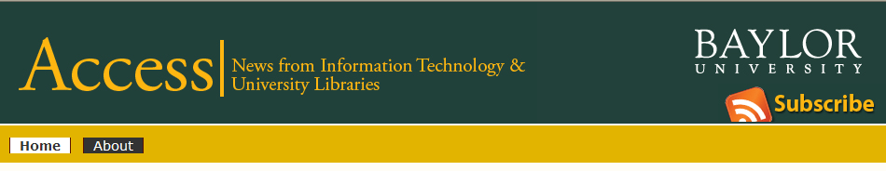


Monthly electronic newsletter to division
Electronic newsletter to faculty/staff each term
Quarterly electronic newsletter to campus
Internal IT newsletter for staff

Slide 22
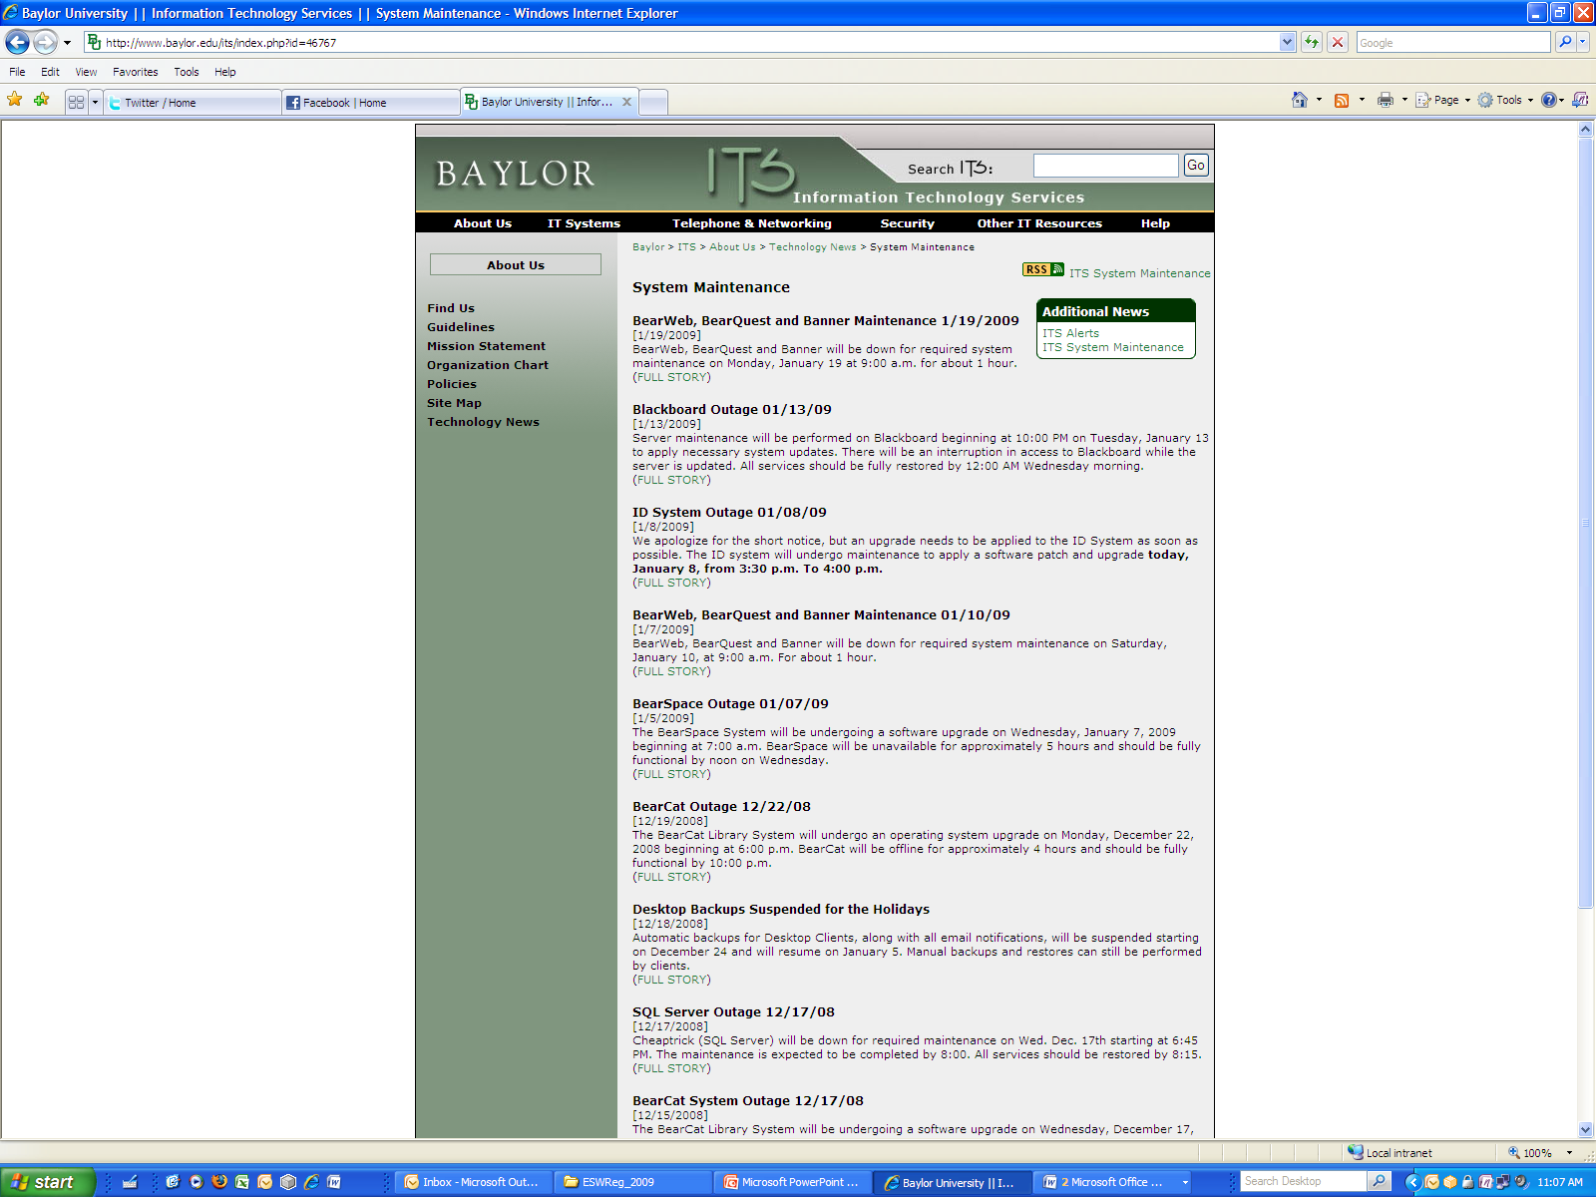
Outage notification process
Need approved by IT AVP or manager
Outage request form completed
Pending outage notification sent
Official outage notification sent
DOWN phone line (ext. DOWN/3696)
Posted to web page

Slide 23

It’s about more than information overload…
Certain messages for certain audiences
Timing
Building trust
Demonstrating competence & credibility
Branding
Telling our story
Blah, blah, blah

Slide 24
Questions? Comments?
Your input is important to us!
Click on “Evaluate This Session” on the conference program page.

