Slide 1
Developing a next-generation campus Web Portal
EDUCAUSE 11-5-2009
11:45 AM – 12:35 PM
David Weil (dweil@ithaca.edu) & Benjamin Costello (bcostello@ithaca.edu)
Copyright Ithaca College, 2009. This work is the intellectual property of the author. Permission is granted for this material to be shared for non-commercial, educational purposes, provided that this copyright statement appears on the reproduced materials and notice is given that the copying is by permission of the author. To disseminate otherwise or to republish requires written permission from the author.

Slide 2
Welcome
David Weil
Director, Enterprise Application Services
dweil@ithaca.edu
Benjamin Costello
Manager, Web & eMedia Development
bcostello@ithaca.edu
More information:
Email us
Visit: www.ithaca.edu/myhome

Slide 3
Reminder: Online Session Evaluations
Available at the email kiosks
Link on the conference program page until November 23rd

Slide 4
Presentation overview
Background
What we developed
Why we did what we did
Technologies Used
Demo
Community Response
Next Steps
Q&A

Slide 5
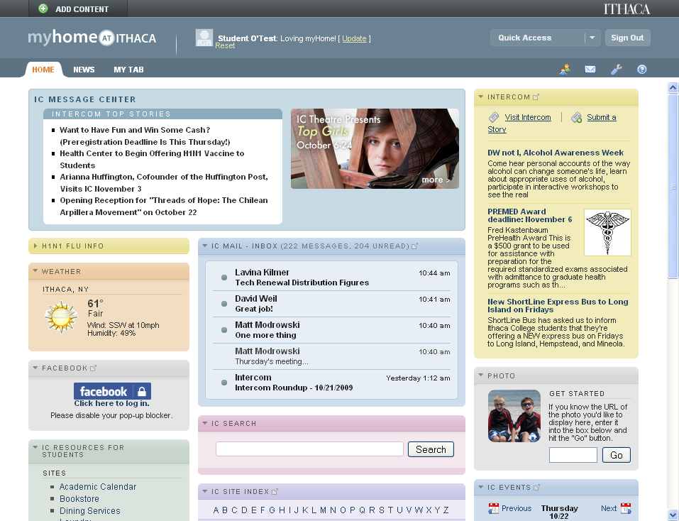

Slide 6
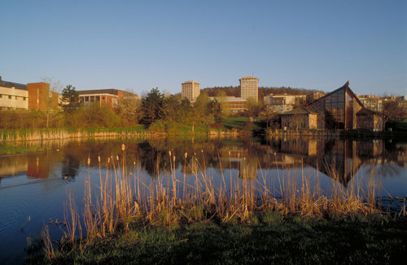
Ithaca College
Private, residential undergraduate liberal arts college in upstate New York
Comprehensive, masters one institution
5 schools, over 100 degree programs
Faculty | 463 FT / 216 PT
Staff | 800 FT / 190 PT
Student FTE
Undergraduate | 6,000
Graduate | 400

Slide 7
Web Roles & Governance
Web Strategy Group
Information Technology Services
Marketing Communications
Executive oversight
Technical Leadership
Shares responsibility with ITS for managing the college’s Web presence
Reviews & approves policies, guidelines and resource needs
Hosting services
Web & eMedia developers

Slide 8
Web Strategy Group Membership
Vice Presidents:
VP for Finance and Administration
VP for Enrollment Management
Designee for the Vice President for Student Affairs
Associate Provost
IT Management:
Assoc. VP for Information Technology Services
Director of Enterprise Application Services**
Manager of Web Development
Marketing
Executive Director of Marketing Communications**
Associate Director of Web Marketing
Director of Admission

Slide 9
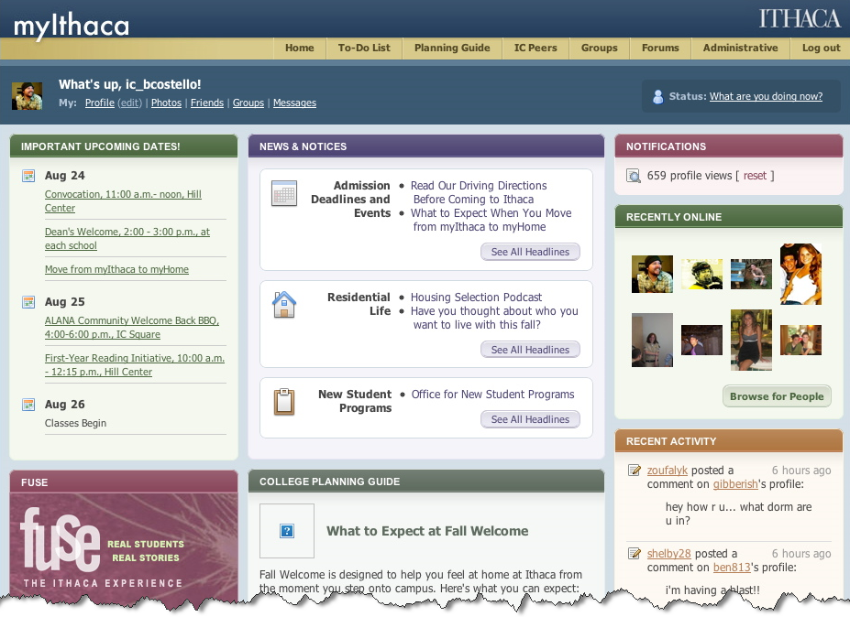
Why undertake this project?
We had an award winning Web portal-like resource for prospective students…
…but, once they matriculated they were faced with a vastly inferior Web experience

Slide 10
High-Level Goals
Provide a “home” for a person’s Web activities
Single entry point
Lightweight implementation
Offer myIthaca-like experience for current students
Improved communication
Between college and IC community
Within IC community
Increase satisfaction by making…
Common transactions more intuitive, easier & online
Information easier to find

Slide 11
“Lightweight”
Leverages existing Web services and content
Emphasis on user interface and presentation layer
Built using existing technology infrastructure
Political sensitivity to the concept of implementing a “Portal”

Slide 12
Options Considered
Oracle Portal
Luminis Portal / Campus Pipeline
uPortal
Doing it ourselves

Slide 13
Spring 2007
Summer 2007
Fall 2007
Web Strategy Group Defined Need
Proposal Created and Funded
Development Work Started
Spring 2008
Alpha Version – Jan
Public Beta – March
August 2008
Public Launch - Release 1
Researched Options
August 2009
Release 2 (Community & Mobile)

Slide 14
Why Do It Ourselves?
Leverage existing work
Wanted a “Web 2.0” experience
Work in our heterogeneous environment
Avoid a heavy enterprise implementation
Ability to integrate with non-campus services
Make use of evolving web standards

Slide 15
What We Developed
A Web 2.0 Portal Experience
Drag and drop interactivity for arranging layout and adding new content
Dynamic auto-refreshing content w/intelligent caching
An Ithaca College Experience
Integrated Webmail, Calendaring, and single-sign-on brokering to most campus web services
Ithaca College-centric social networking
An Aggregated Web Experience
Access to 3rd party email accounts (Yahoo,Gmail,IMAP)
Facebook, RSS feeds, bus schedules, etc.

Slide 16
Major Components
Portlets
Customizable User Tabs
Service Tabs
eMail, Calendar, Account Management
Community
Social Network, Discussion Forums
Mobile

Slide 17
WWW (Public Web)
myHome
Webmail
Calendar
myIthaca
(Prospective Students)
Community
CMS
Directory Services
Self Service
Other Web Services
ERP
myHome relationships with other services

Slide 18
Technologies Behind The Scenes
Javascript
Controls interactive interface
AJAX calls refresh content and update preferences
XML
Defines basic portal configuration
Defines portlets and their functionality
Stores all user customization settings
PHP / mySQL
Integrate with and allow Ajax to refresh data from external systems
Facilitate authentication, session management and single-sign-on brokering
Integration with our CMS

Slide 19
Resources
Web developer / designer resource
Year one (inception to release 1.0): 1 FTE
Year two: ½ FTE
On-going: ¼ FTE
Concept development and project management
Additional technical support (minimal)
Runs on existing servers
Web server - Sun hardware, Solaris, Apache, PHP
mySQL server – Sun hardware, Solaris, mySQL

Slide 20
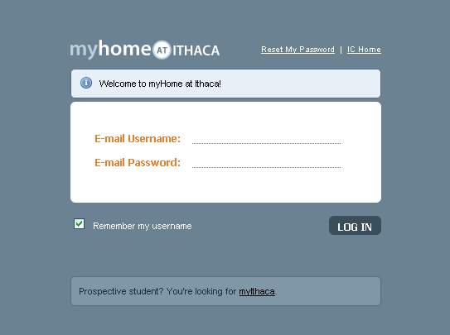

Slide 22
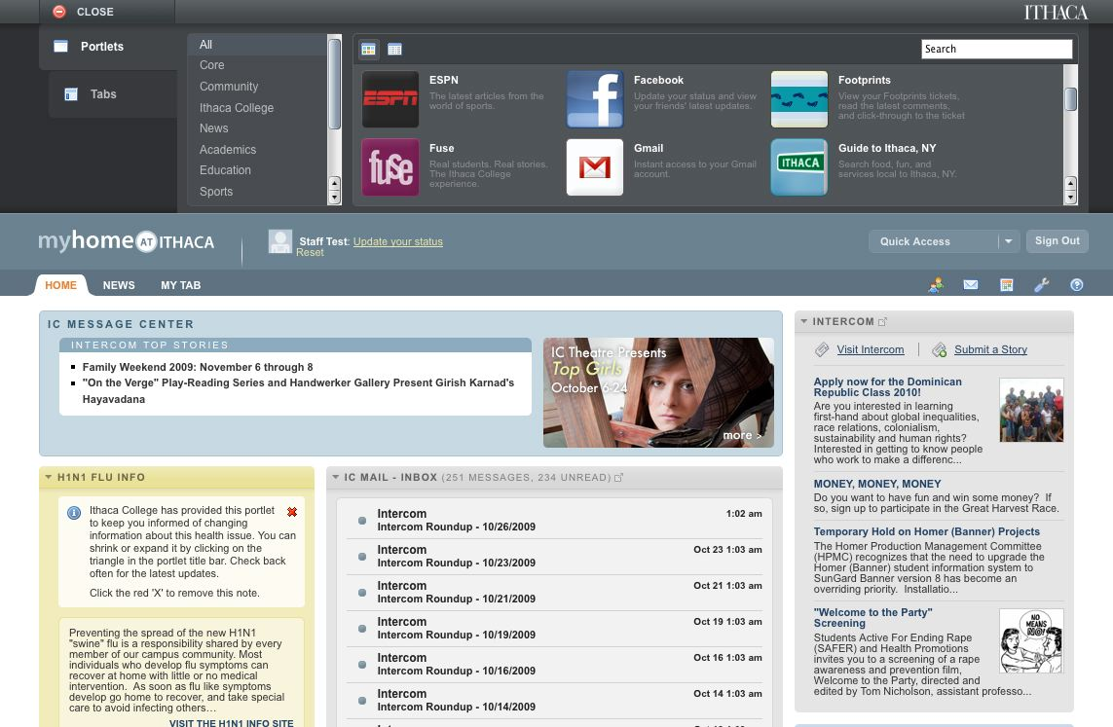

Slide 23
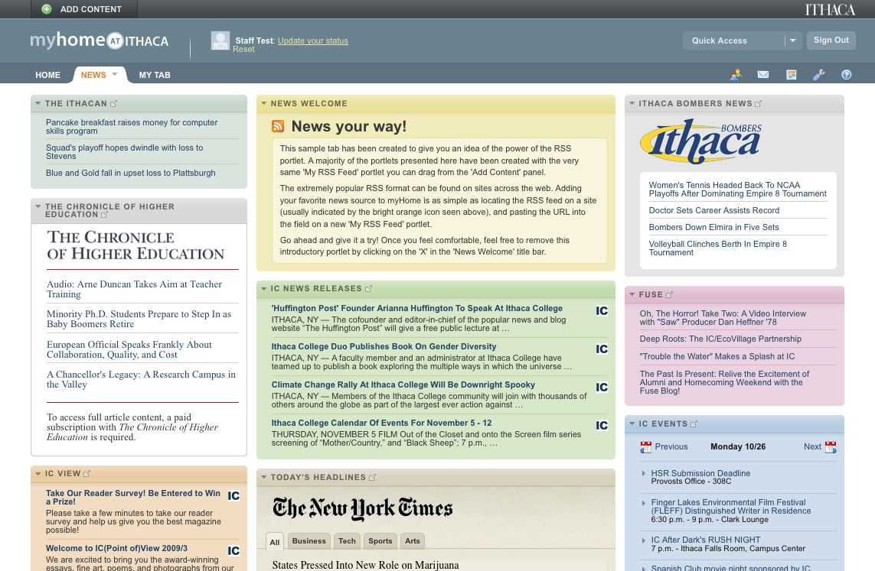

Slide 24
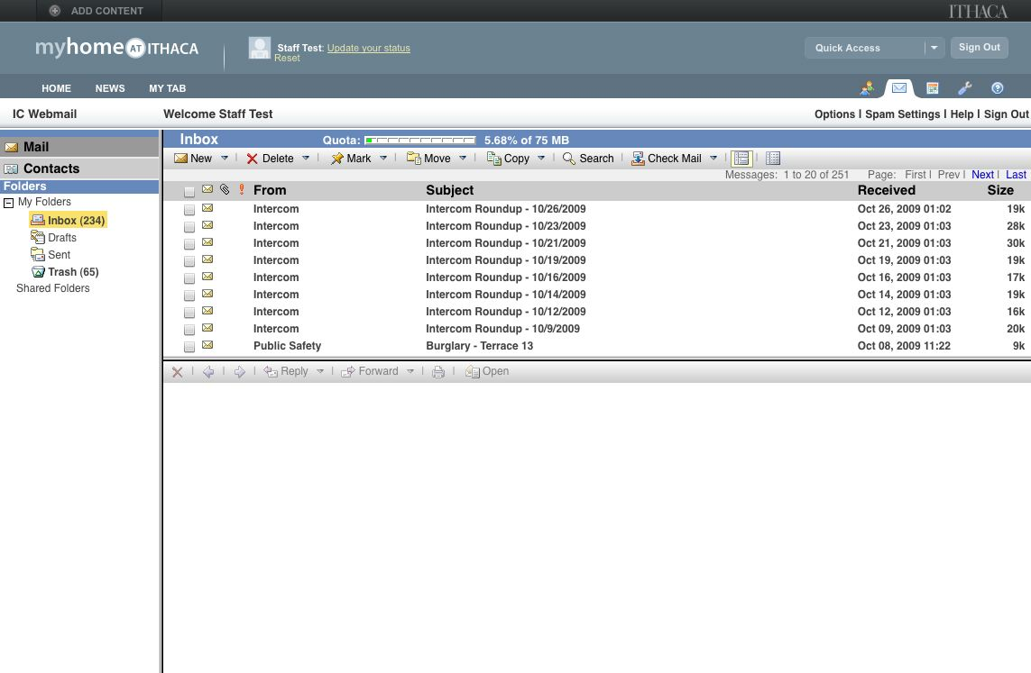

Slide 25
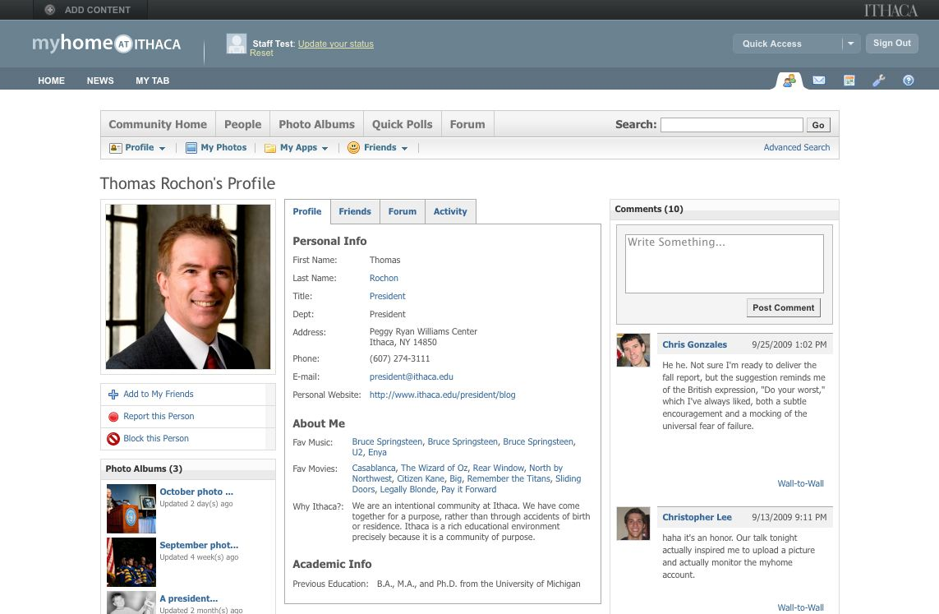

Slide 26
Live Demo

Slide 27
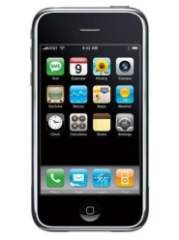
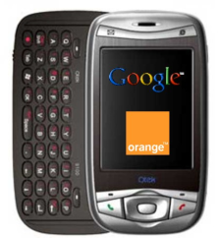
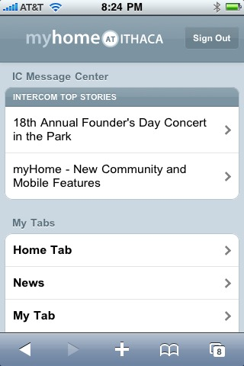
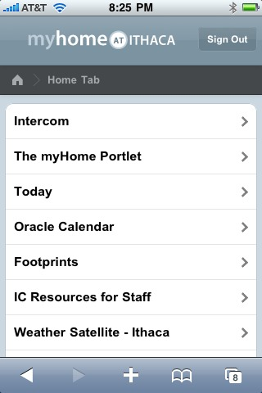
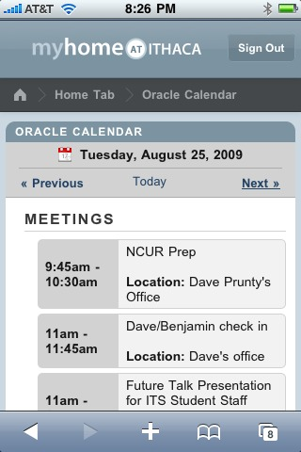
myHome Mobile
Go to myhome.ithaca.edu from a mobile device
Access most portlets and information

Slide 28
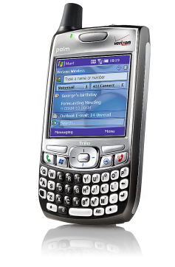
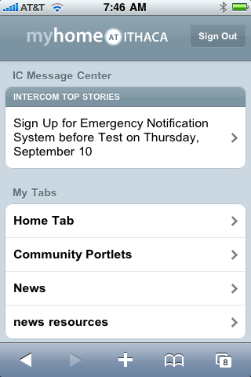
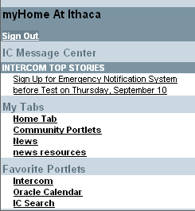
Automatically formats for your device
Devices with more limited mobile browsers
iPhone, Palm Pre, etc.

Slide 29
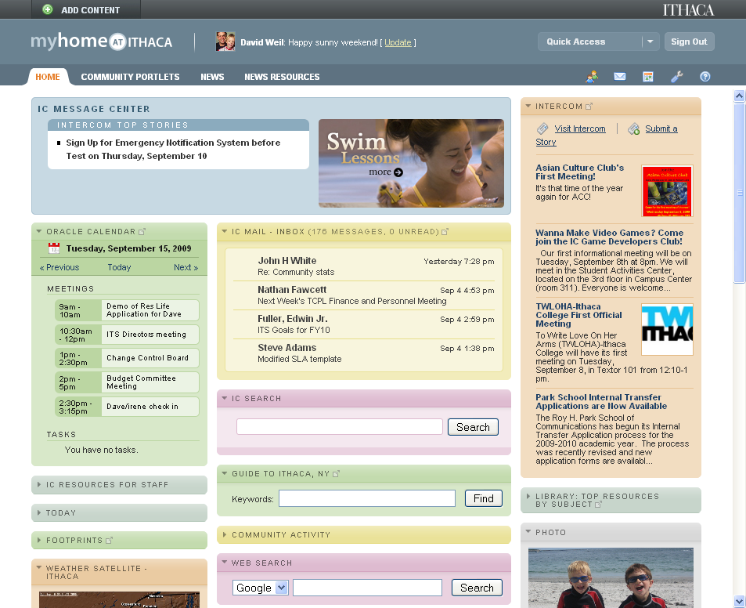
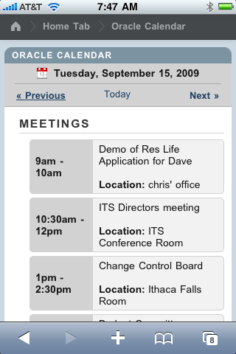
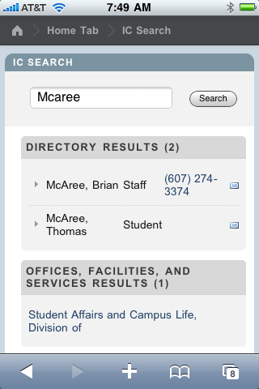
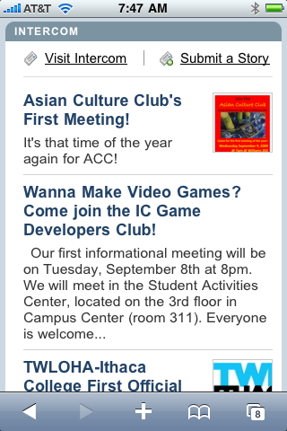
Mobile Menu
Oracle Calendar
IC Search
Intercom

Slide 30
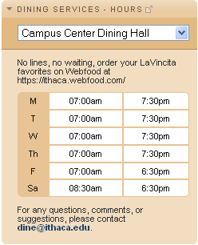
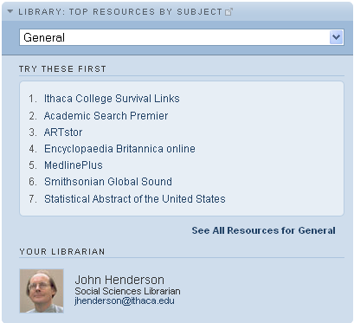
Distributed Content Providers
User Submitted Portlets and Tabs
FIRST YEAR STUDENTS
Resources for new students
PHYSICS MAJORS
Resources for Physics
CAMPUS HAPPENINGS
What’s going on

Slide 31
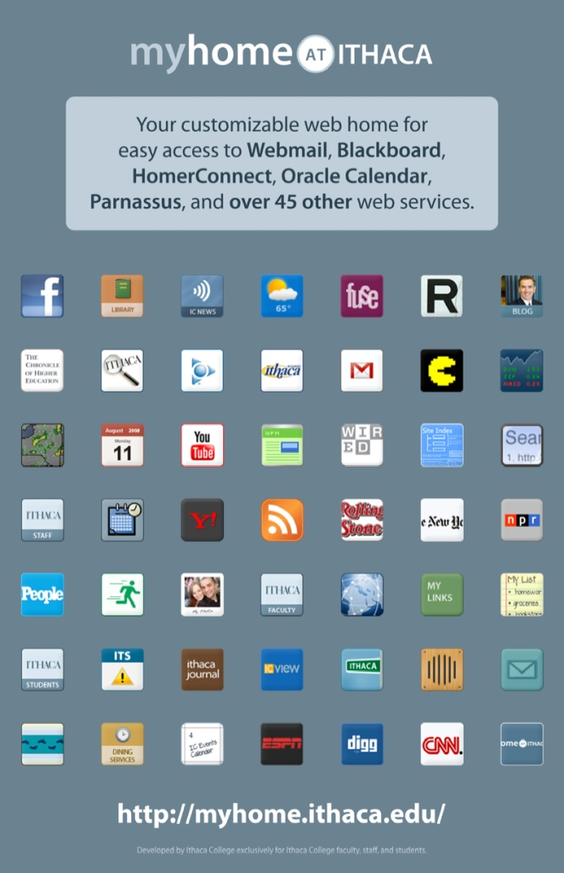
Campus-Wide Rollout
Released 1.0 August 2008
Ads in student paper
Intercom Announcements
Posters around campus
Use was optional
Released 2.0 August 2009
Required that all Webmail users go through myHome
Community & Mobile

Slide 32
Community Response
I absolutely love the new myHome!
This is amazing!
This is AWESOME. Serious props to whoever brought this idea into existence.
This is one of the best ideas Ithaca has ever had!

Slide 33
Release 1 Usage
Through March 2009

Slide 34
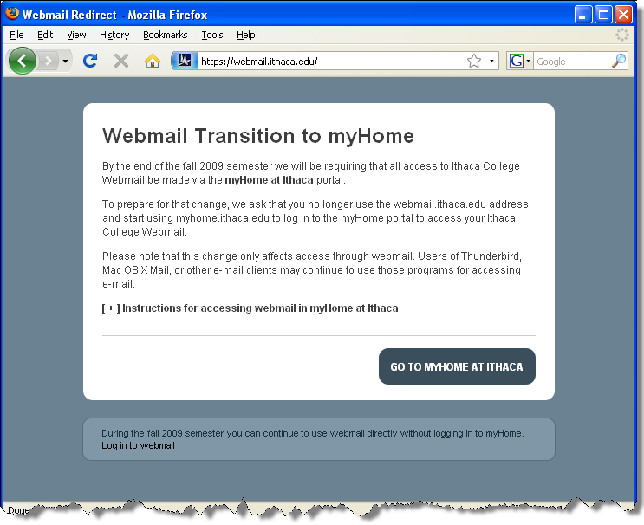
Effective August 10, 2009

Slide 35
Total myHome Logins per day
Redirected all Webmail users to myHome

Slide 37
Typical myHome Logins Per Hour
Data from 10/22/09

Slide 38
Future plans
IC Collaborate
Include access to institutional data
Entry point for all web-based services
Enhancements to social networking and discussion tools

Slide 39
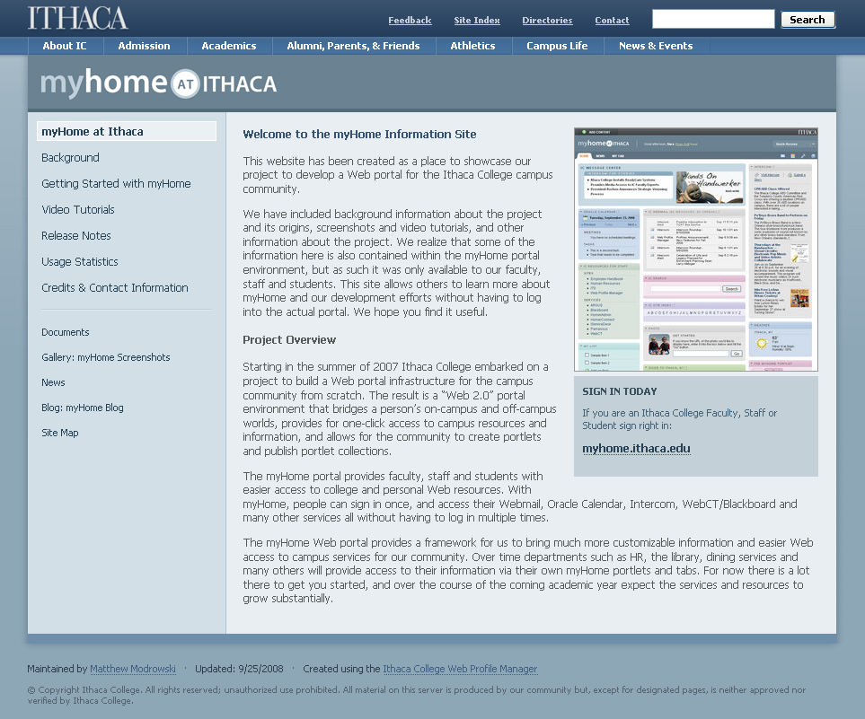
Questions?
Information Site: www.ithaca.edu/myhome
Video tutorials & screenshots
Background information
Copy of this presentation
eMail us:
dweil@ithaca.edu
bcostello@ithaca.edu
Please don’t forget the session evaluation

