Slide 1


Community-Source Evaluation Strategies: Is Sakai Right for Your Institution?
Josh Baron | November 5, 2009

Slide 2
How many are running Sakai today?

Slide 3
How many are piloting or evaluating Sakai?

Slide 4
How many came because you thought we were evaluating rice wine or sushi?
☺
Do you know where the name Sakai comes from? Remind me to answer that later…

Slide 5
Presentation Overview
What is Sakai? – Brief Overview
Marist College’s Sakai Journey
Sakai Evaluation and Outcomes
Transition Update – We’re done!
Where We are Going Next
Q & A

Slide 6





Sakai – Solving a Classic Challenge
By late 1990’s “homegrown” LMSs were old
Faced “Build (again) or Buy” dilemma
  Wanted to control destiny without the risks and costs of “homegrown”
Sakai Project started in 2004 to address dilemma
  Michigan, Indiana, Stanford, MIT (and Berkeley)
  Mellon Foundation Grant
Version 2.6.1 just released

Slide 7

Community
Collaborative Learning Environment Software
Sakai Foundation
Open-Source Model
What is Sakai?
It’s more than just software…

Slide 8
Community
Collaborative Learning Environment Software
Sakai Foundation
Open-Source Model
What is Sakai?

Slide 9
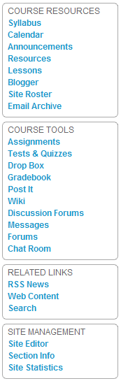
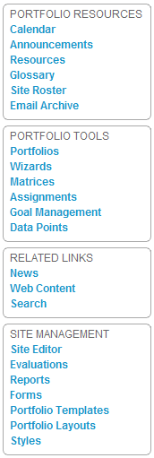
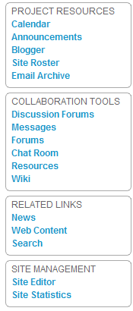
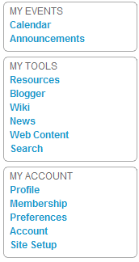
Sakai CLE Tool Overview
Courses
Portfolios
Projects
My Workspace

Slide 10
Community
Collaborative Learning Environment Software
Sakai Foundation
Open-Source Model
What is Sakai?

Slide 11
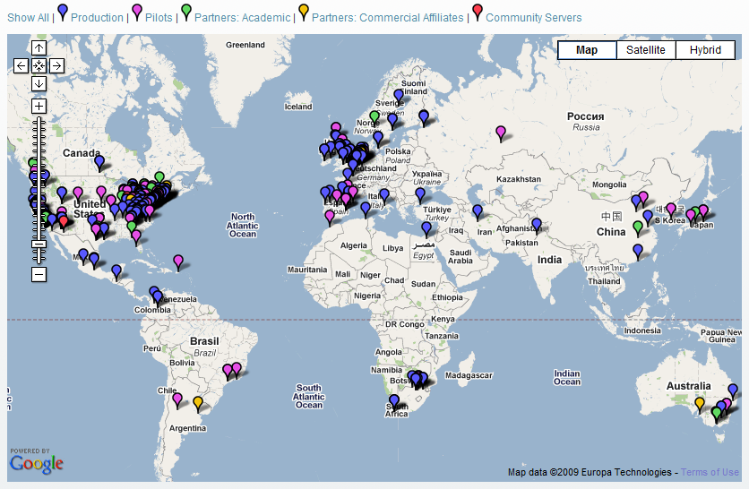
The sakai community

Slide 12
Community
Collaborative Learning Environment Software
Sakai Foundation
Open-Source Model
What is Sakai?

Slide 13
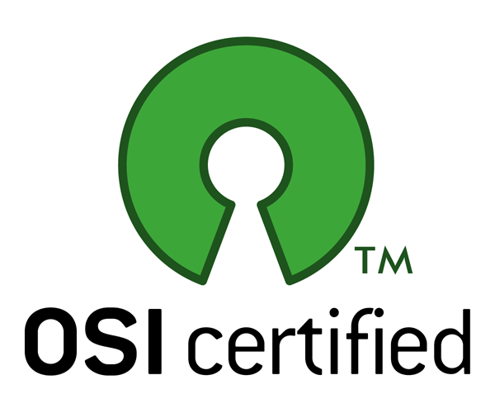
Open Source Model: Licensing
OPEN LICENSING
  Sakai’s software is made available under
  the terms of the ECL, a variant of the Apache license
NO FEES OR ROYALTIES
  Sakai is free to acquire, use, copy, modify, merge, publish, redistribute & sublicense for any purpose provided our copyright notice & disclaimer are included.
CANNOT BE SOLD!
  Because of its licensing and Sakai Foundation’s ownership of copyrights and trademarks, Sakai cannot be sold to other entities!
Notes:
ECL: Limitations are few: preservation of the copyright notice & disclaimer required; name & trademarks of copyright holder(s) may NOT be used in advertising or publicity pertaining to the Original or Derivative Works without specific, written prior permission. It is very similar to the Apache 2.0 License
The GPL copyleft: The GPL does not give the licensee unlimited redistribution rights. The right to redistribute is granted only if the licensee includes the source code (or a legally-binding offer to provide the source code), including any modifications made. Furthermore, the distributed copies, including the modifications, must also be licensed under the terms of the GPL.This requirement is known as copyleft, & it gets its legal teeth from the fact that the program is copyrighted. Because it is copyrighted, a licensee has no right to modify or redistribute it (barring fair use), except under the terms of the copyleft.

Slide 14
Community
Collaborative Learning Environment Software
Sakai Foundation
Open-Source Model
What is Sakai?

Slide 15
The Foundation
MISSION — manage & protect intellectual property; provide basic infrastructure & small staff; help coordinate design, development, testing & distribution of software; champion open source & open standards.
GOVERNANCE — ten board members elected by member reps to serve three-year terms; Executive Director manages day-to-day operations. Product Council (new!) oversees and coordinates releases.
PARTNERS — over 100 member organizations contribute $10K per year ($5K for smaller institutions).
BUDGET — funds 4-6 staffers, admin services, computing infrastructure, project coordination, conferences, Sakai Fellows Program, advocacy & outreach activities.
Enjoying Denver? Come on back for the 11th International Sakai Conference – July 2010 in Denver

Slide 16
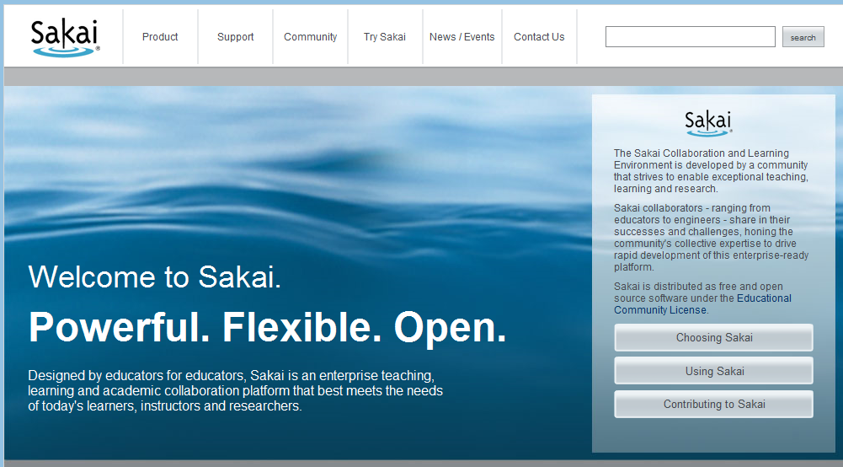
Our New Website! www.sakaiproject.org

Slide 17
Marist College’s
Sakai Journey

Slide 18


Marist College Snapshot
Comprehensive liberal arts college
Located in Poughkeepsie, New York
5700 FTE students, 220 full-time faculty, 450 part-time faculty
Strategic plan calls for growth in distance learning
LMS is a “business critical” technology

Slide 19
How I (really) got started…
Flash Back to Spring 2005…
Senior Muckety-Muck: “Hey Josh, the College thinks an open-source (i.e. free) CMS would be great (i.e. free)! Could you develop a plan to adopt Sakai? (i.e. to save money)
Josh: “Wow, that sounds great! You guys are so smart!” (i.e. I’m a dead man!)
My Secret Evil Plan: Learn about Sakai, identify all of the reasons why it was crazy and get approval for proprietary system.
My Secret Plan Failed Miserably!!!

Slide 20
Community-source held potential to transform the LMS industry
Why did I fail?

Slide 21
Community-source = innovation
“Built by educators, for educators”
  Bottom line is not a profit-margin
“Crowd-sourcing”– The human collective
  5 Foundation staff
  225 developers & 500 active contributors
  10,000+ instructors & 1,000,000+ students
Decoupling “code” from the “service”
Open standards support interoperability
  IMS Course Cartridge, QTI

Slide 22
Evaluation process

Slide 23
Phased pilot Model
Phase I: Spring 2006 - Kicking the Tires
  Rigorous internal testing, small scale use by faculty
Phase II: Fall 2006 - Production Pilot
  Began production pilot with one cohort (NSF funding)
  Upgraded to new version, migrated content
Phase III: Fall 2007 - Expansion
  Established rSmart partnership for support services
  Faculty adoption and communication strategy
Phase IV: Fall 2008 - Full Production

Slide 24
Evaluating Sakai - Decision Criteria
Functionality Requirements
  Where there Critical, Essential or Desirable functionality gaps?
Staffing and Support Requirements
  Would we need to hire more staff?
Health of the Sakai Community
  Is the Sakai Community here to stay?
Reliability & Scalability
  Can we scale up over the next decade to meet demand?
Realizing Innovation
  Would innovation truly be realized?
Surveys
Focus Groups
Faculty Interviews
Faculty Committee Briefings
Deans Council Briefings
Sakai Conferences

Slide 25
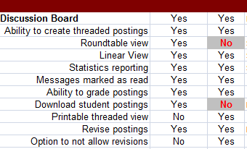
Functionality Requirements
Key Questions and Issues
  What capabilities are considered “critical” by users?
  Will we lose capabilities found in our old LMS?
  What new capabilities would Sakai provide?
Evaluation Approach
  Gap Analysis looked at 250+
  distinct capabilities
  Categorized them as
  desirable, essential or critical
  Goal: no “critical” gaps &
  solutions for “essential” gaps

Slide 26
Functionality Requirements
Outcomes
  Faculty valued effort and ability to track progress
  Within first year of the pilot the goal was met
  Sakai had more capabilities overall, some major
Update from Today
  All of the essential gaps have been closed
    Addition of a “global” Student View
    Import grades from spreadsheet into Gradebook
    Weighting of grades in Gradebook
    Ability to edit publishes assessments

Slide 27
Staffing and support requirements
Key Questions
  Will we need to add support staff to use OSS?
  Do we need JAVA developers to use Sakai?
  Can we live without commercial support?
Evaluation Approach
  Looked at issues such as:
    FTE resources needed at other institutions
    Amount of JAVA coding required to run Sakai
    Availability and cost of commercial support

Slide 28
Staffing and support requirements
Code Commits | HIGH | HIGH | MED | MED | MED | LOW | LOW | LOW
Role | Michigan (45K users) | Stanford (14K users) | Rutgers (27K users) | GA Tech (20K users) | UCT (25K users) | Yale (15K users) | Cerritos (20K users) | Rice (10K users)
PM | .75 | 1.00 | .50 |  | .50 | .20 | .10 | .10
Technical Lead |  |  |  |  | .25 | .50 | .10 | .10
Sys Admin | 2.50 | 1.00 | .50 | 1.00 | .25 | .10 | .20 | .50
DBA | .50 | .25 |  | .50 |  | .10 | .10 | .10
Developer | 3.00 | 3.00 | 2.00 | 1.00 | .50 | 2.50 | .10 | .50
QA | 1.50 |  |  |  |  | .25 | .10 | .10
UI Designer | 1.00 |  |  |  | .25 |  | .10
Instructional Designer | 1.00 |  | 1.25 | .75 | .25 |  | .10 | .10
Technical Writer | .25 |  |  |  |  |  | .10
End-User Support | 3.00 | 4.00 | 1.00 | 1.00 | 1.25 | 1.50 | .50 | .25
Trainer | .50 |  |  | .50 | .50 |  | .50 | .10
Totals | 14.00 | 9.25 | 5.25 | 4.75 | 3.75 | 5.15 | 2.00 | 1.85

Slide 29
Staffing and support requirements
Outcomes and Findings
  Sakai has the some requirements as other LMSs with regards to end-user support
  Need for JAVA programmers turned out to be a myth
  Sakai Commercial Affiliates provide support services
Update from Today
  Continue to support Sakai without additional FTE
  Materials, Tier 1 support and patches come from rSmart
  Completed SIS integration in partnership with rSmart

Slide 30
Realizing Innovation
Key Questions
  Would we save money moving to Sakai?
  Would we get a more innovative product?
  Would we receive better support services?
Evaluation Approach
  Projected cost savings based on switch to other LMSs
  Tracked release of new and innovative capabilities
  Tracked response and resolution time on support issues

Slide 31
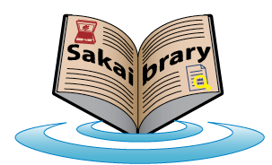
Realizing Innovation
Outcomes and Findings
  Significant cost savings over commercial LMS
  Facilitated shifted from licensing fees to human capital
  Technical issues were rapidly responded to and resolved
  Suggestions were incorporated (e.g. student podcasting)
Update from Today
  More than 20 “Contrib” tools available
    Citation Helper provide library database integration
  Lesson tool supports IMS Common Cartridge
  Test & Quizzes support QTI

Slide 32
Health of the sakai community
Key Questions
  Is the community growing or shrinking?
  Are community set deadlines and goals being met?
  Are commercial affiliates coming onboard?
  Disruptive forces (e.g. legal issues)
Evaluation Criteria
  Sakai adoption rates and committers
  Deadlines for major releases
  Number and type of commercial affiliates
  Status of Blackboard patient lawsuits

Slide 33









Sakai commercial affiliates

Slide 34
Health of the sakai community
Outcomes and Findings
  Increase in number of committers
  Diverse group of Commercial Affiliates
  Blackboard committed to not suing open-source LMSs
Update from Today
  160 institutions/organizations around the world
  5 out of the top 10 institutions in the world use Sakai
  Blackboard has lost each round of litigation to date

Slide 35
Reliability and scalability
Key Questions
  What type of quality assurance testing is done?
  How are security issues handled?
  Can Sakai scale to meet future needs?
  Can Sakai integrate with other systems (e.g. SIS)?
Evaluation Criteria
  Review QA and security reporting processes
  Tracked speed at which bugs were addressed
  Reviewed performance benchmarks at larger institutions

Slide 36
Reliability and scalability
Outcomes and Findings
  Robust software engineering processes for coding and Quality Assurance.
  Security issues are handled through private communication channels
  Being used with 100,000+ students at some institutions
Update from Today
  Integrations already exist for most major SIS systems as well as other proprietary software (e.g. Eluminate, Turnitin.com, etc.)

Slide 37
UNC Sakai Evaluation Final Report
Looking for more evaluation data?

Slide 38
Where we are today and were we are headed…

Slide 39
Sakai Transition Overview
Sakai Conversion Rates
  Goal for Fall 08: 20%; Outcome: 65%
  Conversion was completed Fall 2009
  Seeing big increase in use of Project Sites
Training Services
  Introduction to Sakai, Refresher, & Open Labs
Migration Services
  Migrated data from old CMS to Sakai for faculty
ePortfolios are our next major initiative

Slide 40
Q & A
Josh Baron
Director, Academic Technology & eLearning
Marist College
Josh.Baron@marist.edu
(845) 575 - 3623

