Slide 1


Implementing a
Cost-Effective and
User-Friendly E-Mail, Calendaring, and Collaboration System
Georgia Tech and
University of Pennsylvania
EDUCAUSE 2009
Enterprise Systems Track
  Friday, Nov 6th, 2009 • 8:10 AM - 9:00 AM • Korbel Ballroom 1E/F

Slide 2
Outline
What is Zimbra?
GT Implementation
UPenn Implementation
Discussion

Slide 3
Abstract
Georgia Tech and the University of Pennsylvania have both transitioned to Zimbra for centralized e-mail and calendaring services. Come hear about the transition challenges, cost-effectiveness, and integration aspects of these two initiatives and the unique aspects of each implementation. The University of Pennsylvania interoperates with Exchange to streamline collaboration across the institution through calendar free/busy sharing, while Georgia Tech has integrated Zimbra with its student portal and is leveraging student development of Zimlets to enhance adoption among students.

Slide 4
What is Zimbra?
Zimbra Collaboration Suite is a complete messaging and collaboration server with an AJAX Web Client. It features Email, Contacts, Calendar, Documents, Instant Messaging, Tasks, plus synchronization to other desktops and devices.

Slide 5
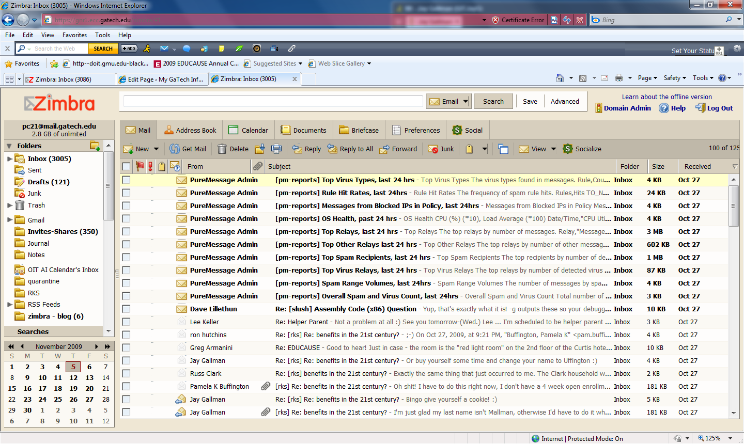

Slide 6
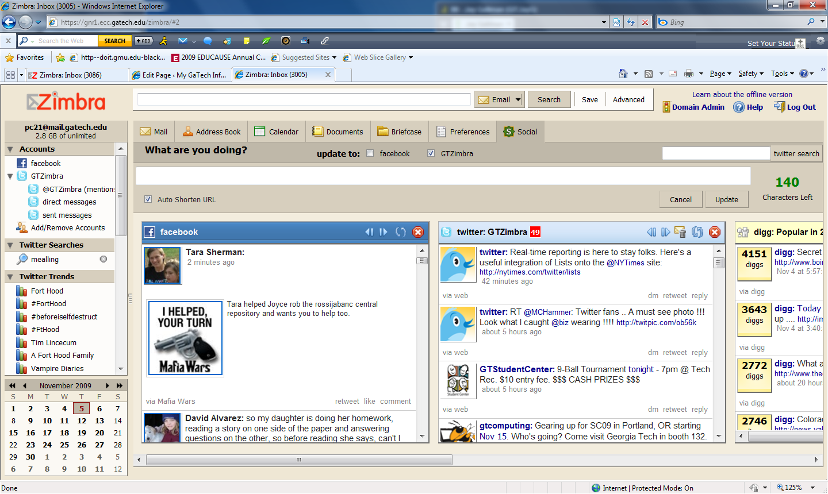

Slide 7
Georgia Tech
https://my.gatech.edu
Pam Buffington project manager pam.buffington@oit.gatech.edu
http://info.my.gatech.edu

Slide 8
GT Summary
2007 | Drivers for Change | Goals | 2009
Cyrus IMAP Horde/Imp webmail Oracle CorporateTime 9.0.4 Sympa lists Highly decentralized campus email & calendar Eudora POP users | Aging hardware Outdated email features 1800 calendar accounts Limited funds Mobile access | Replace email infrastructure Replace/integrate calendar (everyone) Upgrade edge infrastructure Upgrade Sympa list server Add in mobility (cherry on top) | 6 edge, 1 Sympa 11 Zimbra 12.7T of mail (7.2T primary, 5.4T HSM) 23T NAS (D2D backups) 60,000 accounts 10,000 employees 22,000 students 20,000 applicants 8,000 others

Slide 9
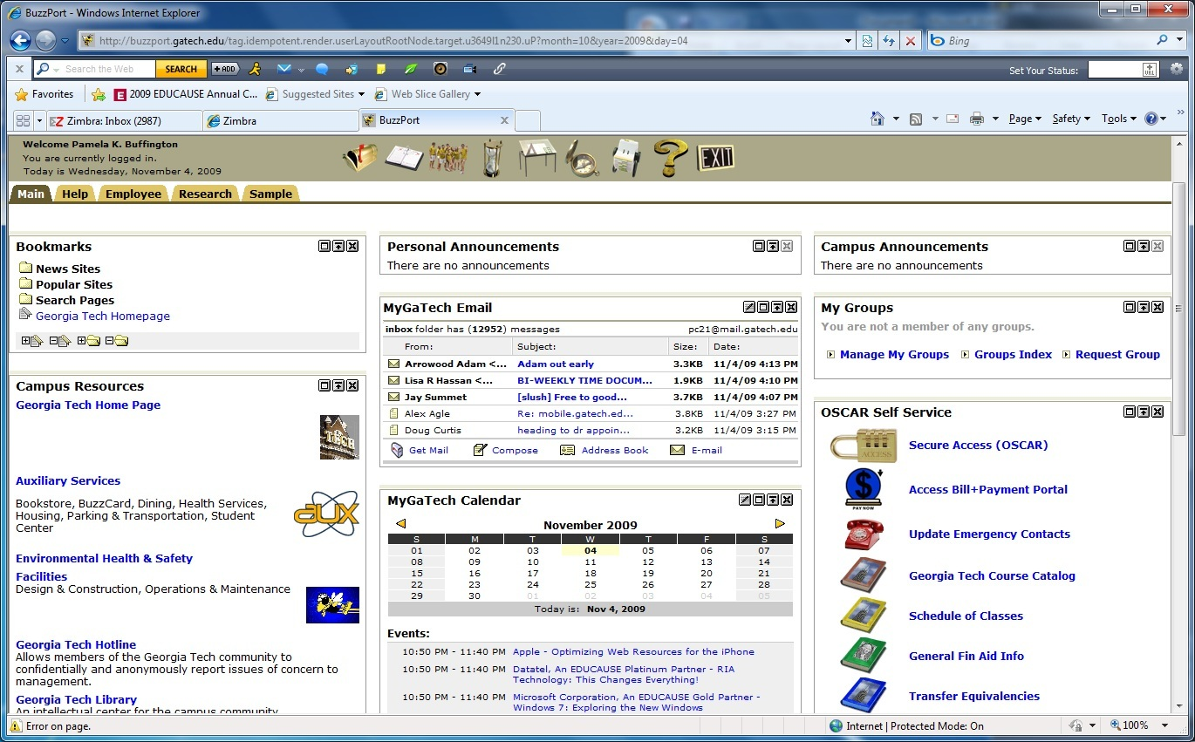
GT student portal & Zimbra integration

Slide 10
GT Timeline
1st Half 2007 | 2nd Half 2007 | 1st Half 2008 | 2nd Half 2008 | 1st Half 2009 | 2nd Half 2009 | 1st Half 2010
OIT Email
Email migration
Last legacy accounts migrated
6.0 Testing
Luminus Portal Integration
BES Testing
Identify Gaps & Prepare for Calendar Cutover
OIT Calendar
EOL Oracle Calendar
(5/26/09)
Mobile
support

Slide 11
GT Zimbra protocol usage by month

Slide 12
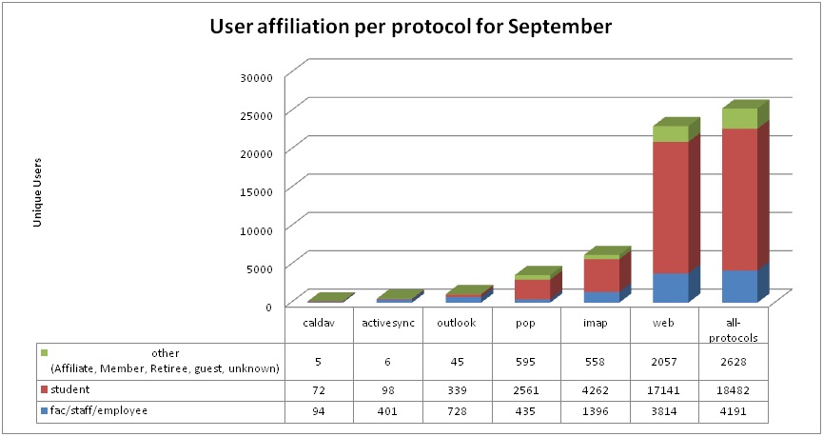
GT Zimbra usage by population

Slide 13
GT Lessons Learned
Mobility and BES specifically are requirements not an optional addition – BES not yet ready
Outlook with ZCO has been rocky.
5GB employee & 2 GB student quotas are A LOT of data.
Corporate Time & Zimbra calendar philosophies are different and require some business process changes.
Beware of scope creep
Be aware of your Executive branch.
Beware of bugs that have nothing to do with Zimbra

Slide 14
GT Conclusion
Webclient is a huge hit!
Departments are migrating to central service
Zimlet Class!
Integration with Course Info
Integration with Luminus Portal
People want More!
Blackberry Enterprise Service (hold)
Integration with SSO (Dec 2009)
Integration with Sakai (proposed)
Crowdsourcing for Zimlets (proposed)
More Campus Calendars
Georgia Tech • UPenn / Email

Slide 15


Slide 16
Penn Model
Central services with no central funding
Chargeback
Zimbra and Exchange interoperating
15 subdomains as well as @upenn.edu addresses
Only faculty, staff, and graduate students
Penn schools with undergrads run separate Exchange or Open Source collab solutions, or they outsource

Slide 17
Decentralized Mail Services at Penn
Exchange
Zimbra

Slide 18
Penn Numbers
38% of campus email users on central service
Zimbra 5.0.15 (13,700 accounts)
Exchange 2007 SP1 (3,100 accounts)
9-15 million inbound messages per month
54% valid / 45% spam / 1% virus
1 million outbound messages per month

Slide 19
Penn Integration
Single sign-on via Kerberos/CoSign works
Mail domains can be split across services, e.g. staff on Exchange, faculty/grad students on Zimbra
Same AV/AS solution (MessageLabs) for both services
Boundary encryption across both (HIPAA)
Free/busy schedule sharing no matter what service
Unified Communications: Voicemail to email
Similar look and feel for local web provisioning tools
Quarterly release cycles (alternating features / infra)
Notes:
Domains split via central mail routing infrastructure.

Slide 20
Penn and Free/busy
Zimbra<->Exchange works much of the time, but not all
Users with accounts on both services
  May appear in the GAL twice (unless hidden)
  May use one service for calendar and other for email
  Zimbra may not recognize Exchange invites or updates and vice versa (more often anomalies from Mac clients)
  Strategy to share free/busy with other campus providers

Slide 21
Penn Timeline
 | 2007 | 2008 | 2009 | 2010
Exchange 2007
Development / Integration / Projects
Zimbra
Test
Rollups
Rollups
Mmaker->Exchange
Test
PDA Security
New Policy
Revisions
2
Support
Free/Busy
Testing
Support
BlackBerry
Testing
Support
Storage
Migrate SAN
Test 5.0.8
Test
5.0.11
6.0
Milestone Key
Rollouts, service packs New services, infrastructure changes
Migrations, policy changes Rollouts, migrations, point releases
Notes:
The only constant is change.

Slide 22
Cost Components at Penn
Notes:
Labels for X axis removed, but the scale is right. Mail routing shared across Exchange and Zimbra services.

Slide 23
Penn Charges
Zimbra: $3.00/account/month
Exchange: $7.50/account/month
BlackBerry: $13.50/account/month
500 MB base quota, multi-GB max, uplift charges for more quota
Rates are set based on our costs

Slide 24
Cost Strategies
Develop delegated provisioning tools
Use cheap(er) disk
Prepay license costs (or go perpetual)
Leave old calendar data behind
Track staff time well
Bring trainers to staff
Budget for backfill or consulting help
Someday: Server-to-server sync

Slide 25
Penn Challenges
Changing critical infrastructure (storage) at the same time adds complexity
Integrating existing local Jabber and Asterisk services still needs work
It may be a long wait for Kerberized access to calendars on the server or the clients
Low quotas can discourage use of collab features
BlackBerry handhelds may take more staff time to support
Mobile devices need PINs, remote wipe, and encryption, but policies and capabilities vary across devices

Slide 26
References
http://info.my.gatech.edu/
Pam Buffington <pam.buffington@oit.gatech.edu>
http://www.upenn.edu/computing/email/
“Case Study: Penn Migrates 13,000 Open-Source E-Mail Users to Zimbra” (Gartner ID G00165040, February 18, 2009)
Adam Preset <preset@isc.upenn.edu>

Slide 27
Discussion

