Slide 1

Collaboration in a Competitive Environment: Sustaining Success through Shared Services
Sarah Porter, Head of Innovation, JISC
Joint Information Systems Committee
Supporting education and research

Slide 2

The UK Higher Education Sector
165 higher education institutions in the UK
450 colleges of further education
Average annual turnover of individual universities is £100 million
About 2 million full time students (1 in 7 from overseas)
Overseas’ student fees income: £1.3 billion
England the favourite destination of international students after the US university system
UK HE sector a substantial industry (£45.1bn total output 2003/04)
Income (earned revenue) of UK HEIs is £16.87 billion (2003/04)

Slide 3

Context: why do we need the JISC in UK education?
Changing student expectations: the student as ‘customer’ and the need to support diverse learners e.g. work-based, international and part-time
The need for more visionary and innovative use of ICT in institutional management and administration
The need for best practice in supporting and managing research in order to retain excellence
Increased global competition in higher education
Changes in the economic environment
Need to balance increased competition between institutions
With the value that is brought by collaboration in the right areas
15/10/2010 | Supporting education and research | Slide 3
Notes:
3

Slide 4
Funding and governance
Funding:
Funded by all the public funding organisations that pay for tertiary education in the UK
Seven major funders – England, Northern Ireland, Scotland, Wales
Additional income from charges for particular services
Governance:
Governed by representatives from the education sector not by government
Board and sub-committees made up of representatives who decide what activities should be funded three times per year

Slide 5
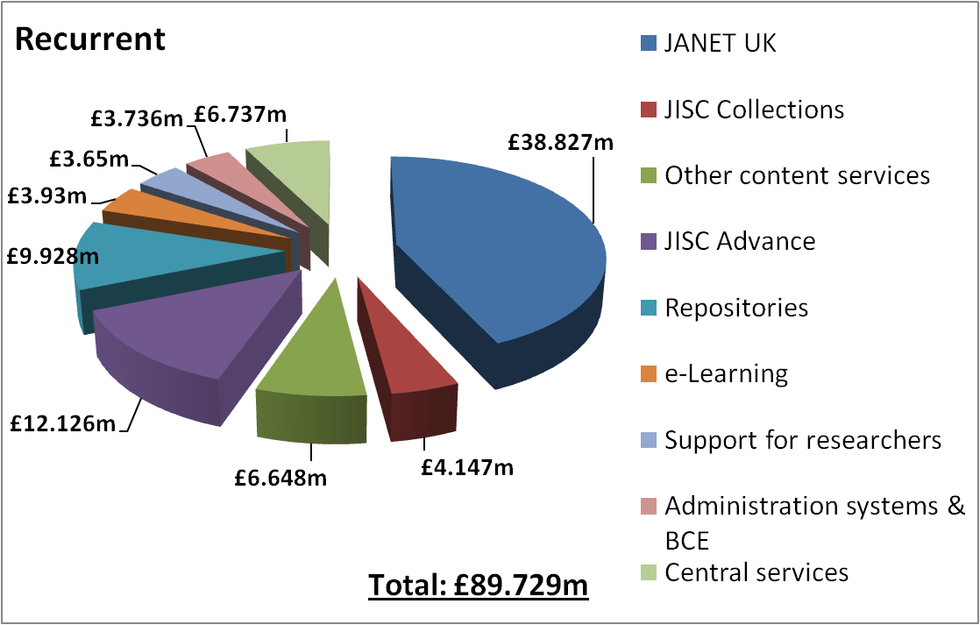
JISC budget 2010-11
15/10/2010 | Supporting education and research | Slide 5
Notes:
5
HEFCE contribution to recurrent budget is 74.8%. May wish to mention cuts / that we are subject to similar spending controls as HEFCE.
JISC receives core funding on an annual basis (August - July) from its core funders (HEFCE, SFC, HEFCW, DCELLS & DEL N.I.). In addition to this, JISC receives capital funding for new innovation programmes from HEFCE and HEFCW. The funding (whether core or capital) used for each activity impacts on the eligibility of HE/FE institutions from the devolved countries.

Slide 6

JISC Strategy 2010-2012: four priority investment areas
Cost-effective shared infrastructure and resources
Efficient and effective institutions
Effective, creative approaches to teaching and an enhanced learning experience
Increased research quality, impact and productivity, and innovative approaches to supporting the research process
15/10/2010 | Supporting education and research | Slide 6
Notes:
6
JISC funds through thematic areas of investment based around the strategic objectives. These objectives match the main relevant concerns of universities and colleges, the funding councils and central and devolved governments. Investment areas are also influenced by and seek to influence relevant global issues and concerns.

Slide 7

JISC: a shared service
Aim: to provide services and resources that individual institutions cannot provide as efficiently or effectively
JANET: essential infrastructure
for research and education
JISC Access Management Federation
JISC Collections: for every £1 funding,
the community received services with
a commercial value of over £34
JISC Advance: its services save the sector
around £12 for every £1 invested
in them
Other specialist services provided such as
National Grid Service
15/10/2010 | Supporting education and research | Slide 7

Slide 8











Delivery: services
JISC funds a portfolio of 49 services giving institutions access to :
Underpinning infrastructure via
  JANET(UK) (computing network)
  Access Management Federation
Online resources
  Learning resources
  Primary and secondary
  materials e.g. PubMedCentral
  All media formats
Advice and support via
  JISC Advance (advisory services)

Slide 9

Education and research network: JANET
Established in 1984 (26 years old!)
Provides reliable, high quality, high speed network connection to over 18 million users from higher ed, further ed (community colleges), research institutes and all publically funded K-12 schools
Also provides connectivity to other sections of the public sector
Other services include video-conferencing, Eduroam, web-hosting and training.

Slide 10

Funding
Block grant of about £40m per year from JISC
Additional one-off funding from JISC for significant upgrades
Tiered Annual Tariff for higher education institutions based on their annual income
Access by colleges and schools funded by income from other central funding bodies

Slide 11


Slide 12


The UK access management federation
Launched November 2006
Replaced system that had been in place since mid 1990s
Used by all UK research institutes and public education at all levels (K12, community colleges and higher education)
Shibboleth based system
Discovery Service
Resilient WAYF service
Hosting of metadata
Monitoring of Service Providers and Identity Providers

Slide 13
Funding and governance
  Organisational structure
    Federation ‘owned’ by JISC and Becta
    Policy & Governance Board
    Technical Advisory Group
Funding
  Funded entirely by JISC and Becta at present

Slide 14

http://www.jisc-content.ac.uk/

Slide 15


Not-for-profit membership organisation spun out from the JISC several years ago
Negotiates reasonable licence costs for access to digital resources
Tiered charging approach
Some resources provided free to education in perpetuity after bulk purchase
Delivered over £25 million in efficiency gains in 2008/09
Most collections heavily used. E.g. Over 2 million articles were downloaded from the Oxford Journals Archive in 2008/09.

Slide 16
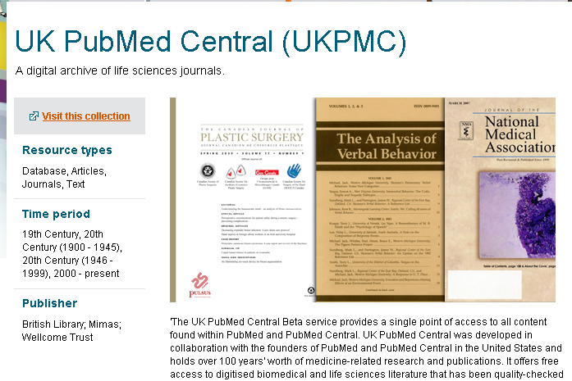

Slide 17
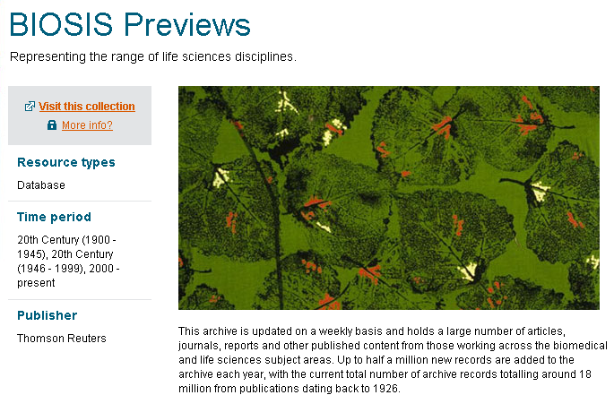

Slide 18


Images and other media from a range of organisations
British Film Institute - InView (Authentication required - free for all FE and HE) https://www.bfi.org.uk/inview/theme/health
Over a thousand hours of non-fiction films from the BFI archives
British Cartoon Archive
http://www.cartoons.ac.uk/
150,000 cartoons

Slide 19

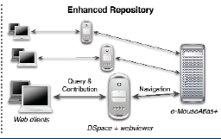
Community content: repositories for learning, teaching and research
Medical image repository at Middlesex university: http://www.jisc.ac.uk/whatwedo/programmes/inf11/sue2/mirage.aspx
biophysical repository at King’s College London http://www.jisc.ac.uk/whatwedo/programmes/inf11/digpres/bril.aspx
A Google maps type interface for exploring and annotating embryo images: http://www.jisc.ac.uk/whatwedo/programmes/inf11/sue2/nextgenerationembryology.aspx
An information environment for neuroscientists – collaboration between Oxford, Reading and Southampton http://www.jisc.ac.uk/whatwedo/programmes/inf11/einf/neurohub.aspx

Slide 20
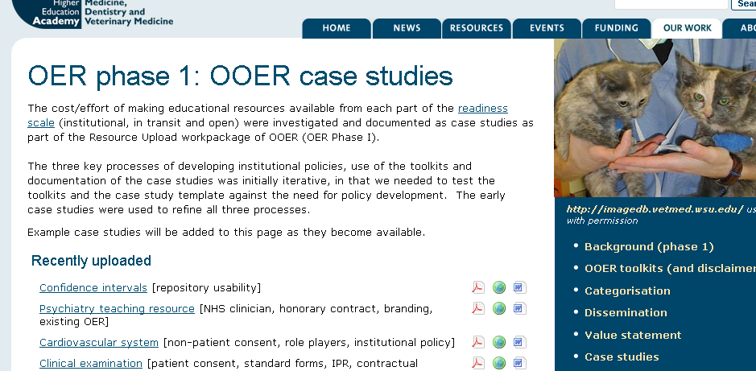
Community content: Open Educational Resources

Slide 21
Effective Practice series (www.jisc.ac.uk/publications)
Effective Assessment in a Digital Age
Effective Practice in a Digital Age
Effective Practice with e-Portfolios
In Their Own Words – Exploring the learners’ perspective on e-learning
Designing Spaces for Effective Learning
Innovative Practice with e-Learning
Notes:
A popular set of guides created from the findings from our innovation programmes. They will be of interest to anyone who seeks to better understand better how to integrate technology into teaching.

Slide 22
Development of Future Services
UK Cloud for Higher Education
  Focused upon research community in its first phase
  Challenging timescales for delivery
Software and application services in the Cloud
  Working with commercial sector to work towards cloud-based hosting for major administrative services used by colleges and universities
  Not clear what areas should be targeted
  Shared procurement services or central hosting – or both?

Slide 23
Other perspectives on Shared Services and Cloud Computing
Walter van Dijk, SURF NET, Dutch approach to Shared Services and Cloud
Jacob-Steen Madsen, WAYF, Danish approach to Shared Services and Cloud

Slide 24
Key issue 1: business models
Business model based upon central funding from government may be challenged
  Also, not enough funding to provide all desired services (‘gap between aspiration and resource’)
Option: Pass all costs on to institutions?
Risks:
  may lead to break up of the organisation
  May lead to ‘lowest common denominator’ instead of broad portfolio of innovative services
Option: collaborate with commercial sector or other bodies
Risks
  May lose ability to respond to needs of public sector

Slide 25
Key issue 2: governance
Option to provide differentiated offer
  Core set of services for all
  ‘opt in’ services in some cases
Risks:
  Need to retain balance in favour of core services for all
  Where value is considered for the consortium as a whole, not for each individual organisation
  May lose bargaining power if fragmentation is allowed to start

Slide 26
Key issue 3: sustaining innovation
All services have developed from experimental, innovative funding
After innovation has proved its value, becomes part of the JISC Service Portfolio
  JANET, Access Management Federation, JISC Collections, data centres ...
Need to sustain development of new services
Whilst maintaining reliable portfolio with long-term commitment
Models that allow innovation ‘bottom up’ rather than trying to anticipate requirements centrally

Slide 27
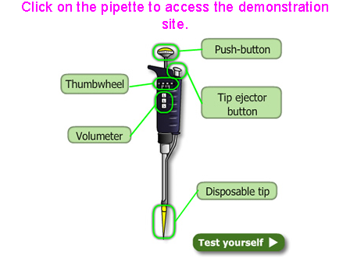
Potential future Shared Service: eBioLabs
eBioLabs, Dept of Biochemistry, University of Bristol
Focused upon laboratory based modules in the biosciences
developed preparatory materials online which learners have to engage with pre-lab,
Learners are better prepared for the face to face lab session.
Learners are assessed online - with support for marking which has made the process more efficient.
More info at: http://www.jisc.ac.uk/whatwedo/programmes/elearning/curriculumdelivery/ebiolabs.aspx

Slide 28
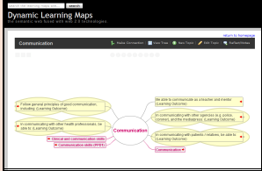
Potential future Shared Service: dynamic learning maps
Dynamic Learning Maps, School of Medical Sciences, Newcastle University
Viewing the ‘curriculum’ using a fusion of curriculum maps, learner content with elements of web 2.0 and semantic web approaches;
Enable learners and tutors to see an alternative map of the curriculum, either in nodes or list form;
Helps to map the relationships between modules, and links through the learners portfolios - so enabling more sense to be made of the curricula as a whole. More info at: http://www.jisc.ac.uk/whatwedo/programmes/elearning/curriculumdelivery/dynamiclearningmaps.aspx
Notes:
Newcastle University

Slide 29
Contact details
Sarah Porter, s.porter@jisc.ac.uk
Tel. +44 203 006 6060
http://www.jisc.ac.uk/

