Slide 1

Educause 2010
“Second Life and Its Real-Life Double:
How to Get Started in a Virtual World, and Why You Would
Want to…”
Copyright Johanna S. Brams 2010. This work is the intellectual property of the author. Permission is granted for this material to be shared for non-commercial, educational purposes, provided that this copyright statement appears on the reproduced materials and notice is given that the copying is by permission of the author. To disseminate otherwise or to republish requires written permission from the author.

Slide 2
Problem?
How can a university effect a virtual, immersive, digital environment using mostly student workers and interactive, constructive pedagogy?

Slide 3
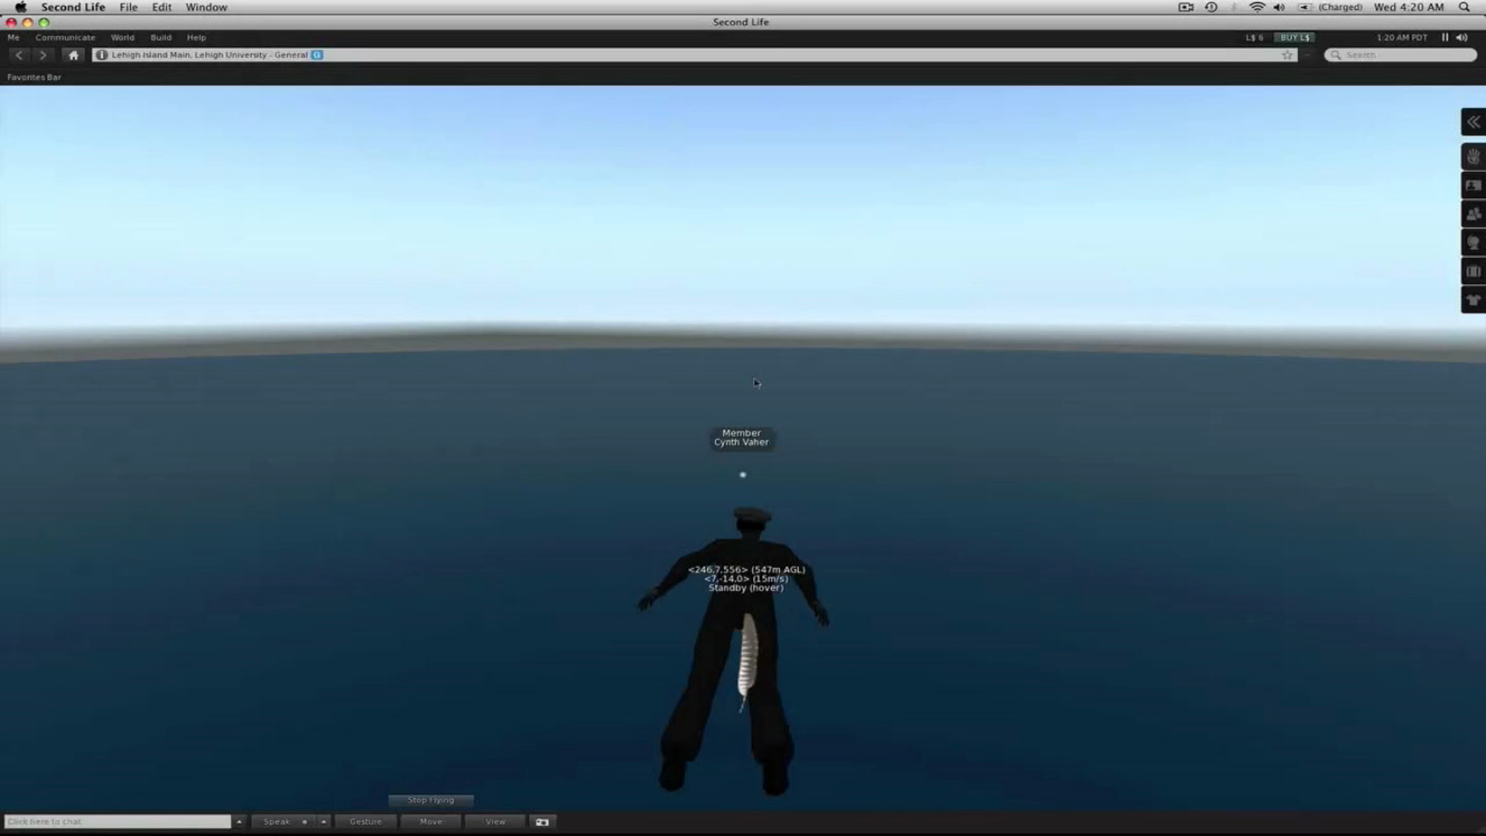
Introductory thoughts and a ‘Flyover’

Slide 4
Introductory thoughts and a ‘Flyover’
Oscar Wilde regarded the theatre as “the greatest of all art forms.” To Wilde, the broken barrier between stage and audience was “the most immediate way in which a human being [could] share with another the sense of what it [was] to be a human being.”
Lehigh Island is an extension of this philosophy; by creating a safe space online where students can hone their skill in interactive classroom environments, the Island effectively transports the Lehigh learning experience to anywhere in the world.
From the art tower to the planetarium, from foreign languages to theology, the Island provides the ideal platform to present elementary disciplines with the click of a mouse.
Through the imaginative efforts of the student workers at the IMRC at Lehigh University, this virtual reality can help to convey and enhance what is best about education…

Slide 5
Diving into the Virtual Sea…
research we conducted before we began building,
the rationale of our process of design and construction,
the context in which we integrated ideas…

Slide 6
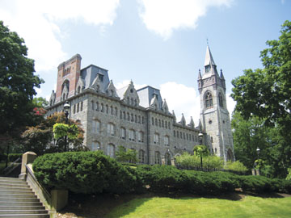
SOME BACKGROUND AND A LITTLE PERSPECTIVE
Who are we?
  Lehigh University is an institution with 6300 students, 464 faculty, and 1215 staff.

Slide 7
What is the IMRC?
  The IMRC (the International Multimedia Resource Center) is one of three multimedia centers on campus, part of Instructional Media Services, which is part of Library and Technology Services at Lehigh.
  We have one full-time staff person and 25-30 student workers.
  Our model is based on mentoring: The senior students teach applications and best practices to the newer students, under the direction of staff.

Slide 8
  The IMRC at Lehigh helps to provide the following services to the university community:
    web authoring and web-based database design,
    digital video,
    graphic design, and
    new types of gaming and virtual design such as Second Life.

Slide 9
What we knew when we began…
At this juncture, many people agree that some form of virtual immersive environment similar to Second Life will be key to the future of higher education.
Also…

Slide 10
…and theoretically Second Life is an ideal medium for:
  Modeling
  Simulation
  Collaborative Learning
  Distance Learning
  Social and Academic Scaffolding
  Immersion

Slide 11
Thanks Greg!!
…So we decided, under the auspices of Faculty Development Director Greg Reihman, to develop an island for Lehigh University in Second Life…

Slide 12
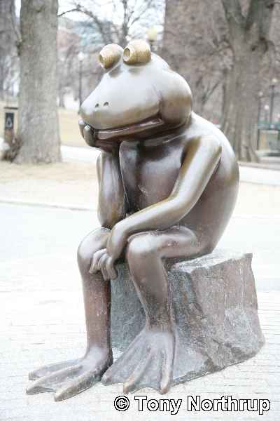
Here is the historical and philosophical perspective we developed on approaching Second Life…
…or at least
the context we considered ……

Slide 13
From the External to the Internal…
What is and what can really be considered to be the conception of “Virtual Reality?
  If we consider accurate or ‘realistic’ visual arts to be some version of virtual reality, examples of visual images representing alternate realities can be found throughout the ages.

Slide 14
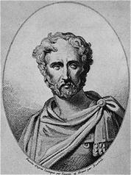
Pliny the Elder
Earliest reference to a virtual life representation?...

Slide 15
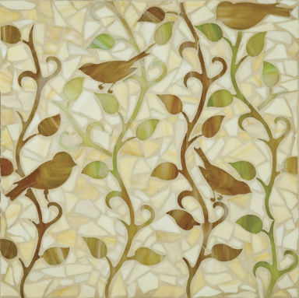
  “Zeuxis produced a picture of grapes so dexterously represented that birds began to fly down to eat from the painted vine. Whereupon Parrhasius designed so lifelike a picture of a curtain that Zeuxis, proud of the verdict of the birds, requested that the curtain should now be drawn back and the picture displayed. When he realized his mistake, with a modesty that did him honor, he yielded up the palm, saying that what whereas he had managed to deceive only birds …Parrhasius had fooled Zeuxis…[2].”

Slide 16
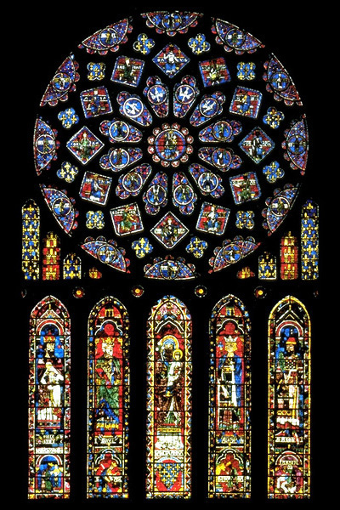
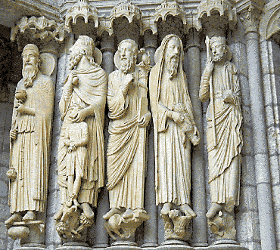
Architecture, art, and sculpture during the Middle Ages –
….the Church used the visual arts to teach theology to the largely illiterate masses.

Slide 17
German art historian and media theorist Oliver Frau…
  …In his book Virtual Art gives examples of panoramic paintings and murals dating back to the 16th century.
  http://www.panoramas.dk/church-murals/elmelunde-1.html

Slide 18

Among other theorists of the virtual, Frau mentions Cineorama, a 360-degree film projection simulating a hot air balloon ride, created by Raoul Grimoin-Sanson at the Paris World Exhibition of 1900 [3].

Slide 19
So much for the visual arts…what about the literary?
Roman and Greek Mythology
Dante’s seven circles of hell
The underwater world of Jules Verne
Lewis Carroll’s Alice in Wonderland
Religious narratives of heaven, hell…

Slide 20
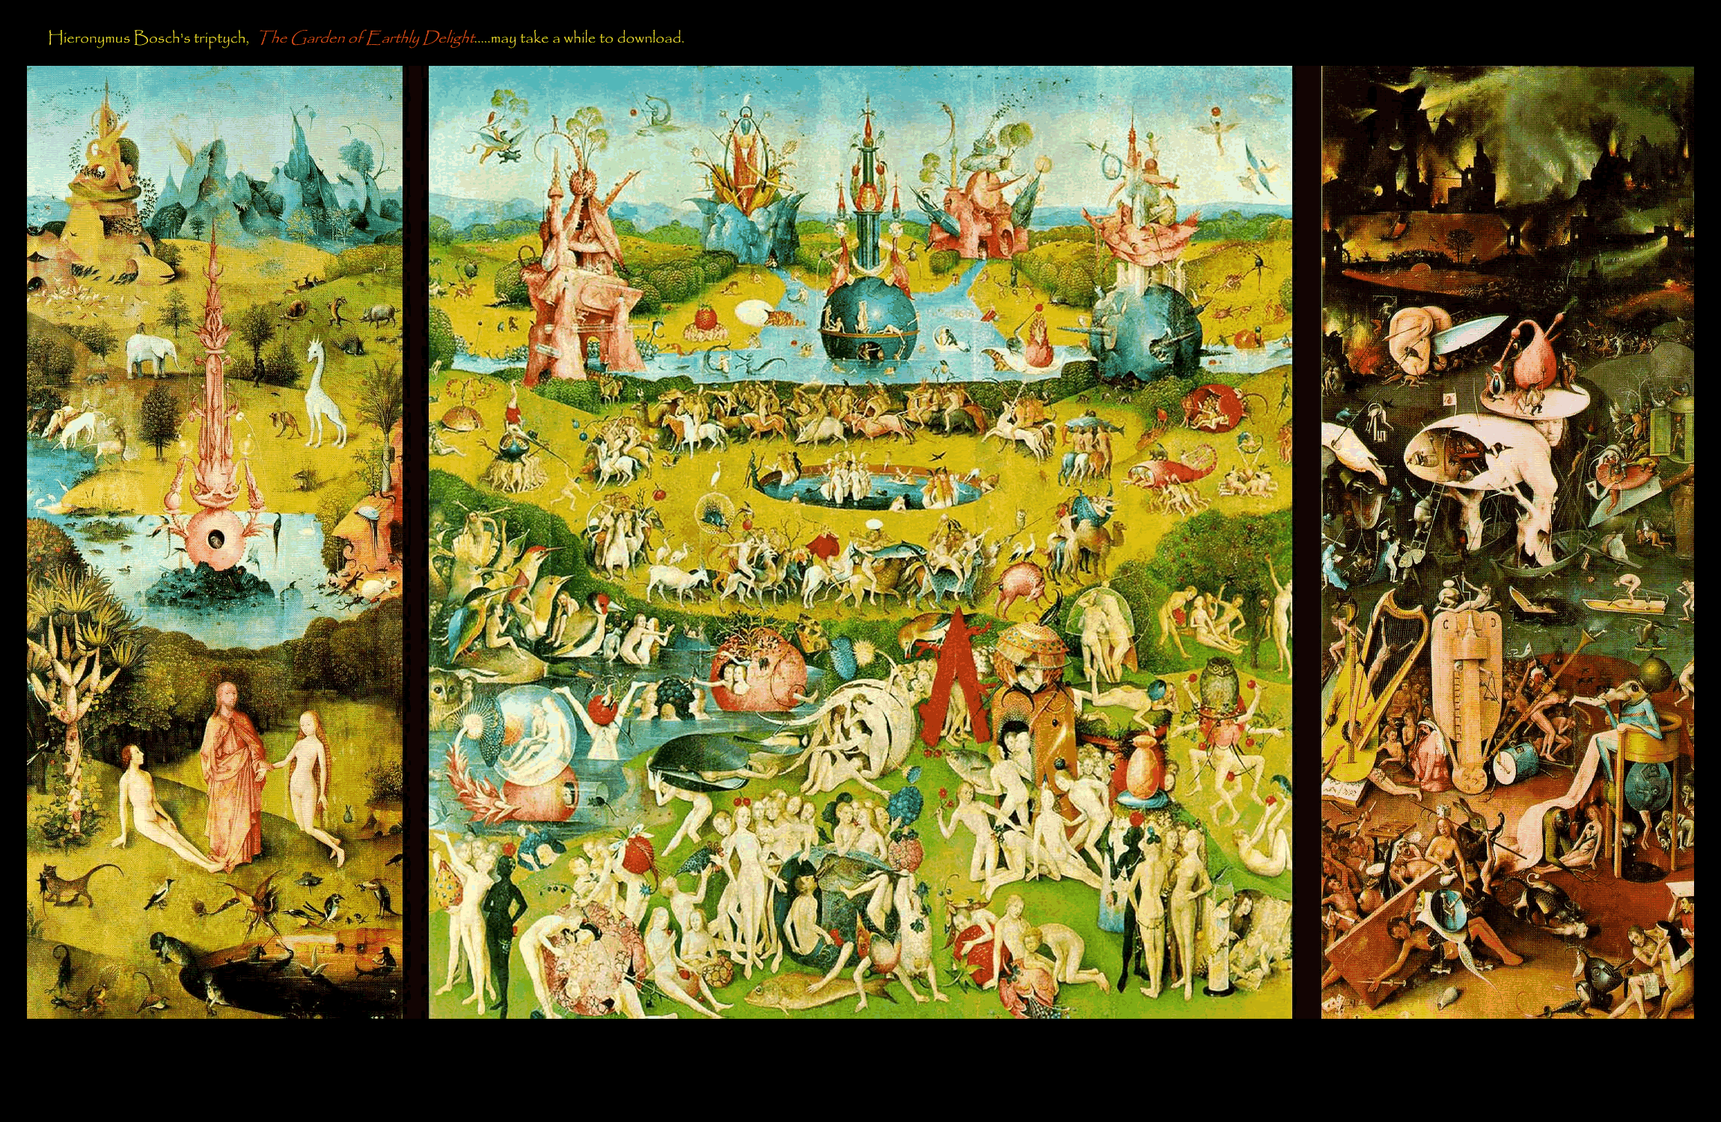
Hey, I know this is visual, but I couldn’t resist!....

Slide 21
…If we are looking to immerse ourselves in the visual arts…
What about theatre?
Artaud in film…
  http://www.youtube.com/watch?v=LAS0g0qY2AU&feature=related

Slide 22
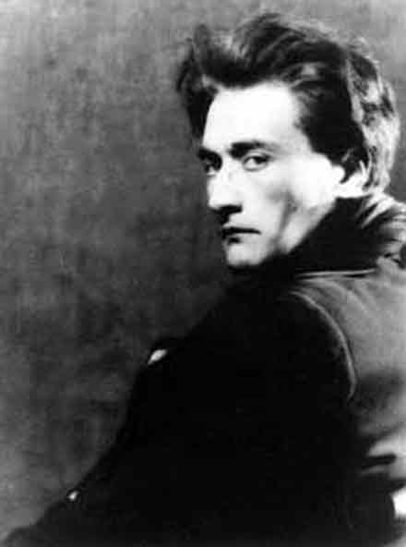
Virtual reality is a term initially coined and defined by the mad genius Antonin Artaud in "The Theatre and Its Double" in the 1930's. According to Artaud the mission of theatre was to eliminate the "4th wall" between the play and the audience, to immerse
the audience in a new
reality, like that of a
dream.
(The double of
theatre is real life.)

Slide 23
Theatre of Cruelty
The earliest precedent is considered to be the pre-surrealist Alfred Jarry. He broke with traditional theatrical context in his absurdist play “Ubu Roi” – in which the senses are assailed by loud noise, obscenities, absurdist spectacle, and chaotic action spilling off the stage into the audience.
Artaud began experimenting with altering the mise en scene in Paris in the 1920’s. The philosophy which evolved from his experimentation resulted in his theoretical book The Theatre and Its Double, first published in France in 1938. [1]

Slide 24
Some Quotes from Artaud…
  “Every real effigy has a shadow which is its double…Like all magic cultures expressed by appropriate hieroglyphs, the true theatre has its shadows too, and of all languages and all arts, the theatre is the only one left whose shadows have shattered their limitations. From the beginning, one might say its shadows did not tolerate limitations…
  For the theater as for culture, it remains a question of naming and directing shadows: and the theatre, not confined to a fixed language and form, not only destroys false shadows but prepares the way for a new generation of shadows, around which assembles the true spectacle of life…”
Artaud also, in an eerily apt insight, compared theatre to illness, to the plague. Like catastrophic illness, theatre assails ALL the senses, not just sight and sound.

Slide 25
According to Artaud, theatre should be contagious. It should be intuitive. It should be ‘cruel’—meaning it should be loud and spectacular, encroaching physical space, touching you, taking hold of hold of you. You should experience it physically – creating a passion like fever – and ultimately inciting a sort of catharsis. After one experiences it, one’s life is changed.
“First of all we must recognize that theatre, like the plague, is a delirium and is communicative. The mind believes what it sees and does what it believes: that is the secret of the fascination…” …The Theatre and its Double
Artaud first coined the phrase “Virtual Life” in his book.

Slide 26
Artaud’s philosophy can be summarized as working from the external to the internal…and we started thinking about different approaches…

Slide 27
Vygotsky: Social Constructivism and Virtual Reality
…How about an ‘internal’ process? Instead of a device being applied or loud noises or special effects being used as a catapult against human senses, perhaps there should be an internal construct in which an individual builds his or her own individual reality… from the inside out.
You may recognize this idea as similar to Social Constructivism, originating with the Russian Learning Theorist Lev Vygotsky.
Vygotsky’s central idea is that an individual structures his or her own reality from the most available and accessible environment -- beginning even in the womb. This range of the most readily available, accessible experience is called the zone of proximate learning. Growth is realized as the individual absorbs intellectual content available to him in the zone. Those things that most closely resemble what is already known (the most intuitive) are absorbed first and most readily.

Slide 28
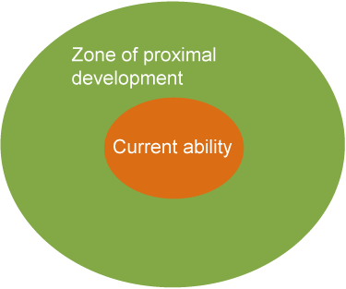
The Zone of Proximate Development
One can enrich the zone of proximate learning in order to elevate the level of learning.
Think, then, of the external (immersing the senses) construct relative to an internal (structuring for exploration from the inside out) process. Now you are getting an idea of what we wanted to try and achieve in the design of Lehigh University’s island …

Slide 29
…Therefore, having researched Second Life for several months, we decided to design the island based on interactive and philosophical concepts of both theatre and learning, as presented by Artaud, but also considering the constructive collaborative concepts of Vygotsky, as well as more modern digital gurus.

Slide 30
Other Perspectives…
We also spent time researching many other sites, especially those of other universities, and paid close attention to what others had done, both successfully and not so.
(We noticed many sites were very passive environments.)
Therefore we thought our approach might make the island more interactive, interesting and useable.

Slide 31
Initial Parameters
Create one building that will be a model of a recognizable, symbolically important Lehigh building.
Create some meeting spaces that will allow groups to gather and share ideas.
Add some features that would be impossible to find at physical Lehigh..
Leave plenty of space to accommodate other people and news ideas as the project progresses…

Slide 32
Our first forays into Second Life met a number of issues.
…For instance, initially, we thought we could build in AutoCAD and Maya, and transfer structures into the 'prims’ or building blocks of Second Life. This proved to be difficult and the results were not what we had had envisioned.
  (More recent versions are supposed to allow for a better transfer…we have not tried it…)
In the end, we tore down what we had built and started over, using only Second Life ‘prims’.

Slide 33
In the process of starting over, we spent more time conceptualizing, and actually designed the island from the ground up before going in, eventually ‘terraforming’ the island according to a preliminary map.
This map not only featured our initial concepts for building, but included a large area or ‘sandbox’ for design, and left enough area of the island free – to be developed according to faculty ideas, as they would eventually come in.
By the end of the summer of 2008, the island was beginning to take shape. We finally felt confident enough with our security to go ‘public’ in March of 2009, and by that summer, a number of faculty and staff had experimented, held regular classes or had done research in our structures on the island.

Slide 34
…Sometimes we met obstacles…
Permissions gave us (and continue to give us) many headaches.
We finally figured out how to best assign areas to different faculty and staff interested in working on the island – and to do so securely and privately without interfering with others’ settings.
We wound up assigning basic privileges and ‘ownership” for building and administration to one generic avatar: Lehigh Bookmite.

Slide 35
…There were mistakes and there were successes. ..
Once, in an attempt to delete something built, we eradicated a good portion of the island, and had to call New Media Consortium to roll the island back in time!
However, the flip side of this disaster was discovering that nothing was going to break the island – there was always recourse, even if complicated. Such knowledge gave us confidence to experiment more.

Slide 36
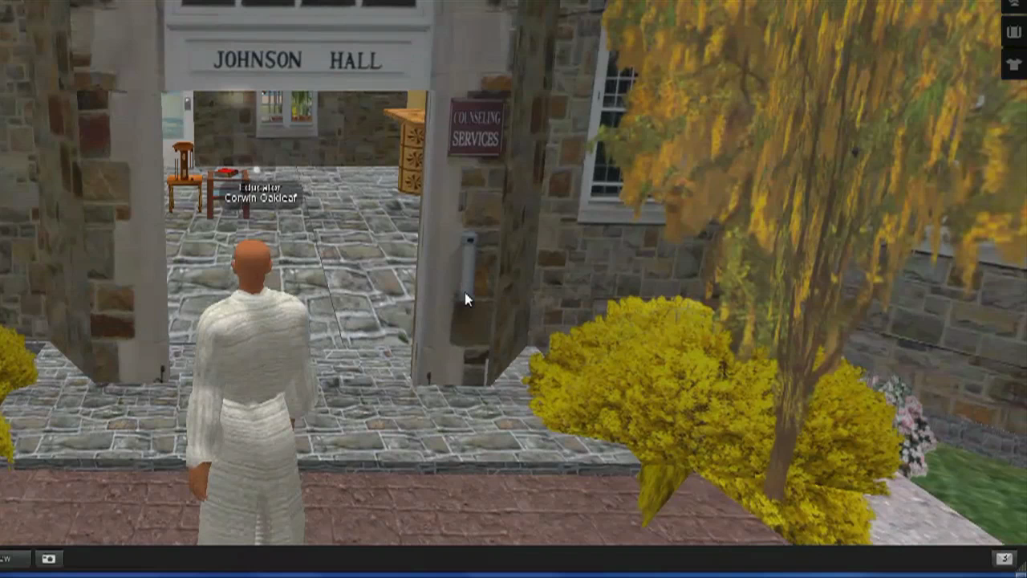
Counseling Center

Slide 37
Counseling Center
The University Counseling and Psychological Services Center has utilized Second Life to administer both group and individual therapy sessions on the island. Volunteer graduate students either speak through or interact online with their clients. Virtual individual or group sessions are held in a “clam” room underwater to secure privacy. According to research by staff members presented at national conferences, the experience is not dissimilar from face-to-face or phone therapy.

Slide 38
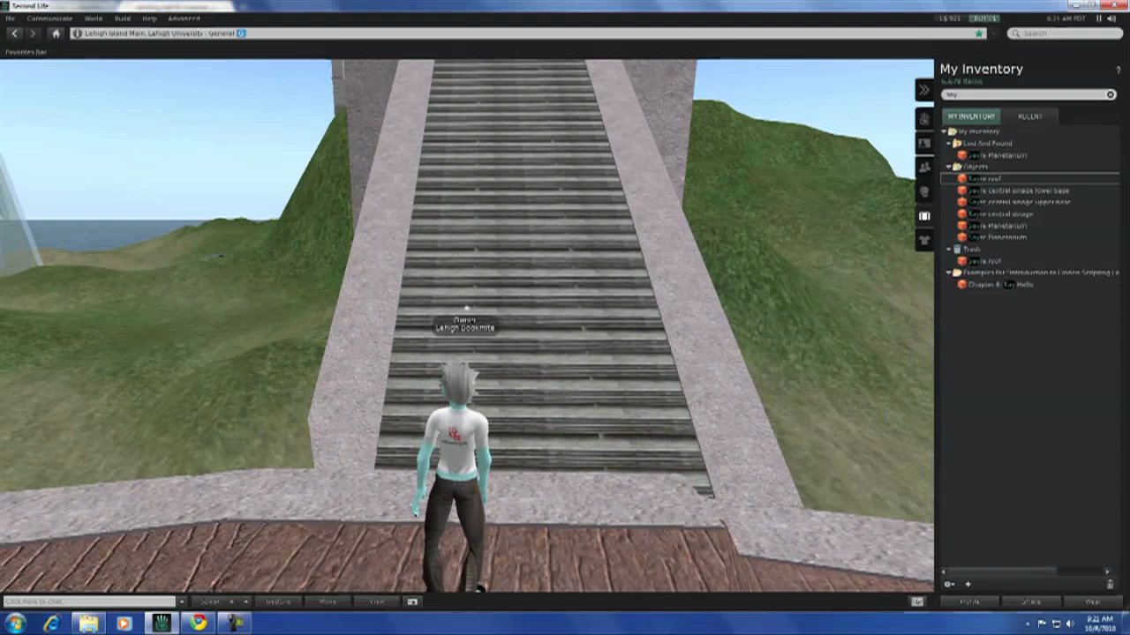
Planetarium

Slide 39
Planetarium
We built a planetarium to feature Dr. Carol Keily’s website on the microscopic images of moondust…small particles of the actual material brought back from the moon by Astronauts Armstrong, Aldrin and Collins, during the Apollo 11 mission in 1969.
Recent improvements to Second Life not only makes these images live from the web, but allows us to alter the “lens” of the roof of the planetarium to give a rounded perspective – much like a real planetarium.

Slide 40
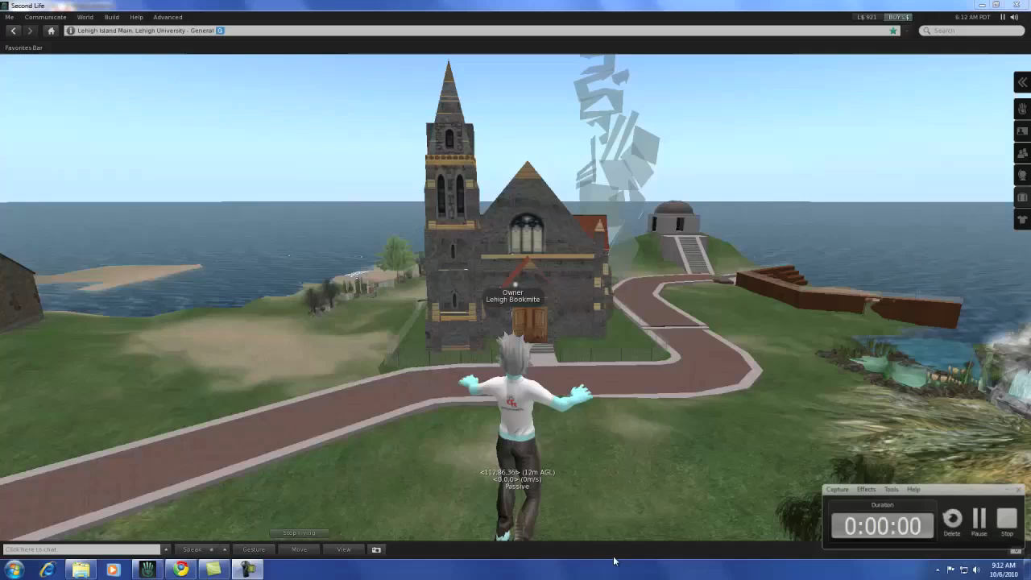
Interfaith Chapel

Slide 41
Theatre
…No virtual reality can replicate the actual performing environment better than an auditorium. The concert hall in Lehigh’s Second Life is designed to serve various types of performances and audiences.
In the words of Prof. Deborah Field, it allows students the chance to “sing with a live audience.” For young musicians and performers away from campus, it is invaluable to continue practicing whenever and wherever they please. With the concert hall, they can…and even do it underwater!!

Slide 42

Art Tower

Slide 43
Art Tower
Traversing the campus, one will observe quite easily that the Lehigh campus does not have a ten thousand foot tall structure made of broken glass shards devoted to all things visual arts, but on Lehigh Island we compensate for that inconvenient truth.
The art tower, for artists such as Berrisford Boothe, Professor of Art, turns fantasy into virtual reality by providing the previously unimaginable opportunity of actually stepping through the looking-glass. “I found myself slipping into a correlative mode of presence with my avatar describing the meanings and history of my practice,” Booth says.

Slide 44

What people say…
Jeff and Maura

Slide 45
Labor and Expense
The initial maintenance and purchase cost (May 2008) : $5,540.
  The maintenance cost is $4,300 per year.
Initial Attempt
  Using CAD and later Maya to design one building: Approx 100 hours.
Main work on site was accomplished by a 5 person core= to date early summer about 1300 hours.
Ancillary work, including researching other university sites, involved about a dozen other members of our student staff …probably another 100 hours.
Cost is relative…much of the 2nd Life project was accomplished “in the background” – as a default project for students to work on in between more pressing projects.
Learning to build in 2nd life involved a learning curve…I would say we could have subtracted about 20-30 hours per core designer.

Slide 46
Problems we face…
Expense
Stability
Learning Curve
Cognitive Dissonance
Will it be 2nd Life?
  Will it be transferable?

Slide 47
Issues…
The learning curve of building the island is relatively steep.
  Interestingly enough, the learning curve of participants in an island’s established structure is relatively flat. One can teach a class how to build an avatar and navigate with it in one class.
    Of course the angle of learning changes with different objectives, but immersing students (and faculty) into the medium should take planning and time, as well as mentoring – in order to have a meaningful experience with sound pedagogy. (On the other hand, is this really different than with any interesting class planning?)
    Linden Labs is not keeping up with the technology. One has only to look at the finessed images of many video games to recognize how much still has to be achieved by a better graphic presence in the now slightly cartoonish Second Life. More realistic and/or 3D imagery certainly can’t be accomplished through an application based on prims.

Slide 48
More issues…
Linden Labs also appears to have too many unannounced technical issues that result in slow response times and other occasional server-related issues.
Initial setup for distanced participants can sometimes be tricky and should be effected before any actual class.
It may be that private contractors like Linden Labs are not the way of the future. They simply do not have the agility to keep up with the change and demand of the medium.
Those of us used to the openness of the Internet dislike the expense and proprietary nature of Linden Labs. Why put the time and energy in to build an online presence that lives on someone else’s server?
  We would like to think that open source applications might evolve more quickly and adapt more readily. They may be the way of the future.

Slide 49
On the Other Hand…
There are many, many hierarchically placed servers balancing Second Life. Many people would have to participate in an open source project to achieve the same power that exists today through Second Life. Cloud computing might provide a solution, but realistically, that resolution won’t happen very soon.
Also, many people do not want to lose what they have achieved in Second Life, and any open source application should be able to port prim constructs into their own medium.
The new edition of Second Life makes posting of PPTs, video, internet, docs, images…really easy!

Slide 50
Good News and a Look Toward the Future…
Academic virtual reality is here to stay. Second Life may or may not ultimately turn out to be the best version of VR.
  Exploring its potential is key: We as educators and innovators need to think about how to better apply pedagogy dynamically in Second Life before we move on to the inevitable next, more highly evolved iteration of the virtual reality medium.
  Theory taken from both Theatrical and Educational philosophers can contribute to a substantial approach to such pedagogy .

