Slide 1
The National
Broadband Plan and Higher Education
John Windhausen
President, Telepoly Consulting
jwindhausen@telepoly.com
(202) 256-9616

Slide 2
The 2009 American Recovery and Reinvestment Act (ARRA)
Section 6001(k) instructs the FCC to submit to Congress a National Broadband Plan to:
analyze mechanisms for ensuring broadband access by all people of the United States;
provide a detailed strategy for achieving affordability and maximum usage; and
include a plan for use of broadband to advance national purposes such as education, health care, energy, and public safety.

Slide 3
Connecting America:
The National Broadband Plan
March 16, 2010
340 Pages (not including appendices)
203 Recommendations
55 Exhibits
5 Appendices

Slide 4
Six Long-Term Goals
Goal No. 1: at least 100 million U.S. homes should have affordable access to actual download speeds of at least 100 megabits per second and actual upload speeds of at least 50 megabits per second.
Goal No. 2: The United States should lead the world in mobile innovation, with the fastest and most extensive wireless networks of any nation.
Goal No. 3: Every American should have affordable access to robust broadband service, and the means and skills to subscribe if they so choose.

Slide 5
Six Long-Term Goals (cont’d)
Goal No. 4: Every American community should have affordable access to at least 1 gigabit per second broadband service to anchor institutions such as schools, hospitals , and government buildings.
Goal No. 5: To ensure the safety of the American people, every first responder should have access to a nationwide, wireless, interoperable broadband public safety network.
Goal No. 6: To ensure that America leads in the clean energy economy, every American should be able to use broadband to track and manage their real-time energy consumption.

Slide 6
Chapter
203 Recommendations
Broadband Competition and Innovation Policy
Spectrum
Infrastructure
Research and Development
Availability
Adoption and Use
Health
Education
Energy
Economic Opportunity
Government Performance
Civic Engagement
Public Safety
Implementation
20
17
10
7
22
14
11
25
12
10
21
14
17
3

Slide 7
Proposed 2010 Key Broadband Action Agenda Items* - 1
TV White Spaces Opinion & Order (OET, MB, WTB)
AWS Bands Analysis (WTB, OET)
Mobility Fund NPRM (WTB, WCB)
Experimental Licensing NPRM (OET)
USF Transformation NPRM (WCB, WTB)
Intercarrier Compensation NPRM (WCB, WTB)
Rural Health Care Reform NPRM (WCB)
FCC-Native Nations Broadband Task Force (CGB)
Spectrum on Tribal Lands NPRM (WTB, CGB)
FCC/FDA Workshop and PN on Converged Devices (OET)
USF Merger Commitments Order (WCB, WTB)
Lifeline Pilot Roundtable (WCB, WTB)
Lifeline Flexibility NPRM (WCB, WTB)

Slide 8
Proposed 2010 Key Broadband Action Agenda Items* - 2
Hearing Aid Compat. Second Report & Order/FNPRM (WTB, OET)
Broadcast TV Spectrum Innovation NPRM (OET, MB, WTB)
Spectrum Sharing/Wireless Backhaul NPRM/NOI (WTB, OET)
Launch FCC Office of Native American Affairs (CGB)
Contiguous Unlicensed Spectrum Proceeding (OET, WTB)
Secondary Markets Internal Review (WTB)
Launch Strategic Spectrum Plan and Triennial Assessment (WTB, OET, OSP)
D Block Order/NPRM (WTB, PSHSB) [Also in Public Safety]
Real-Time Text NOI (CGB, WCB, WTB, OET)
Real-Time Text NPRM (CGB, WCB, WTB, OET)
Internet Video and Device Accessibility NOI (CGB, WCB, WTB)

Slide 9
Proposed 2010 Key Broadband Action Agenda Items* - 3
USF Reform NPRM and NOI (WCB, WTB)
Lifeline/Low-Income Joint Board Referral Order (WCB, WTB)
E-Rate FY2011 NPRM (WCB)
E-Rate FY2011 Order (WCB)
USF Contributions NPRM (WCB, WTB)
Mobile Roaming Order and FNPRM (WTB)
2.3 GHz WCS/SDARS Order (OET, WTB, IB)
Spectrum Dashboard 2.0 (WTB, OET, PSHSB, MB, IB)
AWS Potential Order (WTB, OET)
MSS NPRM (OET, IB, WTB)
Establish Accessibility and Innovation Forum (CGB, WCB, WTB)
Oppor. Use of Spectrum NPRM (OET, WTB, IB, MB, PSHSB)

Slide 10
Proposed 2010 Key Broadband Action Agenda Items* - 4
Pole Attachments Order and FNPRM (WCB)
Mobile Wireless Competition Report (WTB, OSP)
CableCARD NPRM (MB, OET)
Transparency & Disclosure NPRM (CGB, WCB, WTB, OET)
Small Business Broadband & Wholesale Comp. NOI (WCB)
Rights-of-Way Task Force (CGB, WCB)
Small Business Broadband & Wholesale Comp. PN (WCB)
Special Access Workshop (WCB, WTB, OSP)
Smart Video Devices NOI (MB, OET)
Interconnection Clarification Order (WCB)
Broadband Data NPRM (WCB, WTB, OSP)
Special Access NPRM (WCB, WTB, OSP)
Smart Video Devices NPRM (MB, OET)
Launch Tech. Adv. Grp. on Speed & Perf. (CGB, OET, WCB)
Launch Speed and Performance Measurement Program (CGB, WTB, WCB, OET)

Slide 11
Proposed 2010 Key Broadband Action Agenda Items* - 5
Survivability NOI (PSHSB, OET, WTB, WCB)
Cybersecurity Certification NOI (PSHSB, WTB, OET, WCB)
700 MHz Waiver Petitions (PSHSB, WTB, OET)
700 MHz Public Safety Order/FNPRM (PSHSB, WTB, OET)
Location Accuracy FNPRM (PSHSB, OET, WTB)
Serv. Outage & Homeland Security Workshop (PSHSB, OET, WCB, WTB, IB)
Back-Up Power NOI (PSHSB, OET, WTB)
NG 911 NOI (PSHSB, OET, WCB, WTB)
D Block Order/NPRM (WTB, PSHSB) [Also in Mobile]
Public Safety Roaming & Priority Access NPRM (WTB, PSHSB)
ERIC Public Safety Interoperability Order (PSHSB)
Serv. Outage & Homeland Security NPRM (PSHSB, OET, WCB, WTB, IB)

Slide 12
63 Regulatory Proceedings:
Is that all? NO
“This document reflects only proposed FCC actions, not those of other government agencies, and is not exhaustive of all 2010 FCC actions.”

Slide 13
Infrastructure:
Key Recommendations
Reduce Pole Attachment Fees
Simplify process for using Government rights-of-way (including municipal, state and federal);
Require federal highway projects to install fiber conduit.

Slide 14
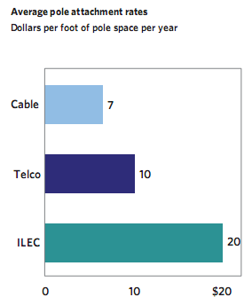
Average Pole Attachment Rates Paid by Different Broadband Providers

Slide 15
Spectrum
Make 500 MHz of spectrum available in next 10 years, with 300 MHz for mobile in 5 years;
FCC should reallocate 120 MHz from commercial broadcasters;
Create a “Spectrum Dashboard” for consumers to determine spectrum licensees and uses;
Congress should allow incumbent spectrum holders to auction spectrum licenses for profit;
Spectrum fees on government and commercial spectrum holders (as in UK);
Make “white spaces” spectrum available for unlicensed use.

Slide 16
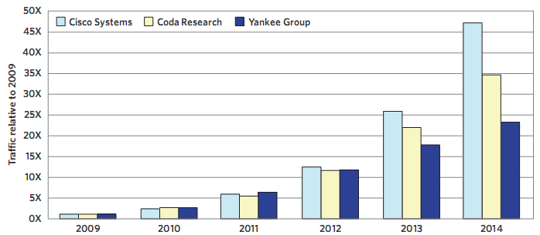
Forecasted Growth in Mobile
Data Traffic (Cisco)

Slide 17
Research and Development:
Key Recommendations
Federal Government should focus broadband R&D on long-term research, not just short-term;
Congress should make the R&E tax credit long-term;
Federal Government should build high-capacity broadband to select DoD installations;
NSF, NAS and NAE should develop broadband research “road map” and broadband research center.
Make more spectrum available for research and researchers (“test beds”).

Slide 18
Broadband Availability:
Key Recommendations
Reform $9 Billion Universal Service Fund (USF) to focus on 4 Mbps Broadband (not telephone)
Create new Mobility Fund and Connect America Fund to subsidize broadband in unserved areas;
Promote Institutional connectivity so that anchor institutions can obtain long-term broadband connectivity, training, applications, etc. (UCAN)
Reform USF contribution mechanism (IP fees? Telephone numbers? Broadband connections?)

Slide 19
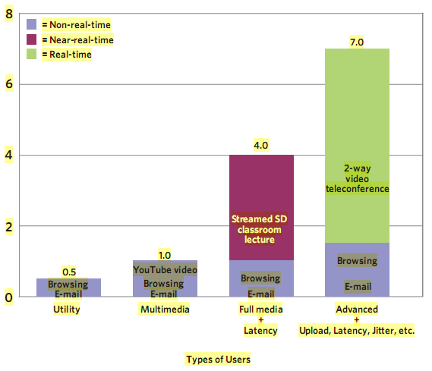
Min. Download Speeds to Run Simult. Apps.

Slide 20
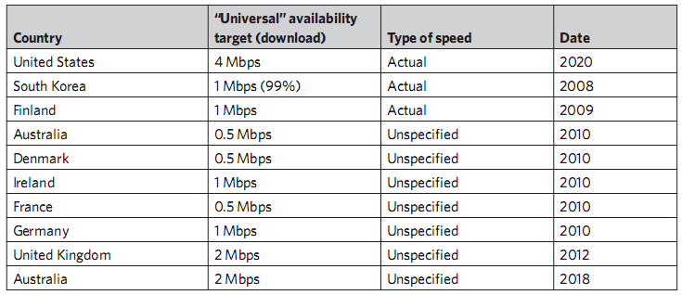
Broadband Deployment Goals of Selected Countries

Slide 21
Broadband Adoption and Use:
Key Recommendations
FCC should expand subsidies to low-income consumers to reduce broadband expenses.
NTIA should establish National Digital Literacy Corps.
Work more closely with Tribal governments and Disabilities organizations.
Federal government should create Broadband Accessibility Working Group.

Slide 22
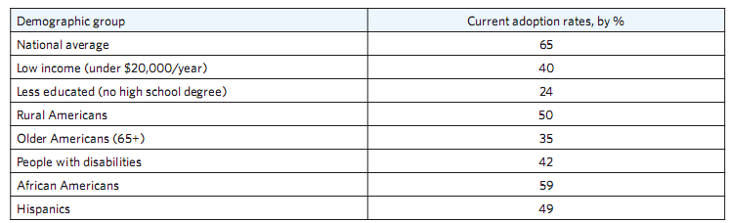
Broadband Adoption by Certain Demographic Groups

Slide 23
EDUCATION:
Key Recommendations
Federal Government should increase supply of digital educational content;
Allow accreditation of on-line courses;
U.S. Dept. of Education should
  invest in open licensed and public domain educational software;
  award grants to train teachers in digital literacy;
  adopt standards for electronic educational records.

Slide 24
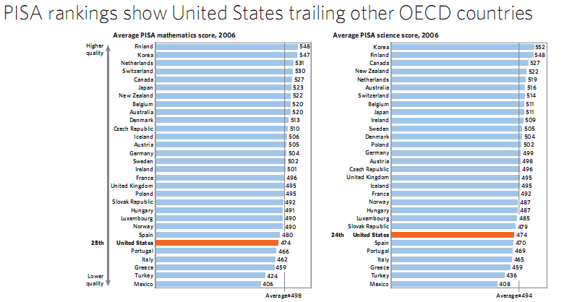

Slide 25
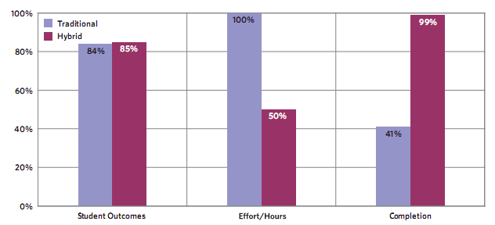
Carnegie Mellon Online
Learning Initiative

Slide 26
E-Rate Reform:
Key Recommendations
Streamline Application process; (done)
Give E-rate applicants more flexibility to purchase dark (and lit) fiber; (done)
Increase the cap on E-rate support based on inflation; (done)
Allow some E-rate funding for portable learning devices (that can be used at home); (pilot project)

Slide 27
E-Rate Reforms (cont’d)
Set goals for minimum broadband connectivity for schools and libraries;
Evaluate how efficiently applicants use E-rate funds;
Congress should allocate additional funding to improve broadband connectivity for all Community Colleges.

Slide 28
Obama Administration task force
Now evaluating FCC’s National Broadband Plan;
About ½ of FCC’s recommendations are directed toward other government agencies;
Task Force co-chaired by Larry Strickling (NTIA) and Scott Harris (Dept. of Energy)
More changes to come ???

Slide 29
Net Neutrality?
FCC accepting additional round of comment on specialized services and wireless.
Possible decision early next year.
Mid-term elections likely to have an impact.

Slide 30
Thank you
John Windhausen
jwindhausen@telepoly.com
(202) 256-9616

