Slide 1


A Grassroots Approach to Implementing Project Portfolio Management
Copyright: Sean Philpott 2010.
This work is the intellectual property of the author. Permission is granted for this material to be shared for non-commercial, educational purposes, provided that this copyright statement appears on the reproduced materials and notice is given that the copying is by permission of the author. To disseminate otherwise or to republish requires written permission from the author.
Notes:
A Grassroots Approach to Implementing Project Portfolio Management
Copyright: Sean Philpott 2010
This work is the intellectual property of the author. Permission is granted for this material to be shared for non-commercial, educational purposes, provided that this copyright statement appears on the reproduced materials and notice is given that the copying is by permission of the author. To disseminate otherwise or to republish requires written permission from the author.

Slide 2
Notes:
Session soundtrack.
If technical setup is complete before session start time, play the following entry music:
Creepin’ In
Norah Jones
(Note: removed song file from presentation for space and copyright concerns.)

Slide 3





Grassroots Approach to
Project Portfolio Management
Sean Philpott
Senior Director of Enterprise Systems
Berklee College of Music
Notes:
Self-introduction
Berklee College of Music
-4,200 students pursuing undergraduate degrees with varying specialties in music performance or music industry fields
Senior Director of Enterprise Systems
-responsible for the college’s primary business and collaboration systems.
Purpose
-talk about an approach to manage a high volume of projects, but more importantly… how to got it in the water.

Slide 4
portfolio management
process
grassroots
results
Q&A
Notes:
Agenda Review
Grassroots – construct a definition
Portfolio Mgmnt – overview
Process – combination of process and using grassroots approach to implementing it
Results – some results of each, grassroots and project portfolio management
Q/A
Grassroots origins
no single authoritative definition.
general agreement that the first reference is…

Slide 5

“This party has come from the grass roots. It has grown from the soil of people's hard necessities."
Albert J. Beveridge
US Senator, Historian, Author
1862-1927
Notes:
People working together
People’s effort
From ground up
“This party has come” indicates effort made to establish something that did not exist previously
common elements to a grassroots effort…

Slide 6
Grassroots efforts are:
Goal oriented
People driven
Low cost
Comprised of many small actions
Easy to engage in
Inclusive
Notes:
Goal oriented - There is a desired outcome, something that someone wants to accomplish
People driven – based on the effort of individuals working in some sort of coordinated manner
Low cost – they almost seem spontaneous. They aren’t big billboard or tv ad campaigns.
Many small actions – characterized by large quantity of small actions, a “whisper storm”
Engaging – premium put on accessibility
Inclusive – encourage identity and community
To verify this definition, introduce experiment done with session…

Slide 7
Experiment:
Goal
People
Cost
Actions
Easy
Inclusive
Experiment:
Goal - content
People – contacts, attendees
Cost - available resources
Actions - survey, emails, postings
Easy - 2 questions
Inclusive - share results
Notes:
Set goal – session attendance and content
People – my own contacts, educause site attendee page
Cost– set a budget of $0
Actions
made survey on Google Apps
performed 40 specific actions including
emailing a couple people on the attendee list
emailing a few contacts
posting on linkedin
posting on twitter
Easy – 2 questions, linked to it in every communication
Inclusive – promised share results

Slide 8
Results?
direct contact
volunteer effort
140% ROI
Notes:
Direct contact – “good luck”, some comments on the topic, people asking for a copy of it.
Volunteer effort – a colleague posted it on PM listserv, educause folks posted it on their twitter page (leveraged their credibility)
Invested 40 actions over the course of a week. For my 40 actions, I received 56 surveys.
140% return on my investment. (over 50% included contact information)
So, how can these ideas be applied to implementing something like project portfolio management? Why talk about PPM in the first place.

Slide 9
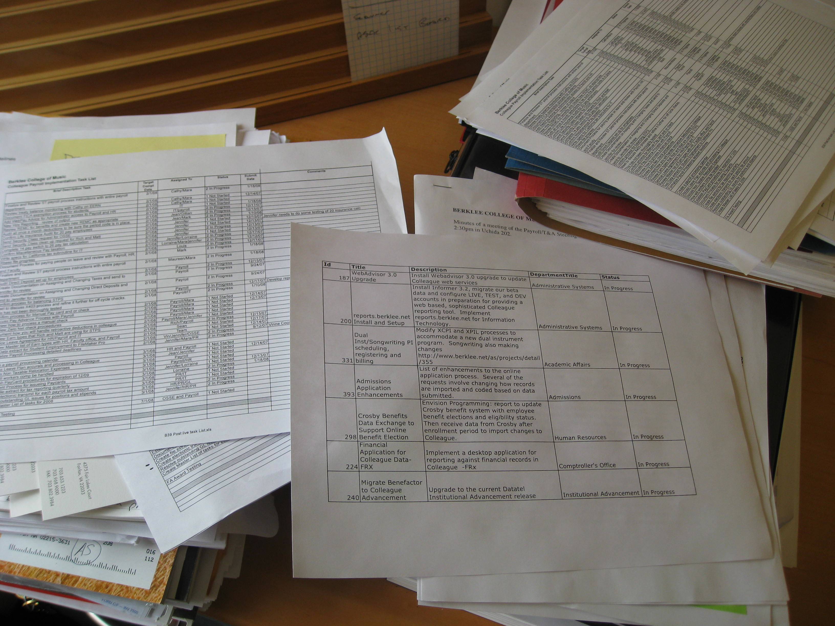
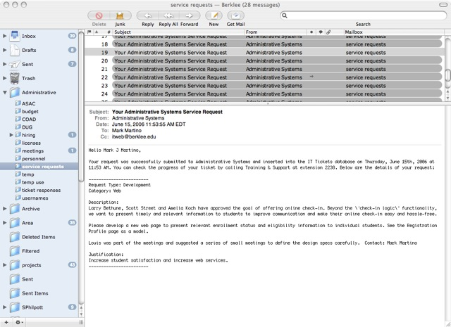
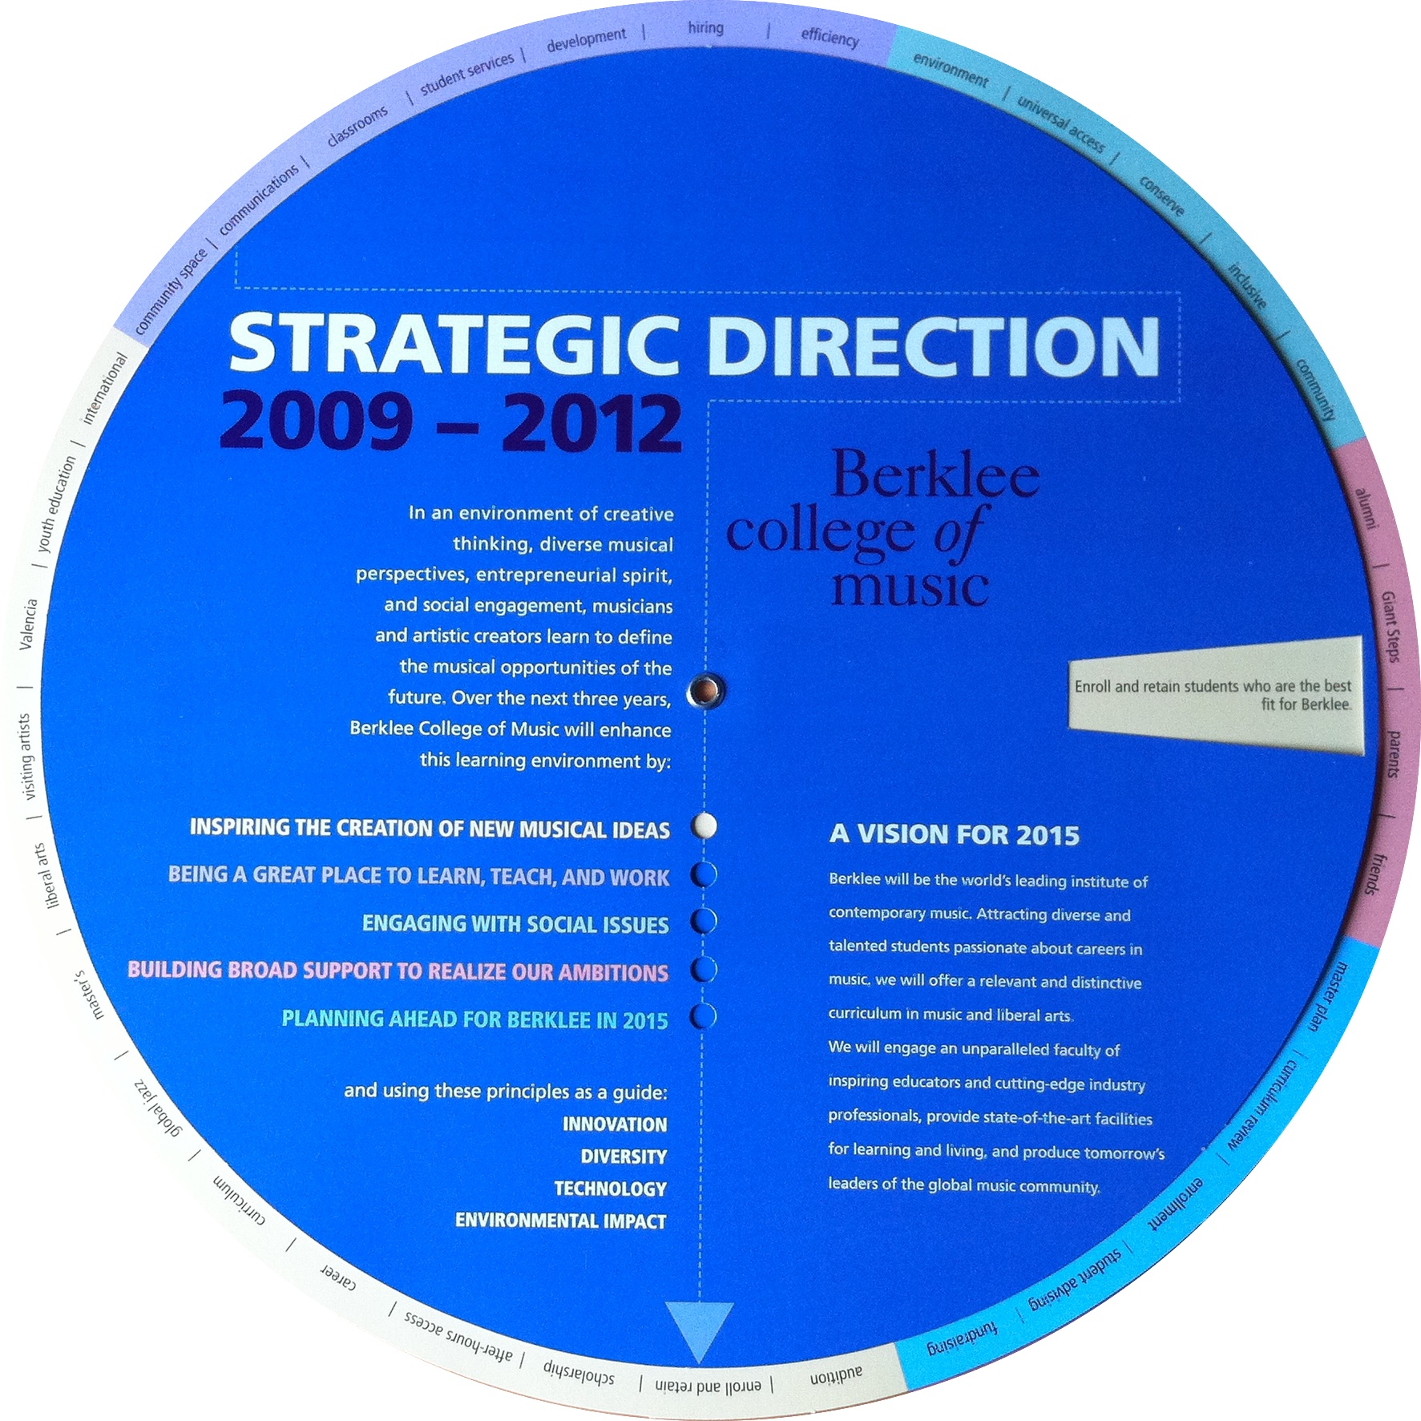
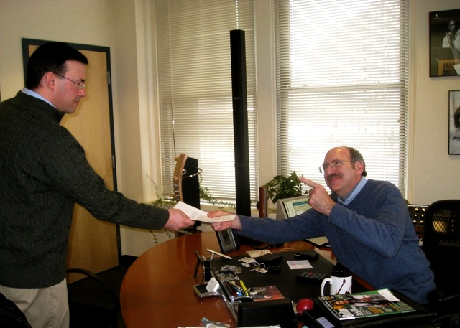
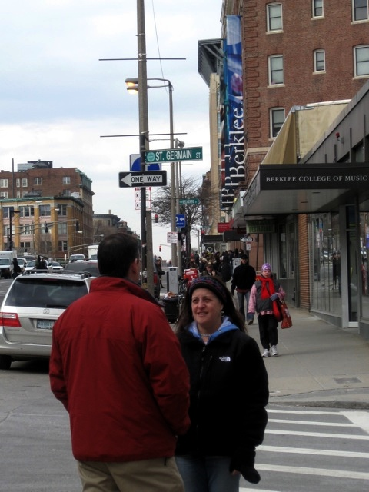
Notes:
Multiple channels for requests
34 items on plan
College grown: in 2001 there were 3000 – today there are 4200
Technology is changing, Expectations are changing
No clear sense of Priority
Knowing this, why grassroots approach to getting there? Lack of support
Story: “good idea, I think you should do it, as long as it doesn’t apply to me”
In a case where there is a need but there is a lack of support, let’s try out the definition of grassroots constructed at the beginning of the session.
First, the goal…

Slide 10
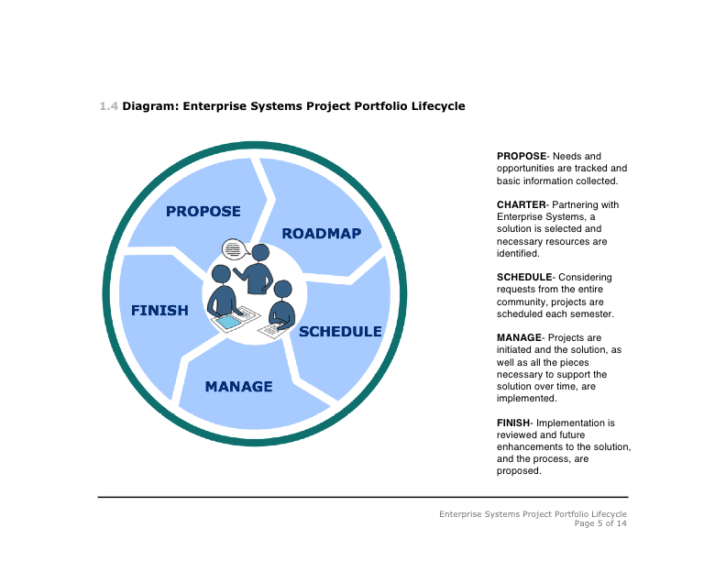
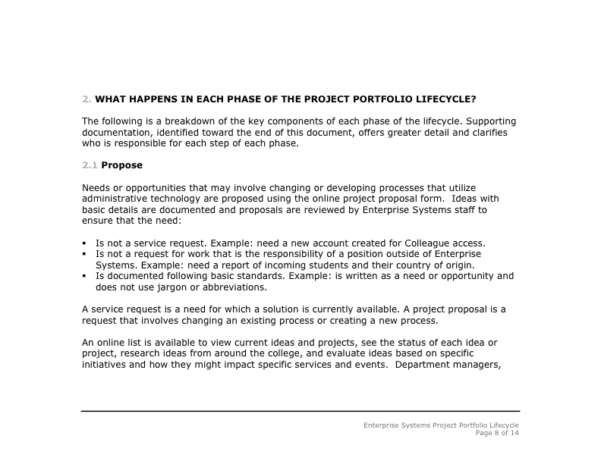
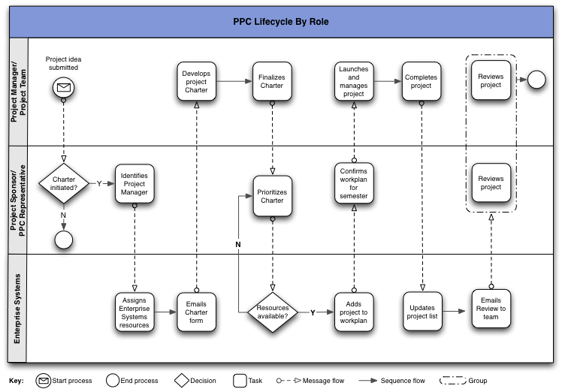
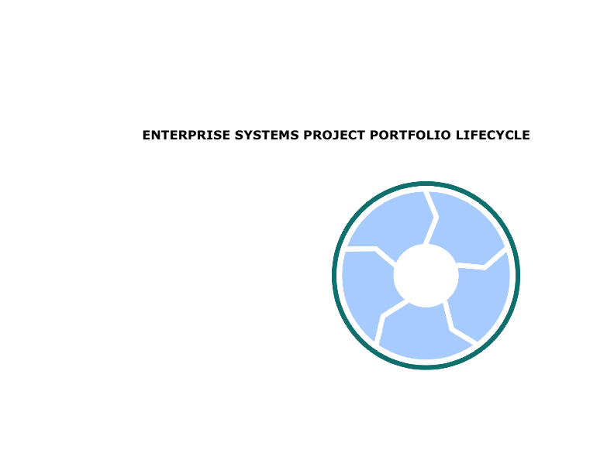
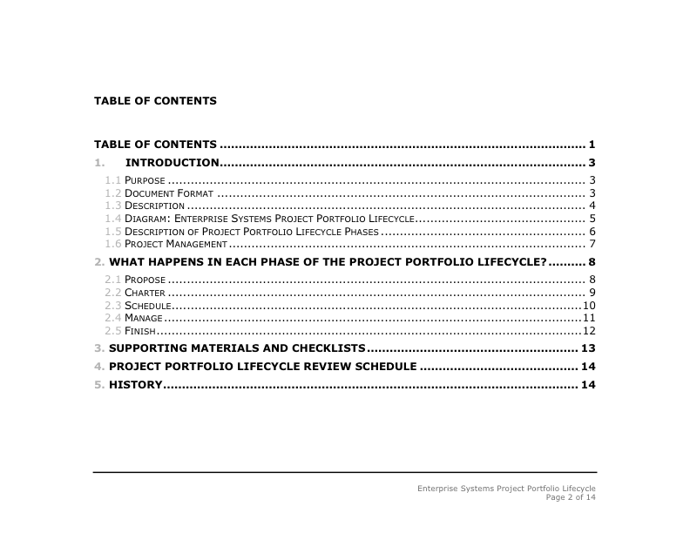
Goal
Notes:
Sorry folks, no magic bullets. You have to put in the effort up front. These things don’t ‘just happen’
Goals
Structure and Document process to support loose, improvisational culture
Partner with the right people and clarify roles
Build resources to make the process as easy and transparent as possible
Grassroots efforts are highly organized. Not all of the members of the effort are, but the core team has to be.
Key members of team
developed and documented a PPM process
documentation serves to encourage consistency of message
provides a resource when someone unavailable to speak to a point
becomes a tangible representation of your objective
Next, had to find the people…

Slide 11
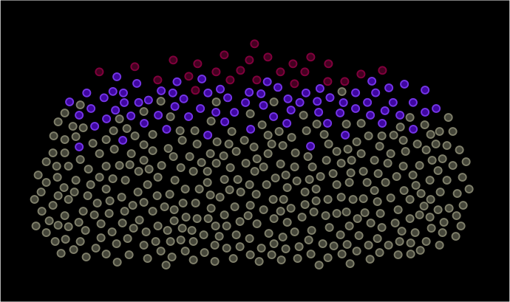
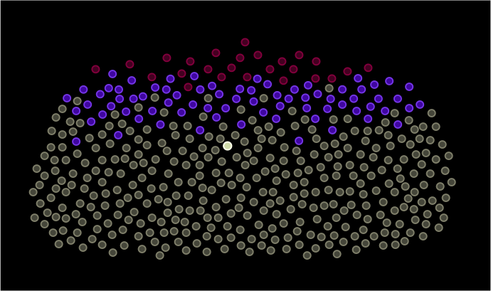
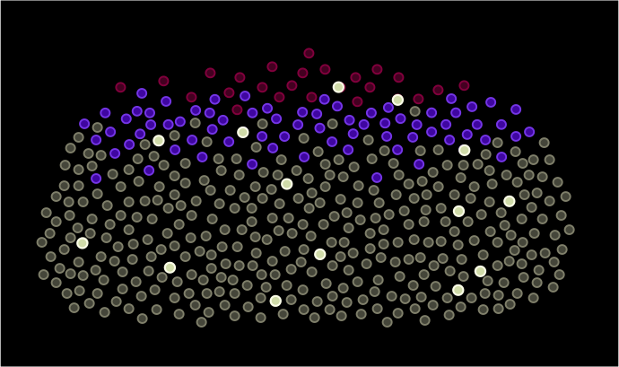
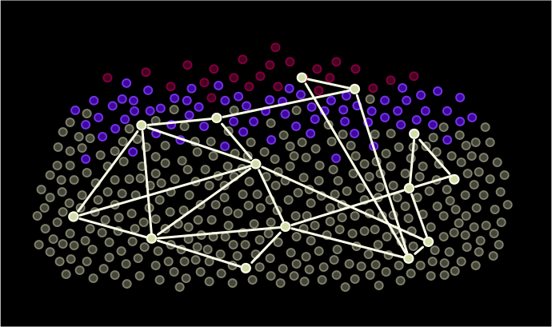
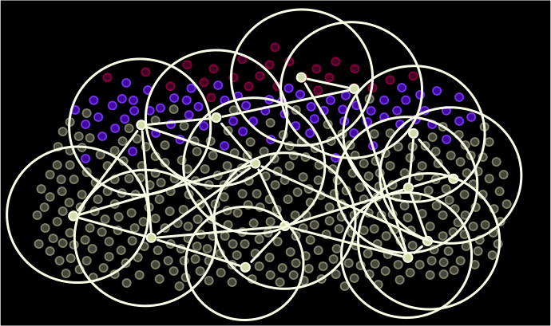

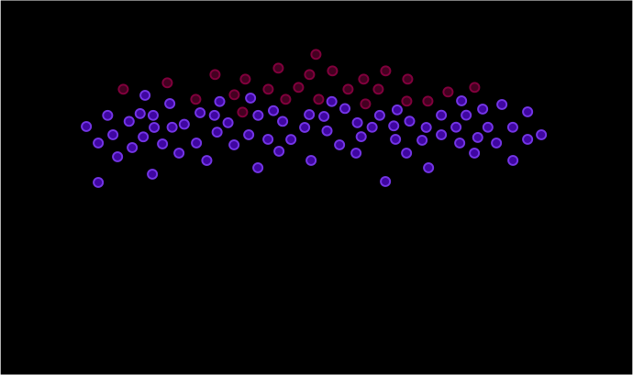
People
Notes:
Like most organizations, we have senior management, middle management, and staff positions. Pretty standard layering of positions and responsibilities.
Also, like most organizations… there are special folks:
They know how to make things happen
They push things along
They tend to take on more than they are actually responsible for
You never know where you are going to find them, but once you do, you know it. They are important because they can help you make connections throughout the whole organization. I call ours the “Berklee fabric”. If you can tap this in some way, you are well on your way.
With their individual spheres of influence, you can have coverage like this if you involve them. That is a better coverage map than anything ATT or Verizon can claim.

Slide 12
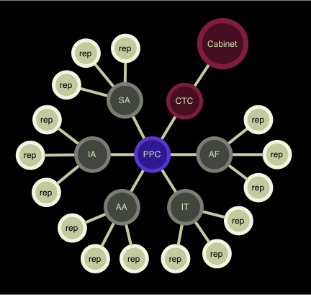
People
Notes:
Kept that in mind when building structure
Describe committee and membership
PPC – project portfolio committee
3 representatives each from the following divisions:
Student affairs
Academic Affairs
Advancement
Administration & Finance
IT (held ourselves to all the same rules we were applying to everyone else)
Committee reports to CTC (college technology council), which in turn reports to cabinet. Note: this was not true at outset.
Not all representatives are Berklee fabric folks but there are enough to provide the benefit sought.
Cost…

Slide 13
Cost
Notes:
Project Portfolio Committee formation
-commandeered existing committee that was not functioning
-low cost because there was no need to establish new committee and get support for it or commit people’s time to something new
Tools
-use what is available to you
-no need to request funds
-Started with excel to keep track and we still do resource planning that way.
-Lucky to have a good web developer who built a pretty sexy list manager. Intentionally made with really basic functionality but what is there is pretty cool.
Actions…

Slide 14
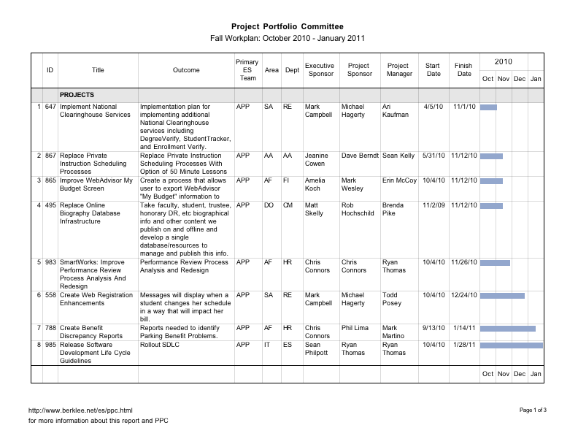
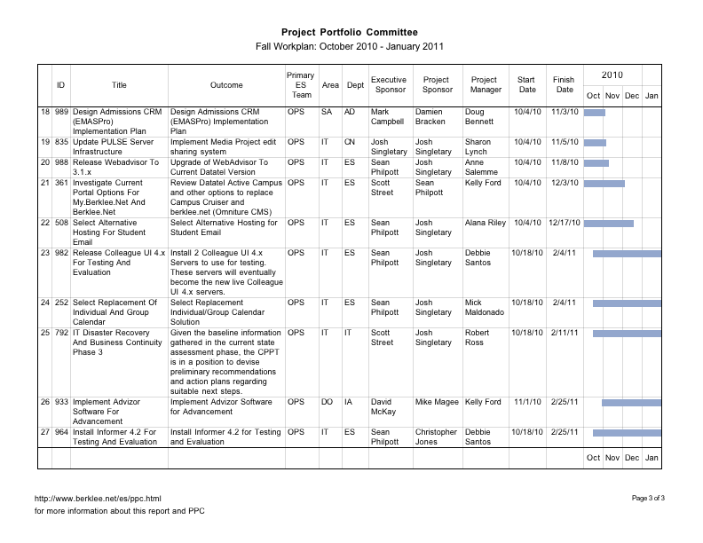
Actions
workplan development
assigned tasks
communication
Notes:
Engaged them and asked them to do things
-Sent what we had recorded as their projects and asked them review
-Had them iteratively develop 4 month workplan
-collect requests
-areas prioritize their needs
-preliminary project definition through project charters
-project selection
-project resourcing/scheduling
-workplan development and distribution
Wherever possible, supported them in completing tasks – creates ownership, pride (not universally). Interesting to note that the ‘Berklee fabric’ folks responded most positively to this. Demonstrates need to locate and engage them.
Easy…

Slide 15
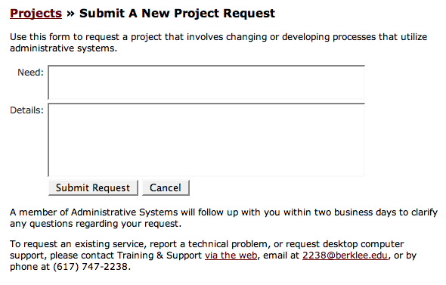
Easy
reduced number of meetings
low barrier to entry
publicly available
Notes:
Reduced number of meetings.
Administration and Finance example. Potential savings of 60 meetings a month.
Form is overly simple and publicly available. Beyond that… we also said you don’t have to use it. We’ll do it for you. The point was centralizing inputs and knowing what was out there, detail could come later.
Inclusive…

Slide 16
Inclusive
Identity, role, and purpose
Public recognition
PPM community
Notes:
Create identity, purpose, and community
Listed names on website, listed roles and responsibilities
Used individual and group meetings
So, how did it go?

Slide 17
Grassroots Results:
Visibility
Engagement of representatives
Adoption of terminology
Notes:
From a grassroots perspective:
Big early win – annual awards ceremony at Berklee and the group was mentioned as an entity in three different awards given, both team and individual awards.
Most representatives assumed role and want to see it work, getting very frustrated when things don’t go as described.
Terminology we used was entering the Berklee lexicon. People use some of the words we put in the water and they are universally understood. That, to me, was a pretty amazing early success.

Slide 18
Portfolio Management Results:
Semesterly workplans
Increased leadership involvement
Recognition of PM need
Foundation for technology plan
Data
Notes:
From a project portfolio management perspective:
Workplan – every semester since spring of 2008
College technology council has assumed sponsorship of PPC
People are talking about the need for PM roles and even PMO at college
It absolutely set the stage for building our first multi-year strategic technology plan, recently approved by the college cabinet
It provides data
With data, you can tell stories…

Slide 19
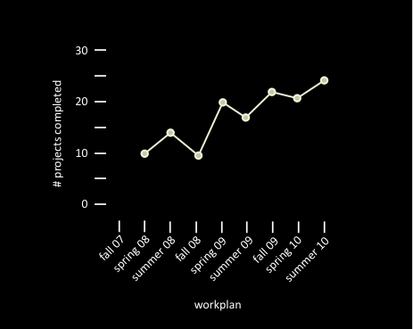
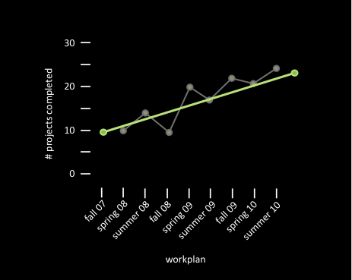
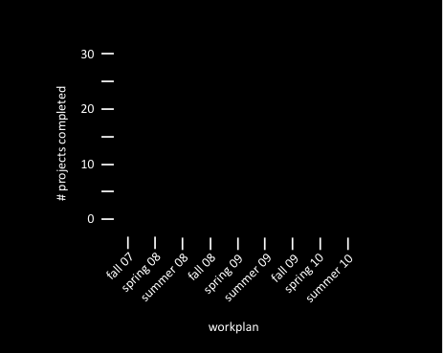
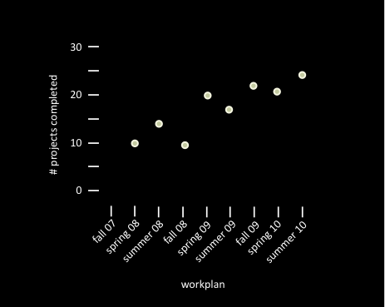
Notes:
Building information from data
What does this tell us?
Increased efficiency?
increased adoption?
Up to you to tell the story but now you have data to support your story
Another example…

Slide 20
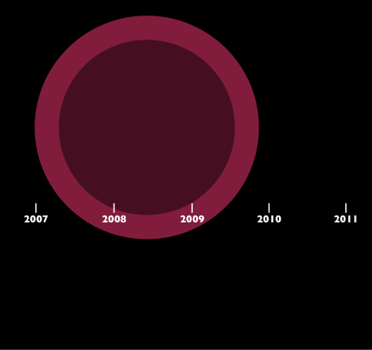
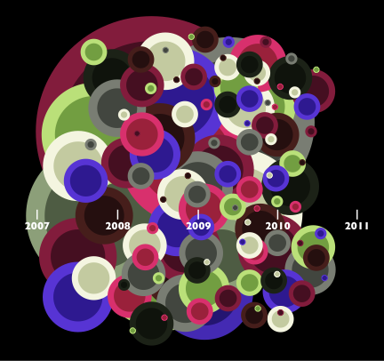
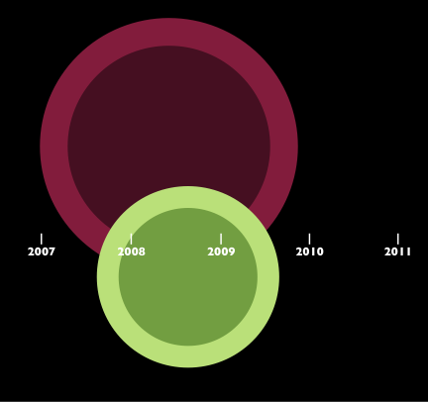
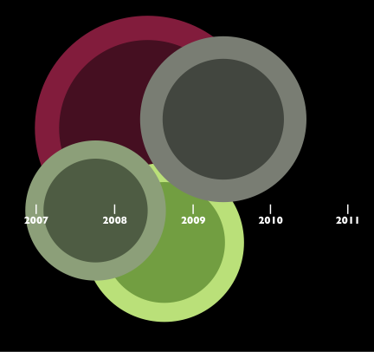
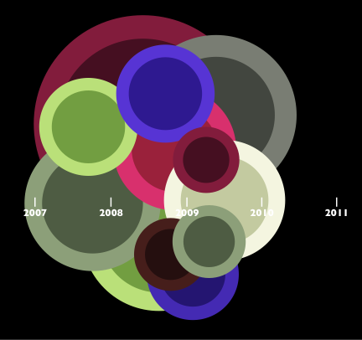
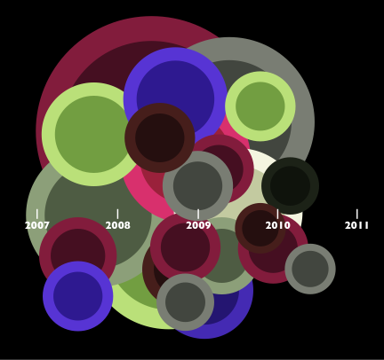
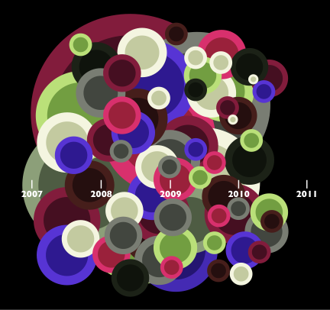
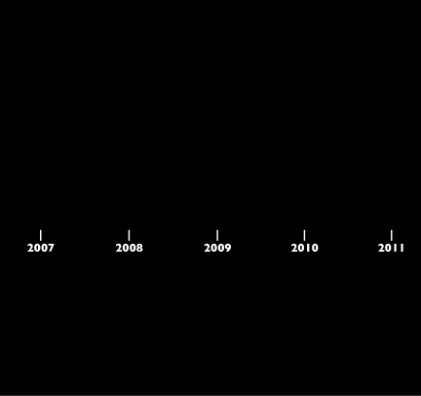
Notes:
Again, building information from data
Is this the same story? What does this tell us?
Increased efficiency?
increased adoption?
143 projects completed, 17.75 per workplan (4 month period) or about one a week.
Can the organization even handle that rate of change?
Note: If you go this route, don’t go around promising data and charts for informed decision making. As you can see here, it takes a few years of collecting data before you are in a position to create information like that.
All good stuff but some things to be aware of…

Slide 21
Lessons learned:
Extraordinary time commitment
Heroes required
Focus on benefit, not process
Know the real goal
Don’t leave issues to ‘fix themselves’
Notes:
Required Time – tons, expect to repeat yourself often and don’t let it get to you
Heroes – you need champions, you need to be a champion
Benefit – over time, went astray from the benefit message to focusing on the process, didn’t work well. Remember that the process benefits you, the projects, the organization. The results of the process benefit the individuals. Focus your messaging on what people get out of this, not on the steps of doing it.
Goal – didn’t realize my real goal was leadership and community support for this idea, not the process itself. Would have changed how I communicated.
Issues – whether it is grassroots or portfolio management; we are talking about mucking around in what people want. As soon as an individual questions the approach with either one, you risk losing them. ‘House of cards”
One last piece – look at our organizations and fit for this approach…

Slide 22
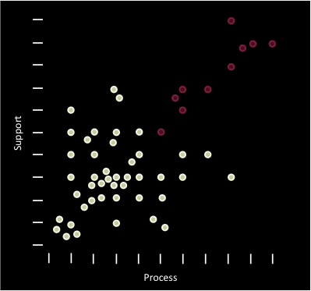
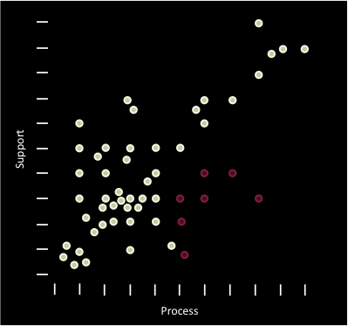
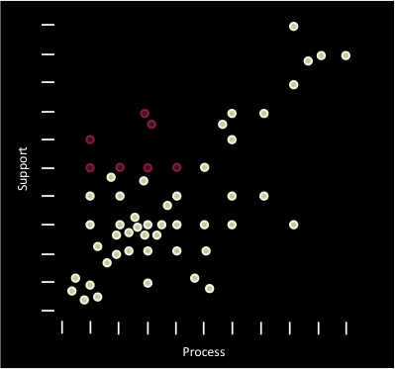
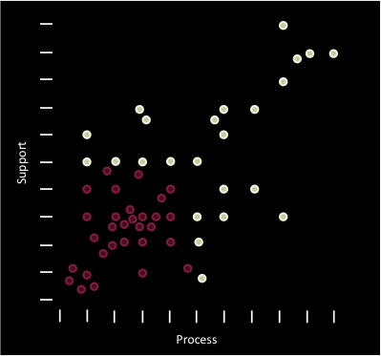
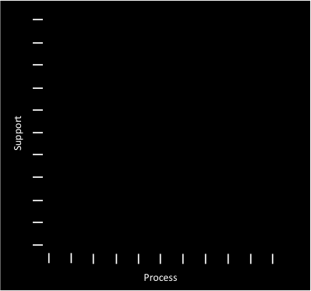
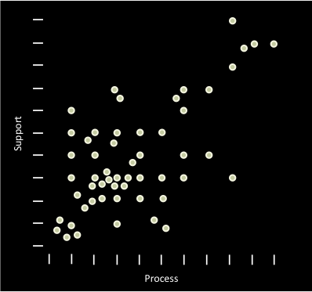
astroturfing
Notes:
~19% High Support::High Process
Congratulations, you found the golden ticket!
This is the wrong session for you.
-don’t be disingenuous – you have the mandate and the tools so use them. You can use some of the same communication strategies but the messaging is different. People are perceptive and if you go about a ‘grassroots’ effort when you are already established, you will be seen as trying to manipulate. This is know as astroturfing, a fake grassroots efforts.
~13% - High Process::Low Support
Good potential for using these ideas
~13% - High Support::Low Process
In that case, you just have a project that needs to get kicked off
~56% - Low Support::Low Process
The perfect conditions… not overly mature process and the need to gain senior leadership support. This is where we were and I can honestly say that this approach has moved us a good way towards the upper right quadrant. Still a good ways to go… Maybe we will see each other again and I can update you on progress.

Slide 23
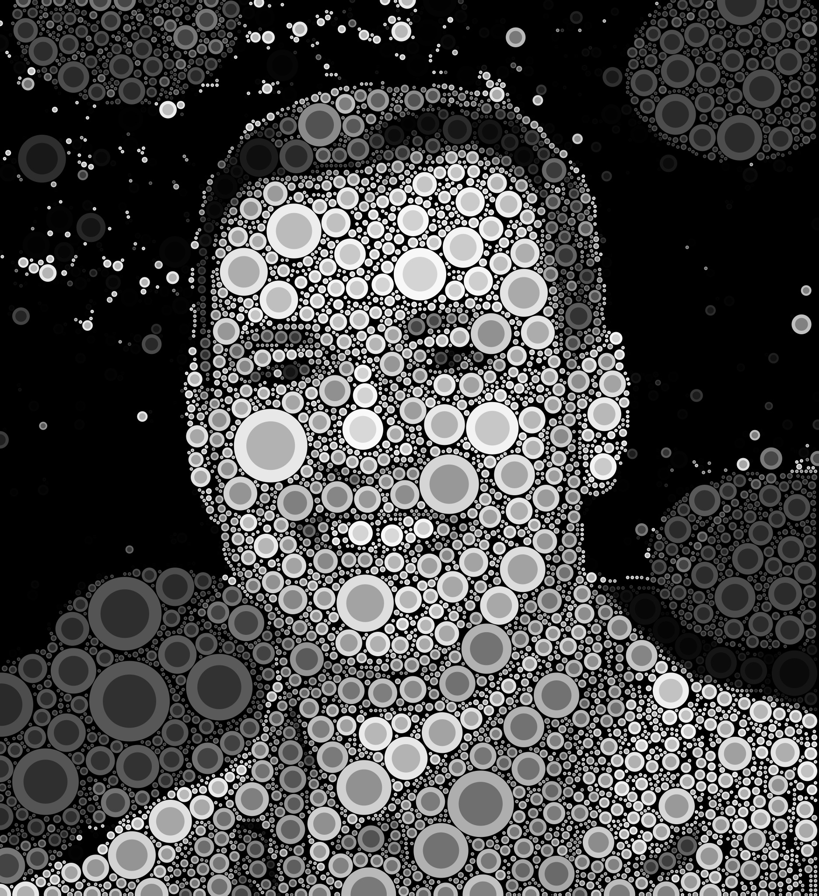
Questions?
Sean Philpott
sphilpott@berklee.edu
Notes:
Thank you for attending
Please fill out survey
Questions?

Slide 24

Grassroots Approach to
Project Portfolio Management
Sean Philpott
Senior Director of Enterprise Systems
Berklee College of Music
Notes:
Session soundtrack.
If time left at end of session, play the following exit music:
The Bear
Stephen Kellogg & the Sixers
(Note: removed song file from presentation for space and copyright concerns.)

