Slide 1

HUBzero at Indiana University: the indiana CTSI Hub
^{Bill Barnett}
^{EDUCAUSE}
^{October 14, 2010}

Slide 2

The Indiana Clinical and Translational Sciences Institute (CTSI)
One of 55 institutes nationally with the goal of advancing health outcomes by improving:
  ‘bench to bedside’ (first time in humans testing),
  medical education,
  community outreach,
  administrative processes, and
  tech transfer.

Slide 3
The Indiana CTSI as a Virtual Organization
A statewide partnership of IU School of Medicine, IU Bloomington, Purdue, and Notre Dame
Challenge to shift research for its own sake to research with a health outcome trajectory
Challenge of broad geography and multiple institutional cultures
Challenge of innovating administrative processes

Slide 4
The Indiana CTSI HUB Challenges
A more institutional and process focused VO
Deal with inertia of existing processes
Deal with established, or changing, organizations
Deal with a wide variety of stakeholders
Solutions need to be simple, with low barrier of entry
Educause, October 14, 2010

Slide 5
Key Features of HUB frameworks for IU
Extensible – anyone can create and contribute new applications and access distributed resources (such as computational grids)
Open - Fully compliant with Web 2.0 standards provides flexibility
Trustworthy – IP management and citation system structures contributions
Collaborative – Social networking and group-based sharing features
Interactive – tools for online tutorials, podcasts, simulations, and analysis
Evaluative - user ranking and feedback, and trouble ticketing
Descriptive - Semantic tagging infrastructure for resource description

Slide 6
The Indiana CTSI approach to HUBs
An institutional and process focused VO
Need both Core HUBzero features, plus independent applications
Need Multi-institutional Identity Management
Need Central repository of relevant data
Educause, October 14, 2010

Slide 7
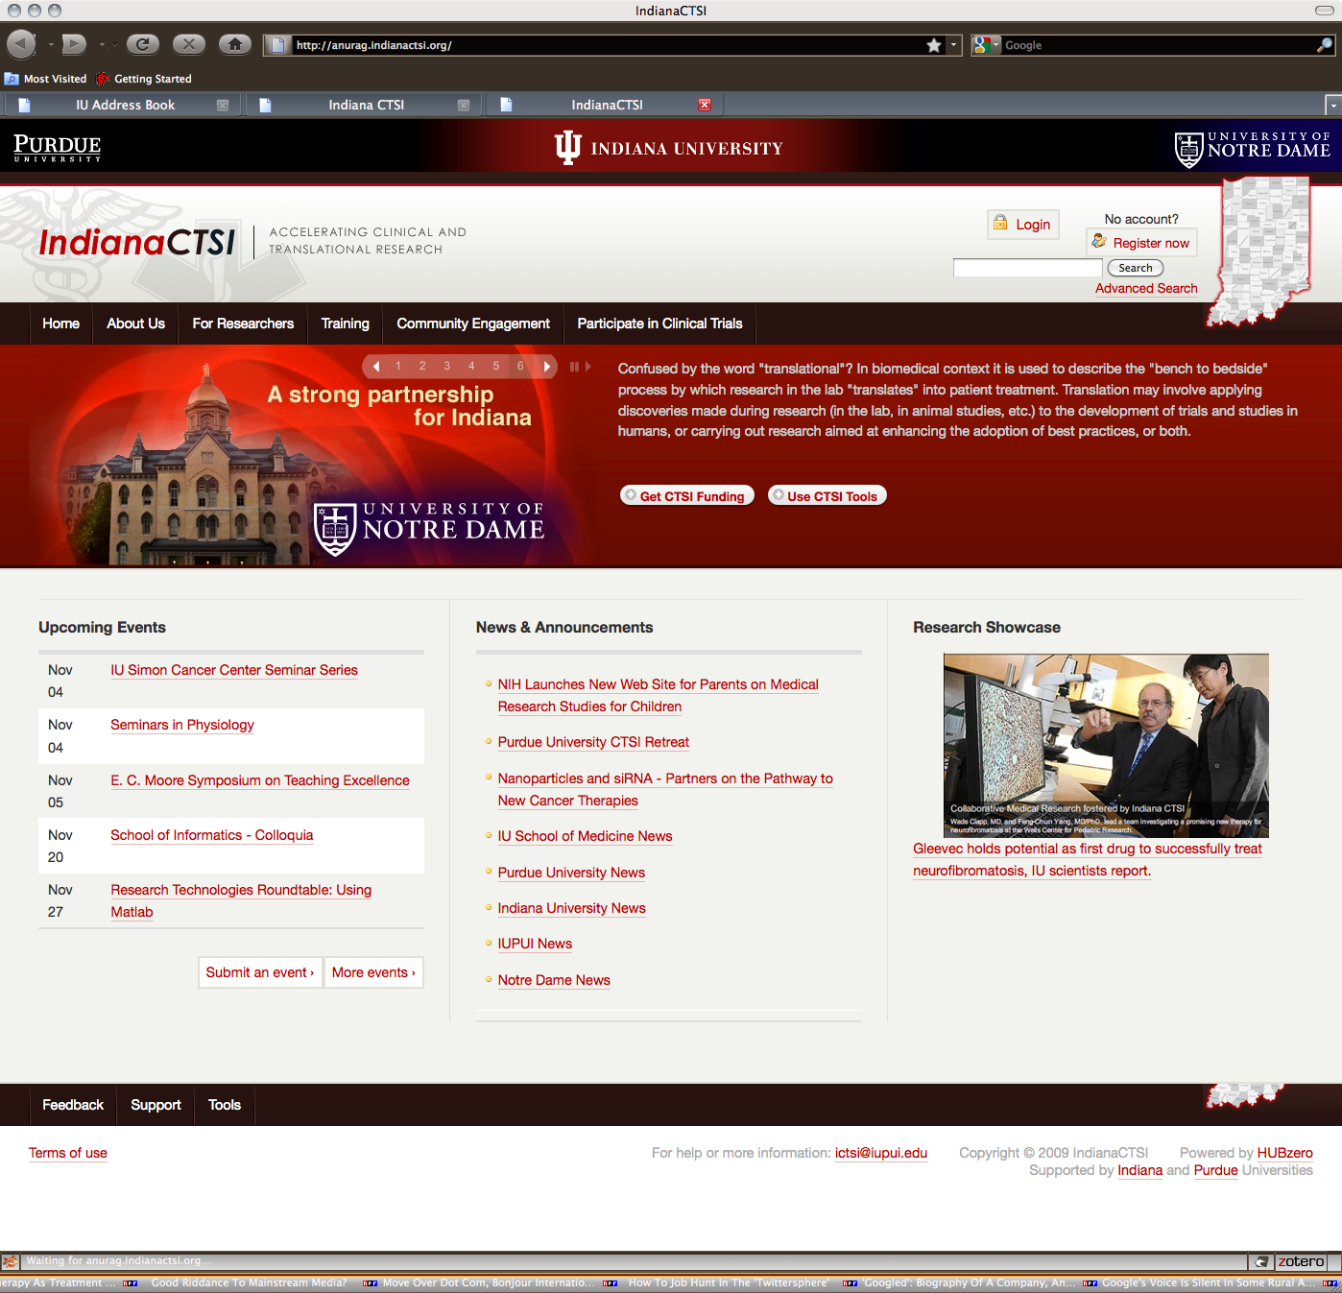
The Indiana CTSI HUB
Login
Search
Stakeholders
Tools
Events and
Information

Slide 8

Indiana CTSI HUB Software Developments - 1
Modified Open Journal System (PKP) to manage administration of CTSI grant programs.
Provided authoritative list of Clinical Trials for the State of Indiana
Created an online resource for using Cores at Indiana CTSI institutions
Educause, October 14, 2010

Slide 9

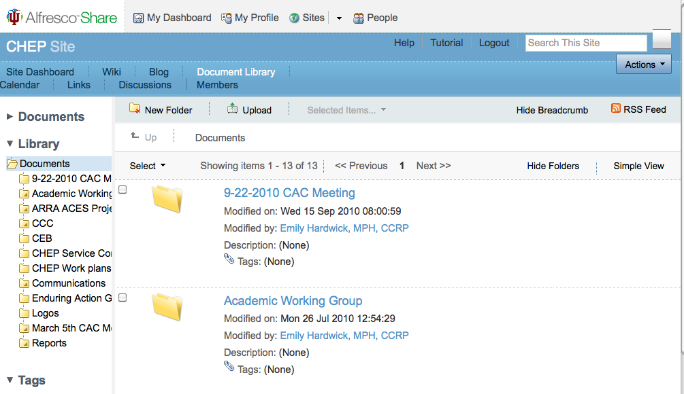

Indiana CTSI HUB Software Developments - 2
Pioneered HUBzero/InCommon Federated Identity Management Infrastructure – first among NIH clinical and translational science awards (Thanks Alan Walsh!).
Alfresco Share multi-institutional file sharing system for collaborative research (Open Source)
REDCap (Research Electronic Data Capture) software for research data collection and management (Vanderbilt)
Supported by NIH/NCRR ARRA Supplement to the Indiana CTSI, # 3UL1RR025761-02S3

Slide 10
Indiana CTSI HUB: Next Steps
Home page and site architecture rebranding and redesign
Ontologically based tagging of HUB content to make discovery easier
Partner with VIVO initiative to provide Semantic Web based personal profile management in institutional repositories as resource for a number of applications like CV generation.

Slide 11
Thanks! Questions?
Bill Barnett (barnettw@iu.edu)
Director, Information Infrastructures, Indiana CTSI
Pervasive Technologies Institute
Indiana University

