Slide 1
HUBzero at CLEMSON UNIVERSITY
Jill Gemmill | October 14, 2010

Slide 2
Why?
Multi-institutional collaboration environments needed; scalable, re-useable
Build, buy, or adopt?
How we use hubs.

Slide 3


The Open Parks Grid (OPG) at Clemson University
A collaborative endeavor between Clemson University and the National Park Service
Notes:
Adobe working well
Several folks calling in….

Slide 4
What is the OPG?
Knowledge Pipeline for Park Professionals
The purpose of the OPG is to unite the highly distributed parks community of managers, researchers, policy-makers, and citizens, through the development and use of cyberinfrastructure, to foster greater distribution of knowledge and facilitate more informed management decisions.

Slide 5
Principles to Guide Us
Facilitate the protection of our natural and cultural heritage
Enable parks to operate more efficiently and effectively
Leverage existing information resources without duplicating them
Build a scalable system
Build a sustainable system
Notes:
Wonder if we should separate the paragraph on partnership into separate slide form Principles…would allow for larger font and keep the slide from being so busy….

Slide 6
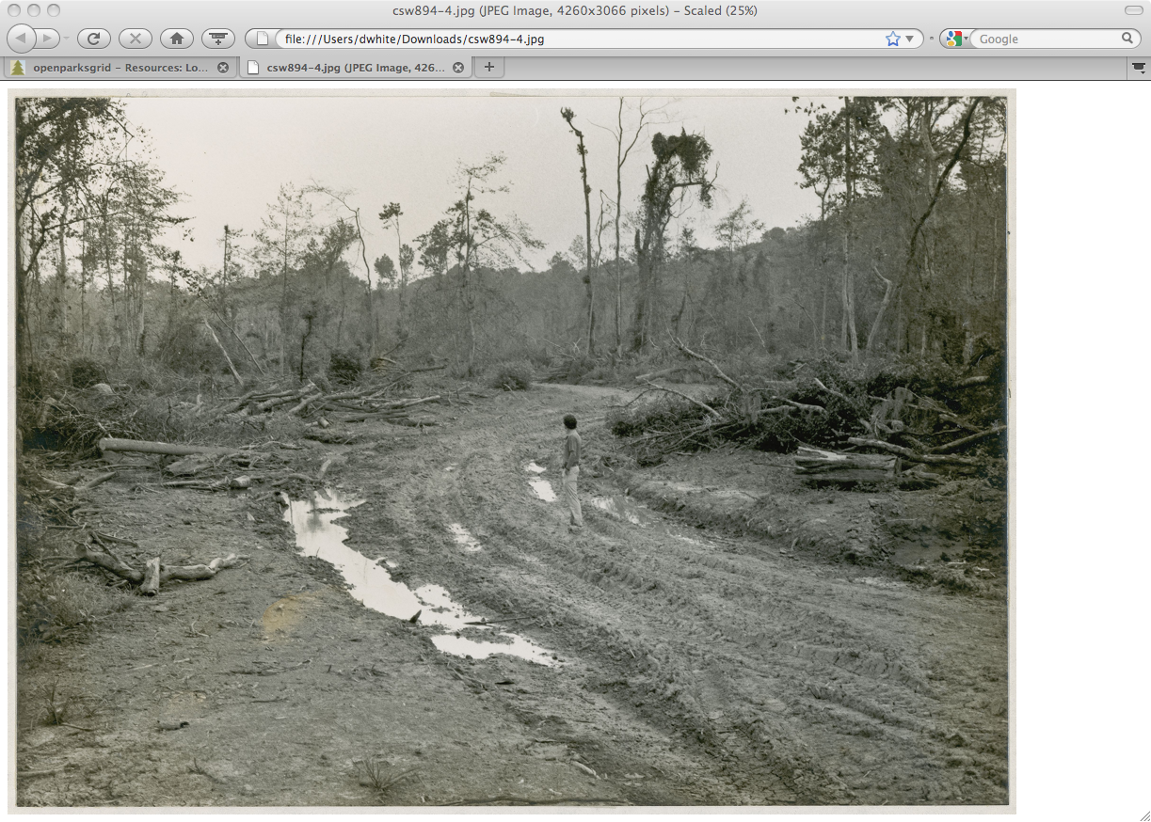
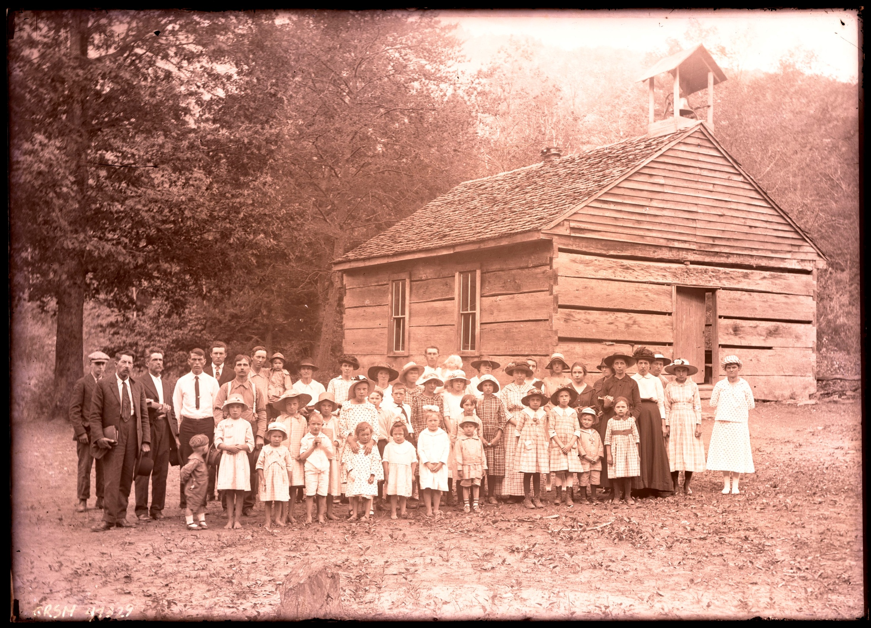
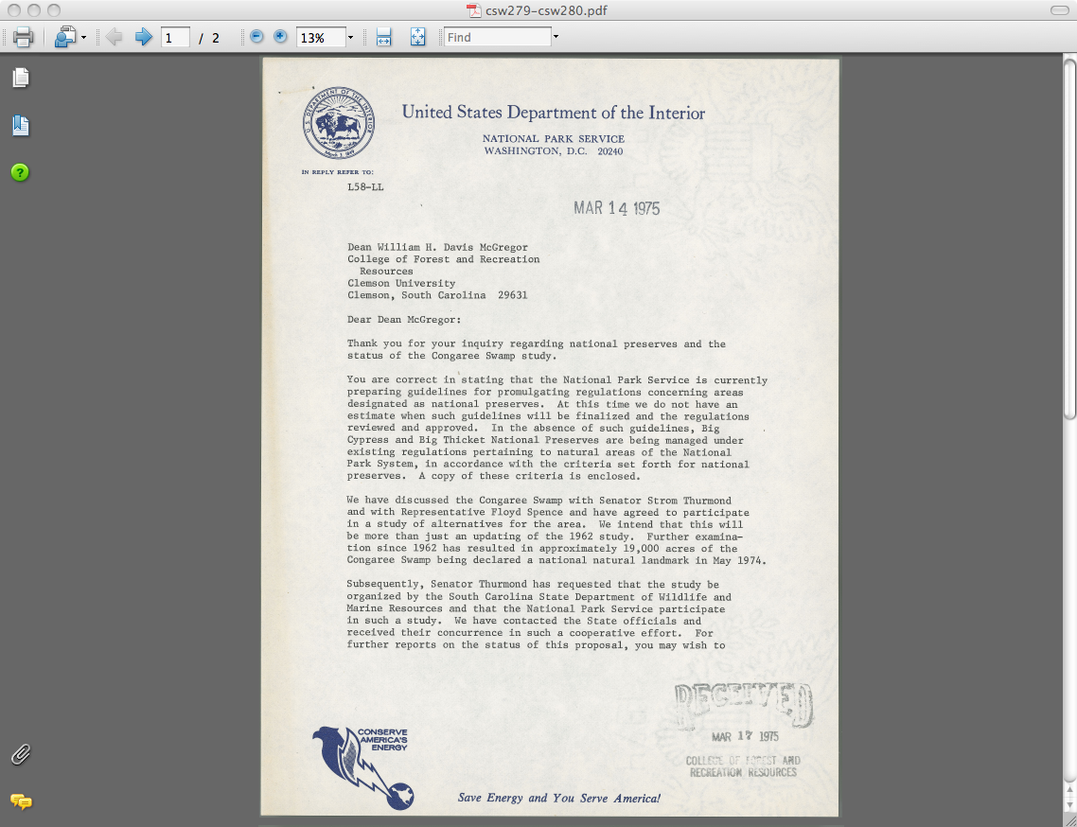
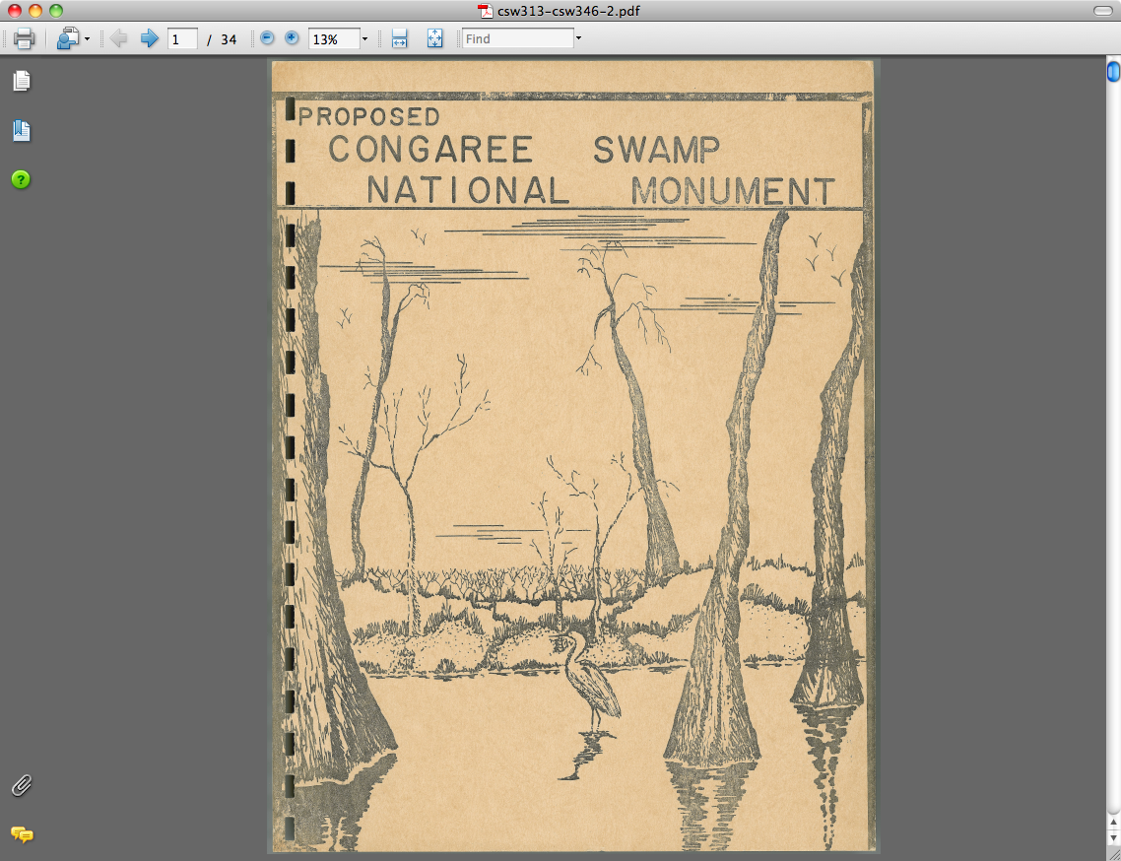
Digital Artifacts

Slide 7
Selection & Metadata
Selection of materials for OPG prototype has been done by superintendents and cultural resource specialists at the beta parks
Goal of selection of materials for beta was to provide a representative sample of materials
The use of exisiting metadata provided by the Parks is also key

Slide 8
Location of past burn areas (red), water quality monitoring instruments (black dots), and information associated with Fontana Lake in Greater Smokey Mountain Park.

Slide 9
Evolution of OPG
$135,000 award from NPS/CESU Sept. 2010
Meeting at Cosmos Club,
April 2007
Director Bomar Presentation
October 2008
Selection of Beta Sites
March 2009
Beta Testing
2010
Clemson’s Content & Technical Teams
SE Regional Directorate Presentation
November 2008
Prototype Development
2009 - 2010

Slide 10
IMLS Grant
Award Amount: $773,444; Matching Provided by Clemson: $799,167 Total: $1.57 million
With this money we will build on the pilot project to turn the OPG into a content-rich, fully functioning portal for parks information
Award is for 3 years and includes almost $300,000 for the digitization of materials held by the parks

Slide 11
Goals for OPG Repository
Single search that will tie together existing repositories via the OPG portal
Build a Fedora-based repository to store and manage digital objects over time.
The development of enhanced GIS tools
Digital Objects to be ingested include items being digitized in partnership with the NPS and state parks of NC, SC, GA (proposed 3 million pages) and 150,000 digital objects (including maps and artifacts)
  To date, we have digitized maps (geo-rectify), panoramic photographs, glass plate negatives, letters and reports. We anticipate these objects and more in the grant.

Slide 12
Architecture

Slide 13
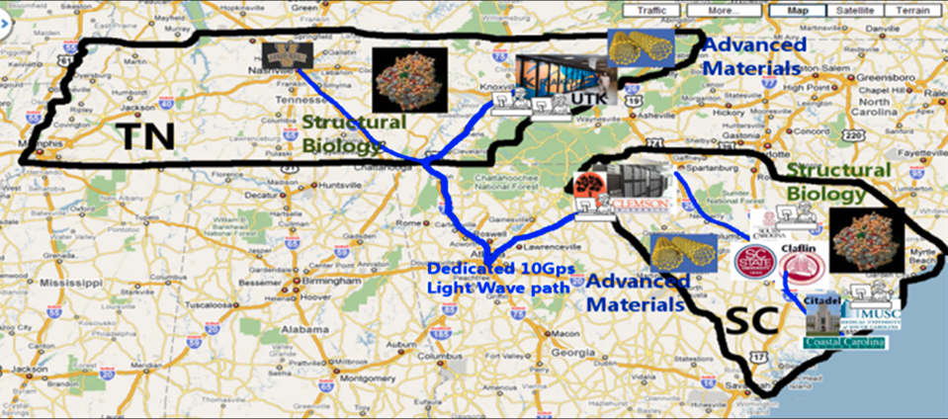
A Desktop to TeraGrid Ecosystem
EPS-0919440 (SC)
Jim Bottum and Jill Gemmill, Clemson University
EPS-0919463 (TN)
Thomas Zacharia, University of Tennessee-Knoxville Peter Cummings, Vanderbilt University

Slide 14
Partners / Participants
South Carolina
  The Citadel+
  Claflin University*
  Clemson University
  College of Charleston+
  Medical University of South Carolina
  South Carolina State University*
  University of South Carolina
Advisory Board
  Jesse Bemley, JEF
  Rebecca Doerge, Purdue
  Ian Foster, UChicago
  Mike Ellisman, UCSD
Tennessee
  Oak Ridge National Laboratory
  University of Tennessee-Knoxville
  Vanderbilt University
External Evaluator
  Tom Finholt, U Mich
MSI-CIEC (NSF OCI 0636352)
  K. Barnes, R. Alo
+ comprehensive undergrad
* HBCU

Slide 15
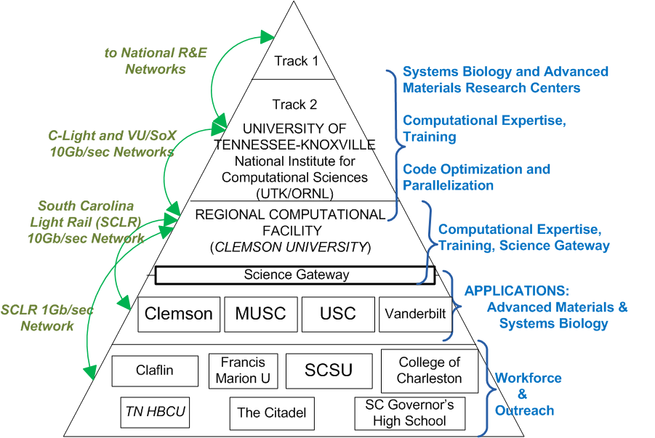
Desktop to TeraGrid Program Highlights
Network Upgrades
Compute Resources
Biology WorkBench
Computational EndStation for
Advanced Materials Research
PetaScale
Application(s)
TeraGrid allocation
8 computational scientists
Science Gateway
Training/Outreach
A campus-based regional facility and science gateway bridge campus researchers to national facilities

Slide 16
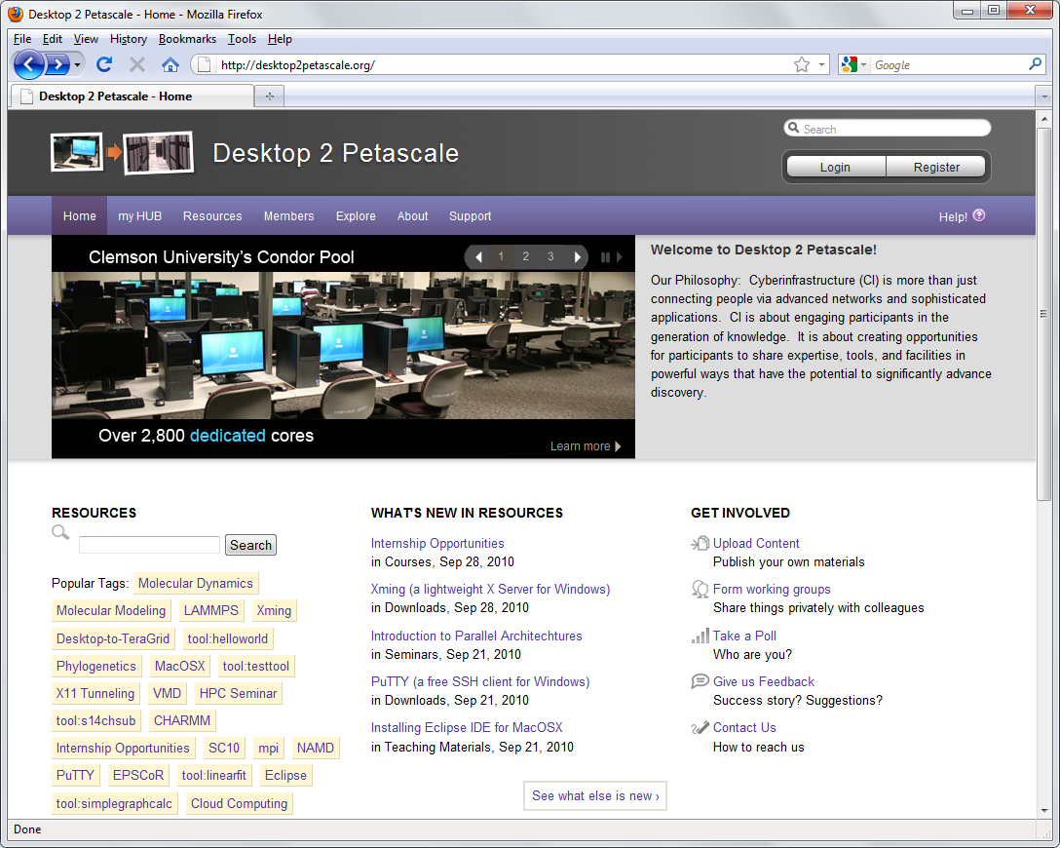
Science Gateway – Leveraging HUBZero software
http://www.desktop2petascale.org/

Slide 17
Demo
www.openparksgrid.org
www.desktop2petascale.org

