Slide 1
Measuring and Validating Attempts to Green Columbia’s Data Center
Rich Hall
Peter M Crosta
Alan Crosswell
Columbia University Information Technology
October 14, 2010

Slide 2
Agenda
Opportunities to “Go Green”
Columbia University’s Advanced Concepts Datacenter Demonstration project
Challenges and Successes
Lessons Learned
Questions & Answers
2
IBM 7090 in University Computer Center, 1966

Slide 3
Opportunities to “Go Green”
Data centers consume 3% of all electricity in New York State (1.5% nationally - estimated in 2006 which translates to $4.5 billion annually)
Centralizing research computing saves energy, space and money
Columbia’s commitment to Mayor Bloomberg’s PlaNYC 30% carbon footprint reduction by 2017.
NYS Gov. Paterson’s 15 x15 goal - 15% electrical demand reduction by 2015
National Save Energy Now 25% energy intensity reduction in 10 yrs.

Slide 4
CU Data Center Improvement Program
Begun with an assessment and recommendation performed by Bruns-Pak, Inc. in 2009.
Columbia Facilities Operations HVAC (Heating, Ventilation, Air Conditioning) study by Horizon Engineering.
Generator overload mitigation study by Rowland Engineering.
JB&B, Gensler & Structuretone developed a master plan which was used to develop:
  DOE ARRA grant application for HVAC improvements (not awarded).
  NIH ARRA grant application for electrical improvements (awarded 04/15/10 Core Research Computing Facility).
  NYSERDA grant application awarded 04/01/2009.
  Future funding opportunities

Slide 5

Columbia’s NYSERDA project
New York State Energy Research & Development Authority is a public benefit corporation funded by NYS electric utility customers. http://www.nyserda.org
Columbia competed for and was awarded an “Advanced Concepts Data Center Demonstration Project”
  24 months starting April 2009
  ~ $1.2M ($447K Direct costs from NYSERDA)
Goals:
  Learn about and test some industry best practices in an operational datacenter
  Measure and verify claimed energy efficiency improvements
  Share lessons learned with our peers

Slide 6
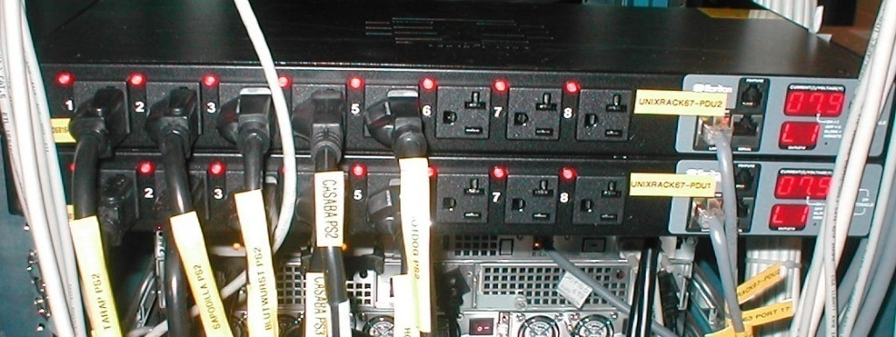
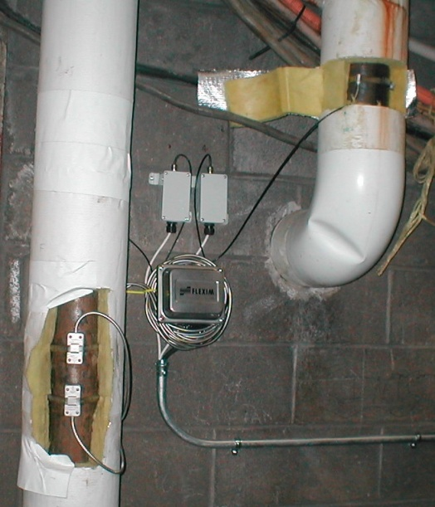
Scope of Work
Inventory
  Create detailed physical inventory of existing servers
Measure server power consumption
  Install network-monitored power distribution units (PDUs) for each server
Measure server input air temperature and data center chilled water
  Install input ambient air temperature monitors for each server
  Install BTU metering on data center supply and return lines
6
6
Notes:
6

Slide 7
Scope of Work Cont’d
Establish overall data center power consumption profile
  Utilize equipment load results to establish baselines
  Develop Power Usage Effectiveness ratio for entire data center
Implement 9 high density racks with in-row cooling
Replace 30 “old” servers and measure efficiency improvement
  Consolidate the replacement servers into high density racks and re-implement the same IT services
  Take measurements of before-and-after power consumption
  Document expected and actual efficiency improvement

Slide 8
Scope of Work Cont’d
Compare old and new high performance research clusters
  Document changes in energy consumption
Implement server power management features
  BIOS- and operating system-level tweaks
Increase chilled water set point and measure
  Document measured before-and-after energy consumption
8
8
Notes:
8
Rich

Slide 9
Challenges
Operational data center
Communication between IT and Facilities
Costs
Identification of what to measure
Implementing and storing measurements
Notes:
Peter
Operational data center
- speaks for itself. Can’t just start unplugging and testing things
- taking production hosts out of service to run benchmarks
IT’s limited infrastructure knowledge requires Communication between IT and Facilities
- who owns instrumentation
- different protocols
- different management bureaucracies
- much work out of IT control; heavy reliance on facilities workers
Costs
- mention both anticipated and unanticipated costs?
- costs of servers is easy; costs of facilities improvements more complicated
- wasn’t just cost of self cooled racks, but a bunch of infrastructure costs we didn’t anticipate
Identification of what to measure and Compare
- raw power consumption – active and idle
- efficiency measure: MIPS/W, FLOPS/W
- Some benchmark program; which one?
Implementing measurements
- beating the clock for hosts slated for retirement
- building a useful measurement data base of appropriate size (instinct is to collect everything forever; costs)

Slide 10
Successes
Measurement Infrastructure
  Installed power meters throughout data center
    20 Power Panels (17 in DC, 3 feeders panels in machine room)
    Established overall data center IT load ~ 247kW
  Installed metered PDUs and plugged in servers
  Installed chilled water flow meters
    Sensors installed to measure flow rate and temperature
    Established overall data center heat load ~ 120tons
General Infrastructure
  Hardware Consolidation
  Cable Tray
  Revised Layout (Hot & Cold aisle) format
Estimated Columbia data center PUE (Power Usage Effectiveness)
Notes:
Peter
Measurement infrastructure can be used past scope of project
General Infra:
- though out of scope of project (not a direct), but a side benefit of knowledge gained from the project, we implemented some other energy efficient practices
- hardware consolidation outside of the project
- cable trays are green: cables were under the floor blocking air flow, so raised cables overhead
- hot/cold aisle allows direction of cold air to hot aisles; allows ACs to work where they should be working; avoids air mixing at higher temperatures and ACs working overtime
PUE
- Can calculate a PUE at any time

Slide 11
CU Data Center PUE
Estimated Power Usage Effectiveness = 2.26
11
Notes:
Peter
We will move toward the annualized average pue which is becoming the industry standard. Right now, we are looking at PUE differences per season.
PUE is an industry standard,
Lower is better,
According to the Uptime Institute, the typical data center has an average PUE of 2.5. EPA says 2.0. This means that for every 2.5 watts in at the utility meter, only one watt is delivered out to the IT load. Uptime estimates most facilities could achieve 1.6 PUE using the most efficient equipment and best practices.
11

Slide 12
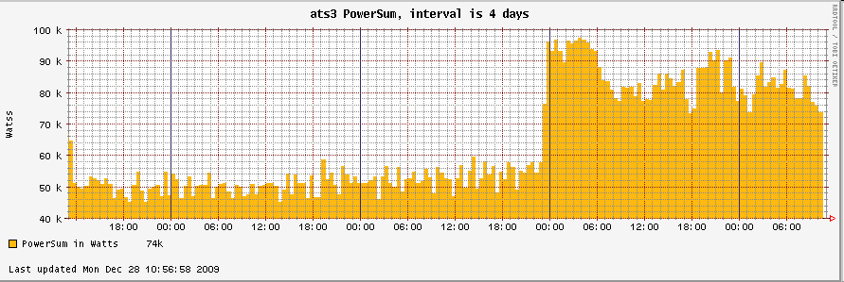
Successes cont’d
High Performance Computing (HPC) Cluster Comparison
  - Validated new research cluster by comparing power usage between old and new clusters
Measurement Database
  Continuous collection of server power usage (5 minute intervals)
  Integration with Cricket and Nagios tools
  Validation of hardware upgrades and consolidation
    Total power usage over time
    Also used SPECpower benchmark – performance per watt

Slide 13
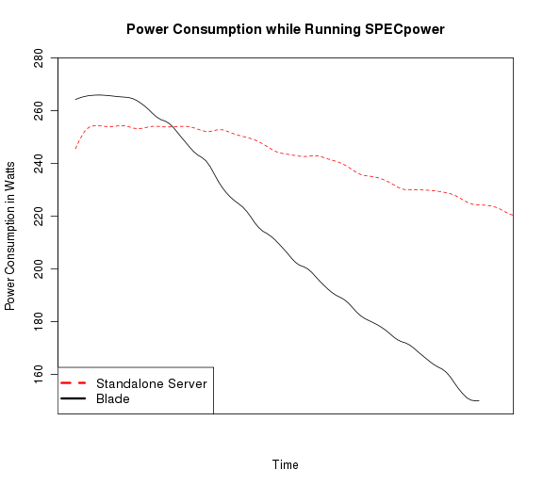
Sample SPECpower Comparison
DL360 G5p standalone server
  Max: 255 W
  Idle: 221 W
  Overall ssj_ops/W: 139
BL460 G6 Blade
  Max: 266 W
  Idle: 150 W
  Overall ssj_ops/W: 600
Standalone server
Blade
SPECpower benchmarks only valid for internal CUIT comparisons.
Results were smoothed for visual clarity.

Slide 14
Lessons Learned
Work with facilities early to anticipate dependencies
  Chilled water set point change
  Installation of high-density self-cooled racks
Low-hanging fruit of power tuning servers not as promising as we thought
Brand-new not always necessary for green improvement
Don’t need to measure every piece of hardware

Slide 15
Future Considerations
Post-project monitoring, measurement, and data collection
Integrating data with hardware retirement and purchase decisions
Effective dissemination of information

Slide 16
Thank You!
Questions
More info: http://blogs.cuit.columbia.edu/greendc/
This work is supported in part by the New York State Energy Research and Development Authority (NYSERDA agreement number 11145). NYSERDA has not reviewed the information contained herein, and the opinions expressed do not necessarily reflect those of NYSERDA or the State of New York.

Slide 17
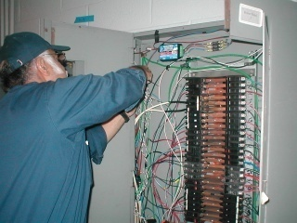

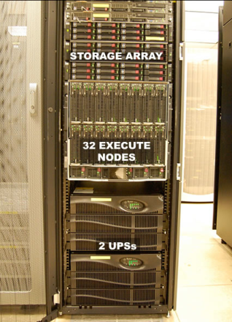
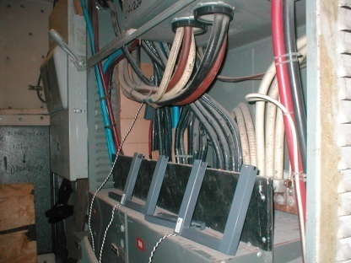
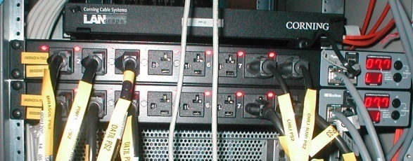
Wattnode meters
Campus Level
power panel
CRAC unit
Data Center: 200 Level
Flexim meters
chilled water pipes
Mechanical Room: 100 Level
Main IT power feed (ATS4)
server rack
Raritan Power Distribution Units (PDUs)
and Uninterruptible Power Supplies (UPSs)

