Slide 1
Sakai 3
A New Paradigm for Education

Slide 2
Josh Baron
Senior Academic Technology Officer
Marist College
Mara Hancock
Director for Educational Technologies
University of California, Berkeley
Lance Speelmon
Scholarly Technologist
Indiana University System

Slide 3
Sakai OAE
Sakai 3 as an open academic environment

Slide 4
Sakai oae
Flexible and controllable workspaces
People, academic networking, and groups
Rich content development
Resource discovery and use
Collaboration, communication, and sharing
Openness and permeability

Slide 5
Introducing Sakai 3: evolving the LMS
Josh Baron
Senior Academic Technology Officer
Marist College

Slide 6
Is it an upgrade?
Show of hands…

Slide 7
Is it a Traditional LMS?
Show of hands…

Slide 8
How many came for the sushi?
Show of hands…

Slide 9
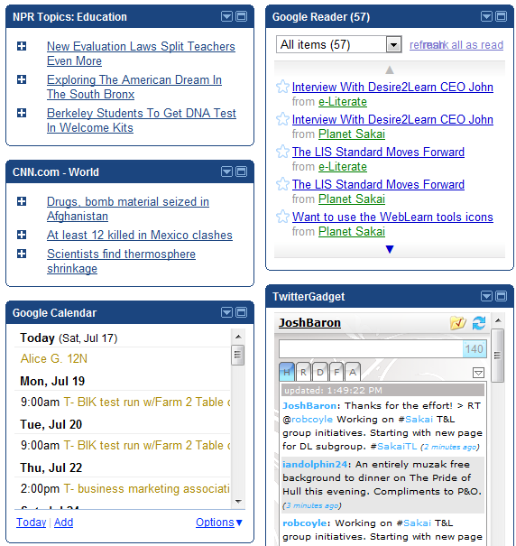
Sakai’s Evolution & the post-lms era
Personal Learning Environment
  Leverage Web 2.0-based tools
  Integrates content and networks
  Created/customized by learner
  Facilitates self-directed learning
LMS > closed, status quo, teacher/course-centric
PLE > open, participatory, learner-centric
Pros/cons with both
Notes:
** These are just general notes I like to write up for planning purposes, I won’t be reading these or saying exactly what I have here…**
Sakai 3 really represents a “re-birth” of Sakai in the post-LMS era that many feel that we are entering (or have entered already) in higher education.
To me, this Post-LMS era is being heralded by the increasing use of “Personal Learning Environments” by students, faculty and the general public.
These PLE’s are leveraging Web 2.0 tools (blogs, wikis, social networking, etc.) along with technologies (e.g. iGoogle) to integrate content and networks together in highly personalized/customized environments. The image on the right is my PLE in which I’ve brought together my Blog reader, twitter feed, calendar, and RSS feeds. It is a fairly simplistic PLE but extremely powerful for facilitating self-directed learning. In a small unscientific experiment, I found that I learned about 40 new “things” in a 4-5 day period using my PLE.
Today, there is a lot of “tension” between the traditional LMS, which tends to be closed/secure, supports status quo teaching methods (i.e. lecture) and is very teacher/course-centric and the PLE, which tends to be open, participatory and learner/user-centric.
There are pros/cons of both…security issues, privacy issues, FERPA issues vs. ease of collaboration, support for open education, etc.
Today, we have an either/or situation in which users can use a PLE or an LMS but not both…

Slide 10
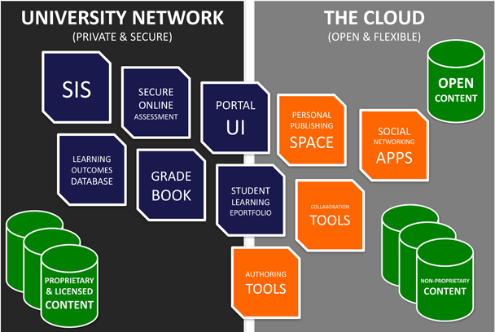
Open Academic Environment (OAE)
Mash-up between LMS & PLE
Some things are “private & secure” while others are “open & flexible”
  Semi-permeable Security
Uses open standards
  IMS Course Cartridge
  IMS Learning Tool Interoperability
  OpenSocial API
Jonathan Mott Asst. to the Academic VP - Academic Technology Brigham Young University
Notes:
The concept of the “Open Academic Environment” provides a vision for how we can combine the best of both worlds to create an environment in which some things are “private and secure” within the institutions network while other things are “open and flexible” out in the Cloud with a type of “semi-permeable security membrane” allowing for the flow of data between the two.
This concept was recently discussed by Jon Mott at BYU, who refers to it as an Open Learning Network, in a recent EDUCAUSE Review article which is where the diagram comes from…as you can see, in his vision pieces of the traditional LMS, such as the grade book, would reside in the university network while collaboration tools and things like social networking apps would sit in the Cloud. This approach is one that would be facilitated through the use of open standards.

Slide 11

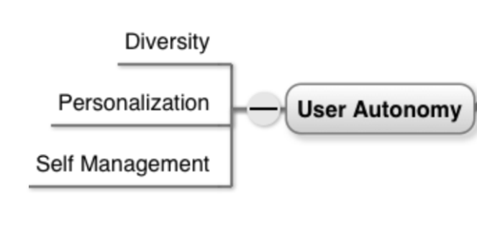
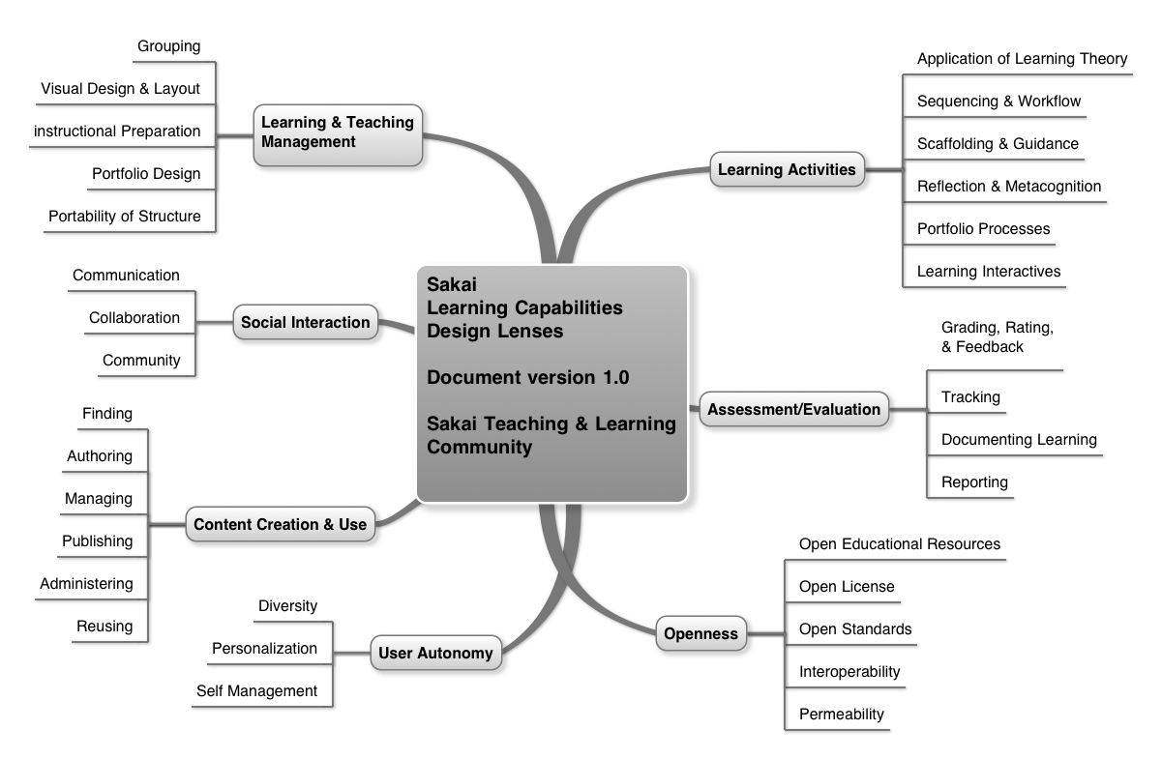
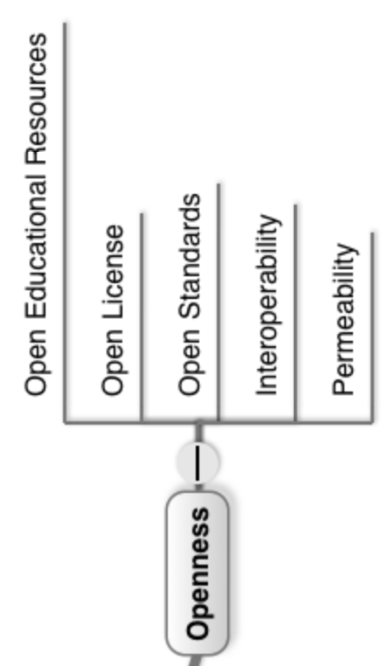
How the Sakai “OAE” is being designed
T&L “visioning” effort
  Lead by Sakai Teaching and Learning Group (2009 -10)
  Goal was to chart our evolutionary path and create design tools
  Resulted in 7 Learning Design “Lenses” & 32 “Facets”
    View through the eyes of T&L folks
    Support OAE concept
  Learning Design Lenses incorporated into Sakai OAE
  Road Map
Notes:
I’ll end by sharing how the design and development of Sakai’s Open Academic Environment is, unlike the early version of Sakai, being driven by a vision created by teaching and learning practitioners.
During the 2009 -10 academic year, the T&L Group within Sakai engaged in a intensive “visioning” initiative that began with an international brainstorming effort and culminated in the identifying of 7 “Learning Design Lenses” and 32 related “Facets”. We call these “lenses” as they are intended to not only communicate a high level vision of the types of learning that the next generation of Sakai need to support but are also intended to be tools by which designers/developers can peer through the eyes of a teaching and learning expert as they are doing their work to ensure that their design supports not only their primary objective (e.g. online discussion) but all of the facets that are important to powerful learning experiences. GIVE EXAMPLE.
The T&L group also worked to ensure that we were not only capturing the traditional capabilities that we all expect in an LMS but also those innovations that our early adopter faculty members are pioneering which we know will become the mainstream users of tomorrow.
This work has now been incorporated into the Sakai 3 Road Map as means to ensure that it is designed to fulfill this vision.

Slide 12
The path to an open academic environment at UC Berkeley
Mara Hancock
Director for Educational Technologies
University of California, Berkeley

Slide 13
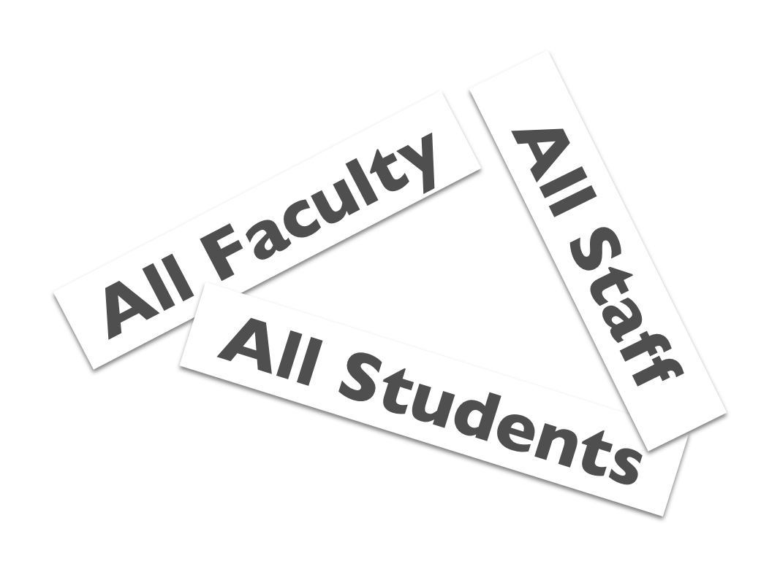
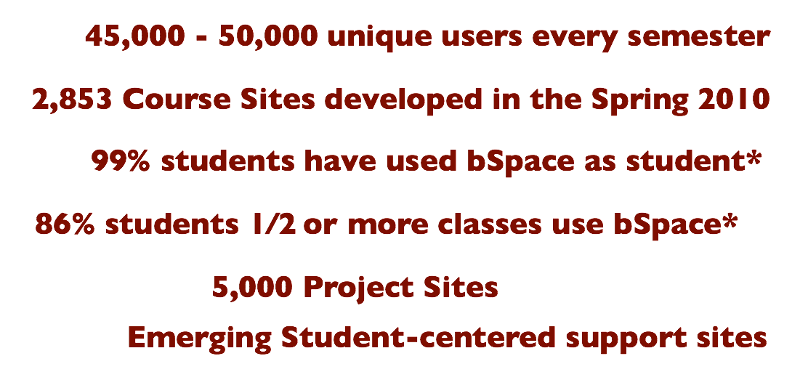
The landscape
bSpace First Generation
bringing you iterative improvements since 2005…

Slide 14
Students lead the charge
Sole UC campus without a single source for critical information
Students clamoring – LDP, OE, bSpace surveys | ASUC, STC, COSE
“Improve my online student experience”
  Students are drowning in our “solutions”
  One-stop site for information sources and transaction processing
  Be about ME (the student), accessible, customizable, and easy to use
Operational Excellence Student Services priority
Opportunity for alignment of Sakai with Kuali to increase capabilities and create a future facing environment

Slide 15
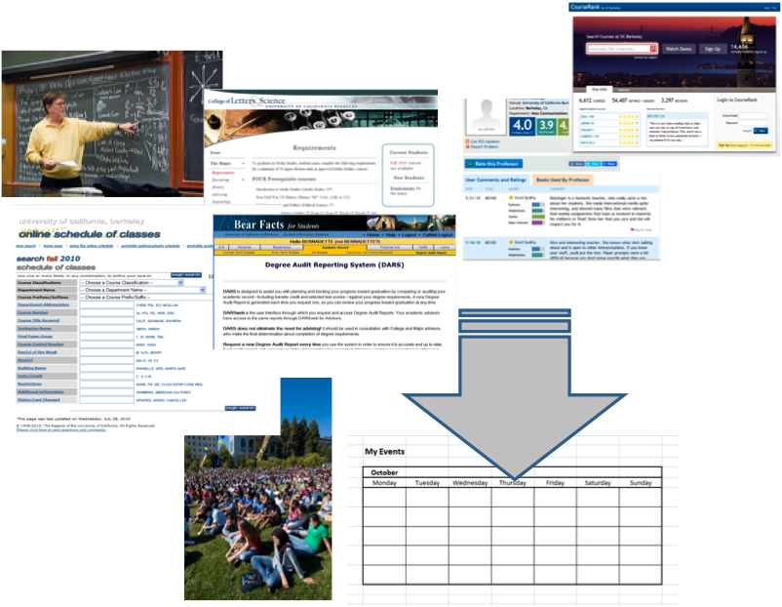
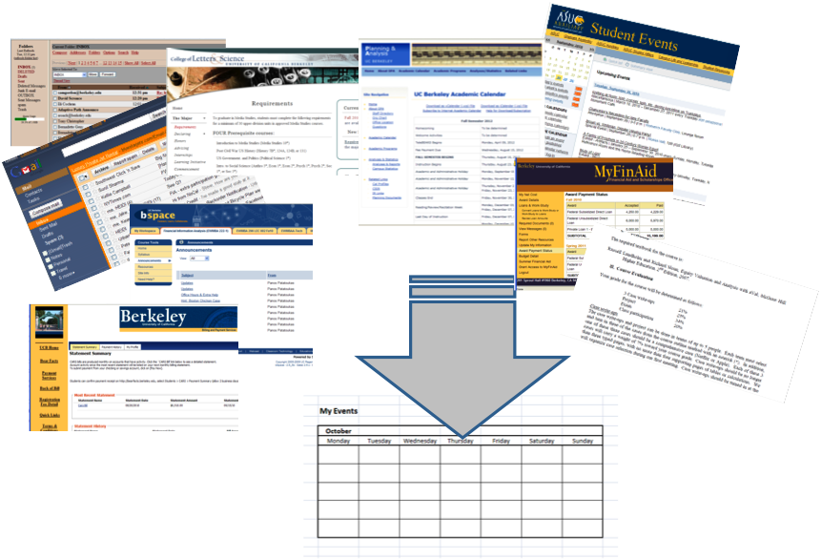
The Students’ World…
ASSEMBLY REQUIRED…
Professor and peer course recommendations
Major and Minor requirements
DARS graduation check
Review schedule, repeat
Check Professor ratings
Check CourseRank
Calendar schedule options
Telebears register for classes
ASSEMBLY REQUIRED…
Emailed announcements
Messages from advisors, professors, club officers …
Major requirements
Bill payment due dates
Class due dates
Student events
bSpace announcements
FinAid actions
…
Remind Me...
Making Decisions...

Slide 16
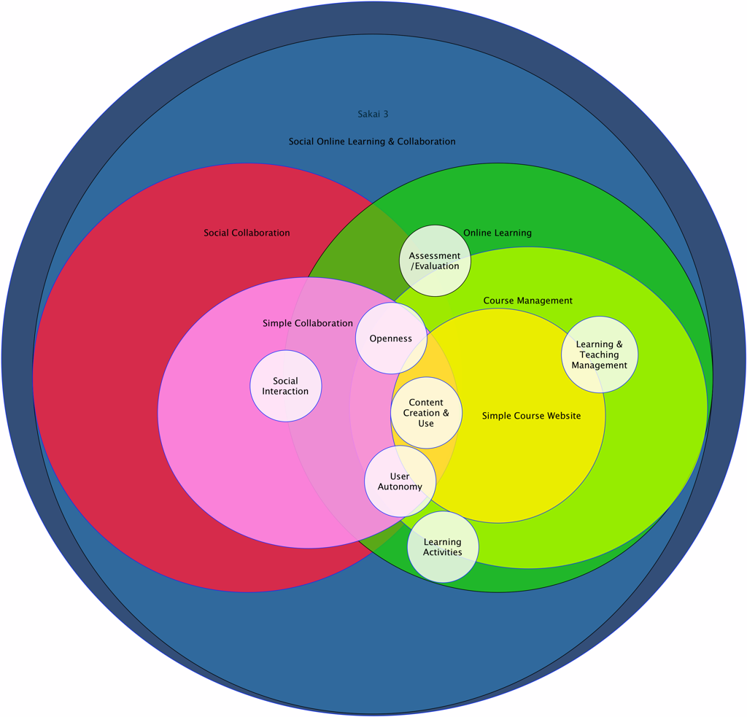
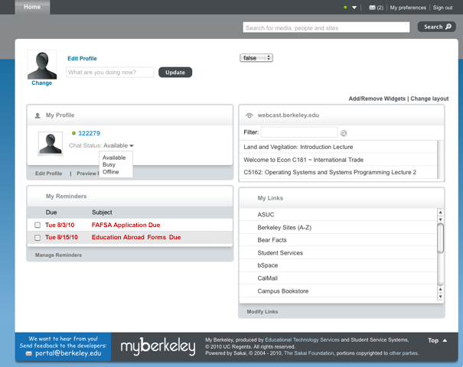
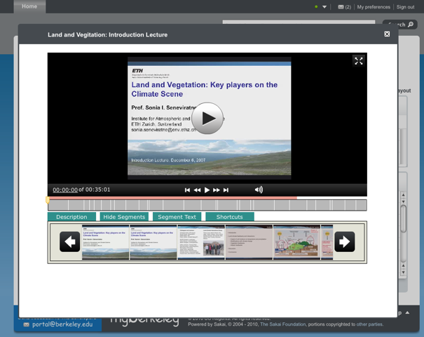
What is this thing?
Next Generation Teaching & Learning environment
Gateway to student services & systems
Gateway to faculty services & academic systems
Academic and Student life collaboration environment
SAKAI 3.0 is…
Transforming

Slide 17
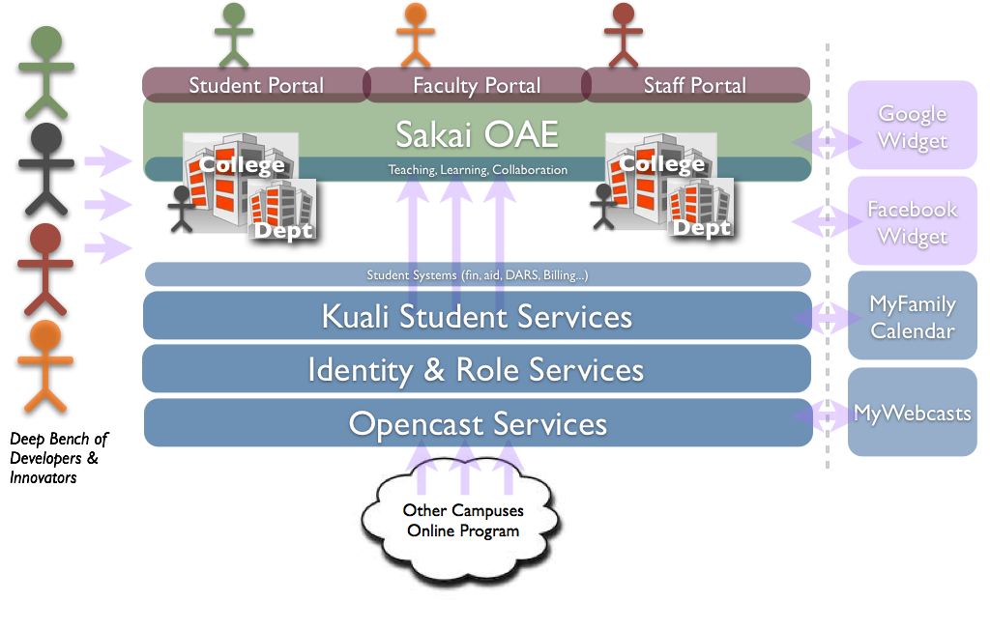
The opportunity

Slide 18
A Phased roadmap
bSpace (Sakai 2.x)
Portal Pilot
Portal Launch
MyBerkeley Student (Sakai 3.0)
Native Sakai Functionality:
Profile
Community
Content
Messages
Chat
Berkeley Features:
My Links
To Do’s & Reminder
My Calendar
Campus Calendar
My Questions
My CourseCasts
Crowd-Sourcing support
Sakai 3.0 OAE
Collaboration
Teaching & Learning
bSpace NG
September 2010
September 2011
September 2012
January 2011
January 2012
Notes:
My Calendar – requires coordination and collaboration with CalAgenda team
Campus Calendar – integration with existing campus calendar (Public Affairs, partner)
My Questions – in lieu of a full-blown CRM, explore the use of the Career Center’s FAQ system
My CourseCasts – could be part of My Classes widget; assess work involved to integrate, esp. on search
Crowd-Sourcing support – requires developers guide, contribution and QA processes, policies, “app store” or registry; contributed applets and widgets

Slide 19
Sakai OAE hybrid
Lance Speelmon
Scholarly Technologist
Indiana University System

