Slide 1
Against All Odds:
A Case Study of ITIL adoption at
Rice University
Gary Kidney
Niki Serakiotou
Barry Ribbeck
Friday, October 15, 2010
Copyright 2010. This work is the intellectual property of the authors. Permission is granted for this material to be shared for non-commercial, educational purposes, provided that this copyright statement appears on the reproduced materials and notice is given that the copying is by permission of the author. To disseminate otherwise or to republish requires written permission from the authors.

Slide 2

Rice University
Private
Research University
Houston, TX

Slide 3

Owl Sharing
Rice culture
Rice IT
ITIL and us
Where we hope to go
What did we accomplish
How we did it

Slide 4

Rice University
  3,400 undergrads
  2,300 grad students
  644 full-time faculty
  400 part-timers or adjuncts
  2,084 staff members
  74 buildings
  115 acres

Slide 5

Rice Culture
  100 years of being a small, research university
  Many Rice Alums among the faculty and staff
  Place-based; no distance learning
  College-based non-curricular environment
  More than moderate resistance to change
  Dispersed decision-making

Slide 6

Rice Culture Cont’d
  Technology grew organically
  Central IT, Administrative Systems, Library, and many departments with IT-like staff
  Rugged individualism – no two field configurations the same
  Distributed purchasing
  Technology standards & agented software perceived as threatening

Slide 7
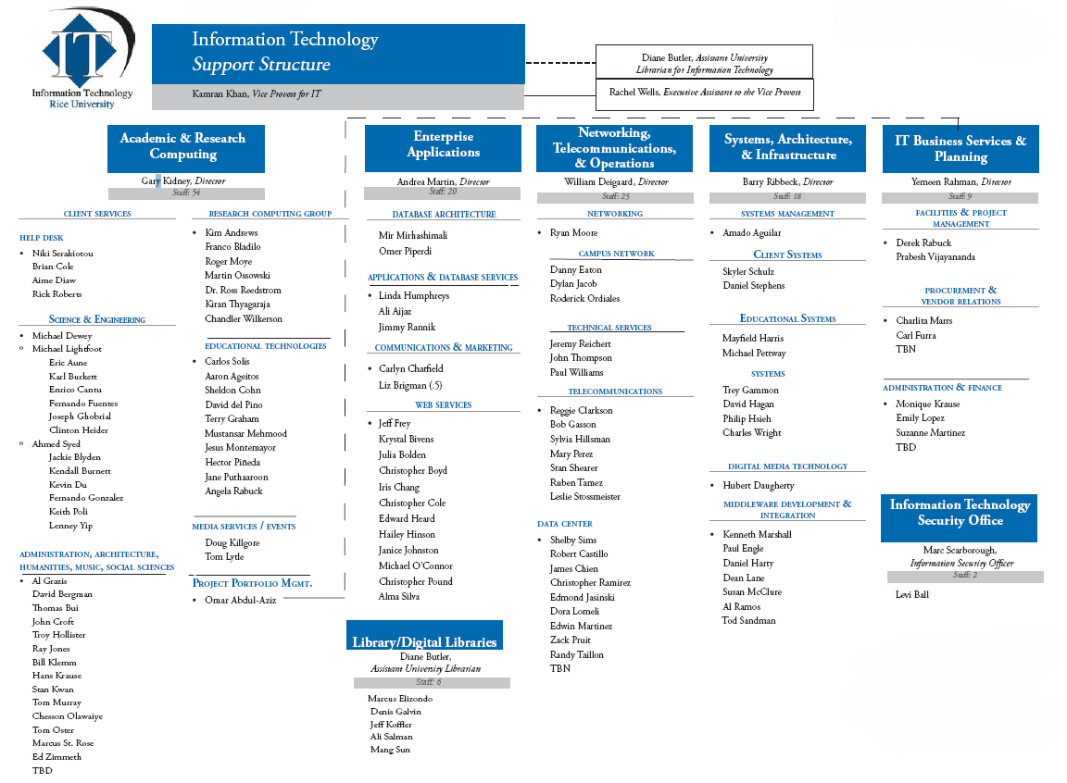
Rice IT
S
u
p
P
o
r
t
A
p
p
l
i
c
a
t
i
o
n
s
N
e
t
w
o
r
k
&
T
e
e
e
c
o
m
B
u
s
i
n
e
e
s
S
y
s
t
e
m
s
Security

Slide 8
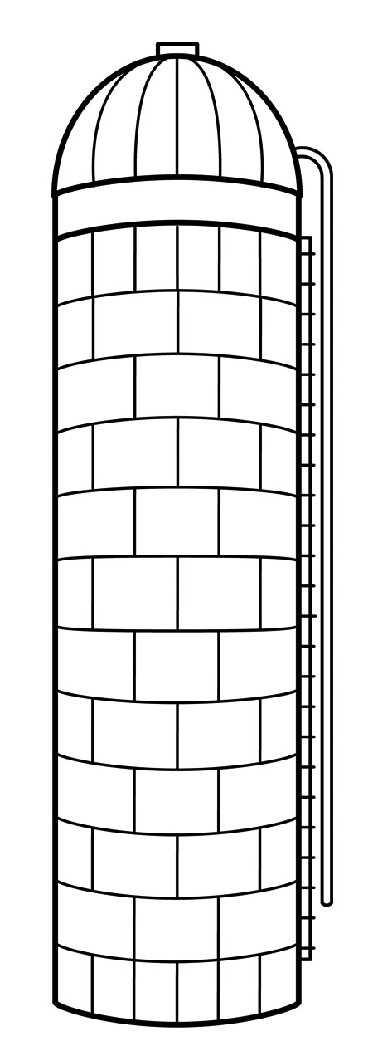
Rice IT – You Got the Idea
S
u
p
P
o
r
t
A
p
p
l
i
c
a
t
i
o
n
s
N
e
t
w
o
r
k
&
T
e
e
e
c
o
m
B
u
s
i
n
e
e
s
S
y
s
t
e
m
s
Security

Slide 9

“And now the price of [best practices] might be nothing less than their lives.”
--Reworked tagline from the 1984 movie

Slide 10
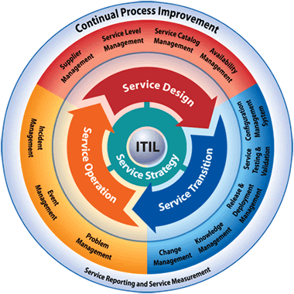
Along Comes ITIL
Good Advice:
The important thing is just to get started.
Pick a current problem and use ITIL to find a process-based solution.
Start with “low hanging fruit.”

Slide 11
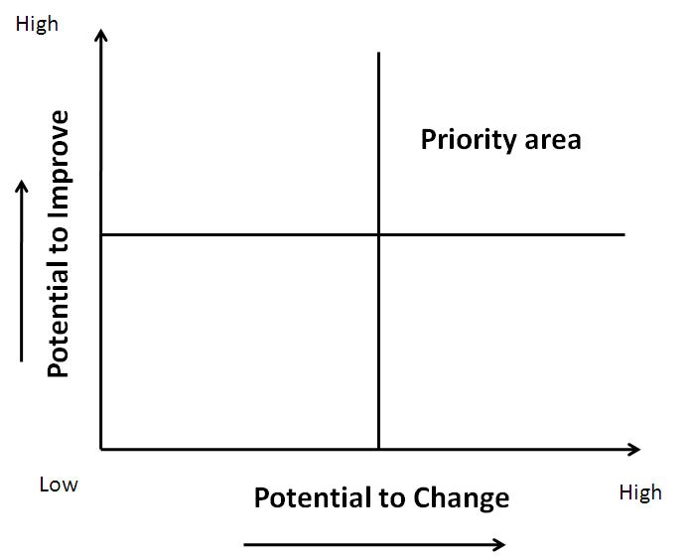

Low- Hanging Fruit

Slide 12

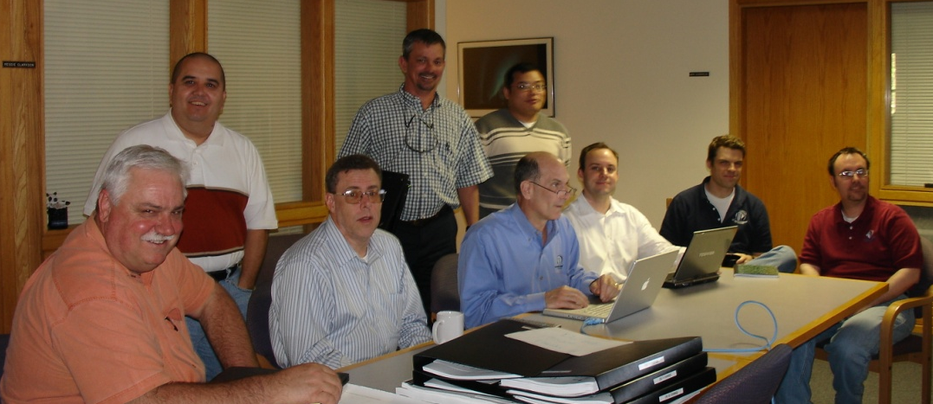
Rice’s “Low-Hanging Fruit” – Change Mgt.
  Started meeting regularly to discuss changes.
  Created a change process.
  Developed a change request form.
  Created a change communications channel.
  Designated a “change manager.”
  Built a change management tool.
We are here!

Slide 13
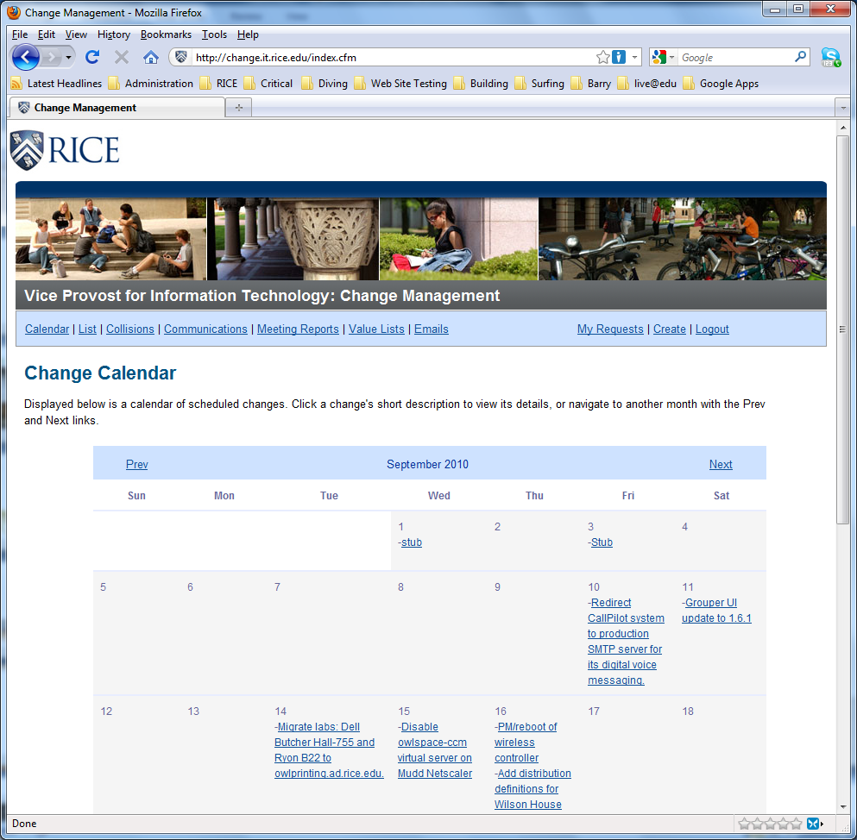
Rice’s Change Management Tool
  Calendar of changes
  Meeting Notes and attendance
  Review of change requests
  Change collision planner
  Searchable historical reference
  Online Change Request Form
  Communication Tool

Slide 14

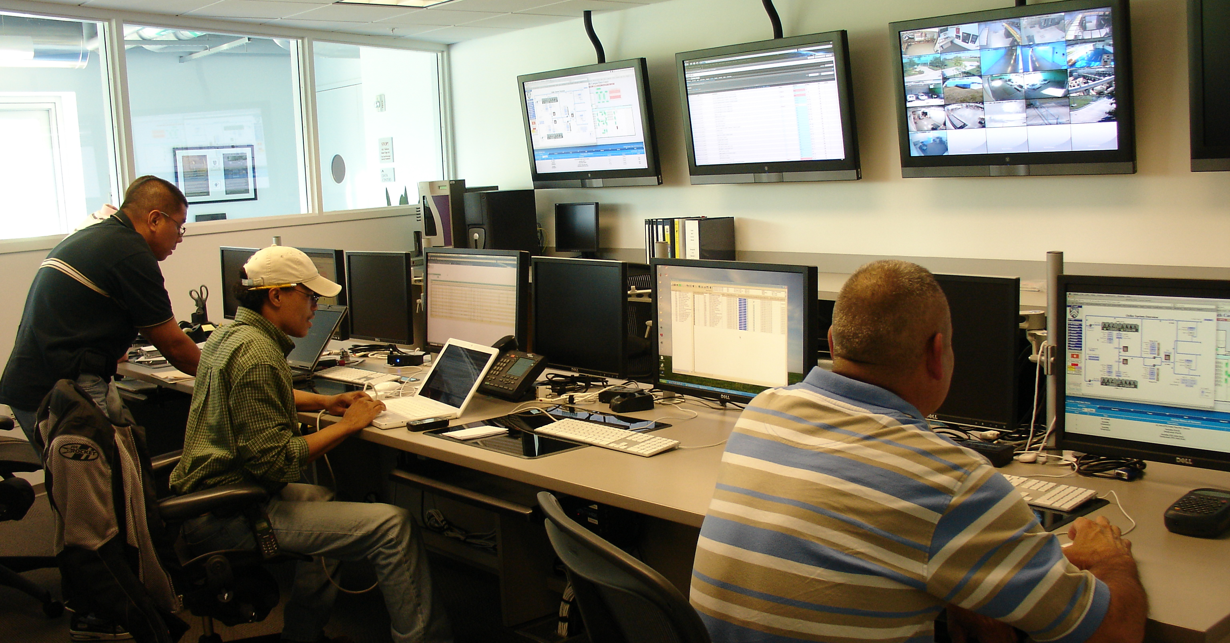
Rice’s “Low-Hanging Fruit” – Event Mgt.
Figured out what events to monitor and who to alert.
Defined when a service is considered down.
Figured out how to calculate metrics.
Implemented an event management tool.
Built a reporting dashboard.
Evaluate and adjust service expectations.
We are here!

Slide 15
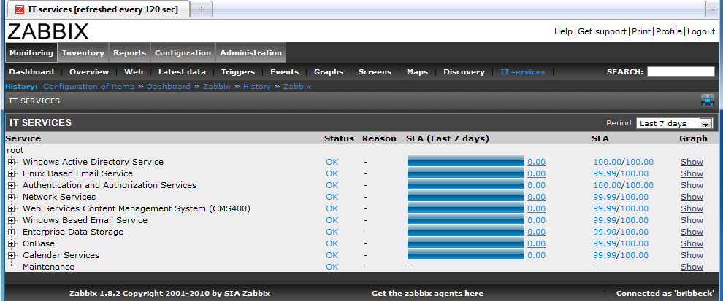
Rice’s Event Management Tool
Good Advice:
Needs include trend analysis, traps, polling, service checks, depen-dency correlation, and redundancy.
Early detection of problems to prevent service outages is the goal.

Slide 16
Some of Rice’s Service Expectations
Service | Uptime Goal | Achieved Availability | MTBF | MTTR | Maintenance per year
Email Services | 99.99% | 99.97 | N/A | 2 hours | 52 hours *
File Services | 99.9% | 100% | N/A |  | 12 hours
Web Services | 99.99% | 100% | N/A |  | 12 hours *
Data Center Power | 100% | 100% | N/A |  | 48 hours *
Core Network | 100% | 100% | N/A |  | 48 hours *
Dependencies | 100% |  | N/A |  | 48 hours *
Printing Services | 99.9% | 99.999% | N/A |  | 48 hours *
* = some or total redundant services with automatic failover

Slide 17
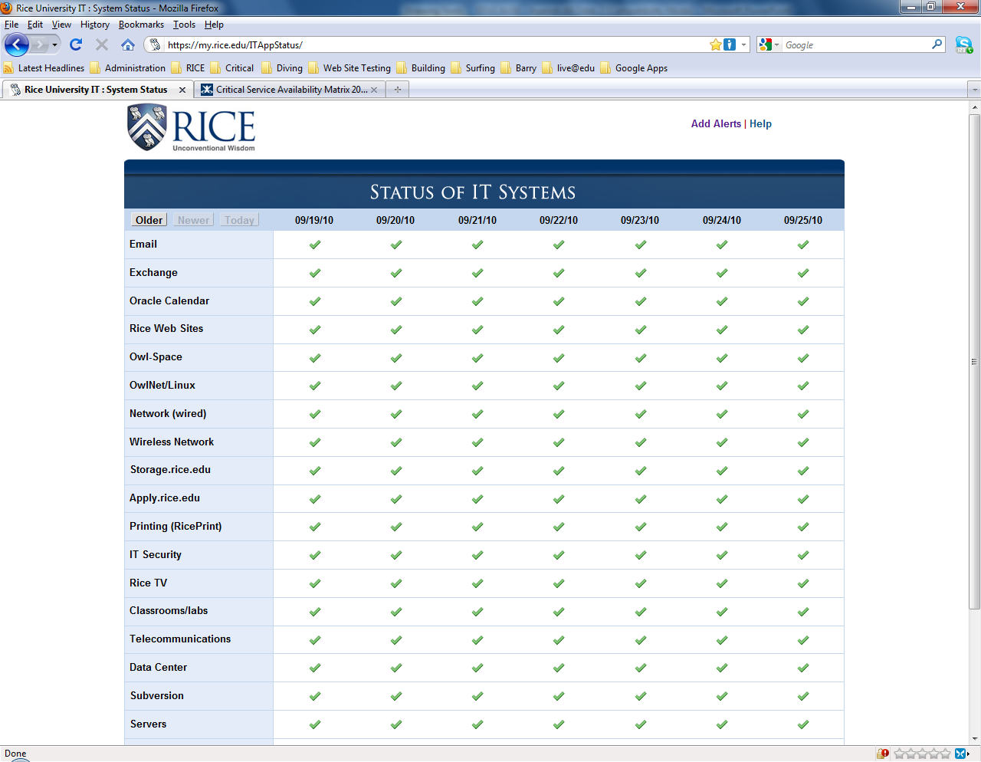
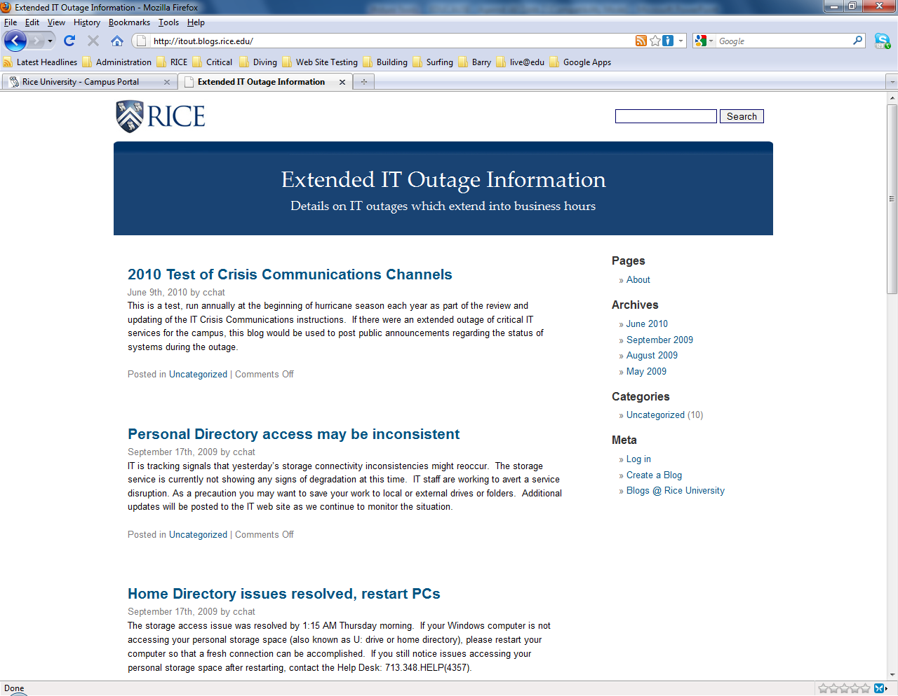
Rice’s Service Dashboard

Slide 18

Next Steps After the “Low-Hanging Fruit”
Good Advice:
Know your own organization.
Figure out how your users perceive your organization.
Understand what your users want.

Slide 19

Rice’s “Next Steps” – Request for Service
  Created a service catalog.
  Created a single contact point for service requests.
  Designed a process workflow for each service.
  Vetted processes to insure correct input and output.
  Designated a “service manager.”
  Bought a service desk and workflow automation tool.
We are here!

Slide 20
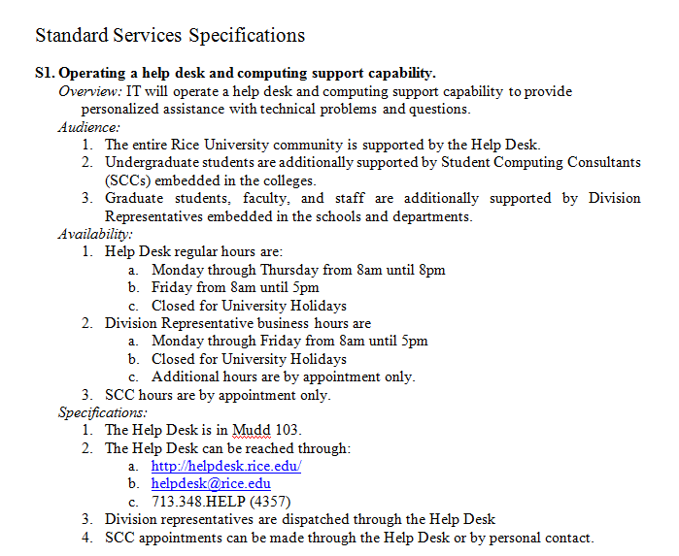
Rice’s Service Catalog
Each service:
Overview (required)
Audience (required)
Availability (required)
Specifications (optional)
Recommendations (optional)

Slide 21
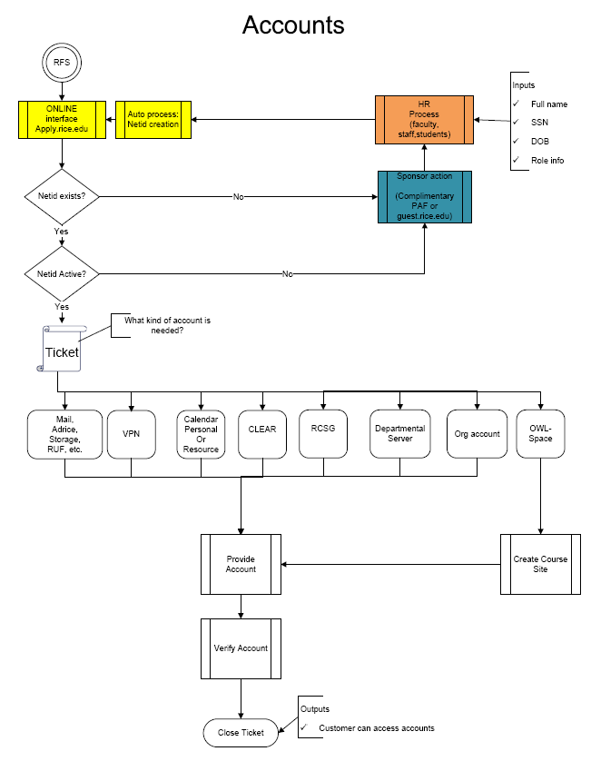
Rice’s Request for Service Workflows
  Defines process and workflow.
  Identifies who does what.
  Defines required inputs.
  Defines expected outputs.
  Allows for metrics and measurements.
  Promotes opportunities to remove variance as a continuous quality improvement activity.

Slide 22
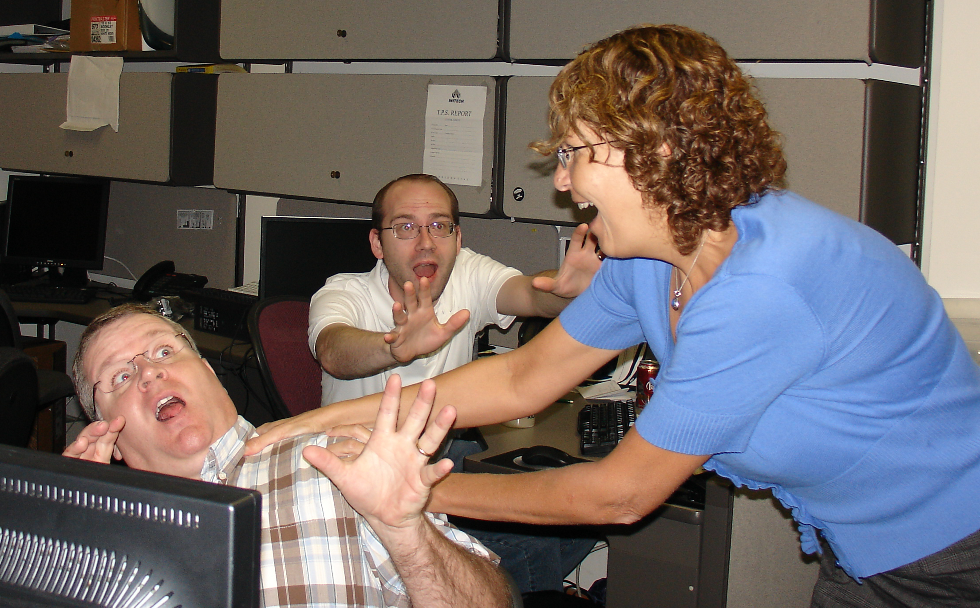
Rice’s “next steps” – Problem Management
  Cross-functional team met to plan problem management response.
  Created process, defined who could raise a problem and how.
  Trained problem reporters and responders.
  Implemented problem queue.
  Tested procedures and methodologies.
We are here!

Slide 23

Rice’s “next steps” – Incident Management
  Types of incidents compiled from past data.
  Process created for each incident type.
  Vetted processes with management teams.
  Developed queues for each incident type.
  Developed workflows for each incident type.
  Deploy queues and workflows.
We are here!

Slide 24

Rice’s “future steps”
  Configuration management for more than infrastructure.
  Tools for tracking and workflow
  Service catalog management.
  Service lifecycle.
  Asset management.
  Knowledge management (and sharing).
  Continued improvement.
We are here!

Slide 25
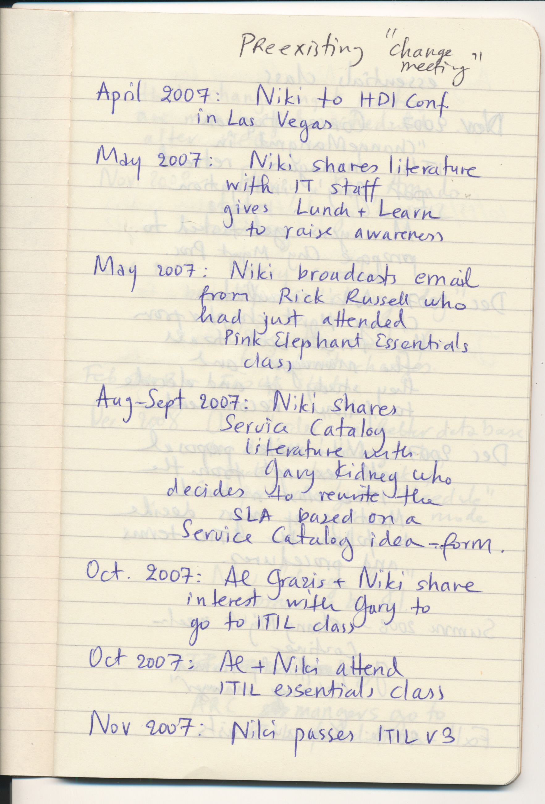
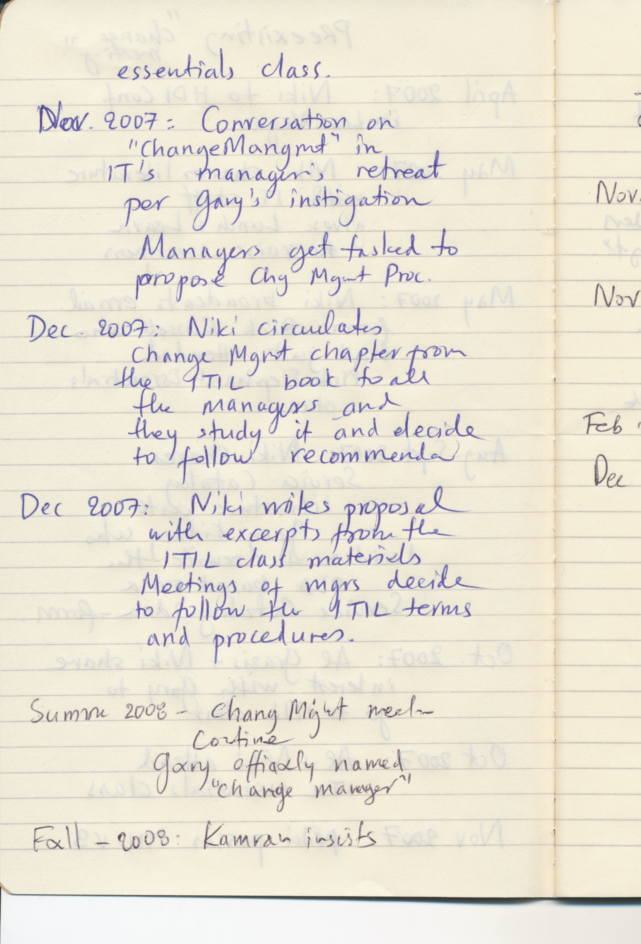
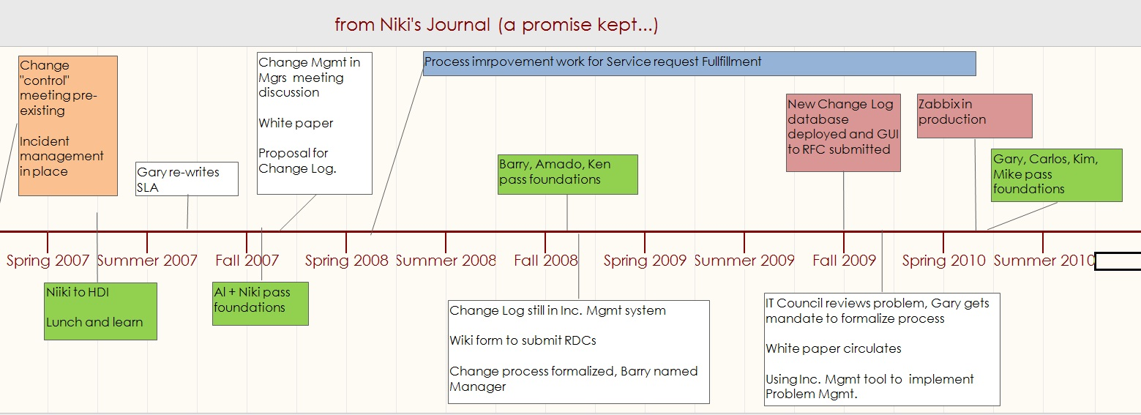
How We Did It

Slide 26
How has ITIL Changed Rice IT?
User Satisfaction with IT from Annual Survey
Stratified by group, 5-pt likert scale, 5=very satisfied

Slide 27
How has ITIL Changed Rice IT?
Change
Event
Service
Cross-functional Teams
Problem
Incident

Slide 28
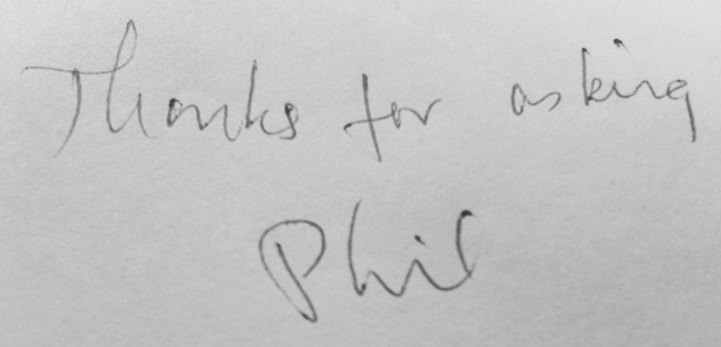
How has ITIL Changed Rice IT?
  Service discontinuance and forced migration
  1,055 faculty users
  6 choices offered by letter with email reminders
  99.34% response rate
  17% wrote back:

Slide 29




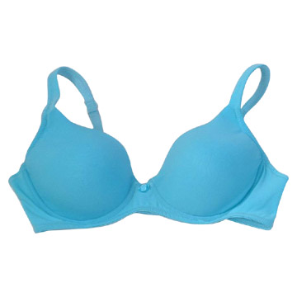

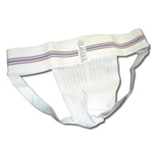
How We Did It …
Top-down
Approach
No
Consultants
Plan
Committee
Campus
Support

Slide 30

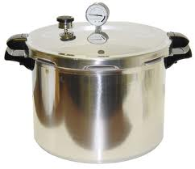

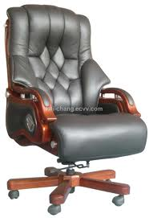


How We Did It …
Vocabulary
Little
Pressure
Training
Money
Executive
Involvement

Slide 31

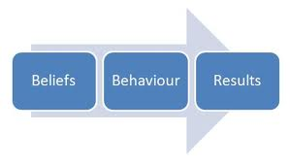


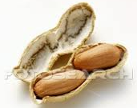

How We Did It …
Communication
Slow organizational
change
Searching for
practical implementations
A Lot
Trial
&
Error
Shelling the business-speak out of ITIL
Thought

Slide 32
THANK YOU

