Slide 1
Above-Campus Services: Achievements and Roadmap
Shel Waggener Vice Provost for IT & CIO University of California Berkeley | Brad Wheeler Vice President for IT & CIO Indiana University
© Shelton Waggener and Brad Wheeler, Creative Commons Attribution 3.0

Slide 2


Or…Why ‘Cloud’ Matters
(in higher education)
Feb 2010

Slide 3
It doesn’t…

Slide 4
…and it’s not new.

Slide 5
We’ve seen the benefits of aggregation before … and we’ve missed the boat before.

Slide 6
Benefits of Aggregating Supply
Capitalizing on significant economies of scale. By aggregating across multiple institutions, it should be possible to drive the operational costs per user significantly lower than they are likely to be for a single institution.
Increasing efficiency through standardization. By focusing on aggregation/implementation above the level of the individual campus, we should be able to leverage standardization in ways that benefit operational efficiencies and the bottom line.

Slide 7
Benefits of Aggregating Demand
Increasing interoperability and associated capacity for collaboration. By aggregating demand and associated operations above the level of the individual campus, we will create a technical environment that is easier to navigate across institutions .
Streamlining the contracting process. It should be possible to negotiate a master agreement rather than dozens of one-off contracts, thereby saving institutions and vendors time and resources.

Slide 8
Let’s Review
Higher Ed’s approaches to evolutions in technology

Slide 9

Era 1:
Advanced Digital Networks

Slide 11
Reflections on Era 1
Aggregated demand
Established rules (AUP)
Created financial models
Engaged effectively with Feds/States
I2/NLR merger misstep
Federation with state Regional Optical Nets

Slide 12
Era 2:
Big Systems (ERP, etc.)

Slide 13
Reflections on Era 2
Cleaned up a generation of one-off systems
(Arguably) better information
Spent over $5 Billion? (Kvavik & Katz)
Rarely reduced total headcount
Lost control of systems, features, cost
Pay via mismatched pricing models
Intractable switching costs raises overall costs

Slide 14
Era 3:
Clouds?

Slide 15
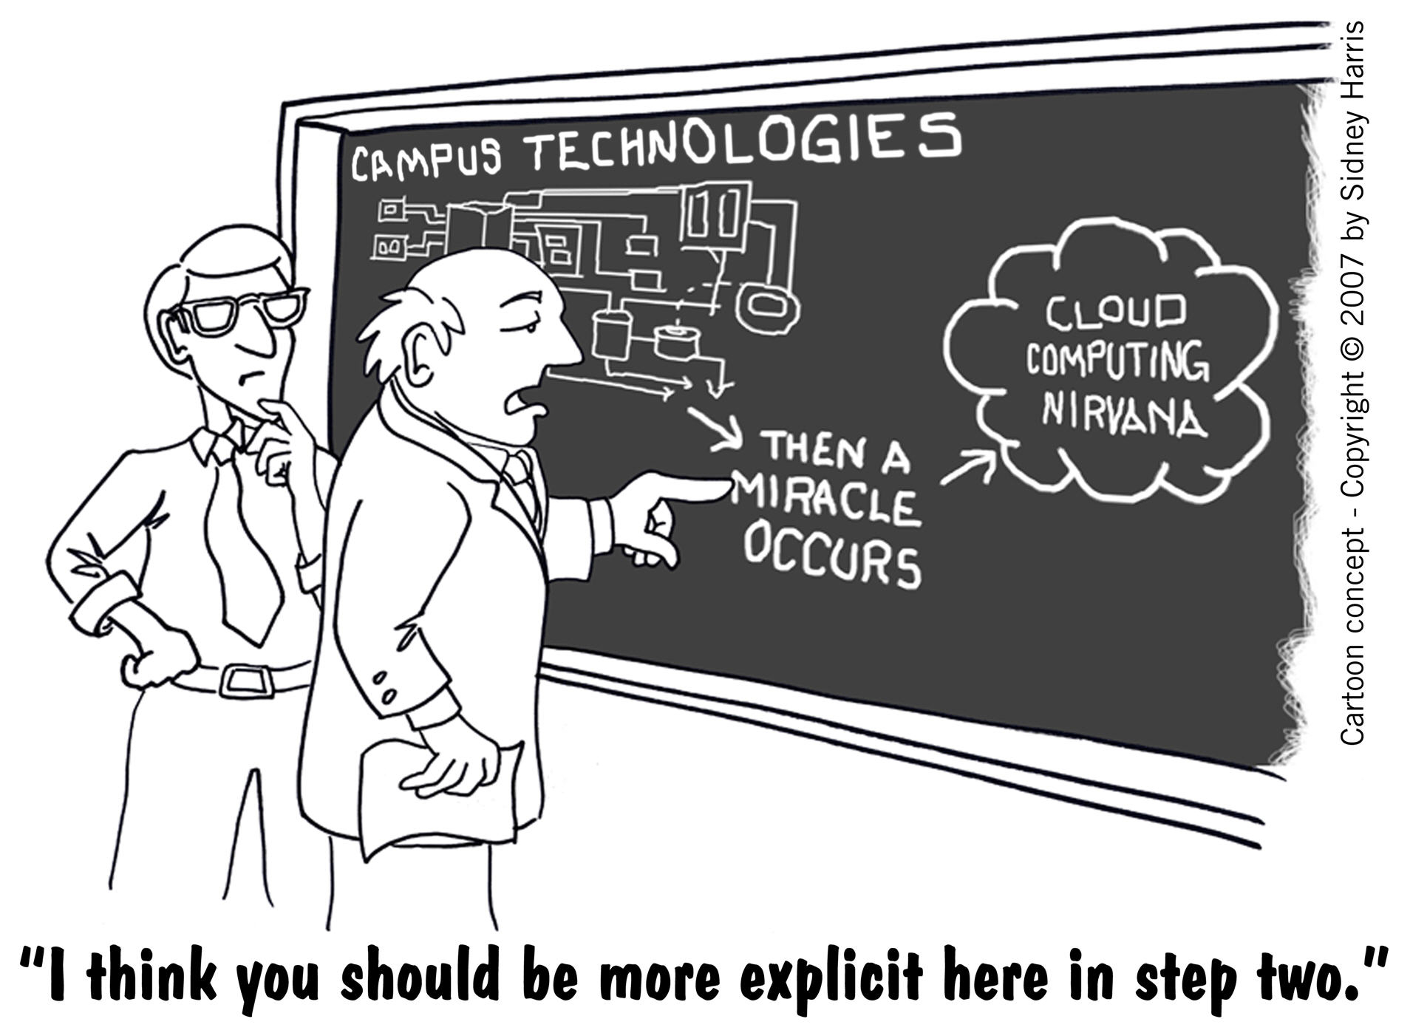

Slide 16
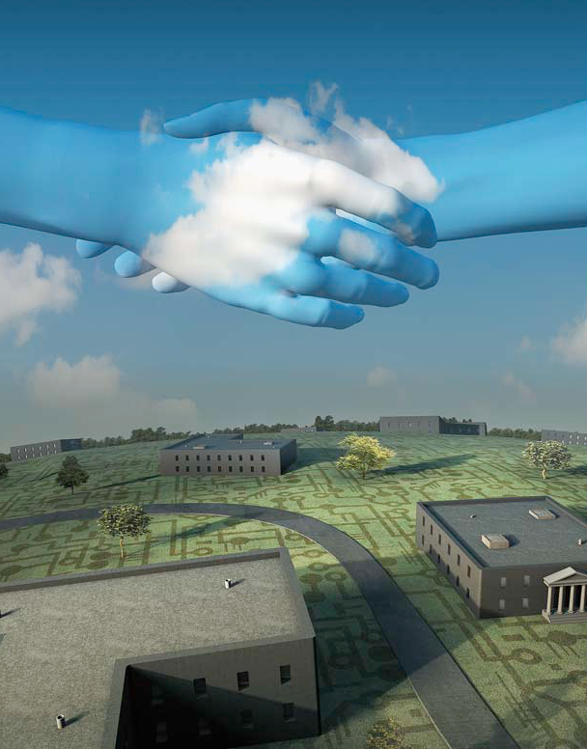
Above-Campus Services
Shaping the Promise of Cloud Computing for Higher Education by Brad Wheeler and Shelton Waggener
Illustration by Randy Lyhus ©2009
EDUCAUSE Review, Nov/Dec 2009

Slide 17

Charles M. Vest
President Emeritus, MIT
Core Mission
“…we are seeing the early emergence of a meta-university – a transcendent, accessible,
empowering, dynamic, communally constructed framework of open materials and platforms on which much of higher education worldwide can be constructed or enhanced.”
EDUCAUSE Review, May/June 2006, p. 30.

Slide 18
Department
School
Campus
Faculty
Administration
Our
recently conducted a
thorough review of (e.g.) Course Mgmt System options.
Sakai
Moodle
Desire2Learn
We concluded that
hosted by
us
Firm X
Firm Y…
was absolutely the best path forward.
EDUCAUSE CIO Listserv, Feb 2010

Slide 19







Meta-university Collaborations
Towards Above-campus Services
c
c
c
PUBLIC
KNOWLEDGE
PROJECT
Books
Journals
Textbooks
c
c
c
Learning
Administrative
DuraCloud
(Just to name a few…)

Slide 20











…and Commercial Engagement
…and more..
Notes:
We have two new Commercial Affiliates: Sciquest and VivanTech. Sciquest brings expertise in eprocurement and plan on assisting the KFS project with creating linkages between KFS and shopping carts within Sciquest. VivanTech brings expertise in developing custom financial information systems, and has been assisting some of the Kuali partners in their implementation planning for KFS. We welcome these 2 new CA’s.

Slide 21
Projecting the Insights of 2000-2010 Forward

Slide 22
Above-Campus Services
Sourcing Models: Demand Aggregator?
  Commercial Sourcing: gmail, iTunesU, S3, Azure
  Institutional Sourcing: HathiTrust, Network Op Ctr
  Consortium Sourcing: Kuali Ready
Exit ‘below-campus’ needs as they are consumerized away

Slide 23
Progress? 2010
Four Examples

Slide 24
1) Federated Identity
InCommon

Slide 25
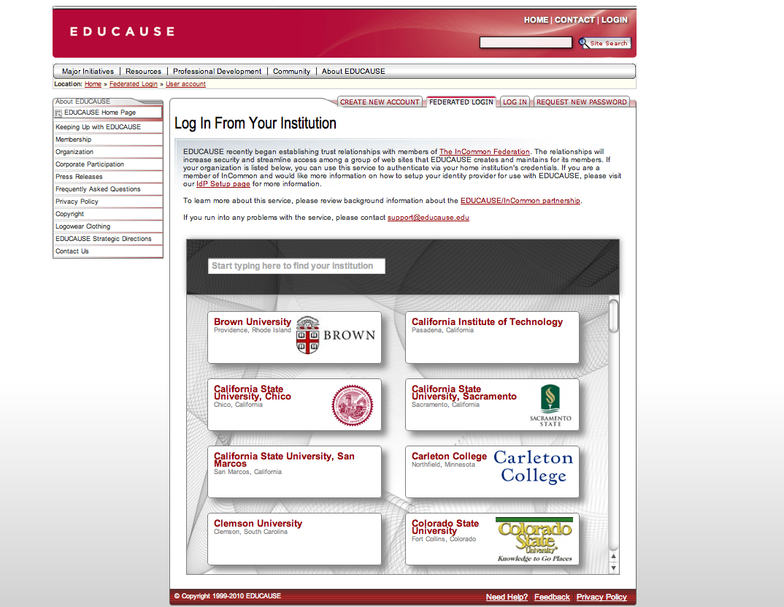

Slide 26
2) Tribal Aggregation
Private Clouds

Slide 27












3) Consortium Pilot (RFP)

Slide 28
4) Common Solution Group
Student/Campus Email Model RFP

Slide 29
Other Examples?

Slide 30

Challenges toward 2015…2020?
How will we respond?

Slide 31


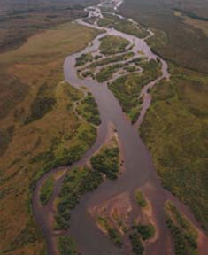

“Planned?”
“Emergent?”

Slide 32
Emergence
Leading in times of Emergence
  Known start point, unknown end point
  Adjust fundamental conditions, so new opportunities will emerge
  Instill a discipline of ‘fine-tune as you go,’ refine based on experience
James Hilton

Slide 33
So what do we believe?

Slide 34
“Our actions collectively
co-create our future”
“We will respond to the
forces around us”
“Trajectories are clear
enough to act”
“More study is needed”
“We learn and adapt
as we proceed”
“First, a full plan for
contingencies is required”
“Action is
essential now”
“This is not an
urgent matter”

Slide 35
Above-Campus Services: Achievements and Roadmap
Shel Waggener Vice Provost for IT & CIO University of California Berkeley | Brad Wheeler Vice President for IT & CIO Indiana University
© Shelton Waggener and Brad Wheeler, Creative Commons Attribution 3.0

