Slide 1
CIO CONSTITUENT GROUP MEETING
Theresa Rowe | October 18, 2011

Slide 2
WELCOME AND INTRODUCTIONS
Welcome CIOs, VPs, directors and aspirants
You’ve taken care of your phone, right?
No scheduled breaks – please come and go quietly as you wish
New CIOs out in the audience?

Slide 3
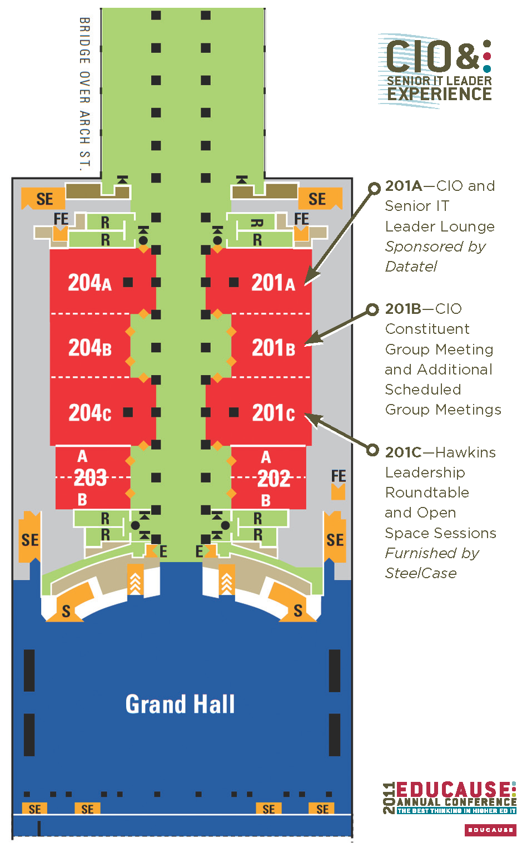
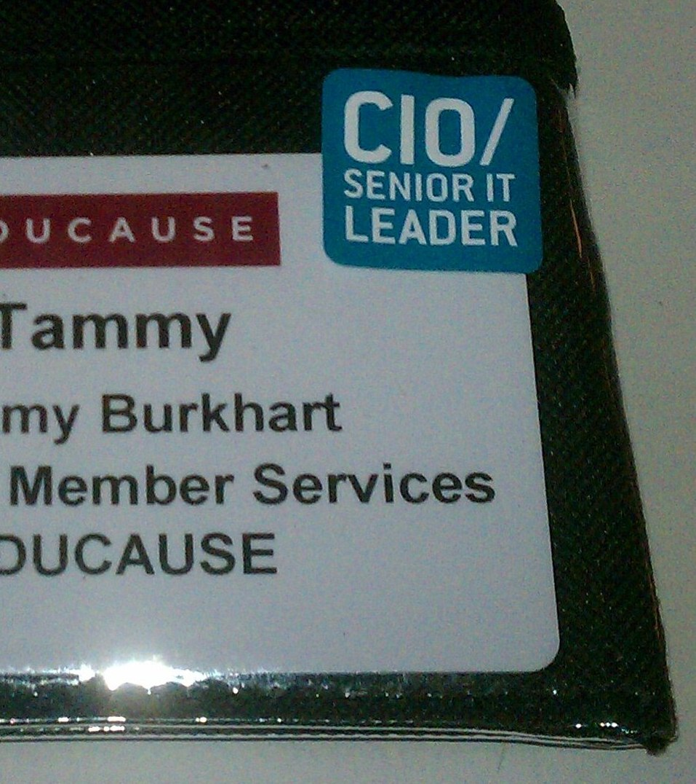
COMMUNITY
Notes:
This year we have more space devoted to CIO and senior leaders – three rooms total. This year, blue badge stickers will help you to identify peers here in Philly.

Slide 4
COMMUNITY
Twitter hash tags:
  #EDU11 for the conference
  #E11_DISC03 for this session
CIO and Senior Leader Lounge, Room 201A
  Tuesday, 1:00–5:00 p.m.
  Wednesday, 7:30 a.m.–6:00 p.m.
  Thursday, 7:30 a.m.–6:00 p.m.
  Friday, 7:30 a.m.–12:00 noon

Slide 5
COMMUNITY
865 CIOs and Senior IT Leaders attending
    14 percent more than 2010
    23 percent more than 2009
New! CIO and Senior IT Leader Open Space Sessions
    See complete list at educause.edu/E2011/program/CIO
    Thanks to all who participated in IdeaScale topic selection
Questions? Ask EDUCAUSE Staff in CIO Lounge, Lisa Gesner and Ashlan Sarff.

Slide 6
FUTURE OF THE INTERNET STUDY
New survey from Pew Research Center’s Internet and American Life Project
EDUCAUSE members invited to participate
Ensure that higher ed IT leaders have a voice
Help to enrich EDUCAUSE data collection
http://survey.fs.elon.edu/surveys/JVGZNA
The survey will remain open through the end of October.

Slide 7

NEWS FROM IN-COMMON
  Jack Suess
  UMBC VP of IT & CIO
http://www.internet2.edu/

Slide 8

NEWS FROM INTERNET2
  Jerry Grochow
  Interim VP for NET+,
  Internet2
http://www.internet2.edu/\
http://www.internet2.edu/netplus/

Slide 9

NEWS FROM REN-ISAC
Research and Education Networking – Information Sharing and Analysis Center
www.ren-isac-net
Membership growth from 301 to 341 institutions
730 to 858 individuals
Security focus, relationships with US-CERT, NCFTA, APWG
More partners, more sharing
Notes:
National Cyber-Forensics & Training Alliance (NCFTA)
US-CERT: United States Computer Emergency Readiness Team
APWG www.antiphishing.org
Involvement in strategic industry groups focused at the take-down of
specific security threats
Advancement of the SES tool (v1 -> v2), created the Collective
Intelligence Framework (CIF): threat data repository, flexible API,
support for analyst threat research
NSF award OCI-1127425 for development of SES v3, including support for
inter-federation, scaling, additional data types, and tool integration.
Engagement with the NSF International Research Network Connections,
TransPAC3 and America Connects to Europe projects, supporting "community
security" activities.
Partnership with the Multi-State ISAC and SANS to bring an aggressive
aggregate buy program for Securing The Human training to EDU.
Engagement in international standards work for security incident
reporting (IODEF)
Handling of 0-day vulnerability communications between members and
vendors, conducting responsible disclosure.
Increase in number of notifications (more data sources) regarding
observed infected EDU-based machine: > 12,000 notifications/month
Additional staff, funded by membership fees, permitting substantial
strengthening of our infrastructure, and deployment of new services

Slide 10


SAKAI & JASIG UPDATES –
MERGER PROPOSAL
  SAKAI – Michael Feldstein, Senior Program Manager, MindTap MindApps Cengage Learning
  JASIG – Jens Haeusser, Director, Strategy
  The University of British Columbia
Notes:
Michael Feldstein is Senior Program Manager for MindTap and Cengage Learning and author of the e-Literate weblog. Previously, he has been Senior Product Manager in Oracle's Higher Education division and Assistant Director at the SUNY Learning Network. Jens Haeusser is the Chair of the Jasig Board of Directors, and the Director of Strategic Innovation in the Information Technology Department at the University of British Columbia. At UBC, Jens is responsible for fostering outstanding IT solutions by developing creative and relevant IT strategies and long range plans that anticipate and reflect broad campus needs. As Jasig Chair, Jens is a strong advocate for the transformative role of IT and open source software in higher education.

Slide 11

EDUCAUSE Policy UPDATE
Joan Cheverie, Jarret Cummings, Greg Haledjian
Policy Specialists
Rodney Petersen
  Managing Director &
  Senior Government Relations Officer
Greg Jackson
  Vice President
Subscribe to Policy Digest at educause.edu/policy/news

Slide 12
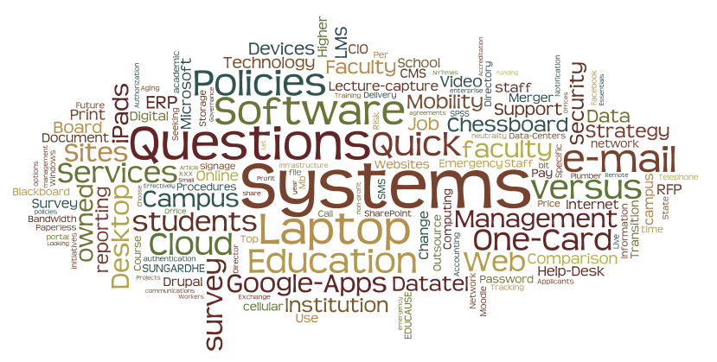
WHAT WAS THE BUZZ
Notes:
Taking the subject lines from the CIO mailing list archives for the last year, and doing a little clean-up for labeling consistency, here’s what we talked about. We talk about systems more than services. We like to do surveys and ask questions. We mention doing it “quick” quite often, what ever it is. We read and share, particularly from the Educause periodicals, the Chronicle of Higher Education and the New York Times. The book that we discussed the most was Leading Geeks: How to Manage and Lead the People Who Deliver Technology by Paul Glen, David Maister and Warren G. Bennis. Google Apps for Education, Microsoft Live@edu, and e-mail in general consume a lot of our discussion space. We talk about choice and choosing, particularly in the sense of this versus that. Mergers and sales generated a lot of talk, particularly involving SunGard, Datatel, and Blackboard. Many shared they were still looking at making LMS decisions and we talked about Moodle. We had several strategy discucssions over the course of the year, including the “plumber or strategist” debate triggered by Brad Wheeler and Brian Voss at last year’s conference and including a discussion about our chessboard, leading to a session this year let by Brad. We had more discussion about ownership, particularly as it relates to devices that we no longer own and control, representative of the consumerization of IT. Another aspect of consumerization is the software explosion, which engaged us on many levels. Mobility was a growing hot topic through the year. It seems that more of us are planning for multiple locations, so that situation informed discussion. We seemed to talk less about budget and funding issues – maybe we are getting used to the “new normal”.

Slide 13
Demand Aggregation: The Higher Ed IT Chessboard
Wednesday, Oct 19th, 2011 * 3:30 PM - 4:20 PM
Meeting Room 201C
Discussion, led by Brad Wheeler, will focus on buy-side concerns for higher education IT. As we (the buy-side) remain highly fragmented and the sell-side aggregates/consolidates, we will be subjected to capital owners rightly pursuing strategies to maximize their interests. Attend this session for a productive conversation regarding how our collective behaviors and money can rebalance the economic chessboard for this decade.
Notes:
This session was scheduled as a result of a lively list discussion. Other sessions are planned as a result of your voting in IdeaScale.

Slide 14
LEVERAGING SUPPORT
Thursday, Oct 20th, 2011 * 5:00 PM – 5:50 PM
Meeting Room 203B
This discussion, led by Sue Workman, will focus on strategic thinking around leveraging common IT support tools and services. Many institutions are spending money developing and delivering duplicate services and tools that exist elsewhere or could be shared, such as Knowledge Base content, notification systems, ticketing systems, and even human support services. We will discuss what might be leveraged between institutions and determine interest, then create a plan for next steps.
Notes:
This session was scheduled as a result of a lively list discussion. Other sessions are planned as a result of your voting in IdeaScale.

Slide 15
ADDITIONAL OPEN SPACE
SESSION TOPICS
Career Planning for CIOs
Identity Management
IT Consumerization
IT Governance
IT Strategy
Professional Development for Managers
Promoting the Value of IT for Teaching and Learning
Sourcing: Outsourcing, Open Source and Traditional
Notes:
This session was scheduled as a result of a lively list discussion. Other sessions are planned as a result of your voting in IdeaScale.

Slide 16
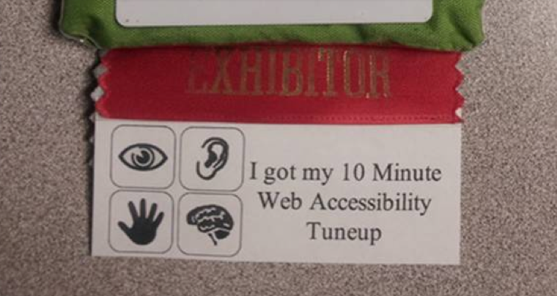
ACCESSIBILITY
Thinking about Accessibility? Check in with the Accessibility Constituent Group.

Slide 17

JOIN US AFTER THIS MEETING
EDUCAUSE Annual Business Meeting
  Tuesday, 5–6 p.m., Meeting Room 114
Opening Reception in the Exhibit Hall
  Tuesday, 4–7 p.m., Exhibit Hall A-C

Slide 18
CONVERSATION STARTERS
E-mail in any flavor
App Development
Career Steps
One-Card and Campus ID Card
Learning Management Systems
Mobility and Device Management – iPads, Smart Phones and NetBooks

Slide 19
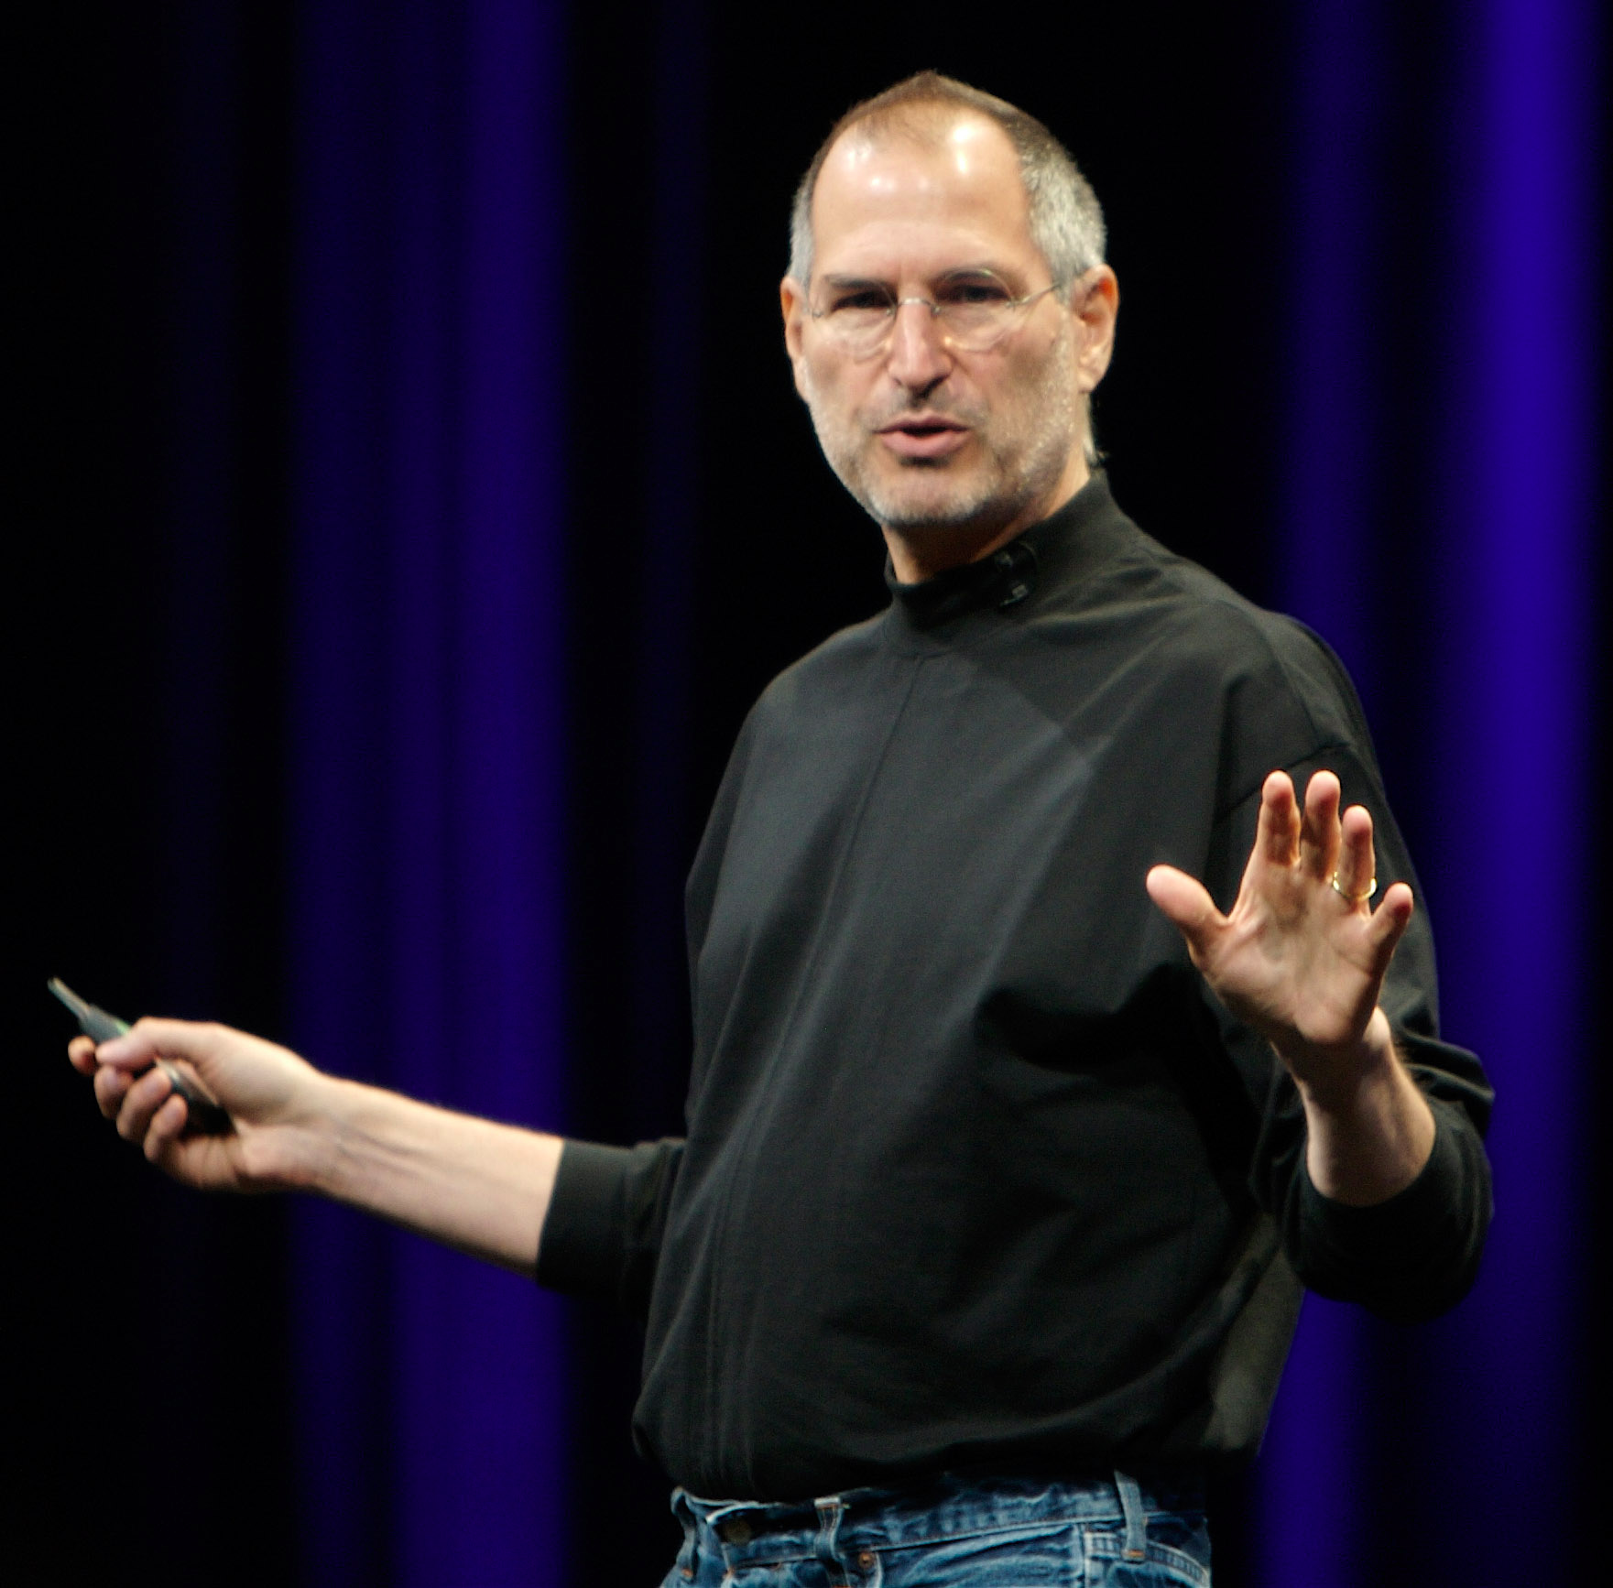
EMBRACE THE CHALLENGE
Notes:
TO THINK DIFFERENT
Your time is limited, so don't waste it living someone else's life. Don't be trapped by dogma — which is living with the results of other people's thinking. Don't let the noise of others' opinions drown out your own inner voice. And most important, have the courage to follow your heart and intuition. They somehow already know what you truly want to become. Everything else is secondary.
Read more: http://www.businessinsider.com/the-full-text-of-steve-jobs-stanford-commencement-speech-2011-10#ixzz1az2BwVFq

Slide 20
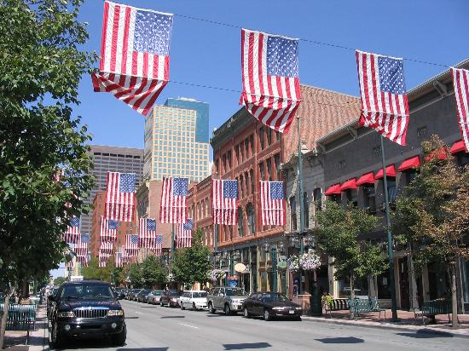
THANKS FOR YOUR LEADERSHIP
See you next year!
EDUCAUSE 2012
November 6–9, 2012
Denver, Colorado or Online
  Photo www.tripadvisor.com
  #17035317

Slide 21
THANK YOU

