Slide 1
TRANSFORMING LEARNING THROUGH ANALYTICS:
A Conversation with
George Siemens and Vernon Smith
October 21, 2011

Slide 2
Objectives
Review of Rio Salado as “The Outlier”
Examine the process of building predictive modeling
Lessons learned and questions remaining

Slide 3


  Located in Tempe, AZ. Part of the Maricopa County Community College District. Largest Public, Non-Profit Online 2-year college.
FY10-11 Total Unduplicated Headcount: 69,619*
  43,093 distance students.**
Unique attributes
  One course, many sections
  48 Weekly start dates
  23 Faculty – 1,300 + Adjunct Faculty
  RioLearn, highly scalable LMS
* Includes credit, non-credit, & ABE/GED.
** Includes students who took online, print-based, or mixed media courses.

Slide 4


Slide 5
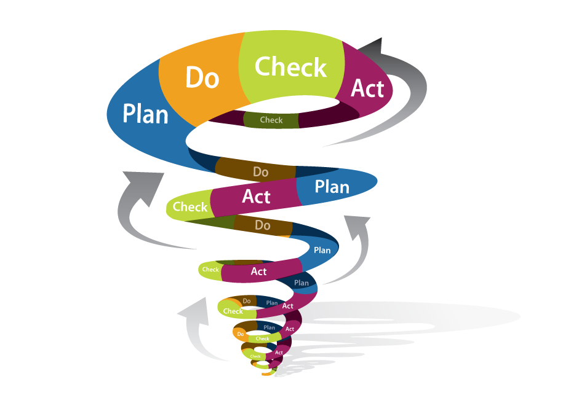
Relentless Improvement

Slide 6
Why your institution should be developing predictive analytics?
There is tremendous growth in online community college enrollment (Allen and Seaman, 2008). Need practical institutional responses to the challenges of online retention and success.
We all need to identify at-risk students and drive early alert systems to optimize completion and the student experience.
Facilitate and strengthen linkages between the institution and at-risk students –New ways of Academic and Social Integration.

Slide 7
The Outlier
“You really shouldn’t exist.”

Slide 8
Rio Salado’s Journey
Which factors are effective as early/point-in-time predictors of course outcome* in an online environment?
Can we predict course outcomes using data retrieved from our SIS and LMS? If so, can we generate early and/or rolling predictions?
How do we respond to students flagged as at-risk?
* Successful = ‘C’ grade or higher.
Notes:
I

Slide 9
Five Steps of Analytics (Campbell & Oblinger, 2007)
Capture
Report
Predict
Act
Refine
Charter
Capture
Report
Predict
Act
Refine

Slide 10
The Charter
“What if you could use this for good?”
Notes:
I recommend you have a specific purpose.

Slide 11

CaptUre/Harvest
Five Steps of Analytics (Campbell & Oblinger, 2007)

Slide 12




Add blue and reporting server
Blue /
Explorance
SQL
Reporting
District PeopleSoft
101010001011010
101010001011010
CDS
Hourly
RDS
Nightly
101010001011010
101010001011010
10101000101101011001
Course Schedule
ESF
FIS
IVR
Teacher Prep
Test Tracker
CALS
Localized AD
WebDial
CPS
10101000101101011001
CRM
Data Import
CRM Integration
10101000101101011001
Partnership
3rd Party Billing
AUAO
RioLearn
COTA
Helpdesk
RS Reports
IVR Callbacks
Self Service
Tech Check
Faculty Roster
10101000101101011001
10101000101101011001
Proctor
Student Login
RioLearn Admin
Course Definition
Rio AD Matrix
Ottawa Registration
FAemail
Notes:
SQL Reporting Server
Blue / Explorance Server

Slide 13

Report/Analysis
Five Steps of Analytics (Campbell & Oblinger, 2007)

Slide 14
Predictive LMS Factors = LSP
Log ins
  Frequency of log ins to the course section homepage
Site engagement
  Frequency of LMS activities that suggest at least some level of course engagement (e.g. Opening a lesson, viewing assignment feedback, etc.)
Pace
  Measured using total points submitted for grading

Slide 15
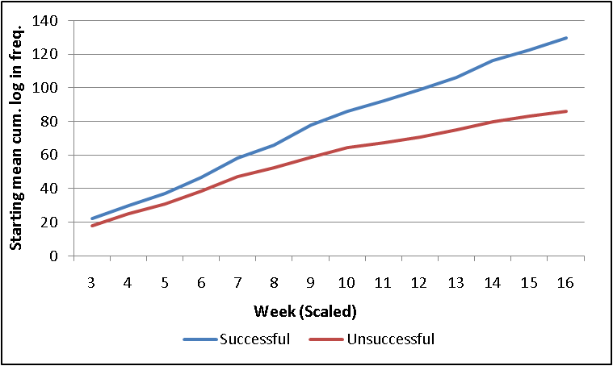
Log ins
Chemistry 151 Summer & Fall 2009 (N_{unit 3} = 159)
Measurement as of the beginning of the “week.”
Weekly measurements only include students who are upgraded and still enrolled as of the beginning of the week.

Slide 16
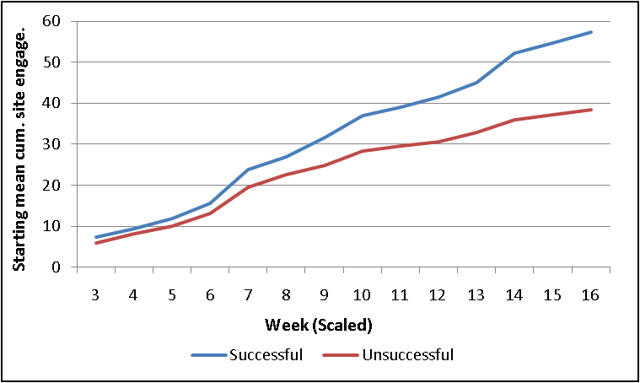
Site engagement
Chemistry 151 Summer & Fall 2009 (N_{unit 3} = 159)

Slide 17
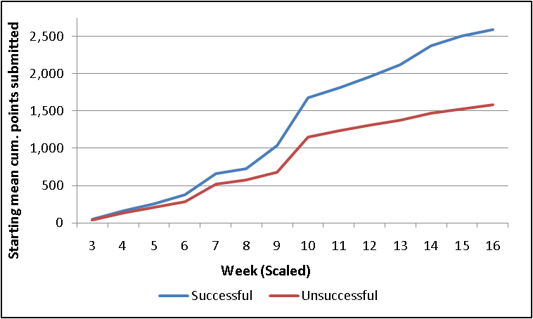
Pace
Chemistry 151 Summer & Fall 2009 (N_{unit 3} = 159)

Slide 18
Activity Weighting
In a practical application, recent behavior is most relevant.
Log in and site engagement factors weighted based on when the event occurred relative to the course start and end dates.

Slide 19
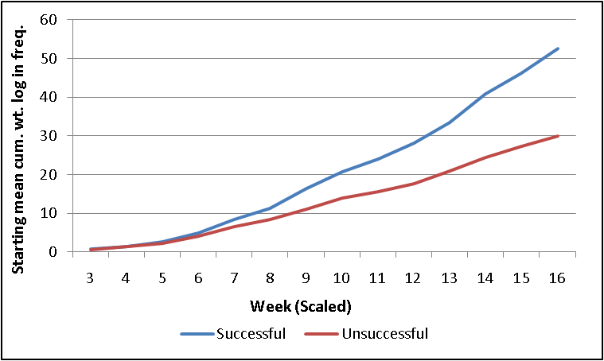
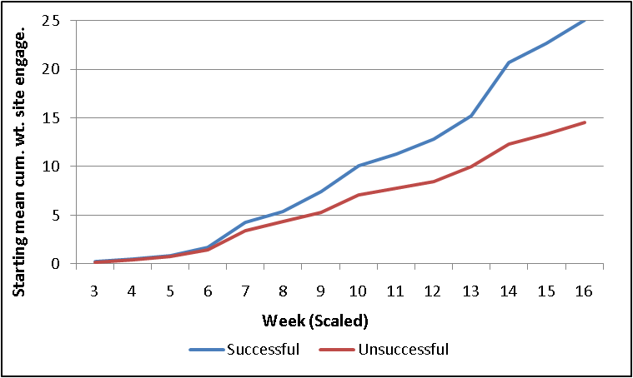
Activity Weighting
Chemistry 151 Summer & Fall 2009 (N_{unit 3} = 159)
Weighted log ins
Weighted site engagement

Slide 20
Per-week** correlations
Factor | Statistic | Week (Scaled)**
 |  | 3 | 4 | 5 | 6 | 7 | 8 | 9
Log in | Pearson r | 0.162, p=0.041* | 0.136, p=0.089 | 0.148, p=0.065 | 0.149, p=0.067 | 0.176, p=0.031* | 0.178, p=0.036* | 0.212, p=0.016*
 | Spearman ρ | 0.146, p=0.066 | 0.082, p=0.309 | 0.087, p=0.282 | 0.098, p=0.232 | 0.124, p=0.132 | 0.153, p=0.074* | 0.18, p=0.041*
Weighted Log in | Pearson r | 0.103, p=0.198 | 0.072, p=0.367 | 0.109, p=0.177 | 0.127, p=0.118 | 0.191, p=0.019* | 0.198, p=0.020* | 0.258, p=0.003*
 | Spearman ρ | 0.086, p=0.278 | -0.004, p=0.955 | 0.023, p=0.778 | 0.087, p=0.286 | 0.179, p=0.029* | 0.232, p=0.006* | 0.272, p=0.002*
Factor | Statistic | Week (Scaled)**
 |  | 10 | 11 | 12 | 13 | 14 | 15 | 16
Log in | Pearson r | 0.218, p=0.014* | 0.231, p=0.009* | 0.246, p=0.006* | 0.247, p=0.006* | 0.269, p=0.002* | 0.273, p=0.002* | 0.288, p=0.001*
 | Spearman ρ | 0.218, p=0.015* | 0.226, p=0.011* | 0.244, p=0.006* | 0.258, p=0.004* | 0.288, p=0.001* | 0.273, p=0.003* | 0.324, p=0.000*
Weighted Log in | Pearson r | 0.218, p=0.016* | 0.274, p=0.002* | 0.295, p=0.001* | 0.285, p=0.001* | 0.32, p=0.000* | 0.273, p=0.004* | 0.336, p=0.000*
 | Spearman ρ | 0.218, p=0.017* | 0.305, p=0.001* | 0.335, p=0.000* | 0.354, p=0.000* | 0.381, p=0.000* | 0.273, p=0.005* | 0.415, p=0.000*
Significant correlation between log ins and course outcome
Significance of correlation increases throughout duration of course.
Similar findings with other LMS activity measures
* Significant at the .05 level.
** Scaled weeks (16-unit scale)

Slide 21


Predict
Five Steps of Analytics (Campbell & Oblinger, 2007)
Source: http://sf.metblogs.com/2009/02/05/book-on-as-gm-to-lens-brad-pitt-will-play-billy-beane/
Notes:
Brad Pitt as Billy Beane

Slide 22
Predictive Model #1 (8th day at-risk)
Purpose
  Run only on 8th day of class. Derive estimated probability of success and generate warning levels: Low, Moderate, High.
Factors
  30 factors selected covering broad spectrum of LMS behavioral data and enrollment information.
Methodology - Naïve Bayes classification model
  Accurate, robust, fast, easy to implement. (Lewis, 1998); (Domingos & Pazzani, 1997)
Accuracy**
  70% of unsuccessful* students correctly predicted for 6 participating disciplines.
  Warning levels correlated with course outcome.
* Success = ‘C’ or higher
** Tested using random sub-sampling cross-validation (10 repetitions)

Slide 23
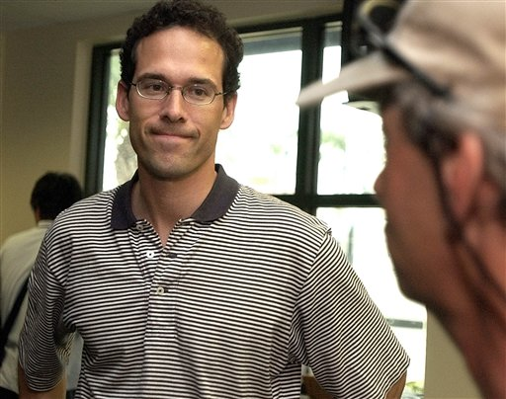

Refine
Five Steps of Analytics (Campbell & Oblinger, 2007)
Notes:
Paul DePodesta AKA Peter Brand (Jonah Hill)

Slide 24
Predictive Model #2 (Rio Pace)
Rio Progress And-Course Engagement
Institutionalization of predictive modeling into LMS at Rio Salado
Piloted April 2010
Automatically updates weekly (every Monday)
Integrated within RioLearn course rosters

Slide 25
Predictive Model #2 (Rio Pace)
Warning levels
  Generated using naïve Bayes model with 5 input factors
    Weighted log-in frequency
    Weighted site engagement
    Points earned
    Points submitted
    Current credit load
  ‘High’ warning = Student has low probability of success if his/her current trajectory does not change.

Slide 26
Predictive Model #2 (Rio Pace)
Activity metrics
  Log in
    Excellent, Good, or Below Average
  Site engagement
    Excellent, Good, or Below Average
  Pace
    Working ahead, Keeping pace, Falling behind
Calculated using historical per-week* means and standard deviations for each metric in each course. Derived using previously successful students only. Example:
Log in activity:
Below average
Good
Excellent
…
…
-σ
μ
σ

Slide 27
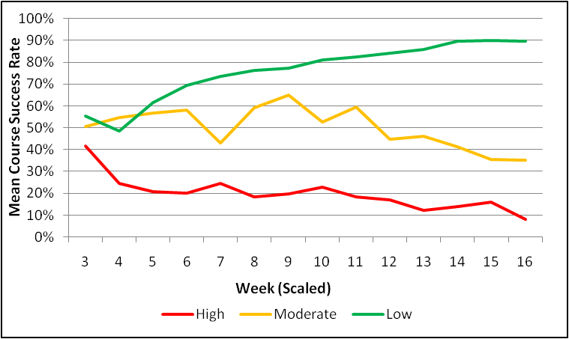
Predictive Model #2 (Rio PACE)
Warning level distribution
  Distribution is approximately uniform at beginning of class.
  ‘Moderate’ decreases and ‘Low/High’ increases over time.
Chemistry 151 Summer & Fall 2009
Accuracy*
Correlation between warning level and success rate.
Success_{low} > Success_{mod} > Success_{high}
.

Slide 28
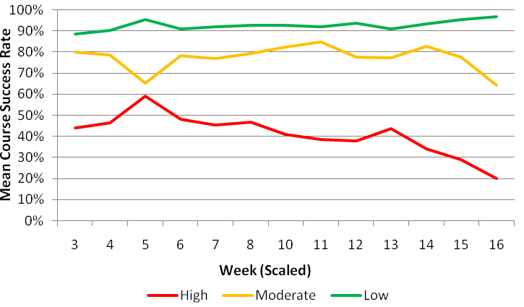
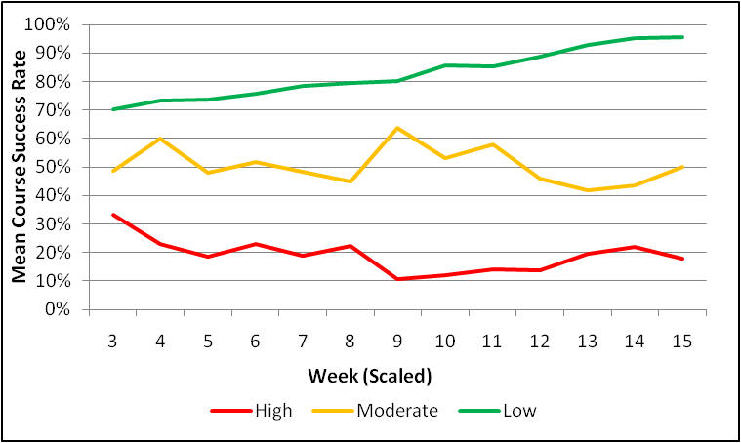
Predictive Model #2 (Rio PACE)
Accuracy*
Other courses
Sociology 101 Summer & Fall 2009 (N = 731)
Accounting 111 Summer & Fall 2009 (N = 539)
*Obtained using random sub-sampling cross-validation (50 repetitions)

Slide 29
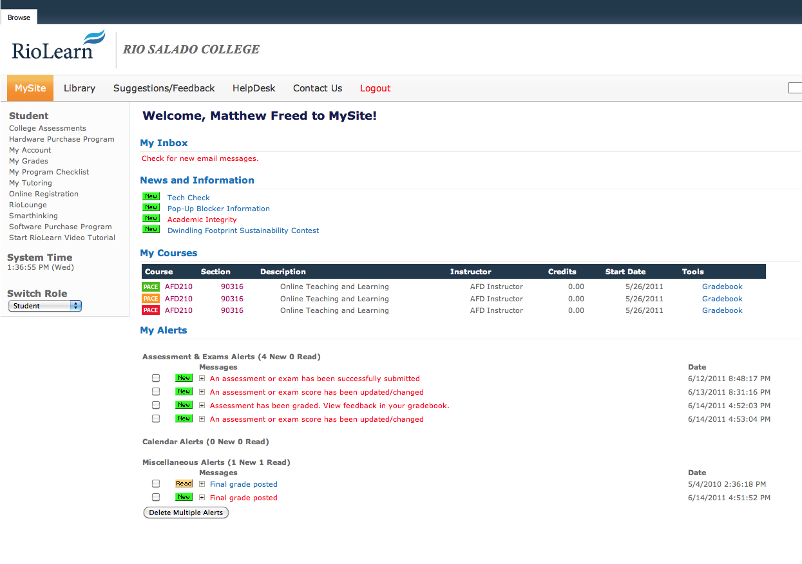
Rio PACE
(Student View)

Slide 30
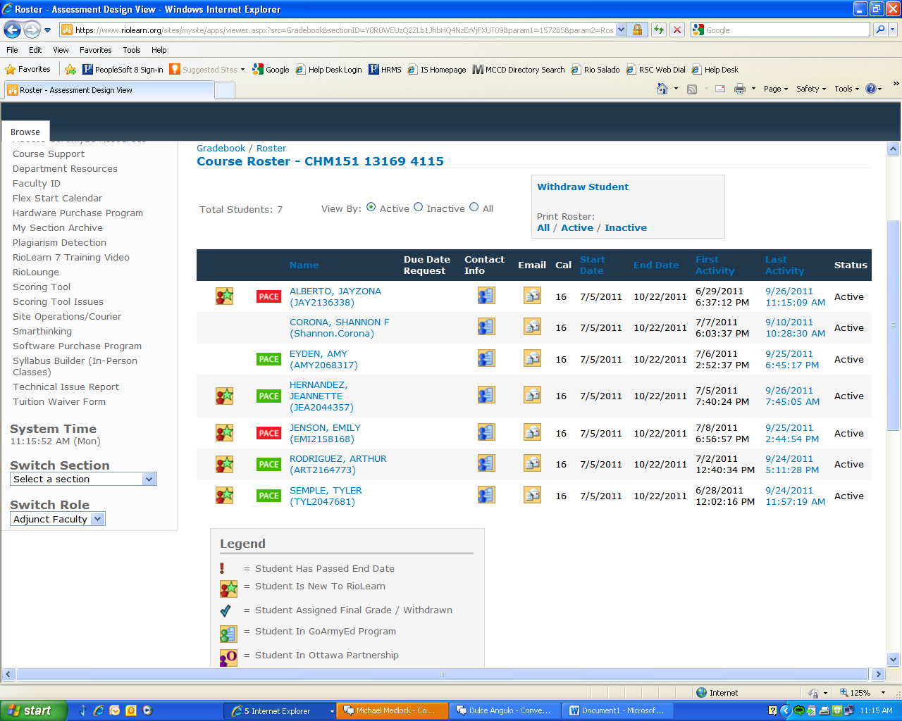
Rio PACE (Faculty View)

Slide 31
Act
Five Steps of Analytics (Campbell & Oblinger, 2007)

Slide 32
At-risk Interventions
Course welcome emails
  Encourage students to engage early.
  Gen-ed students who log in on the 1st day of class succeed 21% more often than students who do not.*
  Small trial in Fall ‘09 showed 40% decrease in drop rate.
  Could not duplicate when expanded to large scale – more investigation needed.
8th day at-risk interventions
  Trial in Sum & Fall ’09 showed no overall increase in success.
  Low contact rate – difficult for faculty to reach students.
  However, students who did receive direct contact succeeded more often than those who were unreachable.
*Obtained from Spring 2009 online general education courses at Rio Salado College.

Slide 33
Roles for Successful Predictive Modeling
Project Champion/Institutional Support – Predictive modeling requires resources and someone who can champion the cause.
Stakeholders – this could include administration, faculty, student services and people from the IT department. The stakeholders need to be willing to review models and provide insight and feedback as the model is developed.
IT department – Something will be needed from IT whether it be data or implementing the model in a production setting.
Predictive Modeler – Contrary to some marketing brochures, predictive modeling is not a turnkey solution.
Programmer/analyst – Having support from a programmer/analyst can help the person doing the modeling to be more efficient. A great deal of the work that goes into predictive modeling can be supported by a programmer/analyst.

Slide 34
Getting Started
The stakeholders, especially those making use of the outcomes of the project, need to be invested. If they do not buy into the process, they will not use it. If they are not involved in the development (or have representation in the development process), they will not use it. If they do not understand the output they will not use it.
Having a good working relationship with the IT department is essential. Generally, they have the data and other resources that may be needed.
Time is key for many reasons. Time is needed for model development, testing, training, and development for production.
Institutional support includes many things, such as software, hardware, training, conferences, and time for research.

Slide 35
Conclusions
LSP Matters! Log ins, site engagement, and pace are correlated with course outcome, even at an early point in the course.
Colleges can build and “bootstrap” predictive models using existing LMS data to identify online students who are struggling or are likely to struggle.
Simple metrics can be used to assess activity performance, which might help instructors launch more customized interventions.
More research needed on the intervention side, but the best step is to “just get started.”

Slide 36
THANK YOU

Slide 37
References
Allen, I. E., & Seaman, J. (2008). Staying the Course: Online Education in the United States. The Sloan Consortium.
Campbell, J., & Oblinger, D. (2007). Academic Analytics. EDUCAUSE White Paper. http://www.educause.edu/ir/library/pdf/PUB6101.pdf
Green, K. (2009, November 4). LMS 3.0. Inside Higher Ed. Retrieved from http://www.insidehighered.com/views/2009/11/04/green.
Iten, L., Arnold, K., Pistilli, M. (2008, March 4). Mining real-time data to improve student success in a gateway course. 11th Annual TLT Conference. Purdue University.
Johnson, N., Oliff, P., Williams, E. (2009, December 18). An update on state budget cuts. Center on Budget Policy and Priorities. Retrieved from http://www.cbpp.org/files/3-13-08sfp.pdf.
Kolowich, S. (2009, October 30). The new diagnostics. Inside Higher Ed. Retrieved from http://www.insidehighered.com/news/2009/10/30/predict.
Lewis, D. (1998). Naive (Bayes) at forty: The independence assumption in information retrieval. Lecture Notes in Computer Science, 1398, 4-15.
by the president on the American Graduation Initiative." Macomb Community College. Warren, MI.
Ross, E. (2009, November 7). College connection. Oklahoma City, OK: Oklahoma State Regents for Higher Education.
Terence, C. (2010, January 14). Colleges cap enrollment amid budget cuts. Associated Press. Retrieved from http://www.pbs.org/nbr/headlines/US_Competing_for_Admission/index.html.
Hernández, R. (2009). Development and Validation of an Instrument to Predict Community College Student Success in Online Courses Using Faculty Perceptions. Annual Conference of the Council for the Study of Community Colleges.
Macfadyen, L., Dawson, S. (2010). Mining LMS data to develop an ‘‘early warning system” for educators: A proof of concept. Computers & Education, 54, 588-599.
Domingos, P., Pazzani, M. (1997). On the Optimality of the Simple Bayesian Classifier under Zero-One Loss. Machine Learning, 29, 103-130.

Slide 38
THANK YOU

