Slide 1
Innovation with Impact
What does it take to make innovation work?
Christien Bok

Slide 2



Slide 3


CALIFORNIA, USA
THE NETHERLANDS
VS
420,000 km²
37,000,000
40
size
42,000 km²
16,600,000
60
citizens
universities

Slide 4
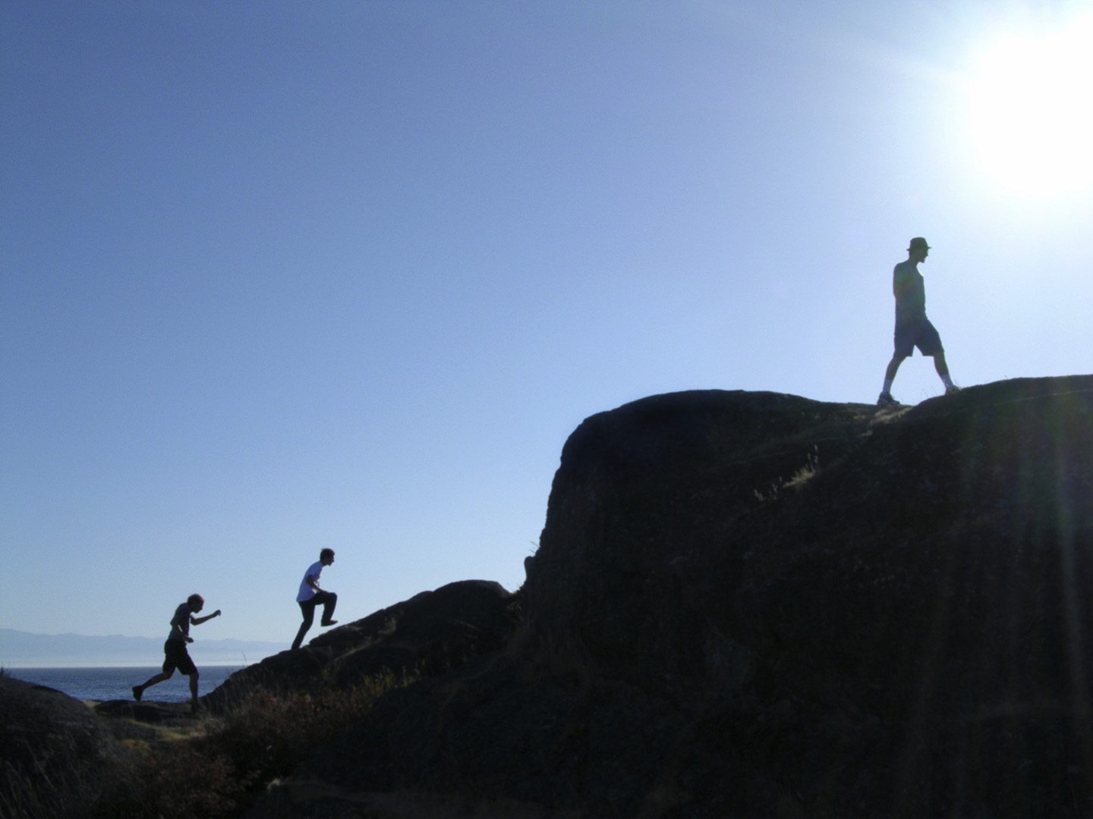
SURF: ICT innovation by and for higher education and research
Research universities, universities of applied sciences, and research institutions work together in SURF, in order to
Improve the quality of research and education
By creating pioneering ICT innovations
For more than twenty years, collaboration within SURF has led to products and services that the participating institutions could not have achieved on their own

Slide 5


The SURF Approach

Slide 6



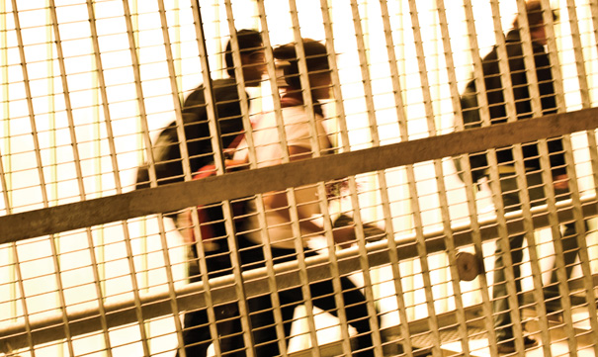
Designing a Program
Educational Innovation Program
1999-2010
70 projects, avg. €550, 000
Nationwide Program e-Learning
2006-2012
22 projects, avg. €750,000
€40,000,000
€16,627,000
Study choice Interviews
2009-2011
28 projects, avg. €80,000
Testing and Test driven Learning
2011-2015
11 projects, avg. €300,000
€2,220,000
€3,400,000

Slide 7
Four stages of innovations
Grassroots projects
Development projects
Up scaling projects
Implementation projects
Objective: small-scale experi-mentation with new techniques in educational practice
Objective: development and design of promising techniques in educational practice
Objective: larger-scale deploy-ment of successful techniques in educational practice
Objective: implementation of successful tech-niques in existing organization

Slide 8


Slide 9
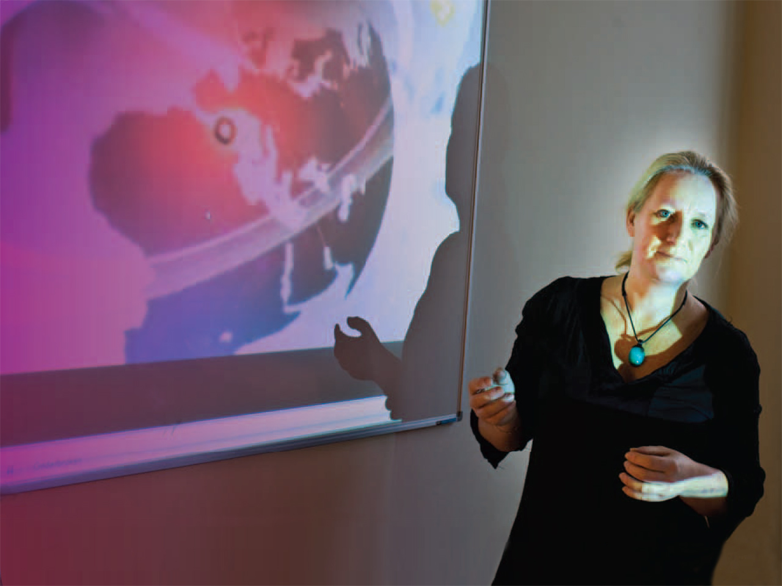
The SURF Approach
Tender with criteria
A project must involve collaboration between a number of institutions
A project must be in line with the policy pursued by the institutions that implement it
Institutions make their own financial contribution to the project
The results of the project can be freely used by all higher education and research institutions

Slide 10

EXPLORE AND EVALUATE
FACILITATE AND PARTICIPATE IN NETWORKS
BUILD KNOWLEDGE AND SHARE INFORMATION
PROFESSIONAL DEVELOPMENT
EXPERIMENT, DEVELOP AND ENCOURAGE USE
PROVIDE TECHNICAL PRECONDITIONS

Slide 11

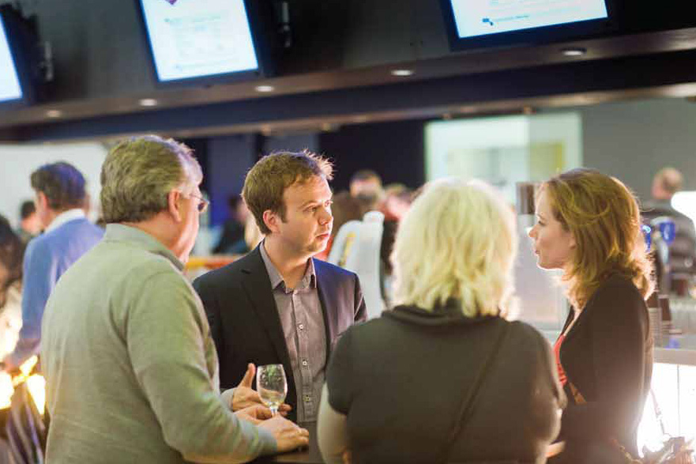
FACILITATE AND PARTICIPATE IN NETWORKS
14 Special Interest Groups
2,300 participants

Slide 13


BUILD KNOWLEDGE AND SHARE INFORMATION

Slide 14


PROFESSIONAL DEVELOPMENT

Slide 15

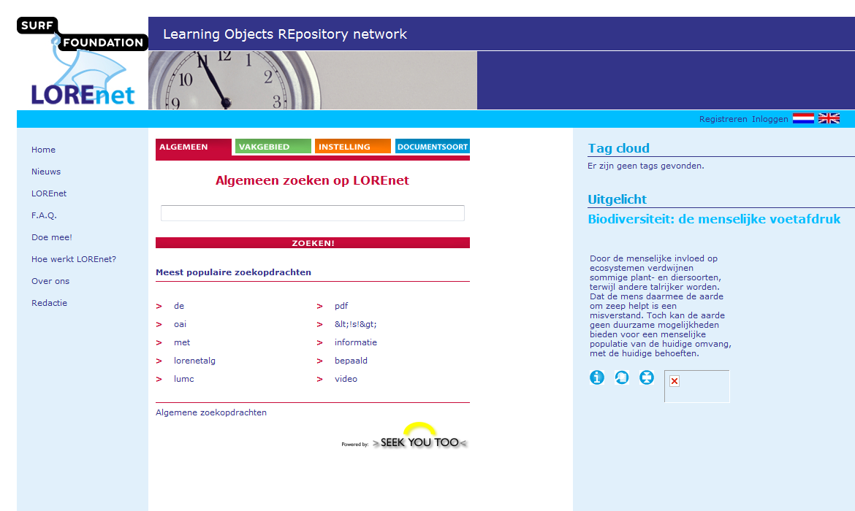
PROVIDE.TECHNICAL PRECONDITIONS

Slide 16


EXPLORE .AND EVALUATE

Slide 17
Measuring impact
Grassroots projects
Development projects
Up scaling projects
Implementation projects
Before
During
After
Long-term
Keep it clear and simple!
Objective, hypothesis, and substantiation of selected intervention
Objective: small-scale experi-mentation with new techniques in educational practice
Objective: development and design of promising techniques in educational practice
Objective: larger-scale deploy-ment of successful techniques in educational practice
Objective: implementation of successful tech-niques in existing organization
Monitor objective
Test hypothesis
Conclusion and evaluation
Long-term conclusions

Slide 18

Clear objectives
Before
During
After
Long-term
Objective, hypothesis, and substantiation of selected intervention
Monitor objective
Test hypothesis
Conclusion and evaluation
Long-term conclusions

Slide 20
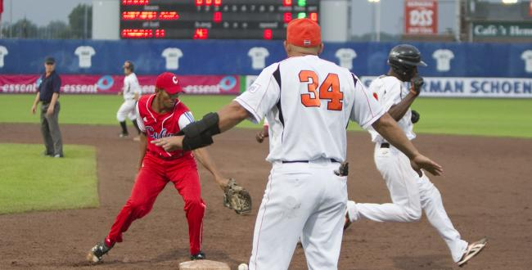
Realistic choices and Monitoring
Before
During
After
Long-term
Objective, hypothesis, and substantiation of selected intervention
Monitor objective
Test hypothesis
Conclusion and evaluation
Long-term conclusions

Slide 22

Lessons Learned
Before
During
After
Long-term
Objective, hypothesis, and substantiation of selected intervention
Monitor objective
Test hypothesis
Conclusion and evaluation
Long-term conclusions

Slide 24
EXPLORE AND EVALUATE
FACILITATE AND PARTICIPATE IN NETWORKS
BUILD KNOWLEDGE AND SHARE INFORMATION
PROFESSIONAL DEVELOPMENT
EXPERIMENT, DEVELOP AND ENCOURAGE USE
PROVIDE TECHNICAL PRECONDITIONS

Slide 25
