Slide 1
Seminar 01A
Discussing the Big Questions for CIOs and Enterprise IT Leaders
Mark Askren, Becky King, Gerry McCartney | October 18, 2011
Notes:
I want to talk about the roles of senior IT leaders in higher ed today, some issues impacting those roles, and the personas that can lead to success.
AND I looked for some CIO humor & evidently there is NOTHING funny about being a CIO these days.

Slide 2
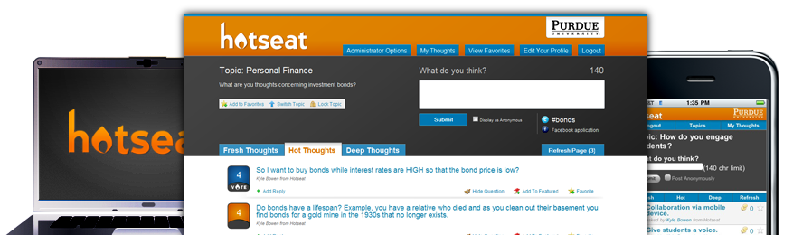



purdue.edu/hotseat/open
Connect to Hotseat using one of these accounts:
Available from many mobile Web browsers -
including iOS and Android.
Text CIO to (765) 560-4177 with your comments or questions.

Slide 3
WHO ARE WE? WHO DO WE NEED TO BE?
Becky King | October 18, 2011
Notes:
I want to talk about the roles of senior IT leaders in higher ed today, some issues impacting those roles, and the personas that can lead to success.
AND I looked for some CIO humor & evidently there is NOTHING funny about being a CIO these days.

Slide 4
My greatest fear is that no one will remember me after I’m dead.
– some dead guy

Slide 5
THE ROLE(S) OF THE CIO TODAY
Technology Leadership: Today’s Higher Education CIO – ECAR, Aug, 2011
The Continually changing Role of the CIO – CIOUpdate.com, Aug, 2010
Evolution of the CIO – EDUCAUSE Issues Brief, Oct, 2009
The Changing Role of the CIO – Business Intelligence Forum, Jun, 2004

Slide 6
THE ROLE(S) OF THE CIO TODAY (cont.)
The Evolving Role of the CIO – MIT Sloan School of Mgt, Aug, 1999
New Information Systems Leaders: A Changing Role in a changing World – MIS Quarterly, Dec, 1992
Changing Role of the Corporate Information Systems Officer – MIS Quarterly, Sept, 1985

Slide 7

NEW challenges for the cio
Social Media
Risk Management/Physical Security
Cellular Coverage
Sustainability
Plethora of Devices
Contract Review
Marketing & Communications
Compliance Requirements

Slide 8
CIO.com top 10 business predictions for 2011
10. Social media will keep dominating the business conversation...
9. The CIO-CMO relationship will change for the better, growing closer and more collaborative.
8. Cloud will move from an overhyped theory to an adopted practice in mainstream business.
7. Mobile moves aggressively into the data & applications arena … to empower the workforce, speed decision making & grow top-line revenue.
6. Real-time analytics will define & drive the real-time organization.

Slide 9
CIO.com top 10 business predictions for 2011 (cont.)
5. Security breaches will hit an all-time high as data keeps getting pushed beyond the enterprise walls.
4. A battle will break out between IT & the lines of business over who really owns the user interface.
3. CIOs will continue evolving beyond an operational focus, spending more time transforming business processes & setting strategy.
2. Vendor consolidations will cause major support issues at your organizations…
1. CIO turnover will increase if businesses can’t scale. …energies will be spent reducing cycle times & helping organizations increase revenue instead of cutting costs.

Slide 10
The CIO should not be viewed simply as the “highest ranking IT person.” The CIO should be both the leader of the company’s IT discipline and a key contributor to the company’s overall business strategy.
– Starbucks CIO Stephen Gillett, 2010

Slide 11
IT Budget Changes 2011, Unweighted Average
Source: Gartner (March 2011)

Slide 12
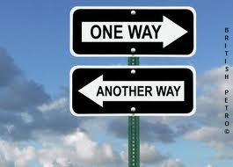

Slide 13

Four Personas for CIO Success
Chief Infrastructure Officer
Chief Integration Officer
Chief Intelligence Officer
Chief Innovation Officer

Slide 14
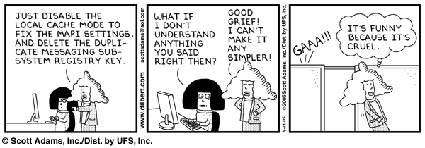
First, A word about communication

Slide 15
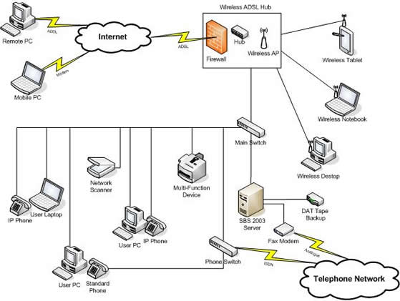
Chief infrastructure officer
Run the utility
Network, Network, Network
Legacy & ERP systems
Execution is critical
24x7
Security, compliance
Budgets & funding

Slide 16

Chief integration officer
BPR
Combine in-sourced & out-sourced
Consolidating operations & resources
Manage projects, services & relationships
Collaboration, negotiation
Social/political abilities
Budgets & funding

Slide 17
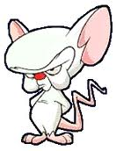
Chief intelligence officer
Business Knowledge
Analytics
Communication
Strategic Planning
Assessment
Solving of Wicked Problems
Researcher
Policy

Slide 18

Chief innovation officer
Reading & Research
Agility/Change Management
Risk
Quick assessment of new technologies
Cost Control (anyone can innovate with unlimited $$)
Business as UNusual

Slide 19
HOTSEAT Results 1
On which ‘I’ role do you spend the most time?
Infrastructure – 15%
Integration – 37%
Intelligence – 22%
Innovation – 26%

Slide 20
HOTSEAT Results 2
Which ‘I’ role is the most critical to success for the CIO?
Infrastructure – 3%
Integration – 18%
Intelligence – 36%
Innovation – 43%

Slide 21
HOTSEAT Results 3
Which of the following aspects of the senior IT leader role do you personally prefer?
Learning new technologies & applying them – 27%
Relationship building & communication – 24%
Strategic & business planning – 33%
People mgt & organization building – 15%

Slide 22
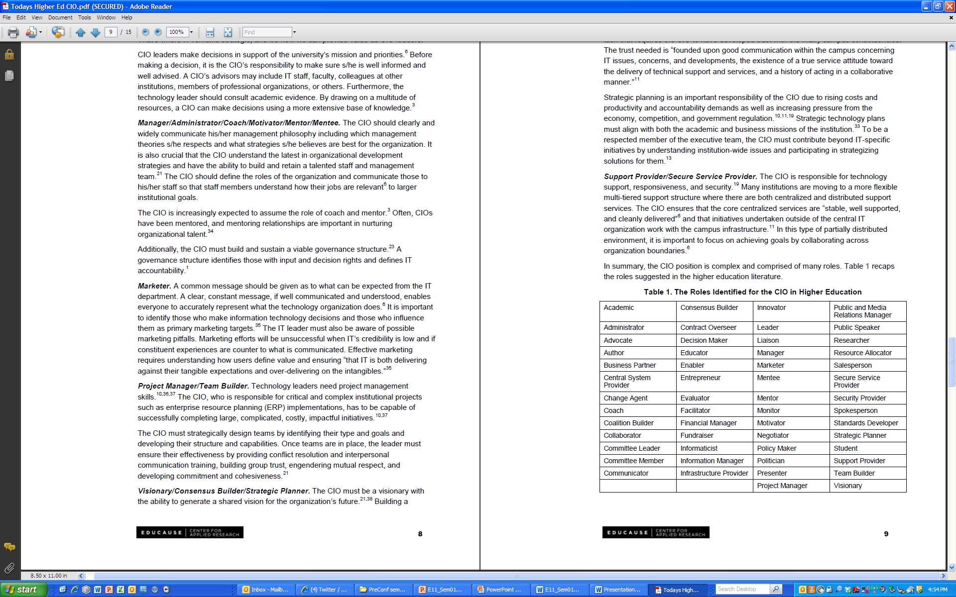
  Technology Leadership: Today’s Higher Education CIO
  ECAR Research Bulletin 11, 2011
Notes:
Here are some additional thoughts on the roles a successful CIO may be expected to assume at his or her institution. This is from Meredith Weiss’ recent ECAR Research Bulletin.

Slide 23
References & Readings
  Top Ten Business Predictions for 2011
  http://www.cio.com/article/638177/Top_Ten_Business_Predictions_for_2011
  4 Personas of the Next-Generation CIO
  http://www.cio.com/article/671573/4_Personas_of_the_Next_Generation_CIO
  The Evolution of the CIO
  http://www.educause.edu/Resources/TheEvolutionoftheCIOAnEDUCAUSE/188629
  Technology Leadership: Today’s Higher Education CIO
  http://www.educause.edu/Resources/TechnologyLeadershipTodaysHigh/234063 (currently limited to ECAR subscribers)
  The Higher Education CIO
  http://net.educause.edu/ir/library/pdf/ECAR_SO/ERS/ERS1102/ERS1102W.pdf (currently limited to ECAR subscribers)

Slide 24

Caution: Dangerous Curves Ahead
{ Insert IT Vision Here }
Gerry McCartney | October 18, 2011
Vice President for Information Technology and CIO
Olga Oesterle England Professor of Information Technology
Purdue University
gerrymccartney

Slide 25

Join the backchannel at purdue.edu/hotseat/open
or text CIO to (765) 560-4177 with your comments.

Slide 26

Join the backchannel at purdue.edu/hotseat/open
or text CIO to (765) 560-4177 with your comments.

Slide 27

Top Issues for IT
Top Issues for Presidents
    Funding IT
Addressing budget shortfalls
    Improving or maintaining
    administrative/ERP systems
    Dealing with changes in
    state support
    Adopting or maintaining Teaching
    and Learning technologies
    Maintaining quality of
    academic programs
    Improving IT Security
    Addressing rising tuition and
    college affordability
    Adopting mobile technologies
    Dealing with cuts in federal
    research support
Join the backchannel at purdue.edu/hotseat/open
or text CIO to (765) 560-4177 with your comments.

Slide 28

Join the backchannel at purdue.edu/hotseat/open
or text CIO to (765) 560-4177 with your comments.

Slide 29
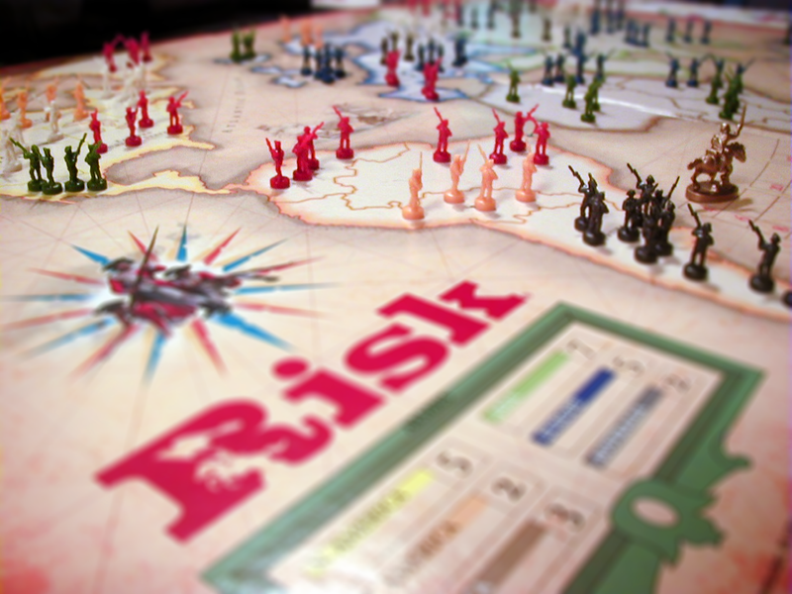
Join the backchannel at purdue.edu/hotseat/open
or text CIO to (765) 560-4177 with your comments.

Slide 30
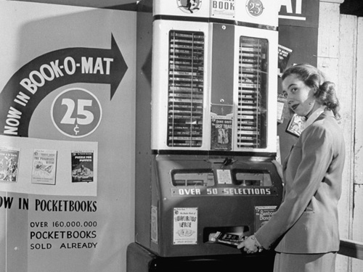
Join the backchannel at purdue.edu/hotseat/open
or text CIO to (765) 560-4177 with your comments.

Slide 31
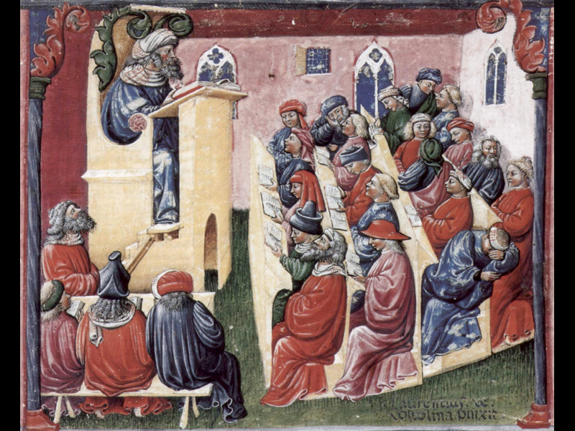
Join the backchannel at purdue.edu/hotseat/open
or text CIO to (765) 560-4177 with your comments.

Slide 32
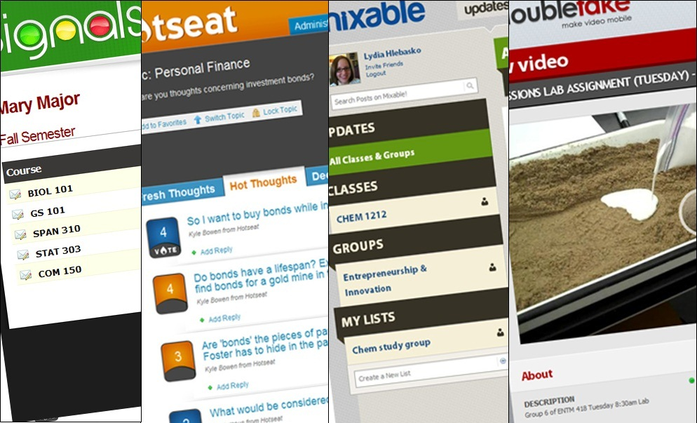
purdue.edu/studio

Slide 33

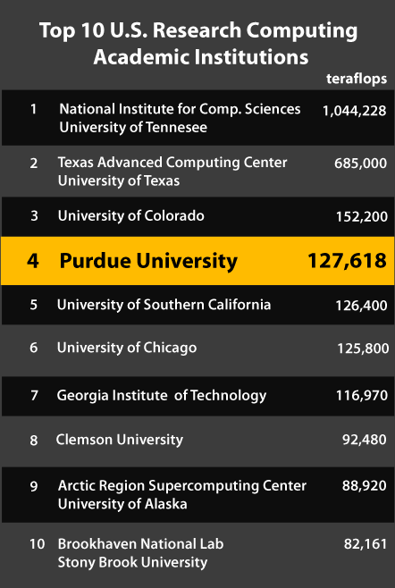

hubzero.org

Slide 34

Join the backchannel at purdue.edu/hotseat/open
or text CIO to (765) 560-4177 with your comments.

Slide 35

For more information:
http://www.purdue.edu/studio

Slide 36

IT Changes in higher education… are you ready for the next 10 years?
Mark Askren | October 18, 2011
CIO, University of Nebraska - Lincoln

Slide 37
The future keeps changing…but expect
It won’t revolve around our campus central IT departments (at least physically)
We will be defined by our services and how much they cost, and how we compare to our peers
Data integrity will be critical as we will have trouble securing our data and Web sites
Collaboration and strategic sourcing will be the critical skill sets
It will be mobile beyond our current comprehension

Slide 38
The money trail…
Today we spend our budgets on:
  Permanent staff
  ERP implementations, upgrades, maintenance
  Office space (usually not paid for by IT departments)
  Data centers and fixed equipment
Over the next decade our costs will shift to:
  Temporary staffing (on demand)
  SaaS ERPs and Cloud cycle/storage capacity
  Consortium investments
  Licensing and other Intellectual Property agreements
  Security services

Slide 39
Who (and where) are the CIOs?
Institutions will choose to:
  Invest in a CIO that is a senior leader and sourcing expert and leverage IT as a strategic differentiator, or
  Go the utility route (all that matters is that the commodity services are provided with reasonable quality at the lowest possible cost)
It will not be unusual in years ahead for universities to source major IT services to peer institutions (including the CIO role)

Slide 40

How far will IT consolidation go?
Currently we are seeing the early stages of university system consolidation, including state government in some cases
In the next decade we will not have campus systems with their own “peer” CIOs at each campus, nor will we have dozens of full-service IT shops on our large campuses offering largely similar services
We will no longer brag about building $20-30M data centers on our campuses

Slide 41
Can universities really work together?
Initiatives like I2 Net+ and Gig.U are
promising examples of “Big” collaboration
Community source provides a third option in some areas. A series of “free” vendor cloud ERP solutions will further disrupt the current market
Going forward IT spend will be further divided into consumables vs. strategic procurement.
CIOs and other IT leaders will lose control over technology purchasing negotiations unless we aggregate demand.

Slide 42
You need a career plan, or find an exit strategy
IT as an industry is changing faster than we are as a profession (don’t expect that to change)
Figure out your career path over the next decade, or someone else will decide it for you
With baby boomers retiring there will be many high-level opportunities
It will be easier to get the CIO position in the future than it will be to stay in that role
Go big, or burrow in

Slide 43
Failures in IT leadership remain predictable
Lack of delivery is the single biggest derailer for CIOs.
A close second is the failure to engage meaningfully and clearly at the highest levels of the organization and with peers throughout the institution.
Struggling CIOs tend to be either too externally focused or “high level”, and aren’t executing. Or too “in the weeds” and technical, and not connecting at the right level with the right people.
Matt Aiello
Principal, Heidrick & Struggles
202. 331.4900

Slide 44
So, are you ready for the higher ed IT future?
Do you understand the critical challenges facing your institution, and can you produce results?
Are you able to create new revenue streams?
Can you drive (and survive) continually increasing change?
Are you able to solve ill-defined and almost impossible problems?
Do you trust other universities to provide mission critical services for your institution?

Slide 45
In Summary: The Big Questions for CIOs and Enterprise IT Leaders
Additional views on what we’ve discussed?
Key areas we haven’t talked about this morning?

