Slide 1
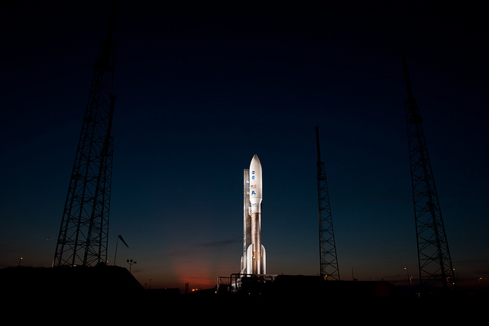
The Right Stuff
Insights for Next-Generation Technology Leaders and the CIOs Who Mentor Them
Photo by nasa hq photo, available under CC BY-NC 2.0
Notes:
Copyright Bruce Maas, Brian Paige, Michael Ridley, Theresa Rowe, Bo Wandschneider, Melissa Woo, 2011. This work is the intellectual property of the author. Permission is granted for this material to be shared for non-commercial, educational purposes, provided that this copyright statement appears on the reproduced materials and notice is given that the copying is by permission of the author. To disseminate otherwise or to republish requires written permission from the author.
Intro by Sean: - 5 minutes
There is significant discussion around the changing demographic of the CIO and the move from current generation CIOs to next generation CIOs.
The role of the CIO is continuously changing and the career path to becoming a CIO is not always well defined. The combination of these factors creates a challenge for current Technology Leaders (TLs) who are not yet CIOs but aspire to the role. While both the role and the CIO may not be the same in future years as they are today, there are actions that the next generations of TLs can take to prepare themselves, their institutions and the role for the transition.
Today's forum will be a discussion between 3 CIOS and their mentors. It is a discussion they have at home and will try and share today. This is meant to be fun and engaging and we hope you will join our dialogue.

Slide 2

Bruce Maas
University of Wisconsin-Madison
Brian Paige
Oakland University
Michael Ridley
University of Guelph
Theresa Rowe
Oakland University
Bo Wandschneider
Queen's University
Melissa Woo
University of Wisconsin-Milwaukee
Moderator:
Sean Reynolds - Northwestern University
Notes:
3 minutes
Each individual provides a "hello I am _____", title, and role at their university. Maybe another background Tidbit "I've been in hi-ed for x years," etc.

Slide 3

Framework
Photo by nasa hq photo, available under CC BY-NC 2.0
Notes:
Bo - 2 minutes
This presentation is not about the mentoring process or the mentoring relationship or a guide for mentoring
This presentation is about the outcomes and lessons learned in already existing mentoring relationships between CIO's and Technology Leaders
This presentation is also highly personal, not just dealing with the hypothetical, but relevant because ... (next slide)

Slide 4
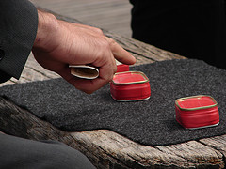
It's all about CHANGE
Photo by emilykbecker, available under CC BY-NC-ND 2.0
Notes:
Mike - 5 minutes
Ok- before we start - we all know that in higher Ed teaching it is all about change - give a BRIEF overview of changes -2 or 3 examples

Slide 5

Bruce: UW-Milwaukee to UW-Madison as CIO
Mike: CIO role at Guelph into personal pursuits
Bo: moved into a CIO and AVP role at Queen's University
Melissa, Brian, and Theresa are managing change internal to our institutions
Photo by FatMandy, available under CC BY-NC-ND 2.0
Notes:
Mike just outline changes since we wrote this paper

Slide 6

  What professional development is needed?
  What is the role of IT leadership on campus?
Notes:
Theresa? and Bruce? - 5 minutes
As the leader for the CIO constituent group and an individual passionate about and respected for growing leaders Theresa might be able to do a bigger "set up" or "preamble" about the rest of the discussion.
Bruce can jump in with thoughts.
identify and clarify what professional development efforts are needed to prepare an aspiring CIO for a possible future CIO role and initiate similar discussions at their home institutions
understand the role of IT leadership in the campus decision making framework and where the role of the CIO is going. Ask the question: “Is the CIO a product line leader or an institutional leader?”
inspire people toward a personal investment in technology leadership
Brian or Melissa- 3 minutes
Discuss the responsibilies and attitudes of technology leaders preparing for roles of greater responsibility
Understanding hi-ed as as a whole and not just the tech
Commiting to personal development and maturation as identified by the CIO's
Being open to correction and re-direction

Slide 7
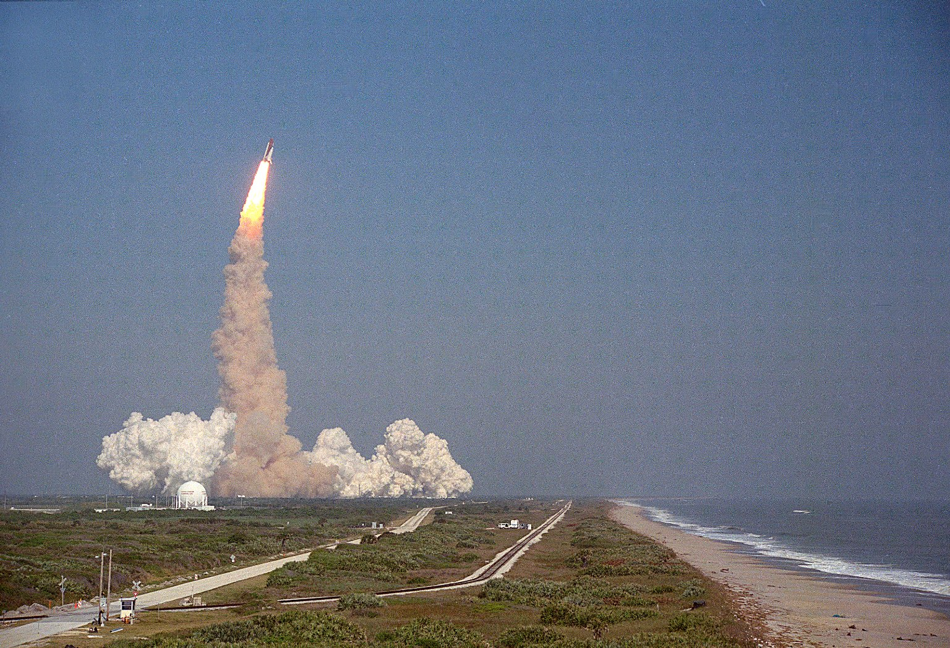
How has your educational, professional, and experiential background helped you?
How will this be the same or different for future CIOs?
NASA/courtesy of nasaimages.org
Notes:
5 minutes

Slide 8
Technology leaders, how do you perceive that your CIO’s education, professional and experiential background has prepared him/her for the role?
NASA/courtesy of nasaimages.org
Notes:
5 min

Slide 9
How have your personal strengths positioned you for your current success?
What strengths have you focused on developing to make you successful in your role?
Technology Leaders, what strengths are you focusing on developing for your next role?
NASA/courtesy of nasaimages.org
Notes:
5 min

Slide 10
What do you see as the most critical competencies for current and future CIOs?
Are these competencies changing?
NASA/courtesy of nasaimages.org
Notes:
5 min

Slide 11
Questions for the Audience
  Are there things this group is not considering?
  What are you doing to prepare your next generation leaders?
  As a next generation leader, what are you doing to prepare?
  Are there other questions or comments?
Notes:
Go to the floor. We shouold be 40 minutes to this point - we can enter back into discussion if we want - revisit outcomes..... we could engage community at each trigger?
If time we can ask panel for 1 key take away

Slide 12

Thank you!
Bruce Maas
Brian Paige
Michael Ridley
Theresa Rowe
Bo Wandschneider
Melissa Woo
... and many thanks
to Sean Reynolds!
Photo by Alan Vernon, available under CC BY 2.0

