Slide 1
Higher Education’s Role in the Identity Ecosystem
Peter Alterman, NIST
Renee Shuey, Penn State
Ken Klingenstein, Internet2
Jack Suess, UMBC

Slide 2

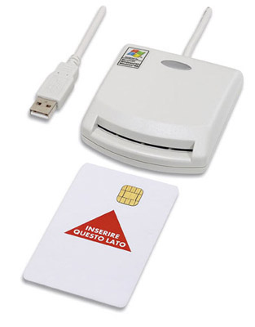


Status Update: National Strategy for Trusted Identities in Cyberspace Peter Alterman
NIST

Slide 3
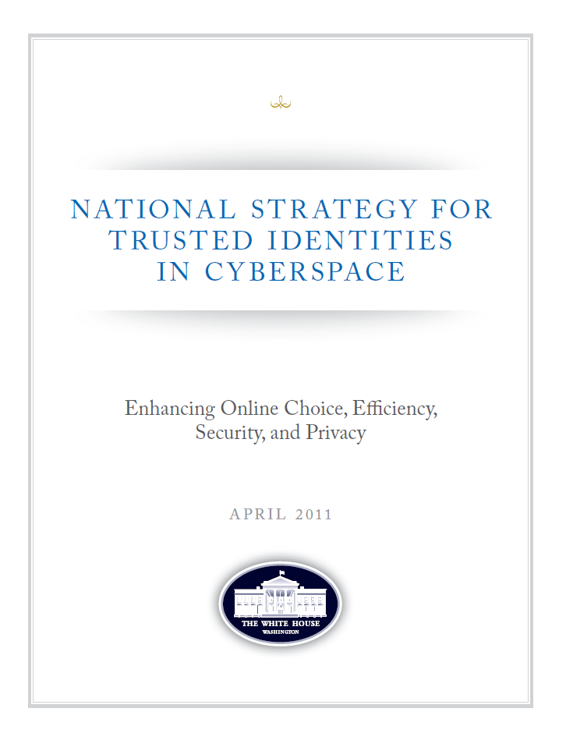
What is NSTIC?
Called for in President’s Cyberspace Policy Review (May 2009): a “cybersecurity focused identity management vision and strategy”
Guiding Principles
Privacy-Enhancing and Voluntary
Secure and Resilient
Interoperable
Cost-Effective and Easy To Use
NSTIC calls for an Identity Ecosystem, “an online environment where individuals and organizations will be able to trust each other because they follow agreed upon standards to obtain and authenticate their digital identities.”

Slide 4
What does NSTIC call for?
Private sector will lead the effort
Industry is in the best position to drive technologies and solutions
Can identify what barriers need to be overcome
Federal government will provide support
Help develop a private-sector led governance model
Facilitate and lead development of interoperable standards
Provide clarity on national policy and legal framework around liability and privacy
Act as an early adopter to stimulate demand
Not a government-run identity program

Slide 5

Privacy and Civil Liberties are Fundamental
Increase privacy
Minimize sharing of unnecessary information
Minimum standards for organizations - such as adherence to Fair Information Practice Principles (FIPPs)
Voluntary and private-sector led
Individuals can choose not to participate
Individuals who participate can choose from public or private-sector identity providers
No central database is created
Preserves anonymity
Digital anonymity and pseudonymity supports free speech and freedom of association

Slide 6
So Far?
Convene the Private Sector
Hosted the Workshop on Governance, June 9, 10 in Washington, DC
Government as an early adopter to stimulate demand
Support for existing eGovernment and federated identity management initiatives directly and indirectly through participation in identity management related work with formal and informal sector players such as ISOC, Kantara, OASIS, ANSI, ISO, ITU-T, TSCP, ABA, SAFE-BioPharma, CertiPath, W3C, The Open Group, others
Support industry-led initiative to create an OASIS Trust Elevation Technical Committee to investigate current and new transaction trust and trust elevation methods as an approach to correlating risk assessment approach to credential trust with NIST 800-63
Many Agency pilots incorporating federated authentication in play, including Health IT in play today
Hosted the Workshop on Privacy, June 27 & 28 in Boston

Slide 7
The Plan Going Forward
Convene the Private Sector
FY11 Focus
Establish a Functioning Governance Entity for the Identity Ecosystem by the end of 2011
Pilots:
Develop criteria for selection
Assess proposed initiatives
Prepare for formal pilot launches with funding in FY12
Government as an early adopter to stimulate demand
Ensure government-wide alignment with the Federal Identity, Credential, and Access Management (FICAM) Roadmap
Enable adoption of consensus standards and operating rules, including risk-based models for trust assessment
Private sector led; multi-stakeholder collaboration
Explore models for addressing liability
Increased adoption of Trust Framework Providers (TFP)
Continue outreach activities
Support adoption of effective attribute management architectures and model implementations
Perhaps other Workshops as partners identify needs (legal issues? Attributes? Others?)
Encourage agencies to enable federated trust at all LOA to provide online services to citizens

Slide 8
Discussion Topics? Questions?
National Program Office, NSTIC
nstic@nist.gov
Dr. Peter Alterman
Peter.alterman@nih.gov
240-507-7107

Slide 9
Panel Discussion

