Slide 1

Using IT Governance to Make Hard Decisions
EDUCAUSE 2011
Cindy Wells, Lynn Johnson & Vlad Wielbut

Slide 2
Agenda
1990-2010: The Way We Were
IT Governance @ U-M
Collaboration Tools: Our First Big Step
Q&A

Slide 3
1990-2010:
The Way We Were
Vlad Wielbut
Director of Informatics and Computing Services
School of Public Health

Slide 4
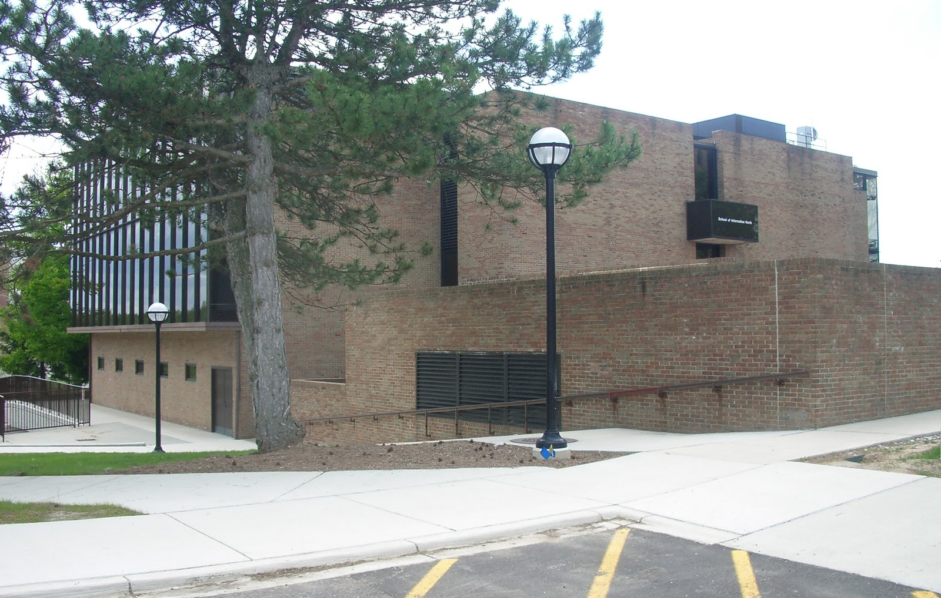
The Great Centrifuge
Notes:
It’s not that building, but it is the perfect background to my story. It used to house a computer – a mainframe serving the entire campus. When the PC era came, the mainframe was dismantled and the building eventually converted for human habitation and given to the School of Information. The Great Centrifuge was the process that eventually moved computing and IT away from the center and into units, with all its implications: good and bad. School of Information really rode this centrifugal force from the beginning. A big part of the reason was that it was a young school, with insatiable appetite for cutting-edge technology, which the central IT could not deliver. Or not deliver quickly enough. So the School moved toward self-sufficiency, which seemed like a quick and easy solution to the problem at hand, but eventually deteriorated into a trap.

Slide 5
The Great Centrifuge
From mainframe to PCs
IT shifts from center to units
Central IT provider unable to deliver cutting-edge technology quickly
Units move toward self-sufficiency

Slide 6
The Trap of Self-sufficiency
Units, even small ones, do everything internally
It is inefficient
It is difficult to get out of
Some things are incompatible with the rest of the campus

Slide 7
The Server Invasion
Standard for the 1990’s and beyond: “Have a problem? Get a server!”
Proliferation of sub-standard “server rooms”
May work fine for a while, but this is high-risk

Slide 8
The Improvising
How do we get out of the trap of self-sufficiency?
Not enough manpower or know-how in units do everything
Smaller units band together to try and share resources – with limited success
IT Commons is formed – campus-wide venue for all units; lots of discussions, not a lot of action

Slide 9
The Plunge
Getting “commodity” services out of units
“Low-hanging fruits”: file storage, web services, network, data centers, HPC
More challenging: end-user computing, network “to-the-jack”, lecture capture
Will the ability to innovate remain within units?
Will the savings be re-invested in unit IT?

Slide 10
IT Governance @ U-M
Cindy Wells
Deputy Chief Information Officer
Medical School

Slide 11
Transforming IT – Mission Focused Investments
NextGen Michigan
Unit Products
And Services
Shared Products
and Services
Shared Infrastructure
ITS
Rationalize IT Across Campus
Campus
Organizational
Structure
Alignment and Culture
Governance

Slide 12
University IT Executive Committee
Information & Technology Services
Teaching & Learning
Unit IT Steering Committee
UNIVERSITY
INFORMATION
TECHNOLOGY
COUNCIL
Knowledge
Medical Ctr. Information Technology
Research
Deans, Faculty & Students
Patient Care
Information & Infrastructure Assurance
Administration
Notes:
Animate the process: Unit IT Steering Committee > IT Council > IT Executive Committee

Slide 13
Faculty Driven Governance
University IT Executive Committee
Information & Technology Services
Teaching & Learning
Unit IT Steering Committee
UNIVERSITY
INFORMATION
TECHNOLOGY
COUNCIL
Knowledge
Medical Ctr. Information Technology
Research
Deans, Faculty & Students
Patient Care
Information & Infrastructure Assurance
Administration
Faculty Chair
Additional Faculty Members
Notes:
Involved faculty who were world renown leaders (Dan Atkins and Deborah Ball)

Slide 14
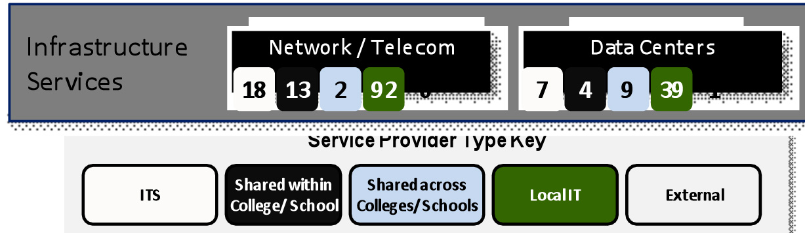
2010 State of IT at UM: Fragmented & Inefficient
Service differentiation occurs in the Mission Services layer and
should be built on a common IT foundation.

Slide 15
IT Service Vision
The IT vision is to increase use of shared providers to manage reusable, extensible services and allow Unit IT to focus on mission-aligned services.
2010 IT Service Model
To-Be IT Service Model Vision
UNIQUE
(Services used
by one unit)
Unit Services
Unit Services
Unit Services
COMMUNITY
(Services used by segment of common users)
Innovation Path
Shared Service
Unit Services
TOLL
(Services used
by most units)
Central Services
Service Retirement Path
Service
Service
Reuse
Service
PUBLIC
GOOD
(Services used
by all units)
Reuse
Service
Reuse
© 2010 Accenture LLP All rights reserved.
Notes:
Current IT Service Model
Redundant services are performed across units
Many Unit IT services compete with central offerings
Shared service adoption is low
Central services are fragmented
To-Be IT Service Model Vision
IT services are optimized, reusable, and extensible
Unit IT is focused on unique mission-aligned services
Shared service organizations deliver services to administration and academic user groups
Public good and toll services meet the broad needs of the University

Slide 16
Major Strategic Sponsored Initiatives
  IT Rationalization
  Collaborative Learning Environment
    Sakai 3 Development
  CIRRUS Project (Computing and Information Resources for Research as a Utility Service)
    HPC shared cluster and data centers
  MiChart
    EPIC electronic medical record
  Google NextGen Collaborative Environment

Slide 17
Collaboration Tools:
Our first big step
http://nextgen.umich.edu/collaboration/selection.php
Lynn Johnson, PhD
Professor & Asst. Dean for Informatics and Innovation
School of Dentistry

Slide 18
IT Council Charge
To provide the U-M community a contemporary, tailorable, extensible, secure, and continually improving personal productivity and group collaboration environment that reduces as many barriers as possible to collaboration in carrying out our academic mission anytime, anyplace, and with anyone in the world having Internet access. The focus of this environment should be to serve the direct academic mission of the university, but if it can also serve the administrative functions that serve this mission, all the better.
To provide this environment in the most cost-effective way possible consistent with the above goals.
Notes:
Charge is critical. We started without a clear charge and struggled with the decision making. This clarified what we were to do. We are trying to shift to being mission focused. New thinking for IT staff.

Slide 19
Process
June -
July
August -
Oct
Nov
Nov
Requirements sent to vendors
NDA vendor briefings
Accenture business case development
Sept - Oct
Vendor demonstrations
IT provider feedback session
Campus wide survey
Oct
Business Engagement Ctr & Office of Devel. feedback
Faculty collaboration use research
LSA student gov. engagement and resolution
Start negotiation process
June-Oct
Oct
Notes:
Events that occurred over the course of six months. The highlighted events indicate campus involvement.

Slide 20
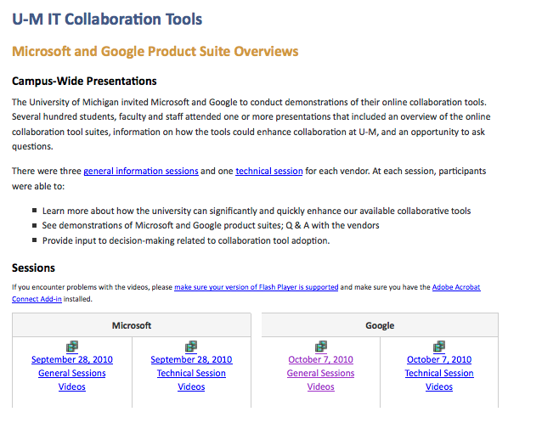
Vendor Demonstrations
http://nextgen.umich.edu/collaboration/session-video.php
Notes:
Website where information was made available to campus. Note: Each vendor gave three General Session and one Technical Session. Each asked to respond to same outline.

Slide 21
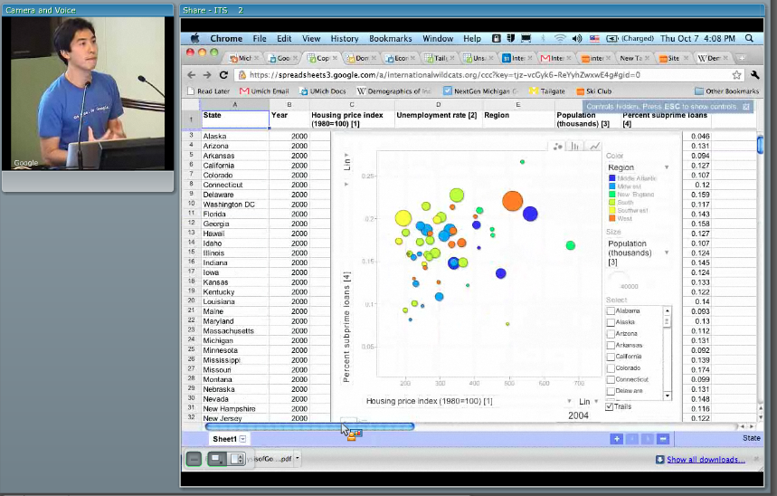
Google Video

Slide 22
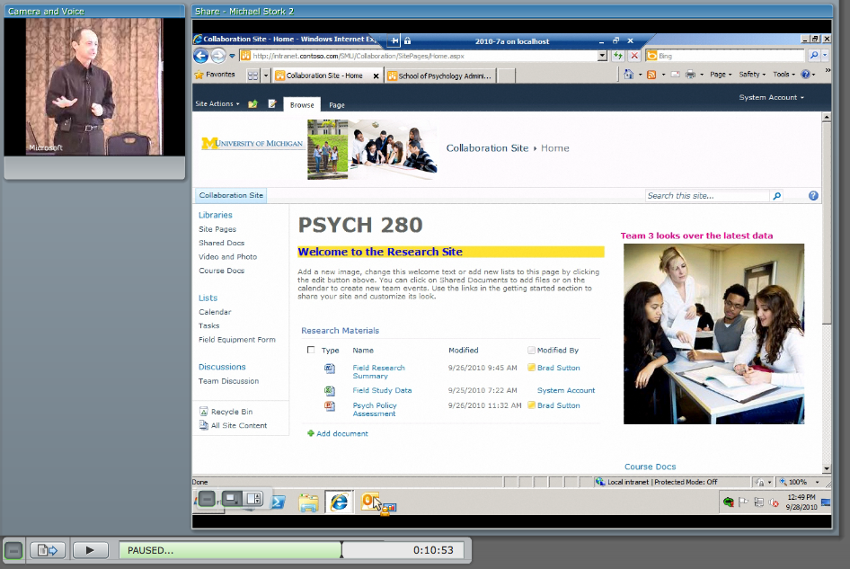
Microsoft Video

Slide 23
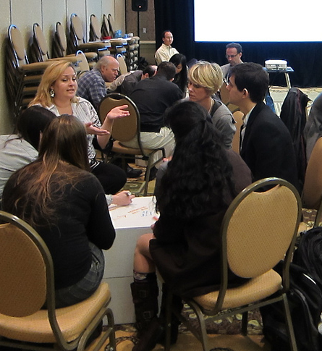
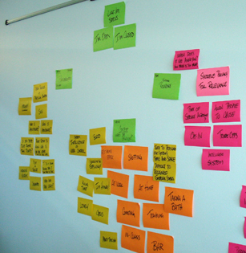
IT Provider Feedback Session
Image courtesy of blueoxen under a Creative Commons license: BY-SA
Image courtesy of lynjohns under a Creative Commons license: BY

Slide 24
All things considered, which suite better enables collaboration for your constituents?
Notes:
Key Themes for Choice
aGoogle
Open standards and open API
Students and some faculty already using
Interface and ease of use
More open to innovation
Microsoft
Offers integration with other MS products
Medical campus going to Exchange
Easier Transition and implementation
More Stability
Better enables productivity for staff
Just One
Going with both will be a mistake. Not achieve goals and cost more.
Both
Google for e-mail and calendar. MS Office for documents.

Slide 25
What concerns you the most about each of the suites?
Notes:
*Count represents the number of red dots and individual votes for each feedback item posted during the Technical Feedback Session on 10/11, Both is an interpretation of answers that appeared to apply to both solutions

Slide 26
What opportunities or new possibilities would be provided by each of the collaborative suites?

Slide 27
Campus Survey
http://nextgen.umich.edu/collaboration/Collaboration_Tools_Campus_Survey_Results.pdf

Slide 28
I am confident that the university could establish processes & a contract with this vendor that would protect my privacy & information.
Notes:
I am confident that the university could establish processes and a contract with this vendor that would protect my privacy and information.

Slide 29
I am confident this vendor would provide reliable services.
Notes:
I am confident this vendor that would will provide reliable services.

Slide 30
I am confident that if this vendor was selected, I could collaborate effectively.
Notes:
I am confident that if this vendor was selected, I could collaborate effectively.

Slide 31
Process
June -
July
August -
Oct
Nov
Nov
Requirements sent to vendors
NDA vendor briefings
Accenture business case development
Sept - Oct
Vendor demonstrations
IT provider feedback session
Campus wide survey
Oct
Business Engagement Ctr & Office of Devel. feedback
Faculty collaboration use research
LSA student gov. engagement and resolution
Start negotiation process
June-Oct
Oct
Notes:
Events that occurred over the course of six months. The highlighted events indicate campus involvement. The LSA student involvement came through the link on the IT Counci.

Slide 32
Costs/Savings
$12
$10
$8
$6
$4
$2
$0
($2)
($4)
($6)
Google
Microsoft
Hybrid
Millions
YR1
YR2
YR3
YR4
YR5
YR6
YR7
YR8
YR9
YR10

Slide 33
Decision-Making Process
Mission Domains Constituency | Teaching & Learning | Research | Patient Care | Knowledge Curation & Dissemination | Administration
Students
Faculty
Staff
Alumni
Leadership
Notes:
While we discussed each element in the matrix our final recommendation focused on these elements. Major discussion topics included going with a hybrid solution or select just a single collaboration tool.

Slide 34
Recommendations
Vote | Recommendation
8-1 | Select one cloud collaboration suite.
8-1 | Contract with Google
9-0 | Single instance of on-premise Exchange
9-0 | Extend Microsoft site license.
http://nextgen.umich.edu/collaboration/U-M_Collaboration_Suite_Recommendation.pdf
Notes:
Vote
Recommendation
8-1
The university select and invest in one cloud collaboration suite.
8-1
The university contract with Google to provide a consistent collaboration environment for all students, staff, and faculty as a public good. The selection of Google in the cloud does not mean that Microsoft products will not be used at the university.
9-0
Single instance of on-premise Exchange available for any department that has a business or security need that cannot be addressed with the Google collaboration suite.
9-0
The university should extend its Microsoft site license for practical and economic reasons. The site license provides Microsoft Office for all faculty and staff for business use and deeply-discounted copies for personal use. Additionally, the site license provides licenses for the on-premise Microsoft server infrastructure needed to run many applications for campus. During the next renewal cycle in three years, we should evaluate the Microsoft site license and drop any software that does not have campus-wide value.

Slide 35
IT Governance @ U-M
University IT Executive Committee
Information & Technology Services
Teaching & Learning
Unit IT Steering Committee
UNIVERSITY
INFORMATION
TECHNOLOGY
COUNCIL
Knowledge
Medical Ctr. Information Technology
Research
Deans, Faculty & Students
Patient Care
Information & Infrastructure Assurance
Administration
Notes:
Past governance model based on the number of schools and colleges. Result was major players (Library) with no voice; strong chasm between medical campus and remainder of campus; strong desire for transparency; minimize the voice of administrative computing which had gotten bulk of IT funding for computing for the last 15 years; need for strong sponsorship for research and teaching and learning.
Laura was asked to do this by deans. Had built relationships.

Slide 36
Questions?

