Slide 1
Higher Education Information Security Council
Rodney Petersen
Managing Director
Washington Office
EDUCAUSE

Slide 2


HEISC Mission
HEISC works to improve information security and privacy programs across the higher education sector through its community members and focused partnerships with government, industry, and other academic organizations. HEISC actively develops and promotes awareness and understanding, effective practices and policies, and solutions for the protection of critical IT assets and infrastructures.

Slide 3

Heisc strategic directions
Develop leadership of CIOs, ISOs, and other information security professionals
Conduct outreach and education of key campus stakeholders and their respective professional associations
Promote data protection, especially in an era of shared services
Leverage partnerships and collaborations with government, industry, and academia

Slide 4

HEISC OrGanization
Working Groups
  People: Awareness & Training
  Process: Governance, Risk, and Compliance
  Technology: Technology, Operations, and Practices
Information Security Guide Editorial Board
Security Conference Program Committee
Research and Educational Networking Information Sharing and Analysis Center (REN-ISAC)

Slide 5


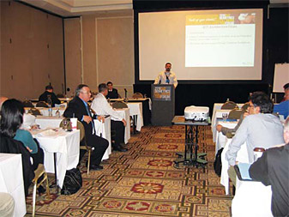


SECurity professionals Conference
May 14-16, 2011, in Indianapolis, Indiana

Slide 6

How to get involved
Join/Share: Security Discussion Group
Volunteer: HEISC Working Group
Attend: Security 2012 in Indianapolis
Contribute: Higher Ed InfoSec Guide
Follow: @HEISCouncil
For more information, see www.educause.edu/security

