Slide 1

Developing a Professional Development Plan
A practical guide to developing a practical tool for practically any position
Martin Klubeck, University of Notre Dame
Don Padgett, University of Notre Dame
Don Padgett, University of Notre Dame
Notes:
Poll Questions?
Does your supervisor know what you do?
Does your supervisor know what skills are required to do your job?
Does your supervisor know the skill level you possess for the tasks involved in your job?
Have you received training in the last 12 months?
Has that training directly improved your ability to perform your job?
What would help you do your job better? 1. better tools 2. training 3. better instructions 4. more incentives

Slide 2


Developing a Professional Development Plan
Basic Concepts
Master Task Lists
Required Skill Levels
Evaluating Current Skill Levels
Identify Skill Deficiencies
Prioritize Skill Needs
Find Training
Evaluate Training
Bonus
Notes:
The basic components to developing a training plan are:
Identifying all tasks involved in doing the job
Evaluating each task to determine
if it is a training requirement
What, if any, job aids will help
How best to deliver the training when required
Determining the required level of proficiency for each task
Assessing the workers present level of proficiency for each task
Finding, scheduling, and attending training where deficiencies exist
Evaluating training
Reevaluating the worker’s current level of proficiency for each task (basically back to step 4)

Slide 3
Professional Development Plans – Basic Concepts
You don’t hire workers who are 100% skilled
You can’t afford to hire workers who are 100% skilled
If workers are our organization’s greatest assets,
it’s strange that we…
Don’t train
Use inferior training vehicles
Train on the wrong things
Don’t evaluate skill levels
Don’t know what workers really do
Don’t know what workers really can do
Don’t know what workers really can do
Don’t know what workers really do
Use inferior training vehicles
Train on the wrong things
Don’t train
Don’t evaluate skill levels

Slide 4
Professional Development Plan – Master Task Lists
What does the position require you to do?
Lead with an Action Verb
Ensure actually a task for this job
Avoid compounds!
If you can’t evaluate Break it Down
Notes:
Rule 1. Each task has to start with a “verb.” Notice that the task break-down above for “create a strategic plan” has five subtasks – each starting with a verb. Regardless of the level you decide to use, each task must start with a verb (or least have the verb in the task statement somewhere). I don’t have to understand the task – but you, and your worker should.
Rule 2. Each task must actually be a job requirement. Don’t put things in the Master Task List for the position which are not actually necessary to the job. It’s not a wish list. You will end up using this list to train your worker(s). There is a place for “professional development” tasks later.

Slide 5

Professional Development Plan – Master Task Lists
The Fantastic Four Factors
Frequency
Criticality
Complexity to Perform
Complexity to Teach/Learn
Notes:
Before we visit the worker, you might want to know why we don’t include things like:
“understand Microsoft Word”
SPSS tool knowledge
Biometric calibration
These are not tasks. Because they are not tasks, they are hard to train to or evaluate. Every pure knowledge item has a driving task associated with it. Otherwise, we’d pay our workers for sitting all day and thinking. Even Customer Service technicians – who we pay to be knowledgeable, are task driven. We don’t pay them to “know how to solve problems.” We pay them to actually solve them (or help customers solve them). We don’t pay head coaches to “know how to lead your men and women.” We pay them to WIN GAMES. Or “build a winning program.” Or in the case of specific skills coaches, we pay them to teach those skills to players – not to simply have knowledge. The knowledge component is a necessity – to do something. We pay for results. We expect our workers to produce.
We use four “fantastic” factors to determine:
Is the task a “training requirement?
Would the performance of the task benefit from:
Checklists?
Thorough Instructions?
Emergency Procedures?

Slide 6



Professional Development Plan – Master Task Lists
HIGH
Frequency
Criticality
Complexity to Perform
MEDIUM
Complexity to Teach/Learn
LOW
Notes:
We use four factors to determine:
Is the task a “training requirement?
Would the performance of the task benefit from:
Checklists?
Thorough Instructions?
Emergency Procedures?

Slide 7


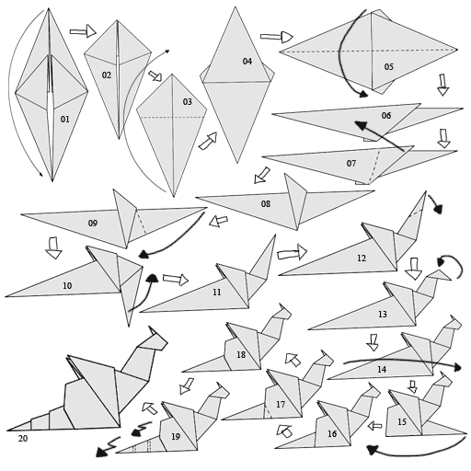





Professional Development Plan – Master Task Lists
Frequency
L
Criticality
H
M
Complexity to
Perform
H
M
Complexity to
Teach/Learn
H
M
L
Notes:
We use four factors to determine:
Is the task a “training requirement?
Would the performance of the task benefit from:
Checklists?
Thorough Instructions?
Emergency Procedures?
Training Reqt? = Complexity’s to be either Both M or either H
Knowledge = Complexity (either) are H…
Checklist = Criticality = M or higher
Quality Check = if Criticality is High
OJT = if Complexity to Learn is Low AND is a training requirement
Thorough Instructions? = Training Reqt AND Frequency is Low
Formal Training ? = Training Reqt AND Complexity to Learn is M or higher

Slide 8




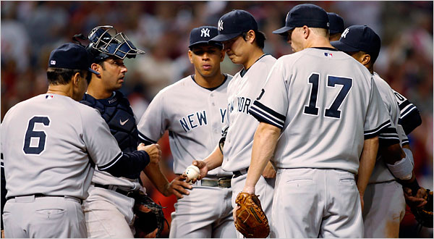


Professional Development Plan –
Skill Levels
5. Expert
4. Proficient
3. Experienced
2. Developing
1. Novice
Notes:
NOVICE - no demonstrated skill - may demonstrate awareness of skill need DEVELOPING - Able to perform basic functions - Limited in simpler/limited number of environments - Consistency may vary - May require frequent supervision/advice/… EXPERIENCED - Demonstrates skill consistently - Can adapt to some changes in environment - Recognizes and utilizes opportunites to exhibit or use skill PROFICIENT - Demonstrates high skill in very consistent manner - Exhibits mastery in a wide variety of situations and circumstances - Often regarded as an authority in skill area EXPERT - Demonstrates great skill with highest degree and breadth of knowledge - Exhibits mastery in a wide variety of complex situations and circumstances - Capable of mentoring and teaching others - Exhibits continual learning

Slide 9
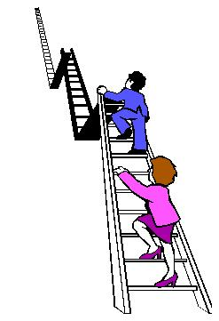

Professional Development Plan – Determining Required Skill Levels
5 - Expert
Rare!
4 - Proficient
3 - Experienced
Employee View
2 - Developing
Supervisor view
1- Novice
Rare!
Notes:
NOVICE - no demonstrated skill - may demonstrate awareness of skill need DEVELOPING - Able to perform basic functions - Limited in simpler/limited number of environments - Consistency may vary - May require frequent supervision/advice/… EXPERIENCED - Demonstrates skill consistently - Can adapt to some changes in environment - Recognizes and utilizes opportunites to exhibit or use skill PROFICIENT - Demonstrates high skill in very consistent manner - Exhibits mastery in a wide variety of situations and circumstances - Often regarded as an authority in skill area EXPERT - Demonstrates great skill with highest degree and breadth of knowledge - Exhibits mastery in a wide variety of complex situations and circumstances - Capable of mentoring and teaching others - Exhibits continual learning

Slide 10
Professional Development Plan – evaluating current Skill Levels
5 - Expert
Rare!
Supervisor view
4 - Proficient
3 - Experienced
Employee View
2 - Developing
1- Novice
Rare!
Notes:
NOVICE - no demonstrated skill - may demonstrate awareness of skill need DEVELOPING - Able to perform basic functions - Limited in simpler/limited number of environments - Consistency may vary - May require frequent supervision/advice/… EXPERIENCED - Demonstrates skill consistently - Can adapt to some changes in environment - Recognizes and utilizes opportunites to exhibit or use skill PROFICIENT - Demonstrates high skill in very consistent manner - Exhibits mastery in a wide variety of situations and circumstances - Often regarded as an authority in skill area EXPERT - Demonstrates great skill with highest degree and breadth of knowledge - Exhibits mastery in a wide variety of complex situations and circumstances - Capable of mentoring and teaching others - Exhibits continual learning

Slide 11


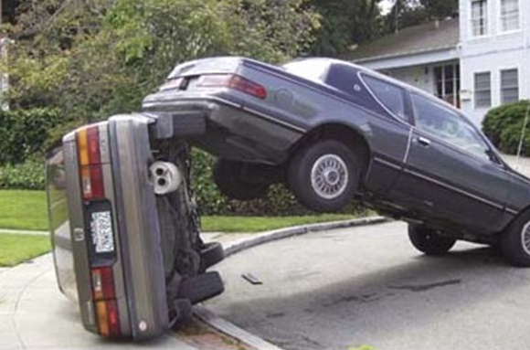
Professional Development Plan – Identify Skill Deficiencies
5 - Expert
Required
4 - Proficient
3 - Experienced
Current
2 - Developing
Required
1- Novice

Slide 12

Professional Development Plan – Prioritize Skill Needs
A
B
C
1
2
3

Slide 13



Professional Development Plan –
Find Training
Notes:
Don’t forget to also look internally. Your own HR or training departments. We have our own IT training unit for example. But also look to your EXPERTS to train your novices. In house, on-the-job training is a great resource.
Also, remember webinars, podcasts and Computer-Based-Training. You can even learn a lot via YouTube now-a-days

Slide 14



Professional Development Plan – Evaluate Training
Notes:
Not really an evaluation of the “course” – not a course critique
Not an evaluation of the person / worker
IT IS an evaluation of how well the training helped the worker improve his/her skills

Slide 15
BONUS
Build Database of Training
  With effectiveness of each
Build Skills Database
Cross-train Easier
Training for New Positions Easier
  Qualify Before Seeking
Clearly Define What Each Position DOES
Notes:
And DOESN’T DO!

Slide 16

Developing a Professional Development Plan
HANDS ON PORTION

Slide 17
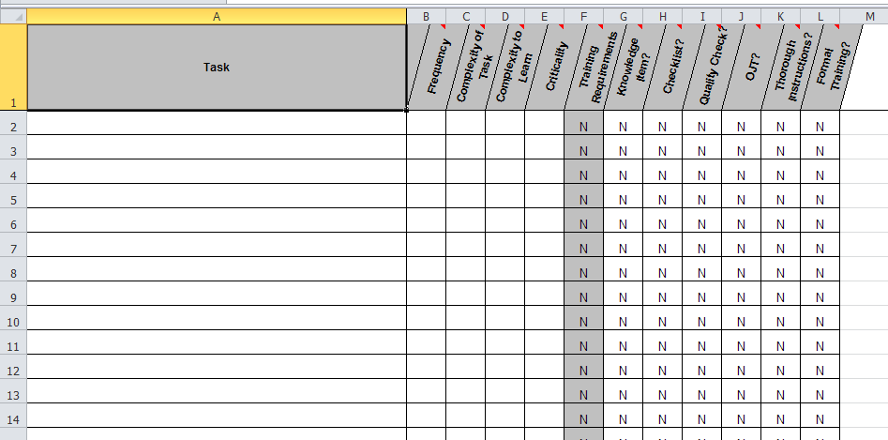
Master Task List (MTL)

Slide 18
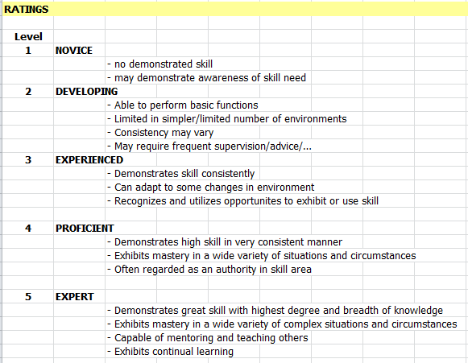
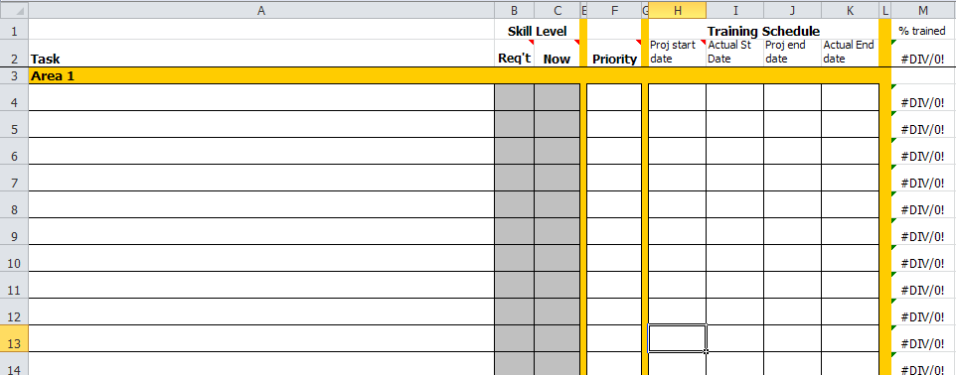
Training Evaluation Worksheet

Slide 19
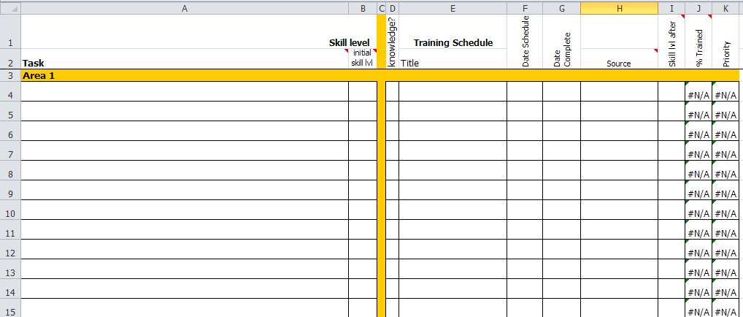
Schedule Worksheet

Slide 20

Questions?

