Slide 1
MOOCs: The Coming Revolution? The University of Maryland Joins Coursera and One CIOs Thoughts On The Revolution
Brian D. Voss University of Maryland
AKA … that guy who followed Daphne Koller
click

Slide 2
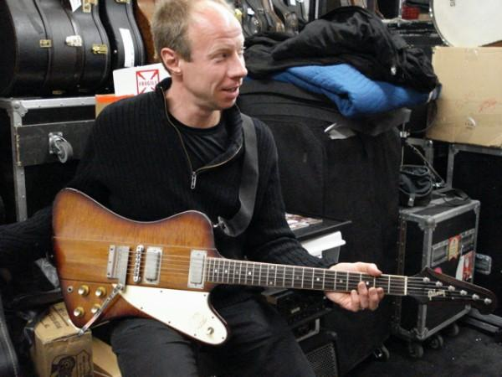
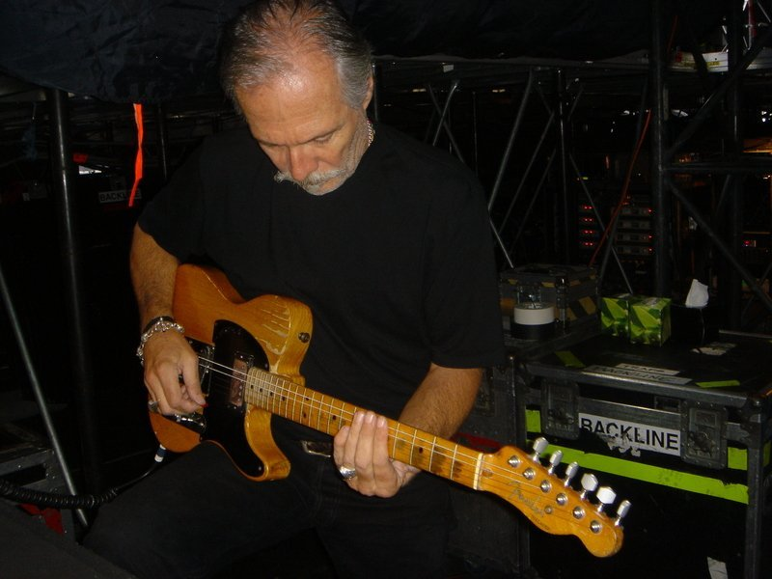
Let’s start with a little identity management …. Do you know these two?

Slide 3
Maybe their names will help?
Pierre du Beauport
Johnny Starbuck

Slide 4



No? How about these two?
Ronnie Wood
Keith Richards

Slide 5
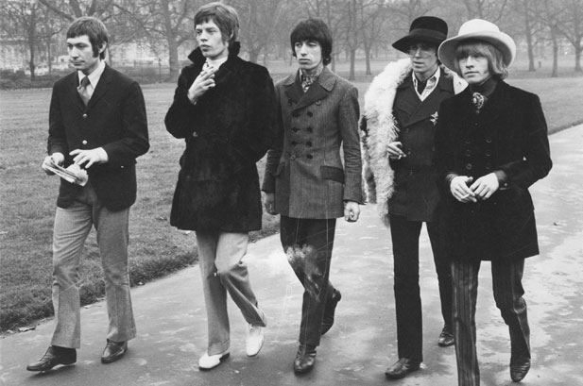

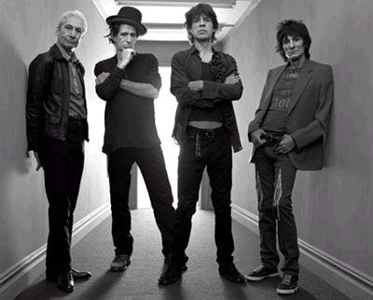
Pierre & Johnny are guitar Techs for the Rolling Stones!
They have been taking care of Keith and Ronnie (and Brian & Mick … and Mick and Bill) for decades from backstage!

Slide 6
And this has what to do with MOOCs and The Revolution?

Slide 7
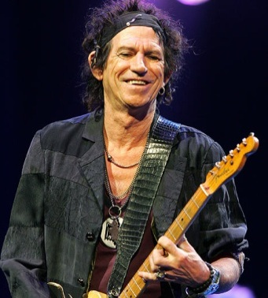
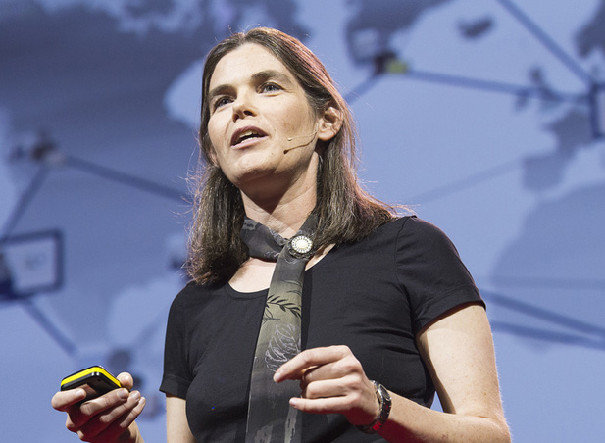


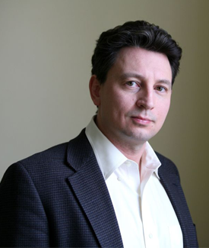

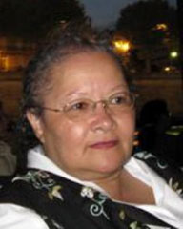
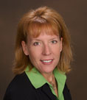
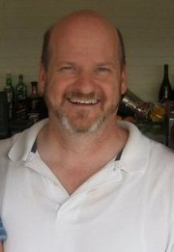

It’s not about IT …
The ‘Stars’ ON Stage
Who become the Guides on the Side
The ‘Techs’ Backstage
It’s about
teaching and learning
I’ll come back to this later …

Slide 8
The Truly Exciting and Informative Tale of How The University of Maryland Joined Coursera
Or …
How I had no idea how we’d spend our summer … and why having CIO friends is a good thing … and also maybe not such a good thing.

Slide 9
How I THOUGHT we’d spend our summer
Hiring two new deputies
IT Strategic Planning
The never-ending search for floorspace, power, and cooling
and …
Obtaining a Microsoft CLA for the campus
E-mail migrations (migraines?) and futures
Kick-off of Kuali Financial implementation
eTextbooks

Slide 10
Change of Plans – MOOCs
Stanford Classes which gave rise to Coursera
Udacity & Thrun’s 100K+ students
edX announcement – MIT & Harvard
U-Virginia storyline unfolds (thinking about my friend James)
Coursera Expansion July 17, 2012, ~3:00am EDT
A call to three friends (Khan, Futhey, Hilton) ~9:00am EDT
A call from my President ~10:30am EDT
A visit to the office of my President ~Noon EDT
What’s a nice CIO like me doing in the middle of this?
Hello Daphne! July 17, 2012, 3:00pm EDT
clicks

Slide 11
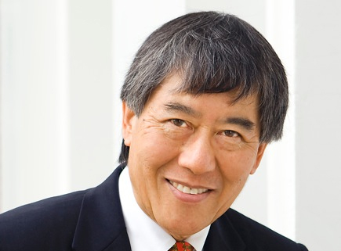
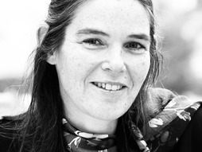
Choosing Coursera
Coursera (Daphne, Andrew & Co.) actively seeking university participants to provide courses
UMD President Wallace Loh felt we needed to act
“This is what leading institutions do!”
Community (faculty, regents, donors, legislators, etc.) expressed belief that UMD should become involved … with something!
And the CIO? … Believed we could best learn about the MOOC platform and promoting and IT-enabling a MOOC-driven ‘flipped classroom’ approach by working with Coursera, rather than watching from the sidelines
Convinced we could not do this “on our own”

Slide 12
As Easy As 1-2-3-4 ….
Sign contract with Coursera
Identify ~4 courses
Create “Course Landing Pages”
Partner on release
Should be easy … we have three months*
* Some institutions had only a few days!

Slide 13
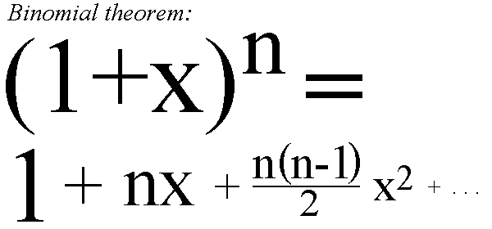
Well … maybe more like
Contract
easy (thanks to Daphne!)
Creating Course Landing Pages
straightforward if non-trivial
Partnering on release
Maybe time was NOT on our side… (two people can keep a secret …); but in the end, all ended well!
Identifying the courses/faculty
ay, there’s the rub

Slide 14
Challenge: Identifying Courses/Faculty
Summertime – and the faculty are …. elsewhere
Psssst! Wanna teach a MOOC? (Recruiting on the QT)
Who decides courses to be offered?
President, Provost, Deans, Faculty, Coursera? (certainly not IT!)
Volunteers – but for what are we volunteering?
Misconceptions about MOOCs; online learning, etc.
Confusion on mission, scope, etc.
Is this all we’re doing? A ‘monolithic mindset.’
Swift Action versus Deliberative, Inclusive Process
Shared governance role?

Slide 15
UMD Process
Provost solicited Deans for candidate courses/faculty (deans solicited chairs, etc.)
Provost reviewed and selected ‘primary participants’ and ‘back-up crew’
Four initial selections
One almost immediately withdrew and was replaced by a ‘back-up’
Four courses initially offered on 19-October-2012
A few modifications – UMD will have five courses in Spring 2013
Course delivery elements just now getting underway

Slide 16
Challenges
This is not about IT (I said I’d come back to this)
But sometimes, IT is ‘drafted’ to lead the effort
The question looms: Can IT get off the stage and backstage where it belongs?
Coursera is a new approach to pedagogy
Faculty must understand this … and embrace it
The entire online education ‘disruptive event’ is about how pedagogy will change (via technology); it is NOT about IT!
Here’s a familiar IT term: Business Process Re-engineering

Slide 17
Even As We Prepare Courses The Discussion Continues …
Are MOOCs an end, or a means, or a step along the way?
Are there many ‘spices’ in the rack? – many tools in the kit?
Monetization Strategies? Certification/Accreditation?
Plenty of possibilities – but what direction(s) to take?
What role will the faculty play in charting directions?
Action versus Deliberation?
Is there need for a central online leadership role?
And where would such a role be located?
Keeping focus on how pedagogy is changing thru technology, and not on the technology itself?
What is the role of IT
Collaborator? Supporter? Leader?

Slide 18


Brian’s thoughts …
Can’t decide which movie to watch to prepare myself for the coming year …
clicks

Slide 19
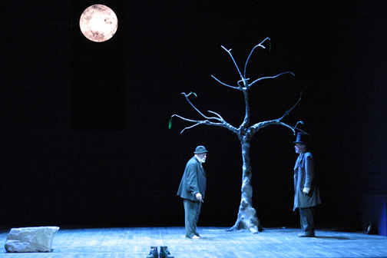
Brian’s thoughts …
If you’re waiting for someone to invent a perfect device/platform that overnight transitions faculty from the ‘old way’ to the ‘new way’ …. you’re waiting for Godot.
This will be a task requiring people – course designers, multi-media specialists, support for faculty
This will take a significant investment in this humanware over the rest of this decade to transform the way teaching is delivered – blended, totally online, and all points in between
Whether this is managed centrally or distributed – and how it is facilitated – is a matter of institutional culture

Slide 20
Brian’s thoughts …
This effort must be led out of the academy – provosts, deans, chairs, and faculty must embrace the change and lead the charge
In most instances …. IT people can play the role of collaborators or supporters of the process of change (not to mention instigators of change), but if this is viewed as “an IT thing” along with all the other IT things facing campuses now – this will not succeed

Slide 21
Brian’s thoughts …
The CIC CIOs recently pondered: Is this time different? And answered: Yes, it is. Now is the time for our universities to be taking action.
Governing Boards are insisting – Presidents, Provosts, and their attendant administrations are being pressed to act
Students (and their parents) are demanding more online options and more use of “modern technology” (better or perceived better?)
Faculty are, as usual, across a spectrum of interest and opinion as to approach; but more and more are pushing to move toward blended, ‘flipped,’ and online capabilities
This challenge is raising many other IT-centric questions (centralization versus not, etc.); some not so comfortably

Slide 22
Brian’s thoughts …
There will be a lot of discussion and debate about whether MOOCs and other forms of IT-enabled teaching tools actually improve learning outcomes
Whether it does or not is … academic (not ITechnical)
Remember Clay Shirky’s point about the music industry vis-à-vis CD quality versus MP3

Slide 23

In the immortal words of David Byrne
This ain’t no party …
This ain’t no disco …
This ain’t no foolin’ around.

Slide 24
And about that summer in College Park?
While maneuvering Coursera participation …
hired two deputy CIOs
completed a (draft) IT strategic plan
think we’ve found some data center space
kicked-off our Kuali Financial System implementation
commenced planning for IT services in the Library
signed a Microsoft CLA and distributed over 12K copies of software
migrated to a new version of Exchange
commenced our migration from Blackboard to Canvas
went to Paris for a week (well … not the whole IT Division)

Slide 25
And here’s my new homepage …
http://chronicle.com/article/What-You-Need-to-Know-About/133475/
The Chronicle of Higher Education – What You Need to Know About MOOC’s
It has temporarily dislodged http://www.cnn.com!
EDUCAUSE has resources and uncommon thinking …
What Campus Leaders Need to Know About MOOCs (September 2012)
>21 items in the EDUCAUSE Library (AND GROWING!)
Massive Open Online Courses (MOOCs) Constituent Group
Planning MOOC gathering for 2013 (TBD)

Slide 26
Your Questions?

