Slide 1
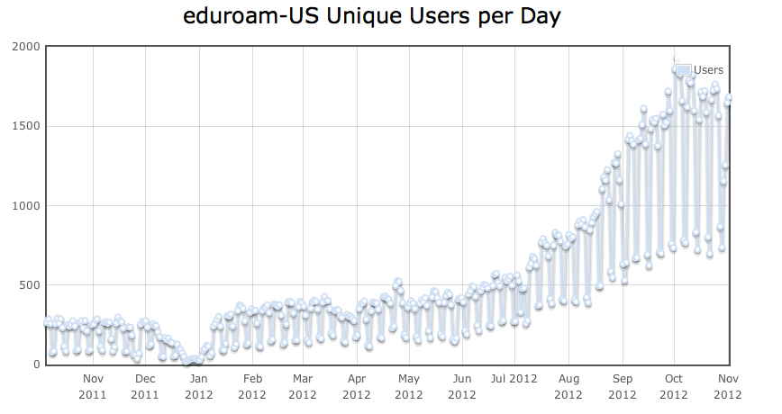
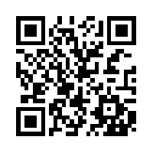
Wi-Fi Guest Access with
eduroam (education roaming) is the secure worldwide federated network access service developed
for the international research and education community
What does eduroam do for the traveler? eduroam provides encrypted and authenticated Wi-Fi for visitors from participating institutions, without the need to gain guest credentials on arrival to an eduroam enabled location. The connectivity is instantaneous and the infrastructure is authenticated by the user. Study abroad students can join thousands of eduroam hotspots without any hassle or any data roaming charges
What does eduroam do for the institution? eduroam removes the administrative steps required to provision visitors from other educational institutions. Access between networks from R&E institutions is negotiated once during the federation process and for all members of participating institutions. The eduroam network addresses CALEA requirements for visitors from other schools
Available to all participants in the following locations
The service has gained a lot of popularity in the US
Did you know? eduroam-US is now an Internet2 service
www.internet2.edu/netplus/eduroam/index.html, www.eduroamus.org, www.eduroam.org

