Slide 1
eTextbook Myths and Challenges of eTextbook Creation
Dr. Roger Von Holzen
Director--Center for Information Technology in Education
Director--Textbook Services
Northwest Missouri State University

Slide 2

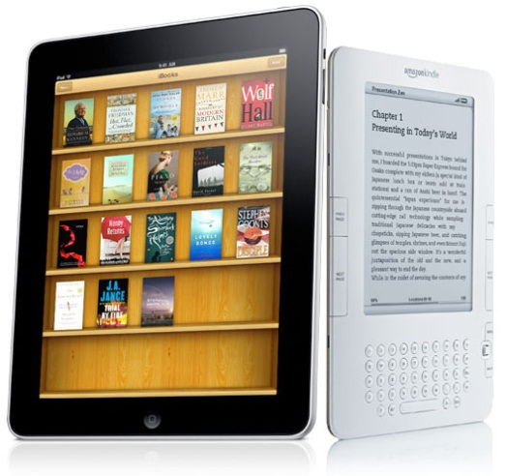
Background
Typical college student could spend up to $1,000 per year for textbooks
Publisher eTextbooks still cost in the $500-$600 per year range

Slide 3
Issues to Consider for eTextbook Creation
Faculty
Online resources
Universal design/accessibility
Copyright clearance
Faculty governance and academic freedom
Maintenance costs
Hardware/software decisions
Customization needs

Slide 4
Faculty
Release time
  Are there funds to cover the cost for release time?
Compensation
  Will the institution fund the project or will the students pay?
Content expertise
  Is their expertise broad enough for the
  subject?
Writing skills
  Do they have adequate writing skills?
Dependence on leader
  Is there a dominant leader?

Slide 5
Online Resources
Unreliable
  How authoritative is the source?
  How current is the information?
  How likely will the information persist over time?

Slide 6
Universal Design/Accessibility
Need to build in universal design in order to meet an array of accessibility issues
  Color blindness
  Text size
  Audio conversion
  Descriptive interactive graphics

Slide 7
Copyright Clearance
Is there a need to secure copyright clearance of all non-original content, pictures, drawings, animations, videos?
Is there content available under Creative Commons?

Slide 8

Faculty Governance and
Academic Freedom
Agreement on design, content, focus
Require faculty to use eTextbook
  Faculty resistance to mandated textbooks

Slide 9

Maintenance Costs
Who is responsible for updating the content?
How do you deal with the lack of financial viability with respect to low enrollment courses and content areas?
  Will eTextbooks for such
  areas ever be developed?

Slide 10

Hardware/Software Decisions
Hardware platform
  What platform should be targeted?
  PC/Mac/Android/Tablet?
  How is the cost of the devices factored in?
Is Internet accessibility require?

Slide 11

Hardware/Software Decisions
Software issues
  Is the eTextbook a stand alone product or integrated into a course management system?
    Available and concurrent across devices?
  Are proprietary apps or open standard software used?
    iBook Author
    SoftChalk
    Flash
    HTML5

Slide 12
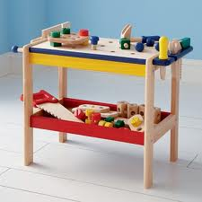
Customization Needs
Wish to customize:
  content
  delivery order
  examples
  animations
Cost of customization
  money
  time

Slide 13
Issues with State-wide,
National or Private Projects
Use of one-time money
Cherry picking of courses
  California eTextbook initiative
    $20 million
    50 undergraduate courses
Flat World Knowledge--115 titles
Inkling--Over 200 titles
Northwest--793 textbook titles in stock

Slide 14

Issues with State-wide,
National or Private Projects
Orphan courses
  Low enrollment courses
  Few cost effective options
  PDF format only--publishers won’t put resources into developing interactive eTextbooks
Need for lasting infrastructure

