Slide 2
Crafting an Action Plan/Strategy for Analytics on Your Campus
Dr. Linda L. Baer
Dr. Donald M. Norris
Dr. Ann Hill Duin
November 6, 2012

Slide 3
Workshop Schedule
Introduction: What participants want from this workshop
Background: Analytics and why they are useful.
Processes: Using Analytics, creating an Analytics Action Plan, and crafting an Analytics Strategy for the Institution.
Case Study Examples: Institutions with successful analytics plans, strategies and/or achievements
Each participant: Build My Own Action Plans and Strategy for Analytics for My Institution

Slide 4
Workshop Schedule
8:00-8:30 I. What Do Participants Want from this Workshop?
8:30--9:30 II. What Are Analytics? Why Are They Useful?
9:30-10:00 Break
10:00-11:30 III. Understanding Analytics Processes/Plans
11:30-12:30 Lunch
12:30-2:00 IV. Case Studies, Starting Your Plan 2:00-2:30 Break
2:30-4:00 V. Putting it all Together – Finishing Your Plan

Slide 5
I. What do participants want from this workshop? 8:00 – 8:30 am

Slide 6
Questions for Participants
At your institution, what is your stage of development?
Just starting to focus on analytics, looking for how to start
Looking to understand what others like us are doing, to emulate their success and accelerate our progress
More advanced/experienced, looking to craft an Action Plan and/or Institutional Strategy for Analytics
Who is on the analytics team at your institution?
What are you looking to get from this workshop?

Slide 7
II. What are analytics? Why are they useful? 8:30-9:30 am

Slide 8
Session Focus
Intelligent investments in analytics are critical to achieving strategic outcomes.
1. What are analytics?
2. Where are analytics most useful??
3. What are some of the best practices in leading institutions and solution providers in analytics?
4. What are the key concerns and gaps in building and sustaining a foundation for analytics?
5. What does the ECAR Maturity tell us about Organizational Capacity for Analytics?

Slide 9
1. What Are Analytics?

Slide 10
Definition: Analytics is the use of data, statistical analysis and explanatory and predictive models to gain insights and act on complex issues.
http://www.educause.edu/library/resources/2012-ecar-study-analytics-higher-education

Slide 11
ANALYTICS
STRATEGIC QUESTION
DATA ANALYSIS AND PREDICTION
INSIGHT AND ACTION
http://www.educause.edu/library/resources/2012-ecar-study-analytics-higher-education

Slide 12
Additional Definitions
Leveraging Analytics is the purposeful building of analytics organizational capacity and using of analytics to gain insights, take actions and accelerate the addressing of key strategic problems/goals for institutions.
Action Plans for Analytics frame and address strategic problems that can be solved through analytics.
Institutional Strategy for Analytics expresses the leveraging of analytics as a major change initiative that can be aligned with and embedded in other institutional strategies.

Slide 13
Steps in the Analytics Process
Start with a strategic question.
Finding or collecting the appropriate data to answer that question.
Analyzing the data with an eye toward prediction and insight.
Representing or presenting findings in ways that are both understandable and actionable.
Feeding back into the process of addressing strategic questions and creating new.

Slide 14
Purposefully Build Analytics Capacity
Understand the analytics elements that add value.
Focus on key strategic goals – such as optimizing student success.
Use understandable frameworks (Davenport and Harris) to communicate current and desired future states.
Purposefully develop organizational capacity for analytics toward strategic ends.
Use accelerants to advance development.

Slide 15
Useful Templates and Typologies
Davenport/Harris typology 8 levels - reporting, query, analysis, optimization
Davenport – DELTA typology (Data, enterprise, leadership, targets, analysis) - 5 elements
Norris/Baer typology - Student Success 7 levels
Organization Capacity/Maturity Index 5 elements

Slide 16
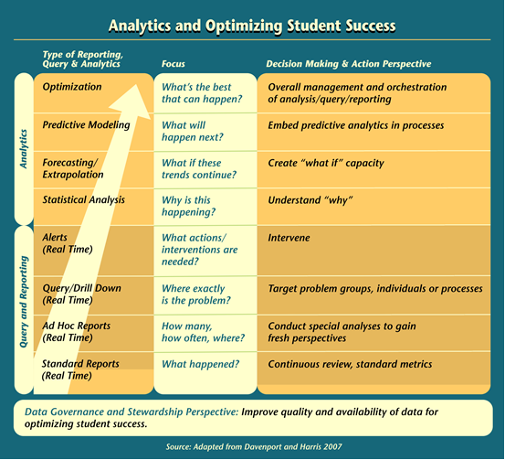
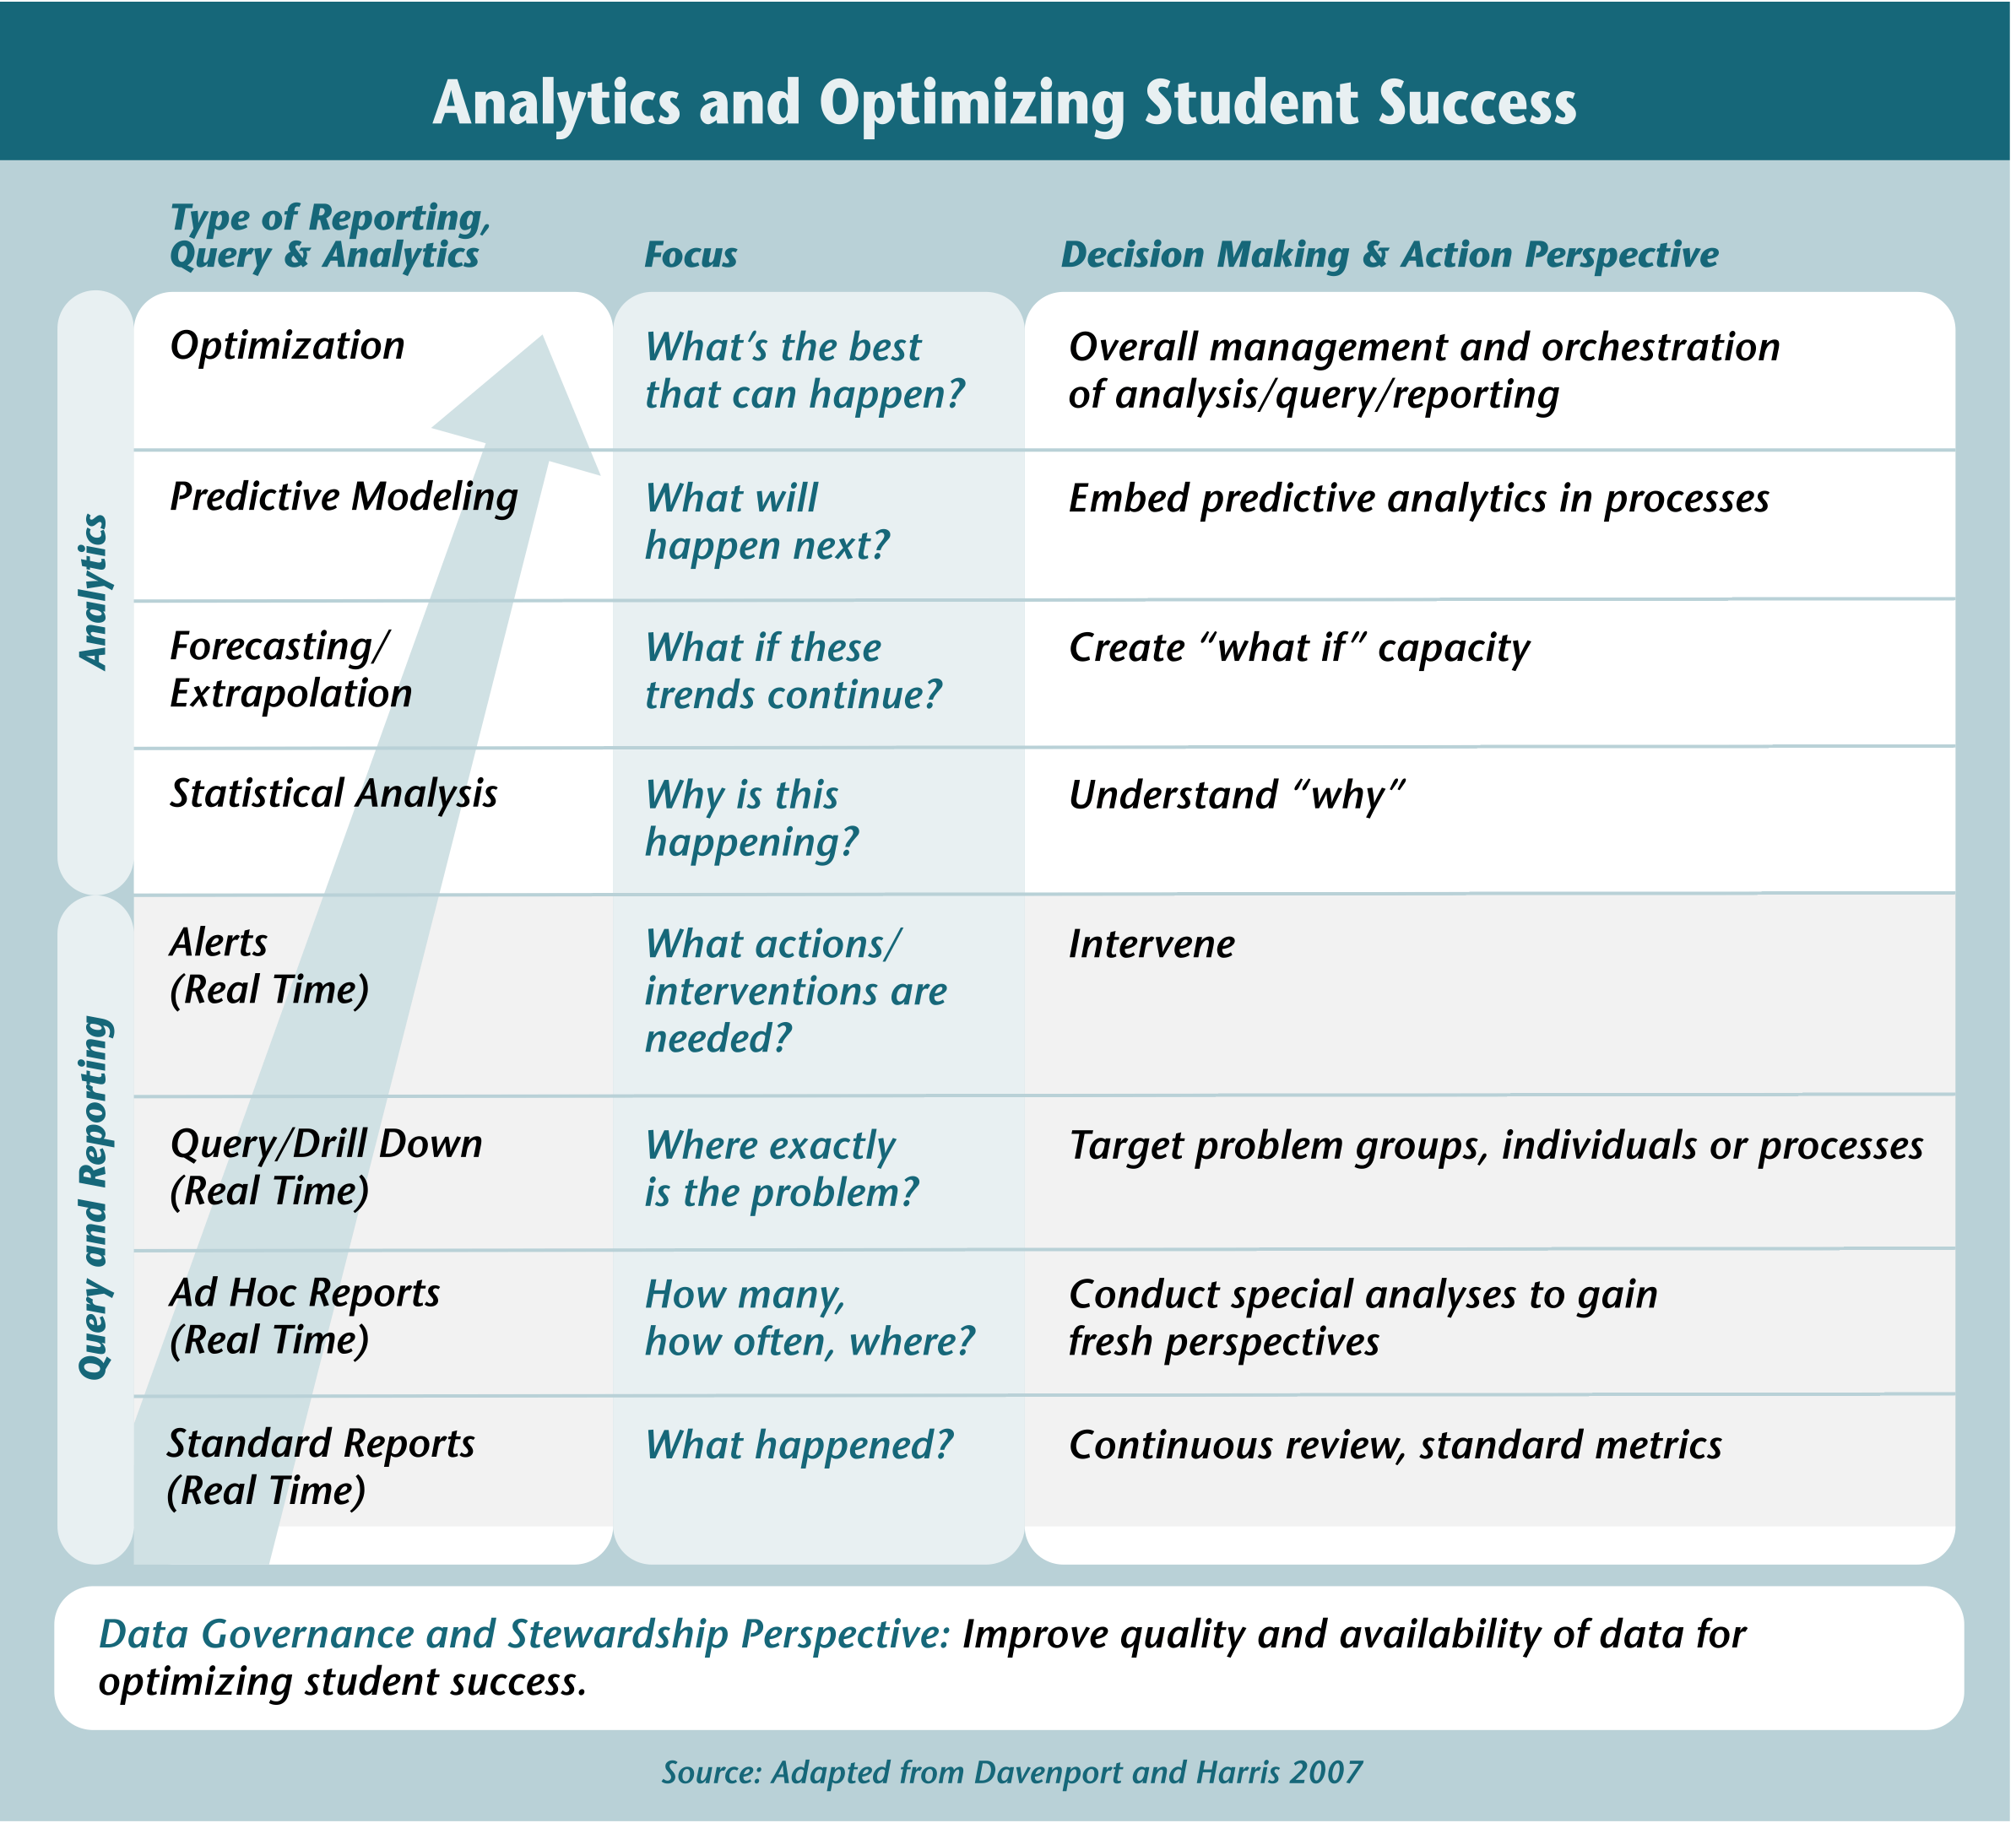

Slide 17
2. Where are Analytics Most Useful?

Slide 18
Primary Sources of Information
ECAR Survey – representative study of use of analytics in all applications, survey of IT and IR professionals at several hundred institutions
Optimizing Student Success – Selective study of use of analytics to optimize student success at 40 leading institutions (all types) and 20 solution providers

Slide 19
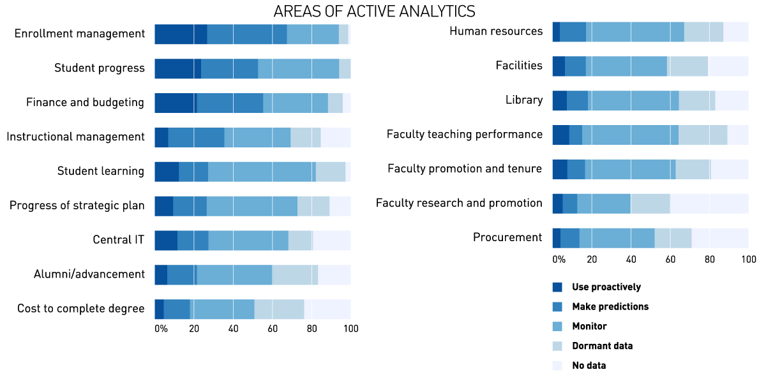
Most Activity in Student and Finance Areas, Least in Faculty
INSERT TYSON CHART 4
http://www.educause.edu/library/resources/2012-ecar-study-analytics-higher-education
Provide your best estimate of how data are being used at your institution.; N = 339, EDU + AIR
Notes:
More than 50% of institutions are using data to make predictions or to be proactive.

Slide 20
Targets and Benefits of Analytics (From Previous Slide)
Enrollment management
Finance and budgeting
Student progress
Instructional management
Central IT
Student learning
Progress of strategic plan
Alumni advancement
Research administration
http://www.educause.edu/library/resources/2012-ecar-study-analytics-higher-education

Slide 21
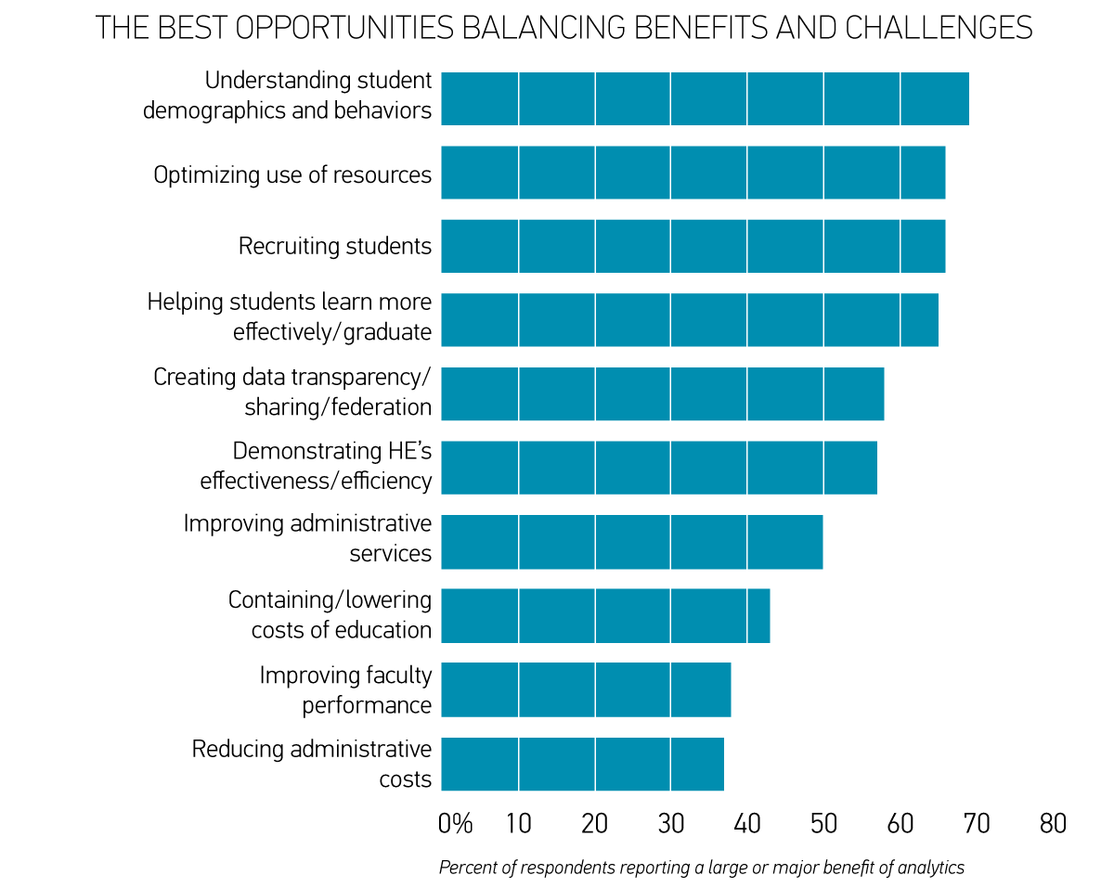
More Optimism around Student Areas than Cost or Faculty

Slide 22
Proven Means for Optimizing Student Success
Managing the student pipeline, at risk students
Eliminating impediments to success
Dynamic query, alert and intervention, at-risk behavior
Learner relationship management systems and processes
Personalized learning system environments and learning analytics (Next Gen Learning)
Data mining/Big Data
Extend success to include employability/work

Slide 23
3. What Are Some of the Best Practices in Leading Institutions and Solution Providers?
P

Slide 24
Selecting Institutions and Solution Providers
40+ leading institutions – primarily online, research universities, comprehensive universities, community colleges, private institutions, systems of institutions
20 solution providers in a range of areas – ERP, LMS, retention, analytics, personalized learning

Slide 25
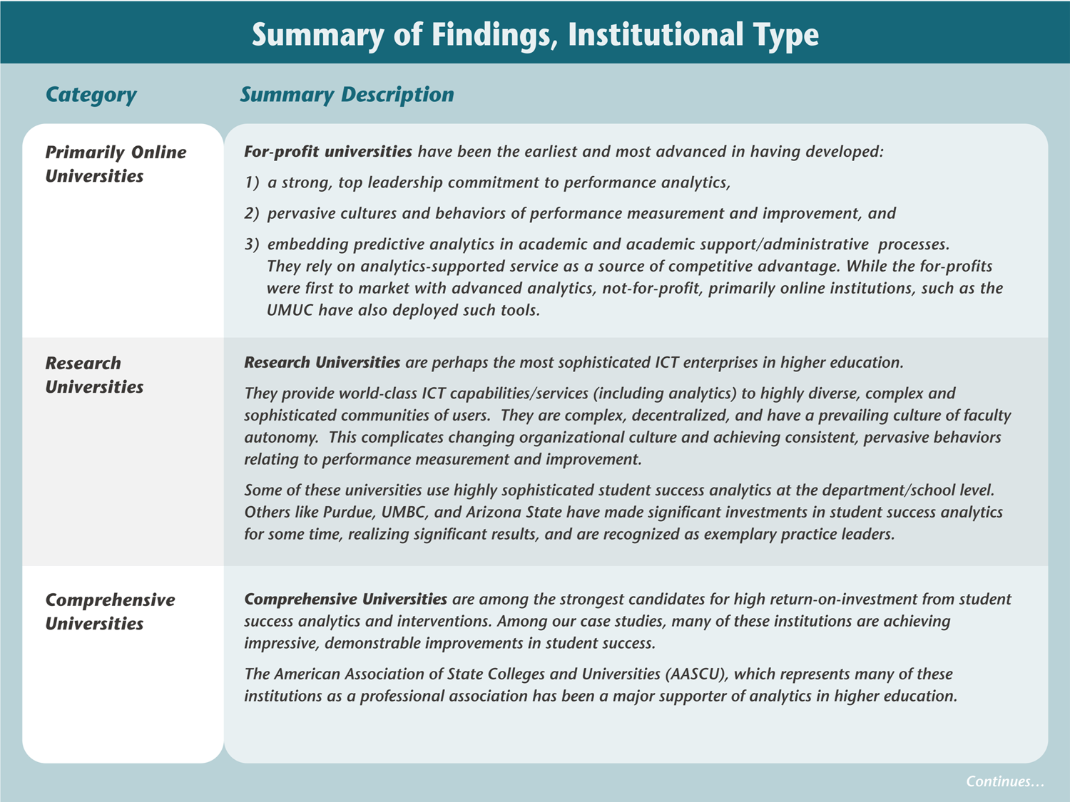
A Survey of Leading Institutions
For-Profit and Online Not-for-Profit Institutions
Research Universities
Comprehensive Universities
Private Colleges and Universities
Community Colleges
Systems of Institutions

Slide 26
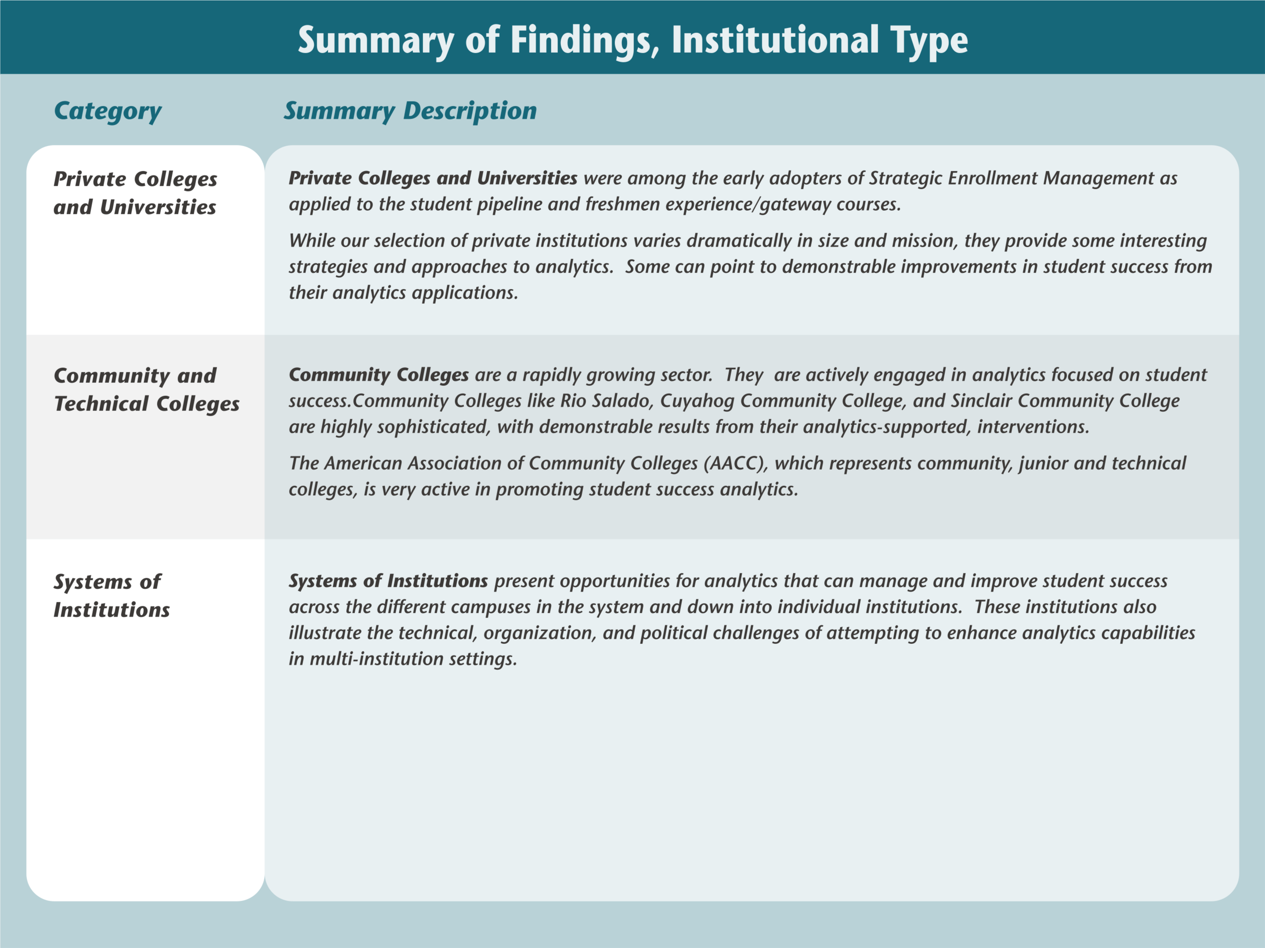

Slide 27
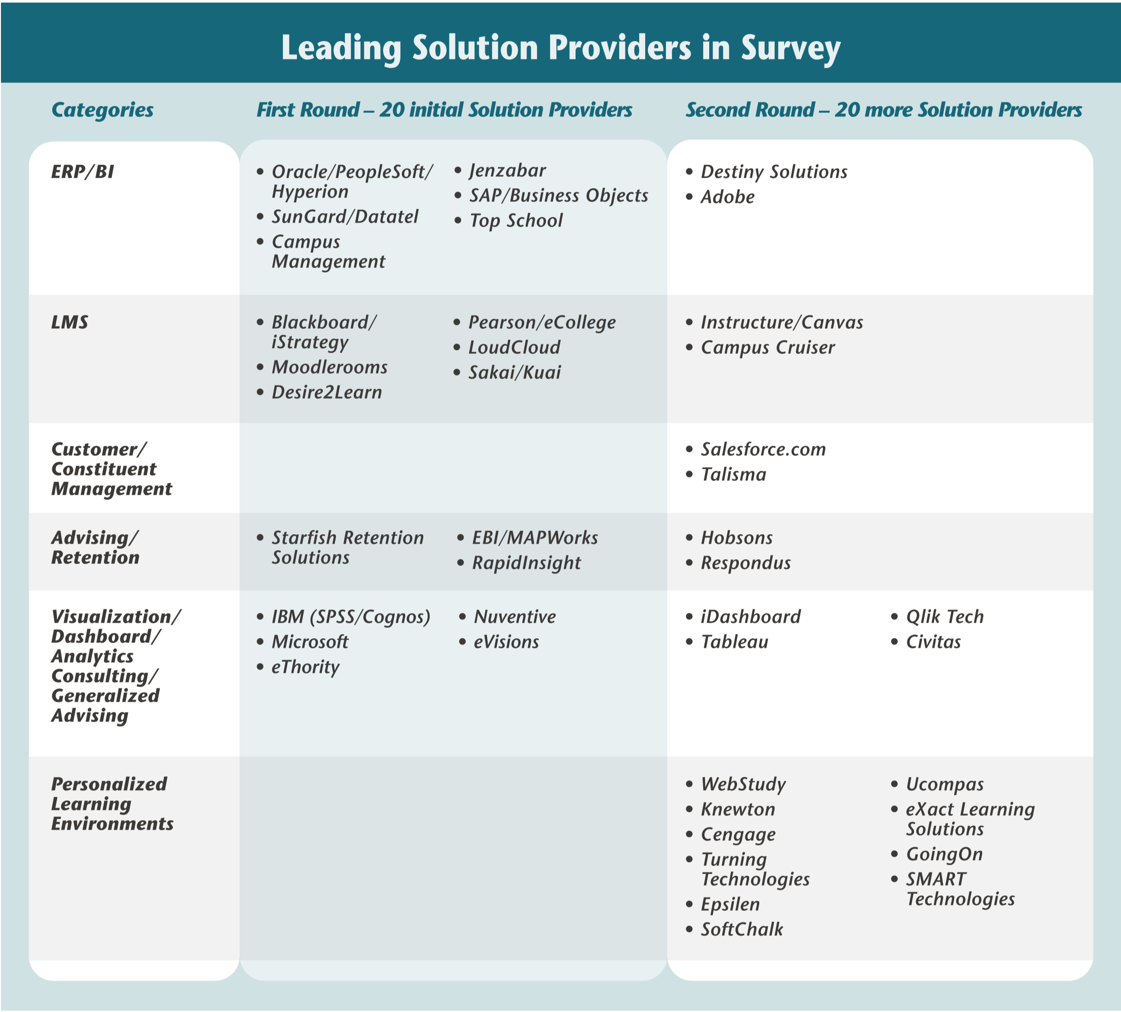

Slide 28
Many Types of Student Success Analytics
These institutions are all engaging in student success analytics of seven types
Most institutions were engaged in 3-5 of these activities
Even among these leaders, there was great variation in levels of accomplishment and sophistication
The solution vendors believe the industry has a long way to go

Slide 29
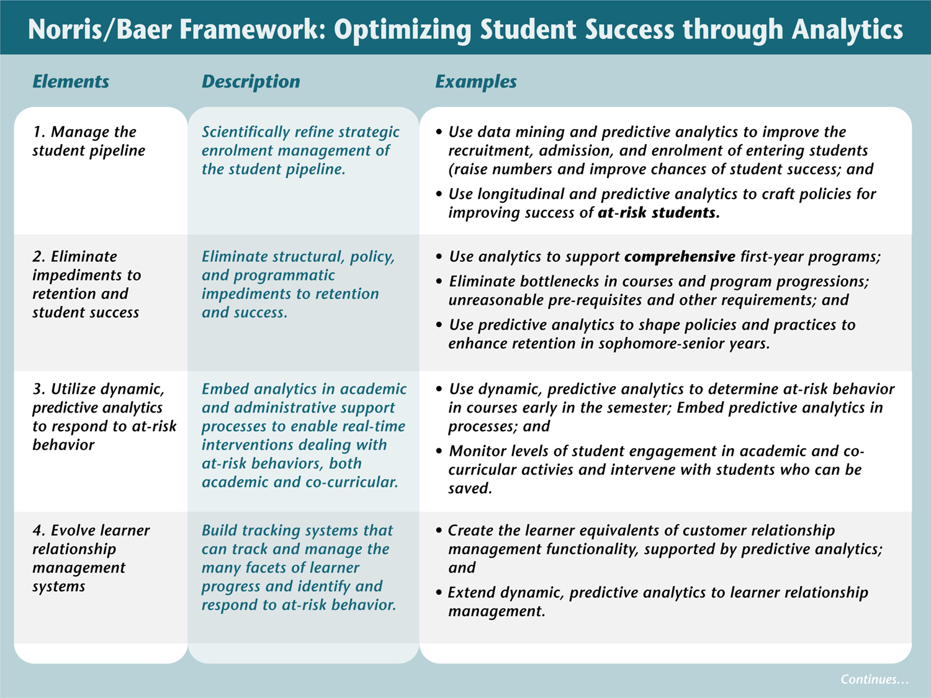
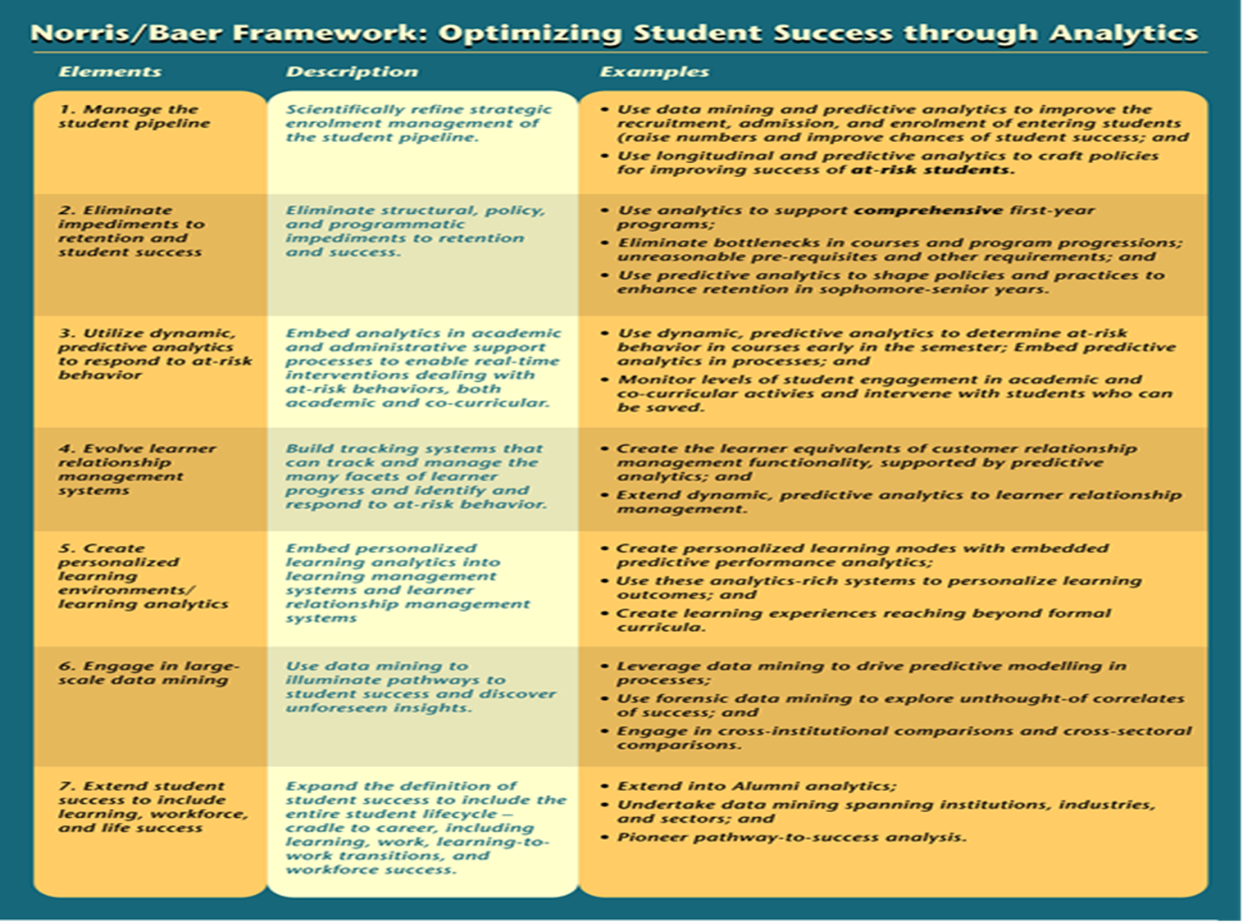

Slide 30
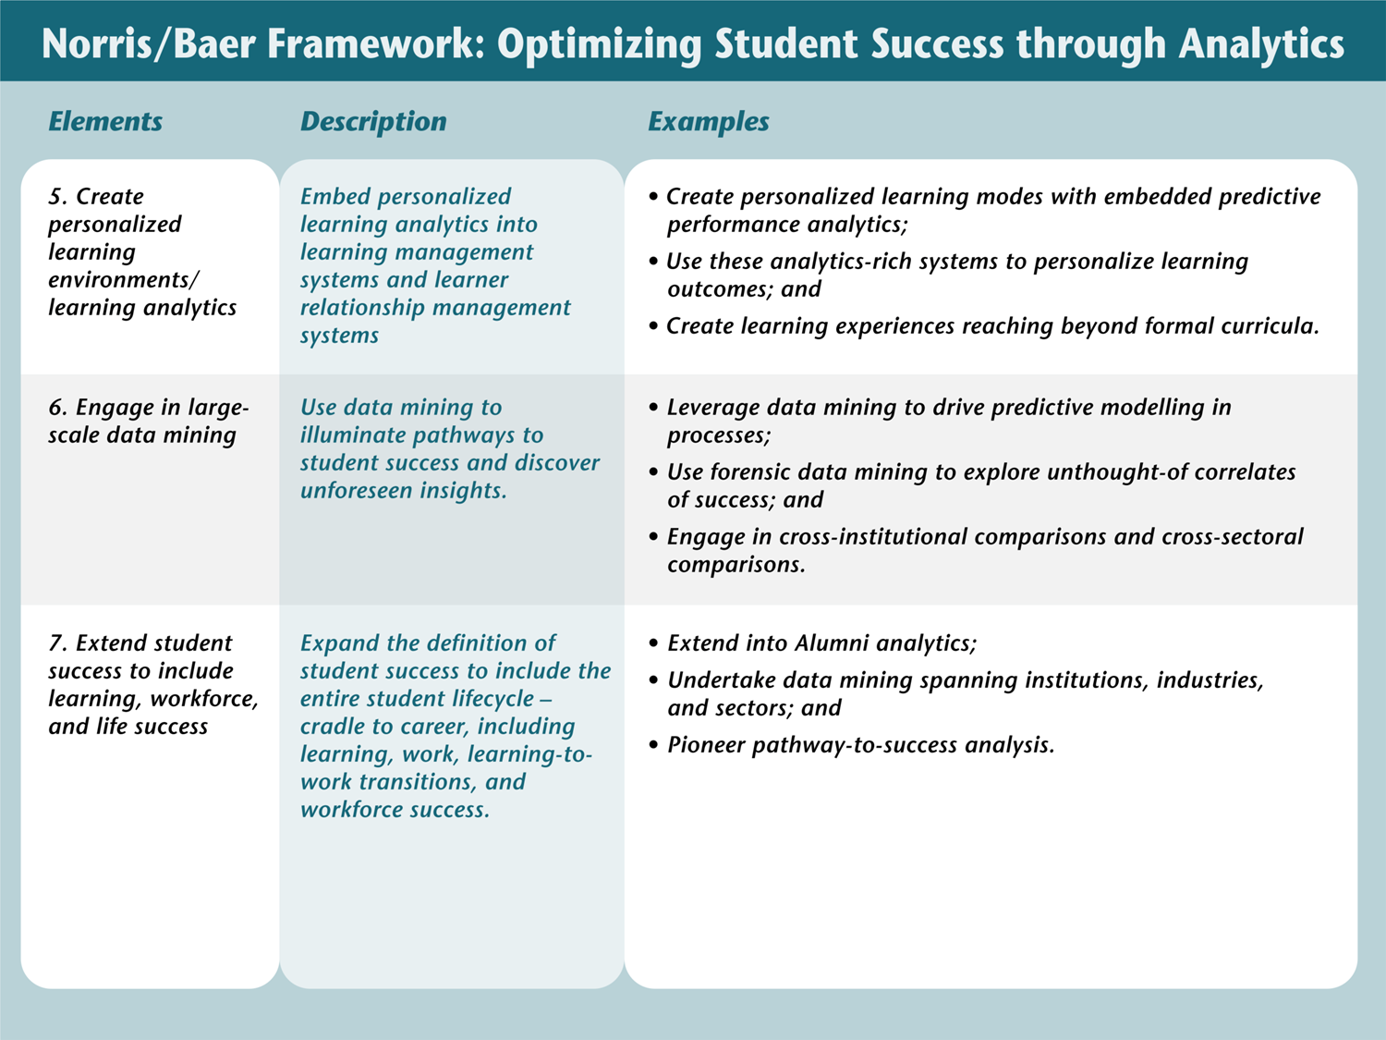

Slide 31
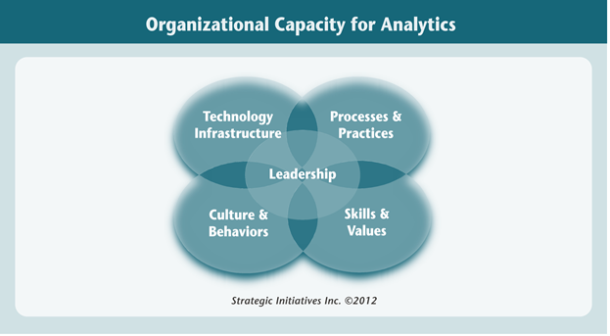
Organizational Capacity for Student Success Analytics
Technology infrastructures, tools, applications, solutions and services
Processes, policies and practices
Values and skills of faculty, staff, students, alumni
Culture and behaviors
Leadership

Slide 32
Preliminary Insights – Leading Institutions (1)
Some leading-edge institutions are achieving strong ROI on student success analytics, the killer app for analytics
Good case studies on successful execution and capacity building, with different patterns for different types of institutions
Leadership commitment is critical to move beyond departmental solutions and to changing behaviors
Examples of all levels of optimizing student success techniques being demonstrated by some leading institutions
Wide variety of build/buy/mash-up strategies being used

Slide 33
Preliminary Insights – Solution Provider Capacity (2)
Expanded emphasis on analytics – new functionalities, applications, solutions, consulting services
Expanded student success solutions from BI/ERP and LMS providers
New vendors in many categories – retention and student success, personalized learning, K-12, workforce
Cloud-based applications demonstrate the cloud’s potential to leverage vendor infrastructure, solutions, processes, cross-sector linkages, know-how
Strong marketplace incentives for continuing vendor innovations, expansion to Next Gen learning

Slide 34
Preliminary Insights – Capacity of Typical Institutions(3)
Many institutional leaders overestimate their data, information and analytics capacity. Substantial need for professional development, capacity building, and raising “analytics IQ”
Need for affordable analytics solution that deliver student success-based ROI. The bar keeps being raised for analytics possibilities
Strong accountability demands for analytics for student success and productivity
Learning analytics combines enterprise-based and free-range learning.

Slide 35
4.What are Key Concerns and Gaps in Building and Sustaining a Foundation for Analytics?

Slide 36
The Analytics Capacity Gap
The talent gap - Lack of analytics expertise and experience in our industry, difficulties in hiring
Pervasive need for professional development at all levels
Need for continuing enhancements in tools, applications, solutions and services – the bar is being raised
Need for consulting, know-how, institutional “capacity augmentation”
Need for “free-range” personal capacity build

Slide 37
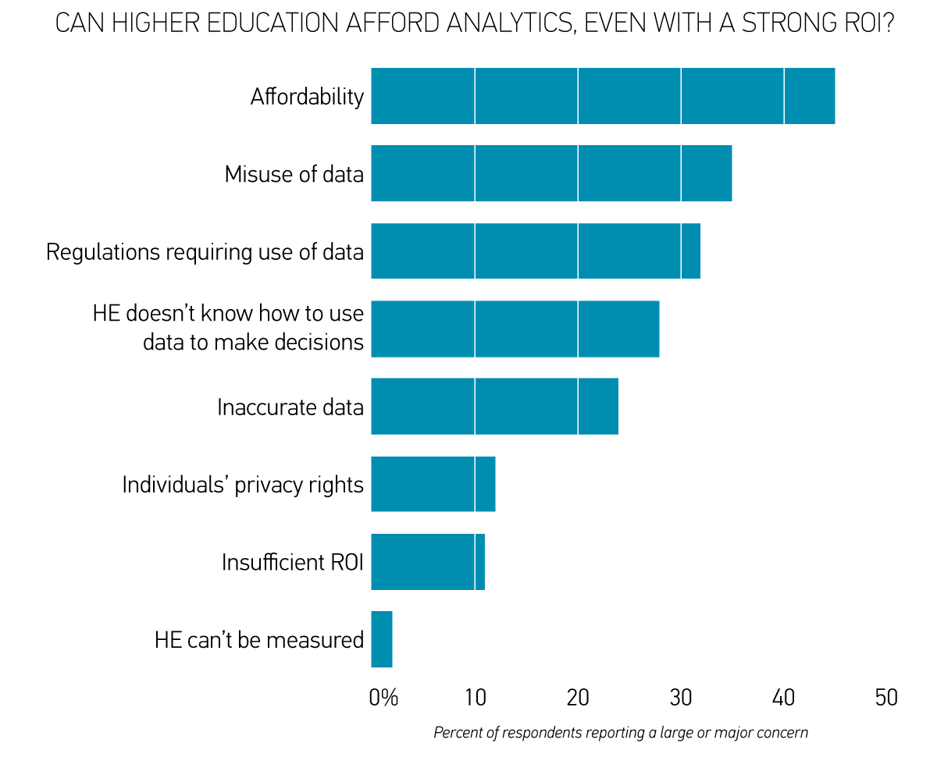
DATA AND AFFORDABILITY ARE THE BIGGEST CONCERNS
erwyrewgf
http://www.educause.edu/library/resources/2012-ecar-study-analytics-higher-education
What are your concerns about the growing use of analytics in higher education?; N = 339, EDU + AIR

Slide 38
IT and IR Differences Concerning Analytics
IT Professionals
IR Professionals
The use of analytics to mange central IT is more advanced
Funding for analytics at their institutions is viewed as an investment in future outcomes
Their administration accepts the use of analytics
Their institutions’ IT professionals know how to support analytics
Individuals’ privacy rights are a concern
Affordability is a concern
Return on investment is a concern
The use of analytics in faculty promotion and tenure is more advanced
The use of analytics in procurement is more advanced
Their institutions have dedicated professionals with specialized training in analytics
Their institutions’ IR professionals know how to support analytics
http://www.educause.edu/library/resources/2012-ecar-study-analytics-higher-education

Slide 39
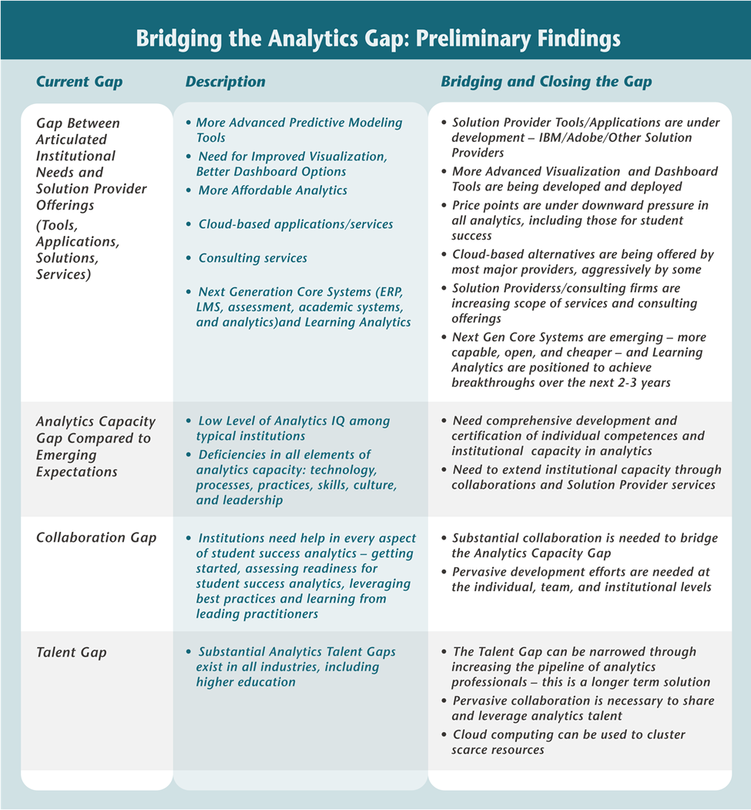

Slide 40
5. What Does the ECAR Maturity Index Tell Us about Current Capacity?

Slide 41
Analytics Maturity in Higher Education
CULTURE --Committed leadership; culture accepts use of data to make decisions
DATA & TOOLS ----Clean, standardized data and reports; right tools and software
INVESTMENT-- Funding and staffing for analytics
EXPERTISE--IR and/or business professionals with analytics training
INFRASTRUCTURE--Storage capacity; IT professionals supporting analytics; policies regarding security and rights to data
http://www.educause.edu/library/resources/2012-ecar-study-analytics-higher-education

Slide 42
Culture and Process
Senior leaders who are interested in and committed to suing data to make decisions
Our administration largely accepts the use of analytics
We have a culture that accepts the use of data to make decisions; we are not reliant on anecdote, precedent, or intuition
We have identified the key outcomes we are trying to improve and better use of data
We have a process for moving from what the data say to making changes and decisions
Our faculty largely accept the use of analytics

Slide 43
Data/Reporting Tools
Our data are of the right quality and are clean
We have the right kind of data
Our data are standardized to support comparisons across areas
Reports are in the right format and show the right data to inform decisions
We have the right tools and software for analytics

Slide 44
Investment
We have an appropriate amount of funding for analytics
Funding for analytics is viewed as an investment in future outcomes rather than an incremental expense
We have an appropriate number of analysts for analytics

Slide 45
Expertise
We have IR professionals who know how to support analytics
We have dedicated professionals who have specialized analytics training
We have business professionals who know how to apply analytics to their areas

Slide 46
Governance/Infrastructure
Our information security policies and practices are sufficiently robust to safeguard the use of data for analytics
We have sufficient capacity to store, manage, and analyze increasingly large volumes of data
We have policies that specify rights and privileges regarding access to institutional and individual data
We have IT professionals who know how to support analytics

Slide 47
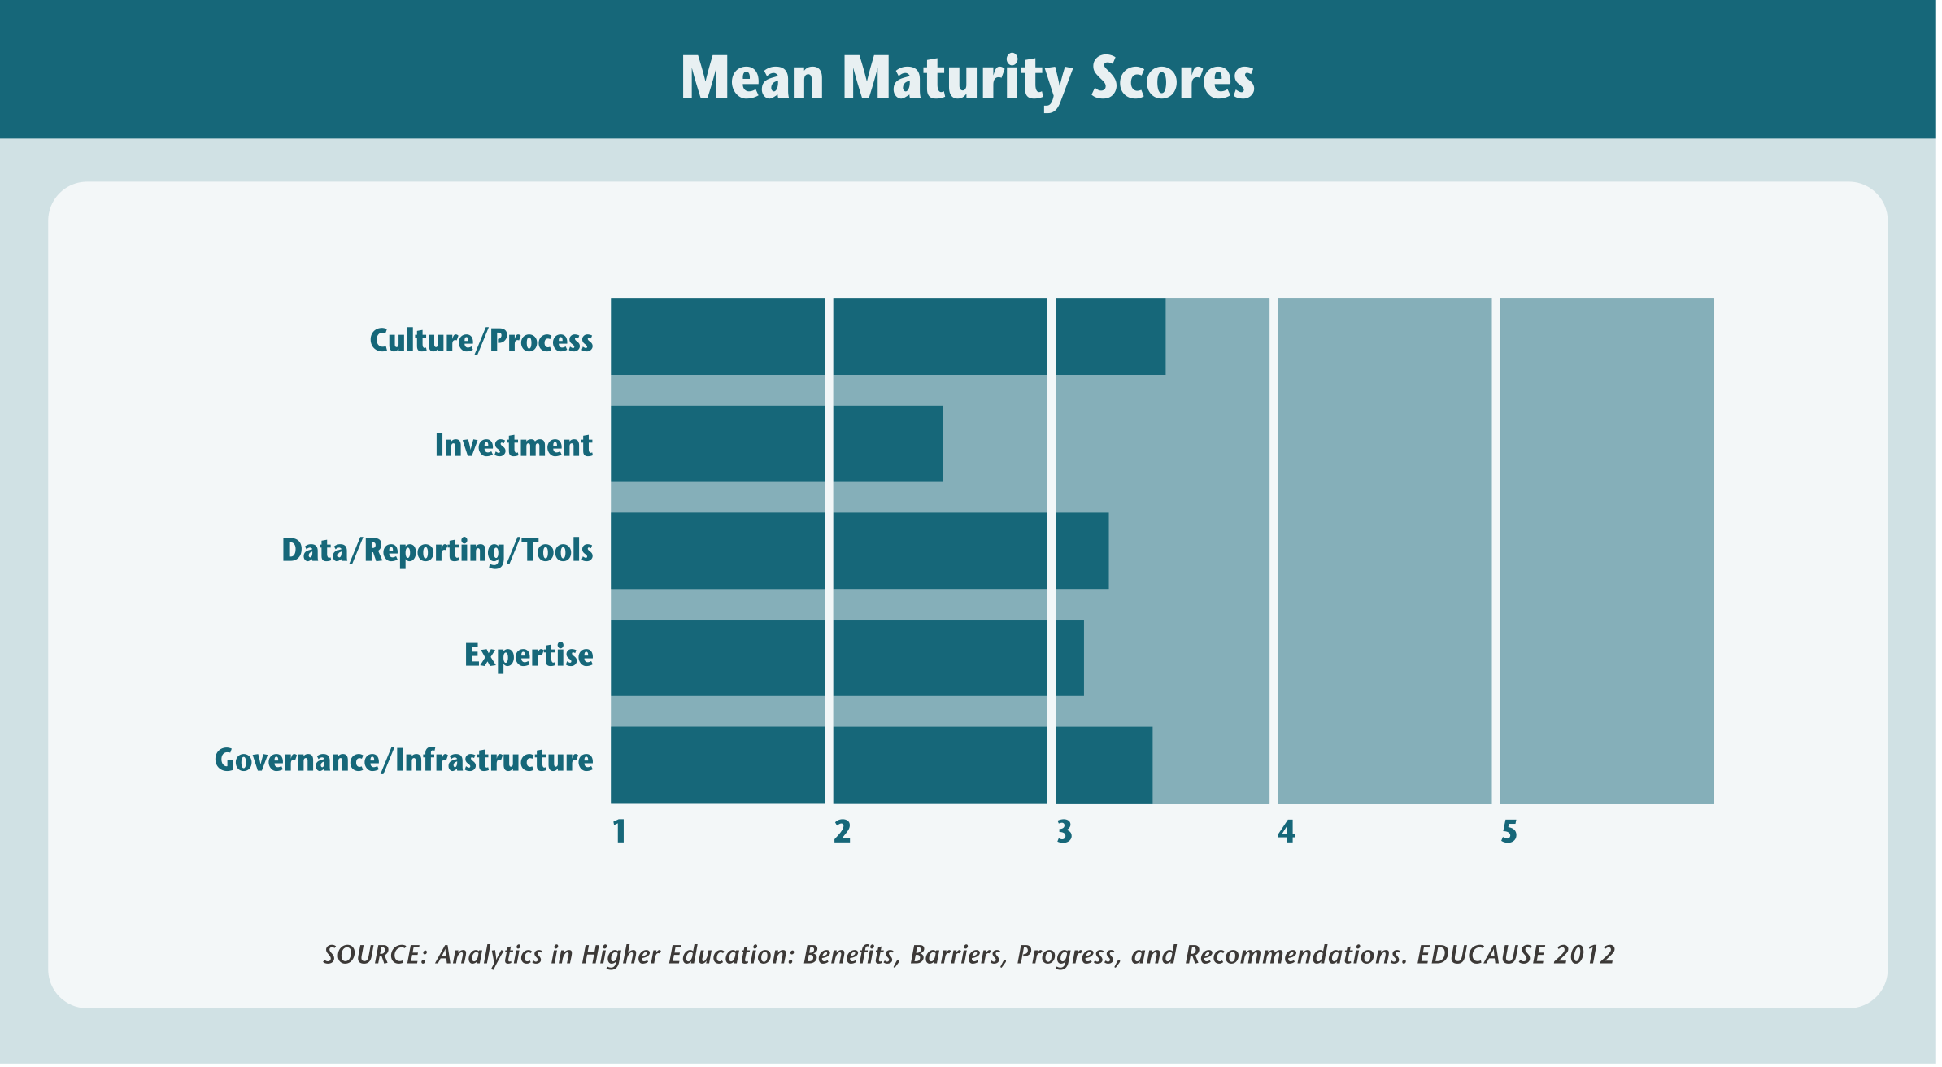
ECAR Overall Maturity Index – All Institutions Participating

Slide 48
Next Steps: Building Your Template (As Part of Your Case Study or Plan)
Culture and Process
Data/Reporting Tools
Investment
Expertise
Governance/Infrastructure

Slide 49
III. Understanding analytics processes, plans, and strategies 10:00 – 11:30 am

Slide 50
The Purposes of this Section
Understanding the ongoing processes of analytics and how to accelerate them.
Combining purposeful planning, strategy making, and capacity building with analytics.
Embedding analytics into on-going planning and strategy processes and initiatives.
Elevating the leveraging of analytics into a major change initiative at your institution.
Considering future inflection points, today.

Slide 51
1. The Analytics Process
The five-step analytics process is the basis for the continuous churn of analytics activities.
At any time, there are constellations of ongoing analytics activities.
Davenport describe a five-step process for “getting starting with analytics” – which is a means of focusing organizational attention on analytics.

Slide 52
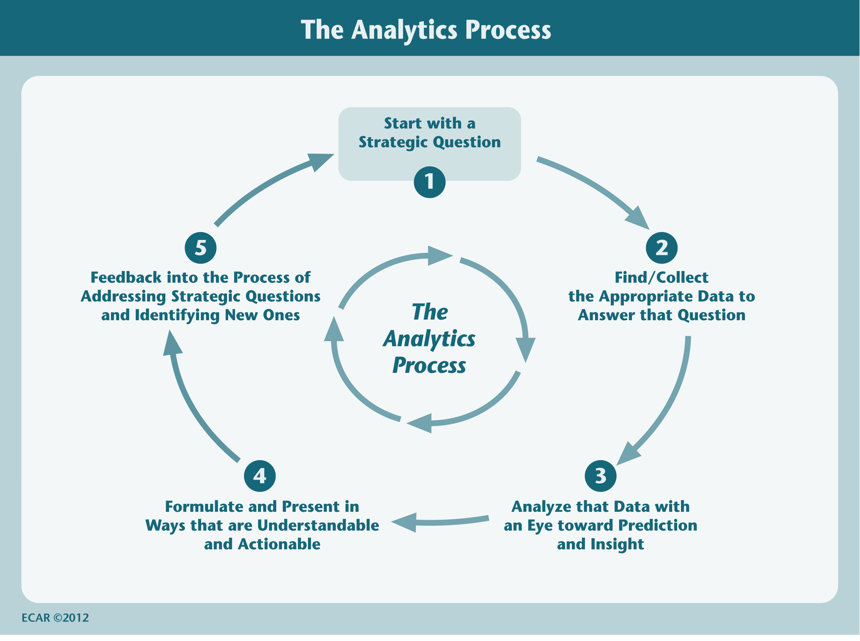

Slide 53
“The more people that touch the data, the better the understanding.”
Institutional leader, Mankato State University.

Slide 54
2. Creating an Action Plan for Analytics
An Action Plan is a handy way to increase the impact and accelerate the uptake of analytics.
It can be used to organize multiple analytics projects into a more coherent initiative.
Action Plans can be excellent communication vehicles for applying “What Works” in analytics at other institutions to your institution.
Understandable Action Plans set the stage for institutional strategies for leveraging analytics.

Slide 55
When Might You Need an Action Plan for Analytics?
A particular problem has arisen that requires a greater investment in analytics (cite examples from the Toolkit)
You are just getting started and want to learn from what others have done and accelerate your development.
Your leadership wants to engage a broader cross-section of the institution in expanding analytics. Elevate from departmental to enterprise perspective.

Slide 56
Examples of Institutional Action Planning
American Public University System
Arizona State University
University of Maryland Baltimore County
University of Minnesota
Sinclair Community College
Rio Salado Community College
Northeastern University

Slide 57
“Action plans are implemented. Strategies are executed, over time, in an expeditionary manner.” Donald Norris and Linda Baer, The Toolkit

Slide 58
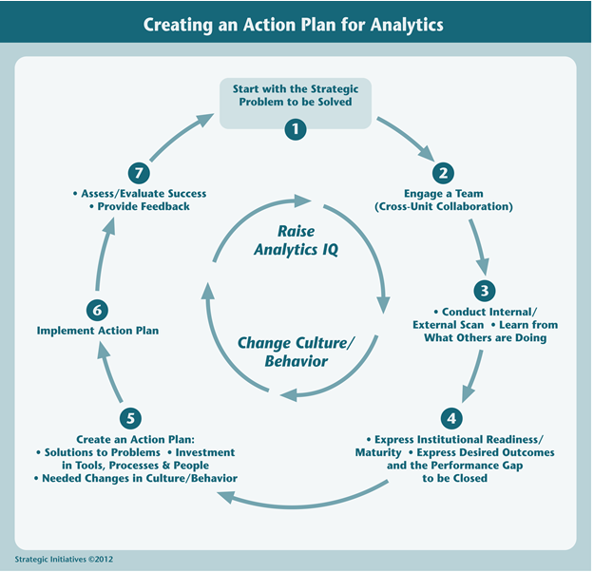

Slide 59
Helpful Hints for Action Plans
Be aware in wide variations in analytics capabilities across functional areas
Identify Quick Wins, Harvest “Low Hanging Fruit”
Get the President/Chancellor and Cabinet using dashboards and analytics
Pursue “analytics for the masses” and create “single points of truth”
Reach out to engage teams
Engage Deans, Department Chairs and Admin Assistants in analytics applications

Slide 60
Sample Elements of Action Plan for “State University” (In Workbook)
Creating an Action Plan for State University
Performance Leaps at State University – Focusing on Student Success
Changes in Institutional Research’s Role at State University
Expeditionary Initiatives at State University Involving Action Analytics

Slide 61
3. Crafting Institutional Strategy for Analytics
Strategy is consistent, focused behavior over time.
Making analytics strategic elevates its importance.
An activity is strategic when it deals with the entire enterprise & the changing environment.
Action plans are like projects. Turning the leveraging of analytics into a strategy transforms it into a major change initiative.

Slide 62
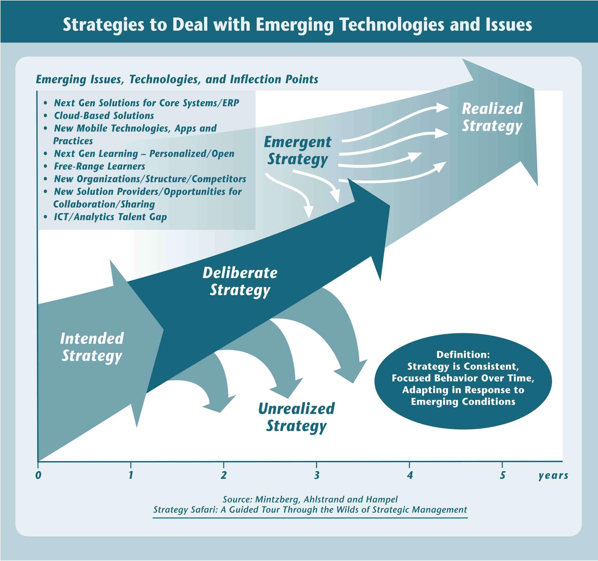

Slide 63
When Might You Need an Institutional Strategy for Analytics?
Your analytics efforts have been successful but fragmented.
A new leadership team has called for a major focus on student success, a greater investment in analytics, and a strategic commitment (See Toolkit for examples).
The playing field has changed - the new opportunities provided by Big Data are bigger than your earlier vision.

Slide 64
“Most institutional analytics strategies are emergent and expeditionary. They are best understood by looking backward to explain analytics behavior that has emerged over the past five to seven years.” Donald Norris and Linda Baer, A Toolkit for Building Organizational Capacity for Analytics

Slide 65
Examples of Emergent Institutional Strategies for Analytics
American Public University System
Arizona State University
University of Maryland Baltimore County
St. Cloud State University
Sinclair Community College

Slide 66
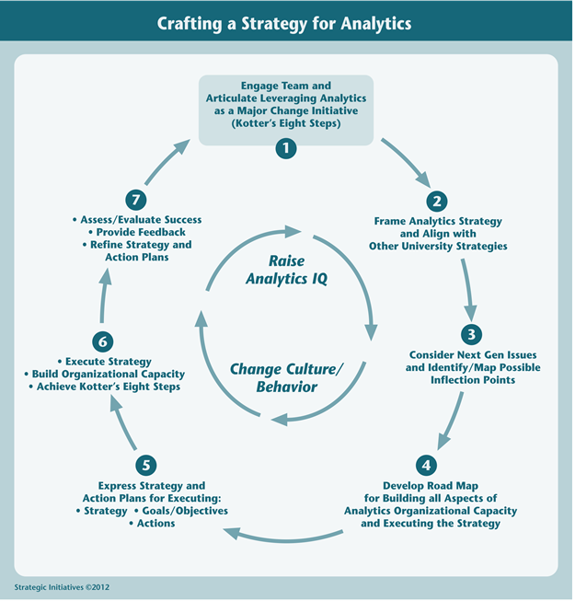

Slide 67
“Crafting strategy for leveraging analytics both accelerates progress and enables greater sense making,”
.

Slide 68
Kotter’s Eight Elements of Major Change
Either incorporate part of Kotter’s eight steps of major change as part of the Action Plan or as the first step in articulating the Strategy.
Focus on how analytics are used to create “game changing” moments and experiences
Express a vision for colleges, universities and free-range learners operating in a “Big Data” universe

Slide 69
State University Focusing on Optimizing Student Success (Sample)
Establish a sense of urgency
Form a powerful guiding coalition
Create a vision
Communicate the vision
Empower others to act on the vision
Plan for and create short-term wins
Consolidate improvements and produce still more change
Institutionalize new approaches

Slide 70
Use Strategy to Frame Next Gen Issues
Establish a working group to frame Next Gen issues and possible inflection points
Next Gen solutions – Core Systems and Personalized Learning
Cloud computing
Free-range learners
ICT Talent Gap
Mobile applications
New solution providers/collaborators
Link short-term and long-term thinking

Slide 71
Align with Institutional Strategies/ Embed in Institutional Strategies
Analytics are most powerful when embedded in a genuine institutional priority – such as optimizing student success
The most effective statement of analytics strategy may be a Kotter-type blueprint, with analytics elements embedded in other institutional strategies
Look for ways to simplify and expand understanding of institutional strategies

Slide 72
Other Key Considerations
Describe how to navigate change
Communications and public relations
Engage key participants, create “Champions,” “Zealots” and “Change Agents”
Assess and evaluate progress
Raise analytics IQ
Change behaviors and model the impact of changed behaviors

Slide 73
Lunch 11:30-12:30

Slide 74
IV. Case studies and starting your plan/strategy 12:30 – 2:00 pm

Slide 75
Purpose of this Section
Prepare participants to start on their own Action Plan/Strategy
Share what we have learned from Case Studies of successful analytics institutions
Focus on “Lessons Learned” about accelerating use of analytics to optimize student success
Focus on University of Minnesota Case Study

Slide 76
1. Samples of Case Studies (Viewed Online – not all in the session)
American Public University System
Arizona State University
University of Maryland Baltimore County
Sinclair Community College
Northeastern University
University of Hawaii System

Slide 77
2. Stages of Student Success Analytics
Based on feedback from institutional leaders and solution providers
Long way to go for most institutions
Seek to accelerate every institution’s rate of development
Leap to dynamic analysis and intervention, eventually optimization
Analytics is a 5 to 7 year campaign for most institutions

Slide 78
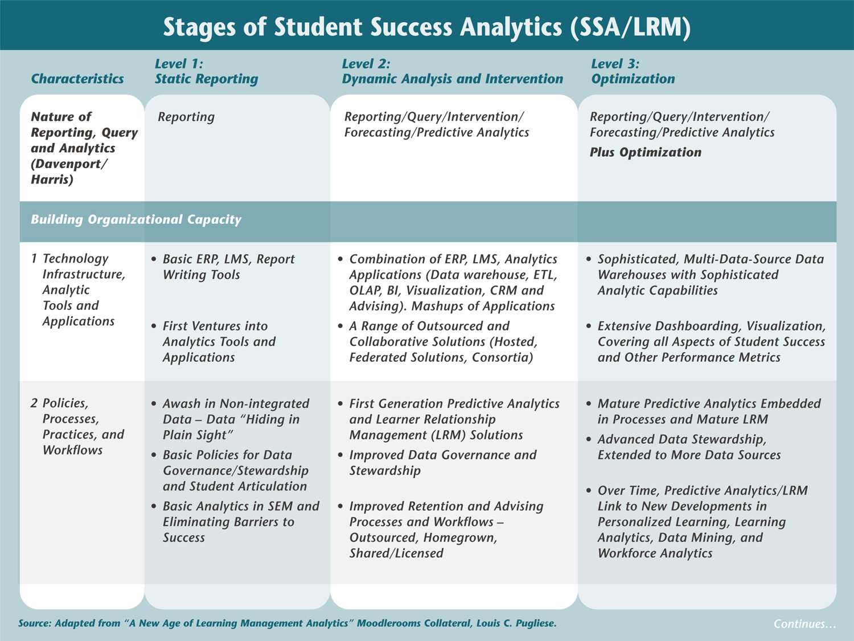

Slide 79
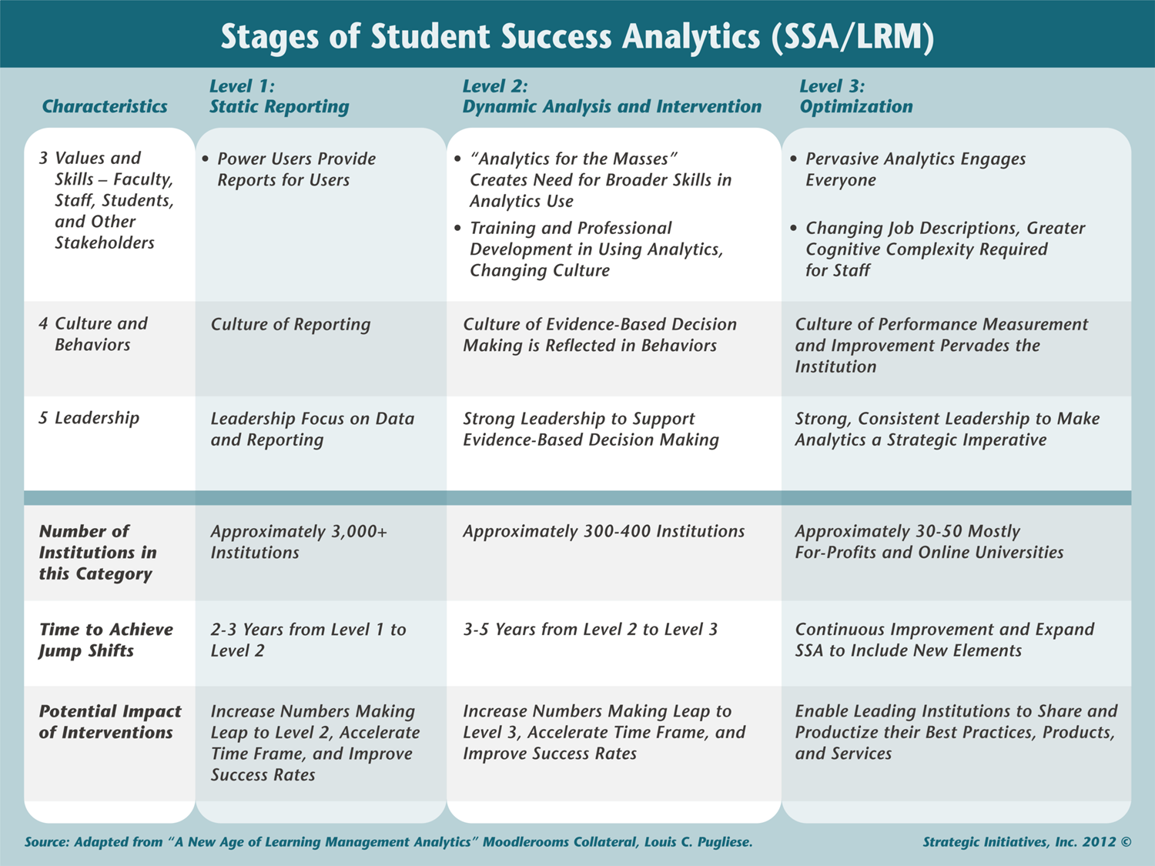

Slide 80
Initiatives to Accelerate Capacity Building for Student Success
Student Success is the Killer App for Analytics
Link to Case Studies, Learn from Leaders
Incorporate Insights in Your Action Plans
Embed Insights in Institutional Strategies

Slide 81
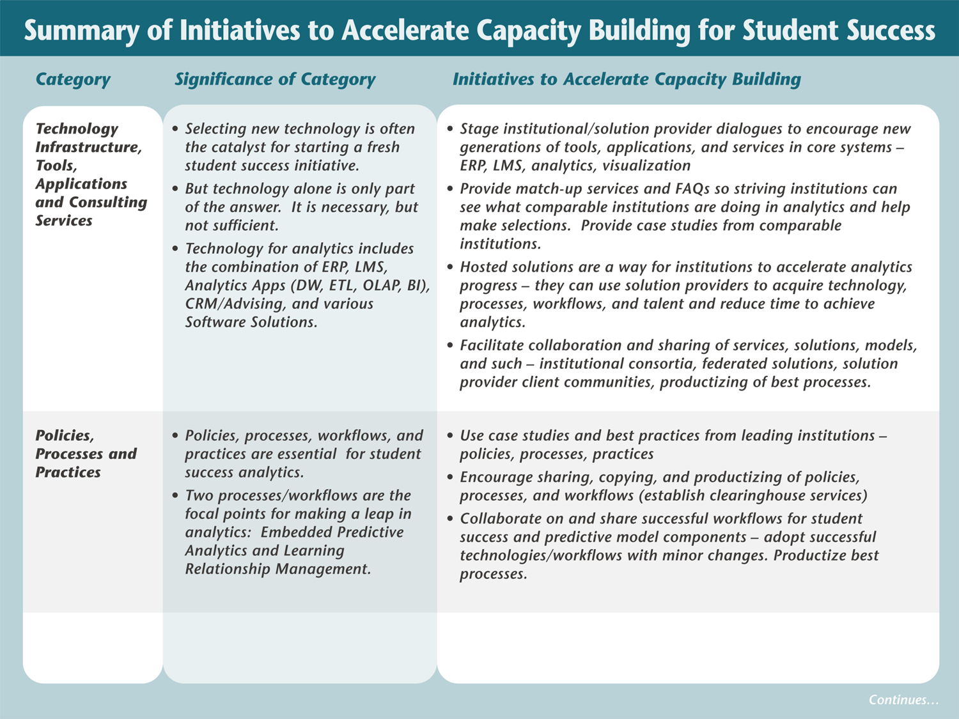

Slide 82
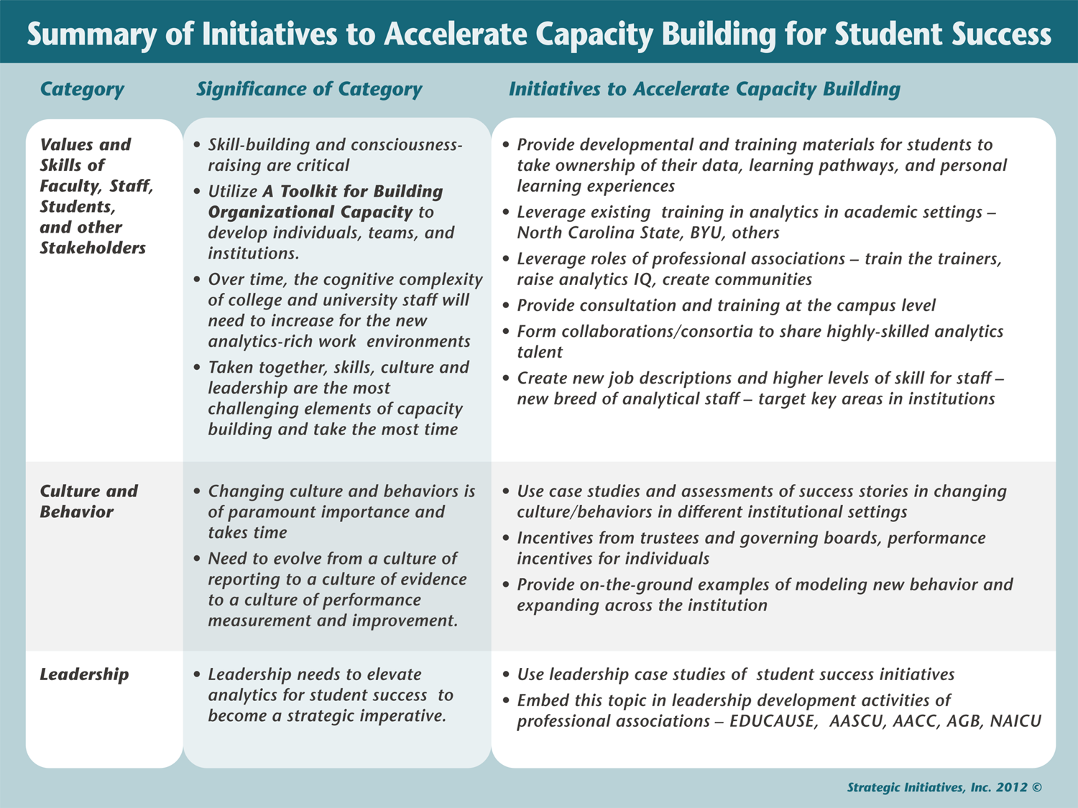

Slide 83
3. University of Minnesota Case Study
The University of Minnesota’s Extraordinary Education Goal is to recruit, educate, challenge, and graduate outstanding students in a timely manner who become highly motivated lifelong learners, leaders, and global citizens.

Slide 84
STRATEGIC QUESTION
DATA ANALYSIS AND PREDICTION
INSIGHT AND ACTION
The University of Minnesota’s Extraordinary Education Goal is to recruit, educate, challenge, and graduate outstanding students in a timely manner who become highly motivated lifelong learners, leaders, and global citizens.

Slide 85
Institutional Level
Analytics
Finance
Academic Affairs
HR
IT
Research
Student Affairs
Facilities
…

Slide 86
From Reports to Analytics
Transactional Database
Real-time updates
Data Warehouse
Frozen snapshot
UM Reports
Aggregate data
Single variables
Simple relationships
Predictive Models
Individual Data
High-dimensional
Complex relationships

Slide 87
Retention and Student Success
Action Plans for Analytics address strategic problems that can be solved through analytics
At UMN – Grad Planner, Aplus advising tool
Institutional Strategy for Analytics expresses the leveraging of analytics as a major change initiative that can be aligned with and embedded in other institutional strategies.
At UMN – BI and academic analytics work underway
At UM Rochester – iSEAL – intelligent System for Education, Assessment, and Learning

Slide 88
BI and Academic Analytics at UMN
Enterprise strategy, goals, and governance
Multiple directions and offices
Distinction between academic and learning analytics
New paradigm
iSEAL at UM Rochester

Slide 89
Enterprise Strategy and Goals
A shared
reporting strategy for the entire University;
data platform that is a common home for institutional and unit data;
understanding of key metrics, data definitions and appropriate use;
set of tools providing an enterprise platform for data analysis and reporting; and
development environment enabling units to share knowledge, ideas, and reports.
Peter Radcliffe, Director, Planning & Analysis
July 2012 interview
Notes:
We will support a variety of data query methods, such as:
Predictive Modeling
Trending
Analysis
Summarized/Aggregated
Operational/Standard Reports
Transactional/Raw Data

Slide 90




Business Intelligence tool (IT)
DELIVERY
COLLABORATION
CONTENT MANAGEMENT
SEARCH
SharePoint Server
Reports
Dashboards
Excel
Workbooks
Analytic
Views
Scorecards
Plans
END USER TOOLS & PERFORMANCE MANAGEMENT APPS
Excel
PerformancePoint Server
BI PLATFORM
SQL Server
Reporting Services
SQL Server
Analysis Services
SQL Server DBMS
SQL Server Integration Services

Slide 91
UMN Data Governance Roles and Responsibilities
Strategic Altitude
30,000
Executive Leadership – To provide the highest level vision, resources, and decision-making needed to advance a culture of data supported decision-making. This group is comprised of University executives, that includes Senior Vice Presidents, Provosts, Vice Presidents, and Vice Chancellors.
Data Governance Council – To set the data governance direction through endorsing policies that affect the production, availability, usability, integrity and security of data used throughout the organization. This group is comprised of data custodians, OIT, OPA, and collegiate/coordinate campus leadership.
Data Governance Team – To lead the implementation, to strengthen and formalize how the University defines, produces and uses data to support informed decision making that spans all campuses, administrative and collegiate units of the University. The Team will accomplish this by defining and building policies, practices, guidelines and processes that support and enforce key data governance deliverables. This group is comprised of data custodial, OIT, OPA, collegiate, and communications representatives.
Data Governance Operators – Though not a formal group, these people are tasked with upholding and enforcing data governance policies, practices and procedures. Many people are involved, through the report development life-cycle. This would generally include centralized/ decentralized OIT, Analytics Collaborative, data experts, data entry staff, report creators, and others.
Executive
25,000
Strategic Level: Why we have Data Governance
Training, Communication and Change Management
Execution and/or Decision Path
15,000
Tactical Level:
How Data Governance will be implemented
Ground
Operational Level:
Where people work with data
Peter Radcliffe, 2012
Notes:
Vision
The Enterprise Data Management and Reporting Strategy advances the University’s competitive position through the provision of information for decision makers and provides support for those activities and systems which support academic and administrative excellence. Enterprise Data Management and Reporting operations support the University’s mission, vision, goals, strategies and objectives.
Values
We value data driven decision making, collaboration amongst all units, quality and efficiencies in our data management and reporting practices and environments, business and technical expertise, and end user engagement.

Slide 92
Analytics Collaborative (Core and Extended)
Academic Units
Business Area(s)
Reporting Professional
Extended Virtual Team
Partners
Service Request Process
Change Management
Enterprise Architect
Colleges
Program Management
BI Implement Committee
Core Team
IT Strategic Planning
Project Facilitation
End Users
Business Strategic Planning
Incident Management
Academic Support Resources
Finance
Knowledge Management
Training
Human Resources
Process Management
Peter Radcliffe, 2012

Slide 93
It takes LEADERSHIP
Rankings exist because we haven’t put good data on the table. Show me your data.
It’s about the curriculum, not the course.
Analytics is a different mindset. Be informed by data. Data shapes how you think about things; it’s the importance of an evidence-based culture.
Data allows us to embrace the complex issues.
Bioinformatics creates a common language across disciplines.
At the end of the day, the data is the connector. Interview.
Stephen Lehmkuhle, Chancellor, UMR. 2012

Slide 94
Individual Paradigm
It’s no longer about curing cancer; it’s about curing the individual.
It’s the individual data that is important, not the institutional data. Stephen Lehmkuhle, Chancellor, UMR

Slide 95
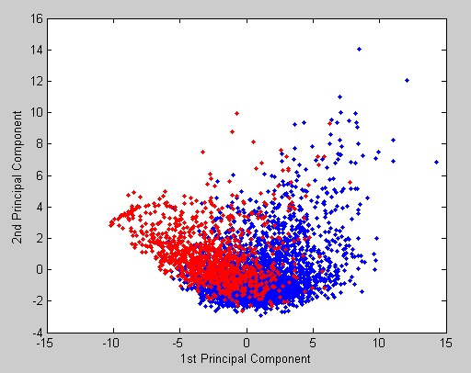
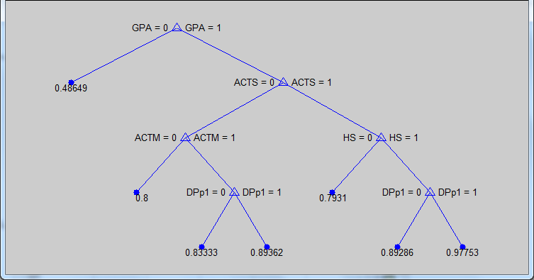
Bioinformatics Methods
Clustering to identify groups of students who differ in their success
Personalized approach
Decision trees to identify factors important to success
Algorithms to develop college specific approaches
Claudia Neuhauser, Vice Chancellor, UMR
Notes:
The top figure is the visualization of the first two principal components of a data set that was used to investigate reasons why students leave in their fourth year. Each dot is a student. Red indicates that the student left after the third year without graduating, whereas blue indicates students who are still enrolled in their fourth year.
The bottom tree is a classification tree for a set of students. The classification is according to status at Year 2 (enrolled vs. not enrolled).

Slide 96
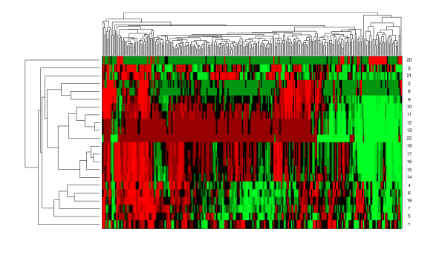
The paradigm: Individualized medicine
Claudia Neuhauser (2012). From Academic Analytics to Individualized Education. In Duin, A.H., Nater, E.A., Anklesaria, F. (Eds.). Cultivating change in the academy: 50+ stories from the digital frontlines at the University of Minnesota in 2012. University of Minnesota. http://purl.umn.edu/125273.
Notes:
This relationship between individualized medicine and individualized education became clear to me during a talk on gene expression data in the Biomedical Informatics and Computational Biology Journal Club that I was running in Fall 2007. A few weeks before attending this talk, I had a discussion with Chancellor Lehmkuhle on how to measure student success. He mentioned to me that he would like to have the analog of a medical record for students in our program. When I was sitting in the talk and looking at the heat map of gene expression data, I instead saw the “medical records” of our future students. The pieces fell into place: If we collected detailed data on student learning, we could develop individualized education with a vision that is similar to individualized medicine where prevention, diagnosis, and treatment are tailored to patients. In essence, the tools we use in bioinformatics to extract knowledge out of genomics data could be useful in education where we have become similarly data-rich.
Technology is the key to collecting detailed student data across the curriculum. To implement this we would need a database that collects longitudinal data on student learning. The database would contain learning objects, such as quiz questions, homework problems, reading materials, etc. They would be tagged to be searchable. Learning objects would be combined to form modules, which in turn would be combined and delivered as a credit-bearing course. Over time, the curriculum would be represented by a network of modules, each with its own learning objectives and concepts. As students interacted with the curriculum through a curriculum delivery system that is linked to the database, a rich dataset would emerge that could be mined for multiple purposes. The design of the database was funded through a Howard Hughes Medical Institute professor grant that I had received in 2006. We named the database iSEAL: intelligent system for education, assessment, and learning. Initially, iSEAL was a research project. It is now an enterprise-level project that lives in UMR’s IT unit and has been in use in the curriculum at UMR for the last three years.

Slide 97
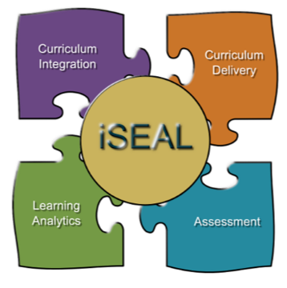
UM Rochester’s iSEAL intelligent System for Education, Assessment, and Learning
Comprehensive data collection tool that tracks all student activity to provide a deep data set for learning analytics
Sharable, reusable materials – tagged with concepts and learning objectives – accessible to students at all times
Linda Dick, Andy Franqueira, Jeremiah Oeltjen. (2012). iSEAL,
An integrated curriculum in its natural habitat.
http://r.umn.edu/campus-resources/it/web-support/iseal/ats/
Notes:
Use analytics to locate correlations and prepare students better

Slide 98
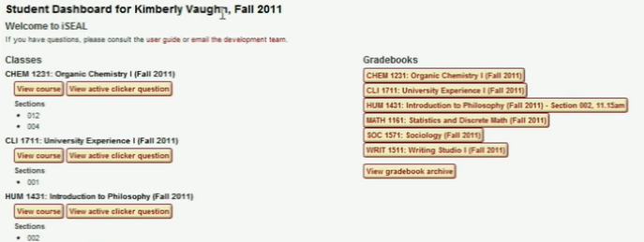
iSEAL

Slide 99
ANALYTICS maturity at UM Rochester
CULTURE
Committed leadership; data-driven decision making
DATA & TOOLS
Continued development of iSEAL
INVESTMENT
Funding and staff for iSEAL
4. EXPERTISE
Leverage central personnel
5. INFRASTRUCTURE
Leverage central IT

Slide 100
Desired Future Capacity
Tailored reports pushed to colleges and coordinate campuses
Performance
Scenarios
Predictive models
Basis for decision making
Central resource
Consistent information and knowledge
Cost-effective: small group can provide results; no need to do analysis in each college individually
Dashboard
Recommender system
Alerts Claudia Neuhauser, Vice Chancellor, UMR

Slide 101
Desired Future Capacity (Continued)
Individual student dashboards to see progress, alerts that are triggered, powerful feedback systems.
Track data on co-curricular impact as well; track team leadership throughout the curriculum and in co-curricular activities.
How do we measure developmental outcomes?
How do we measure that we’ve prepared students for life and career?
Stephen Lehmkuhle, Chancellor, UMR

Slide 102
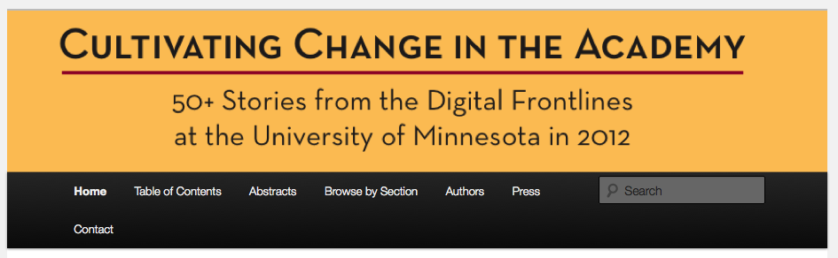
Download at
http://conservancy.umn.edu/handle/125273 Wordpress site for interaction is at
https://cultivatingchange.wp.d.umn.edu/
Twitter hashtag is #CC50

Slide 103
iSEAL links
http://r.umn.edu/campus-resources/it/web-support/iseal/ats/ https://rookery.r.umn.edu/demo/ https://iseal.r.umn.edu/ https://iseal.r.umn.edu/app/faculty/userguide/ umrweb@umn.edu
Contact: Ann Hill Duin

Slide 104
4. Getting Started with Your Institution
Are you doing an Action Plan or a Strategy?
If an Action Plan, Start with the Following Templates:
Strategic Problem to be Solved
Engage Team
Conduct Scan, Learn from What Others Are Doing (FAQs)
Express Readiness/Maturity/Performance Leaps
Create Action Plan
Implement Action Plan
Assess/Evaluate Success/Provide Feedback
Raise Analytics IQ/Change Culture/Behavior

Slide 105
4. Getting Started with Your Institution (Continued)
If you Are Doing a Strategy, Start with the Following Templates (Will be provided)
Engage Team and Articulate Kotter’s Eight Steps
Frame Analytics Strategy and Align with Other University Strategies
Consider Next Gen Issues
Develop Road Map for Building org Capacity
Express Strategy and Action Plans
Execute Strategy, Build Org Capacity
Assess/Evaluate Success/Provide Feedback
Raise Analytics IQ/Change Culture/Behavior
Links to Cases Studies, Success Stories, etc.

Slide 106
Getting Started with Your Institution (Continued)
Electronic versions of the templates with be available to each participant (Word Documents)

Slide 107
Break 2:00 – 2:30 pm

Slide 108
V. Putting it all together – finishing your plan/strategy 2:30-4:00 pm

Slide 109
Working on Your Action Plan/Strategy
The purpose here is to complete the primary architecture/ structure of your action plan/strategy/hybrid combination appropriate to your situation
Work individually or in groups
Complete major elements of templates. To be completed later. Frame the basic architecture.
Use Case Studies and FAQs/Match up services as you get farther along in the process.
Talk with faculty to get assistance, ideas.

Slide 110
FAQs
How can I convince my institution’s leadership that analytics is a good investment? What investments do we need to make in analytics?
How do I get started in student success analytics?
How can build on and extend my current student
success analytics efforts?
How can I determine my institution’s readiness for analytics? Maturity index?
How can I collaborate with other institutions to advance analytics for student success?

Slide 111
FAQs (Continued)
How can I access analytics talent without having to hire them? What kinds of analytics talent are needed to develop and operate student success analytics tools using predictive modeling?
What are the different approaches for an institution to focus on learners and track their success?

Slide 112
Match-up service
What are other institutions like mine doing for analytics to support student success?
What are institutions doing in the different analytics categories (framework for optimizing student success), and what vendor solutions are they deploying to do so?
What specific vendor solutions are available for BI/Analytics?
What solutions are vendors offering, specifically tailored to student retention and success?

Slide 113

Analytics is the “universal decoder” for education reform

Slide 114
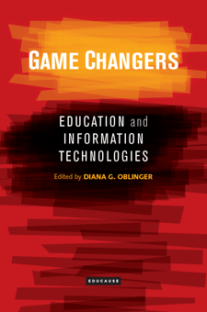
Game Changers
Education changes lives and societies, but can we sustain the current model?
New models and new technologies allow us to rethink many of the premises of education—location and time, credits and credentials, knowledge creation and sharing
http://www.educause.edu/research-publications/books/game-changers-education-and-information-technologies

Slide 115
Contact Information
Linda Baer – lindalbaer@yahoo.com
Donald Norris – dmn@strategicinititatives.com
Ann Hill Duin – ahduin@umn.edu

