Slide 1
Balanced Leadership:
The Role of Behavior Styles and Emotional Intelligence
Morris W. Beverage Jr. & Jeannie Zappe
November 6, 2012

Slide 2
Introductions
Jeannie Zappe & Morris Beverage
Tell us about you…
  Name, etc.
  What brought you here today?
  What do you expect to get out of your time here?

Slide 3
Exercise: Let’s Discover Something About Ourselves…
Complete your individual profile
  Select the word that most describes you at work
  There are no right or wrong answers
  No one will see your selections

Slide 4
Your Behavior Style Profile
External conditions and situations exist at the present time that may impact your current response
Avoid labels
How to score your profile
Notes:
Pass out profiles

Slide 5
Creating Your Profile
Step One | Distribute Profile Materials
Step Two | Complete page 5 (Bar Graph)
Step Three | Complete page 7 (Style Combinations)
Step Four | Find your combinations (Pages 8 – 15 or 16 for Overbalance)
Step Five | Find your energy (“As Others See Me” – Page 3)
Step Six | Group yourselves by style

Slide 6
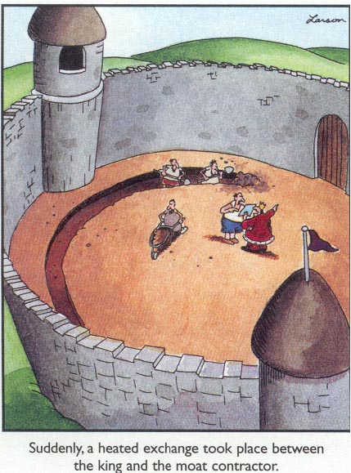
Notes:
Talk a bit about Behavior Styles profile.
We’re going to apply that knowledge as it relates to Interpersonal Communications.

Slide 7
Tasks vs. People
More, better, faster | Capable, competent Likeable
Tasks | People
Notes:
The balance between Technical Skills to get the job done and People Skills to make relationships work is critical in effective interpersonal communications.
These two sets of skills need to be in balance. That does not mean we spend 50% of our time on each.
Ever hear “We have to do more, we have to do it better, and we have to do it faster?”
The fatal mistake is that leaders and managers try to get more, better and faster by focusing on the tasks. This will get a short-term increase, but long-term, it always fails! Why? It burns people out; there is minimal regeneration (there is no time) and the talent leaves.
There is a way to get more, better, faster;
Capable: my assessment of my skills (inside view)
Competent: Your assessment of my skills (outside view)
LIKEABLE: my ability to CONNECT (outside view)
When the balance exists, individuals put more time, energy and talent into completing the tasks.

Slide 8
Process vs. Expediency
Thorough, comprehensive, need to make one RIGHT decision | Fast, gut, quick
Process | Expediency
Notes:
Right side is fast, gut level, quick decisions. Walk fast, talk fast, think fast, act fast, and want you to move your energy in the same way.
Major decisions made in 3-10 seconds.
Cross over to the left side- Process “slow”
Thorough, comprehensive, complete in information gathering, sorting process. Make decisions one time. Needs to be the right one!
Example: Fast gut quick; waits 10 seconds then asks “What do you think?” Process says “I don’t know.” Sarcasm: “When do you think you’ll know?” Answer: “Why are you in such a hurry to be wrong again?”
“I’m right” – not about right and wrong. It’s about dignity.
Resolve: “I’m right” – go to a position of power.

Slide 9
Behavior Styles
Task
ANALYZER
CONTROLLER
Process
Expediency
STABILIZER
PERSUADER
People

Slide 10
Behavior Styles
(Do)
Task
ANALYZER
CONTROLLER
Process
(Ask)
Expediency
(Tell)
STABILIZER
PERSUADER
People
(Do with)

Slide 11
Behavior Styles
(Do)
Accuracy
Task
Action
ANALYZER
CONTROLLER
Process
(Ask)
Expediency
(Tell)
STABILIZER
PERSUADER
Appreciation
Approval
People
(Do with)

Slide 12
Discussion
Look at the “Style Descriptions” and the “Positives and Negatives per Style” matrix.
Do those ring true for you? Do they suggest approaches that may result in successful outcomes when working with or communicating with people whose style is different than your own?

Slide 13
Analyzers
Tendency toward perfectionism
Decisions and information provided are usually accurate and thoughtful
Deal with facts, data, logic, details
Sometimes slow to make decisions
May appear overly cautious and not good risk-takers
Feelings and emotions kept inside
Notes:
Thinking oriented
Just the facts
Deliberate, disciplined
Consistency
Decisions long-lasting
Often viewed as lacking enthusiasm, cold
Calm, common sense
Focus on the past
“Show me” people

Slide 14
Positives and Negatives per Style
A | + Industrious Persistent Serious Exacting Orderly | - Critical Indecisive Stuffy Picky Moralistic |  |  | C
S |  |  |  |  | P

Slide 15
Stabilizers
“Warm and fuzzies”
People and friendships are very important
Good at juggling multiple tasks
Concerned about feelings of others
Dependable
Agreeable; less inclined to speak their mind openly
Can get hurt feelings or be offended easily
Notes:
Relationship-oriented
Lend joy and warmth to the workplace
Cooperative
Uses understanding and mutual respect to achieve objectives
Can feel bulldozed
Power not important, but being accepted is
Sentimental, like traditions
Stick with comfortable, known
The people who send cards….

Slide 16
Positives and Negatives per Style
A |  |  |  |  | C
S | + Supportive Respectful Willing Dependable Agreeable | - Conforming Unsure Pliable Dependent Awkward |  |  | P

Slide 17
Short Break

Slide 18
Controllers
Strong, decisive and results-oriented
Provide strong guidance for others
May appear pushy at times
Demanding of both themselves and others
Highly self-critical
Efficient; resent those who “waste” time with idle chit-chat
Notes:
Action-oriented
Know what they want, where they’re going and how to get there
Seek Power
Type A
Impatient
Pleasant and charming, but on own terms
Often appear uncommunicative, cool, independent, competitive
Focus on today
Toxic relationships, Analytical boss and Controller subordinate

Slide 19
Positives and Negatives per Style
A |  |  | + Strong-willed Independent Practical Decisive Efficient | - Pushy Severe Tough Dominating Harsh | C
S |  |  |  |  | P

Slide 20
Persuaders
Like to get others involved in activities
Highly creative and enthusiastic
Operate primarily by intuition
Party people; like to have a good time
Little tolerance for those who are not expressive
Easily bored or distracted
Difficult to keep on task
Notes:
Intuition-oriented
Like to involve others as supporters
Communicative, warm approachable
Will take risks accordingly
Like change
Act quickly, but can be undisciplined
Dreamers – spend much time and effort moving toward a dream

Slide 21
Positives and Negatives per Style
A |  |  |  |  | C
S |  |  | + Ambitious Stimulating Enthusiastic Dramatic Friendly | - Manipulative Excitable Undisciplined Reacting Egotistical | P

Slide 22
Positives and Negatives per Style
A | + Industrious Persistent Serious Exacting Orderly | - Critical Indecisive Stuffy Picky Moralistic | + Strong-willed Independent Practical Decisive Efficient | - Pushy Severe Tough Dominating Harsh | C
S | + Supportive Respectful Willing Dependable Agreeable | - Conforming Unsure Pliable Dependent Awkward | + Ambitious Stimulating Enthusiastic Dramatic Friendly | - Manipulative Excitable Undisciplined Reacting Egotistical | P

Slide 23
Potentially Toxic Relationships
Natural tensions occur between individuals whose orientations are dramatically different from one another:
Analyzer and Persuader
Controller and Stabilizer
Notes:
Examples:
?Albert Einstein – Analyzer
?Eleanor Roosevelt- Analyzer/Controller
?Steve Jobs – Controller/Persuader
?Elaine from Seinfeld – Controller
?John Denver – Stabilizer
?George W. – Controller?/Stabilizer?
?Lucy from Peanuts – Controller
?Johnny Carson – Persuader/Controller
?Picasso – Persuader?
There is much generalization here

Slide 24
Potentially Compatible Relationships
Controller | and | Analyzer
Analyzer | and | Stabilizer
Stabilizer | and | Persuader
Controller | and | Persuader

Slide 25
Five Types of Team Members
Sheep (15 – 20%)
Yes People (15 - 20%)
Alienated
Survivors
Effective Team Members
30 – 40%
of all teams

Slide 26
Parent / Adult / Child Relationships
Nurturing/
Supportive
Parent
Parent
Critical/
Judgmental
Responsible for
own Behavior
Adult
Adult
Responsible for
own Behavior
Rebellious/
Detached
Child
Child
Creative/
Innovative

Slide 27
Intent vs. Impact
People with highly developed EI are aware of their impact.
They are acutely aware that the impact that behavior has on others can be different from what you intend or expect.
People respond to you based upon what they perceive about your behavior, not what you think they perceive.

Slide 28
INTENT = IMPACT
Notes:
I want to show you why it’s so important to know your impact. Clearly we need to know our impact to make our communications and relationships work. When our intent (purpose) matches /equals our impact (behavior), then we are experienced as credible.
FLIPCHART
Write Intent = Impact in center of flipchart
Credibility involves two variables; I trust you and I respect you.
Write the word CREDIBLE in the lower right hand corner with the bullets Trust and Respect under it.
Think of someone who is credible in your eyes. Do you trust them? Respect them? Here’s another way to say the same thing: “What I think and what I say (Intent) needs to equal what I do (Impact).
Write “Think and Say” above Intent. Write “Do” above Impact.
When this happens, I am credible.
Now I’m going to destroy this model with one simple line. If this happens, the consequence is automatic and there is nothing you can do about it. Here’s the line.
Draw a line diagonally through the equal sign.
When my intent does not equal my impact, then what I think and what I say does not match what I do- this is immediate and automatic. People guess the “intent.”
Draw the rounded arrow from Impact to Intent and write “GUESS!”
Examples of Guessing:
You know what the real agenda is don’t you?
You know why this is happening, don’t you?
You know why he/she was promoted, don’t you?
You know what’s going to happen next, don’t you?

Slide 29
INTENT =/= IMPACT
?

Slide 30
Small Group Exercise
Think of a meeting or event you attended where someone’s observed behavior resulted in an impact not equaling their intent.
Discuss the incident with your group.

Slide 31
Observable Behaviors
Report out on small group exercise
    How did you see others?
    How did others see you?
    Intent vs. Impact issues?
    Other work or life experiences?

Slide 32
Analyzers in Teams…
Contributions…
  Perceived as thorough, analytical and accurate, above all else
  Focus on getting things right (emphasis on “task” rather than “people”)
Limitations…
  Can overanalyze things that don’t warrant the attention (analysis-paralysis). Concern for getting it right can slow or freeze the team’s progress.
  Can be perceived as aloof and have an excessive concern with perfection that can stifle creativity in the group
Fear…
  Unwarranted personal criticism

Slide 33
Stabilizers in Teams…
Contributions…
  Often viewed by team members as a good team player
  Empathetic and sensitive to the needs of others
  Likes harmony in team
Limitations…
  Can be indecisive, unwilling to confront directly, and resist change. Because of their need to maintain team harmony, their own needs may be suppressed. Over time, this can cause resentment and a degree of passive-aggressiveness.
  Not inclined to celebrate their accomplishments, yet they can become frustrated and perhaps resentful if their contributions go unnoticed too long
Fear…
  Confusion, chaos, and change

Slide 34
Controllers in Teams…
Contributions…
  Able to make decisions when no one else wants to
  Is not afraid to confront tough issues
  Embraces change as a personal challenge
Limitations…
  Can be perceived as overly opinionated, combative, arrogant, impatient, and like change for change sake
  May overextend him/herself due to competing priorities and become inefficient
Fear…
  Losing control

Slide 35
Persuaders in Teams…
Contributions…
  Has great enthusiasm for working with others
  Inspires and motivates others
  Always available to others
  Gives positive feedback easily to others
Limitations…
  Can be perceived as disorganized and superficial in their approach to tasks and people
  Can overdo emotional expression
Fear…
  Being blamed or disliked

Slide 36
Discussion
Which styles are most helpful in teams?
Which styles are least helpful in teams?
What happens when teams have too much
of one style?
Notes:
Will we move people into their style groups for this?

Slide 37
So Communication is…
Understanding between and among people
An interdependent process
Not necessarily agreement
Constant. You cannot NOT communicate. We constantly communicate, and we constantly receive communication from others.

Slide 38
How We Communicate
  What people can see
  What people can hear
  What we actually say
  Communication is in the mind of the recipient. You’re just making noise if the other person doesn’t hear you.
Notes:
What people see is 93% of what is communicated
What people say is only 7% of what is communicated!

Slide 39
With Analyzers…
DO | DON’T
Prepare in advance Be accurate Be direct List pros and cons Present specifics Be persistent Use timetables for actions Provide tangible, practical evidence | Be disorganized or messy Be casual, informal or loud Rush decision-making Fail to follow through Waste time Leave things to chance Threaten or cajole Use opinions as evidence Be manipulative

Slide 40
With Stabilizers…
DO | DON’T
Start with a personal comment Show sincere interest in them as people Listen and be responsive Be casual and non-threatening Ask “how” questions Watch for hurt feelings Provide assurances | Rush into business Stick constantly to business Force them to respond quickly Be demanding Debate facts & figures Be abrupt Be patronizing Decide for them

Slide 41
With Controllers…
DO | DON’T
Be specific & brief Stick to business Be prepared Present facts clearly Ask “what” questions Provide alternative solutions Take issue with facts | Ramble or waste time Be disorganized or messy Leave loopholes or be unclear Ask rhetorical questions Make decisions for them Speculate Be directive

Slide 42
With Persuaders…
DO | DON’T
Be fast-moving, entertaining Leave time for socializing Talk about their goals Deal with the “big” picture Ask for their opinions & ideas Provide examples from people they believe are important Offer incentives or rewards | Legislate Be cold, aloof, or tight-lipped Press for solutions Deal with details Be dogmatic Talk down to them

Slide 43
Discussion
Look at the tips for your own style and discuss them with your style group.
Do they make sense to you? Do they suggest approaches that you appreciate or to which you respond positively?
Notes:
Will we move people into their style groups for this?

Slide 44
Take Home Exercise:
As Others See Me
Have another person complete the tool for you – at work or at home.
Any learning moments?
Implications for intent/impact?
Notes:
Question:
Will they be able to complete this for one another? Do they need to know each other to do this?
If so, can this be a take home?

Slide 45
Basic Principles of Communication
90% of interpersonal communication takes place on the unconscious level.
People judge you by your behavior, not your intent.
People are motivated by their needs, not yours.
Notes:
Behavior is what we say and do and how we say it and do it.
It can get in the way of our intentions because it is so habitual

Slide 46

Communicating Through Filters
values
strong feelings
assumptions
expectations
memories
past experience
interests
prejudice
attitudes
physical environment

Slide 47
Effective Communicators…
Understand how communication occurs
Understand their own communication behavior style
Learn to diagnose the communication needs of others
Develop listening skills
Communicate with others in a way that is sensitive to and aware of their needs
Notes:
Think about your communication disasters… when an effort to communicate fails, our common reaction is “worked before, must be his/her problem.”
Or, was a behavioral preference of mine at least partially to blame for the poor results?
Understanding our own style is VITAL to our communication success.

Slide 48
Philosophy of a Good Communicator
Assume 100% of the responsibility for understanding what the other person means.
Assume 100% of the responsibility for making sure that the person you are communicating with understands you.

Slide 49
Effective Communication Techniques
Use feedback
Choose appropriate (and perhaps multiple) channels
  Email, phone, one-on-one?
  Amount of information and timing?
Be sensitive to the receiver
Be aware of observable behaviors and symbolic meanings
Use simple language
Use repetition
Source: How to Speak and Listen Effectively, Harvey A. Robbins.
Notes:
Feedback: Did you understand? Do you agree?
Channels: Send message verbally, follow up memo, detailed history for Analytical or a visual
Sensitive to receiver: Are they listening, distracted, tuned out?
Symbolic: attitudes, word choice, cultural differences
Use simple language and repetition because we tend to not acknowledge that we weren’t listening…

Slide 50
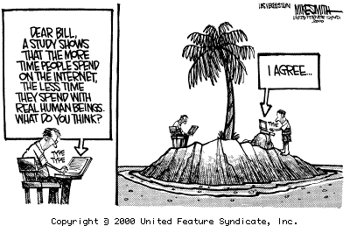
Familiar?

Slide 51
Communication in Summary
Think about your communication/behavioral style
Think about how you apply that style in dealing with others, particularly those with other styles
Remember that communication is more than words
Assume real responsibility for your communication
If you want to get different results, YOU have to do things differently.

Slide 52
Additional Reference Material
Active listening
Giving constructive feedback
Notes:
Do you want to include these next slides on active listening, paraphrasing and giving feedback for reference only and not cover it? It seems like it’s “extra” material, which is how I dealt with it at the Institute.

Slide 53
Three Kinds Of Listening
Half listening
  Paying attention some, focusing on your reaction, waiting to break in, distracted, doodling
Sound listening
  Hearing words not meaning, missing significance of message, responding with logic only
Active listening

Slide 54
Active Listening: What’s Involved
Ignoring distractions
Ignoring delivery quirks
Making eye contact
Being aware of body language
Asking clarifying questions
Recognizing speaker’s intent
Acknowledging emotion involved
Responding appropriately
Remaining engaged

Slide 55
Active Listening: The Bottom Line
Keep an open mind and pay attention
  Focus on speaker’s ideas, not delivery; listen for significance of message; hear before evaluating; control your emotions
Ignore distractions
  Be present; turn phone OFF; close/turn off computer; find the right location for the conversation
PARTICIPATE
  Make eye contact; be aware of your body language; nod; ask questions; acknowledge emotion involved; allow silence; paraphrase; summarize

Slide 56
Constructive Feedback
You are an expert on
  Other people’s behavior
  Your feelings
You are not an expert on
  Your behavior
  Other people’s feelings

Slide 57
Giving Constructive Feedback
1. | “When you . . .” | Start with a “When you...” statement that describes the behavior without judgment, exaggeration, labeling, attribution, or motives. Just state the facts as specifically as possible.
2. | “I feel . . .” | Tell how their behavior affects you. If you need more than a word or two to describe the feeling, it’s probably just some variation of joy, sorrow, anger, concern or fear.
3. | “Because I . . .” | Now say why you are affected that way. Describe the connection between the facts you observed and the feelings they provoke in you.

Slide 58
Giving Constructive Feedback
4. | Pause for discussion | Let the other person respond.
5. | “I would like …” | Describe the change you want the other person to consider…
6. | “Because …” | …and why you think the change will alleviate the problem.
7. | “What do you think? …” | Listen to the other person’s response. Be prepared to discuss options and reach consensus on a solution.
From: Sholtes, Peter R., The Team Handbook, Joiner Associates (1988)

Slide 59
Example: Giving Constructive Feedback
1. | “When you…” | “When you are late for team meetings,
2. | “I feel…” | I get angry...
3. | “Because I…” | ... because I think it is wasting the time of all the other team members and we are never able to get through all of the agenda items.”
4. | (Pause for discussion)
5. | “I would like…” | “I would like you to consider finding some way of planning your schedule that lets you get to these team meetings on time.”
6. | “Because…” | “Because that way we can be more productive at the team meetings and we can all keep to our tight schedules.”
7. | “What do you think?…”

Slide 60
Lunch Break

Slide 61
Behavior Styles: Trust
For this discussion, “trust” means I can rely on you for repeated patterns of expected behavior.
  There is perceived authenticity; you are real, you are genuine.
  There is a perceived pattern in behavior.
  I must believe you CARE.
Notes:
There is a transparency to your actions so your intent is clear and I am confident you will not hurt me. I experience you as an ally, not an adversary. I can accept admonishment, criticism and praise from you because I know you are “for me.”
Things do not happen haphazardly. I can find a pattern where I “predict” what is going to happen next so I don’t get surprised or hurt. It is about adding to a common good that is bigger than an individual or group of individuals. This is perceived integrity.
This third one is critical. The first two could be present, but if this one is missing, I most likely will not be able to trust you. I must know you CARE. It’s my safety net. You could be consistent, authentic and working on a higher order common goal, but if I do not know you care, I always worry. I worry about being used- so I “hear” and respond accordingly.

Slide 62
Behavior Styles: Respect
While trust ties to the chemistry part of a relationship, “respect” ties to the talents and skills a person brings to the relationship.
  It is tied to the fact that you are good at doing something.
  I have a high “regard for” your ability to use your talents and skills.
Notes:
Trust and respect do not happen easily or automatically. Trust and respect are earned over time when you and I work on something together. If we never work on something together, how can I rely on you or have high regard for your skills?

Slide 63
The Trust Continuum
Untrustworthy
Distrust
Skeptical
Maybe
Conditional
Trustworthy
Unconditional
T R U S T

Slide 64
The Respect Continuum
Disrespect
No Respect
Do not Respect
Maybe
Due Respect
Respectful
Admire
R E S P E C T

Slide 65
Trust and Respect
Achievement
Thinking
Activity
(rely on)
Respect
(regard for)
Flight
Fight
Trust
Relationships
Intuition
Acceptance

Slide 66
Impact of Tension on Behavior
How does tension impact our behavior?
Do all styles react the same way?
What happens when we can’t get rid of the tension?

Slide 67
Two Variables
  Two important variables influence what you will do under tension:
CORE | SITUATIONAL
Family of Origin Cultural Norms Personal Belief System World View | What is happening? Who is the person involved? Who else is present or involved? Where is this happening? What is my current energy level?
The Effectiveness Institute, 2009

Slide 68
EXERCISE:
Situational Responses
WITHDRAW
TAKE CONTROL
VERBAL ATTACK
ACQUIESCE
3
2
1
4

Slide 69
Tension – Reaction Behavior
A | Nitpick Leave Prove they are “right” Pull away Withhold emotions | Explode Blame Dictate Take over Suppress emotions | C
S | Wait too long to act Tell others Avoid Give in & get even Worry emotionally | Verbal attack Talk about everything Cry “Dump” it & forget it Overreact emotionally | P

Slide 70
Initial Reactions to Tension & Stress
Controlled
WITHDRAW
TAKE CONTROL
Emotions
Process
Results
Results
Expedient
Emotions
ACQUIESCE
ATTACK
(VERBALLY)
Responsive
Notes:
***Mention that their materials say controllers “dictate” to emphasize that the research and models are ever-changing

Slide 71
Continual Need Deprivation
Take Control
Withdraw
A Integrity | Take Control |  | Withdraw | C Respect
Acquiesce | Attack |  | Acquiesce | Attack
Withdraw | Take Control |  | Withdraw | Take Control
S Loyalty | Attack |  | Acquiesce | P Trust
Acquiesce
Attack

Slide 72
Personal Values
Accomplishment - measurable achievement, fame, career | Independence - self-reliance, self-sufficiency
Competition - winning, being #1 | Leadership - exercising influence over others
Cooperation - helpfulness, being involved in team activities | Loyalty - sense of duty
Courage - standing up for your beliefs | Money - having it, financial security
Creativity - using imagination, being innovative | Recognition - respect, admiration from others
Equality - equal opportunity for all | Responsibility - feeling that others can depend on you
Excitement - adventure, challenge | Self Confidence - self-esteem, faith in your talents
Honesty - sincere, truthful, integrity | Stability - order, tranquility

Slide 73
Exercise: The Impact of Values
From the list, choose the top five values of greatest importance to you.
Choose the five values that are least important to you.
In small groups, discuss your results and compare them with others

Slide 74
Style Flex
Flexibility:
The ability to meet another person’s style needs & satisfy personal style needs as well.
Being flexible means to:
Situationally, purposefully & temporarily modify behavior on one or both dimensions.

Slide 75
Goals of Style Flex
Understand how your preferred style of working comes across to other people
“Read” other people’s behavior so you’ll know the best way to work with them
Find common ground with people while maintaining your individuality and integrity
Adjust your behavior in small ways that dramatically improve results among different styles
Relate effectively—no matter how others react to you
From: People Styles at Work: Making Bad Relationships Good and Good
Relationships Better. Robert Bolton and Dorothy Grover Bolton.

Slide 76
Why Increase Flexibility?
You want to understand how others see you.
You value being more effective with others.
You are willing to obtain more realistic picture of your impact.
You pay attention – you are aware and pick up clues.
You allow adequate time to learn how to adjust.

Slide 77
STAGES of learning
Integration
Skill
Awkwardness
Practice
Choice
Awareness

Slide 78
When and How Do We Learn?
The Zones of Comfort
Where Learning Occurs
Desired State
Comfort
Discomfort
Fear
Current State

Slide 79
Food for Thought
Watch your words; they become actions.
Watch your actions; they become habits.
Watch your habits; they become character.
Watch your character; it becomes your destiny.
        Frank Outlaw

Slide 80
Suggested Reading: Behavior Styles
People Styles at Work: Making Bad Relationships Good and Good Relationships Better, Robert Bolton and Dorothy Grover Bolton
Social Style/Management Style: Developing Productive Work Relationships, Robert Bolton and Dorothy Grover Bolton
Personal Styles & Effective Performance
Make Your Style Work for You, David W. Merrill, Ph.D., Roger H. Reid, M.A.
How to Speak and Listen Effectively, Harvey A. Robbins

Slide 81
Short Break

Slide 82
Balanced Leadership:
The Role of
Emotional Intelligence

Slide 83
Emotional Intelligence
Session purpose
Introduction to emotional intelligence (EI) concepts
Identify components of EI
Understand applicability to work life and leadership

Slide 84
Making the Case for
Emotional Intelligence
IQ vs. EQ
What is IQ?
What is EQ?

Slide 85
I.Q. (Intelligence Quotient)
A number that shows the rating of a person's intelligence. It is found by dividing the mental age, as shown in tests, by the actual age (16 is the largest age used) and multiplying it by 100.
INTELLIGENCE TEST
Any test used to measure mental development.
Most intelligence tests include tasks involving memory, reasoning, definitions, numerical ability, and recalling facts.

Slide 86

Descriptions
Cognitive capacities; technical expertise; educated; know-how; intellect; smarts; skills; book-learning.
IQ (the quotient component) tends not to change much past our teen years.
Why?

Slide 87
What Then Is EI?
E. I. (as defined by World Book): the ability to understand oneself and to empathize with others.
Ex. The phrase "emotional intelligence" was coined ... to describe qualities like understanding one's own feelings ... and "the regulation of emotion in a way that enhances living." (Time)

Slide 88
Another View
Per Daniel Goleman…
EI refers to the capacity for recognizing our own feelings and those of others, for motivating ourselves and for managing emotions well in ourselves and in our relationships.
and
EI is the “ability to motivate oneself and persist in the face of frustrations, to control and delay gratification,
to regulate one’s moods, to empathize and to hope.”
(Emotional Intelligence, 1995, p. 34)

Slide 89
Descriptions
Character; personality; soft skills; socially capable; self-confident; good communicator.
“IQ gets you the interview.
EQ gets you the job.”
Misconceptions: EI does not merely mean “being nice.” Nor does it mean allowing free rein to your feelings or “letting it all hang out.”

Slide 90
Two Different Kinds of Intelligence
Intellectual
and
Emotional

Slide 91
Research Findings
Neuroscience Research
Finding that intellect is based solely on the workings of the neo-cortex (the rational brain), the more recently evolved layers at the top of the brain.
Emotional centers – lower in the brain, closer to the brainstem, in the more ancient sub-cortex or limbic system (the emotional brain).
These two different parts of the brain learn differently.
Emotional centers result in skills grounded in our evolutionary heritage for survival and adaptation.

Slide 92
Gender Differences?
Women tend to be more aware of their emotions, show more empathy and are adept interpersonally.
Men tend to be more self-confident and optimistic, adapt more easily, and handle stress better.
However, on the whole,
men and women are generally equal
in total emotional intelligence.

Slide 93
Further Research
Work focused around the nature and types of emotional competencies have evolved current thinking around expanding the personal and social nature of emotional intelligence.
Emotional intelligence can be learned and is enhanced with experiences and maturing.

Slide 94
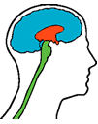
The Three Layers of the Brain
The Layers:
Rational Brain (thinking)
cortex and neo-cortex
analytical & technical ability
Emotional Brain (feeling)
limbic system
feelings, impulses, drives
First Brain
brainstem

Slide 95
The Three Layers of the Brain
The Layers:
Rational Brain (thinking)
cortex and neo-cortex
analytical & technical ability
Emotional Brain (feeling)
limbic system
feelings, impulses, drives
First Brain
brainstem
How Each Layer Learns:
Rational Brain (reading, studying)
  grasps concepts quickly
  associations, comprehension
Emotional Brain (experiencing)
  motivation, extended practice,
  feedback, repetition (breaking a habit)

Slide 96
Survey of Job Descriptions
Position
Clerical
Supervisory
Managerial
President
IQ EQ

Slide 97
Survey of Job Descriptions
Position*
Clerical
Supervisory
Managerial
President
IQ EQ
80% 20%
60% 40%
40% 60%
20% 80%
*IQ requirements increased for positions higher in the organizational structure.

Slide 98
Survey of Attendees’ Responses to Question of “Job Challenges”
IQ IQ/EQ EQ
IQ – Need cognitive skills or competencies to address challenge.
EQ – Need emotional skills or competencies to address challenge.

Slide 99
Survey of Attendees’ Responses to Question of “Job Challenges”
IQ IQ/EQ EQ
53 28 53
IQ – Need cognitive skills or competencies to address challenge.
EQ – Need emotional skills or competencies to address challenge.

Slide 100
The Case for Emotional Intelligence
US Air Force Recruiter Selection
  Most successful recruiters scored significantly higher in EI competencies
  Using EI to select recruiters increased USAF ability to predict successful recruiters by nearly three-fold
  Immediate gain was a savings of $3 million annually.

Slide 101
The Case for Emotional Intelligence
L’Oreal sales agents selected on the basis of EI competencies
  Significantly outsold sales people selected using old procedures.
  Sold $91,370 more than other agents for a net revenue increase of over $2.5 million.
  Had 63% less turnover during their first year.

Slide 102
The Case for Emotional Intelligence
After supervisors in a manufacturing plant received EI training…
  Lost time accidents were reduced by 50%
  Formal grievances were reduced from an average of 15 per year to 3 per year
  The plant exceeded productivity goals by $250,000

Slide 103
The Emotional Competence Framework
Personal Competence
Social Competence

Slide 104
The Components of EI
(Per Daniel Goleman*)
Personal Competence
These competencies determine
how we manage ourselves.
Social Competence
These competencies determine
how we handle relationships.
*(from Working with Emotional Intelligence)

Slide 105
Emotional Intelligence Model
Self awareness
Self management
Emotional awareness
Accurate self-assessment
Self-confidence
Self-control
Trustworthiness Conscientiousness
Adaptability
Achievement drive
Commitment
Initiative
Optimism
SELF
Social awareness
Relationship management
Empathy
Understanding others
Service orientation *
Leveraging diversity
Political awareness
Developing others
Influence
Communication
Conflict management
Leadership
Change catalyst
Building bonds
OTHERS
UNDERSTANDING
APPLYING

Slide 106
Individual Engagement Model
Authentic
leadership
Interpersonal
Connection
coaching
engagement
Self management
Self-awareness

Slide 107
Personal Competence
Self-awareness
Knowing one’s internal states, preferences,
resources and intuitions.
Emotional Awareness
Accurate Self-assessment
Self-confidence

Slide 108
Personal Competence
Self-Management
Self-regulation | Motivation
Managing one’s internal states, preferences and resources. | Emotional tendencies that guide or facilitate reaching goals
Self-control Trustworthiness Conscientiousness Adaptability Innovation | Achievement Drive Commitment Initiative Optimism

Slide 109
Individual Engagement Model
Authentic
leadership
Interpersonal
Connection
coaching
engagement
Self management
Self-awareness

Slide 110
Social Competence
Empathy
Awareness of others’ feelings, needs and concerns.
Understanding Others
Developing Others
Service Orientation
Leveraging Diversity
Political Awareness

Slide 111
Social Competence
Social Skills
Adeptness at inducing desirable results from others.
Influence
Communication
Conflict Management
Leadership
Change Catalyst
Building Bonds

Slide 112
Assessing Individual Competencies
Emotional Competency Evaluations
Give a more detailed description and provide deeper understanding of the specific competencies.
Most use Goleman’s model of competencies and framework.
http://www.eiconsortium.org/

Slide 113
Four Domains of Emotional Intelligence
Personal
Competencies
Self Awareness
Self Management
Social Awareness
Social
Competencies
Relationship Management

Slide 114
Video
Pride and Prejudice

Slide 115
Four Domains of Emotional Intelligence
Personal
Competencies
Self Awareness
Self Management
Social Awareness
Social
Competencies
Relationship Management

Slide 116
POWER BASE
PERSONAL vs. POSITIONAL

Slide 117
Four Domains of Emotional Intelligence
POWER BASE
POSITIONAL
PERSONAL
Personal
Competencies
Self Awareness
Self Management
Social Awareness
Social
Competencies
Relationship Management
Notes:
Types of Power:
Referent power - is based upon the identification with the person who has the resources, or the desire to be like that person. It could be regarded as imitative power, which is often seen in the way children imitate their parents.
Legitimate power - is based on agreement on commonly held values which allow one person to have power over another person, for example an older person or one who has longer service or is seen to be charismatic.
Expert power - is based upon one person perceiving that the other person has expert knowledge of a given subject and is a recognised authority in a given situation eg. the engineer in a building project.
Coercive power - this enables a person to mediate punishments for others. For example, to dissmiss, suspend, reprimand them, or make them carry out unpleasant tasks.
Reward Punishment Power- when a person has the ability to issue rewards and punishments and issues one or the other or both, eg. promotions, recommendations, praise or answers to questions.
Information Power- when an individual has information that the others cannot easily access

Slide 118
The Good and The Bad Exercise

Slide 119
Great Leaders Move Us
Through our emotions –
which are contagious.

Slide 120
Exercise
Think of a leader for whom or with whom you worked -- one that you would gladly work with or for again.
Think of a person in a leadership position that you try to avoid, or left you drained, or hoping for more.
How did each of these people behave? How did they relate to others?

Slide 121
The Good - Descriptions
Good Retail Experience
Friendly Approachable Good Listener Caring Knowledgeable Took Time Reflective Concerned Responsive | Above & Beyond Self Confident Took Ownership Cheerful Helpful Insightful Accommodating Personable
Good Boss
Visionary Humorous Kind Appreciative Good communicator Clear, precise (communication) Hard worker Empathetic | Good team builder Positive Ethical Results-oriented (vs. process)

Slide 122
The Bad - Descriptions
Bad Retail Experience
Rude Headstrong Insensitive Closed Unhelpful Unprofessional Unconcerned Untrained | Incompetent Unethical Lazy / Bored Blame others Smarmy Arrogant Condescending Non-responsive
Bad Boss
Disrespectful Belligerent Demeaning Moody Negative Unethical Incompetent Discouraging | Self-absorbed Inconsistent direction Vindictive Ego-maniac Prideful Manipulative Paranoid

Slide 123
The Good - Feelings
Good Retail Experience
Satisfied You were important Valued Customer for life Relieved Pleasant Open Grateful | Impressed Worthy Validated Happy Equal Encouraged Hopeful Special
Good Boss
Empowered Enthusiastic Valued Energized Hopeful Confident Safe Relaxed Mutual admiration Respected Motivated to excel

Slide 124
The Bad - Feelings
Bad Retail Experience
Angry Ignored Devalued Unimportant Vengeful Helpless Unsatisfied Disrespected Unsafe / Vulnerable Used & Abused | Frustrated Victimized Disappointed Discontent Stressed Distressed In shock Disbelief Drained Hopeless
Bad Boss
Little, small, demeaned Hopeless Stupid Drained Very Stressed Angry Fearful Depressed | Unappreciated Incompetent Rebellious Withdrawn Uncooperative Unproductive Eager to sabotage

Slide 125
Emotionally Intelligent Leaders Flex Their Leadership Style
Leadership Style Summary Phrase
Coercive “Do what I tell you.”
Authoritative “Come with me.”
Affiliative “People come first.”
Democratic “What do you think?”
Pacesetting “Do as I do, now.”
Coaching “Try this.”
Source: Goleman, D. (2000) “Leadership that Gets Results.”

Slide 126
Developing Your
Emotional Intelligence
Acting with Integrity
Difficult choices occur
Align choices with core values
Negative impact from being “out of alignment”

Slide 127
Understanding the Applicability of EI
Gifted individuals who are exceptionally bright can also be remarkably ineffective and unproductive.
Consider your own area of expertise:
Which components are intellectual and which are emotional? (Banking, Public Administration, Education, Service Providers, Engineering, Community Development, etc.)
Behaviors are learned and can be “unlearned.”

Slide 128
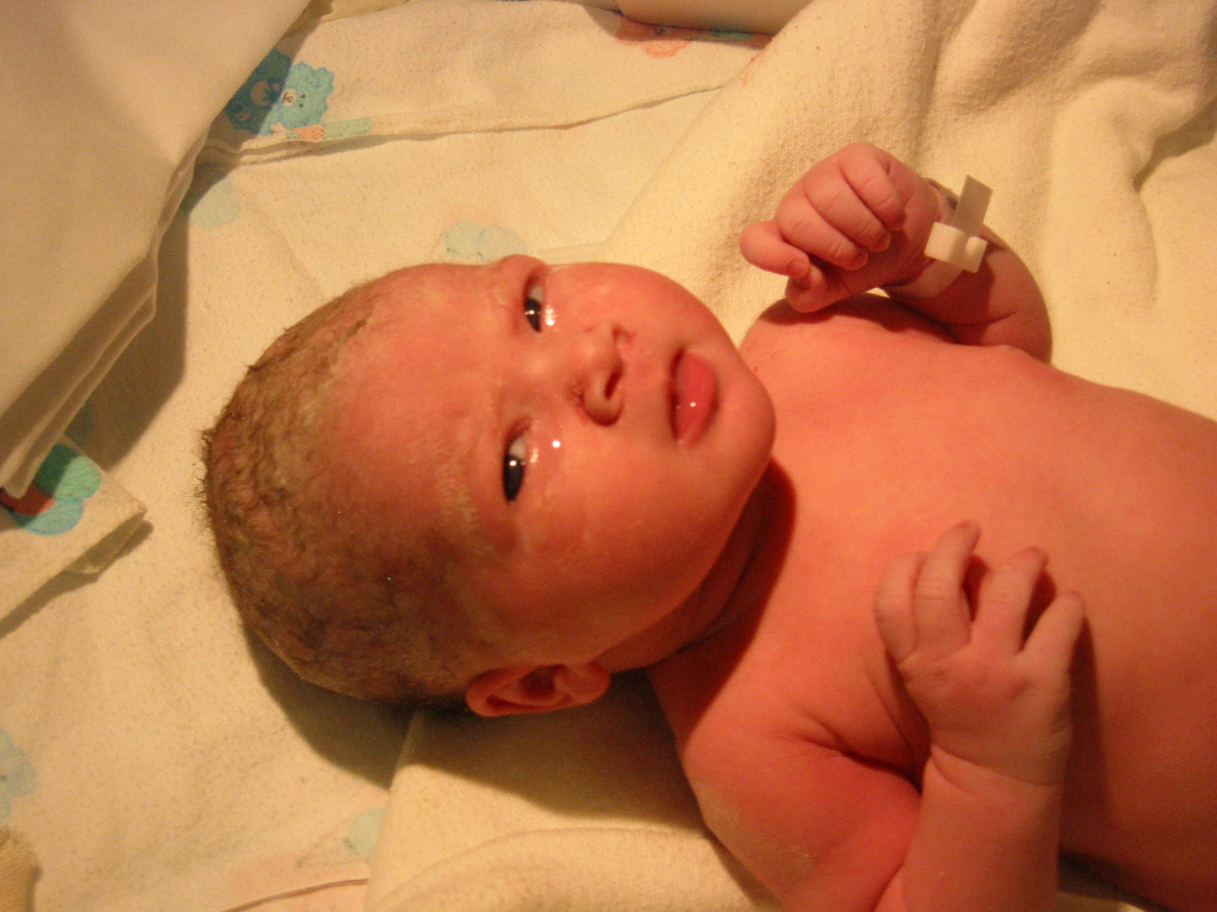
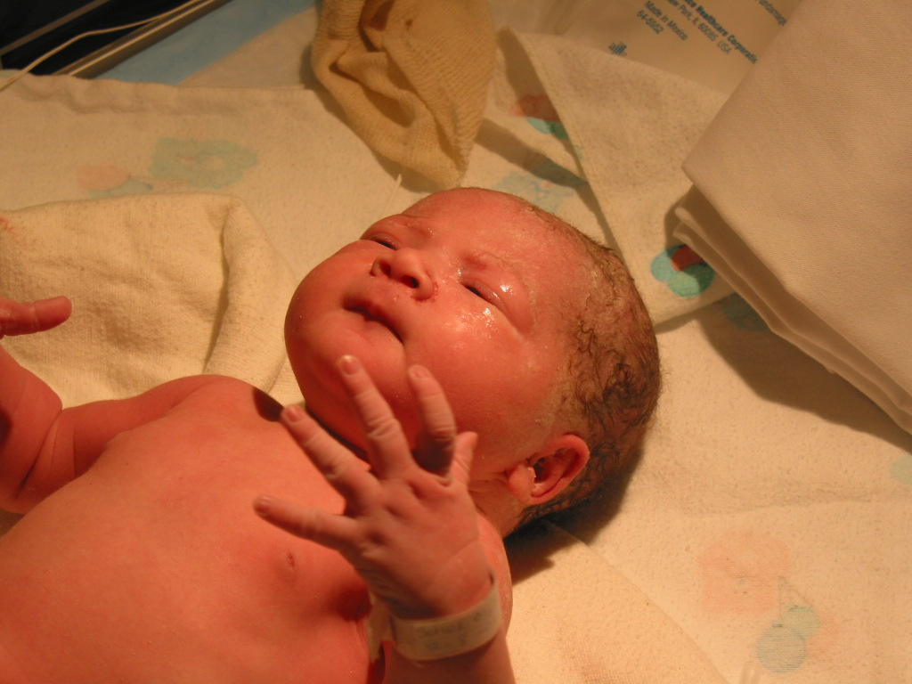
How About Some More EI Stuff?
Peace
Rage

Slide 129
Some More About the Brain…
The brain works on repeated patterns
  MRI tests on memory
    Lions and tigers and bears, and tools
  Random number tables
  Black box of knowledge

Slide 130
Who Sets Our Tone?
Prefrontal Lobes
  The executive center
    Positive or negative

Slide 131
We Do Have Choices,
But it Certainly Takes Some Work.
Peace
Rage

Slide 132

Effective Leadership:
Learning Moments

Slide 133
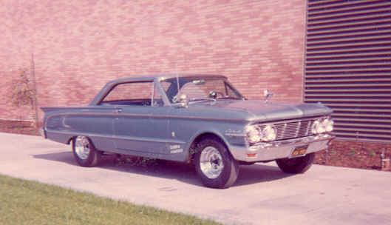
Effective Leadership:
Learning Moments
MORE
1963 Mercury Comet

Slide 134

The Experience

Slide 135
Discussion
How can we strengthen competencies that are currently less-developed?
How does this information shape the way we guide and interact with others?
How does our understanding of behavior styles impact our EI?
How can we use this information to be better leaders?

Slide 136
Intelligence
Intellectual
Emotional

Slide 137
Suggested Readings: Emotional Intelligence
Working with Emotional Intelligence, Daniel Goleman
Primal Leadership, Daniel Goleman, Richard Boyatzis, and Annie McKee
The Manager’s Pocket Guide to Emotional Intelligence, Emily A. Sterrett

Slide 138
More Suggested Reading
Leading Resonant Teams, Daniel Goleman. www.leadertoleader.org.
The Journey to Authenticity, Bill George. www.leadertoleader.org.
Leadership that Gets Results, Goleman, D. Harvard Business Review, March-April 2000,
82-83.
Notes:
I added this slide because this is one of my favorite sites – a compilation of wonderful articles. These two seem to summarize what’s in this presentation and follow on the great leader topic.

Slide 139
Balanced Leadership:
The Role of Behavior Styles and Emotional Intelligence
Thank You!

