Slide 1


Slide 2
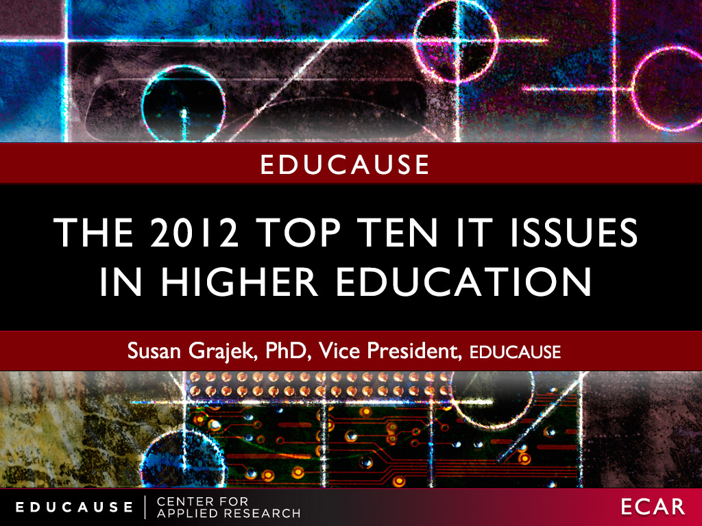

Slide 3
methodology
A representative research panel of 19 higher education IT leaders meets quarterly
The question:
“What is the single-biggest IT-related issue currently facing your institution?”
Notes:
The EDUCAUSE annual publication of top IT issues has long resonated as a yearly snapshot of the most pressing issues for IT leaders in higher education. In 2000, EDUCAUSE changed the method by which the issues were selected and ranked, instituting a member survey. For twelve years, members were asked to select the five most-important IT issues out of a selection of about thirty in each of four areas: (1) issues that are critical for strategic success; (2) issues that are expected to increase in significance; (3) issues that demand the greatest amount of the campus IT leader’s time; and (4) issues that require the largest expenditures of human and fiscal resources.
To echo the 2000 article that inaugurated the new survey methodology, this year we “put a new spin on this tradition”—in response to perceptions that the top issues were at risk of becoming a stale recycling of the same fifteen or so issues (many of the thirty choices never made the cut). In 2011, EDUCAUSE appointed a research panel of IT leaders from nineteen representative member institutions to both identify and prioritize the top IT issues facing their institutions. In two focus group sessions in September and October 2011, the panel members were asked the question: “What is the single-biggest IT-related issue currently facing your institution?” In an online survey in December 2011, panel members were asked to select the top IT issues for 2012 from the results of those focus groups and were invited to provide additional suggestions. Finally, the IT Issues Panel met in January 2012 to review the survey results and write-ins before voting on the final set of issues.
The EDUCAUSE IT Issues Panel (http://www.educause.edu/ITIssues) includes individuals from EDUCAUSE member institutions to provide quick feedback to EDUCAUSE on current issues, problems, and proposals across higher education information technology. Panel members, who are recruited from a randomly drawn and statistically valid sample to represent the EDUCAUSE membership, serve for one year, with staggered terms. Panel members meet quarterly for 90 minutes via webinar or in person. The meetings, facilitated by EDUCAUSE Vice President Susan Grajek, are designed to stimulate an ongoing dialogue to flesh out and refine an array of open-ended technology questions about the IT organization, the institution, and cross-institution boundaries. The members discuss, refine, and vote on the most relevant underlying issues or options. Grajek explains: “There is a richness behind the process that is a little different from giving people a list of topics to vote on. We introduce open-ended questions and let the members bat ideas back and forth. Sometimes there is debate, and then it transitions to refining and defining the issue and what it really means. As facilitators, we summarize what we heard and reflect it back to the panel members. We often get it right, but sometimes we don’t: panel members correct us until we arrive at a final list of issues for the panel to vote on. Our process enables the panel to move from a very open-ended question to a set of bulleted answers, adding some depth in quite a short period of time.”

Slide 4

Notes:
Establishing an IT governance process is possibly the single most-effective step toward effective IT leadership because it will provide a framework for defining decision rights around IT priorities and resource allocation.
Good IT governance is especially imperative because digital technologies are embedded within nearly every operational process on college and university campuses. The expense and strategic value of technology investments, as well as the complexity of IT decisions, warrant an IT governance framework that can ensure coordinated decisions regarding the acquisition of technology devices, software, and standards. IT governance can guide coordinated purchasing, implementation, and support decisions to improve the user experience and can help execute technology standards where appropriate and customize where necessary.

Slide 5
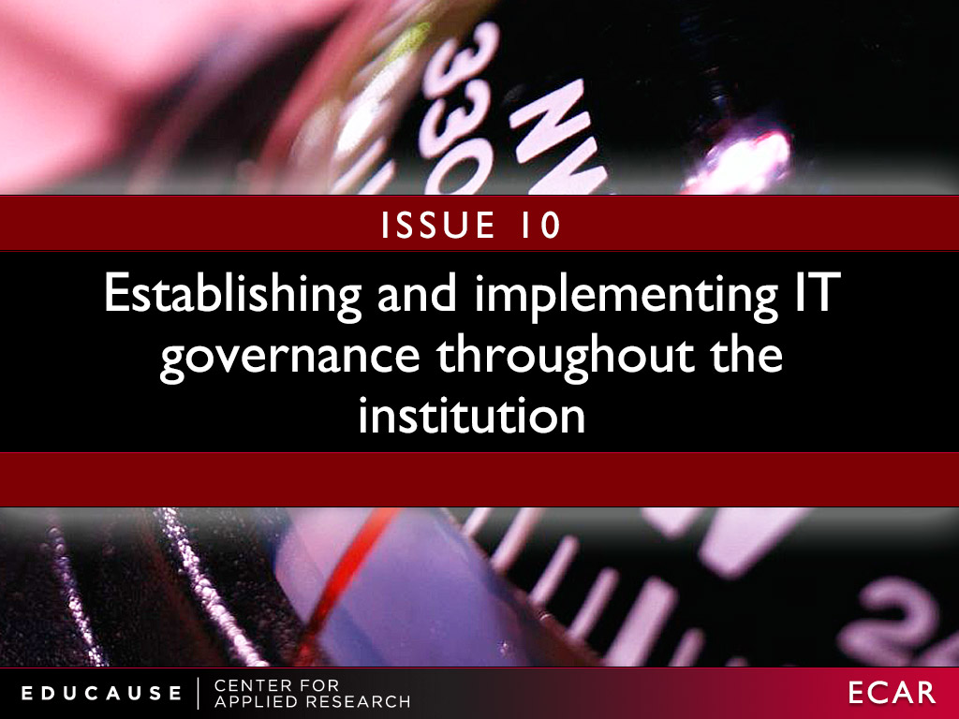

Slide 6
IT Governance: What we know
Notes:
Are the institution’s IT governance principles and structure widely understood?
Is the institution’s IT governance deemed effective? If not, how can IT leaders improve it?
What is the IT governance’s institutional realm of influence?
How does the institution’s IT governance structure adapt to new circumstances and issues such as the decentralization of information technology, new technologies, outsourcing, and cloud-based services?

Slide 7
IT Governance: What we know
Notes:
Are the institution’s IT governance principles and structure widely understood?
Is the institution’s IT governance deemed effective? If not, how can IT leaders improve it?
What is the IT governance’s institutional realm of influence?
How does the institution’s IT governance structure adapt to new circumstances and issues such as the decentralization of information technology, new technologies, outsourcing, and cloud-based services?

Slide 8
Establishing and implementing IT governance throughout the institution
Strategic questions IT is asking
Are IT governance principles and structure widely understood?
Is IT governance effective?
What is the realm of influence?
How does the governance structure adapt?
“Once a structure and process—a framework—is established, the institution can focus on the quality of decisions that flow from it. A good framework will result in decisions that are well understood and widely accepted.”
—CIO and Vice President for Computing
Notes:
Are the institution’s IT governance principles and structure widely understood?
Is the institution’s IT governance deemed effective? If not, how can IT leaders improve it?
What is the IT governance’s institutional realm of influence?
How does the institution’s IT governance structure adapt to new circumstances and issues such as the decentralization of information technology, new technologies, outsourcing, and cloud-based services?

Slide 9

Notes:
Ensuring adequate infrastructure for researchers is challenging higher education institutions, in terms of both physical and human resources, at a pace unseen before. The amount of information being generated continues to grow at an incredible rate, in both big and small science. Network, storage, analytical, and visualization tools need to be implemented, supported, and grown at an unprecedented pace

Slide 10
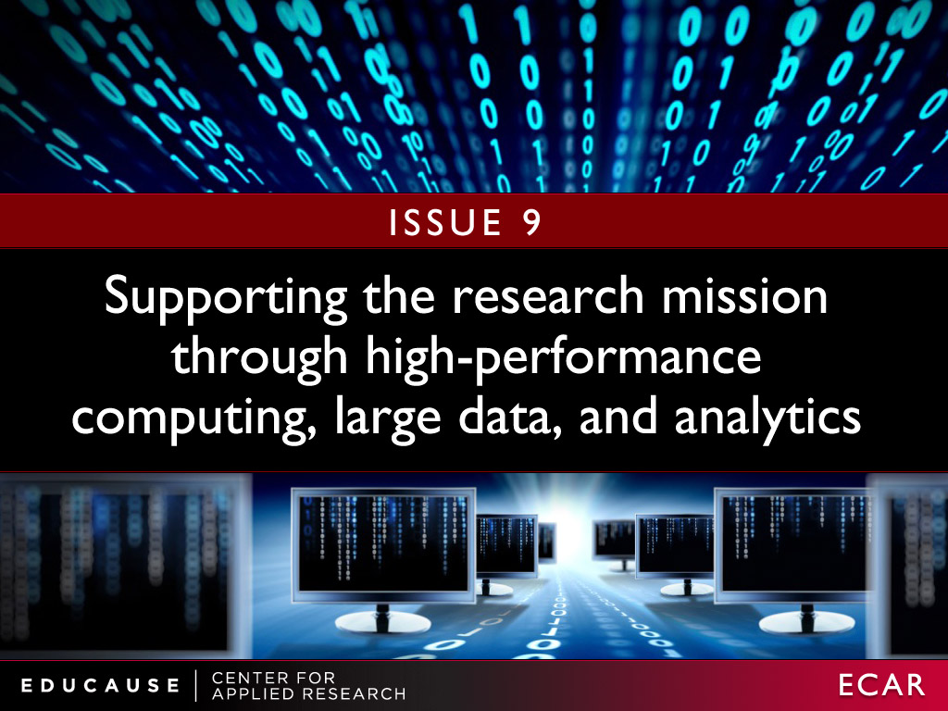

Slide 11
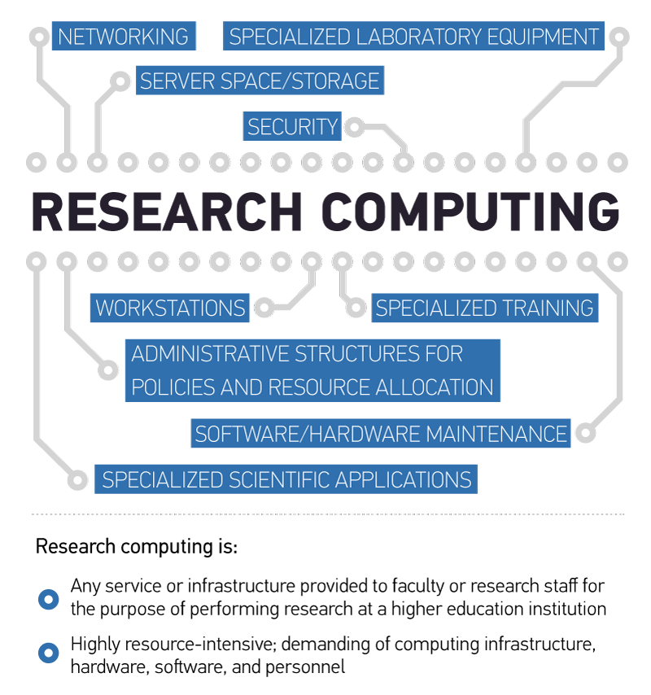
Research computing: What we know
Notes:
Research computing: What we know

Slide 12
Research computing: What we know
All US colleges and universities
Central IT support
Collaborative/team-based science approach
Data management
Planning
Central IT staffing
Funding model
Notes:
Research computing: What we know

Slide 13
Research computing: What we know
Public doctoral universities
Central IT support
Collaborative/team-based science approach
Data management
Planning
Central IT staffing
Funding model
Notes:
Research computing: What we know

Slide 14
Research computing: What we know
Private doctoral universities
Central IT support
Collaborative/team-based science approach
Data management
Planning
Central IT staffing
Funding model
Notes:
Research computing: What we know

Slide 15
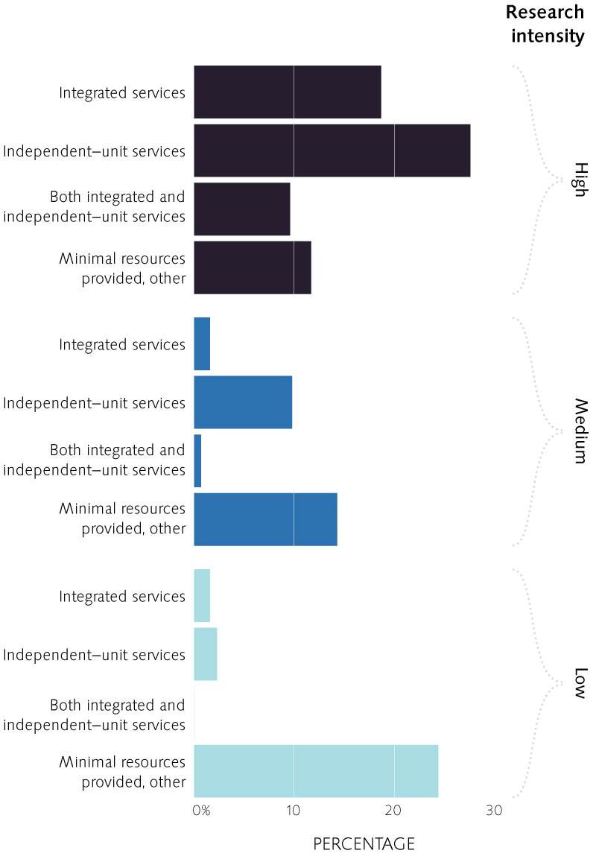
Research computing: What we know
Research Intensity
IPEDS research expenses controlling for institutional size:
Low: $0/student FTE
Medium: <$440/student FTE
High: >$439/student FTE

Slide 16
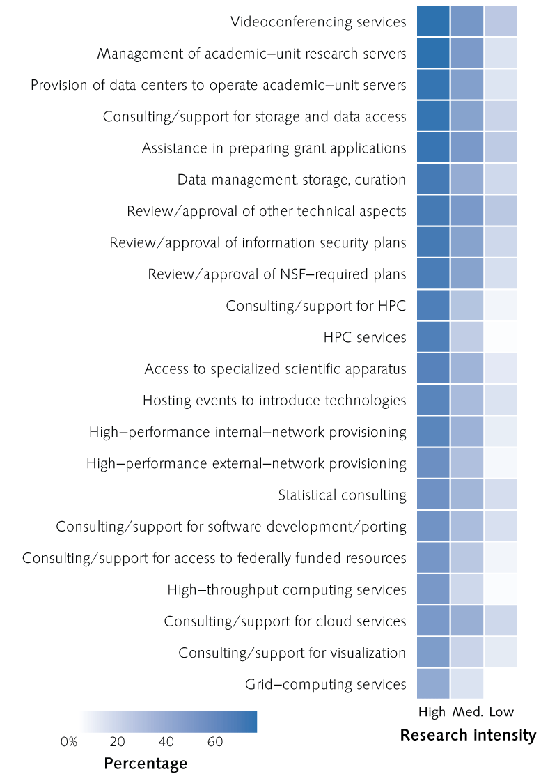
Research computing: What we know

Slide 17
Supporting the research mission through high-performance computing, large data, and analytics
Strategic questions IT is asking
What is the funding strategy?
What is the balance between the central and decentralized IT?
What are the service implications for central IT?
What are the opportunities for cross-institutional collaborations?
“Capturing economies of scale through collaboration is the only way information technology is going to provide the infrastructure needed to stay competitive and support the next generation of discovery and innovation.”
—CIO and Associate Vice Principal, Information Technology
Notes:
What is the institution’s strategy for funding IT research infrastructure?
What is the balance between the central IT organization and decentralized IT support for the institution’s research mission?
What are the infrastructure, application, support, and staffing (levels and specialized roles) implications for central IT in supporting research?
What are the opportunities for cross-institutional collaborations? How do IT leaders evaluate the worth and risks of such collaborations? How do they foster participation and buy-in?

Slide 18

Notes:
Many institutions have already used information technology to achieve efficiencies. But “transformation” is a word du jour. Information technology allied with process reengineering and continuous improvement is the pathway to transformation. All aspects of higher education are being transformed, including teaching and learning, scholarship, research, institutional advancement, admissions, and administrative services. Information technology is never sufficient, but is almost always necessary, for those transformations to have both efficient and effective outcomes.

Slide 19
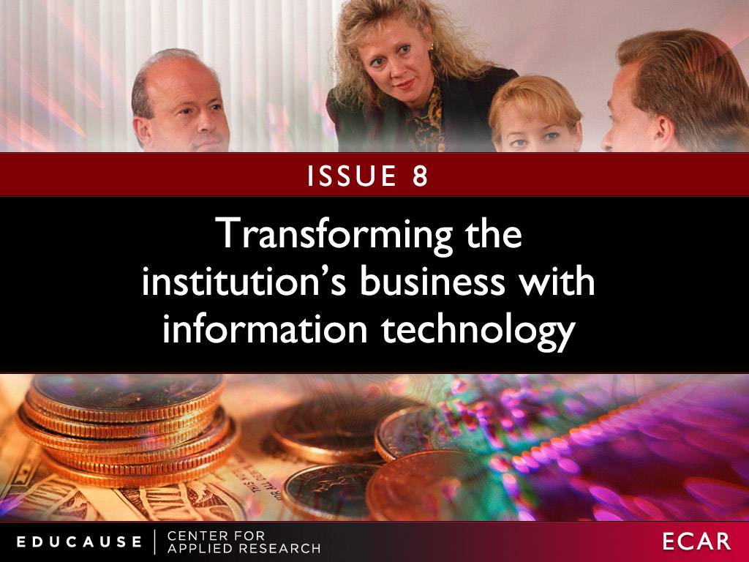

Slide 20
Transforming the institution’s business with technology
Strategic questions IT is asking
Does the institution’s strategic plan include transformative objectives?
Is IT a trusted partner?
How to experiment without undue risk?
Are the right capabilities in place?
“The shift to digital course content is upon us as the rise of remarkable
consumer devices, interactive content, new software platforms, and new economics
pave the way.”
—Vice President for Information Technology and CIO
Notes:
Does the institution’s strategic plan include transformative objectives?
Is the IT organization viewed as a trusted partner in institutional transformation?
How can the institution support experimentation with technology to transform teaching and learning without unduly risking students’ learning outcomes?
Are the process reengineering and continuous improvement capabilities in place to enable transformative information technology?

Slide 21
WHAT IS IT’s Role in transformation?
Drive transformation
Responder: Help departments deploy mature technologies.
Navigator: Determine which technologies will be strategically important.
Scholar: Investigate emerging technologies.
Enable transformation
Counselor: Champion and recommend innovations.
Conductor: Coordinate and leverage distributed activities that are happening elsewhere.
Pollinator: Encourage and mentor distributed innovation.
Source: Gartner
Six Styles of Technology Innovation Groups
Published: 23 April 2012 ID:G00230292
Analyst(s): Jackie Fenn
Notes:
Responder: Determine that a technology is mature enough and help departments deploy it effectively.
Navigator: Determine which technologies will be strategically important. Use tracking, evaluation, and pilots.
Scholar: Investigate emerging technologies. Stay ahead of the institution.
Counselor: Champion and recommend innovations.
Conductor: Coordinate and leverage emerging technology activities that are happening elsewhere.
Pollinator: Encourage and mentor innovation happening elsewhere.
Source: Gartner. Six Styles of Technology Innovation Groups
Published: 23 April 2012 ID:G00230292
Analyst(s): Jackie Fenn

Slide 22

Notes:
It’s very important that IT funding is not viewed as unrelated to decision-making about other academic and operational funding. Information technology serves the mission of the institution; strategic decisions about funding can be made only when the relationship between technology and that mission is clear. The IT organization needs to engage its institutional colleagues in the processes of setting funding priorities and building their ownership in the decisions. As IT resources are becoming more decentralized—putting resources where they are needed—the IT funding big picture becomes more difficult to see clearly.

Slide 23
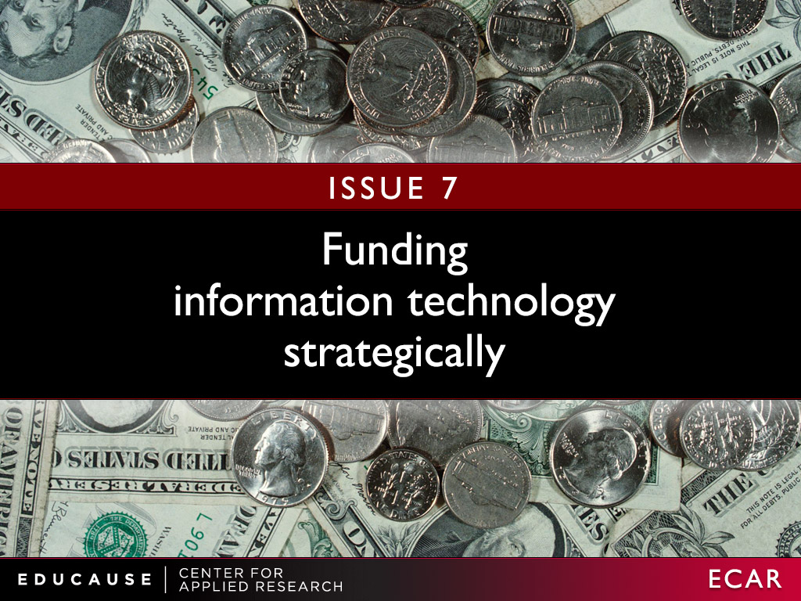

Slide 24
Funding information technology strategically
Strategic questions IT is asking
How to verify efficient use of current resource levels?
How to obtain an institution-wide view of IT spending?
How to integrate IT funding into programs and initiatives?
“We can make [institutional colleagues] partners, or we can make them critics—collaborators or victims .”
—Associate Vice Chancellor, Information Resources
Notes:
How can IT leaders verify they are doing the very best with available IT resources?
How can IT leaders create an institution-wide view of IT funding and expenditures? What relationships and partnerships will they need to cultivate? What business processes might need to be changed?
How can IT leaders interweave an IT funding component into broader, institutional initiatives to ensure IT is appropriately funded to deliver what is needed?

Slide 25
Models for measuring IT costs
Total IT costs
  Central IT + Distributed IT
  Cost/FTE (students, faculty, staff)
  As a percent of institutional budget
Cost/service
Cost/mission (teaching, research, administration, community service)
Proportion of IT budget dedicated to run vs. grow vs. transform activities
Value: TCO, ROI, NPV
Notes:
Distributed vs central IT. Varies greatly from instituiton to institution, range is about 50-50 to 100 (all central)
Run—optimize the execution of activities and processes already in place. Seek organizational growth through offering products and services faster and cheaper than the competition.
Grow—increase market reach, product and service offerings, expand market share, and so on. Seek organizational growth by taking market share from the competition (i.e., get a bigger piece of the pie).
Transform—innovate business processes and/or products and services in a completely new way, move into seemingly different markets, and so on. Seek organizational growth through new and different means.
As you can see, the RGT framework is similar in many ways to both Porter’s three generic strategies and a top-line versus bottom-line approach as follows:
Run overall cost leadership bottom line
Grow focus and differentiation top line
Transform (new) differentiation top line (when the focus is innovation)
Gartner
Run the business: This is an indicator of how much of the IT resource is consumed and focused on the continuing operation of the business. It includes all nondiscretionary expenses as part of the run-the-business cost. Examples include capital expenses for replacement of laptops at the end of their useful life, operating expenses for software maintenance contracts, operating expenses help desk outsourcing, infrastructure utility computing for human resources applications and software maintenance for regulatory software.
Grow the business: This is an indicator of how much of the IT resource is consumed and focused on developing and enhancing IT systems in support of business growth (typically organic growth). Discretionary investments are more likely to be included in the grow-the-business or transform-the-business cost. Examples include ERP upgrade project capital expenses to expand the capacity to include organic growth in software users, bandwidth capacity expansion project capital expenses to accommodate an organic forecast increase in customers using existing Internet applications, or software license upgrade for engineering software.
Transform the business: This is an indicator of how much of the IT resource is consumed and focused on implementing technology systems that enable the enterprise to enact new business models. This is very much a venture category, and would be represented by activities such as a brick-and-mortar retailer moving to online shopping, a traditional bank offering online banking (or moving into offering insurance services) or a commercial airline offering new freight services.

Slide 26
IT spending per FTE
(student/faculty/staff)
2011 CDS – M1Q28– q124
2011 IPEDS FTES
Notes:
From 2010 data, we see roughly the same model as the 2011 data. The spending per student FTE is not different across Carnegie classes, but is estimated at more like 356$ per FTE. The margin of error on that estimate is 226$, so not altogether too different from the 2011 estimate of 630$.The research expenditures (captured as percent of institutional expenditures) were *not* significant in the 2010 data after accounting for Carnegie class.
What’s consistent here is that the central IT spending per student FTE does not vary by Carnegie class after accounting for employee FTE and research expenditures (whether or not they’re significant). Same caveat applies as before about not incorporating information about distributed IT spending.

Slide 27
IT spending per FTE
(student/faculty/staff)
But wait…spending per fte is more complex than this…
2011 CDS – M1Q28– q124
2011 IPEDS FTES
Notes:
From 2010 data, we see roughly the same model as the 2011 data. The spending per student FTE is not different across Carnegie classes, but is estimated at more like 356$ per FTE. The margin of error on that estimate is 226$, so not altogether too different from the 2011 estimate of 630$.The research expenditures (captured as percent of institutional expenditures) were *not* significant in the 2010 data after accounting for Carnegie class.
What’s consistent here is that the central IT spending per student FTE does not vary by Carnegie class after accounting for employee FTE and research expenditures (whether or not they’re significant). Same caveat applies as before about not incorporating information about distributed IT spending.

Slide 28
Most of the variability in IT spending is “explained” by institutional size
Starting at about 800 FTEs and $250K, spending increases by about $645/FTE
This model explains 74% of the variability
Notes:
The story is that the slope of the line shows spending per total FTE. The slope is essentially the same for AAs and everyone except BA LA and DR Private.
***This is naïve because it assumes that IT spending is primarily driven by number of students only AND that if you had 0 students, you’d have 0 costs. In other words, it doesn’t include any estimate of fixed costs. However, it seems to be a pretty tried and true metric.
But if we instead include an estimate of fixed costs, model on total FTE (student+employee), I get a pretty stable estimate that makes sense to me.
The fixed costs vary from year to year and by Carnegie class, but the spending per total FTE is about $645 for all schools EXCEPT DRs ($1168) and BA LAs ($1347). This estimate is stable from 2009, 2010 and 2011. (no signif interaction with year).
Remember also that this spending does not take in to account distributed IT spending.
There are difference in fixed costs across the Carnegie classes, particularly by pub/private.

Slide 29
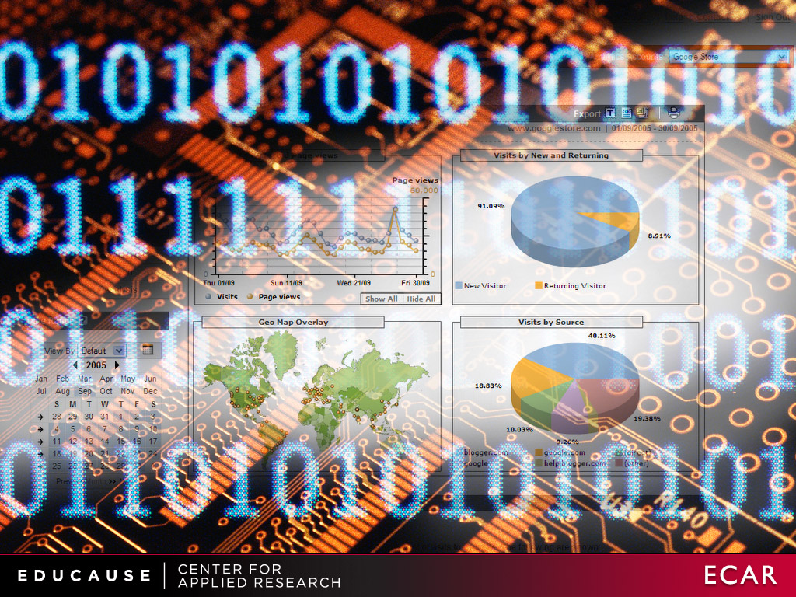
Notes:
Institutions are under continued pressure from accreditors and public funding sources to demonstrate that student outcomes are improving and that institutions are being run efficiently. Students and parents are beginning to clamor for more direct and “real-time” feedback by gaining access to the data that institutions collect about student performance. Sophisticated analytical tools provide a means to draw meaningful conclusions. New interactive data-visualization tools can bring complex data to life and make evidence easily and readily accessible to executives, managers, and the public. Analytics have been a vital and valuable tool in many student success projects such as Achieving the Dream, Completion by Design, Course Signals, and Next Generation Learning Challenges (NGLC). Beyond higher education, research is showing that organizations using analytics are more efficient and effective.

Slide 30
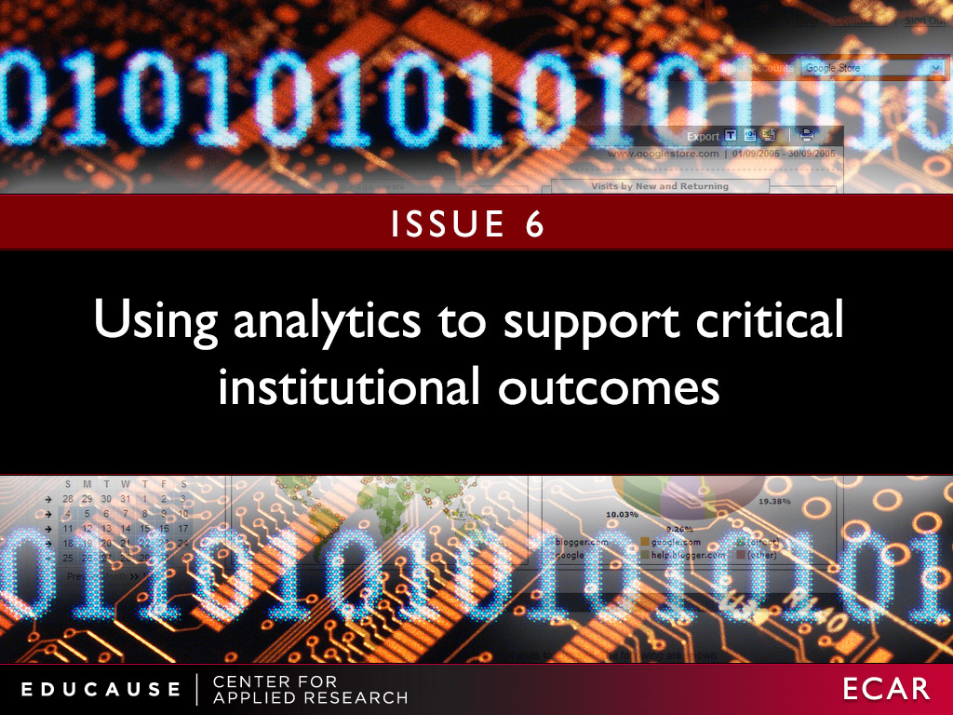
From 2012 ECAR study of analytics in higher education

Slide 31
Using analytics to support critical institutional outcomes
Strategic questions IT is asking
What are the strategic issues for analytics to focus on?
What are the existing capabilities … and the requirements?
What is the role of the IT organization?
Will the culture support or impede adoption of analytics?
“There is accountability for the process that puts the data in and keeps it accurate, to avoid it's becoming misunderstood, changed or corrupted. And CIOs get that.”
—CIO and Vice President
Notes:
What strategic problems or issues can analytics help the institution address and what will be the institution’s initial focus?
What are the institution’s existing analytics capabilities and requirements for data, infrastructure, governance, and staffing?
What is the role of the IT organization?
What are the institution’s cultural issues around buy-in and adoption of analytics? How does analytics relate to accountability?

Slide 32
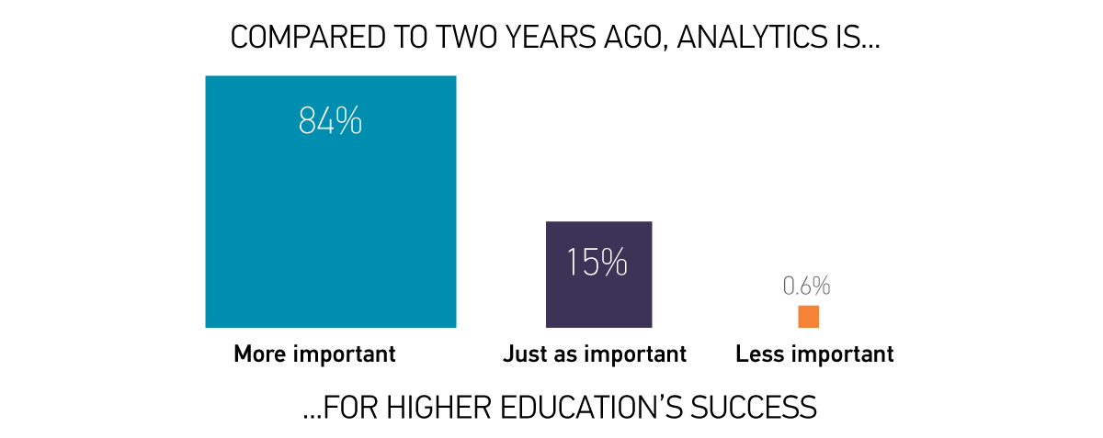
Analytics is a major priority
INSERT TYSON CHART 9
N = 339, EDU + AIR

Slide 33
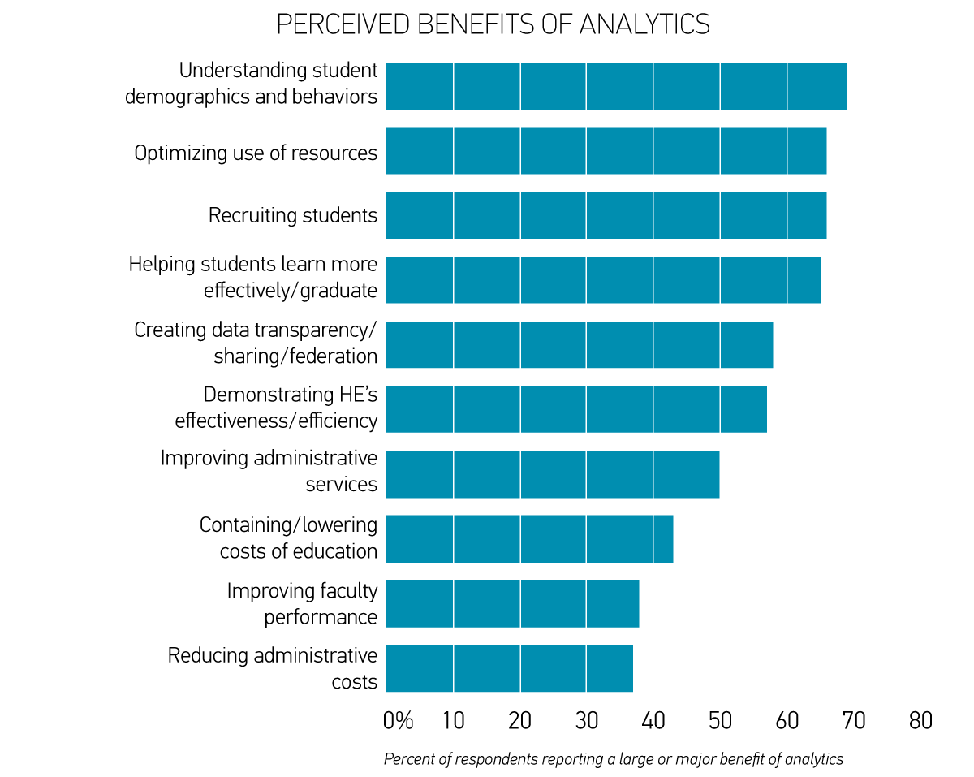
MORE Potential seen for STUDENT AREAS THAN COST OR FACULTY
“What are the potential benefits of analytics in addressing the following challenges?” N = 339, EDU + AIR

Slide 34
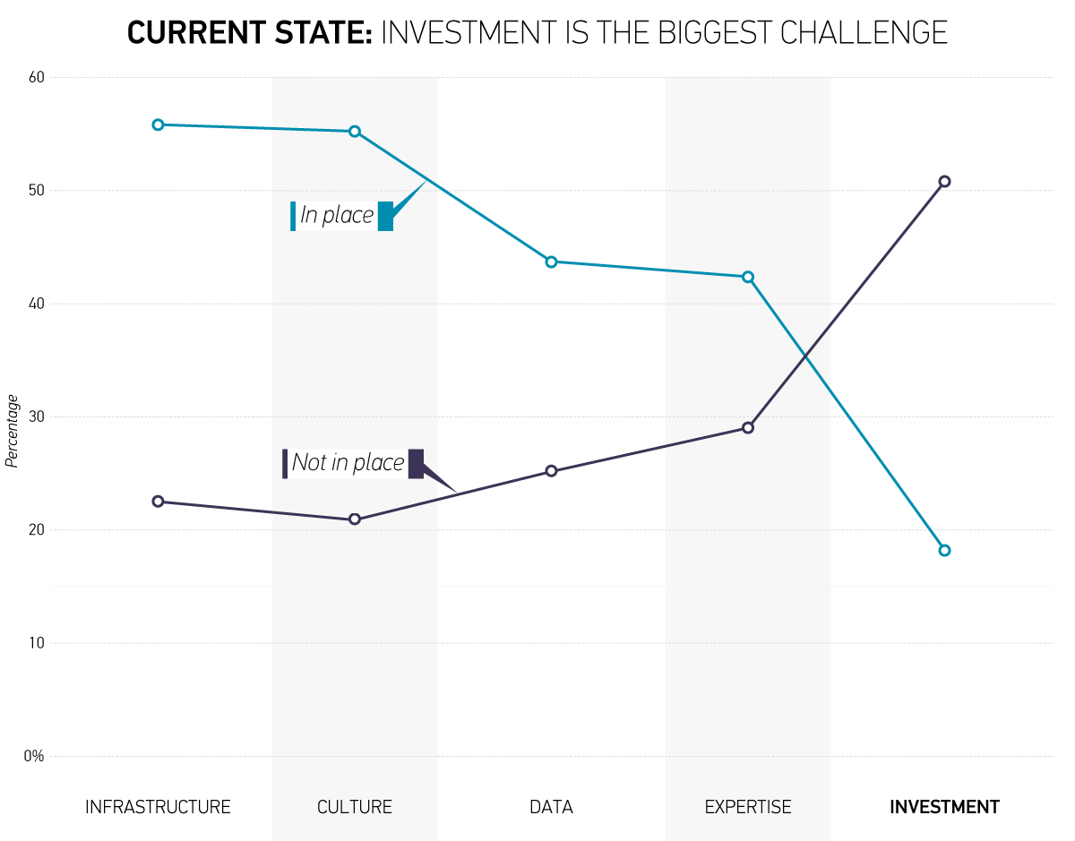
CURRENT STATE: INVESTMENT IS THE BIGGEST CHALLENGE
Notes:
Analytics activities are occurring throughout institutions, but student and financial areas are the most active
Least optimism that analytics can be used to lower HE costs…but promise is seen in optimizing resource usage
The big challenge: How can higher education afford analytics? (Hint: Think investment)

Slide 35

Notes:
At many institutions, information technology isn’t sufficiently integrated into the senior leadership structure to enable the institution to fully embrace and benefit from technology’s strategic advantages. As soon as some people talk about technology, they put it in a box, viewing IT as only an enabling function or a utility and not recognizing its broader potential to operationalize institutional strategy and transformative change.

Slide 36
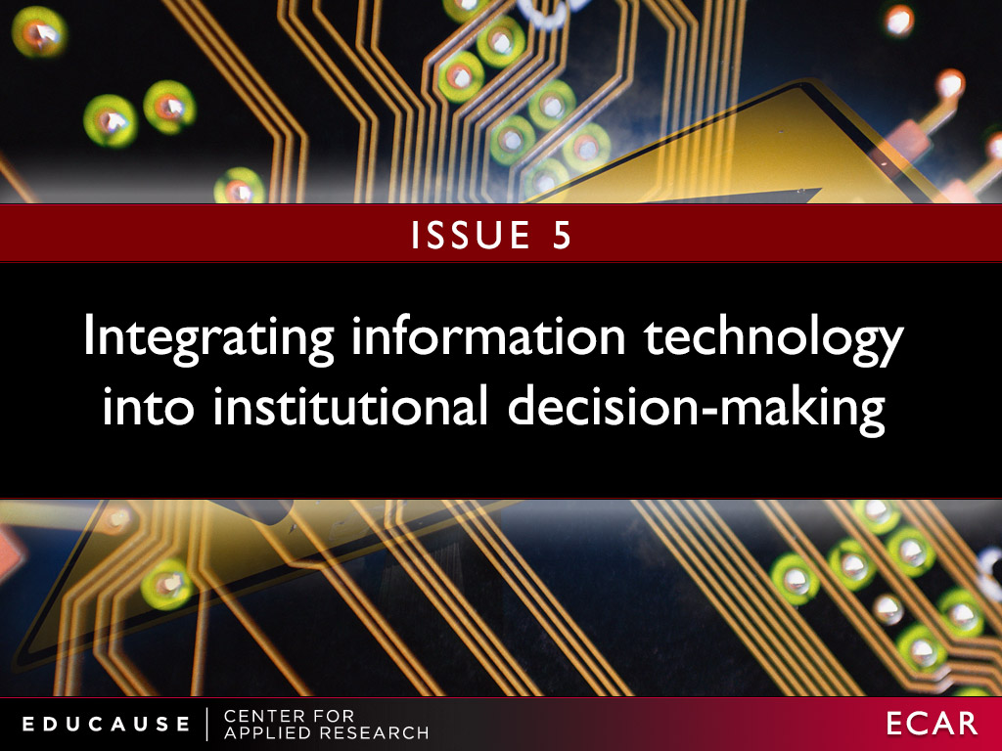

Slide 37
Integrating information technology into institutional decision-making
Strategic questions IT is asking
Do IT’s goals align with the institution’s?
How can CIOs foster truly strategic discussions?
Do IT leaders possess necessary skills?
Does IT understand the institution well enough?
“My dream is that someday the word ‘technology’ disappears from the discussion as it is represented today and, instead, there is simply a discussion about delivering services that make a difference .”
—Executive Director and CIO
Notes:
Do the goals of the IT organization align with the institution’s strategic goals?
How can CIOs transform sidebar discussions about “technology” into a discussion about the tools, capabilities, and services the institution needs to be successful?
Do IT leaders possess the communications, strategic thinking, and negotiation skills to interact effectively with executive leadership?
Does the entire IT organization understand the nature of the many “businesses” at the institution well enough?

Slide 38
Where is the cio role headed?
Today
Challenging and hectic
Multifaceted
Administrative
Focused on technology
Tomorrow
“Transformed”
Still multifaceted
Innovative
Strategic
North American CIOs are quite optimistic about the future of the CIO role.
Notes:
Themes:
The future will not be as busy as the present
Move from tactics and technology to strategy
Multidimensional nature of the IT leadership role
Emergent role of innovation

Slide 39

Notes:
Today, using information technology to improve operational efficiency is no longer just desirable; it has become an imperative due to the ever-shrinking resources brought about by the current economic downturn. Most institutions have many of the required technologies (e.g., workflow, electronic forms, and digital signing) in place, but not everyone has broadly restructured business processes to take advantage of the new technologies.
That’s easier said than done. Electronic workflow can’t realize its full potential when implemented piecemeal and opportunistically

Slide 40
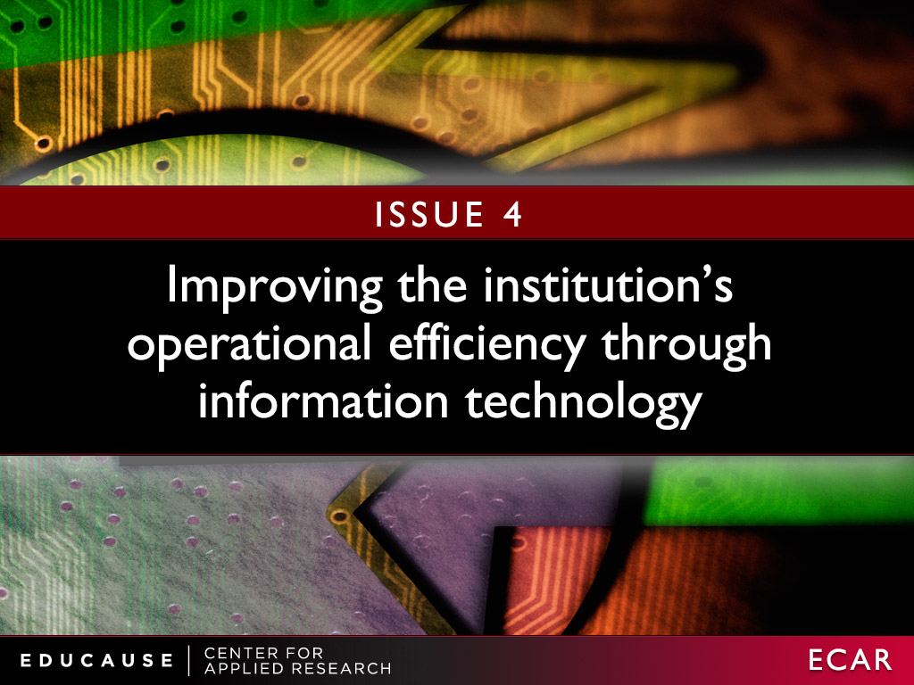

Slide 41
Improving the institution’s operational efficiency through information technology
Strategic questions IT is asking
What business processes could benefit most?
Are IT’s partnerships throughout the institution strong enough?
Are the supporting technologies in place?
How to work with the institution to redefine business processes?
“To be successful will require rethinking many of our fundamental business processes to minimize labor costs and increase timely access to the information needed to support the facilities and services on our campuses .”
—Vice President of Information Technology
Notes:
What business processes could most benefit from greater operational efficiencies using IT?
Does the IT organization have strong-enough institutional partners and partnerships to define new processes and to champion and implement change?
What needed technology pieces (e.g., workflow, electronic forms, and digital signing) are in place now?
What are the institutional strategies, policies, and governance models to map out and redefine business processes?

Slide 42
Advice for IT
Build applications to change, rather than last
Develop expertise in business process management
IT can’t do this alone, requires strong partnership with the institution: Culture, organization, governance, policies

Slide 43

Notes:
Colleges and universities need to develop a coherent strategy about sourcing services in the cloud. A successful strategy has to cover architecture, business models and requirements, procurement and contract management, contingency planning, security, privacy, and compliance. For services that remain available in an on-premise model, campus IT organizations will need to continually demonstrate the value of that model in the face of cloud offerings. For new, cloud-only offerings, the institution will need to establish a strategy for evaluation, selection, risk assessment, and vendor management. It will also need to establish a strategy around data-integration tasks that may have to be undertaken by the campus IT organization.

Slide 44
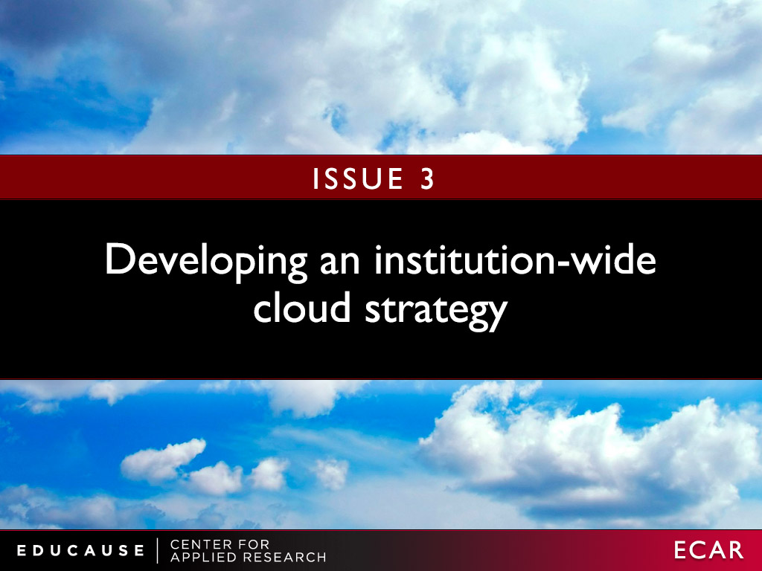
ISSUE #3

Slide 45
Developing an institution-wide cloud strategy
Strategic questions IT is asking
How will cloud add value?
What are all the implications?
How to secure buy-in?
What is the ROI?
How to find the right vendor?
“The bottom line is that you have no choice; do it, do it soon, and keep it agile.”
—CIO and Vice President for Computing
Notes:
How will the cloud service add value to the institution?
What are the cost, security, support, and staffing implications?
How to secure end-users’ buy-in and adoption?
Has the ROI estimate adequately accounted for the financial, political, and organizational costs?
What are the vendor selection criteria?

Slide 46
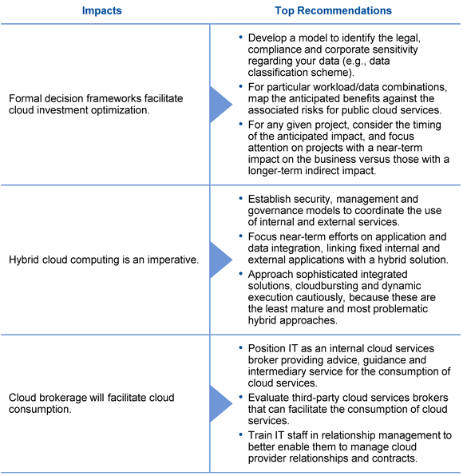
Cloud Computing Advice
Cloud computing starts at home
Make sure you have data governance in place: Policies, owners, security, etc.
Identify the best use cases for Cloud and start with those: Quick wins, less sensitive data, best cost-savings opportunities
Get virtualized
Develop staff skills to manage cloud solutions
  Relationship management
  Vendor management
  Service management
Get started with these basics to acquire skills, experience, and cultural acceptance. That will position you well for future cloud solutions.
Source: Gartner
Hype Cycle for Cloud Computing, 2012
Published: 1 August 2012 ID:G00230930
Analyst(s): David Mitchell Smith
Notes:
Gartner
Hype Cycle for Cloud Computing, 2012
Published: 1 August 2012 ID:G00230930
Analyst(s): David Mitchell Smith

Slide 47
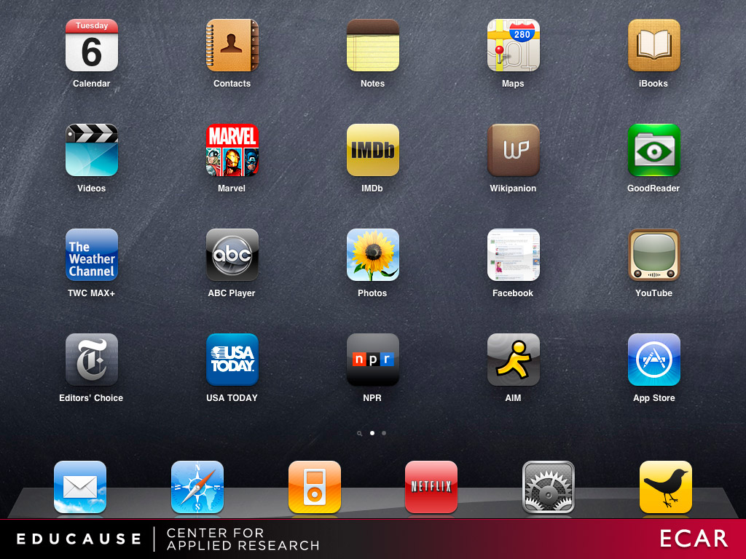
Notes:
While the technology landscape has never been more personal or easy to use, it is simultaneously increasingly complex to manage and support. Faculty, staff, and students no longer need the IT organization as an intermediary in their adoption and application of the most commonly used technologies. They arrive with mature personal computing environments that they have self-configured to meet their specific needs, preferences, and styles of work and recreation. Any college or university that maintains hard-and-fast rules about which devices and communication tools must (or may not) be used risks being irrelevant. Yet the institution’s data and intellectual property must be safeguarded, no matter where it is stored, transmitted, or accessed. Even the most strategic and flexible IT organization may, at times, need to be reactive. Institutions need to learn to adapt to and leverage personal computing environments, not proscribe them.

Slide 48
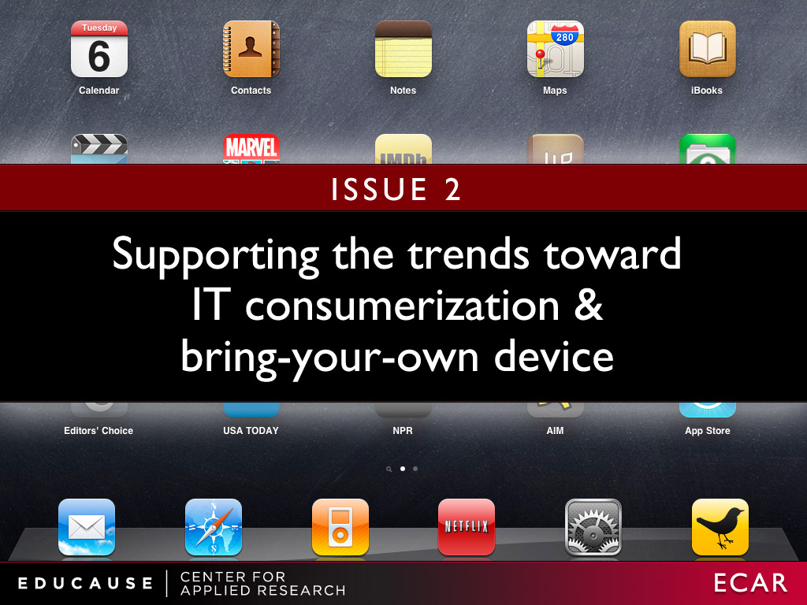

Slide 49
Supporting the trends toward
IT consumerization and bring-your-own device
Strategic questions IT is asking
What is our operational definition?
What are the infrastructure implications?
Should the IT support strategy change?
What are the security implications?
“Resource-constrained organizations face differentiated demands in supporting and integrating the vast choices of technologies brought to campus, while even wealthier organizations must justify and prioritize resource allocations according to user-driven innovation. The IT organization is no longer in control, and it’s not clear who is!”
—CIO
Notes:
What devices, operating systems, applications, and services fall under this umbrella?
What are the infrastructure implications, such as bandwidth and connectivity?
How does BYOD affect the IT organization’s support strategy?
What are the security implications?

Slide 50
BYOD Advice
Worry about securing the data, not the device
Know what's important to your users
  Example: printing from a tablet
Support as many devices as possible
Make the technology available to everyone, even those who can’t afford it
BYOD requires a robust network, wired and wireless
Invest in continuous training for IT staff
Source:
Building a Flexible BYOD Program
Mitch Davis
posted August 13, 2012, appears in the Summer 2012 issue of EdTech Magazine.
Notes:
Source:
Building a Flexible BYOD Program
To succeed at BYOD, organizations must have the flexibility to respond quickly as technologies evolve.
MITCH DAVIS
posted August 13, 2012 | Appears in the Summer 2012 issue of EdTech Magazine.
Know what's important to your users. A BYOD program can succeed only if users are happy, so find out what they want. In doing outreach with students, we found that printing from a tablet was at the top of the list. We then moved printers to spaces where students congregate. Now that we've put printers in more convenient locations, there's less need for students to run back to their dorms or apartments to print.
Support as many devices as possible. What's unique about mobility today is that everyone has access to a device, and they all want to join the conversation and share information. Don't stand in the way by restricting people to specific devices. Be there to educate, support and deliver service. Also be prepared to support all the main platforms, and deliver exceptional service to the ones that work best. Today, we have people across the IT organization doing research on the many different flavors of mobile devices.
Make the technology available to everyone. For a BYOD program to evolve, your stakeholders on campus need access to mobility tools, and not everyone can afford to buy them. That's why we offer free access to equipment through a loaner pool. In the past, users could obtain technology only through their department. Now, everyone has access to every type of mobile device, from tablets and MP3 players to projectors and portable video equipment. Having a loaner program also gives people an opportunity to try new technology before they buy it.
Be proactive, not reactive, when building a robust network. Start by creating a specific plan for delivering adequate wired and wireless bandwidth, including adding switches and access points where necessary. Effective BYOD requires a highly available network that never goes down. With the proper infrastructure and a financial model for funding upgrades in place, it's easier to more flexibly support new technologies as they evolve.
For example, the need for high-performance computing in classes has greatly expanded over the past three to five years. Students and faculty from the sociology, history and geology departments are now asking for access to major systems that store massive amounts of data — and they want access to that information on all of their devices. The IT staff must build a network that's robust and flexible enough so that when technology changes and users are ready to deploy new devices, the network is ready for them.
Keep IT staff engaged and well trained. Create a culture in which continuous learning among IT staff is encouraged and properly funded. It costs time and money to send people to classes, but without the proper training, the IT department will continue to implement old solutions, resist change and be unprepared for a fast-approaching future. The organizational disruption and technology failure that results will hinder everything, from academic research to fundraising.
Bottom-line financial managers may have a hard time understanding that IT skills and technology are a strategic advantage. The time-lost multiplier makes it easy to justify having an informed technology staff. Technology changes every three months. When the staff has limited skills, the group's ability to support innovative programs such as BYOD is diminished

Slide 51

Notes:
Information technology is changing the way it delivers and manages technology services and the IT staff must adapt accordingly. Although the CIO’s changing role has received much attention in recent years, with the need for CIOs to acquire or enhance their strategic planning, relationship management, and communications skills, many other roles in the IT organization are also evolving in similarly disruptive ways.
This “service broker” role requires negotiation, contract review, security review, and product/vendor-vetting skills—skills that many IT staff members do not possess today. Other roles related to process redesign, continuous improvement, the Information ITIL, and metrics and analytics will also require new skills. Other capabilities requiring new roles have been around longer but may still be new to some IT organizations. Examples include project management, knowledge management, and relationship management.

Slide 52
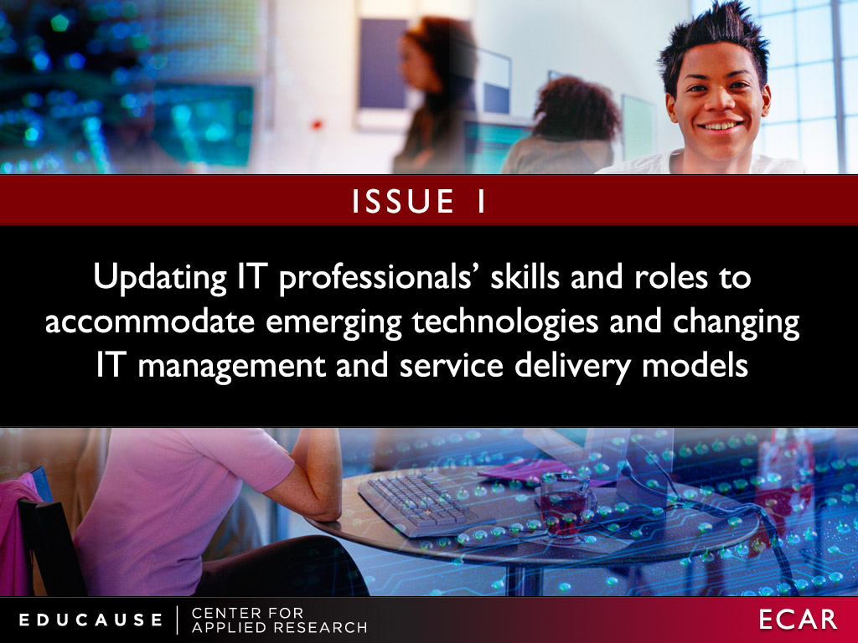

Slide 53
Updating IT professionals’ skills and roles to accommodate emerging technologies and changing IT models
Strategic questions IT is asking
What new skills are needed?
Do we need entirely new roles?
What is the right professional development strategy?
Do staff have time?
“It is incumbent upon [IT leaders] to prepare their staff for these changing roles. It is, however, quite difficult to do this in a ‘just-in-time’ manner. Our existing technical staff members are fully committed to their current roles and may not have the free work-cycles to focus on new responsibilities”
—Associate CIO for Operations and Planning
Notes:
What non-technical skills are required?
Do we need entirely new roles?
What is our professional development strategy to close these gaps?
How to balance professional development with ongoing workloads?

Slide 54
The 2012 Top Ten IT Issues
Updating IT professionals’ skills and roles to accommodate emerging technologies and changing IT management and service delivery models
Supporting the trends toward IT consumerization and bring-your-own device
Developing an institution-wide cloud strategy
Improving the institution’s operational efficiency through information technology
Integrating information technology into institutional decision-making
Using analytics to support critical institutional outcomes
Funding information technology strategically
Transforming the institution’s business with information technology
Supporting the research mission through high-performance computing, large data, and analytics
Establishing and implementing IT governance throughout the institution

Slide 55
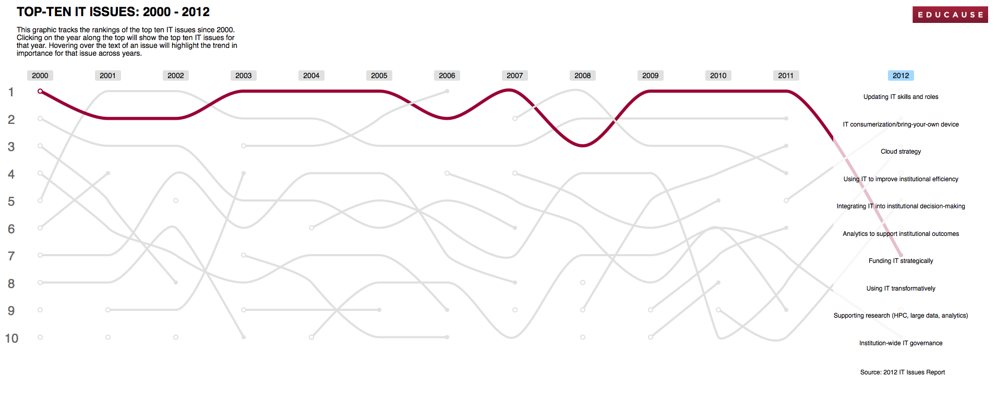
Higher education’s top IT issues:
An interactive historical view
http://www.educause.edu/educause/visualizations/vis1/index.html

Slide 56
Harbingers of 2013?
Balancing resources with priorities
Selecting the right sourcing and solution strategies
E-learning
Supporting the institution’s mobile IT needs
Workforce issues
Notes:
Balancing resources with priorities
The continual cost pressure of the Great Recession affecting IT with both cost reductions and increased demands for automation without governance processes to manage them effectively
Identifying the opportunities that are the most strategic to focus on
Portfolio and project management: selecting the “right” mix of run, grow, and transform projects
Central IT's inability to keep up with demands for service levels and innovation, resulting in fragmented solution environments, partly delivered elsewhere on campus, partly delivered by vendors
Determining the role of online learning and developing a sustainable strategy for that role
Supporting faculty transition including professional/instructional development, technology literacy, understanding that they can and should drive the adoption of technology (not the reverse), and faculty incentives
Active learning (students engaged in the learning process)
Social learning (finding ways to help students engage with one another in collaborative learning activities)
Institutional and learner analytics (the feedback loop for continuous improvement)
Helping the institution select the right sourcing and solution strategies in the context of consumerization, cloud services and SaaS
Demand for WiFi access for multiple devices, ease of connection, and restructure apps for mobility
Workforce issues
Competing for IT talent when higher education compensation is lower than market rates, but higher education jobs are just as intense as industry jobs
Maintaining positive staff morale in times of change

Slide 57
What can IT Stop? Really stop?
Personal storage for students
Personal web pages
Email for students
“The last things we stopped was a modem pool several years ago. Is there anything that people actually stop doing?”
—CIO
Notes:
Portfolio and project management: selecting the “right” mix of run, grow, and transform projects
Demand for WiFi access for multiple devices, ease of connection, and restructure apps for mobility
Helping the institution select the right sourcing and solution strategies in the context of consumerization, cloud services and SaaS
Competing for IT talent when higher education compensation is lower than market rates, but higher education jobs are just as intense as industry jobs

Slide 58


