Slide 1

Rose Rocchio, UCLA
Mojgan Amini, UCSD
Chris Ward, Kennesaw State University
Lori Tirpak , Oakland University, Rochester

Slide 2

ACTI is:
Advanced Core Technologies Initiative
Focus is on bringing leaders together to focus on advanced technologies
Notes:
Early Adopters
Collaborators
Value in Higher Educational Community
* Began meeting in October 2011

Slide 3
ACTI-MWF MISSION:
To promote strategic mobile cooperation across higher education institutions

Slide 4
ACTI-MWF GOALS:
Develop a strategic mobile framework guide & evaluation method
Share strategies to mobile-enable an institution
Monitor evolution of mobile technologies

Slide 5


Promoting strategic mobile cooperation across higher education institutions.
Large R1s, Small public Institutions, private institutions
Geographic diversity

Slide 6
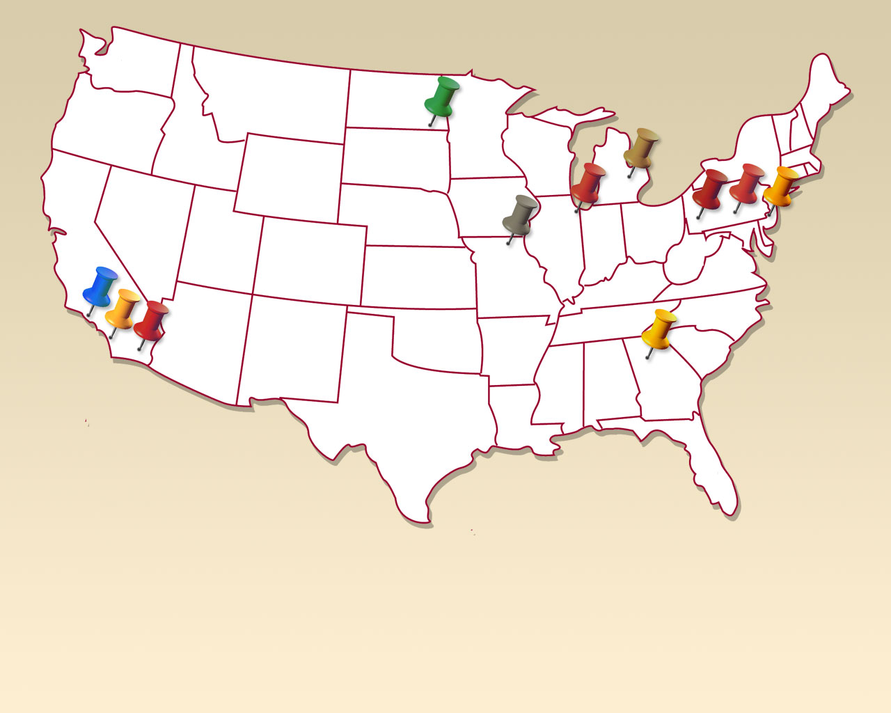
ACTI-MWF Participants

Slide 7






UCLA
Rose Rocchio, Director of Educational & Collaborative Technologies
Kennesaw State University
Christopher Ward, Assistant Director of Web Services
Amos Williams III, Mobile Developer
Princeton
Serge J. Goldstein, Associate CIO & Director of Academic Services
Oakland University
Lori Tirpak, Director Enterprise Systems
UCSD
Mojgan Amini, User Experience Technologies & Middleware
Dickinson College
Jill Forrester, Associate Vice President
Carnegie Mellon University
Mary Ann Blair, Director of Information Security
North Dakota State University
Jill Eleanor Peterson, Database Applications Developer, Department Enterprise Computing & Infrastructure
University of Chicago
Alan Takaoka, Manager of Programming, Web Services, ITS
USC
Phillip Berres, Software Engineer
Penn State University
Vijay K. Agarwala, Senior Director, Research Computing & Cyberinfrastructure
Mark Katsouros, Director, Network Planning & Integration, TNS
ACTI-MWF Participants

Slide 8

Why are we here today?

Slide 9

You may already have a few mobile initiatives…

Slide 10

While others may have none.

Slide 11

We understand the need.

Slide 12
Mobile broadband subscriptions are expected
to grow from nearly 1 billion in 2011 to over 5
billion globally in 2016
By 2015, more Americans will access the
Internet via mobile devices than desktop PCs
As of March 2012, 46% of American adults
were smartphone owners – up from 35% in
May 2011
In 2011, global smartphone shipments
exceeded personal computer shipments for
the first time in history
WhiteHouse.gov, Digital Government: Building A 21st Century Platform to Better Serve The People, May 23, 2012

Slide 13

Take the time to know where you want to go.

Slide 14

One size does not fit all.

Slide 15
No matter who you are, you have to first define your institution’s goals and needs

Slide 16
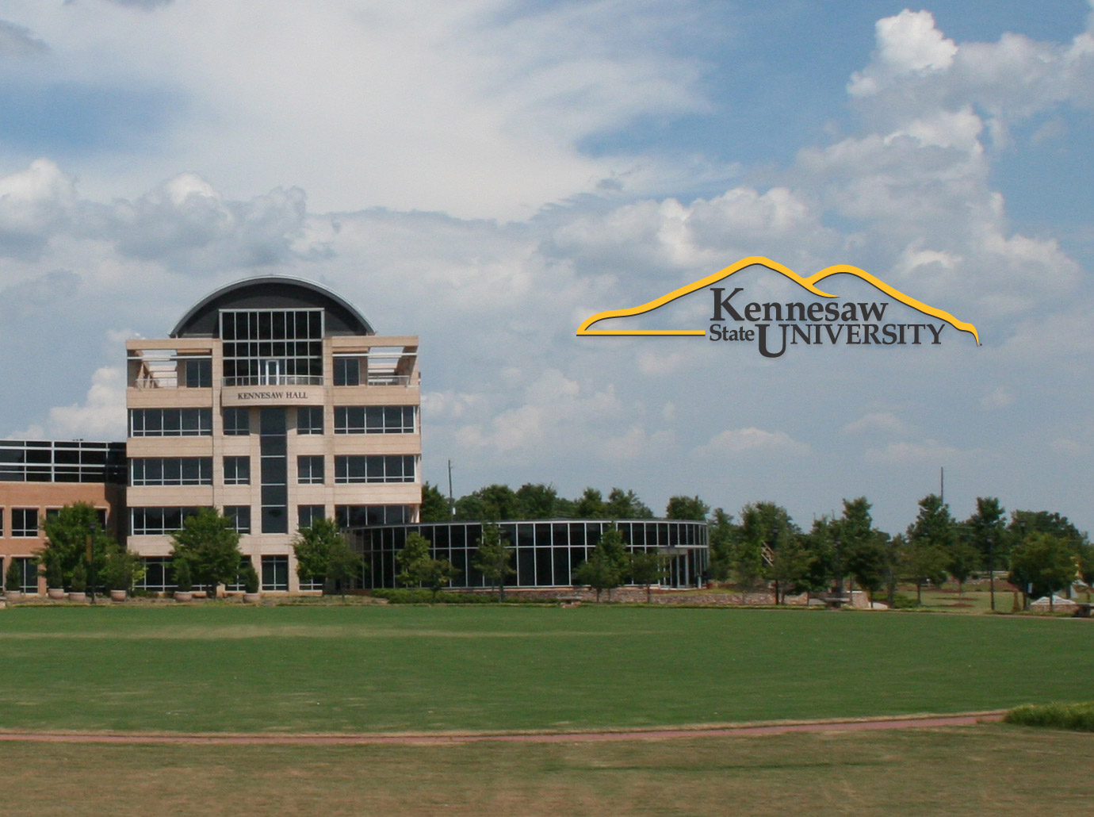
No matter who you are, you have to first define your institution’s goals and needs
Let’s try an example: KSU Admissions wants to use mobile technologies to improve information flow with prospective high school students and parents.

Slide 17
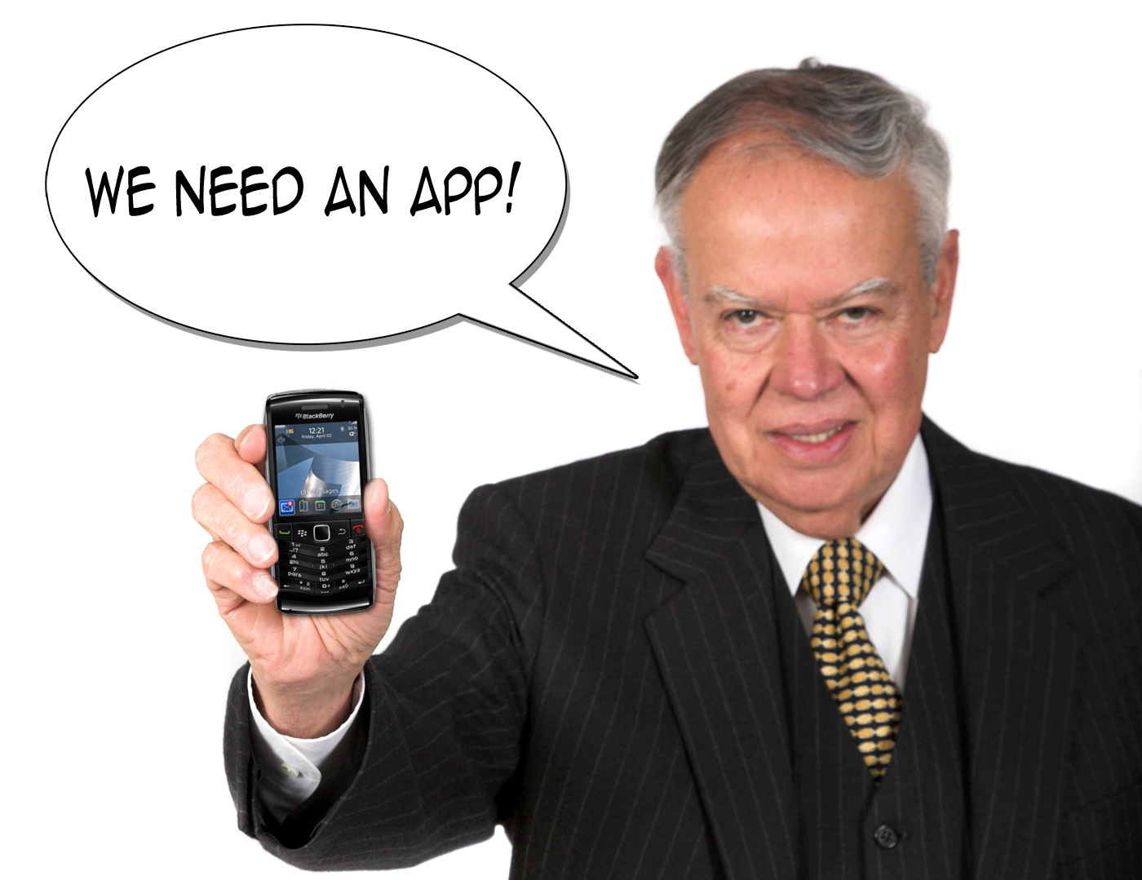

Slide 18
Platform
Resources
Content
Audience
Desktop Web Site
Mobile Web Site
Native App
In-House IT
Learning Curve
Small Budget
Outsourced IT
About KSU
Academic Programs
Tuition & Fees
Stories & Testimony
Application
HS Students
HS Parents
HS Counselors

Slide 19

Dollars + Hope ≠ A Strong Mobile Strategy

Slide 20
Platform
Resources
Content
Audience
Desktop Web Site
Mobile Web Site
Native App
In-House IT
Learning Curve
Small Budget
Outsourced IT
About KSU
Academic Programs
Tuition & Fees
Stories & Testimony
Application
HS Students
HS Parents
HS Counselors

Slide 21
Audience
Content
Resources
Platform
HS Students
HS Parents
HS Counselors
About KSU
Academic Programs
Tuition & Fees
Stories & Testimony
Application
In-House IT
Small Budget
Outsourced IT
Large Budget
Desktop Web Site
Mobile Web Site
Native App

Slide 22

One in 8 visitors to Kennesaw.edu is from a mobile device
Undergraduate Admissions site averages 50,000 visits per month
In-house Web team that specializes in HTML & CSS development
KSU has a business school with a large number of BlackBerry users
Any authentication would require visitors to have a KSU-specific ID
Whatever Admissions gets, Financial Aid & Registrar also get
One size does not fit all.
The guy who can build/support apps left for Google last spring
Enrollment Services needs solution in place for Fall 2012
2013 University spending reduced 3% due to state budget cuts
Two-thirds of Kennesaw mobile traffic is from iOS devices

Slide 23
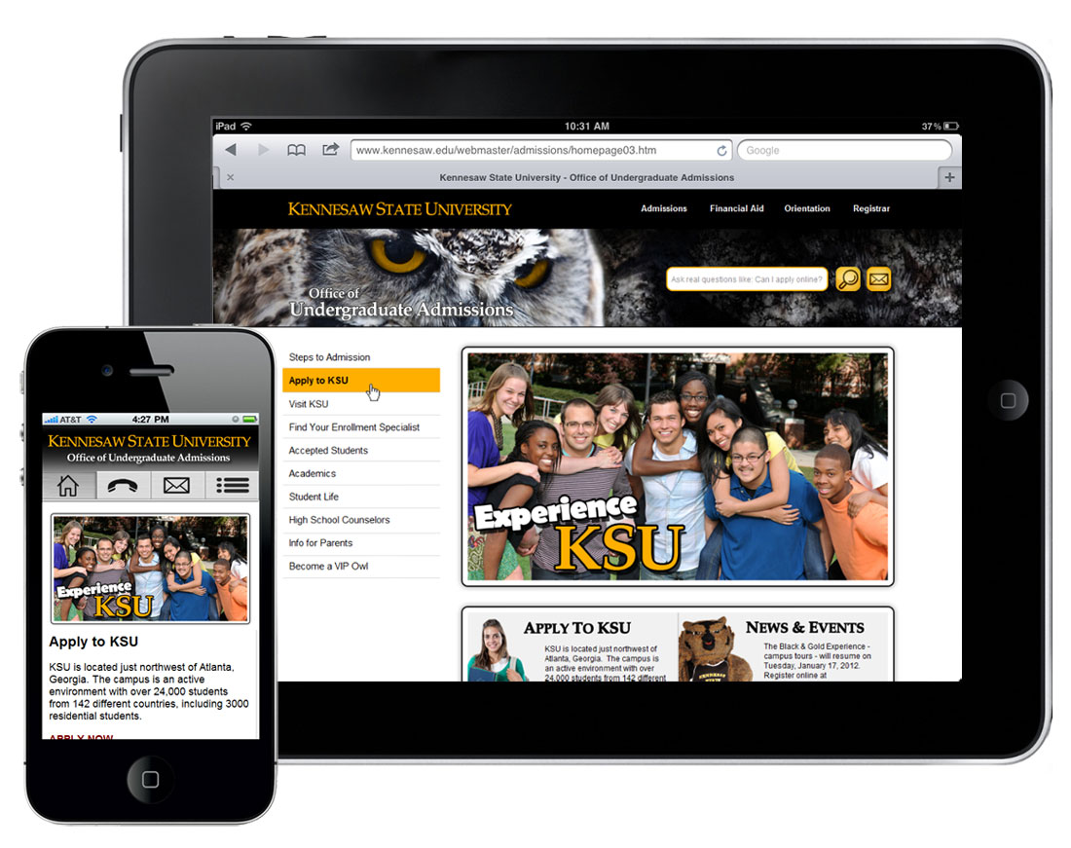

Slide 24
The guide we have created presents
USEFUL METHOLOGIES and RECOMMENDATIONS FOR DEVELOPING A MOBILE STRATEGY
Notes:
Our Goal for the guide is to publish it by the end of the year. But we are going to go over the highlights of what will be in the guide today!

Slide 25

Getting started
Notes:
Gauging where your campus is with Mobile Technologies is your starting point. It is worthwhile to invest the time to meet individually with those who are experimenting with mobility
Recommended to hold a mobility summit where campus units can share what they have tried and what they have learned
If you are fortunate, you built a coalition of the willing – and promote a “PILOT team effort”
It is KEY to use the term PILOT - so as to manage expectations and risk for those interested in dabbling or trying something new out

Slide 26
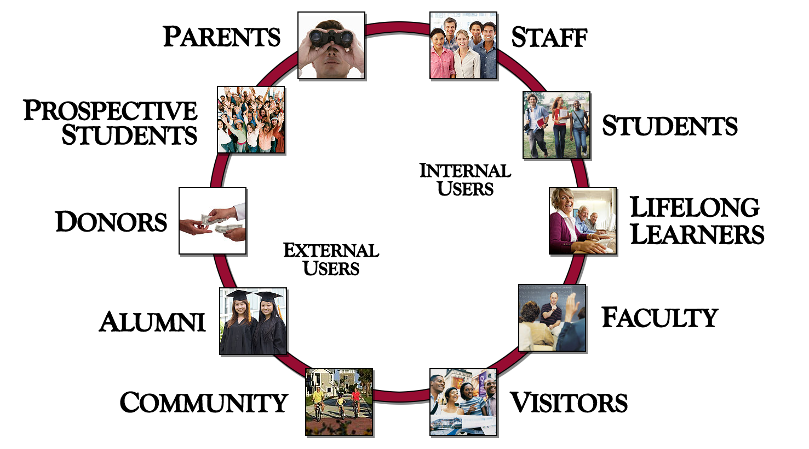
Focus On Audience’s Needs
Notes:
It’s important to recognize that Universities serve many different audiences with differing needs
10 audiences groups that we try to serve
It can be overwhelming at first when you think of all of the differing constituent groups you try to serve with your campus websites: Students, Staff, Faculty, Prospective students, Alumni, Donors, Parents, The community

Slide 27

Engage Key Stakeholders
Notes:
By stakeholder we mean the campus unit that that owns, manages or curates the data
Once you have priorities to focus on you can begin to advocate for a strategic approach to mobility
Focus on the stakeholders that can supply the data that your prioritized audiences most want

Slide 28

Build Momentum
Notes:
Focus on an Opt in collaborative strategy, where the campus can work together to launch a mobile pilot that is more than the sum of it’s parts. The collaborative effort should have a team focus and build a network of support for campus entities that want to join
Hold a kick off pilot meeting with training and supply food
Offer regular “open house” support sessions
Sponsor a crowd sourcing challenge with a TABLET prize

Slide 29

Mobile Governance
Notes:
It’s important to launch an effort to govern your collaboration
Invite the KEY stakeholders to appoint a resource to your pilot steering committee
Include key campus constituents: Faculty and Students
Facilitate the agreement of pilot principles

Slide 30
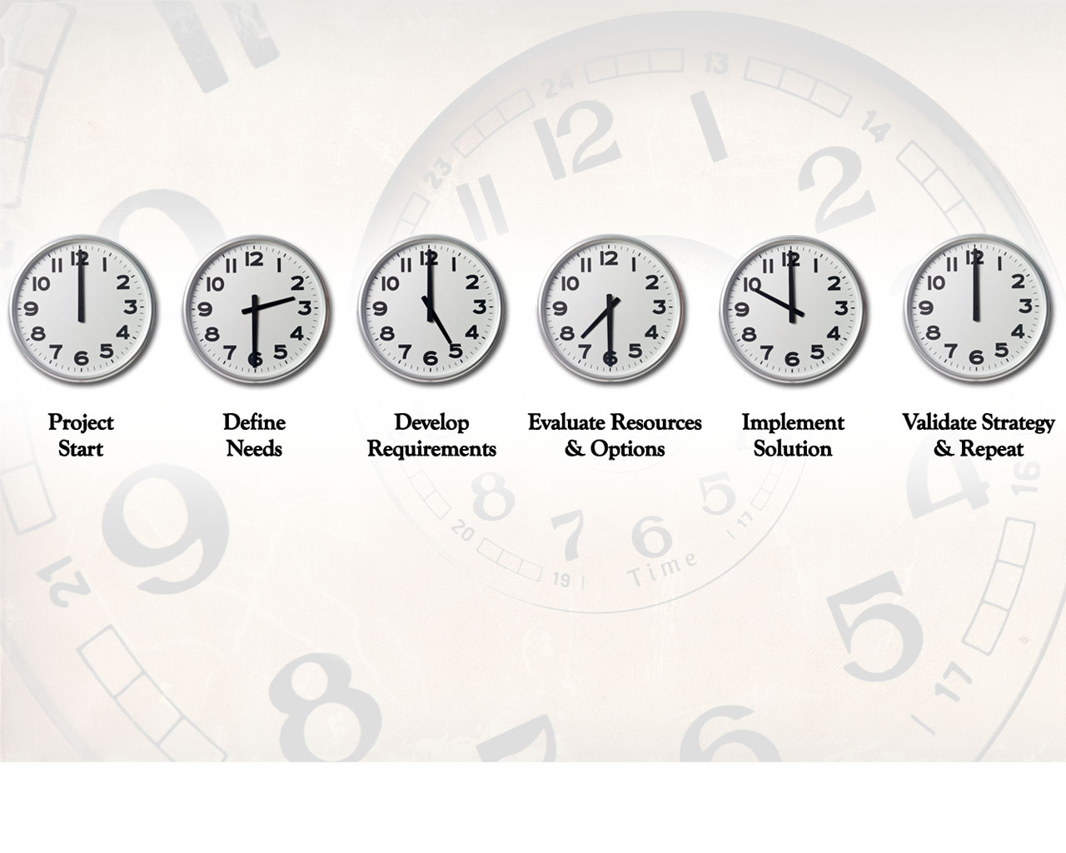
Manage Mobility Timelines
Notes:
Be realistic with goals
Consider 6 month cycles for releases
Recognize that the field is MOVING at a dizzying pace
Strive to understand your “switching costs”

Slide 31
Mobile Strategic Plan
Notes:
It is important to articulate your mobile strategic plan to your campus, regardless of whether that is to have one posted, or simply considered a “pilot” effort.
In fact you may strategically choose to “not have an official one” yet. Different campus cultures need a initiatives to evolve in a grassroots way due to a distributed nature, while others

Slide 32

Who is your primary audience?
Notes:
It’s important to PRIORITIZE your initial mobile offerings to serve the audiences with the greatest needs
Consider “WHO IS USING” these devices
Consider how to make the PAIN threshold LOW
USER experience is paramount

Slide 33
Group your audience types into
manageable categories
(i.e. Internal Users, External Users)
Notes:
Internal audiences: Students, Faculty, Staff, life long learners
External Audiences include: visitors, Donors, prospective students, parents and alumni just to name a few

Slide 34
Data Planning
Separate application code from data.
Identify the definitive data sources and their owners.
Make data owners comfortable with making their data available.
Notes:
Keep your strategy, and especially your data strategy as flexible as possible
Leverage existing web services or multi-purpose architectures as much as possible
Data will always be needed regardless of the strategy

Slide 35

Define your IT capacity & resources
Notes:
Understand what your campus can collectively bring to the effort from a resource perspective
Think of project as federated or crowdsourced if – campus partners and stakeholders have resources they may be able to be leveraged
Learning Mobile programming skills is a desired and fun area for current staff, they may be energized and excited to join in

Slide 36
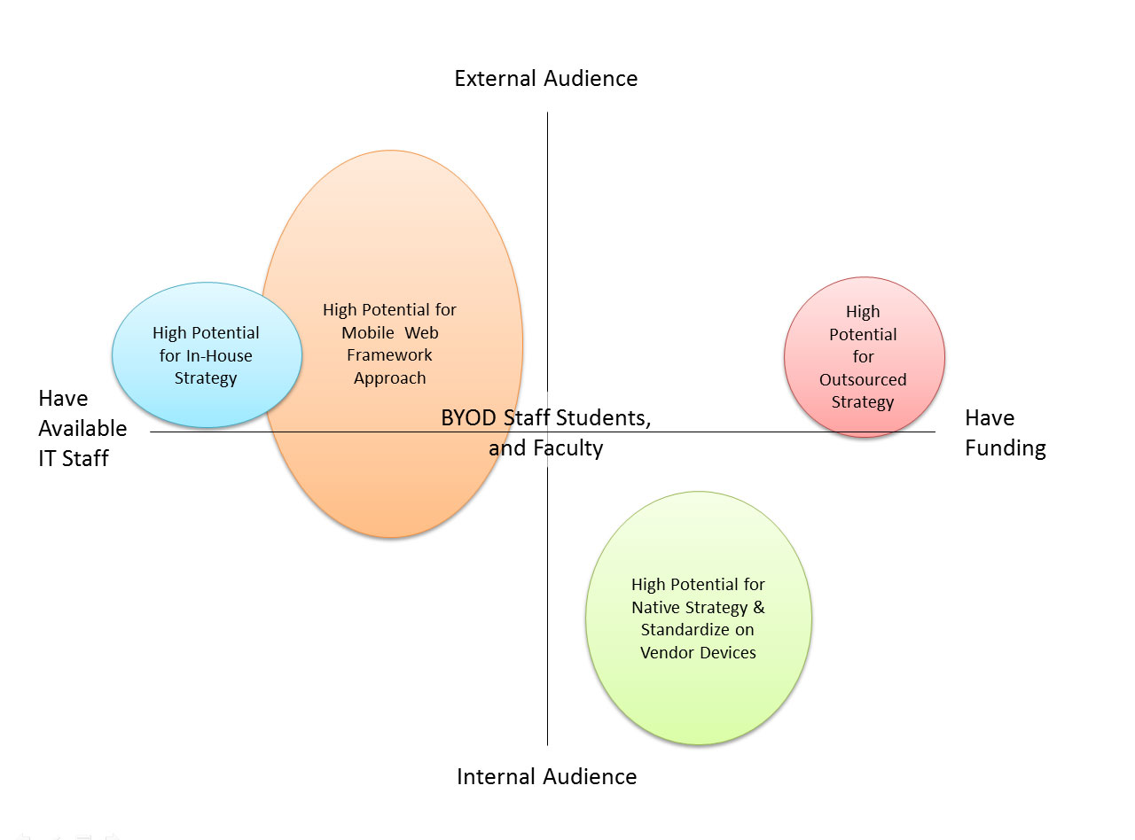
ACTI-MWF – Trade-Off Diagram: Audience versus In- or Outsourcing
Notes:
Once you have an understanding of your campuses interest and willingness to participate, you can affirm your strategy by thinking about how to best serve your prioritized audience with the resources you have available

Slide 37
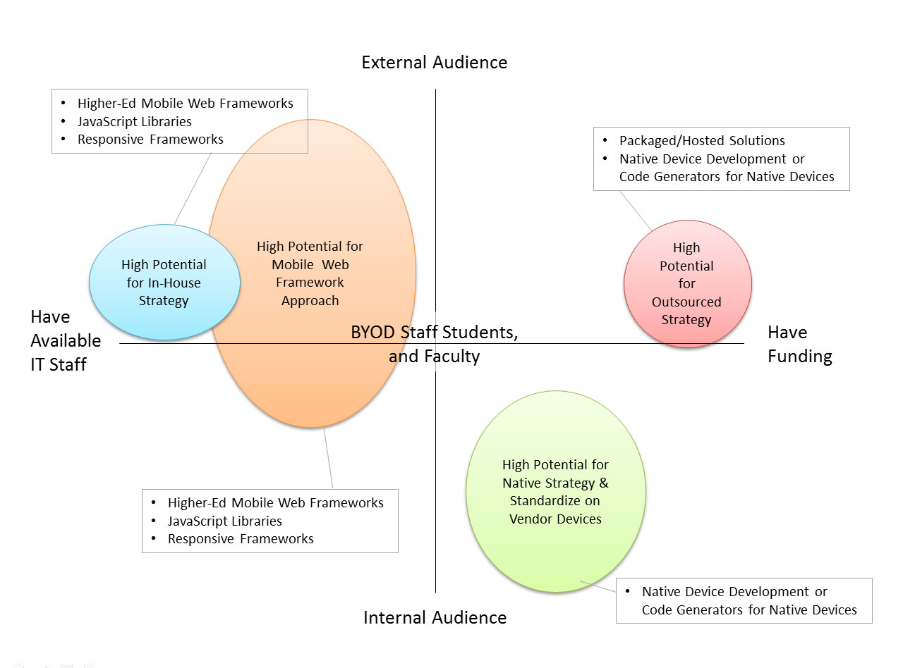
ACTI-MWF – Trade-Off Diagram: Audience versus In- or Outsourcing

Slide 38

Understanding Your Options

Slide 39
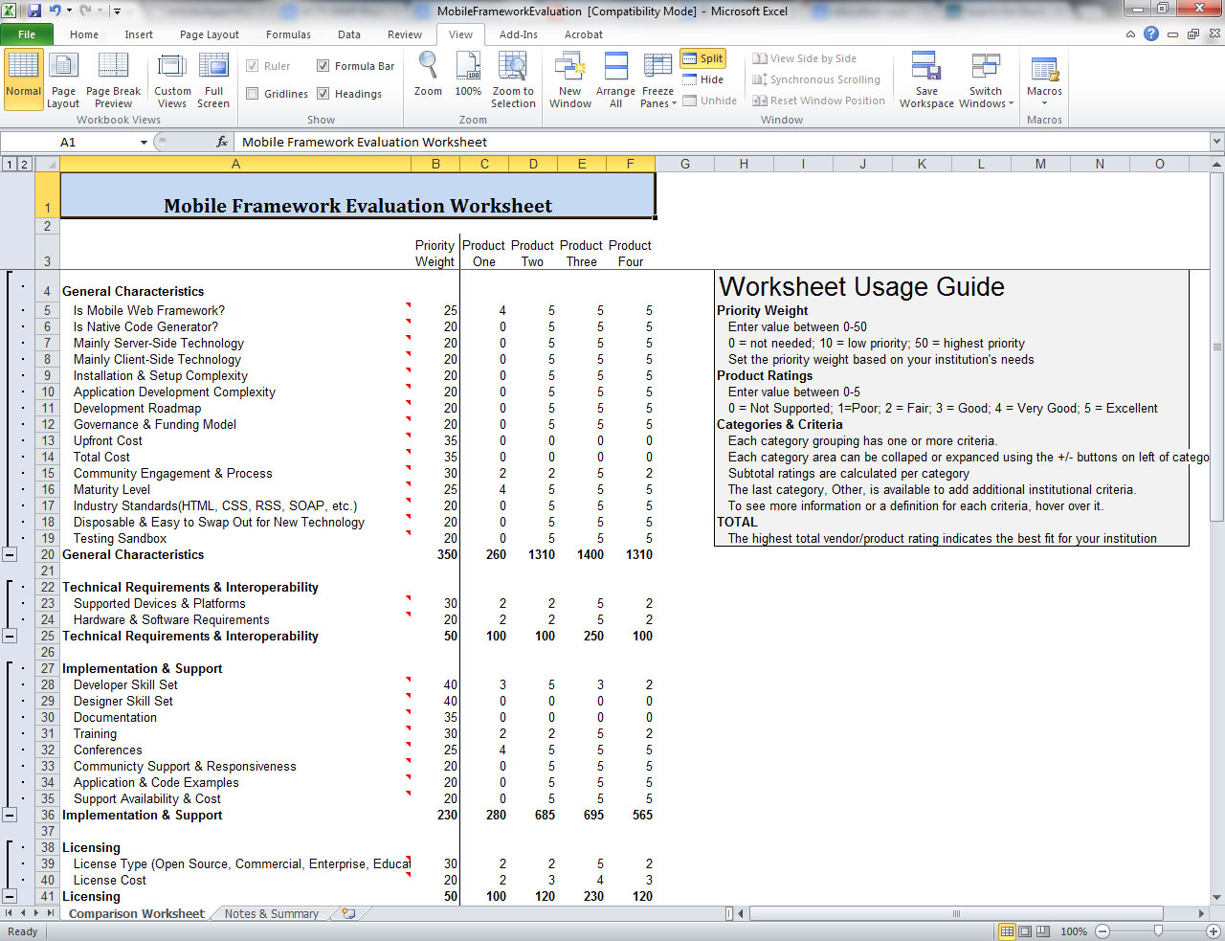

Slide 40

Mobile Tool / App Registry

Slide 41

Integration with SIS & LMS

Slide 42
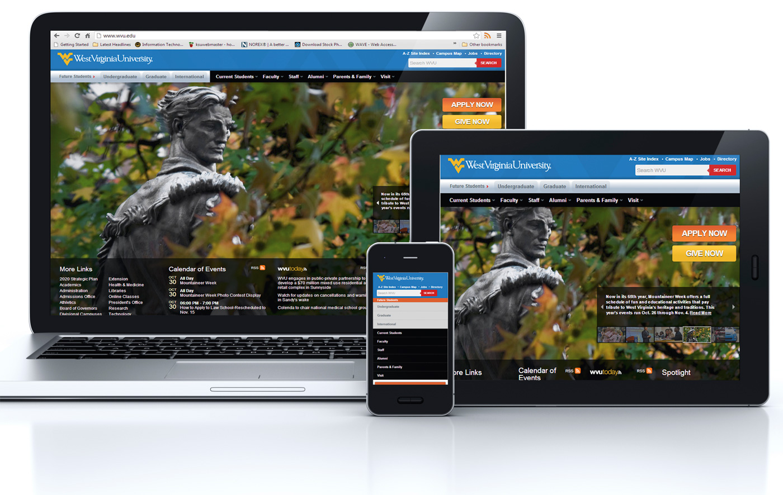
Responsive Web Design

Slide 43
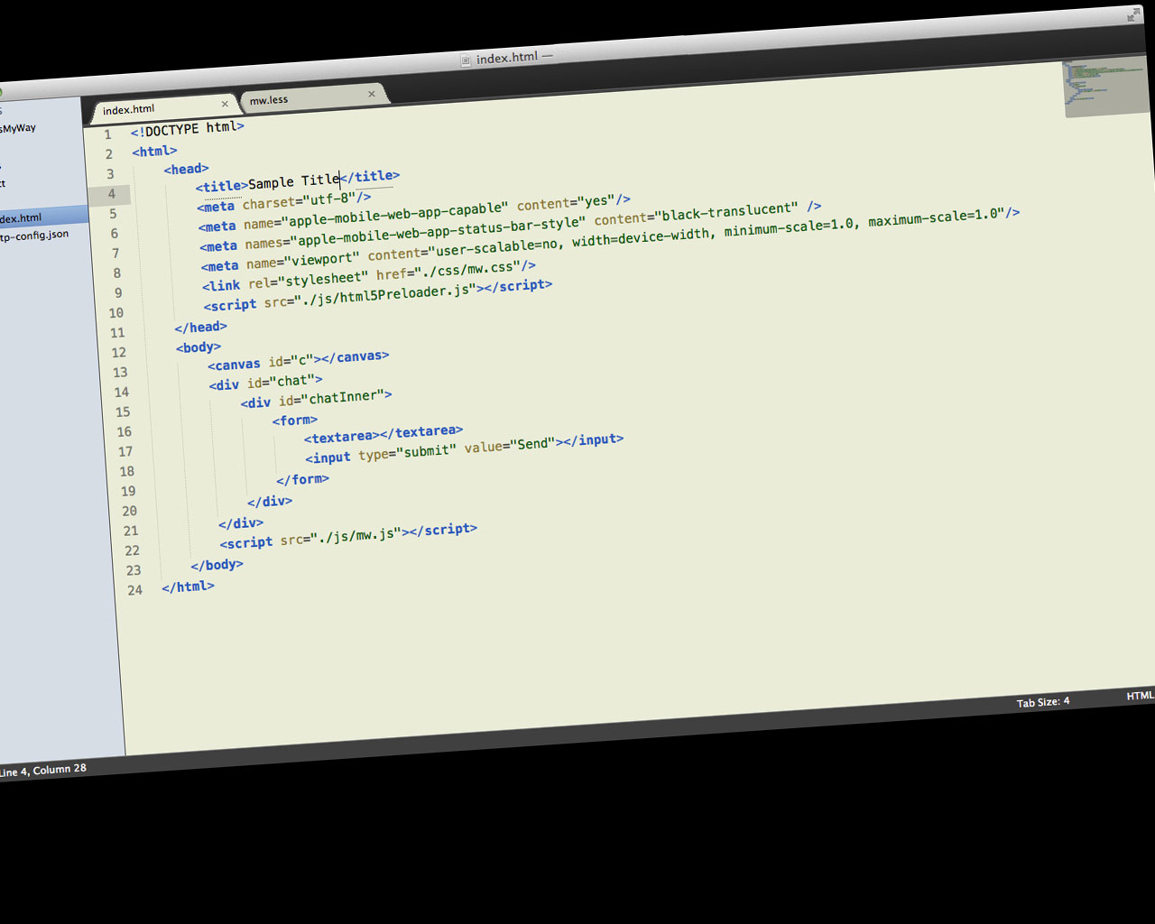
The Evolution of HTML5

Slide 44

Accessibility & Mobile

Slide 45
