Slide 1


Sherpa: Increasing Student Success
with a Recommendation Engine
www.socccd.edu/sherpa
Dr. Bob Bramucci, Vice-Chancellor, Technology and Learning Services
Jim Gaston, IT Director - Academic Systems

Slide 2
Overview
About Us
Importance of Recommendation Engines
Sherpa Architecture
Sherpa Demonstration
What’s Next?

Slide 3
About Us
About the SOCCCD
  Two-college district in southern California
  Approximately 43,000 students (25,000 FTES)
Two Colleges, Three Campuses
  Saddleback College in Mission Viejo
  Irvine Valley College in Irvine
  Advanced Technology and Education Park (ATEP) in Tustin

Slide 4
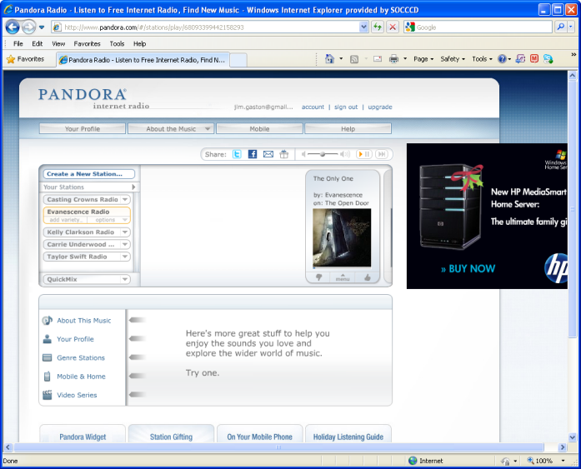
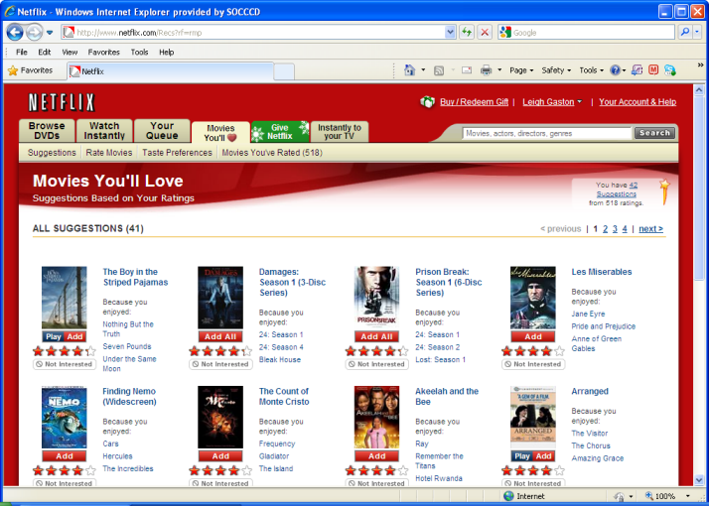
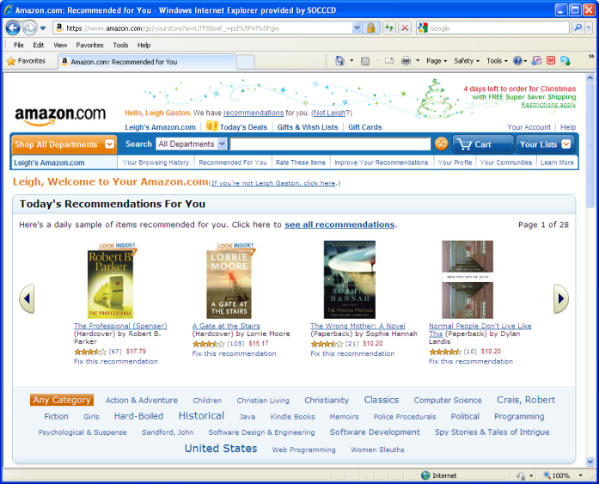
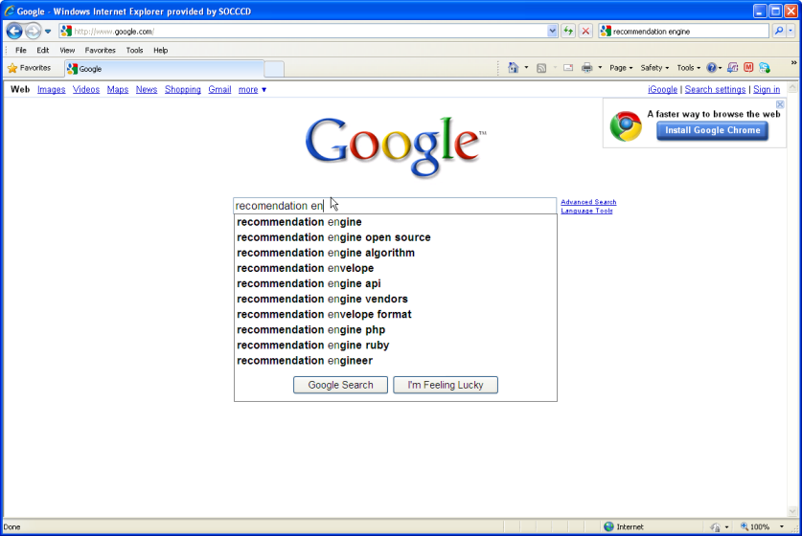
Project Overview
Recommendation Engines

Slide 5

Sherpa
So what is Sherpa?
  Sherpa is a recommendation engine that will guide students to make informed decisions regarding courses, services, tasks and information.

Slide 6
Sherpa Architecture
Timing Event
Trigger
Courses
Services
Information
Tasks
Transcript
GPA
Ed Goal
Reg Activity
Current Classes
Status
Recommendations
Student Profile
Nudge
Feedback - Preferences
Feedback - Ratings
Portal RSS Email Text To-Do List Mobile

Slide 7
Recommendation Examples
Student Profile | Recommendation
New student, not matriculated | Link to online orientation
GPA > 3.5 | Link to honors program
GPA < 2.0 | Link to tutoring program
Transfer student | Courses that fulfill GE pattern
Does not have academic plan | Link to MAP (academic planning tool)
Low assessment scores | Recommend basic skills classes
First time student | Step-by-step instructions
Returning student | Recommend classes based on goals, success patterns and transcript details. Only display classes with an empty seat and that don’t conflict with student’s schedule

Slide 8
Rolling Out in Phases
Phase One – Closed Class Assistance
  Assists students in finding a replacement class during registration
Phase Two – Profiles and Nudges
  Announcements, Email, SMS, Voice-To-Text
Phase Three – Portal Refresh
  Calendar, To-Do List and News Feed
Phase Four – Mobile
  Going live in November 2012
Phase Five – Predictive Analytics
  In planning stage

Slide 9

Focus on Student Success

Slide 10
Some Promising Early Results
Closed Class Assistant
  Has directly resulted in over 10,000 enrollments since October 2010
Matriculation Pilot
  Probation numbers dropped 39% one month after Sherpa notification.
  Students notified of being dismissed were asked in an on-campus workshop why they attended:
    55% - Sherpa email notification
    21% - Sherpa to-do list item.

Slide 11
Enough Talking…
Sherpa Demonstration

Slide 12
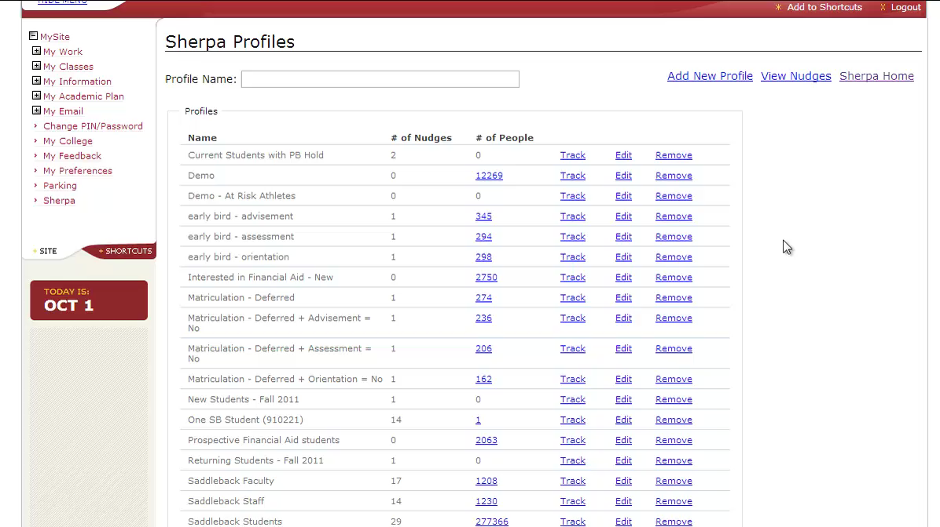
Tracking Results

Slide 13
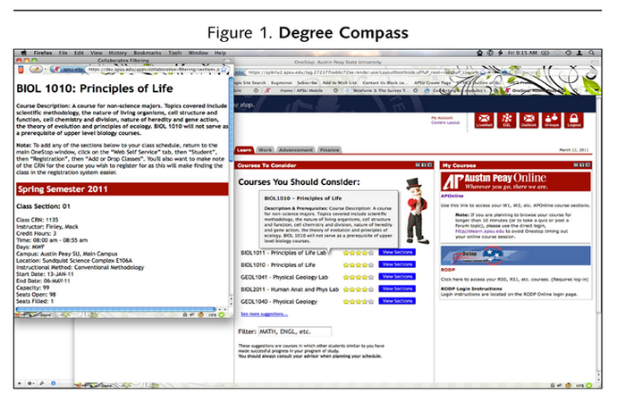



What’s Next? Predictive Analytics

Slide 14
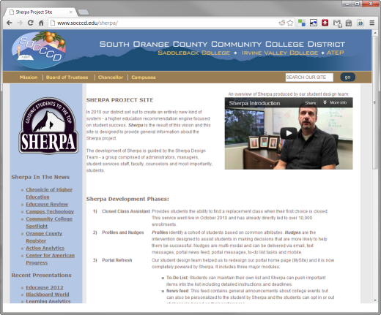

Questions?
  http://www.socccd.edu/sherpa
  Bob Bramucci: rbramucci@socccd.edu
  Jim Gaston: jgaston@socccd.edu

