Slide 1

Speeding Up on Curves
Brad Wheeler, Ph.D.
Indiana University Vice President for IT & CIO
Professor of Information Systems, IU Kelley School of Business

Slide 2

Thank You

Slide 3

There is Nothing New Under the Sun
For Information Technology…
Ecclesiastes 1:9 What has been will be again,
what has been done will be done again;
there is nothing new under the sun.
http://www.bubblews.com/news/302536-sun-facts

Slide 4
Curves are Interesting

Slide 5
Not Like Predictable Linear Lines
Y
X
Time

Slide 6
Y
March to
the Northeast
Corner
Y
Over time
More is known
Less uncertainty
Less opportunity
X
X
Time

Slide 7
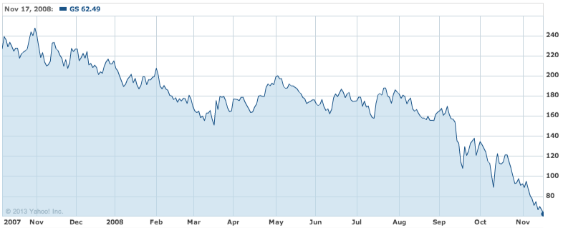
Oct 31st, 2007 = $247 November 17th, 2008 = $53
X
Y
Y
2008

Slide 8
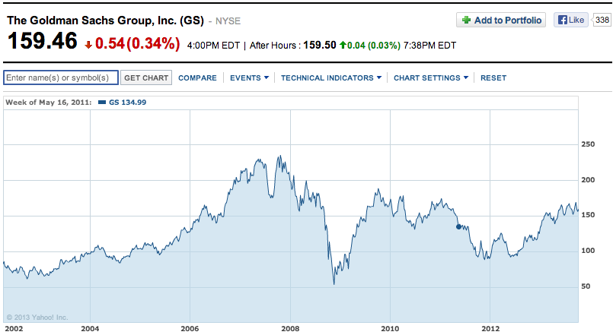
Y
X
Y
Y
X
X
2002
2008
2013

Slide 9
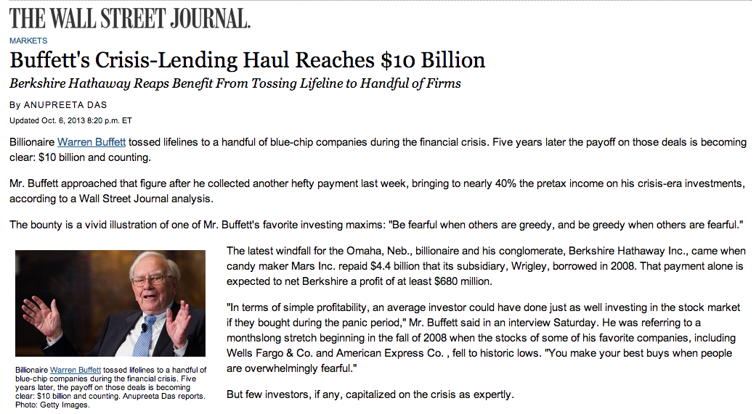
X= Invested $5B
Y= Profited $2.1B

Slide 10

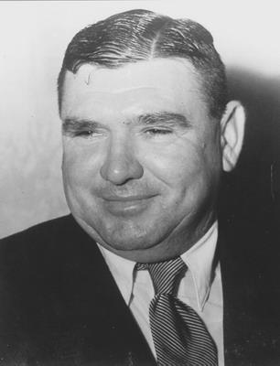
“Investors should remember that excitement and expenses are their enemies. And if they insist on trying to time their participation in equities, they should try to be fearful when others are greedy and greedy only when others are fearful.”
Warren Buffett, Chairman’s Letter, 2004
As the Australian iron ore magnate Lang Hancock (1909-1992) remarked in similar circumstances, "Always do the opposite to what the mob is doing. Works every time.” (oral history)
http://www.wanowandthen.com/Langley-Hancock.html
http://en.wikipedia.org/wiki/File:Warren_Buffett_KU_Visit.jpg

Slide 11
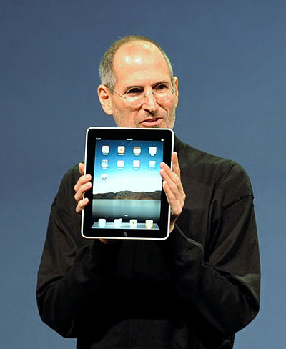
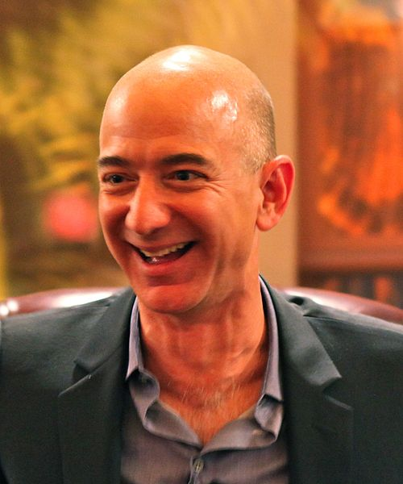
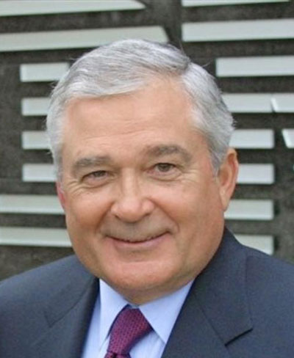
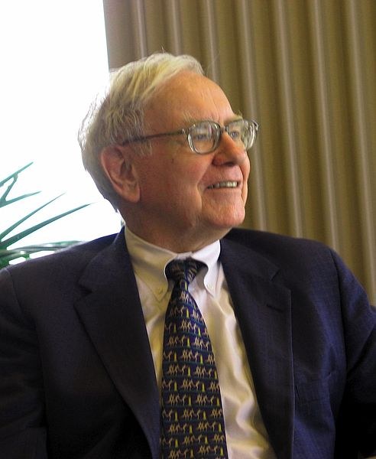
Industrial Heroes Who Think Differently
Jobs
Bezos
Gerstner
Buffett
Thought
Differently
Defined an
Industry
Redefined and
Saved a Company
Oracle
of Omaha
Foresaw and Shaped the Curves

Slide 12
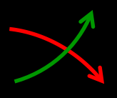
What are the Relevant Curves?
For Higher Education…
What are the Smart Bets? Why?

Slide 13
At Least Three Curves
Public to Private Good …(price/cost pressures)
Digital Favors Scale …(rise of substitutes?)
Campus CIO Influence …(who’s driving?)

Slide 14
1. Funding for Public Education
(Higher Education in Increasingly a Private Good)

Slide 16
HEPI
CPI
Actual

Slide 18
Conclusion: Colleges and Universities Must Substantially Change our Cost Structure
20% by 2020?
50%?
Minimal goal: Can We Reallocate at least 20% of the cost of Administrative Services
to the Mission by 2020?

Slide 19
2. Digital Goes to Scale
What is our Path to Scale?
(Particularly for Online Learning)

Slide 20

Digital Economies of Scale
Content – Distribution – Analytics
Bundles
Textbooks, Simulations,
Media, etc.
Markets
Students with Many Choices
MOOCs, Courses, Lessons,
Degrees, Badges, etc.
Content
Distribution
?
Behavior
Analytics (Improvement)
Analytics (Triggers Improvement)
What role for universities?

Slide 21
Is This Time Different?
Online Learning
Substitutes for colleges/universities?
Complements for colleges/universities?

Slide 22
Four Revenue Models
Residential Education (flipped classroom)
Online Courses / Degrees
Massive Online Courses (MOCs)
Massive Open Online Courses (MOOCs)
$$$
$$
$
Free
Which are complements? Substitutes?

Slide 23
So…What to Do?

Slide 24
3 Generic Campus Strategies for Curve Coping …Shaping?
Independence
Dependence
Interdependence

Slide 25
Campus Independence as a Strategy

Slide 26
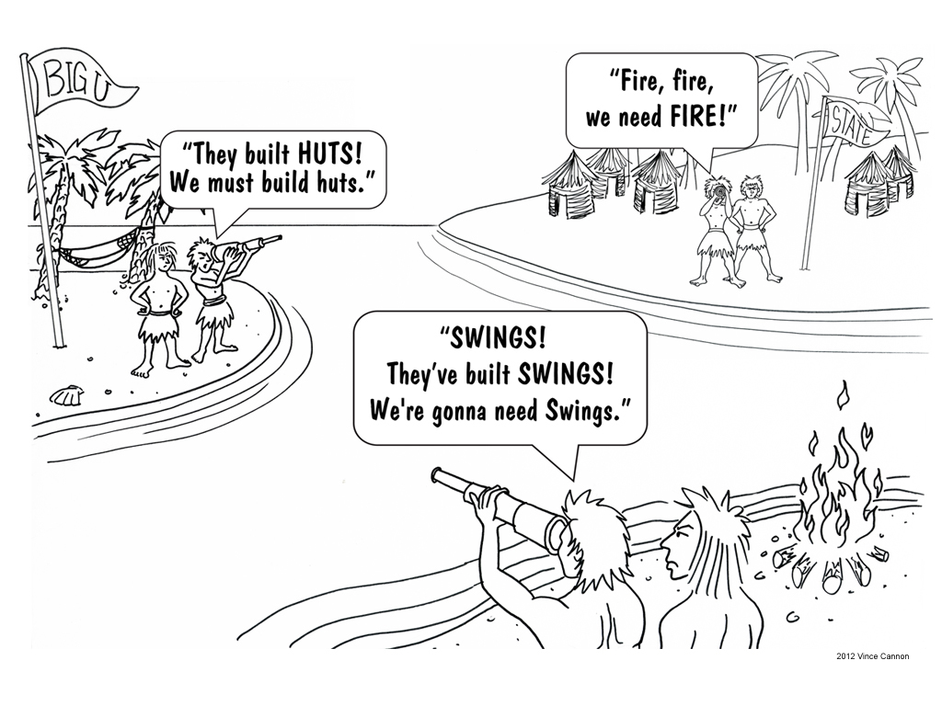

Slide 27
Campus Dependence as a Strategy
Lessons…?

Slide 28
Campus Interdependence as Strategy
Lessons…?

Slide 29
Personal Insights from
Three Strategies

Slide 30
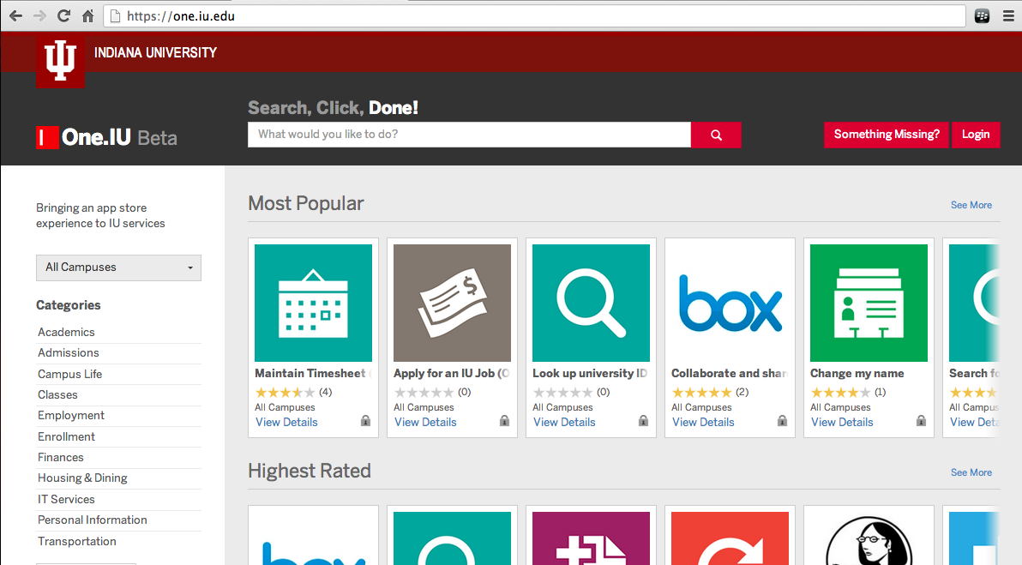

Slide 31
Involving Others
(Personal Insights)
A Tale of Dependence and Interdependence

Slide 32



Slide 33
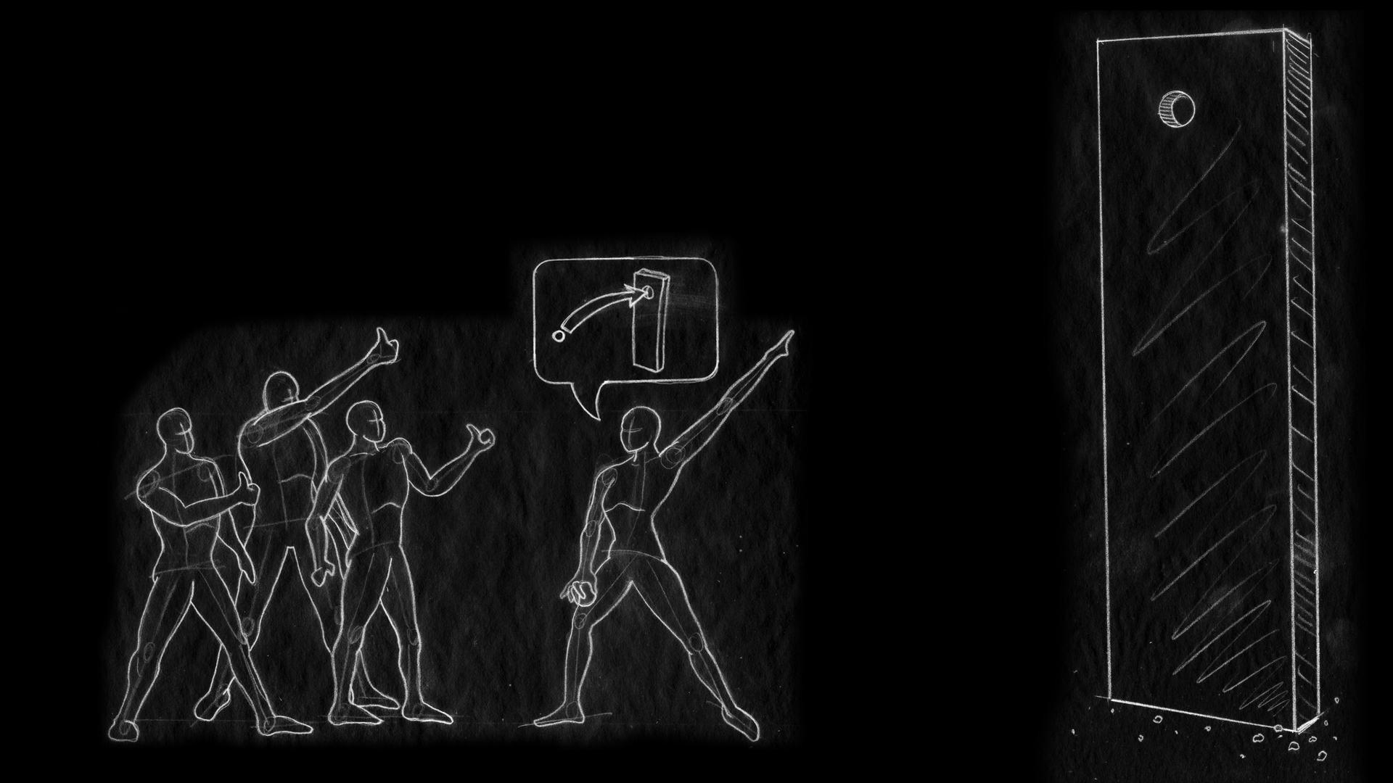
Aspiration

Slide 34

Conflict

Slide 35


Authority
Ownership

Slide 36

Authority
Ownership

Slide 37

Influence

Slide 38

Achieve!
Repeat?

Slide 39
Marketplace of ideas for Intentionally Interdependent Communities, but they need a strong Architecture to help resolve inevitable Conflicts.
Marketecture of Community

Slide 40
Marketecture Matrix
(Examples from University Communities)
Buying
Clubs
Internet2 Net+
Collaborative
Communities
HathiTrust or Kuali
Higher
Influence
Each University
Solo
Contracts
Open Source Software
Cooperative
Communities
Lower
Lower
(Use)
(Own)
Higher
Marketplace
Community
Authority
Wheeler & Hilton, EDUCAUSE Review, Nov/Dec 2012.

Slide 41
Clubs
Collaborative
Influence
Contracts
Cooperative
Authority
Wheeler & Hilton, EDUCAUSE Review, Nov/Dec 2012.

Slide 42
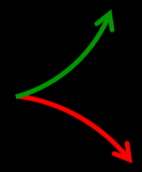
3. Influence of Campus IT Leadership
(I am VERY Worried)

Slide 43
Review: Speeding Up on Curves
Curves
Price and Cost Pressure?
Path to Digital Scale?
Campus CIO Influence?
Generic Strategies
Independence
Dependence
Interdependence*
* Lessons in the Marketecture of Community

Slide 44
Curves are Interesting

Slide 45

Higher Ed Heros Who Think Differently?
?
?
?
?
Thought
Differently
Defined an
Industry
Redefined and
Saved a College
Oracle
of Education
Who will Foresee and Shaped the Curves

Slide 46
Speeding Up on Curves
Brad Wheeler, Ph.D.
Indiana University Vice President for IT & CIO
Professor of Information Systems, IU Kelley School of Business

