Slide 1
OAAI: Deploying an Open Ecosystem for Learning Analytics
Use Hash Tags > #EDU13 and #OAAI

Slide 2
Open Academic Analytics Initiative Deploying an Open Ecosystem for Learning Analytics
Josh Baron
Senior Academic Technology Officer Principle Investigator, OAAI
Marist College
Josh.Baron@Marist.edu
Use Hash Tags > #EDU13 and #OAAI

Slide 3
36%
Reference: Integrated Postsecondary Education Data System (IPEDS)

Slide 4
13%
Four Year Graduation Rate for Savannah State University (2010)
Notes:
Shockingly, was a low as 3% in 2002!

Slide 5
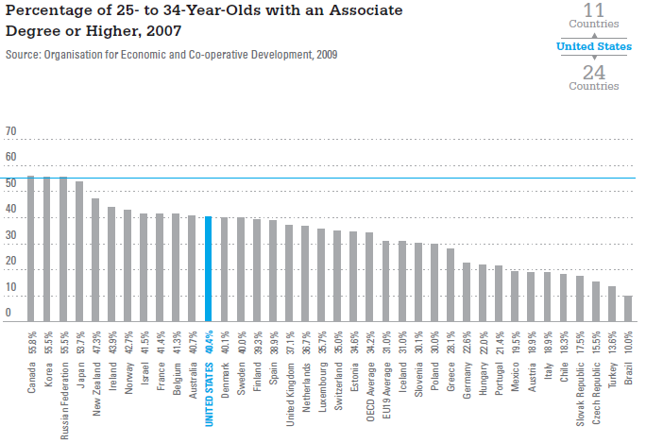

Slide 6
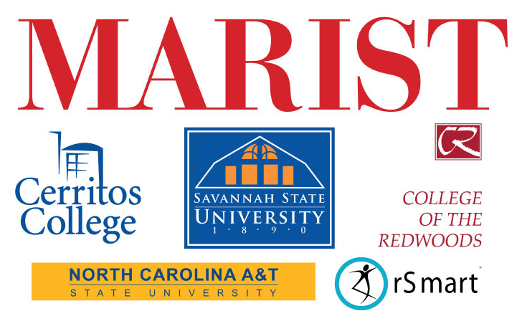
Open Academic Analytics Initiative
EDUCAUSE Next Generation Learning Challenges (NGLC)
Funded by Bill and Melinda Gates Foundations
$250,000 over a 15 month period
Goal: Leverage Learning Analytics to create an open-source academic early alert system and research “scaling factors”
Notes:
OK, so what is the OAAI and how are we working to address this problem…with the goal of leveraging Big Data to create an open-source academic early alert system that allows us to predict which students are at risk to not complete the course (and do so early on in the semester) and then deploy an intervention to help that student succeed.

Slide 7
OAAI Early Alert System Overview
Step #1: Developed model using historical data
SIS Data
Student Attitude Data (SATs, current GPA, etc.)
Academic Alert Report (AAR)
Student Demographic Data (Age, gender, etc.)
Predictive Model Scoring
Identifies students “at risk” to not complete course
LMS Data
Sakai Event Log Data
Model Developed Using Historical Data
Sakai Gradebook Data
“Creating an Open Academic Early Alert System”
Intervention Deployed
“Awareness” or Online Academic Support Environment (OASE)
Notes:
I’ll talk about our intervention strategies in a little more detail a bit later on in the presentation…

Slide 8
OAAI Goals and Milestones
Build learning analytics-based early alert system
Sakai Collaboration and Learning Environment
Secure data capture process for extracting LMS data
Pentaho Business Intelligence Suite
Open-source data mining, integration, analysis & reporting
OAAI Predictive Model released under open license
Predictive Modeling Markup Language
Researching learning analytics scaling factors
How “portable” are predictive models?
What intervention strategies are most effective?
Notes:
OAAI is building on this prior success through two primary “thrusts”…the first is the creation of an “open ecosystem” for academic analytics…this ecosystem contains the Sakai…
We will also be open sourcing our predictive model and releasing it using a standard mark-up language which will allow…
The other major “trust” is researching critical scaling factors…so we are looking at this issue of “portability”…how can you effective take a model developed for one academic context (e.g. liberal arts school) and “port” it to another context (e.g. community college).
We are also looking at what are the most effective intervention strategies, particularly those which use…

Slide 9
Research Design
Deployed OAAI system to 2200 students across four institutions
Two Community Colleges
Two Historically Black Colleges and Universities
One instructors teaching three sections
One section was control, other two sections were treatment groups

Slide 10
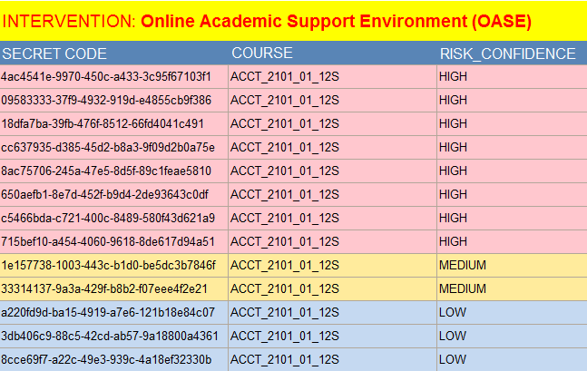
Research Design
Each instructor received an Academic Alert Report (AAR) three times during the semester at 25%, 50% and 75% into the semester.

Slide 11
OAAI Predictive Model
Development and Portability Research Findings

Slide 12
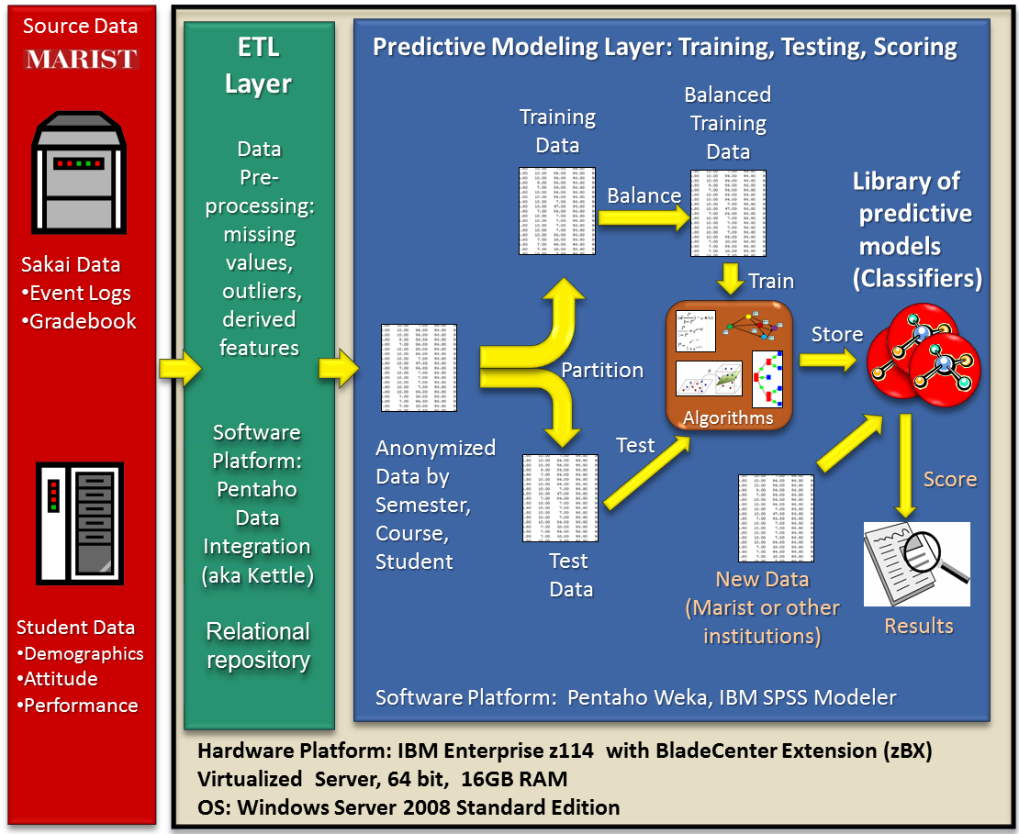
Predictive Model Training

Slide 13
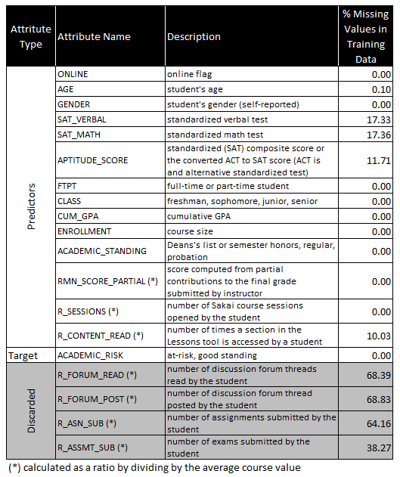
Predictors of Student Risk
LMS predictors were measured relative to course averages.
Some predictors were discarded if not enough data was available.

Slide 14
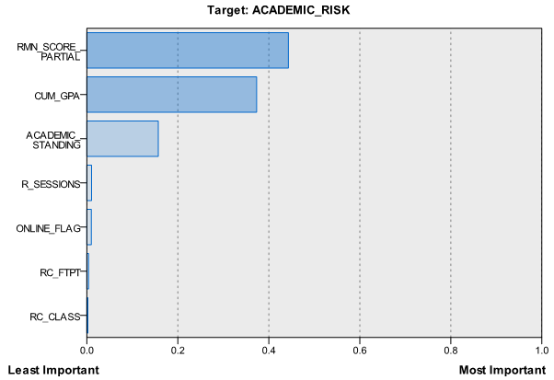
Predictive Power

Slide 15
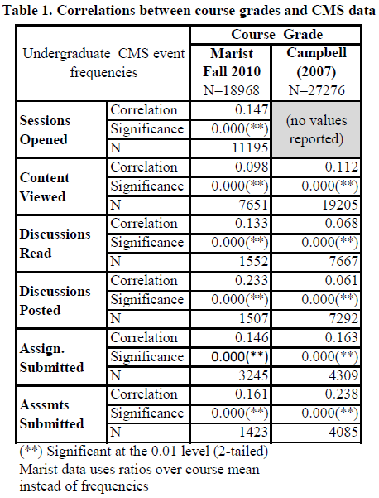
Initial Portability Research Findings
Compared predictive elements and correlations in the Marist data to what was found by Dr. John Campbell in his dissertation research at Purdue.

Slide 16
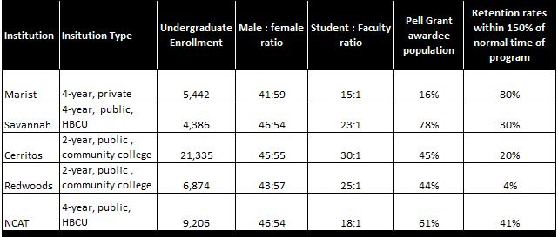
Institutional Profiles

Slide 17
Spring ’12 Portability Findings

Slide 18
Fall ’12 Portability Findings

Slide 19
Intervention Strategies
Design, Deployment and Research Findings

Slide 20
OAAI Early Alert System Overview
Step #1: Developed model using historical data
SIS Data
Student Attitude Data (SATs, current GPA, etc.)
Academic Alert Report (AAR)
Student Demographic Data (Age, gender, etc.)
Predictive Model Scoring
Identifies students “at risk” to not complete course
LMS Data
Sakai Event Log Data
Model Developed Using Historical Data
Sakai Gradebook Data
“Creating an Open Academic Early Alert System”
Intervention Deployed
“Awareness” or Online Academic Support Environment (OASE)
Notes:
I’ll talk about our intervention strategies in a little more detail a bit later on in the presentation…

Slide 21
Awareness Messaging
“Based on your performance on recent graded assignments and exams, as well as other factors that tend to predict academic success, I am becoming worried about your ability to successfully complete this class.
I am reaching out to offer some assistance and to encourage you to consider taking steps to improve your performance. Doing so early in the semester will increase the likelihood of you successfully completing the class and avoid negatively impacting on your academic standing.”

Slide 22
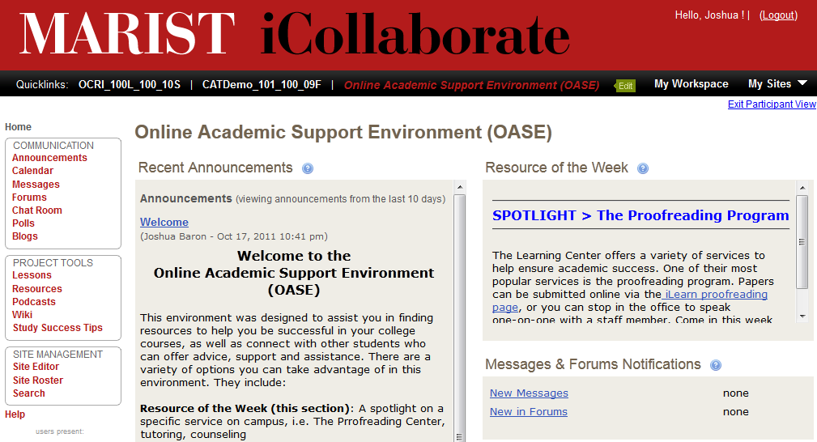
Online Academic Support Environment (OASE)

Slide 23
OASE Design Framework
Follows online course design concepts
Learner – Content Interactions
Learner – Facilitator Interactions
Learner – Mentor Interactions
Leverages Open Educational Resources
Notes:
The approach we have taken is to create a “design framework” for the OASE

Slide 24
Design Frame #1 Learner-Content Interactions
Self-Assessment Instruments
Assist students in self-identifying areas of weakness
OER Content for Remediation
Focus on core subjects (math, writing)
OER Content for Learning Skills
Time management, test taking strategies, etc.
Notes:
Include some screenshots of examples from Khan, etc.

Slide 25
Design Frame #2 Learner - Facilitator Interaction
Academic Learning Specialist role
Connecting learners to people & services
Promoting services and special events
Moderates discussions on pertinent topics
Example: “Your first semester at college”
Notes:
Note that the goal is not to replace tutoring services or answer a lot of subject matter questions online.

Slide 26
Design Frame #3 Learner - Mentor Interactions
Online interactions facilitated by student “mentor”
Facilitates weekly “student perspective” discussions
Online “student lounge” for informal interactions
Let others know about study groups, etc.
Notes:
Note that the goal is not to replace tutoring services or answer a lot of subject matter questions online.

Slide 27
Intervention Research Findings Final Course Grades
Analysis showed a statistically significant positive impact on final course grades
No difference between treatment groups
Saw larger impact in spring then fall
Similar trend amount low income students

Slide 28
Intervention Research Findings Content Mastery
Student in intervention groups were statistically more likely to “master the content” then those in controls.
Content Mastery = Grade of C or better
Similar for low income students.

Slide 29
Intervention Research Findings Withdrawals
Students in intervention groups withdrew more frequently than controls
Possibly due to students avoiding withdrawal penalties.
Consistent with findings from Purdue University

Slide 30
Instructor Feedback
"Not only did this project directly assist my students by guiding students to resources to help them succeed, but as an instructor, it changed my pedagogy; I became more vigilant about reaching out to individual students and providing them with outlets to master necessary skills.
P.S. I have to say that this semester, I received the highest volume of unsolicited positive feedback from students, who reported that they felt I provided them exceptional individual attention!

Slide 31
Future Research Interests
Factors that impact on intervention effectiveness
Intervention Immunity – Students who do not respond to first intervention never do
Student Engagement – How can we increase the level of engagement with OASE?
Can predictive models be customized for specific delivery methods and programs/subjects?
Can Learning Analytics identify “at risk” students who would otherwise not be identified?

Slide 32
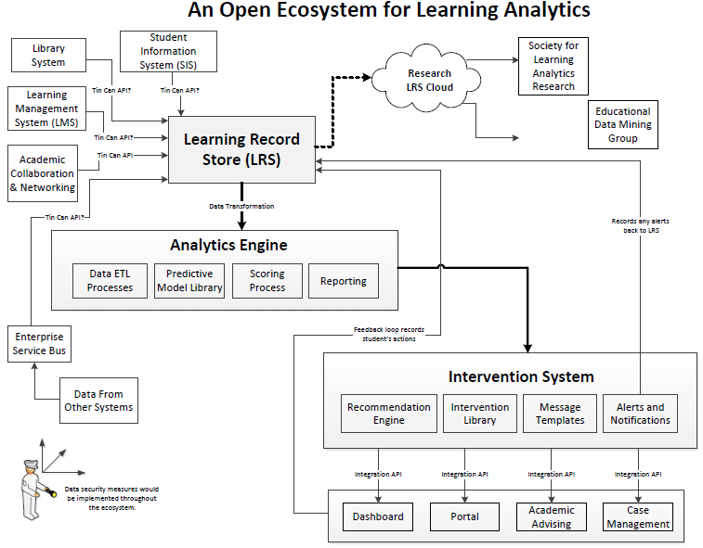

Slide 33
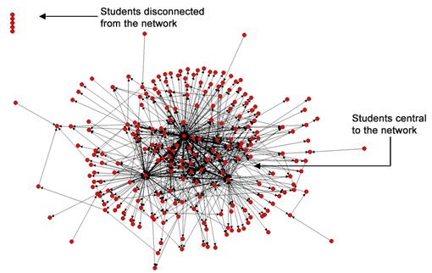
Social Networks Adapting Pedagogical Practice (SNAPP)

Slide 34
Learning Analytics and Knowledge Conference (LAK) The International Journal of the Society for Learning Analytics Research SOLAR Flares – Regional Conferences SOLAR Storms – Distributed Research Lab MOOCs on Learning Analytics
http://www.solaresearch.org/

Slide 35
Questions?
Josh Baron
Josh.Baron@Marist.edu
@JoshBaron

Slide 36
Big Questions about Big Data
Where is Learning Analytics and Big Data in the “hype cycle”? Where will it end up?
What do you see as the biggest ethical issues surrounding Learning Analytics?
How important is “openness” in Learning Analytics? Open standards? Open licensing?
Could Learning Analytics end up driving the wrong learning outcomes?

Slide 37
Questions?
Josh Baron
Josh.Baron@Marist.edu
@JoshBaron

Slide 38
Learning Analytics Ethics
“The obligation of knowing” – John Campbell
If we have the data and tools to improve student success, are we obligated to use them?
Consider This > If a student has a 13% chance of passing a course, should they be dropped? 3%?
Who owns the data, the student? Institution?
Should students be allowed to “opt out”?
Consider This > Is it fair to the other students if by opting out the predictive model’s power drops?
What do we reveal to students? Instructors?
Consider This > If we tell a student in week three they have a 9% chance of passing, what will they do?
Will instructors begin to “profile” students?
Notes:
If we determine a student is “at risk”, are we obligated to intervene?

