Slide 1
Do Clicks Count to Increase
Student Achievement?
Learner Analytics on a
Large Enrollment Hybrid Course
John Whitmer, Ed.D.
Kathy Fernandes
Educause 2013 Annual Meeting
Slides: http://tinyurl.com/clicksedu13

Slide 2
Introductions
Kathy Fernandes
  Director, Learning Design & Technologies
  Academic Technology Services
  California State University, Office of the Chancellor
John Whitmer, Ed.D.
  Program Manager, Academic Technology & Analytics
  Academic Technology Services
  California State University, Office of the Chancellor
Notes:
Context & Background (10)
Case Study: RELS 180 @ Chico State (25)
Follow-on Projects (10)
Q & A (5)

Slide 3
Participant Introductions: Your ‘data context’ and interest
Please pair-share with your neighbor – 3 mins
(ideally someone you don’t know)
  How do you use learning data in your work? How would you like to use data differently?
  What drew you to this session?
  Twitter hashtag for our session: #EU13-LA

Slide 4
Outline
Context & Background
Case Study: RELS 180 @ Chico State
Follow-on Projects
Q & A
Notes:
Context & Background (10)
Case Study: RELS 180 @ Chico State (25)
Follow-on Projects (10)
Q & A (5)

Slide 5
1. Context

Slide 6
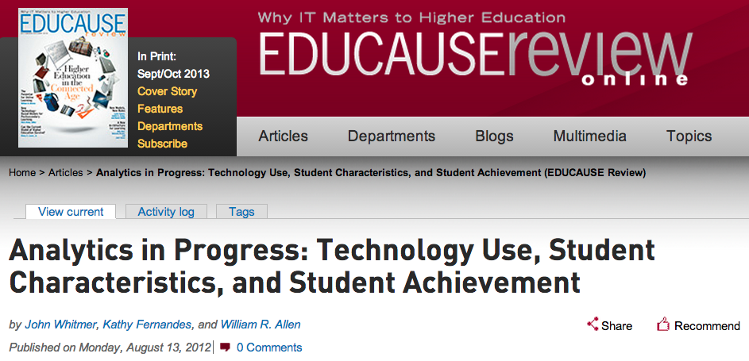
Today’s Presentation: results of preliminary study published in Educause Review Online
Analytics in Progress: Technology User, Student Characteristics and Student Achievement
John Whitmer,
Kathy Fernandes, William R. Allen
August 2012
Notes:
Kathy

Slide 7
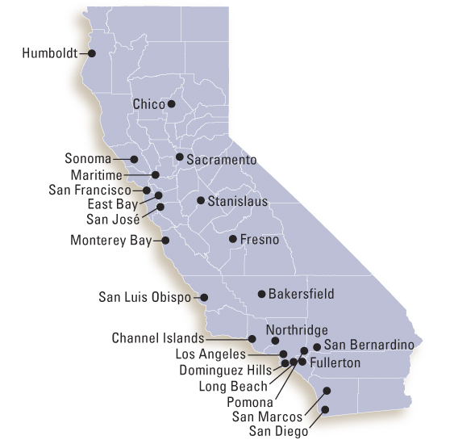
California State University http://calstate.edu
23 campuses
437,000 FTE students
44,000 faculty and staff
Largest, most diverse, & one of the most affordable university systems in the country
Play a vital role in the growth & development of California's communities and economy

Slide 8
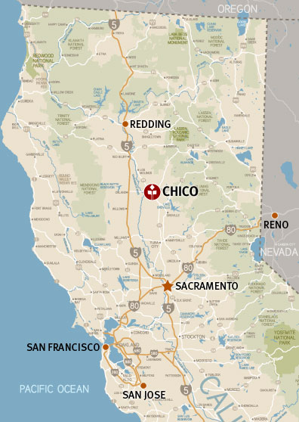

California State University, Chico
Regional Comprehensive University
14,984 FTE
Undergrad Avg Age: 22
Serving 12 counties in N. California, roughly the size of Ohio
Notes:
Kathy

Slide 9
Environment For This Study
Campus was an “early adopter” of LMS
  WebCT -> Vista -> Bb Learn
  Uses the LMS Broadly and Deeply
  Scraping web logs to do reports for years
  Usage of Bb Learn???
  Approx. 78% of the faculty use the LMS
Notes:
Kathy

Slide 10
Academy e-Learning
http://www.csuchico.edu/academy
Institutional Program – Provost Support
Cohorts of faculty redesigning courses
3 week intensive – year long redesign process
Instructional Designers, Assessment Coordinator, librarians, faculty mentors
21st Century Learning – Student engagement – Technology – iPads
Notes:
Kathy

Slide 11
Study Context: Organizational Drivers
Formal project in Chico CIO portfolio
Endorsed by Graduation Initiative Cmte, University Registrar, IRB applications approved
Ed.D. research study: “Logging on to Improve Achievement”

Slide 12
Study Context: Technical Drivers
Deepen/validate campus LMS usage reporting
Foundation for real-time reporting, early warning system
Educational data mining approach (let data drive methods)
Measure IMPACT of course redesign; technology practices on student acheivement

Slide 13
2. Case Study: RELS 180 @ Chico State

Slide 14

Economist. (2010, 11/4/2010). Augmented business: Smart systems will disrupt lots of industries, and perhaps the entire economy. The Economist.
200MB of data emissions annually!

Slide 15
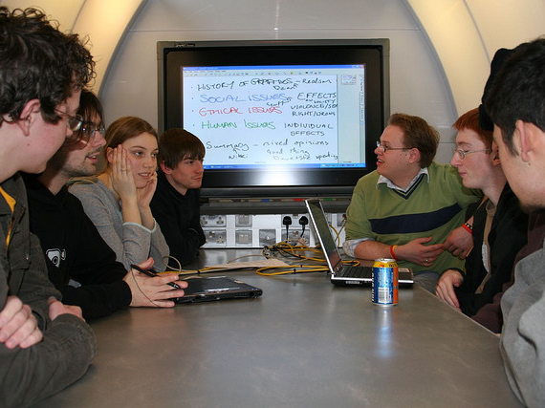
Source: jisc_infonet @ Flickr.com
Logged into course within 24 hours
Interacts frequently in discussion boards
Failed first exam
Hasn’t taken college-level math
No declared major
Source: jisc_infonet @ Flickr.com

Slide 16
Learning Analytics: Working Definition for Academic Technologists
“core proposition is that with the unprecedented amounts of digital data now becoming available about learners’ activities and interests, from educational institutions and elsewhere online, there is significant potential to make better use of this data to improve learning outcomes.
(Buckingham-Shum and Ferguson (2012, p.1)

Slide 17
Case Study: Intro to Religious Studies
Redesigned to hybrid delivery through Academy eLearning
Enrollment: 373 students
(54% increase on largest section)
Highest LMS (Vista) usage
entire campus Fall 2010
(>250k hits)
Bimodal outcomes:
  10% increased SLO mastery
  7% & 11% increase in DWF
Why? Can’t tell with aggregated reporting data
54 F’s

Slide 18
Guiding Questions
How is student LMS use related to academic achievement in a single course section?
How does that finding compare to the relationship of achievement with traditional student characteristic variables?
How are these relationships different for
“at-risk” students (URM & Pell-eligible)?
What data sources, variables and methods are most useful to answer these questions?

Slide 19
Variables
Notes:
John

Slide 20
Gender | Freq. | Percent | University Average | Difference
Female | 231 | 62% | 51% | 11%
Male | 142 | 38% | 48% | -10%
Age |  | 0%
17 | 22 | 6%
18-21 | 302 | 81%
22-30 | 22 | 6%
31+ | 1 | 0%
Under-represented Minority
No | 264 | 71% | 73% | -2%
Yes | 109 | 29% | 27% | 2%
Pell-eligible | Freq. | Percent
No | 210 | 56%
Yes | 163 | 44%
First Attend College | Freq.
No | 268 | 72%
Yes | 105 | 28%
Enrollment Status | Freq.
Continuing Student | 217 | 58%
Transfer | 17 | 5%
First-Time Student | 139 | 37%
Notes:
John

Slide 21
Correlation: LMS Use w/Final Grade
Scatterplot of
Assessment Activity Hits vs. Course Grade
Statistically Significant (strong to weak) | r | % Variance | Sign.
Total Hits | 0.48 | 23% | 0.0000
Assessment activity hits | 0.47 | 22% | 0.0000
Content activity hits | 0.41 | 17% | 0.0000
Engagement activity hits | 0.40 | 16% | 0.0000
Administrative activity hits | 0.35 | 12% | 0.0000
Mean value all significant variables |  | 18%
Notes:
John

Slide 22
Predict the trend
Is LMS use or student characteristics a better predictor of final grade? How much better?
  Student char. are 200% larger
  Student char. are 100% larger
  they are close to the same
  LMS use is 100% larger
  LMS use is 400% larger

Slide 23
Predict the trend
Is LMS use or student characteristics a better predictor of final grade? How much better?
  Student char. are 200% larger
  Student char. are 100% larger
  they are close to the same
  LMS use is 100% larger
  LMS use is 400% larger

Slide 24
Correlation: Student Char. w/Final Grade
Scatterplot of
HS GPA vs. Course Grade

Slide 25
Separate Variables: Correlation LMS Use & Student Characteristic with Final Grade
LMS
Use
Variables
18% Average
(r = 0.35–0.48)
Explanation of change in final grade
Student
Characteristic Variables
4% Average
(r = -0.11–0.31)
Explanation of change in final grade
>

Slide 26
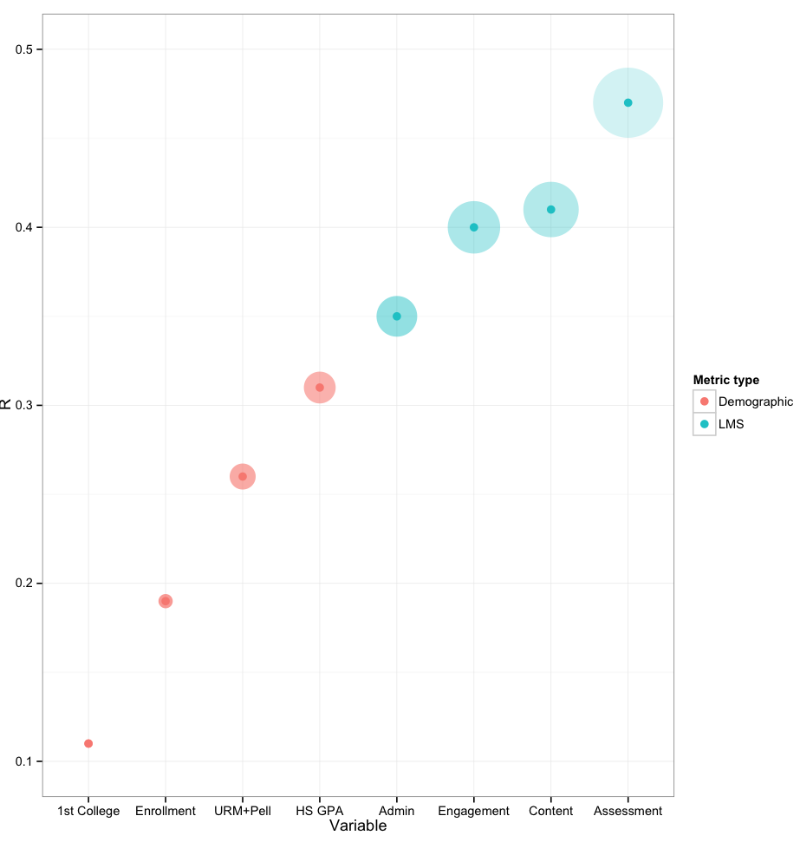

Chart: LMS & Student Characteristics
Notes:
Need to revise for

Slide 27
Combined Variables: Regression Final Grade by LMS Use & Student Characteristic Variables
LMS
Use
Variables
25%
(r²=0.25)
Explanation of change in final grade
Student
Characteristic Variables
+10%
(r²=0.35)
Explanation of change in final grade
>

Slide 28
Predict the trend
Do at-risk* students and non-at-risk students have the same relationship between LMS use and achievement?
If not, what is the difference?
  No difference
  At-risk students have a 10% lower relationship
  At-risk students have a 20% lower relationship
  At-risk students have a 50% lower relationship
*at-risk = BOTH under-represented minority (race) and Pell-eligible (class)

Slide 29
Predict the trend
Do at-risk* students and non-at-risk students have the same relationship between LMS use and achievement?
If not, what is the difference?
  No difference
  At-risk students have a 10% lower relationship
  At-risk students have a 20% lower relationship
  At-risk students have a 50% lower relationship
*at-risk = BOTH under-represented minority (race) and Pell-eligible (class)

Slide 30
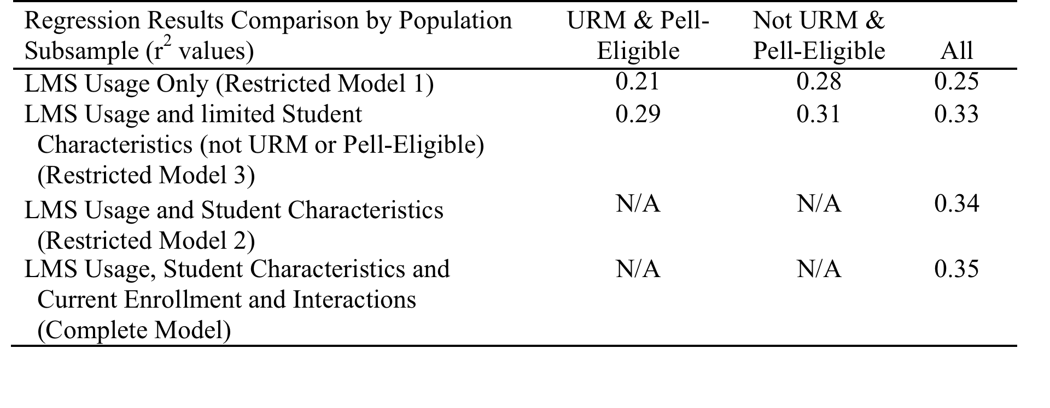
Regression r² Results Comparison

Slide 31
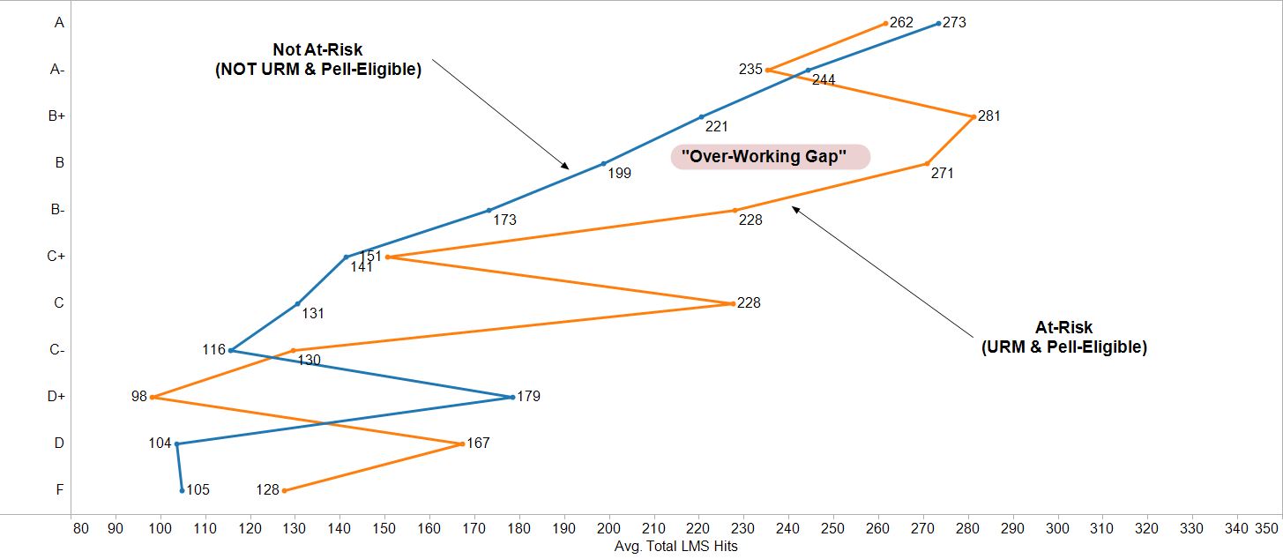

At-Risk Students: “Over-Working Gap”

Slide 32
Conclusions
At the course level, LMS use better predictor of academic achievement than student demographics (what do, not who are).
Small strength magnitude of complete model demonstrates relevance of data, but suggests that better methods could produce stronger results.
LMS data requires extensive filtering to be useful; student variables need pre-screening for missing data.

Slide 33
More Conclusions
LMS use frequency is a proxy for effort. Not a very complex indicator.
Student demographic measures need revision for utility in Postmodern era (importance to student, more frequent sampling, etc.).
LMS effectiveness for at-risk students may be caused by non-technical barriers.
Call for additional research!

Slide 34
Filtering Data – Lots of “Noise”; Low “Signal”
Final data set: 72,000 records (-73%)
Notes:
John

Slide 35
3. Follow on Projects

Slide 36
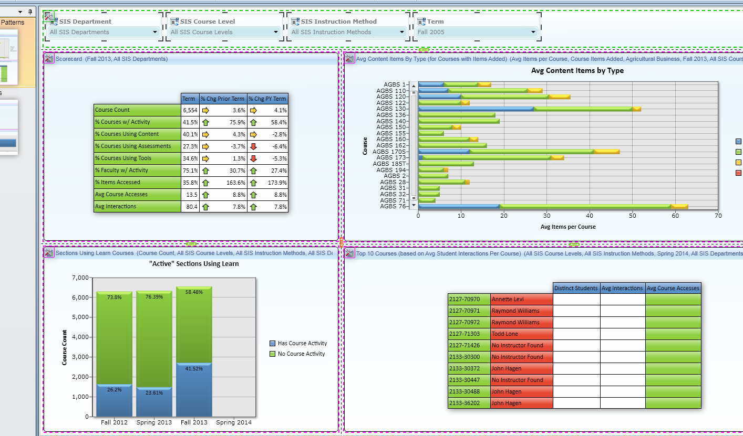

Bb Analytics for Learn Pilot Co-Laboratory
Screenshot Courtesy Fresno State

Slide 37
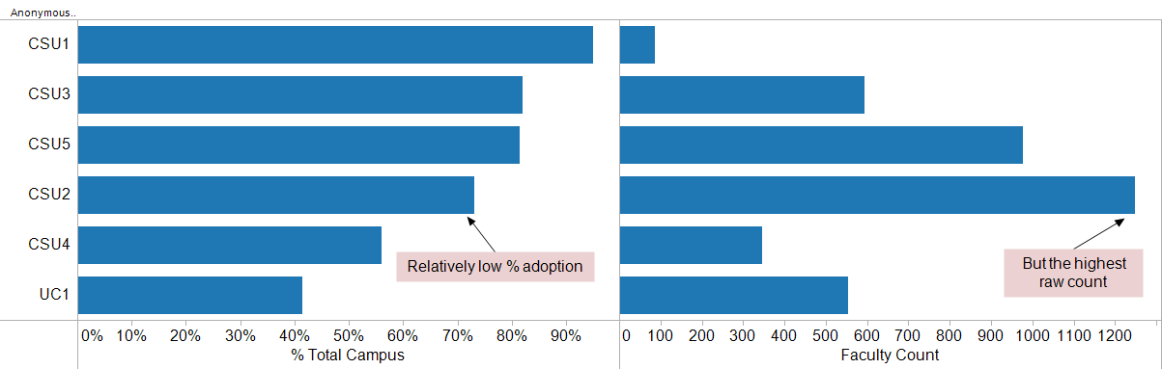
mCURL (Moodle Common Use Reporting & Learner Analytics)
How many faculty are using the LMS in one or more course sections?
Notes:
John

Slide 38
Research in Online Experiments: SJSU+
10%
56%
90%
Percent
Passed
Failed
44%
≥
Problems
Problems
Notes:
JOHN

Slide 39



Coming Soon . . . MOOC Research
“Patterns of Persistence: What Engages Students in a Remedial English Writing MOOC?”
  John Whitmer, PI
  Eva Schorring, Co-PI
  Pat Hanz, Co-PI
Thanks to the leadership & support of:
Notes:
JOHN

Slide 40

Feedback? Questions?
John Whitmer
jwhitmer@calstate.edu
@johncwhitmer
Kathy Fernandes
kfernandes@calstate.edu
For more info on Learning Analytics, see Society for Learning Analytics Research: http://www.solaresearch.org/
Notes:
Kathy

