Slide 1
Kuali Student: Student System Solutions Already Making a Difference
Rajiv Kaushik
Rick Skeel

Slide 2
Quick Poll
How many of you are familiar with Kuali Student?
Kuali 2.0 or Kuali Co?
Kuali 2.0 Blog

Slide 3
What is Kuali Student?

Slide 4
What is Kuali Student?
Kuali Student (KS) is a next generation student system with six modules that support the full student academic lifecycle
KIM People and Permissions
KRMS Rules
KEW Workflow
KRAD Rapid Application Development
rice
Collaborative Functionality
Delivered
In development
Future
Curriculum Management
Enrolment
Admissions
Student Accounts
Academic Plan
Financial Aid

Slide 5
What is Kuali Student?
Kuali Student (KS) is a next generation student system that …
Is designed from the ground up to support local variations in business processes
is being incrementally produced by an international community
institutions can deploy incrementally over time to replace current systems
provides a rich Web based user experience

Slide 6
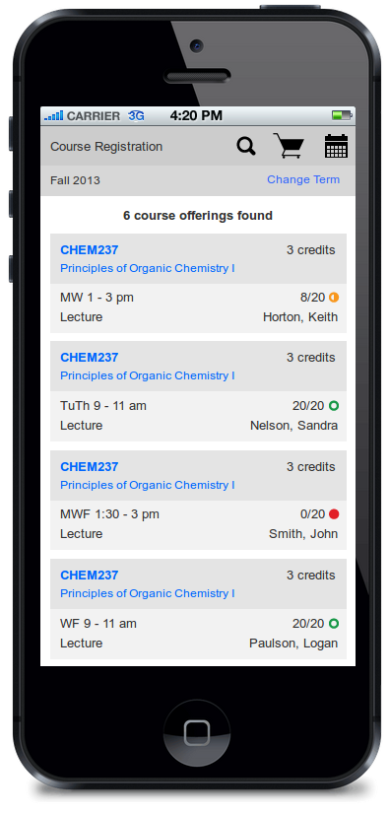
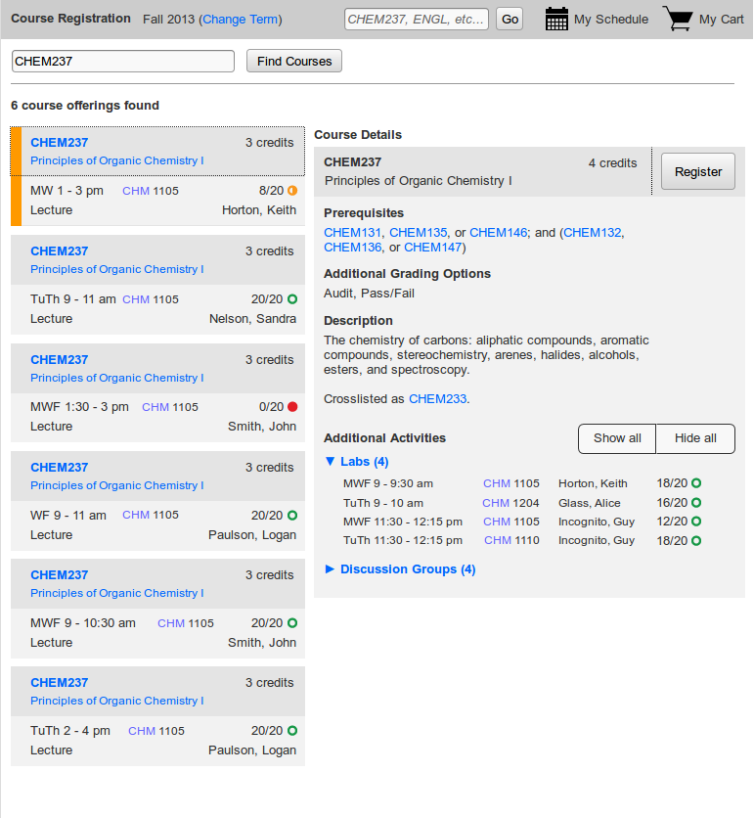
Student UX- Course Registration

Slide 7
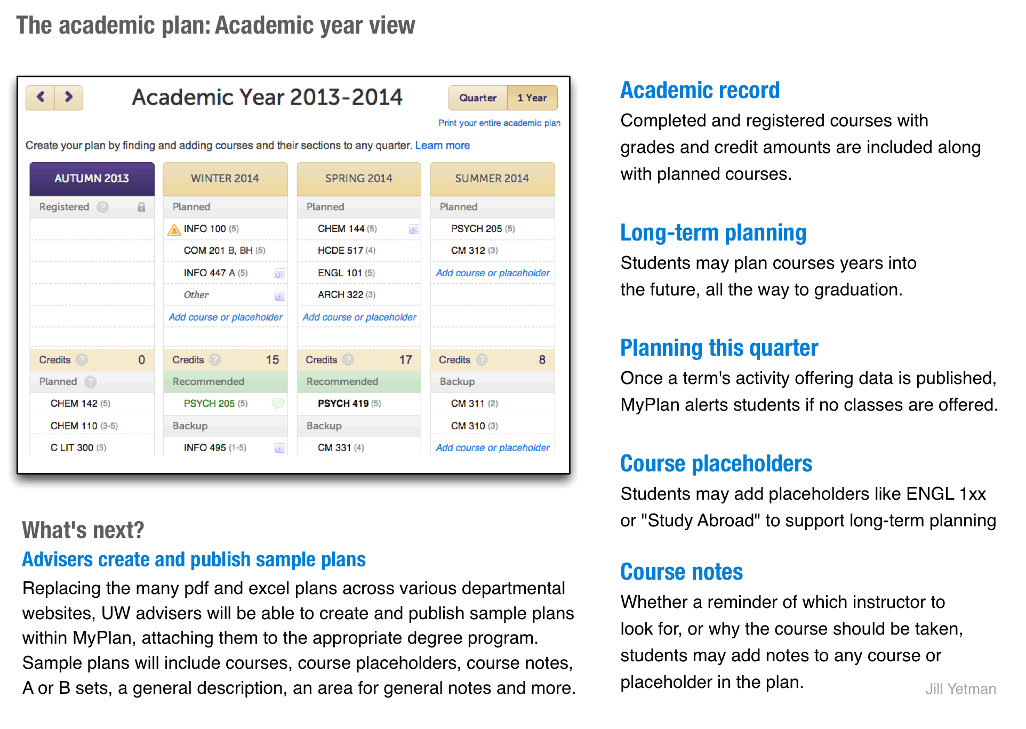
Student UX- Academic Planning

Slide 8
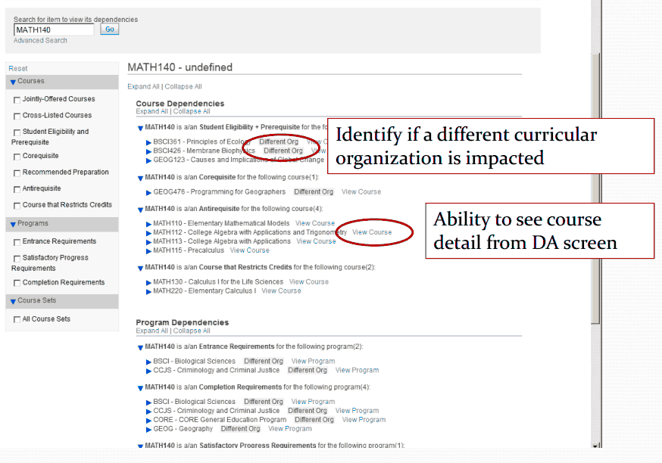
Admin UX- Dependency Analysis

Slide 9
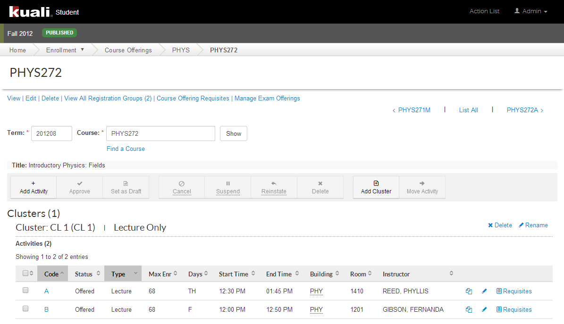
Admin UX- Course Offering

Slide 10
Quick Poll
How are you replacing or enhancing your SIS?
Do you have a need for a new SIS or a new refreshed front-end for your current SIS?

Slide 11
Who is Kuali Student?

Slide 12
Investors
Founders
Partners
Typically contribute full development team of 10 or more staff
Typically contribute 3 or more staff and/or cash
Additional Investors
Typically contribute up to 2 staff and/or cash
Notes:
Stellenbosch University and Iowa State University will soon become investing institutions.

Slide 13
Benefits of Investment
Influence product features and requirements
Buy down implementation costs
Access to Founders Releases and insider knowledge to help KS implementation(s)

Slide 14
Evolving Kuali with Kualico: Why KualiCo?
Complete suite
Consistent cross product user experience
Improved user experience
Faster progress
Self-sustaining

Slide 15
Licensing
AGPL > GPL & ECL for SaaS
Full versions always downloadable by customers
Only feature “held back” is multi-tenant framework

Slide 16
Why Kuali Student?

Slide 17
Why Kuali Student?
Student Centric design leads to rich experience
Locally configurable without the overhead of costly upgrades
Rules for complex relationships

Slide 18
What Makes Us Different?
Efforts to meet complex
business requirements

Slide 19
What Makes Us Different?
Development of best practices among investing institutions
Notes:
Stellenbosch University and Iowa State University will soon become investing institutions.

Slide 20
What Makes Us Different?
Initiatives that help
administrators do
their work more…
Effectively
Productively
Efficiently

Slide 21
Product Overview

Slide 22
Curriculum Management (CM): Overall Scope
?
Courses
Proposal
Process
Create
Programs
View
Modify
Learning Unit
Administrative
Screens
Retire
Group
Ideas
Catalog
Analyze
Curriculum Management

Slide 23
Quick Poll
How many institutions have a web based Curriculum Management function? Are you planning one?

Slide 24
Curriculum Management (CM): Delivered
2011
First major release (focus on Course)
2012 - 2013
3 Patch releases
Live at UMD
Live at
UMD
BC
UW
UI upgrade started

Slide 25
Curriculum Management (CM): Plans
2014
Live at NWU (South Africa)
2015
Kuali 2.0?
Implementation in progress at U of Toronto, Hawaii

Slide 26
Academic Plan (KSAP): Overall Scope
Objective: Suite of planning tools that allow students to maximize opportunities on campus and plan for graduation success.
Scope
Course Search
Planner
Audit against degree requirements
Requires interface to degree auditor
Advisor collaboration and interaction
Student schedule builder

Slide 27
Quick Poll
How many institutions have an Academic Planning application? Are you planning one?

Slide 28
Academic Plan (KSAP): Delivered
2012
Developed as MyPlan by the UW
2013
MyPlan enhanced by UW and IU
Live at the UW
Contribution to KSAP started
Live at IU

Slide 29
Academic Plan (KSAP): Plans
2014
2015
Kuali 2.0?
Enhancements continue at IU and UW
Reconciles and combines UW and IU features
Development of Founders Release

Slide 30
Enrolment: Overall Scope
Institution Facing
Student Facing
Course Offering
Course Registration
Course
Course Assessment
Program Enrolment
Program
Program Offering
Program Assessment
Academic Planning
Academic Record
Common
Setup
People and Permissions

Slide 31
Enrolment: Strategy
Development Strategy
Deliver the “heart” of Enrolment = Enrolment 1
Then deliver the broader vision = Enrolment 2
Deliver Enrolment 1 in 3 chunks
Course Offering
Registration
Academic Record

Slide 32
Enrolment: Delivered
2011
Developed thin-slice across Enrolment as a POC
2012-2013
Developed Course Offering & Academic Calendar
Developed infrastructure components
Founders Release 1 (1/3 of Enrollment 1)
Sandbox implementation at UMD (first implementer)

Slide 33
Enrolment: Plans
2014
Continue enhancements on Course Offering
Develop Course Registration
2015
Kuali 2.0?
Founders Release 2 (completes 2/3 of Enrollment 1)

Slide 34
Student Accounts (KSA): Overall Scope
Receivables Management
Payment Billing
Fee Management
Third Party Billing
Collections Management

Slide 35
Student Accounts (KSA): 2013 Update
2012-2013: Developed as a contribution by a commercial partner, Sigma Systems
Implementations: Boston College in progress

Slide 36
Stay Tuned
Watch Kuali.org for Kuali 2.0 developments
Learn more about why & how to participate in development of KS
Contact Rajiv Kaushik or Rick Skeel: ks.info@kuali.org

