Slide 1

Badges: A New Mode
for Faculty Development
Randy Newbrough
Kate Ellis
Zihang Shao
INDIANA UNIVERSITY

Slide 2
Faculty Perceptions of Digital Badges
How would you describe “digital badges”
in your own words?
“Recognition by peers”
“Virtual status symbols that compose a portfolio of accomplishments, possibly as part of a certification program”
“Rewarding teaching, professional development, etc. through computer”
“A recognition of professional development”
Notes:
From a survey of the members of the Gateway Teaching Academy, IUPUI, Fall 2015

Slide 3
Faculty Perceptions of Digital Badges
How would you describe “digital badges”
in your own words?
“Being recognized digitally for attending and participating in workshops and conferences”
“Recognition of merit in investment of time and energy in continuing professional development”
“Simplified record keeping”
“Boring”
Notes:
From a survey of the members of the Gateway Teaching Academy, IUPUI, Fall 2015

Slide 4
Faculty Perceptions of Digital Badges
How would you describe “digital badges”
in your own words?
“A waste of time and an artificial means of motivation that is not needed for true professionals”
“Gold stars for grownups”
“Subterfuge in lieu of real rewards”
Notes:
From a survey of the members of the Gateway Teaching Academy, IUPUI, Fall 2015

Slide 5
Faculty Perceptions of Digital Badges
How would you describe “digital badges”
in your own words?
“An online certificate of some kind that doesn't carry any real value or reward”
“I don't think they mean anything”
“A gold star for being good”
Notes:
From a survey of the members of the Gateway Teaching Academy, IUPUI, Fall 2015

Slide 6
Faculty Perceptions of Digital Badges
How would you describe “digital badges”
in your own words?
“No idea”
“I don't know.”
“I have no idea.”
“I actually have no concept of this term.”
“I do not know what they are.”
Notes:
From a survey of the members of the Gateway Teaching Academy, IUPUI, Fall 2015

Slide 7
Faculty Perceptions of Digital Badges
“Which of the following names do you think best represents the digital symbols that document and demonstrate your professional development accomplishments via online platforms?”
30% (7) Digital credentials
26% (6) Digital badges
26% (6) Digital certificates
Notes:
From a survey of the members of the Gateway Teaching Academy, IUPUI, Fall 2015

Slide 8
Faculty Perceptions of Digital Badges
“Which of the following names do you think best represents the digital symbols that document and demonstrate your professional development accomplishments via online platforms?”
0% Micro-credentials
0% Open badges
17% (4) Other
Notes:
From a survey of the members of the Gateway Teaching Academy, IUPUI, Fall 2015

Slide 9
Digital Badges
“Badges are digital tokens that appear as icons or logos on a web page … Awarded by institutions, organizations, groups, or individuals, badges signify accomplishments such as completion of a project, mastery of a skill, or marks of experience.”
Educause Learning Initiative - 7 Things you should know about badging for professional development
Notes:
http://www.educause.edu/library/resources/7-things-you-should-know-about-badging-professional-development

Slide 10



Badges @ IU pilots
Issuer: UITS Learning Technologies and the Faculty Colloquium for Excellence in Teaching (FACET)
Topics: Online Presence, eTexts and Accessibility
Participants: open to anyone currently teaching at IU
Each topic has three levels of accomplishment

Slide 11



Badges @ IU pilots
Issuer: IUPUI Gateway Teaching Academy
Topic: Faculty professional development activities
Participants: Adjuncts through tenured faculty who teach large, beginning level courses at IUPUI and are members of the GTA
Three levels for this one topic

Slide 12

Badges @ IU pilots
Issuer: Office of Affirmative Action & Equal Opportunity
Topic: IU ADA Awareness
Participants: for faculty, associate instructors and other instructional staff
A single badge for completing one of two online training modules

Slide 13
More about the Learning Technologies badges
Co-sponsored by the Learning Technologies division of UITS, the central IT organization, and FACET (Faculty Colloquium for Excellence on Teaching)
Offered at progressively tiered levels: Basic (Bronze), Proficient (Silver), and Advanced (Gold)
Three different topics: teaching with an eText, developing an effective instructional online presence, and making course materials accessible for all students.

Slide 14
More about the Learning Technologies badges
The badge requirements are documented at each level through an evidence-based rubric that emphasizes:
Mastery of badge concepts and approaches
Consultation with appropriate a teaching center consultant
Reflection and planning in the context of a real course
Application of approaches in a real course
Creation of sample artifacts of course materials and interactions
Completion of a peer review by a FACET member

Slide 15
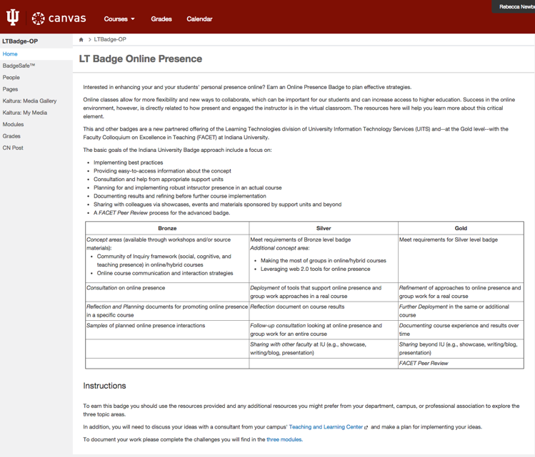
BadgeSafe in Canvas
Notes:
Canvas course site is create and BadgeSafe is added by administrator. Description is added to home page.

Slide 16
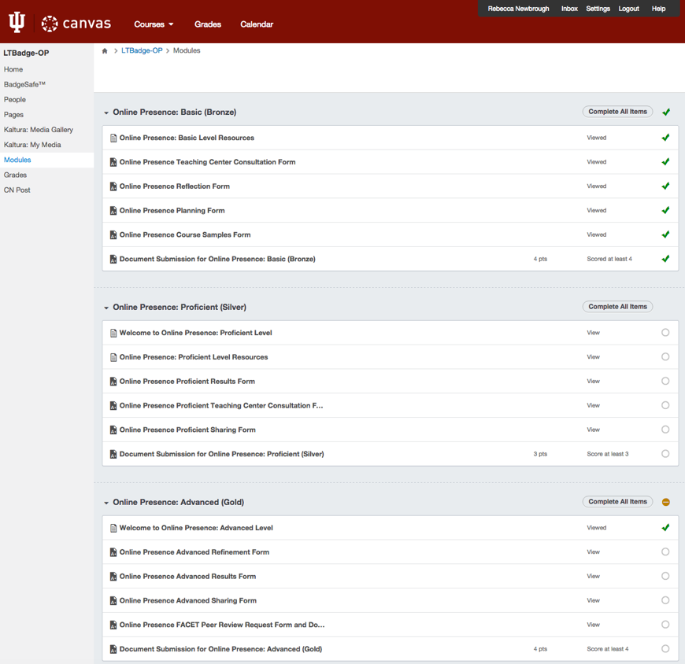
BadgeSafe in Canvas
Notes:
Activities are added to Modules for each of the three levels.

Slide 17
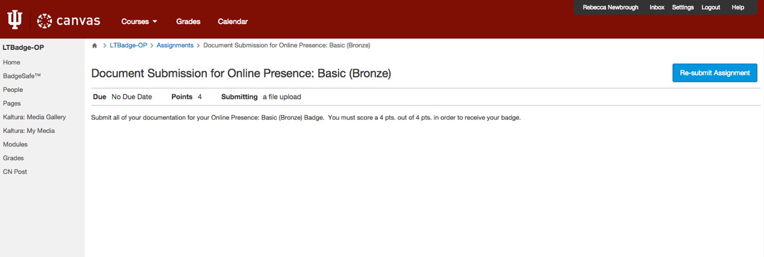
BadgeSafe in Canvas
Notes:
Participant submits work / evidence / artifact for review through the Assignments tool.

Slide 18
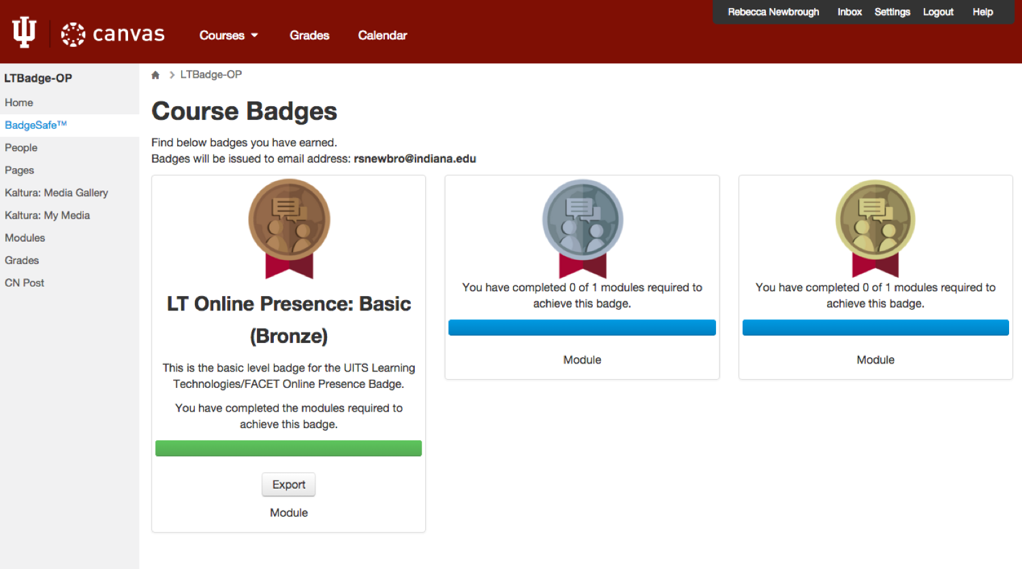
BadgeSafe in Canvas
Notes:
This shows the participant what bages they have earned, and allows them to share it out to other platforms.

Slide 19
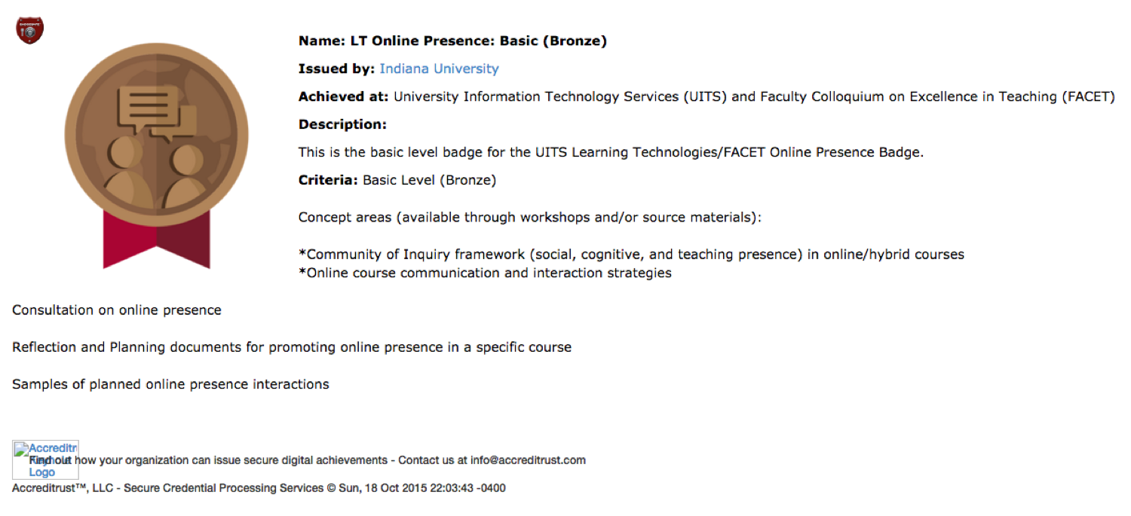
BadgeSafe in Canvas
Notes:
The information that is associated with the badge appears on this screen.

Slide 20
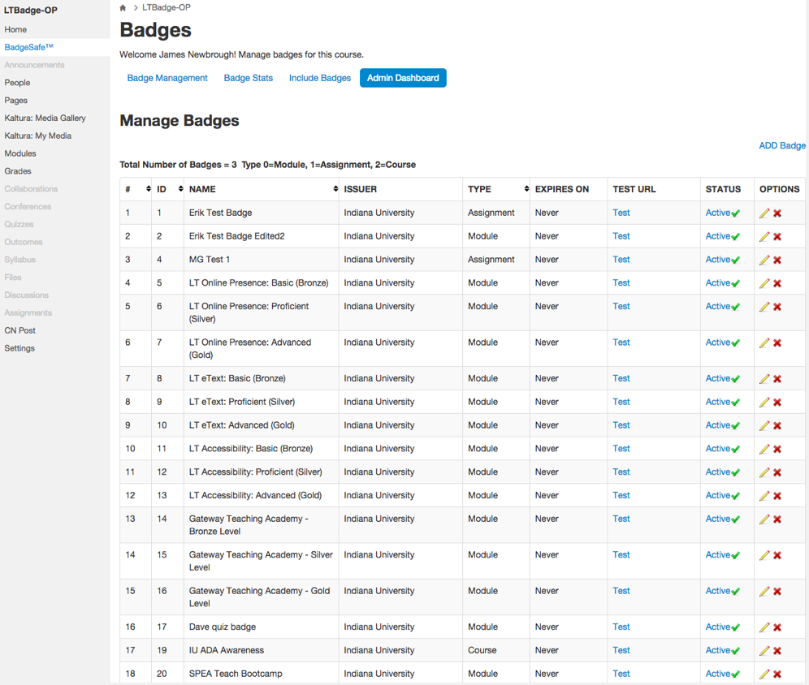
BadgeSafe in Canvas
Notes:
The administrative dashboard

Slide 21
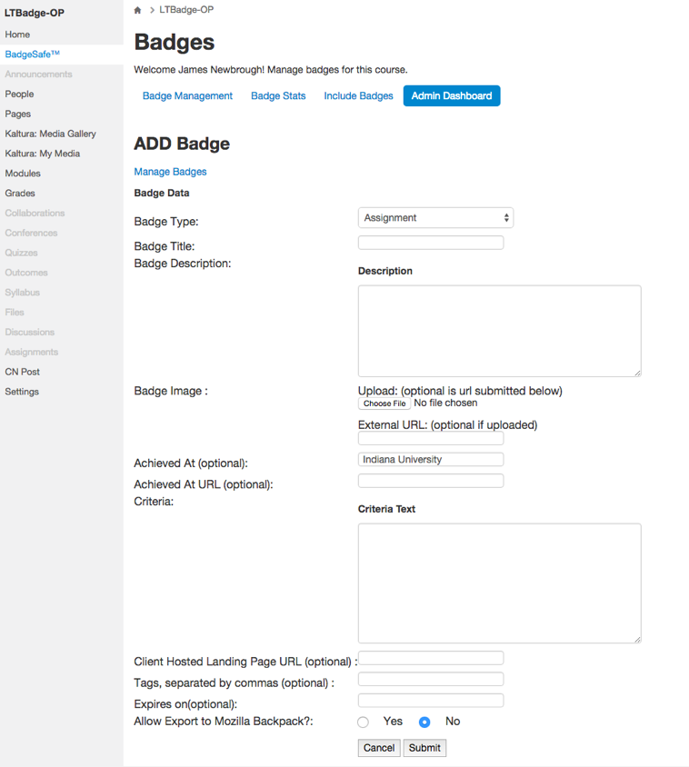
BadgeSafe in Canvas
Notes:
Creating a badge

Slide 22
Contact Us!
Randy Newbrough Principal Instructional and Collaborative Technologist Learning Technologies, UITS rnewbrou@iu.edu
Kate Ellis Principal Instructional Technology Consultant Center for Innovative Teaching and Learning kdellis@indiana.edu
Zihang Shao
PhD Candidate in Instructional Systems Technology
Indiana University Bloomington
zihshao@indiana.edu

