Slide 1
Data Visualization: The What, the Who, & the How
Abraham George, Vice President of IT and Chief Information Officer, Columbus State University
Kamalika Sandell, Associate CIO, Office of Information Technology, American University
John Rome, Deputy CIO, Arizona State University
Hank Childers, Executive Director University Analytics & Institutional Research, University of Arizona

Slide 2

Top 3 Visualization of All Time?

Slide 3
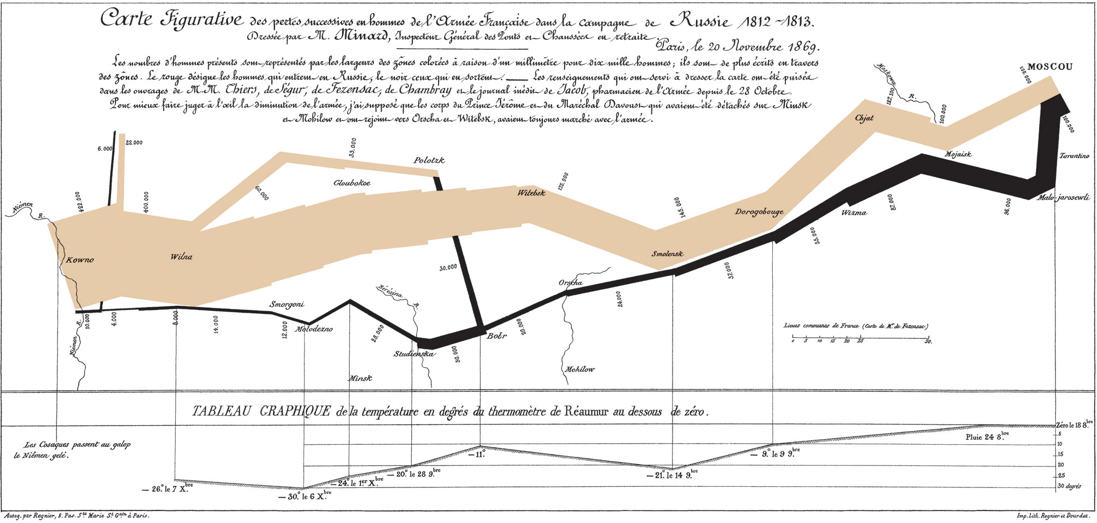
March on Moscow – Charles Minard

Slide 4
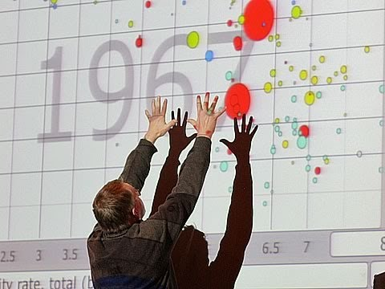
GapMinder - Rosling

Slide 5
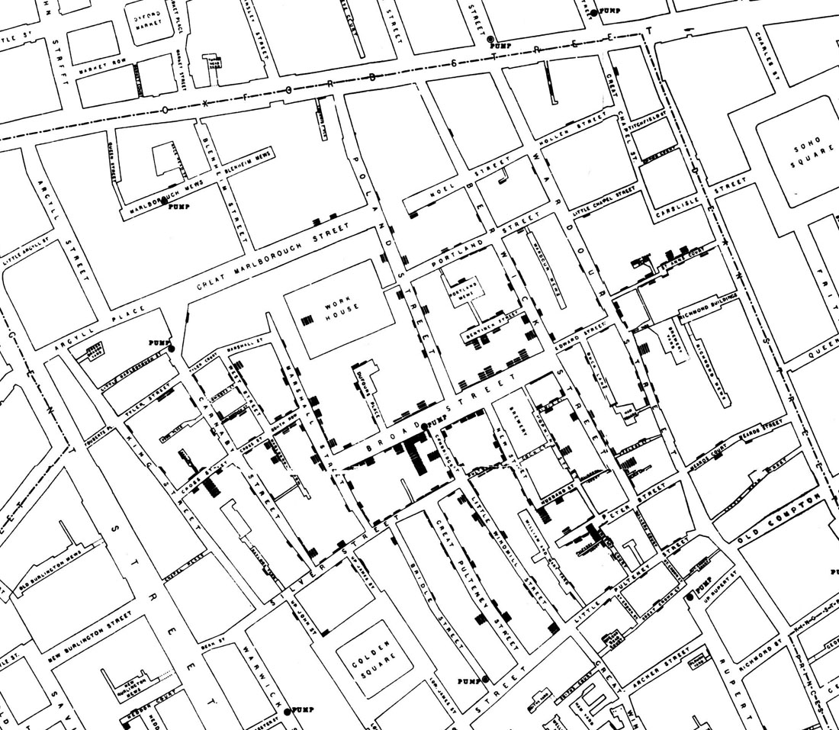
London Cholera Map – John Snow (1854)

Slide 6

Opportunities in the Use of Data Visualization
Objectives:
In order to get people to use the tools and make data driven decisions, it is very important they are comfortable with the tool. Simple tools make the adoption of such tools easier in the enterprise. Thus, the results will drive the performance of the organization to a higher level.

Slide 7
User Community
Developers and Programmers
Non-Developers
Point to note: What works well for technically savvy developers may not work for faculty or staff without those same credentials.

Slide 8
Non-Technical Solutions
Data Wrapper
Raw
Infogram
Tableau
Point to note: These products can take basic data and visualize it in charts, graphs, and in some cases geographical maps. These products can be used by faculty and staff with little intervention from IT, as long as they have a basic familiarity with spreadsheet data.

Slide 9
Developers
Oracle suite of OBIEE (Oracle Business Intelligence Enterprise Edition) has been very successful for CSU
Cognos (IBM) is another tool that is very popular for developers and has been used by USG central office
D3 (For Data Driven Documents)
Fusion Charts
Chart js
Google Charts
Point to note: Helping a programmer or developer learn takes time through training. If he or she can learn by shadowing a consultant or an experienced developer, learning happens quicker.

Slide 10
Reality of Higher Ed Environment and Why Data Visualization Makes Analytic Easy?
Asking a Dean or Chair to use OBIEE is like asking a math major to perform brain surgery. Both examples may get the job accomplished, however, both would be a "bloody" mess.
In addition, many times the "wait" for a developer to provide the data in a dashboard takes too long for these non-technical groups. They want the information now.
Once they (functional users) get the data, they ask more questions since they don’t know what they really want or are looking for!

Slide 11

Two primary design goals supported through Data Visualization
Discovery and Exploration
What story is the data telling you
Identify patterns and exceptions
Decision-making
Compare, contrast, choose
Explain, make a point, decide

Slide 12
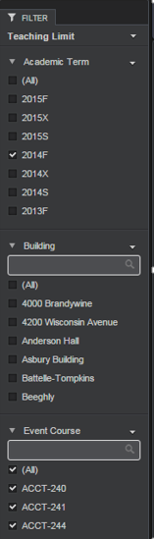
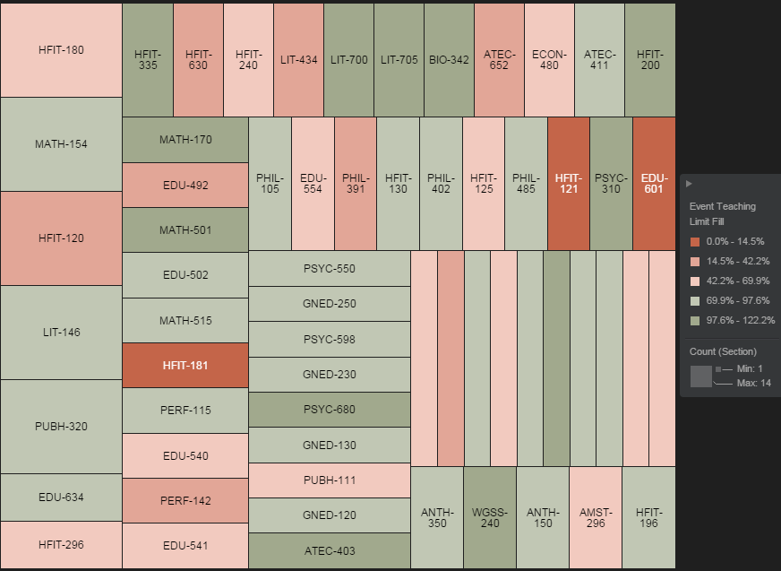
Data Visualization Strategies: Visual Analytics Tools Support Data Discovery
Examples: Heat maps, what-if modeling, predictive modeling, charts
Notes:
Types of analytical interactions:
Drill downs/ accessing details
Comparing
Sorting
Adding variables
Highlighting
Aggregating
Re-expressing
Re-visualizing
Zooming
Re-scaling
Annotating

Slide 13
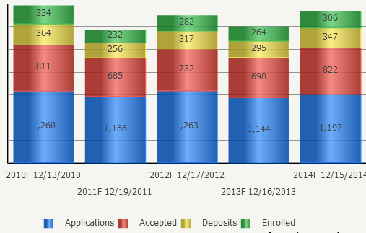
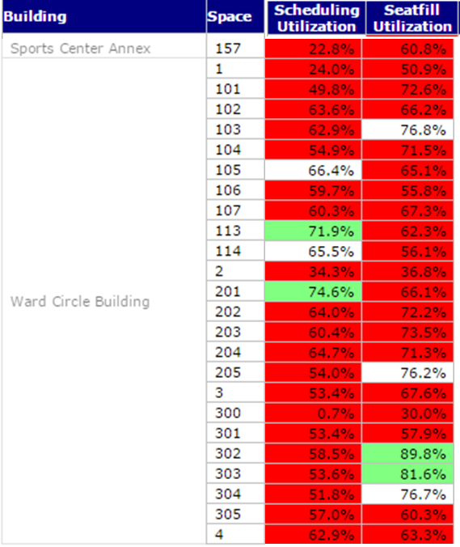
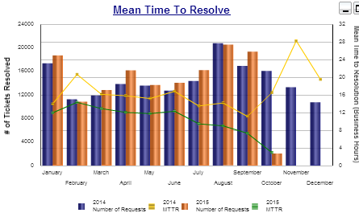
Data Visualization Strategies: Visual Reporting Tools Support Decision-making
Examples: Dashboards, scorecards, KPIs

Slide 14
Tips and Best Practices
Data is still the king
Know your requirements
Recognize your audience
Balance sparsity and density
Prototype-test-iterate
Leverage templates – standard look and feel
Use color for distinction and selection

Slide 15
Using Data Visualization
The University of Arizona
To communicate
Present more clearly or more forcefully than would be accomplished with text or tables
Reports, dashboards, infographics, etc.
To discover
Allow us to see what would be difficult or impossible to see if not presented in a useful visualization
Realm of research but moving into the mainstream
Can same visualization serve both purposes?

Slide 16
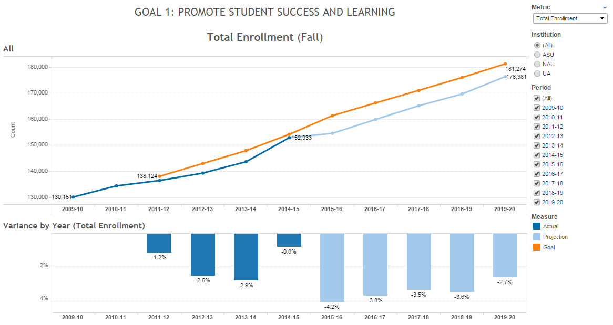
ABOR Actuals/Projections vs. Goals
The University of Arizona

Slide 17
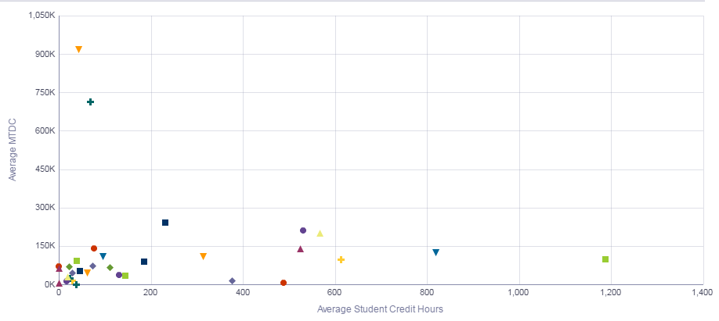
Research $ vs. SCH Taught
The University of Arizona

Slide 18
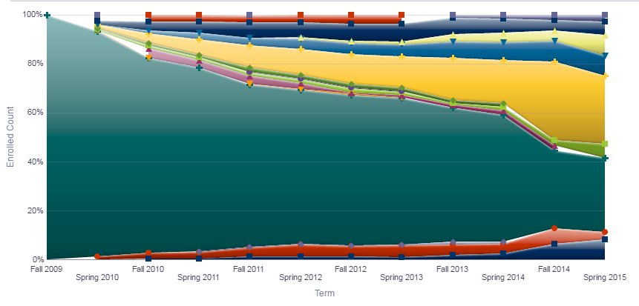
Curricular Flow – Forward
The University of Arizona

Slide 19

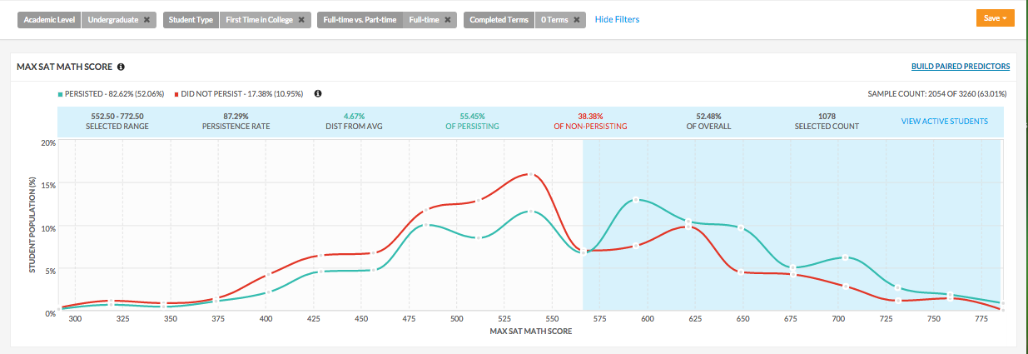
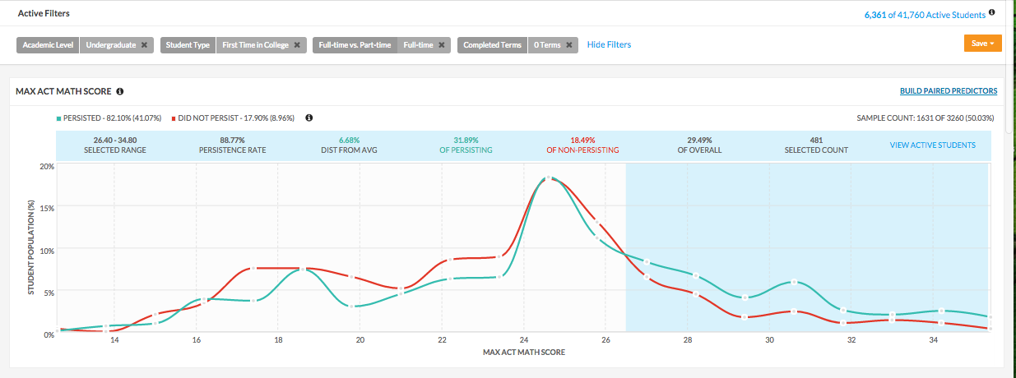
UA INSIGHTS
For FTIC FT Freshman in their First Term, both SAT and ACT Math scores make the list with clear tipping points for both: SAT Math (550) and ACT Math (26).
Students in this segment with SAT Math scores greater than 550 persist at a rate 10 percentage points higher than those below 550
Students in this segment with ACT Math scores greater than 26 also persist at a rate 10 percentage points higher than those below 26
Notes:
DONE

Slide 20
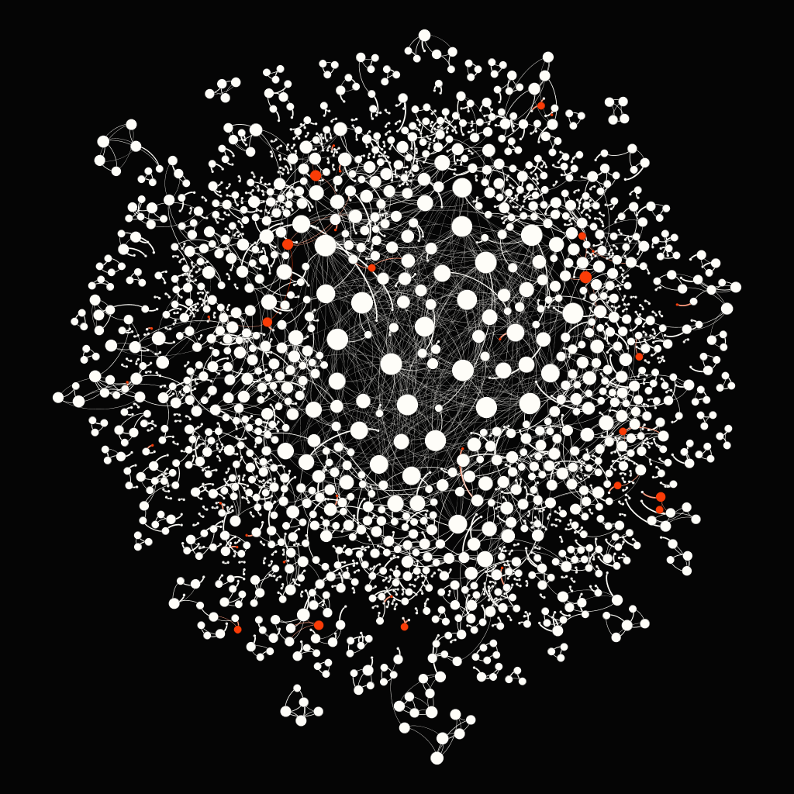
Derived Implicit Social Network Tied to Retention
The University of Arizona

Slide 21
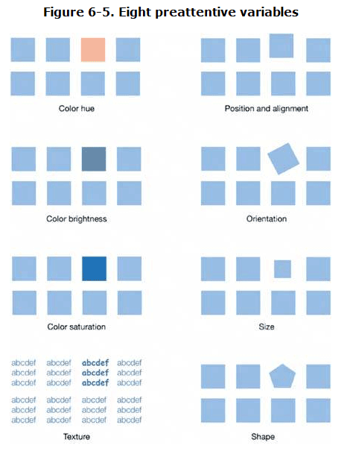

Introduce Pre-Attentive Variables
http://dashboardspy.com/dashboards/47/intuitive-dashboard-design-preattentive-variables
Notes:
21

Slide 22
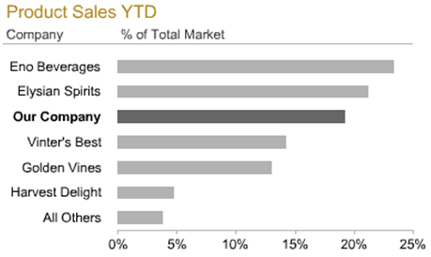
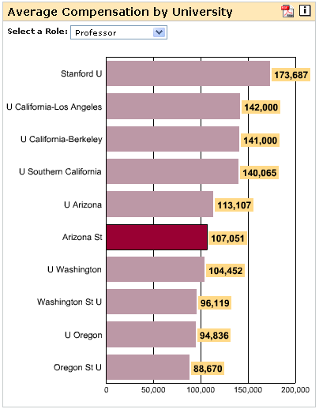
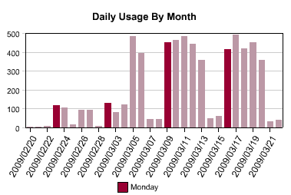
Notes:
22

Slide 23

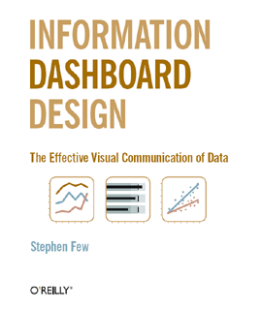
Avoid Pie Charts!!
http://www.perceptualedge.com/articles/visual_business_intelligence/save_the_pies_for_dessert.pdf
Notes:
23

Slide 24
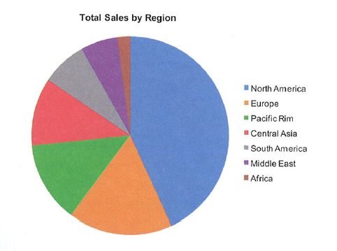
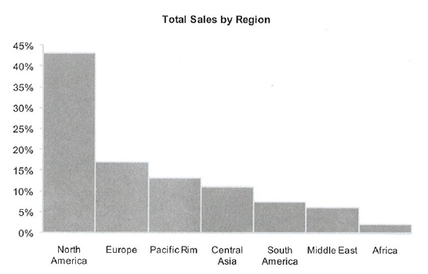
What Do You Think?

Slide 25
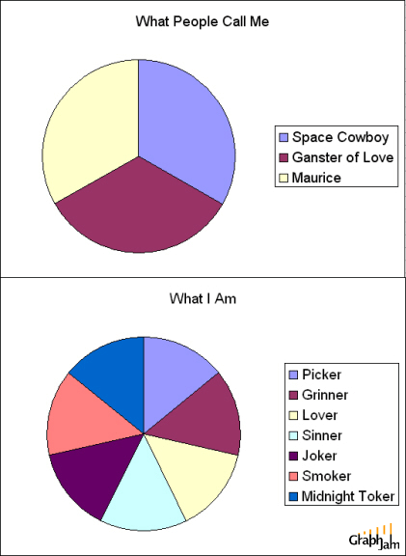
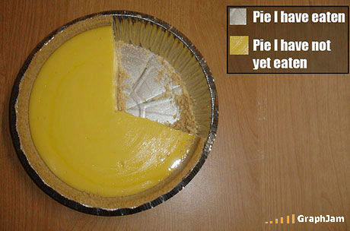
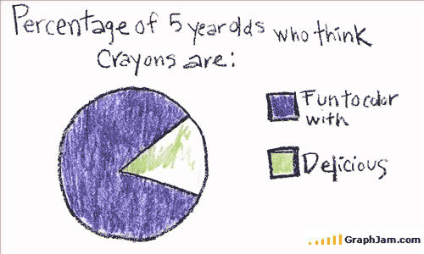
Notes:
25

Slide 26
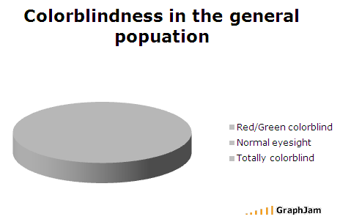
Avoid Pie Charts & Color Usage
Color Blindness in the General Population
Notes:
26

Slide 27
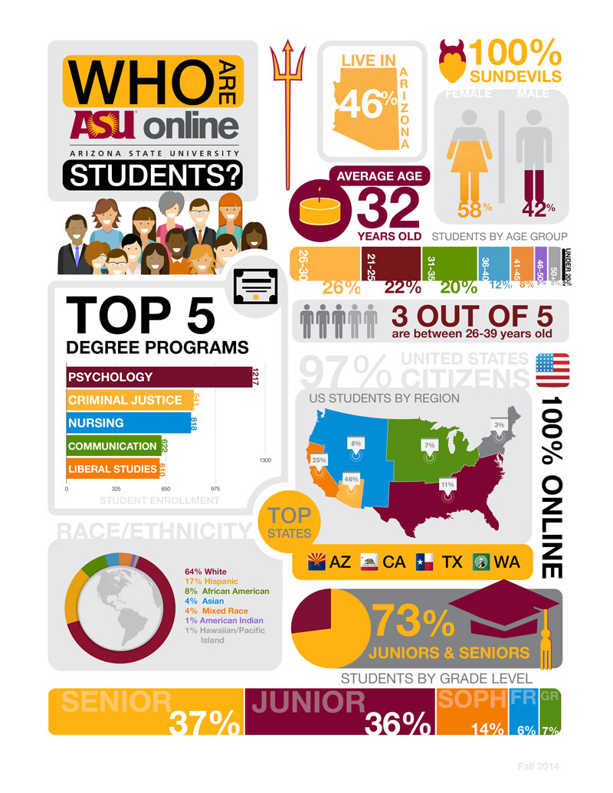
Initiate Infographics

Slide 28
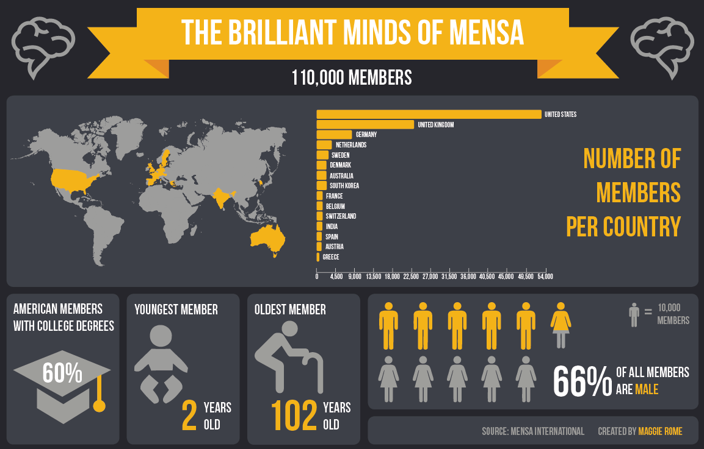

Slide 29
Questions
The University of Arizona
Should we try to supply data visualization tools centrally?
Should we try to support good practices around data visualization?
What organizational unit(s) would be responsible?
Why did our information savvy deans resist our presenting information graphically?
How do we connect the research side of the house with the administrative side?

Slide 30
Questions & Answers?

Slide 31
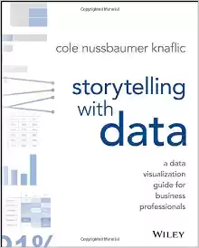
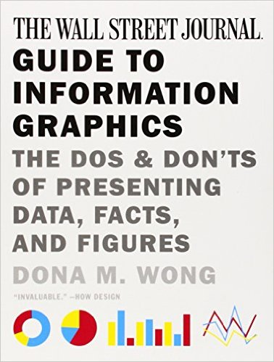
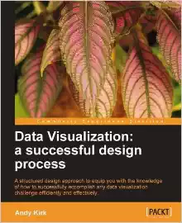
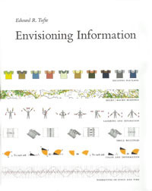

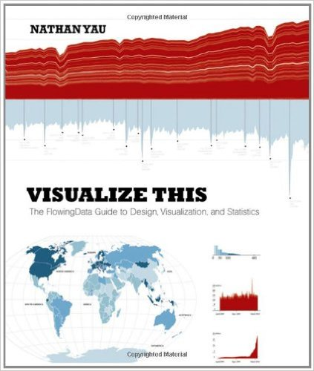


Recommended Resources
Sources for Inspirations:
Notes:
31

Slide 32
Resources

